Slide 1
TÜRKIYE & SYRIA EARTHQUAKES FEB 2023
© UNICEF/Suleiman
Notes:
Image: On 6 February 2023, rescue workers and residents search for people affected by the earthquake amidst the rubble of collapsed buildings in Bisnia, northwest of Idlib, near the Syria-Türkiye border. Two devastating earthquakes and dozens of aftershocks hit southeast Türkiye and Syria on 6 February 2023.

Slide 2
GUIDANCE FOR ADULTS
We know you have been responding to questions about the disaster in Türkiye (Turkey) and Syria over the past few days. In many of your schools there will be children with connections to both countries and you will already be offering these families support.
As adults, your expertise will be invaluable in helping all children to navigate the troubling news. We wanted to share a few thoughts and some supportive information. Slides 4 to 8 may be used in small group, whole class or assembly settings.
Please remember to reassure your pupils that a similar earthquake is unlikely to happen in the UK and that UNICEF is on the ground in Türkiye and Syria, alongside many other organisations, to help children and their families.
As a Rights Respecting School, an approach based on children’s rights can be useful in framing discussions with children and young people and provide a reassuring perspective on this tragic event.

Slide 3
ARTICLES 12 AND 13 –
GUIDANCE FOR ADULTS
THE VOICES OF CHILDREN & YOUNG PEOPLE
As with your response to all traumatic situations, remember to be led by the voice of the children. Where possible facilitate safe and open spaces for them to ask questions and express their thoughts and emotions should they wish to.
There will be questions to which no easy answers may be found. It’s appropriate to be open and honest about that and important for children to realise sometimes adults do not know the answers but will need to go away and find out more. Reassure children and young people that whatever happens adults are always there to help.
Be honest and reassuring, you may need to repeat information if they find it hard to understand.
Let children and young people know their thoughts and ideas are valid and important.
Some children may not want to talk and may be more comfortable drawing, playing or writing. Let them express their ideas and feelings how they wish.

Slide 4
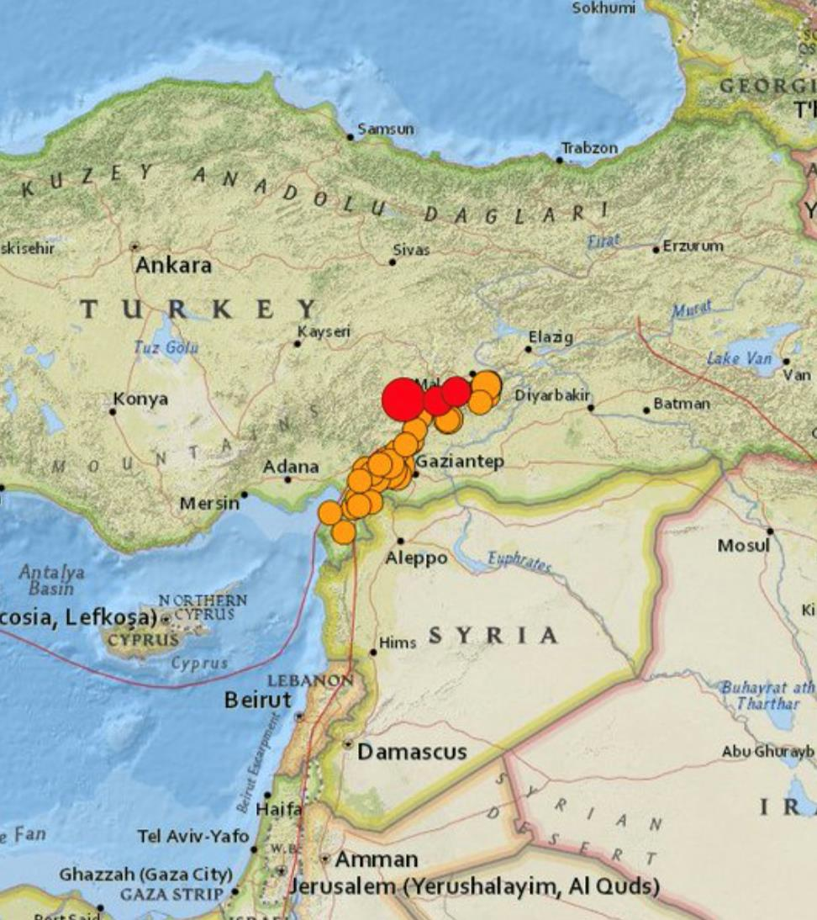
WHAT HAS HAPPENED?
© UNICEF/Erok
A massive earthquake struck Türkiye and Syria at around 4 am local time on 6 February.
It was 7.8 magnitude, and the epicentre was near Gaziantep in southern Türkiye. Millions of people felt the earthquake, including in Lebanon, Israel, Cyprus, and Egypt.
Aftershocks were felt throughout the day, including two further huge earthquakes.
Many children have lost their homes and have been separated from their families.
Access to clean water is a priority. It is exceptionally cold at this time of year so access to shelter, warm clothing and food are also very important.
© UNICEF/USGS
Notes:
Image: Shows the epicentre of the earthquake, near Gaziantep.

Slide 5
WHAT UNICEF DOES IN AN EMERGENCY
In a disaster children may be unable to enjoy all their rights – for instance education, health care. UNICEF works to restore access to these rights as soon as possible.
UNICEF may:
Help provide access to nutritious food, clean water and health care (Article 24).
Set up safe spaces to ensure the immediate safety of children, support them to express their feelings, and to protect them from any further harm (Articles 13 and 19).
Support access to education and children's right to play (Articles 28 and 31)
Send experts to help reunite children with their families wherever possible. Sometimes that may need to be a relative who isn't the parent or immediate caregiver. UNICEF works to ensure that children can connect with people they know and love (Articles 9 and 10).
© UNICEF/UN0779595
Notes:
Image: UNICEF-supported contractors check to ensure the safety of the drinking water being provided by tanker to children and families in the most affected neighbourhoods of Bustan Alkaser, Tareek AlBab and Kadi Askar in Aleppo, northern Syrian Arab Republic. UNICEF is reaching thousands of people with clean water through trucking in the affected neighbourhoods of Aleppo city in the aftermath of a destructive earthquake that hit southeast Türkiye and part of Syria on 6 February.

Slide 6
WHAT IS UNICEF DOING IN SYRIA & TURKIYE?
In Syria, UNICEF is working to ensure access to clean water, and seeking to secure children’s safety and wellbeing.
In Türkiye, UNICEF has mobilised vital emergency supplies and ensured access to safe spaces for children and families.
UNICEF has a huge humanitarian warehouse in Denmark, where supplies are ready to go in case of any emergency.
In this video, a Supply and Logistics Officer talks about the work UNICEF is doing to send life-saving supplies for Türkiye and Syria.
*please check videos will work with your learners before using in class.

Slide 7
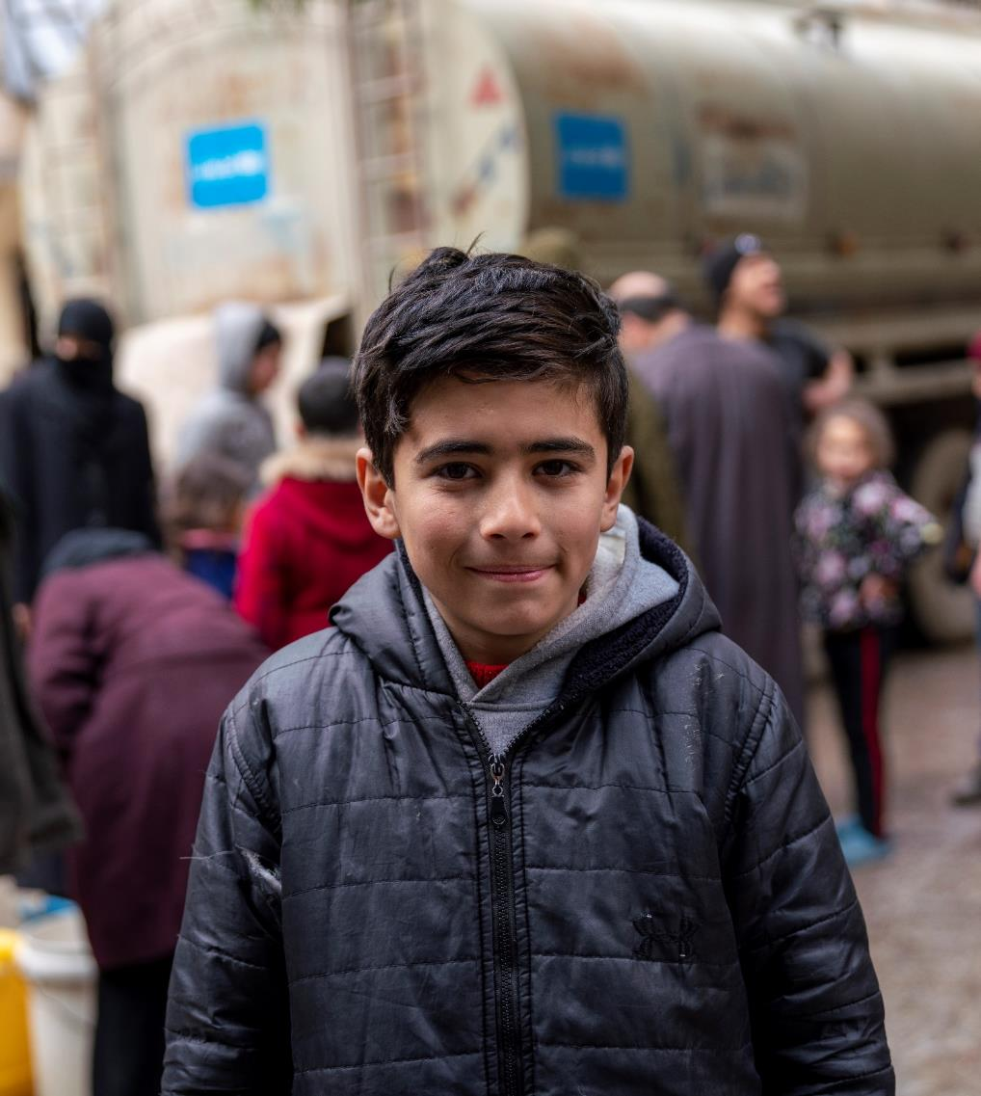
© UNICEF/UN0779600
HOPE & RESILIENCE
Among the sad stories, there have been stories of resilience and hope.
A newborn baby was rescued and is being cared for in hospital. Whole families have escaped from the rubble. And one young girl was exceptionally brave and kept her brother safe, protecting him from dust and rubble until they were rescued.
With local support and global kindness, more and more children can be reached with support, and their rights can be protected and respected.
© UNICEF/UN0779595
© UNICEF/Al-Asadi
Notes:
Image: On 10 February 2023 in the Syrian Arab Republic, 13-year-old seventh grader Moustafa stands in front of a water truck at a distribution point in the Almyassar neighbourhood of Aleppo city, northern Syrian Arab Republic. “I came here to fetch water so we can use it to wash up and for drinking,” says Moustafa, who came here with his grandfather (not pictured). “Since the earthquake happened, we did not have water.” Water and pumping stations in Aleppo were disrupted by the recent earthquakes, affecting a number of the city’s neighbourhoods and preventing people from accessing water. UNICEF is responding by trucking water to the most affected areas.

Slide 8
HOW CAN YOU HELP?
If your school would like to do something to help those affected by the earthquake, the best way to do this is to donate money to an emergency appeal.
You can find information about how to donate to UNICEF UK’s appeal here.
This video from Newsround shows what some schools are doing to help.
UNICEF UK is currently not accepting any physical items for the emergency appeal. These kind donations are really appreciated, but any physical items need to be sorted, cleaned, packed and transported, which is often more costly and can take more time than sourcing items from within Türkiye or Syria.
© UNICEF/Erok
Notes:
Image: Rescue operations following the earthquake in İskenderun, Türkiye on 6 February 2023.

Slide 9
© UNICEF/Zayat
Notes:
Image: On 9 February 2023, two days after a deadly earthquake hit Türkiye and Syria, children sit outside their tents at the Al-Hamam, a makeshift shelter for people who were left homeless, near the town of Jandairis, northern Syria, in the Afrin District of the Aleppo Governorate, on the Syria-Türkiye border.

