Slide 1
ARTICLE OF THE WEEK

Slide 2
INSTRUCTIONS
Slide 3: Guess the article
Slide 4: Introducing Article 17
Slide 5: Exploring Article 17
Slide 6: Some possible answers
Slide 7, 8 & 9: Primary activities
Slide 10, 11 & 12: Secondary activities
Slide 13: Reflection

Slide 3
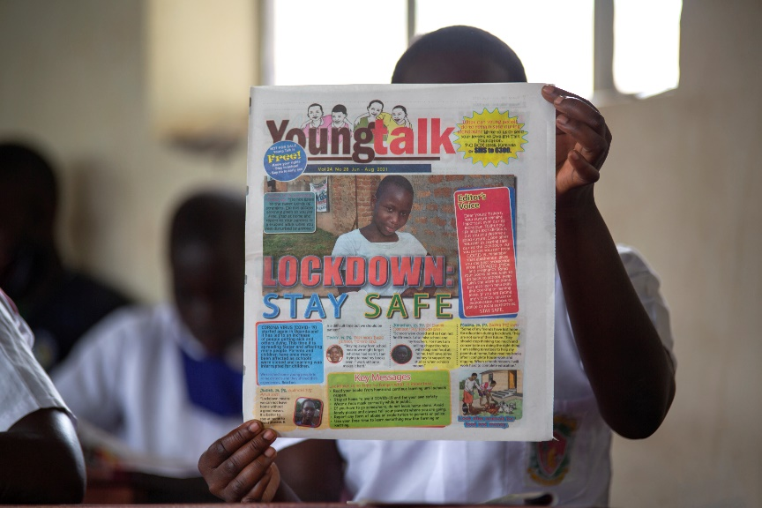
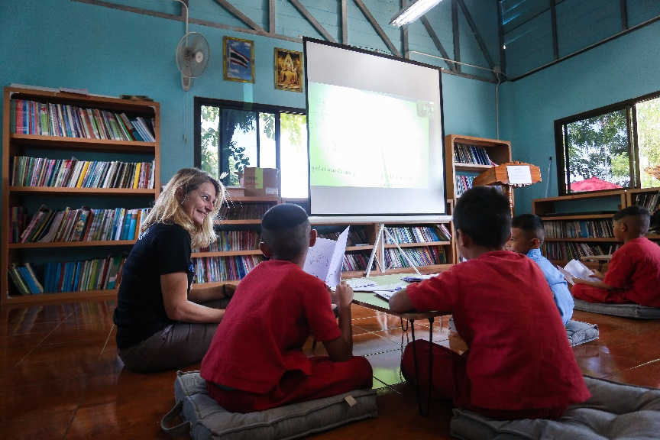
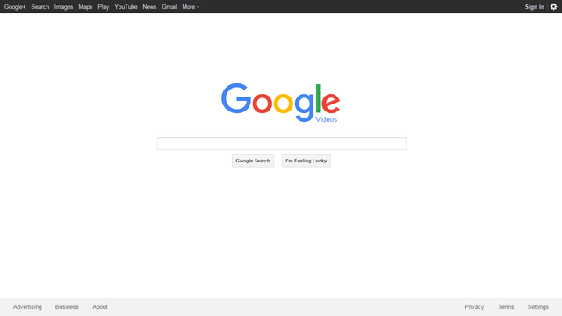
GUESS THE ARTICLE
@UNICEF/Tibaweswa
@UNICEF/Preechapanich
@WikiCommons
These pictures provide a clue to this week’s articles.
How do these pictures help you? Can you guess how they are linked together?
Write down your thoughts or discuss with someone in your class.

Slide 4
INTRODUCING ARTICLE 17
Stuart Whiffin, RRSA Professional Adviser, introduces Article 17
Article 17 – access to information from the media
Every child has the right to reliable information from a variety of sources, and governments should encourage the media to provide information that children can understand. Governments must help protect children from materials that could harm them.
Click here to watch on YouTube

Slide 5
EXPLORING ARTICLE 17
Why do you think it is important to think about whether the information you receive is reliable (can be trusted)?
Have a think and write down some answers.

Slide 6
EXPLORING ARTICLE 17
Did you think of these?
So that we know whether to trust the information to be true.
To help us learn accurate information.
To be able to confidently discuss information with others.
To learn about bias and ‘fake news’.
To know that it’s okay to ask more questions if something doesn't seem right.
To learn the difference between a fact and an opinion.
So that we can have healthy discussions based on facts.
To feel confident to say, ‘I’m not sure if that’s true’.
To know that some people deliberately put false information online.
What else did you think of?

Slide 7
PRIMARY ACTIVITIES
You do not need to complete every activity but if you have time, you can try to complete more than one.
If you wanted to find out more about something you were really interested in, how would you do this? Discuss this as a group and talk about different ways you can find information for example using the internet, or books. Can you draw pictures of the different ways that you can find information?
Look at the different types of books in your school library or reading corner. They will either be fiction or non-fiction. What is the difference? Non-fiction books in libraries are reliable places to get information from. Choose a non-fiction book and read it as a class. What facts have you learned?
Local libraries are brilliant places to find out new things. Does everyone have a library card they can use to access books? Plan a trip to your local library, linked to Article 17, and focus on the non-fiction books that they have available for you to look at and borrow. How can you encourage others to join the library?
Rosa has lots of things she would like to find out, but her local library is closing. So she starts a campaign to keep it open.
Read all about this in We Want Our Books by Jake Alexander.

Slide 8
PRIMARY ACTIVITIES 2
You do not need to complete every activity but if you have time, you can try to complete more than one.
In your library, some books might be quite old. How old is too old? How reliable is this information? Are there occasions where it doesn’t matter how old the book is? Carry out an audit in your library, to see if you can find any books that are no longer reliable and discuss what you could do with these.
There are some brilliant websites that have been created especially for children. As a group, discuss how you can make sure that you are using these websites safely. Is it ever okay to look at the internet without adult supervision? What are your top tips for keeping safe online?
Watch the story of Jack and the Beanstalk. This video tells you the story from the Giant’s point of view. Imagine you are a reporter. Create a news desk in your classroom and pretend you are reporting on the story. Make sure that the report is based on facts and not opinions.
What websites are good for children to use when they are trying to find out about a topic? Are they safe to use? Are they reliable? Work together to create a list of reliable websites that you can share to support other children to access reliable information.

Slide 9
PRIMARY ACTIVITIES 3
You do not need to complete every activity but if you have time, you can try to complete more than one.
Watching Newsround helps to keep you up to date with current affairs around the world. How do you know this is reliable information? When you watch a report, see if you can spot when people share facts or opinions. Take a note and consider creating your own news story, with reliable information, about something that is happening in your community.
Refugee children arriving in a new country need reliable information about the town or city they have arrived in. Create a welcome pack for a new child to your school giving reliable information about what they need to know about the local area. Remember to stick to the facts.
The NewsWise programme has some great checklists and reminders to think about when reading the news to make sure that the information is reliable. Look at these as a class and display them to remind you to think critically.
Social media platforms like Facebook or Instagram are increasingly used to access information. These sites have minimum age limits for signup to keep children safe. Research the age limits on social media platforms and discuss as a class why these limits are in place. Are they fair?

Slide 10
SECONDARY ACTIVITIES
You do not need to complete every activity but if you have time, you can try to complete more than one.
Sometimes the information we see posted online is false. Watch this short video about Fake News from BBC Bitesize here. Take notes on how to spot Fake News and create guidance to help others in your school spot ‘fake news’ or misinformation.
You probably have a good stock of non-fiction books in your school library to support you to access your right to reliable information. However, some of these books may be quite old. How old is too old? How reliable is this information? Are there occasions where it doesn’t matter how old the book is? Carry out an audit in your library, to see if you can find any books that are no longer reliable and discuss what you could do with these.
Where do you get your information? Do you have access to newspapers or online news at school? Make a list of all the different sources you use and give each a score 0-10 for the quality of information you get (e.g. unbiased, truthful, easy to understand).
After thinking about how to spot fake news, try this fun BBC quiz to see if you can spot the fake news headlines.

Slide 11
SECONDARY ACTIVITIES 2
You do not need to complete every activity but if you have time, you can try to complete more than one.
Social media platforms like Facebook or Instagram are increasingly used to access information. These sites have minimum age limits for sign up to keep children safe. Research the age limits on different social media platforms and discuss why these limits are in place. Do you all agree that they are fair?
Trusted organisations can help you find the information you need to live a full and happy life. For example, Young Scot provides information written especially for young people in Scotland on all sorts of important topics, including Article 17. Read their guidance on how to ‘fact check’ information here and create a poster to share this with others.
Refugee children arriving in a new country need reliable information about the town or city they have arrived in. Create a welcome pack for a new child to your school giving reliable information about the local area.
What problems might it cause if people don’t get balanced, reliable information about important events? For example, about climate change, global conflicts or elections? The Economist Educational Foundation have prepared their own Article 17 focused resource which considers this issue in greater detail. Have a look at their free Topical Talk resource for more activities.

Slide 12
SECONDARY ACTIVITIES 3
You do not need to complete every activity but if you have time, you can try to complete more than one.
We get information from lots of places, even the adverts you see. Watch this ‘advert’ about adverts and then find out a bit more about the rules they have to follow on the Advertising Standards Authority website (ASA) here. How does this relate to article 17?
As a school community, how do you share information with others? Do you have a podcast or school newspaper? If you do, how do you make sure the information you share is reliable? If you don’t, how could you go about setting one up?
Without the internet, what would life be like? Do you think information was more reliable or less reliable? Consider an internet free world – what would the impact be? Discuss in small groups and create a pros and cons list.
George Orwell’s 1984, set in a dystopian world overseen by Big Brother, contains the line, “Who controls the past, controls the future: who controls the present, controls the past”. Thinking about your right to reliable information, consider the meaning of that quote in a group discussion.

Slide 13
REFLECTION
Article 17 is an important article which can be linked with many other articles in the UNCRC.
Think about how article 17 links with:
The right to non-discrimination
The right to an education
The right to freedom of opinion and to be listened to
The right to leisure, play and culture
And other articles from the CRC
Think of ways you can improve your access to reliable information in school and choose one idea to work on.

Slide 14
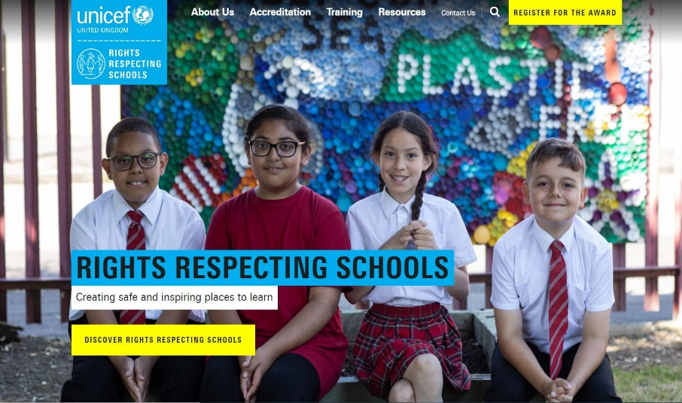
MORE INFO
RRSA WEBSITE
For more information or to download previous Article of the Week packs please visit the RRSA website by clicking on the link below.
CLICK HERE

Slide 15
THANK YOU

