Slide 1
ARTICLE OF THE WEEK
Photo by UNICEF/Catu
Notes:
Image: March 2022, 14-year-old Sofi hugs her brother Vanya, 9, as they rest at the UNICEF-supported Blue Dot hub in Sighet, northern Romania.
Children and families continue to flee Ukraine and UNICEF began to expand the first operational Blue Dot in Romania, at the Sighetu Marmatiei border crossing in northern Romania, which now offers more services to meet the rising needs. Sighetu Marmatiei is the site of the first operational Blue Dot in the country, one of the major crossing points in the country. When conflict forces children to leave their homes, not only do they face the risk of being injured or killed but also being trafficked or forced into child labour. Displaced women and girls are especially at risk of gender-based violence.
UNICEF/Catu

Slide 2
INSTRUCTIONS
Primary Section
Slide 4: Introducing Article 35 – primary video
Slide 5 & 6: Article 35 – question and answers
Slide 7 & 8: Primary activities
Slide 9: Reflection
Secondary Section
Slide 11: Introducing Article 35 – secondary video
Slide 12 & 13: Article 35 – questions and answers
Slide 14, 15 & 16: Secondary activities
Slide 17: Reflection

Slide 3
PRIMARY SECTION

Slide 4
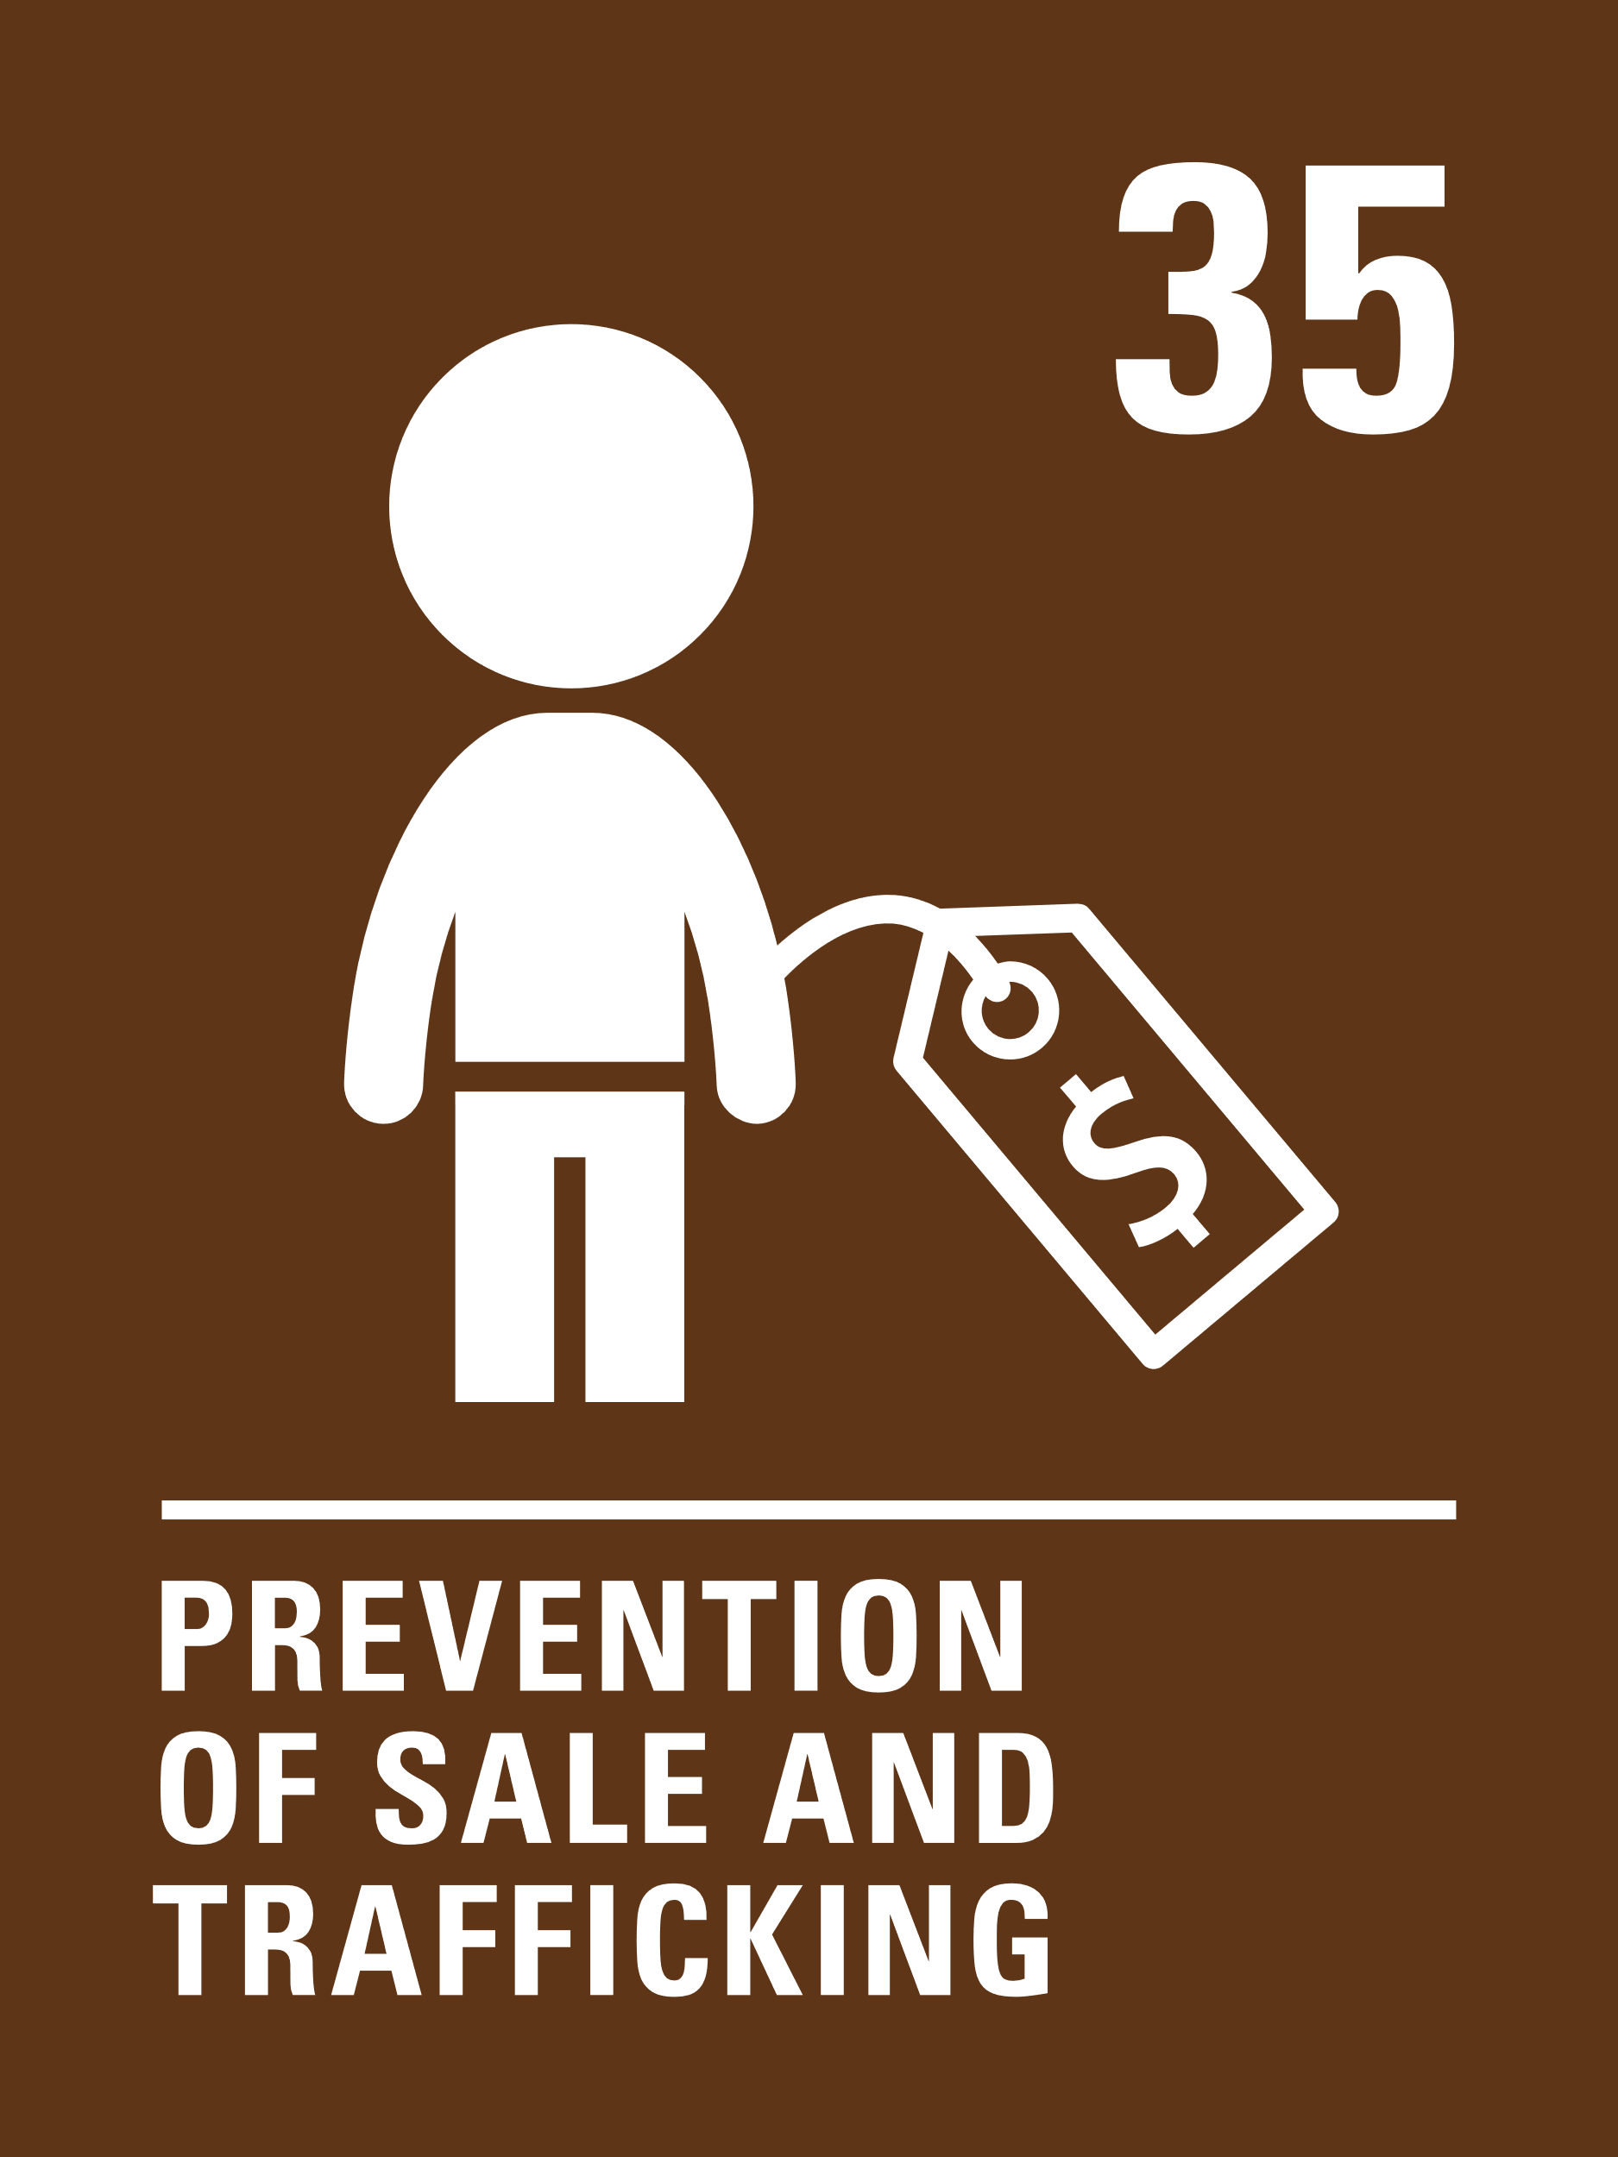
ARTICLE 35 - PRIMARY
Article 35
Governments must protect children from being abducted, sold or moved illegally to a different place in or outside their country for the purpose of exploitation.
Dhanishtha Kuruvilla, Senior Safeguarding Specialist,
introduces Article 35
Click here to watch on YouTube

Slide 5
EXPLORING ARTICLE 35
Abduction, sale and trafficking of children is rare, but it is important to know how to keep yourself safe and know who to talk to if you think yourself or a friend is at risk.
How do you keep yourself safe at home, at school and in the community...
Have a think and write down some answers.
Notes:
Image: May 2019, Fatima, is seen through the screen door of her home. Four years ago she was abducted by an armed group following an attack on her village in northeast Nigeria. “They came in the evening,” Fatima says. “I was at home with my grandmother. They said they would kill her if I didn’t go with them.” Fatima tried to escape after the militants took her, but was caught and taken to Chad, where she spent the next year. She eventually escaped - she volunteered to carry out a suicide mission but instead was able to find help and managed to safely remove the explosive device from her body. With UNICEF's support Fatima is now being provided with psychological care as her recovery process continues.
UNICEF/Kokic

Slide 6
EXPLORING ARTICLE 35
Did you think of these?
By making sure adults know where you are.
By being supervised by adults at home, school or during activities.
By thinking about staying safe online.
By making sure you have safe travel plans in place when socialising.
By considering risks when you do things.
Parents and carers arrange for us to be looked after when they can’t.
Teachers and other staff in school keep us safe during the day and make sure we know who we can talk to if we are worried.
Police officers make sure that we are safe within our communities. If someone is in danger, they will support them.
Social workers can support children who need extra help to stay safe.
Did you think of any other reasons?

Slide 7
PRIMARY ACTIVITIES
You do not need to complete every activity but if you have time, you can try to complete more than one.
You have the right to be safe. On a piece of flipchart paper or whiteboard, draw a picture of your school and draw or annotate it with different ways that you are kept safe at school. For example, you might draw a fence around your playground. Repeat this, focusing on how you stay safe at home.
If you were in the park and realised you were lost, what would you do? Who can help children in this situation? Is it ever okay to speak to a stranger? How can you decide who is best to ask for help? Role play different situations.
Look at the resources from Clever Never Goes which help you to think through how to stay safe in different situations. This resource is for adults working with children, young people and families to educated and inform on avoiding abduction.
To stay safe, it is important that we all learn to say no when we are not comfortable with something. Read this book together and discuss having the confidence to say no when something doesn’t feel right.

Slide 8
PRIMARY ACTIVITIES 2
You do not need to complete every activity but if you have time, you can try to complete more than one.
Childline is a national organisation that helps to keep children safe. As a class explore their special website for children under 12. Look at the information there and discuss how you would access this if you wanted to read more about particular issues. This also links to Article 17, which says that children have the right to access all kinds of information.
To make sure we are all enjoying out right to be safe, it’s really important to think about how to stay safe online. Did you celebrate Safer Internet Day at your school? Remind yourself of some top tips for staying safe online.
Everyone has a right to be safe. Sometimes you may notice that a friend isn’t acting like themselves. What kinds of things might make you worry about a friend? If you were worried about them, what would you do to get them the help they need? Talk about what you can do to support your friends and classmates’ right to be safe.
As you get older, you can do more and more things independently. Look at some of the scenarios here to talk about how to stay safe in different situations.

Slide 9
REFLECTION
Give yourself some time and space and have a think about the following question:
How do the right to education (Article 28) and the right to know your rights (Article 42) link to Article 35 and help to protect children and keep them safe?

Slide 10
SECONDARY SECTION

Slide 11
ARTICLE 35 - SECONDARY
Article 35
Governments must protect children from being abducted, sold or moved illegally to a different place in or outside their country for the purpose of exploitation.
Dhanishtha Kuruvilla, Senior Safeguarding Specialist,
introduces Article 35
Click here to watch on YouTube

Slide 12
EXPLORING ARTICLE 35
Abduction, sale and trafficking of children is rare, but it is important to know how to keep yourself safe and know who to talk to if you think yourself or a friend is at risk.
How do you keep yourself safe at home, at school and in the community...
Have a think and write down some answers.
Notes:
Image: May 2019, Fatima, is seen through the screen door of her home. Four years ago she was abducted by an armed group following an attack on her village in northeast Nigeria. “They came in the evening,” Fatima says. “I was at home with my grandmother. They said they would kill her if I didn’t go with them.” Fatima tried to escape after the militants took her, but was caught and taken to Chad, where she spent the next year. She eventually escaped - she volunteered to carry out a suicide mission but instead was able to find help and managed to safely remove the explosive device from her body. With UNICEF's support Fatima is now being provided with psychological care as her recovery process continues.
UNICEF/Kokic

Slide 13
EXPLORING ARTICLE 35
Did you think of these?
By making sure adults know where you are.
By being supervised by adults at home, school or during activities.
By thinking about staying safe online.
By making sure you have safe travel plans in place when socialising.
By considering risks when you do things.
Parents and carers arrange for us to be looked after when they can’t.
Teachers and other staff in school keep us safe during the day and make sure we know who we can talk to if we are worried.
Police officers make sure that we are safe within our communities. If someone is in danger, they will support them.
Social workers can support children who need extra help to stay safe.
Did you think of any other reasons?

Slide 14
SECONDARY ACTIVITIES
You do not need to complete every activity but if you have time, you can try to complete more than one.
What do you think Modern Day Slavery means? Discuss your ideas with a classmate and then with your class.
Use this website to find out more about the different types of modern slavery.
Abduction
Where and when have you heard this word being used before? What does the word abduction mean? Why is this something that children have a right to be protected from?
Imagine you are a parent and someone promises a better life for your child in another country, but they have to go alone... What questions would you ask? How could you make sure the person is being honest? What would you decide and why?
Article 35 says that children have the right not to be moved to a different place within their own country for the purpose of exploitation. In the UK, County Lines is a process where children are made to travel to different places to sell drugs. Find out more about how to spot the signs of someone who is being exploited in this way and how to help someone who may be at risk.

Slide 15
SECONDARY ACTIVITIES 2
You do not need to complete every activity but if you have time, you can try to complete more than one.
Use the information here to discuss how child marriage could be linked to child abduction and trafficking and how this impacts on children’s rights. Consider how you can raise awareness and campaign to get the UK government to take action this issue.
Read the following report and discuss the issues raised. Explore ways to grow awareness of how these issues impact upon children’s rights. Could you contact a local or national decision maker (like councillors, MPs, Children’s Commissioner) to advocate for better protection?
Watch this video with your teacher or another adult. Discuss why the boy does not choose to join the football club abroad. Find out what FIFA is doing through its FIFA Guardians programme to protect children across the world who play football. You could write to your local football club to ask how they keep children safe and protects them from trafficking.
Explore Modern Day Slavery using these resources from Amnesty International UK which include some useful case studies to discuss. Find out more about organisations that campaign to stop trafficking and modern-day slavery such as Stop the Traffik. How could you raise awareness of this issue in your community?

Slide 16
SECONDARY ACTIVITIES 3
You do not need to complete every activity but if you have time, you can try to complete more than one.
In groups, explore this infographic about trafficking in the USA. Can you create a similar infographic about trafficking in the UK?
Millions of children are on the move. Some are driven from their homes by conflict, poverty or climate change; others leave in the hope of finding a better life. Young people can be particularly vulnerable to abduction and trafficking and are at risk of sexual exploitation. Watch this UNICEF video about young migrants who have been trafficked and forced into prostitution. Find out what the UK Government does to support child victims of trafficking.
How does the UK Government try to make sure that children aren’t taken out of the country without permission? Has anyone travelled abroad? Think about the procedures that are in place to stop children being removed from this country illegally.
Sir Mo Farah recently told his story in a BBC documentary of being trafficked as a child for domestic servitude. Find out more about what happened to him and how he overcame significant challenges and came to terms with his life experiences, including deciding to tell his story publicly. Mo opened up to trusted adults at his school about his situation and received support from them to keep him safe. How can you make sure that everyone in your school knows who to talk to if they have worries about their own or a friend’s safety?

Slide 17
REFLECTION
Give yourself some time and space and have a think about the following question:
How do the right to education (Article 28) and the right to know your rights (Article 42) link to Article 35 and help to protect children and keep them safe?

