Slide 1
ARTICLE OF THE WEEK
Notes:
Image: 'Beads for peace' ("Perlen für den Frieden") was the motto of Emilia, Svea and Yolanda. Over a longer period of time, the three girls made beaded jewelry together and individually at home. On March 18, 2022, the girls gave away their self-made beaded jewelry and sorted-out toys at the marketplace in Warendorf in exchange for a donation to UNICEF. Later, their younger siblings joined them and supported them in their action.

Slide 2
INSTRUCTIONS
Slide 3: Introducing World Water Day
Slide 4: Linked UNCRC articles
Slide 5: Exploring World Water Day
Slide 6: Some possible answers
Slide 7, 8 & 9: Primary activities
Slide 10, 11 & 12: Secondary activities
Slide 13: Reflection

Slide 3
INTRODUCING
WORLD WATER DAY
World Water Day
Steven Kidd, RRSA Professional Adviser, introduces World Water Day
March 22nd is World Water Day.
We all know that water is vital for everyone in their daily lives across the world, and back in 2015 the world committed to working together to make sure that everyone has access to safe, clean water and good sanitation. This was Sustainable Development Goal 6.
But there is still much work to be done with over 2 billion people drinking unsafe water. An important aim of World Water Day is to inspire everyone to take action and make the necessary changes so that the right to clean water can be achieved by 2030 for everyone.
Click here to watch on YouTube

Slide 4
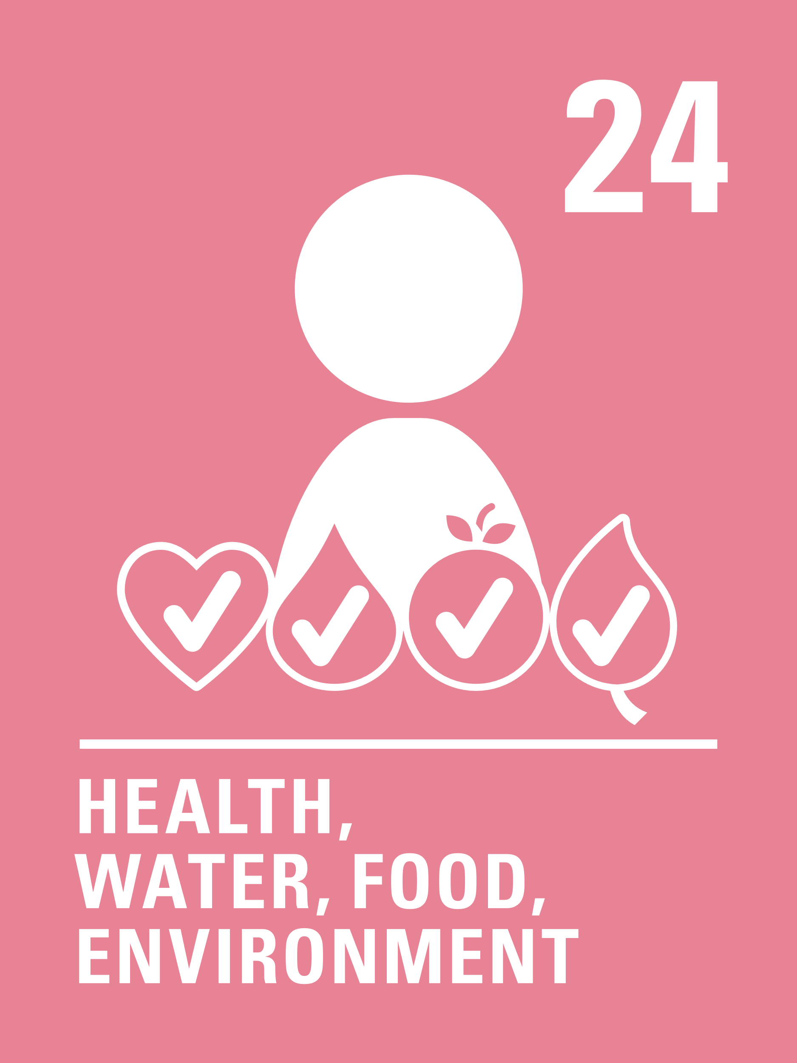
LINKED UNCRC ARTICLES
This week’s activities link to
Articles 24 and 27:
Article 24 (health and health services)
Every child has the right to the best possible health. Governments must provide good quality health care, clean water, nutritious food, and a clean environment and education on health and well-being so that children can stay healthy. Richer countries must help poorer countries achieve this.
Article 27 (adequate standard of living)
Every child has the right to a standard of living that is good enough to meet their physical and social needs and support their development. Governments must help families who cannot afford to provide this.

Slide 5
EXPLORING WORLD WATER DAY
Why do you think that the right to clean water is such an important right?
List as many reasons as you can, share with a friend and then compare with the next slide.

Slide 6
EXPLORING
WORLD WATER DAY
Did you think of these?
Our bodies are made up of over 60% water and we need clean water to keep them working properly and to stay alive.
Drinking dirty, unsafe water can cause serious illnesses.
In some communities, children miss out on their education because they must spend time collecting water.
We need water for washing ourselves and for keeping our clothes and homes clean.
A good water supply is important for good sanitation and flushing our toilets.
Not having access to clean water makes it harder to be healthy and have a decent standard of living.
Water and wetlands provide important habitats for plants and animals.
Pollution of our oceans, rivers and waterways can have a serious impact on all living things.
Water is important to generate power in some places and it is a better for the environment than burning fossil fuels.
What else did you think of?

Slide 7
PRIMARY ACTIVITIES
You do not need to complete every activity but if you have time, you can try to complete more than one.
One of the best ways to prevent the spread of germs and illnesses is by washing your hands with clean water and soap. Watch these step-by-step instructions for good handwashing and then practice it by miming the actions with a friend.
Take a glass of water. It looks ordinary but is actually very special because we all need water to stay alive. Think about all the times water is important to you in your day, like on a hot day after you have been playing. Draw pictures of you or your friends enjoying water.
Team up with Thomas and Friends to learn about the importance of clean water and Global Goal 6: clean water and sanitation for all. Talk about what we can all do to make sure we don’t waste water and also to help keep rivers and oceans clean.
Each year World Water Day identifies a theme. Take a look at the World Water Day website to find out what this year’s theme is. Make a poster or display to promote it and decide on one action that you will take. Can you link the theme to Articles 24 and 27?

Slide 8
PRIMARY ACTIVITIES 2
You do not need to complete every activity but if you have time, you can try to complete more than one.
Watch this fun story about Whale making her way home to the ocean. Can you think of other animals that live in the water? Pick one and create a fact file about it.
UNICEF works in lots of countries to make sure that children have access to clean water.
Watch Stephen’s story and discuss what difference it makes for children when they have safe water taps and clean water.
Saving water can help to save money and also takes less water from our rivers and estuaries, which helps keep the environment healthy. Research some water saving tips for your school and create posters to display in key areas such as the toilets, kitchens and sink areas in classrooms to encourage others to save water too.
How do we get clean water?
This video from an Australian water company talks you through a great science experiment which will help you to see for yourself.

Slide 9
PRIMARY ACTIVITIES 3
You do not need to complete every activity but if you have time, you can try to complete more than one.
Do you ever wonder what happens after you flush the toilet? This video answers your question. Look up the meaning of the word ‘sanitation’ and discuss in class why it is so important. How do Articles 24 and 27 link to sanitation? If you have time look at this UNICEF information.
Learn about UNICEF’s work in South Sudan to provide access to clean water for children at school. What difference do you think it is making to their lives?
Make a ‘water diary’ over a day or week, writing down all the times you use water and in what ways. Can you work out roughly how many litres you use for different things?
Across the world, many children have to walk for miles each day collecting water. Work out how heavy it would be if you had to carry the water you use each day from a pump to your home.
Watch this animation about a hummingbird who puts out a fire one drop at a time. How can you be like the hummingbird and take action on the water and sanitation crisis facing the world? Discuss your ideas in class.

Slide 10
SECONDARY ACTIVITIES
You do not need to complete every activity but if you have time, you can try to complete more than one.
Each year World Water Day identifies a theme. Visit the website to find out more about this year’s theme. Use what you find to prepare a short assembly or organise a discussion in class.
Can you link the theme to Articles 24 and 27?
In January 2022, research by MPs said that no river in England is free from pollution.
Read more here and find out what is causing that pollution.
Is this a problem in your area? Think about starting a campaign to help clean up our rivers, wherever you live.
Usable water is a limited and diminishing resource and the demand for freshwater is growing.
In 2018, Cape Town in South Africa nearly ran out of fresh water. Find out why and then design a campaign to encourage everyone to be more water conscious.
Why does your body need water?
Do some group research and make a short video to encourage people at your school to drink more water.

Slide 11
SECONDARY ACTIVITIES 2
You do not need to complete every activity but if you have time, you can try to complete more than one.
Water makes the Earth a very special place.
It is the only planet in our solar system with liquid water on the surface. Think about the role of water and how it makes the Earth unique and write a poem or a reflective piece.
Hold a photographic exhibition in your school using photographs taken by students and staff that celebrate water. Raise awareness of Article 24 and 27 and Sustainable Development Goal 6 in your exhibition and invite the wider school community to visit.
Climate change is making rainfall patterns change. Some places are drier, causing wells and rivers to dry up. In other places, rainfall has increased causing flooding. This video explains the importance of groundwater and a healthy water cycle in helping to keep our climate and planet healthy. Do you have trees and plants in your school grounds? Could you plant more?
UNICEF always speaks about water alongside sanitation and hygiene. Why do you think this is? Have a look at this information from UNICEF and prepare a short report about the importance of this work for your school newsletter or website.

Slide 12
SECONDARY ACTIVITIES 3
You do not need to complete every activity but if you have time, you can try to complete more than one.
Sustainable Development Goal 6 calls for the world to ensure access to clean water and sanitation by 2030 – use this site to find out how we’re doing. Choose one of the indicators and summarise for your classmates.
Consider holding a Water Conference (like the United Nations). Different groups could represent different countries, research the water crisis issues in their country using this site and share with each other. What should the world’s priority be in working towards Sustainable Development Goal 6?
Write a story set in a world where water has become the new currency. How would things be different? How would Articles 24 and 27 influence your story?
Learn about working in research and development in the water industry: this website could get you started. Is this something you might be interested in? What kind of skills do you think you might need?

Slide 13
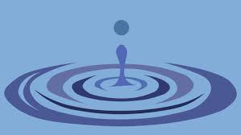
REFLECTION
Think about dropping a pebble into a pond. Imagine the ripples gently spreading outwards through the water.
Now imagine that your action to raise awareness of the importance of the right to clean water is that pebble and the ripples are the positive effects of your action.
Think about what your action might be...

Slide 14
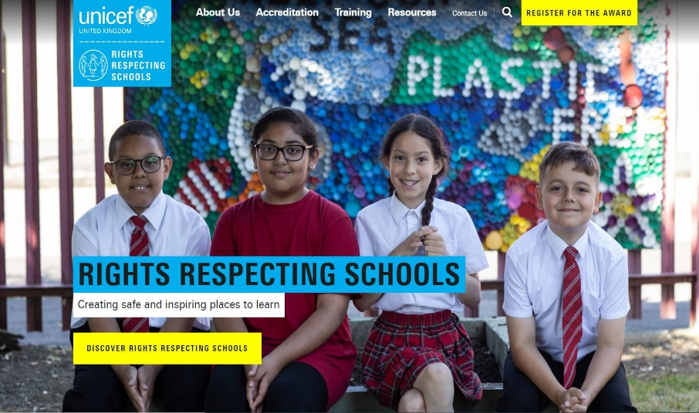
MORE INFO
RRSA WEBSITE
For more information or to download previous Article of the Week packs please visit the RRSA website by clicking on the link below.
CLICK HERE

