Slide 1
ARTICLE OF THE WEEK
UNICEF/Mawa

Slide 2
INSTRUCTIONS
Slide 3: Guess the Article
Slide 4: Introducing Article 6
Slide 5 & 6: Exploring Article 6 - Question & Answer
Slide 7, 8 & 9: Primary Activities
Slide 10, 11 & 12: Secondary Activities
Slide 13: Reflection

Slide 3
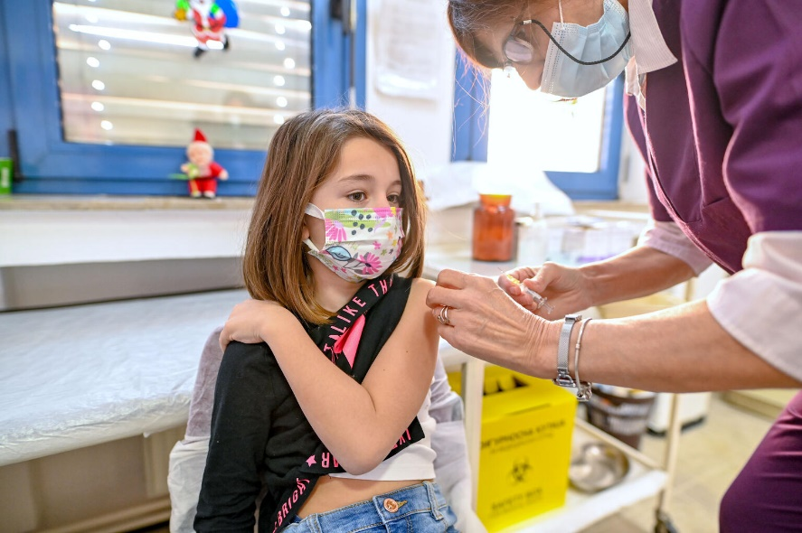
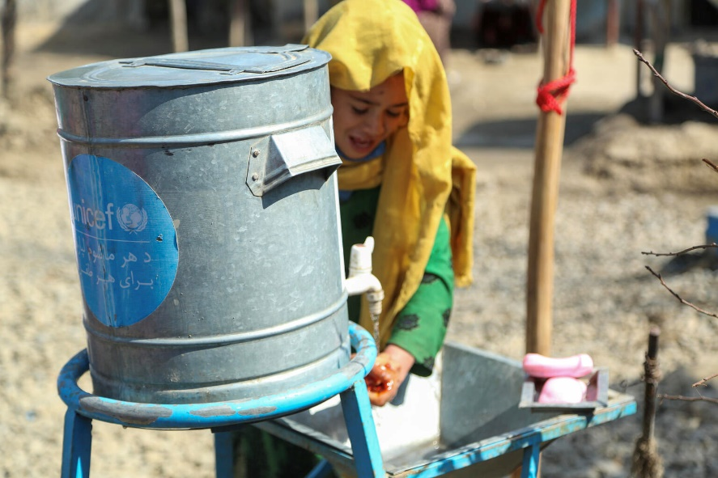
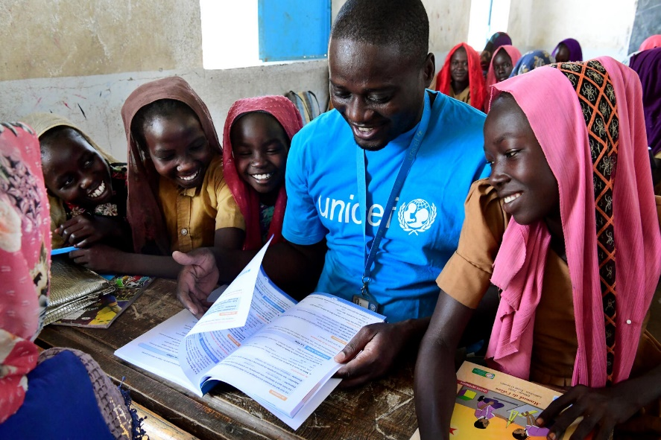
GUESS THE ARTICLE
UNICEF/Georgiev
UNICEF/Houser
UNICEF/Dejongh

Slide 4
Article 6
ARTICLE 6
Introducing Article 6 (life, survival and development)
Every child has the right to life. Governments must do all they can to ensure that children survive and develop to their full potential.
Steven Kidd, Professional Adviser, introduces
Article 6
Click here to watch on YouTube

Slide 5
EXPLORING ARTICLE 6
What are all the things that you need to survive and to develop?
Have a think and write down some answers.

Slide 6
EXPLORING ARTICLE 6
Good health – physical and mental
Education
Healthy food
Clean water
Somewhere safe to live
People to look after you
A name and an identity so you can be registered for healthcare and education
Protection so you are safe from abuse and neglect
A good standard of living
Time and space to relax and play
Knowledge of your rights
Did you think of any other examples?

Slide 7
PRIMARY ACTIVITIES
You do not need to complete every activity but if you have time, you can try to complete more than one.
Work with a partner or in a group.
Draw around one person. On this body outline, draw or write labels or use cut out pictures to show all of the things you think children need to survive, develop and thrive.
Draw an outline of an adult (duty bearer) and label your picture with everything they should do to help you survive and develop. How do these things change over time?
The Very Hungry Caterpillar eats lots and lots of food (not all of it very healthy) to help him grow. How do other animals change as they grow up? Draw a picture of what you might look like when you are a grown up.
Share this story about Titch.
Can you think of three things that you can do now that you couldn’t do when you were younger? Share your ideas with your friends. Perhaps you can create a timeline showing what you could do when you were different ages – remember though, that everybody develops at different speeds.

Slide 8
PRIMARY ACTIVITIES 2
You do not need to complete every activity but if you have time, you can try to complete more than one.
Discuss which rights are referred to in this video and how they link with
Article 6.
Have a look at all the rights in the CRC. How many other articles can you find that link to Article 6?
Work in groups to create a list, then compare your answers.
Choose a key word from Article 6 such as LIFE, SURVIVAL, DEVELOP or POTENTIAL and write an acrostic poem to explain how this right can be achieved for you.
Think about a newborn baby. What do they need to live, survive and develop? Compare this list with what you need. Discuss the differences with each other in class. How might your list be different when you are 14?

Slide 9
PRIMARY ACTIVITIES 3
You do not need to complete every activity but if you have time, you can try to complete more than one.
In this video children in Bangladesh learn to swim which helps them to survive. What life skills do you already have to help you survive and develop?
Article 6 talks about developing to your full potential and surviving; other words that are sometimes used are ‘flourish’ and ‘thrive’. Look up the definitions of these words – do they all mean the same thing? How would you state Article 6 in your own words?
Have a look at this video made by UNICEF about the lives of different children in the world. How could you relate what you see to the right to life, survival and development.*
*Please review this video before sharing with you pupils and be mindful of the context your learners bring with them to this activity.
Children weren’t always protected by the Convention – watch this video to find out what life was like for many children in the UK during the Victorian era. Discuss which rights now help children to survive and develop to their full potential?

Slide 10
SECONDARY ACTIVITIES
You do not need to complete every activity but if you have time, you can try to complete more than one.
Draw a timeline of your life to create a visual image of events and people who have helped you develop and become the person you are today.
UNICEF supports children’s right to life, survival and development around the world every day. Watch these two videos about its work - Help a Child and We Won’t Stop. Discuss your thoughts and reactions to the content. If you wish, use the ideas (especially the vocabulary) to write a report for your school newsletter or create an assembly about UNICEF’S work.
Have you ever watched TV programmes about survival? Discuss a highlight that sticks in your mind with your friends. Identify the top priorities for the people involved in extreme survival situations. Compare your priorities with a friend. Are they the same?
As a group or class create a list of the different things that might slow down a child’s survival and development or even limit their life. Use your research skills to find a current situation where, unfortunately, the things on your list are happening. What do UNICEF and other organisations do to try and prevent or improve such situations?
Discuss how your class/school could raise awareness of and support for this.

Slide 11
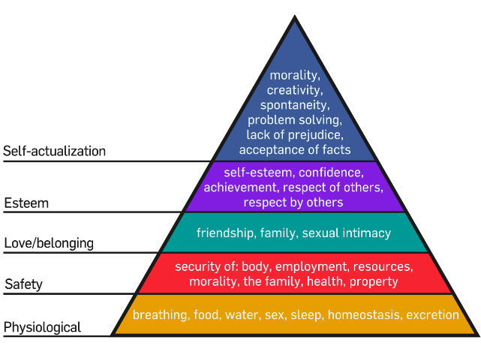
SECONDARY ACTIVITIES 2
You do not need to complete every activity but if you have time, you can try to complete more than one.
Conflict and crises greatly impact on children’s ability to enjoy Article 6. We don’t always hear about them about on the news, but this article in The New Humanitarian highlights eight situations around the world where lives are threatened. Choose one of the examples to further research, update and compile a fact file.
Some people say that the right to life is obvious. Why do you think it was considered important enough to be an article in the CRC?
How many other articles can you find in the Convention that link to Article 6?
Work in groups to create a list, then compare your answers.
Explore Maslow's hierarchy of needs. Discuss how this model relates to the right to life, survival and development.
Image: WikiCommons
UNICEF and other organisations have made a significant difference around the world to reduce the number of children dying before the age of 5. Using the data from this website, prepare your own report on the subject, including graphs and statistics. More recent data can be found here.

Slide 12
SECONDARY ACTIVITIES 3
You do not need to complete every activity but if you have time, you can try to complete more than one.
Read this BBC article about a primary school headteacher whose life was saved by having a defibrillator at school. Find out if your school has one. Write an article for your school newsletter to ensure that people know where the nearest defibrillator is.
Many religions and world views believe that life is so special that it should always be protected and respected and that nobody should ever take a life away.
Discuss your thoughts and beliefs about this.
Accidents (unintentional injuries), homicide, suicide, cancer, and heart disease make up the five leading causes of death for 15 -24-year-olds. This poignant video from Papyrus UK encourages us to support suicide prevention and highlights their free helpline. What advice, help and support does your school offer for mental health, especially to those who are facing difficult or challenging situations? Are local and national organisations signposted? Design a leaflet about this for the new pupils joining your school later in the year.
The UN Convention on the Rights of the Child applies from birth up to 18 years. Find out more about how the right to life is protected for everyone, including adults, in the UK Human Rights Act.

Slide 13
REFLECTION
Use some of your mindfulness skills or a breathing exercise to be still and calm… then give some time to the thoughts and questions below….
Think about your development since you were a tiny baby…
Remember a moment when you learnt to do something for the first time…
How did it make you feel?
What did you do next?
What are you looking forward to learning and experiencing in the future?
Who can you share this with?

Slide 14
MORE INFO
RRSA WEBSITE
For more information or to download previous Article of the Week packs please visit the RRSA website by clicking on the link below.
CLICK HERE

