Slide 1
ARTICLE OF THE WEEK
UNICEF/Andrianantenainaenaina
Notes:
Nina 13 years old, dropped out of school and works at the Vohibola mica mine in the Anosy region, 25 kilometers north from Amboasary-sud, the photography was taken 15 meters under the ground during the winter of June 2022.

Slide 2
INSTRUCTIONS
Slide 3: Guess the article
Slide 4: Introducing Articles 32 & 35
Slide 5: Linked Articles
Slide 6: Exploring Article 32 & 35
Slide 7: Some possible answers
Slide 8, 9 & 10: Primary activities
Slide 11, 12 & 13: Secondary activities
Slide 14: Reflection

Slide 3
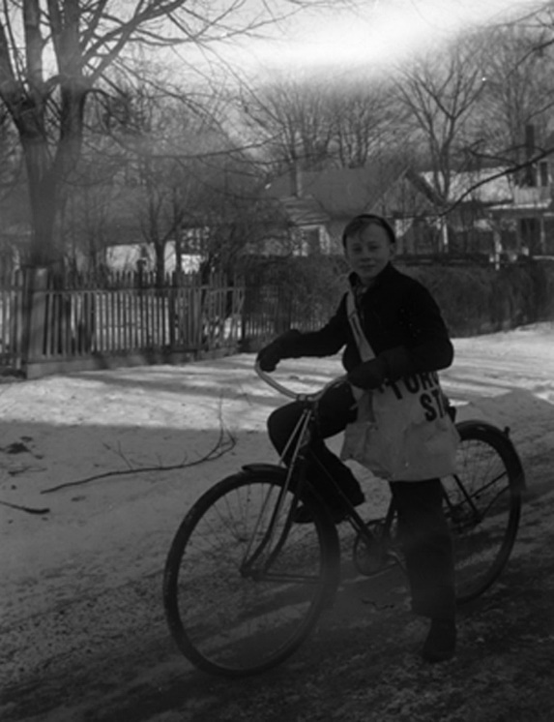
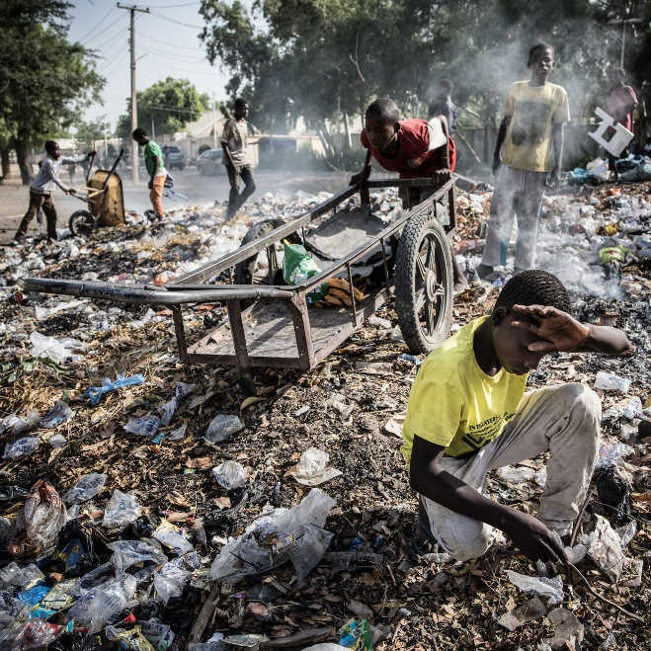
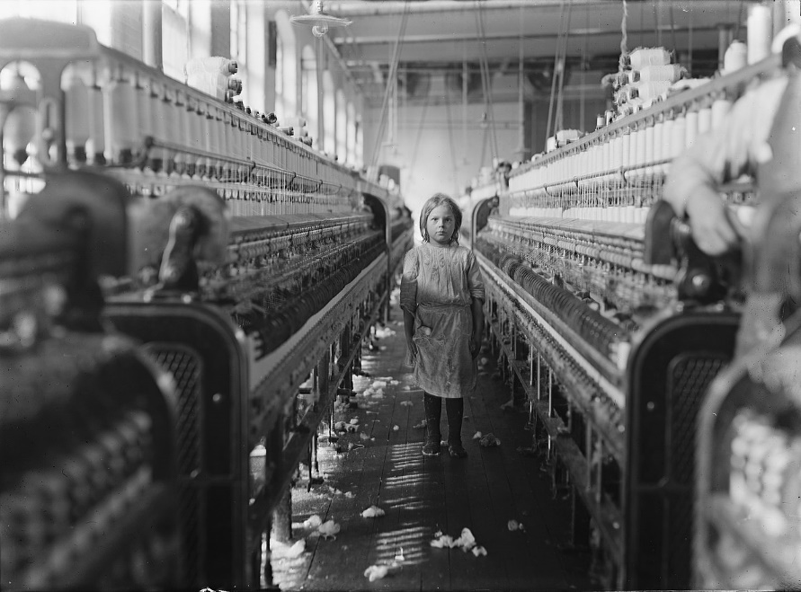
GUESS THE ARTICLE
@UNICEF/Gilbertson VII Photo
WikiCommons
WikiCommons
These pictures provide a clue to this week’s articles.
How do these pictures help you? Can you guess how they are linked together?
Write down your thoughts or discuss with someone in your class.

Slide 4
ARTICLE 32 & 35
Articles 32 & 35 –
World Day Against Child Labour
Throughout history, children have had to work in all sorts of different ways. In the 20th Century the world agreed that work that endangered children or stopped them from enjoying all their rights was unacceptable. In 2002, The International Labour Organization (which was set up by the United Nations) launched the first World Day Against Child Labour to highlight the struggles faced by working children. Held each year on 12th June, the day is intended to promote and encourage the growing worldwide movement against child labour. It is hard for most children and young people in the UK to imagine what it must be like to have to work as a child. Exploring articles 32 and 35, through the activities this week, will help you to understand and think about the effect of child labour.
Hilary Alcock introduces Articles 32 & 35 – World Day Against Child Labour.
Click here to watch on YouTube

Slide 5
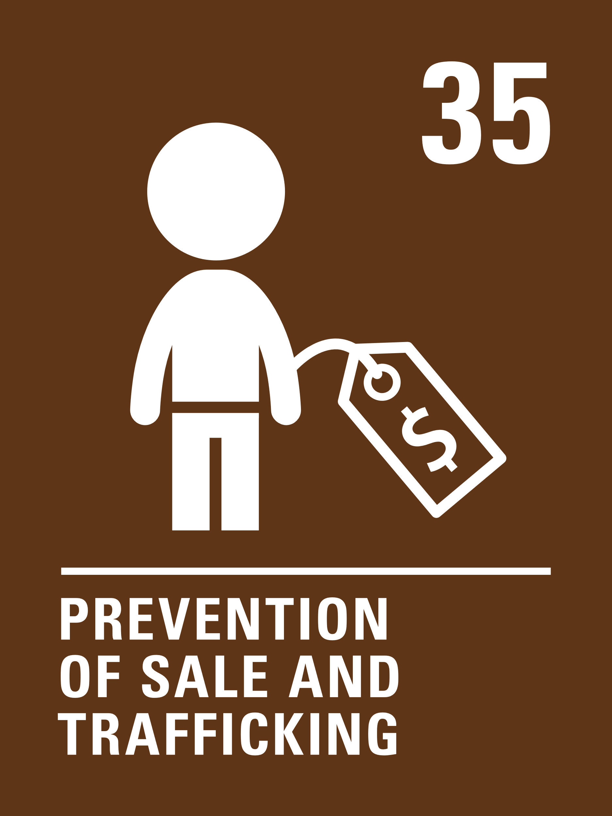
LINKED ARTICLES
Article 32 Child labour – Governments must protect children from economic exploitation and work that is dangerous or might harm their health, development or education. Governments must set a minimum age for children to work and ensure that work conditions are safe and appropriate.
Article 35 Prevention of sale and trafficking -Governments must protect children from being abducted, sold or moved illegally to a different place in or outside their country for the purpose of exploitation.

Slide 6
EXPLORING ARTICLE 32 & 35
How many reasons can you think of why children should be protected from working, especially in dangerous conditions?
Have a think and write down some answers.

Slide 7
EXPLORING ARTICLE 32 & 35
Did you think of these?
Their family should have a good enough standard of living without them working.
Children should be in education.
Their health and safety should be protected.
Children’s views and best interests should be considered.
Other harm could come to them in the workplace.
It could lead to further exploitation or trafficking.
They should have time to be a child and have all their rights.
They should have time to rest and play, and to develop their talents.
What else did you think of?

Slide 8
PRIMARY ACTIVITIES
You do not need to complete every activity but if you have time, you can try to complete more than one.
As a class, listen to a short retelling of Cinderella. In circle time, discuss how she was treated by her stepsisters.
How should her life have been different? Can you talk about the rights she should have enjoyed?
Explore how children ‘help out’ with ‘jobs’ at home and in school. What would it be like to do these all the time and have no time for play or learning?
Talk about the jobs you would like to do when you are grown-up. Draw a picture of yourself doing that job or dress up in the role play area. Discuss why children should not have to work.
Ask your family, grandparents or older friends if they had a job when they were children. What work did they do? How did their work impact on their rights?

Slide 9
PRIMARY ACTIVITIES 2
You do not need to complete every activity but if you have time, you can try to complete more than one.
Children weren’t always protected by the Convention – watch some of this video to find out what life was like for many children in the UK during Victorian era. Discuss what other rights came to your mind as you watched it.
Draw a large clock on a piece of paper and divide it up into 12 equal segments. In each segment write or draw what you are doing on a normal day. Are you at school, sleeping, playing or watching TV? Now imagine you have to fit a job into your day too. What would you have to stop doing to be able to work?
Watch Ibrahim’s Story and read about UNICEF’s work to end child labour here. Create a poem or a piece of art, drama or music to explore some of the feelings involved in what you have seen.
Find out about Fairtrade and discuss how it helps to protect children’s rights, particularly Article 32. Use this information to get started.

Slide 10
PRIMARY ACTIVITIES 3
You do not need to complete every activity but if you have time, you can try to complete more than one.
Child labour often involves children being sold or moved illegally. This links to Article 35 and is sometimes called trafficking. Watch this short clip about Sir Mo Farah. He was trafficked to the UK to work as a domestic servant. What could you do if you felt one of your friends was involved in harmful work?
World Day Against Child Labour brings together Governments, employers and individuals to highlight what can be done to help children who are working in negative situations. Read about some of the previous campaigns. How can you raise awareness of child labour in your community?
Watch this video for the World Day Against Child Labour. Research ten facts about child labour and think of a way to share this information in your school.
How does the government protect children in the UK who work? Use this website to help you. Create a poster to make sure everyone in your school knows the facts about working in the UK.

Slide 11
SECONDARY ACTIVITIES
You do not need to complete every activity but if you have time, you can try to complete more than one.
Do you have a job or know of friends who do? Find out how the law protects children in the UK. Is there anything that surprises you? What is the difference between 'child work' and ‘child labour'? Make up a quiz for your family and friends about what you found out.
What reasons do you think children may have for working? Watch this film. Discuss what you have learnt in class. Are there any other reasons that the film shows that you hadn’t thought of?
Child labour remains a persistent problem in the world today. Research the facts and make a presentation or display to raise awareness in school. Perhaps begin with the stories on page 16 of this report. Check out this information on child labour.
Some of the products we buy such as mobile phones, coffee and chocolate are produced using child labour in dangerous conditions. Research one of the following using the links to get you started:
Child labour and coltan used for mobile phones
Child labour and fashion
Child labour and chocolate

Slide 12
SECONDARY ACTIVITIES 2
You do not need to complete every activity but if you have time, you can try to complete more than one.
The latest global estimates indicate that 160 million children – 63 million girls and 97 million boys – were in child labour globally at the beginning of 2020. This accounts for almost 1 in 10 of all children worldwide. If 1 in 10 children in your school were involved in child labour, how many would this be?*
* Source available here.
In 1888, the female workers of the Bryant and May factory organised what would become known as the Match Girls Strike, protesting their terrible working conditions. Write about the events surrounding the strike from the perspective of one of the children involved.
This article features work from seven street artists from around the world on the theme of child labour. Pick the one you think is most powerful and explain why. Then create your own piece of art (or writing) to express your views on child labour.
Create a piece of art, drama or music to raise awareness and perhaps protest against child labour. Try to show how not being protected through this right might impact on many other rights.

Slide 13
SECONDARY ACTIVITIES 3
You do not need to complete every activity but if you have time, you can try to complete more than one.
Child labour often involves children being sold or moved illegally. This links to Article 35 and it is sometimes called trafficking. Watch this short clip about Sir Mo Farah. He was trafficked to the UK to work as a domestic servant. What could you do if you felt one of your friends was involved in harmful work?
Watch this video: The Secret Gardeners on child trafficking in Vietnam. How did the film make you feel? Were the boys treated fairly. How does it link to articles 32 and 35? What can you do to raise awareness of the rights of children who are trafficked?
A longer task: Listen to the podcast ‘What is wrong with child labour?’ (it starts after 1 minute) and read ‘Child labour is exploitation’. Share your views on child labour and the issues discussed. Hold a debate: “This house believes children should never have to work.” Use the Convention to strengthen your debate, perhaps considering the right to protection vs right to participate and learn new skills.
The NSPCC has some good advice on how to spot if a child has been trafficked and what to do. Think about how you could share this information in school.

Slide 14
REFLECTION
Try to find somewhere peaceful and spend a few minutes being quiet and still … then think about these questions…
Rights are indivisible and all equally important. Imagine you were engaged in child labour; how might your other rights be affected?
What should adults do to make sure any work children do is safe?
Who would you talk to or contact if you were worried about yourself or someone you know in connection with child labour or trafficking?

