Slide 1
ARTICLE OF THE WEEK
Notes:
Highlights from the first child friendly space established inside the "Karkar" bus station, in cooperation between UNICEF, Aswan Governorate, and the Directorate of Health and Population in Aswan, to provide psychosocial support to children and their families. The club was created to serve displaced families and children fleeing from Sudan. UNICEF/Mostafa

Slide 2
INSTRUCTIONS
Slide 3: Guess the article
Slide 4: Introducing Article 15
Slide 5: Exploring Article 15
Slide 6: Some possible answers
Slide 7, 8 & 9: Primary activities
Slide 10, 11 & 12: Secondary activities
Slide 13: Reflection

Slide 3
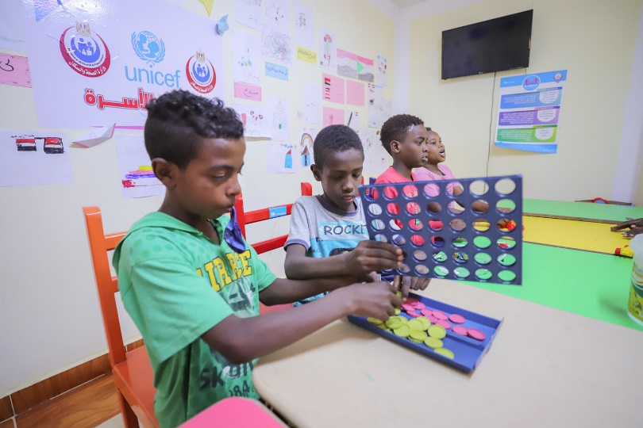
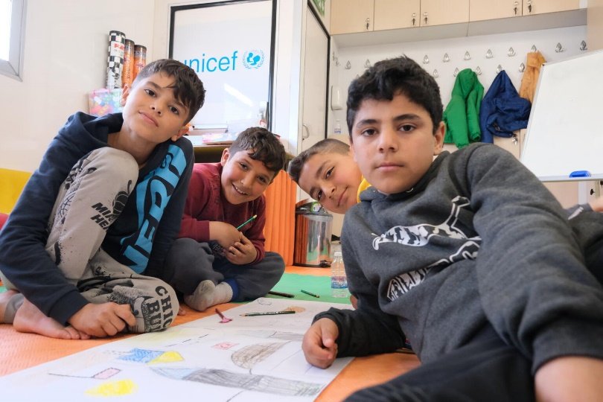
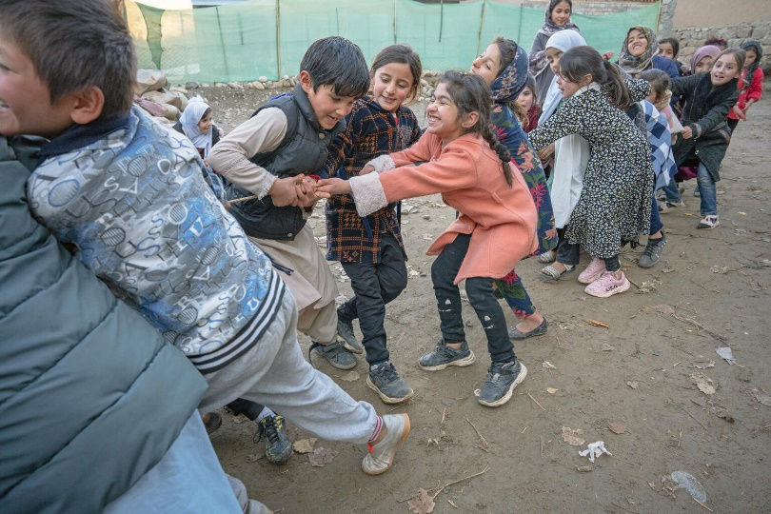
GUESS THE ARTICLE
@UNICEF/Mostafa
@UNICEF/Erkiliç
@UNICEF/Naftalin
These pictures provide a clue to this week’s articles.
How do these pictures help you? Can you guess how they are linked together?
Write down your thoughts or discuss with someone in your class.

Slide 4
ARTICLE 15
Article 15 - Freedom of Association
Samantha Bradey, Communications and Resources Manager, introduces Article 15.
Every child has the right to meet with other children and to join groups and organisations, as long as this does not stop other people from enjoying their rights. Article 15 is about the right of association which is having the opportunity to gather with others for different purposes.
Click here to watch on YouTube

Slide 5
EXPLORING ARTICLE 15
Why is important that young people should have the opportunity to meet, spend time together and share ideas?
Have a think and write down some answers.

Slide 6
EXPLORING ARTICLE 15
Did you think of these?
Joining groups or organisations can help us learn more about different issues.
Meeting others helps us develop new skills: how to resolve issues, find ways to compromise, share, encourage, show support and empathy.
It helps us to learn from and mix with a range of other people.
We can learn a lot from other children and young people that helps to form our views and opinions about different things.
By being with other people, we learn more about ourselves.
People can be stronger together.
Joining together as a group, we can bring about change.
Young people have a right to participate and to be listened to and be heard.
What else did you think of?

Slide 7
PRIMARY ACTIVITIES
You do not need to complete every activity but if you have time, you can try to complete more than one.
Facilitate a discussion with children about friendship and belonging.
Why is ‘belonging’ important to us?
Create an opportunity for children to share and discuss the clubs and activities that they take part in after school or outside of school. Link this to Article 29, which is about developing your talents and abilities.
Imagine you are meeting others in a new club. What would you tell them about yourself? What would you like to know about them? Design a ‘personal profile’. What sort of things do you like to find out when you meet somebody new?
Think about a group or club you are part of in or out of school. Create a poster, leaflet or video to encourage other people to join it. Make sure to list all of the reasons why it is a good idea to join this group and why you love it so much. Can you link your club to any rights?

Slide 8
PRIMARY ACTIVITIES 2
You do not need to complete every activity but if you have time, you can try to complete more than one.
Work together to make a short video that could go on your school’s website to show any new pupils and families the range and purpose of the pupil groups in your school. Link it to Articles 15 and 12. Make it clear what the groups do, how to join and what positive changes they have made and could make.
If you belong to a few different clubs and/or groups – what's the difference between them? Are some just for fun? Do others help you to learn a new skill? Do others help you to make a difference or change something in your school or local community?
Think about what adults can do to help you enjoy your right to meet with others and join groups? This might be a teacher or parents, but you could think about all duty bearers in the wider community. What can you do to claim your rights, relating to Article 15? Perhaps create two separate columns to capture your ideas for what adults as duty bearers can do and you as the rights holders can do.
It is a common misunderstanding that Article 15 means ‘children have the right to have friends.’ Do some research about what ‘freedom of association’ actually means. Can you try to explain Article 15 to others in your school?

Slide 9
PRIMARY ACTIVITIES 3
You do not need to complete every activity but if you have time, you can try to complete more than one.
Being part of a club or group with others can help to develop your skills, personality and talents (Article 29). Find out more about students in your class and the club/groups they enjoy and why.
Find out from any adults you know, parents/carers, other club organisers or teachers about the groups they were part of as children and young people and if it had a lasting positive impact? Plan your interview with a friend and bring back the answers to your class to discuss.
Are children in your school able to influence the groups and clubs available? What would you do if you had an idea for a new club?
What things in your school or community makes it difficult for children and young people to meet together in groups? Who could you speak to about this?

Slide 10
SECONDARY ACTIVITIES
You do not need to complete every activity but if you have time, you can try to complete more than one.
What are the most popular groups that children and young people are involved in outside of school? Devise a questionnaire to help you understand how young people spend their time outside of school.
Work together to make a short video that could go on your school’s website to show any new pupils or families the range and purpose of the pupil groups in your school. Link it to Articles 15 and 12. Make it clear what the groups do, how to join and what positive changes they have made and could make.
It is a common misunderstanding that Article 15 means ‘children have the right to friends’. Do some research about what ‘freedom of association’ actually means. Can you try to explain Article 15 to others in your school?
The Article 15 Project supports child led groups and movements. Their video Child Movement in Nepal shares how young people coming together had a huge impact – take notes of the benefits as you watch the video. If you could create an Article 15 style project that links with your school and local community, what would your focus be?

Slide 11
SECONDARY ACTIVITIES 2
You do not need to complete every activity but if you have time, you can try to complete more than one.
UNICEF’s Youth Advisory Board (YAB) is a group of young people who come together to help UNICEF UK understand what children and young people are interested in and what they care about in the world. You can find out more here. Imagine you were applying to be part of the YAB. What would you say about yourself and the issues you are interested in?
Find out about ‘mosquito’ devices, sometimes used to stop young people gathering together in public places. In 2016, the UN Committee on the Rights of the Child called on the UK to ban the use of these. What do you think about this? Discuss which other rights are affected? You will find some information here about the work of the Children’s Commissioner in Scotland on mosquito devices.
An important part of Article 15 is children’s right to join groups ‘as long as this does not stop other people from enjoying their rights.’ Discuss with a friend what you think this means in practice in school or beyond the school gates. Have you seen examples in the news when groups meet together perhaps in a way that threatens other people or makes them feel annoyed? What are your thoughts about this?
Find out from any adults you know, parents/carers, other club organisers or teachers about the clubs they were part of as children and young people and if it had a lasting positive impact? Plan your interview with a friend and bring back the answers to your class to discuss.

Slide 12
SECONDARY ACTIVITIES 3
You do not need to complete every activity but if you have time, you can try to complete more than one.
Are young people in your school able to influence the groups and clubs available? What would you do if you had an idea for a new group or club?
What things in your school or community makes it difficult for children and young people to meet together in groups? Who could you speak to about this?
Some clubs or groups may only be open and accessible to certain groups of people. Consider the groups or clubs in your school and community, thinking about Article 2, non-discrimination, are there things that can be done to ensure that anyone who wants to join can do so?
What impact did Covid have on people’s ability to meet up with their friends and take part in groups and activities? Talk with someone about how they looked after their wellbeing and got through those difficult times when people couldn’t meet up. Could you create a Top Tips leaflet in case something similar happened again?

Slide 13
REFLECTION
Takes some time alone... to think about time with others!:
Why is it good to meet up?
What’s important about belonging?
How can you help to make others feel that they are welcome and really belong to groups you are part of?
How can you show appreciation for what others bring to groups you are in?
Who are the duty bearers who help to make your groups happen? How could you thank them?

