Slide 1
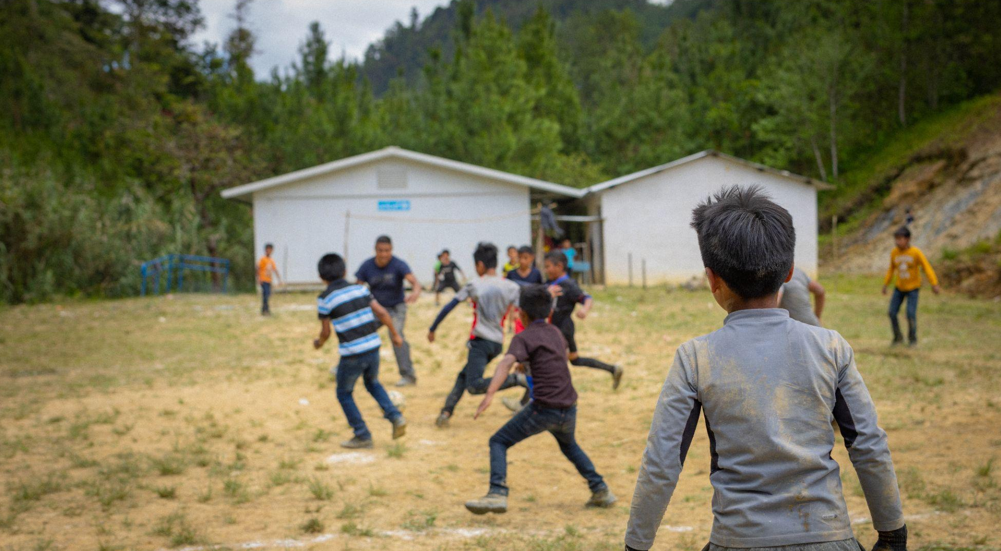


  ACTIVITY 6
  PROTECTING CHILDREN’S
  RIGHT TO EDUCATION IN OUR CHANGING CLIMATE
Children play football outside a temporary classroom that UNICEF helped build after their school was destroyed by hurricanes Eta and Iota.
© UNICEF/Quintero

Slide 2
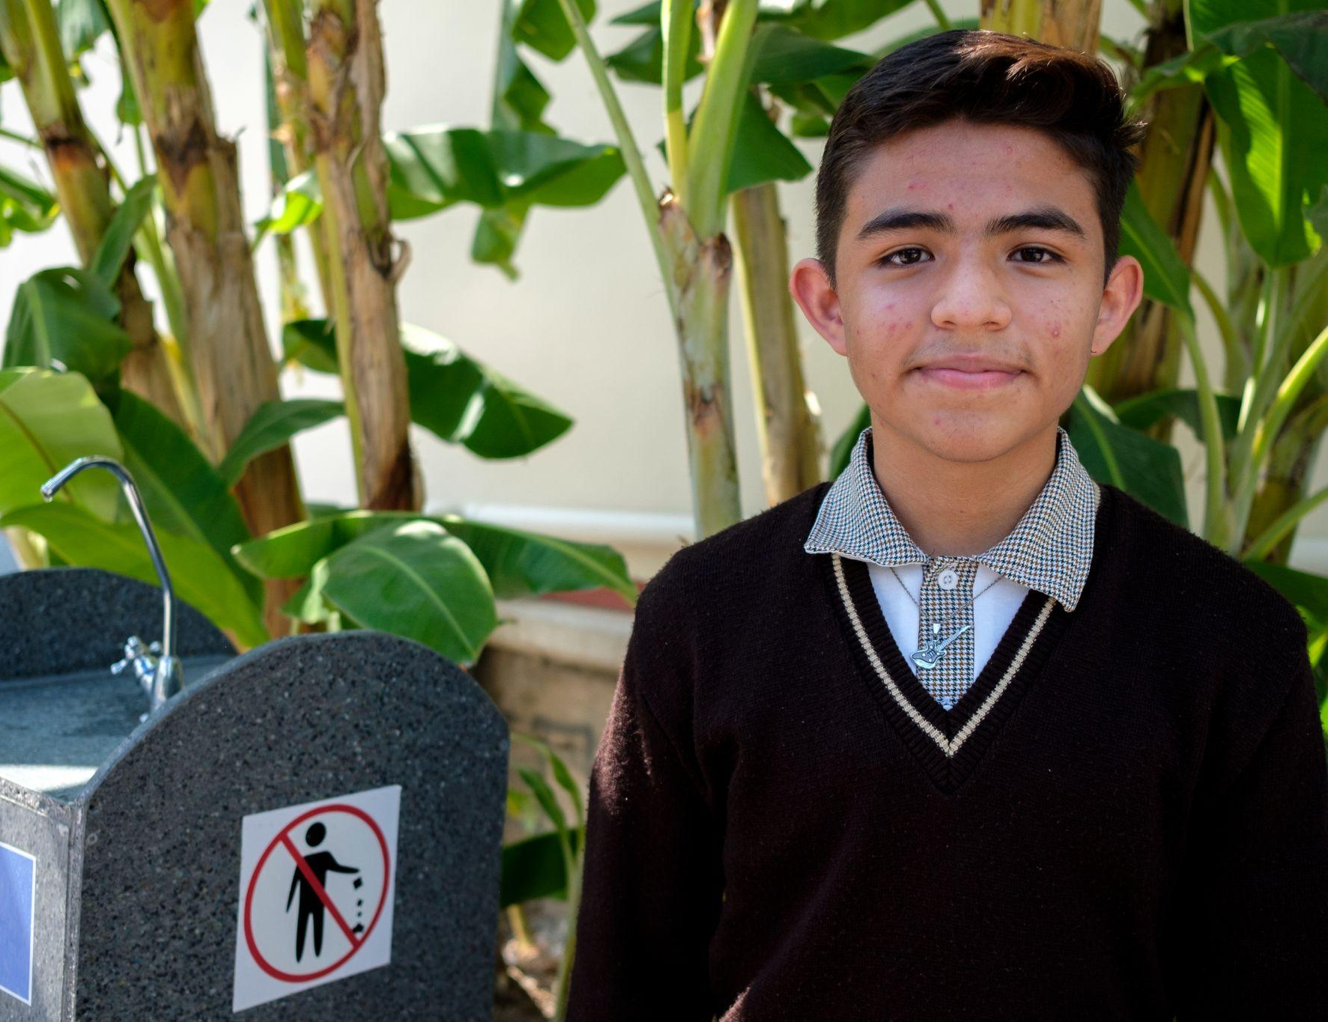
Part 1
REVIEWING OUR RIGHTS
© UNICEF/Balam-Ha'
Yohan, 13. His school in Mexico educates children about sustainability and reducing environmental impact. It uses solar, kinetic and mechanical energy to harvest and filter rainwater, and children collect plastic bottles to recycle into bricks.

Slide 3
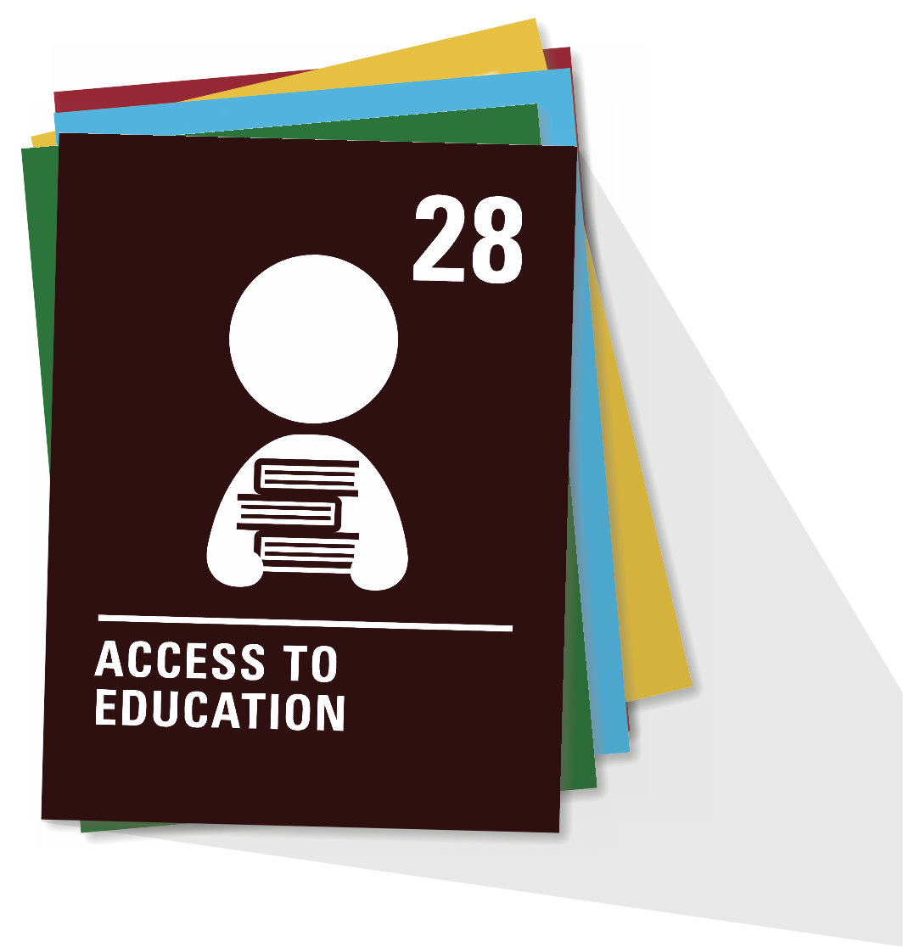
ARTICLE 28
  Right to education
  Every child has the right to an education. Primary education must be free and different forms of secondary education must be available to every child. Discipline in schools must respect children’s dignity and their rights. Richer countries must help poorer countries achieve this.

Slide 4
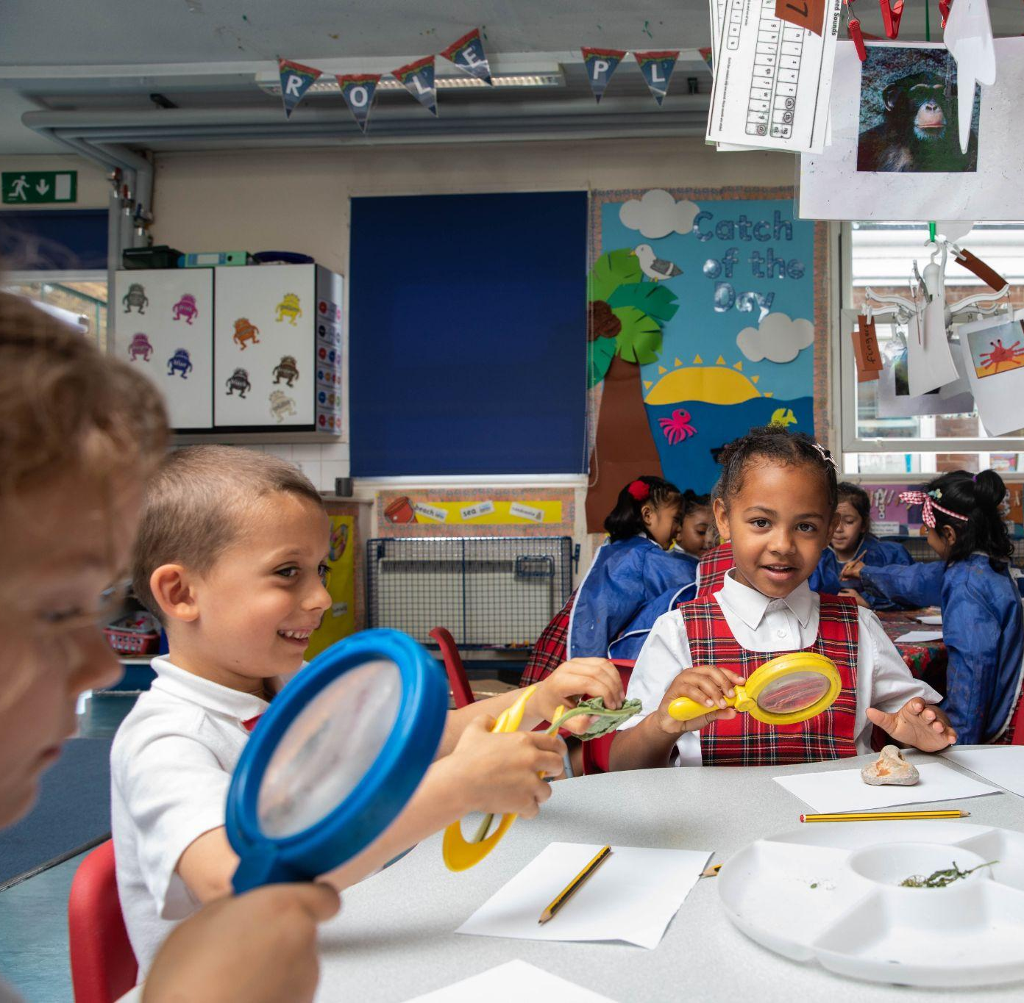
Part 2
© UNICEF/Dawe
EXPLORING EDUCATION AROUND THE WORLD
Children in the classroom at a Rights Respecting school in London in June 2022.

Slide 5
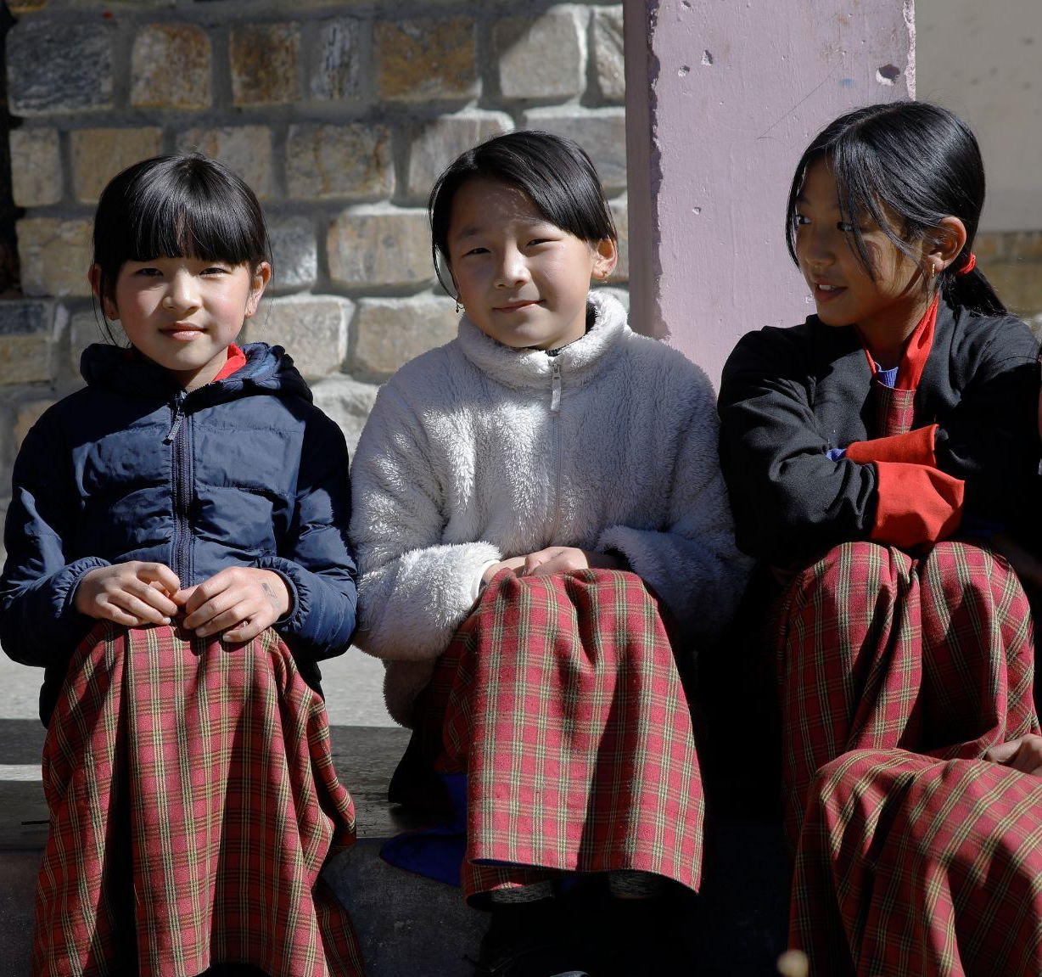
© UNICEF/Samdrup
  Bhutan
  Helping schools stand up to earthquakes
Children at school in Haa, western Bhutan.

Slide 6
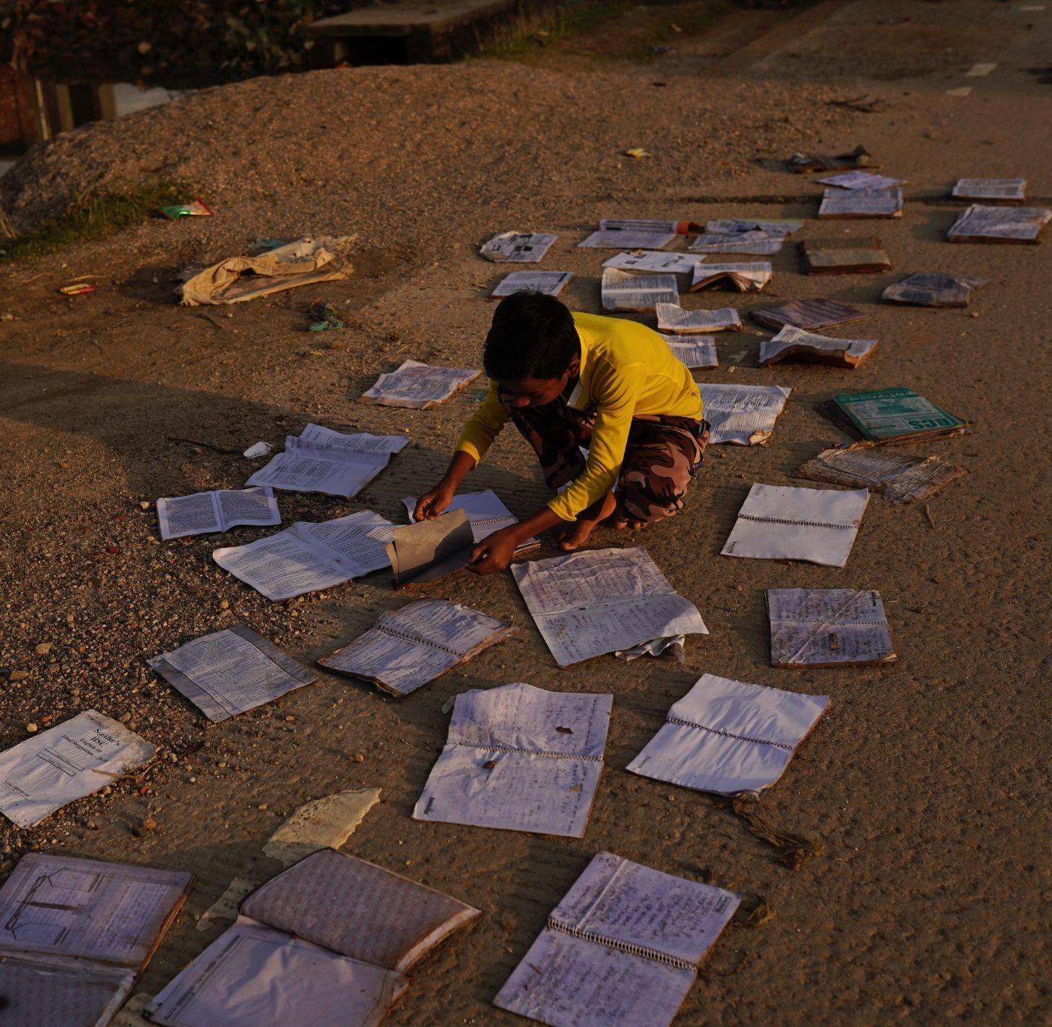
© UNICEF/Mukut
  Bangladesh
  A solar-powered floating school
A child dries his school books in Sylhet, Bangladesh, after his house was flooded in June 2022.

Slide 7
INNOVATION LAB
How will your school work to protect the right of all children to access education?
Choose a climate effect that stops children from being able to go to school
Use your creativity
to design a future school that adapts to this climate effect
Draw or create a model of this school to display

Slide 8
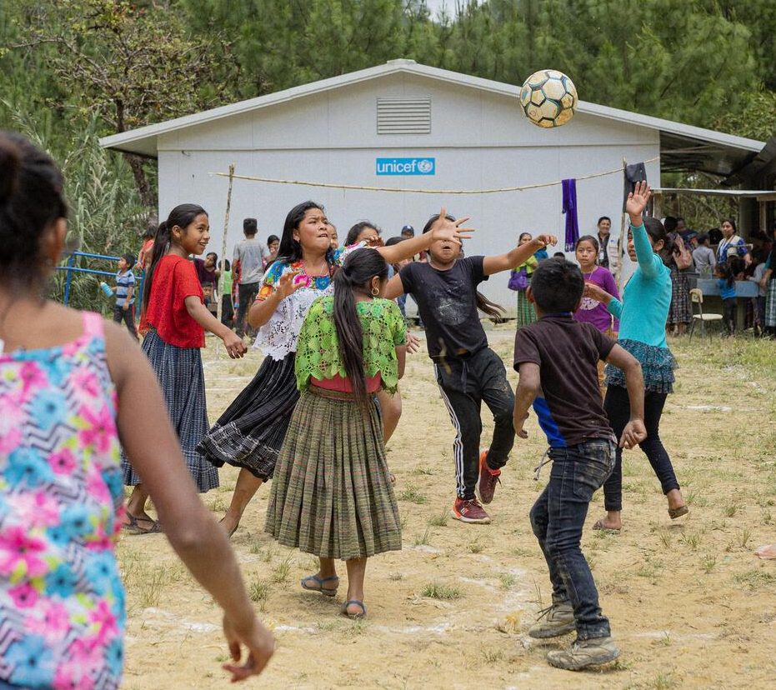
Part 3
© UNICEF/Quintero
INNOVATION LAB
Design a future school​
Children play football outside a temporary classroom that UNICEF helped build after their school was destroyed by hurricanes Eta and Iota.

