Slide 1
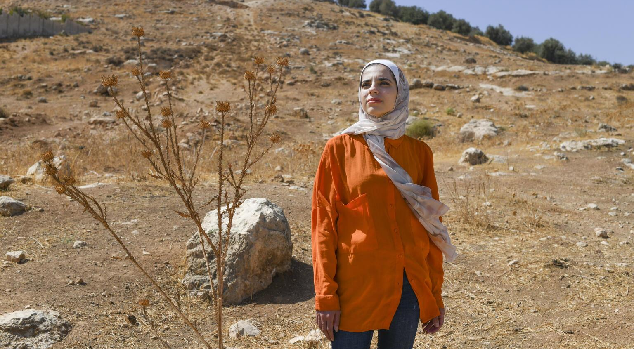
ACTIVITY 1 CLIMATE CHANGE
© UNICEF/Al-Safadi
Anwar, 25, a UNICEF-supported Youth Climate Leader from Jordan, developed a system to help her family grow more crops and make them more sustainable.
© UNICEF/Bseiso

Slide 2
QUESTION
1
All of the gases on the Earth make up the…
a
Sky
b
Atmosphere
c
Weather
d
Ocean

Slide 3
QUESTION
2
The pattern of weather conditions over many years is called the...
a
Atlas
b
Temperature
c
Climate
d
Calendar

Slide 4
QUESTION
3
The increase in the average temperature of the earth’s atmosphere is referred to by scientists as…
a
Global warming
b
Storm
c
Earth change
d
Weather

Slide 5
QUESTION
4
What is the name of the gas released into the air when we burn coal, oil and gas for energy?
a
Carbon dioxide (CO₂)
b
Air
c
Smoke
d
Oxygen (O₂)

Slide 6
QUESTION
5
What do scientists call a system where living things like plants and animals exist together with non-living things water and air?
a
Ecosystem
b
Garden
c
Planet
d
Park

Slide 7
QUESTION
6
Which of these impacts of climate change can put a child’s rights at risk?
a
b
Extreme weather
Drought
c
Warming oceans
d
All of these

Slide 8
QUESTION
7
What do scientists call the gases that are heating the planet?
a
b
Humidity
Rain
c
Greenhouse gases
d
Grey clouds

Slide 9
QUESTION
8
Which one of these actions can help reduce your carbon footprint?
a
b
Recycle
Plant a tree
Walk or cycle instead of using a car
c
d
All of these

Slide 10
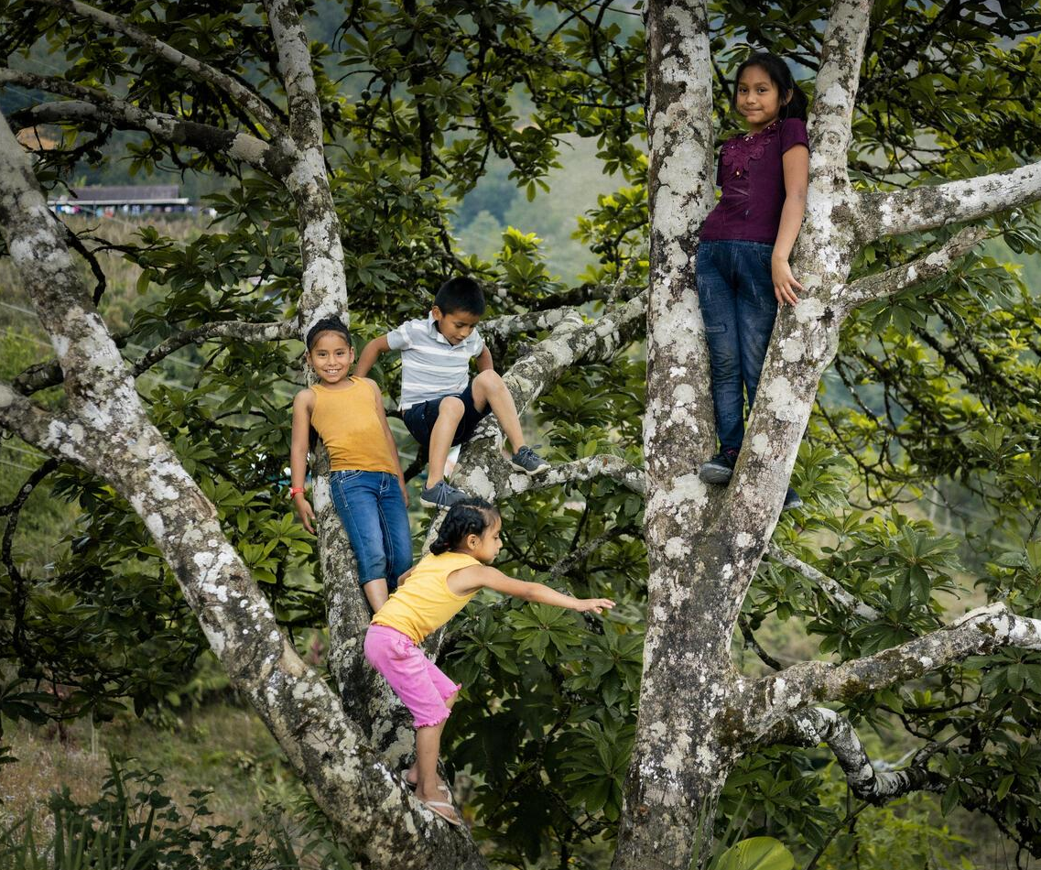
© UNICEF/Quintero
How many questions did you get right?
Four children play among the branches of a tree in Alta Verapaz, Guatemala.

Slide 11
QUESTION
1
All of the gases on the Earth make up the…
a
a
b
Sky
b
Atmosphere
d
c
d
c
Weather
Ocean

Slide 12
QUESTION
2
The pattern of weather conditions over many years is called the...
a
Atlas
b
Temperature
c
Climate
d
Calendar

Slide 13
QUESTION
3
The increase in the average temperature of the earth’s atmosphere is referred to by scientists as…
a
Global warming
b
Storm
c
Earth change
d
Weather

Slide 14
QUESTION
4
What is the name of the gas released into the air when we burn coal, oil and gas for energy?
a
Carbon dioxide (CO₂)
b
Air
c
Smoke
d
Oxygen (O₂)

Slide 15
QUESTION
5
What do scientists call a system where living things like plants and animals exist together with non-living things like water and air?
a
Ecosystem
b
Garden
c
Planet
d
Park

Slide 16
QUESTION
6
Which of these impacts of climate change can put a child’s rights at risk?
a
b
Extreme weather
Drought
c
Warming oceans
d
All of these

Slide 17
QUESTION
7
What do scientists call
the gases that are heating
the planet?
a
b
Humidity
Rain
c
Greenhouse gases
d
Grey clouds

Slide 18
QUESTION
8
Which one of these actions can help reduce your carbon footprint?
a
b
Recycle
Plant a tree
Walk or cycle instead of using a car
c
d
All of these

