Slide 1
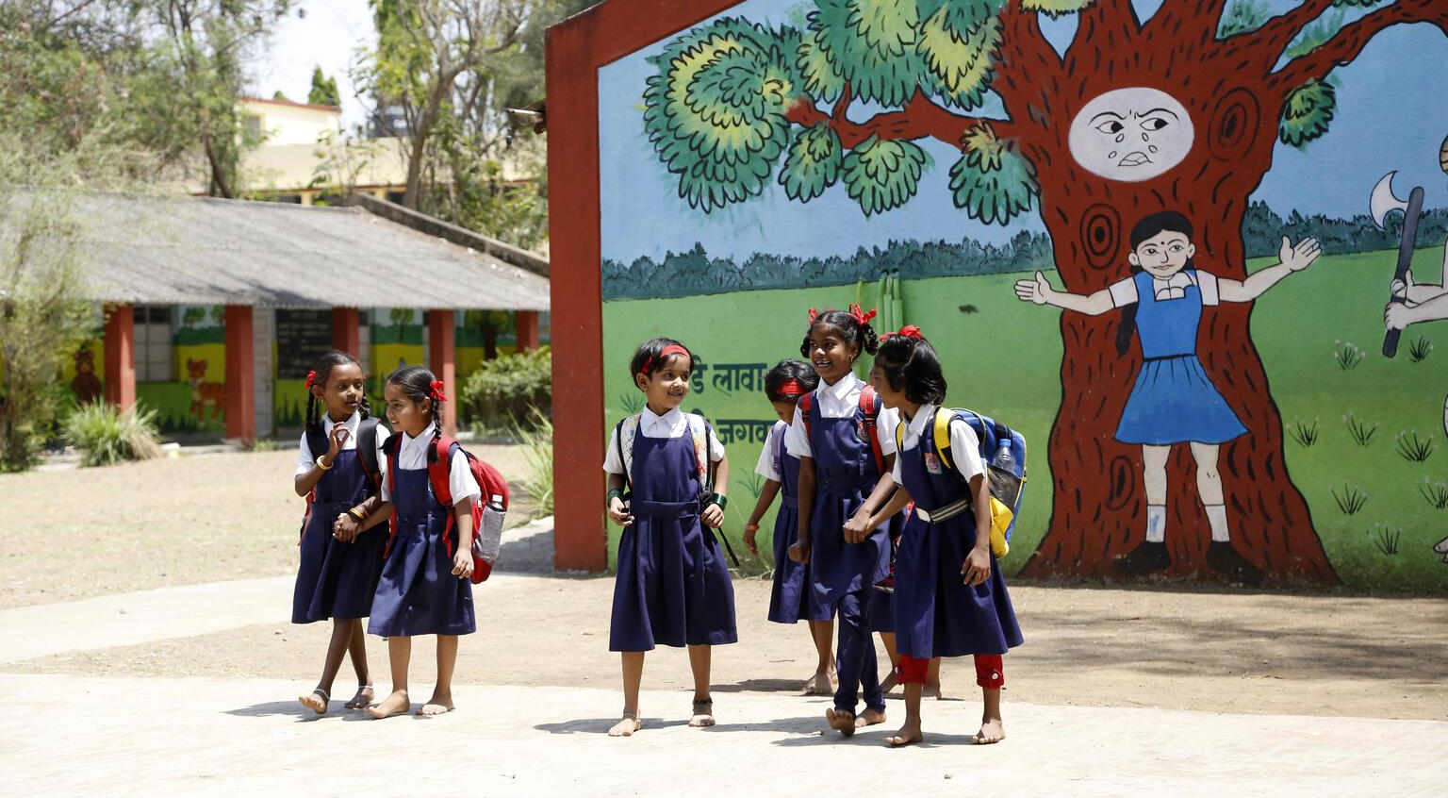
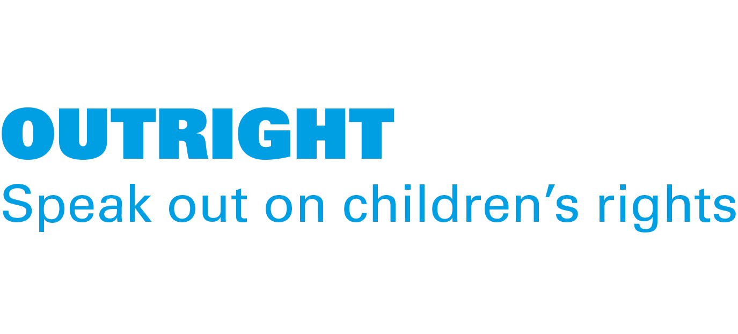
ACTIVITY 2 HOW DOES CLIMATE CHANGE AFFECT CHILDREN’S RIGHTS?
Children walk past a mural on saving trees at a school in Maharashtra, India.
© UNICEF/India Country Office

Slide 2
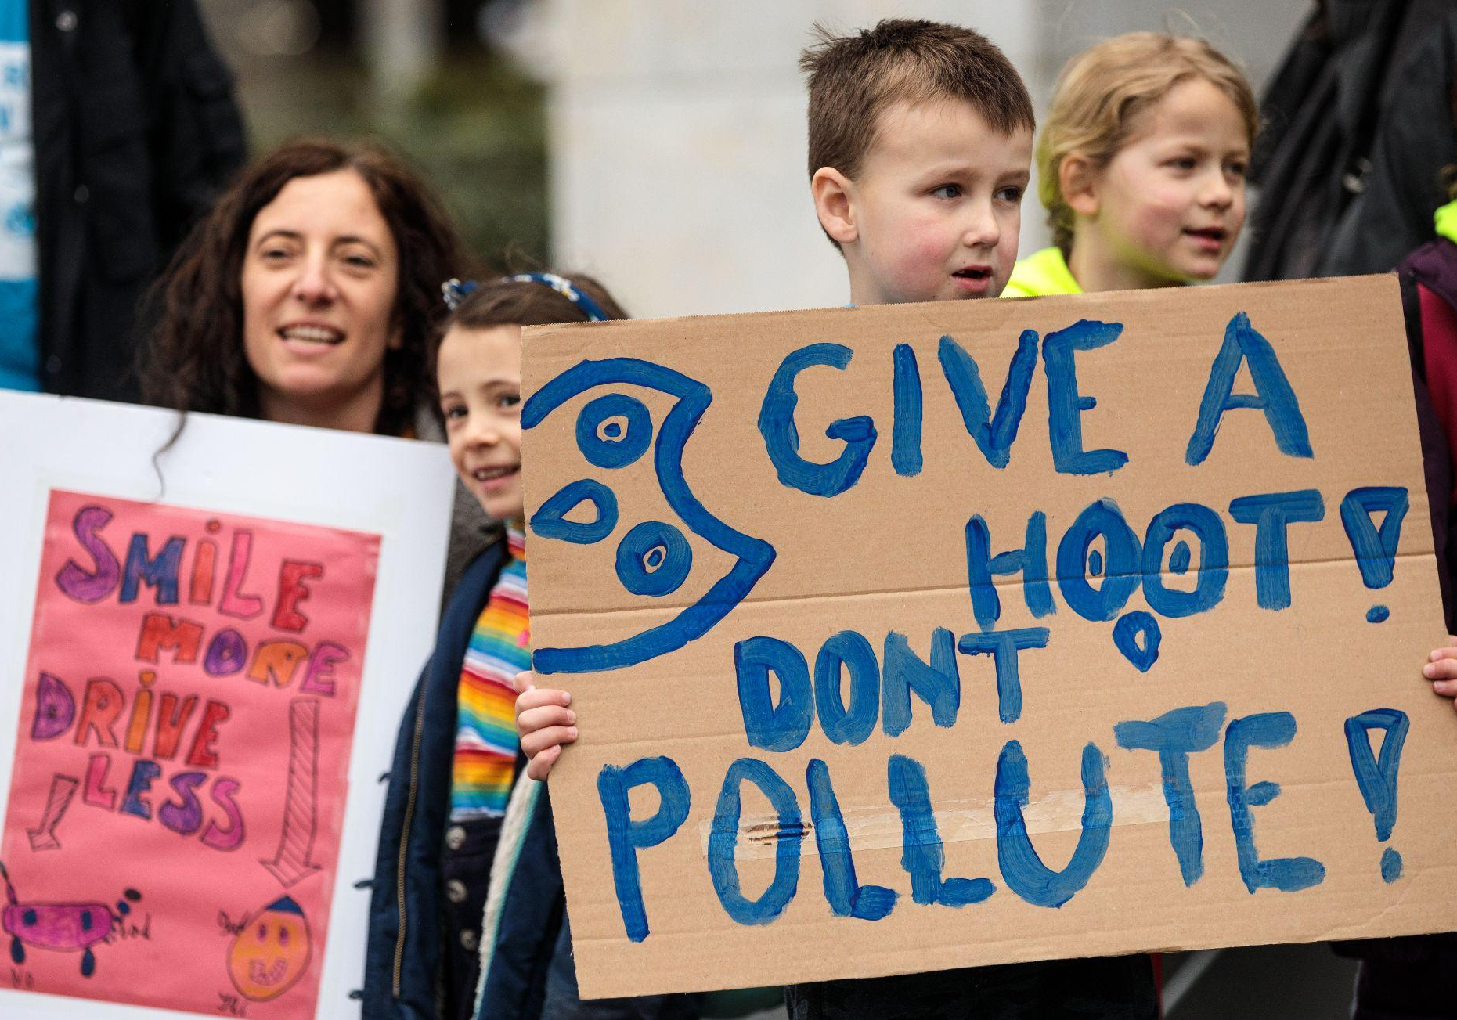
Part 1
© UNICEF/Sutton-Hibbert
RIGHTS
SUMMARY
Families take part in the UNICEF UK Action Day: Protecting Children from Toxic Air demonstration in London, England on March 16, 2019.

Slide 3
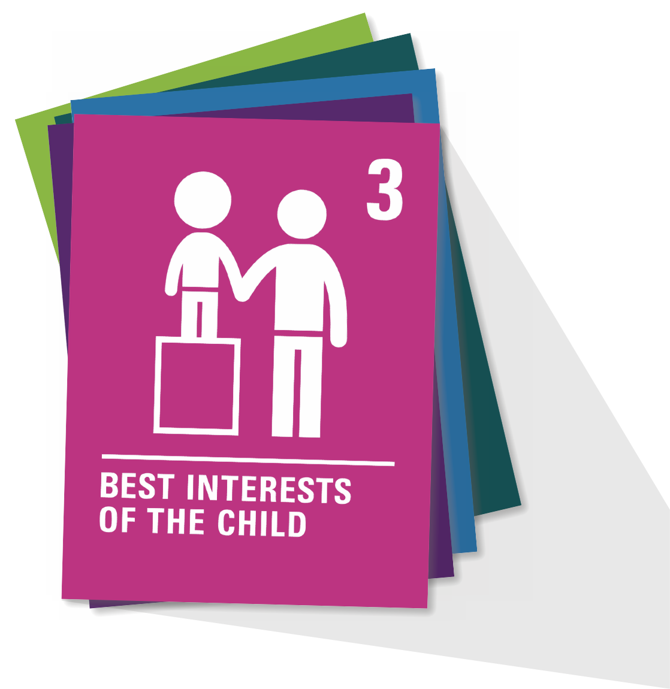
ARTICLE 3
Article 3
When adults make decisions, they should think about how their decisions will affect children. All adults should do what is best for children.
Governments should make sure children are protected and looked after by their parents, or by other people when this is needed.
Governments should make sure that people and places responsible for looking after children are doing a good job.

Slide 4
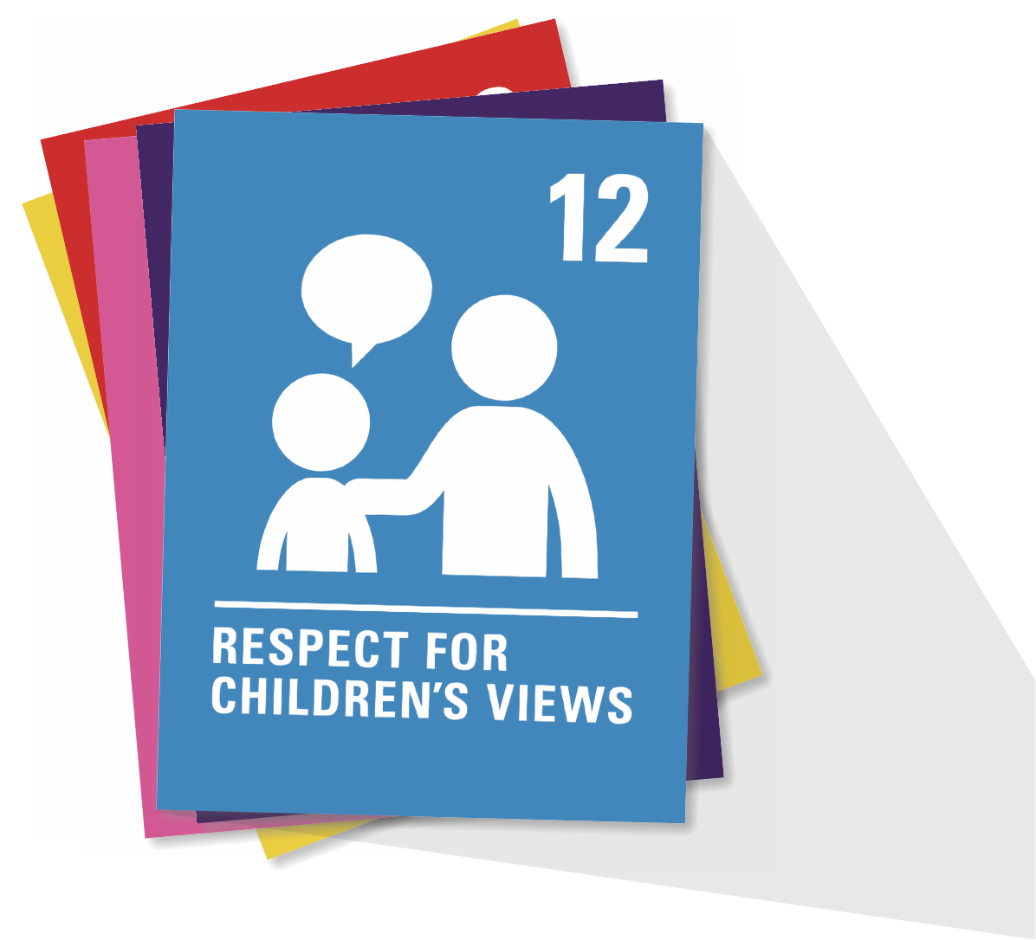
ARTICLE 12
Every child has the right to express their views, feelings and wishes in all matters affecting them, and to have their views considered and taken seriously. This right applies at all times, for example, during immigration proceedings, housing decisions or the child’s day-to-day home life.

Slide 5
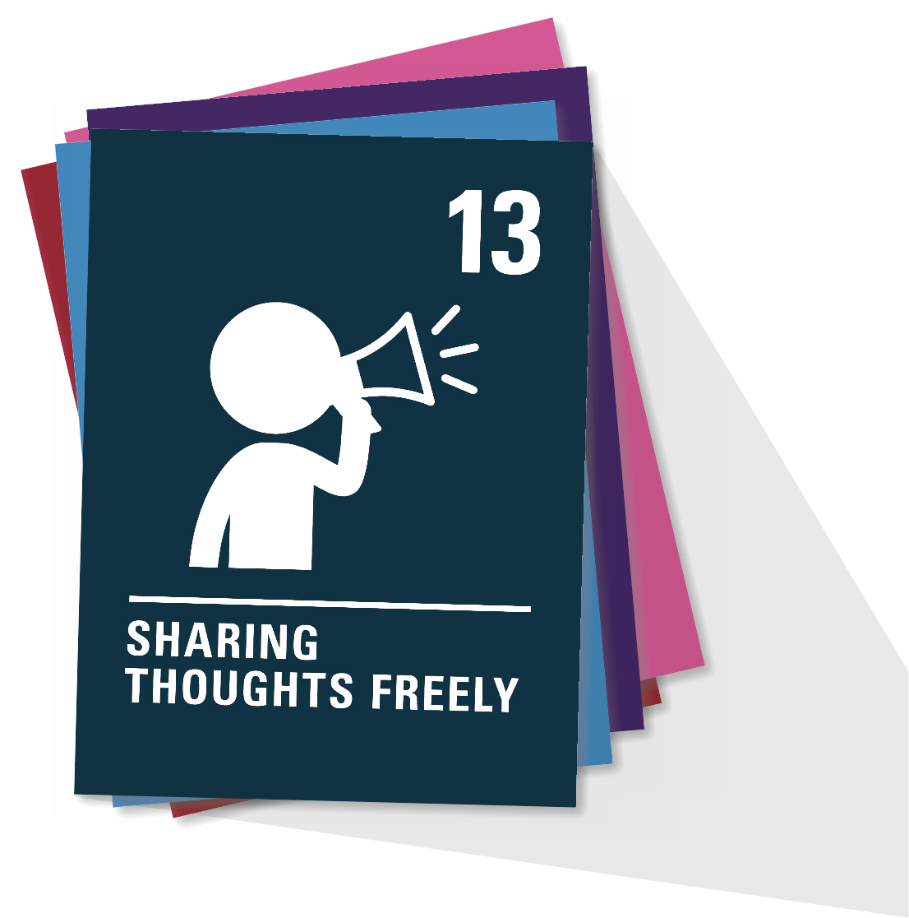
ARTICLE 13
Every child must be free to express their thoughts and opinions and to access all kinds of information, as long as it is within the law.

Slide 6
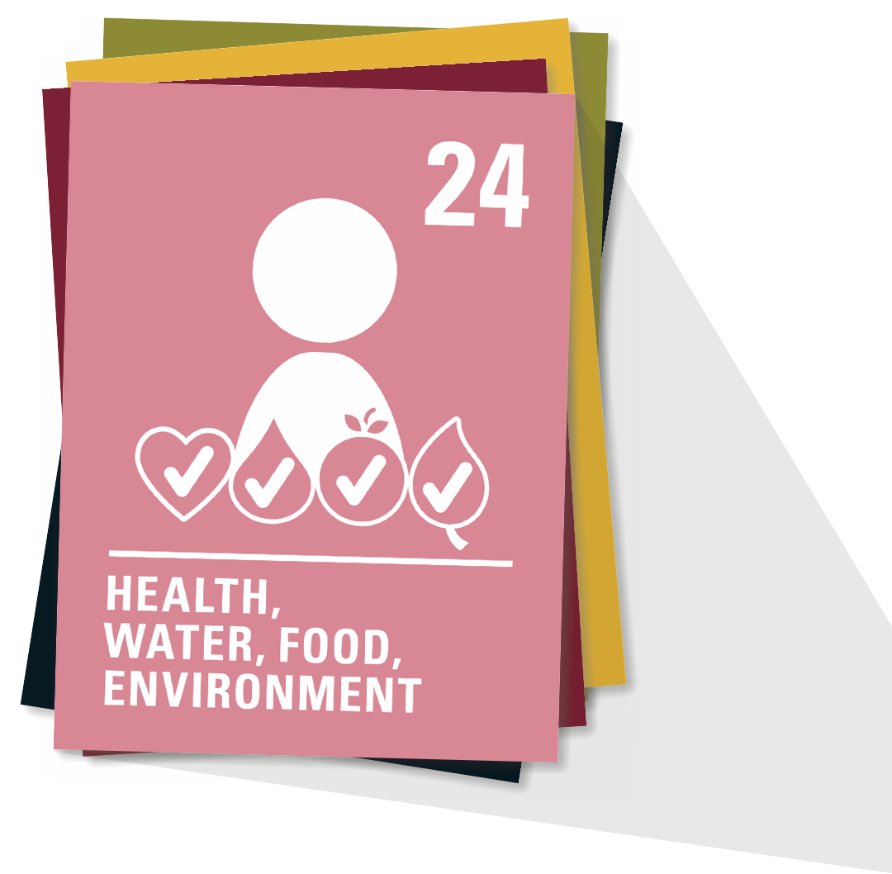
ARTICLE 24
Every child has the right to the best possible health. Governments must provide good quality healthcare, clean water, nutritious food and a clean environment and education on health and wellbeing so that children can stay healthy. Richer countries must help poorer countries achieve this.

Slide 7
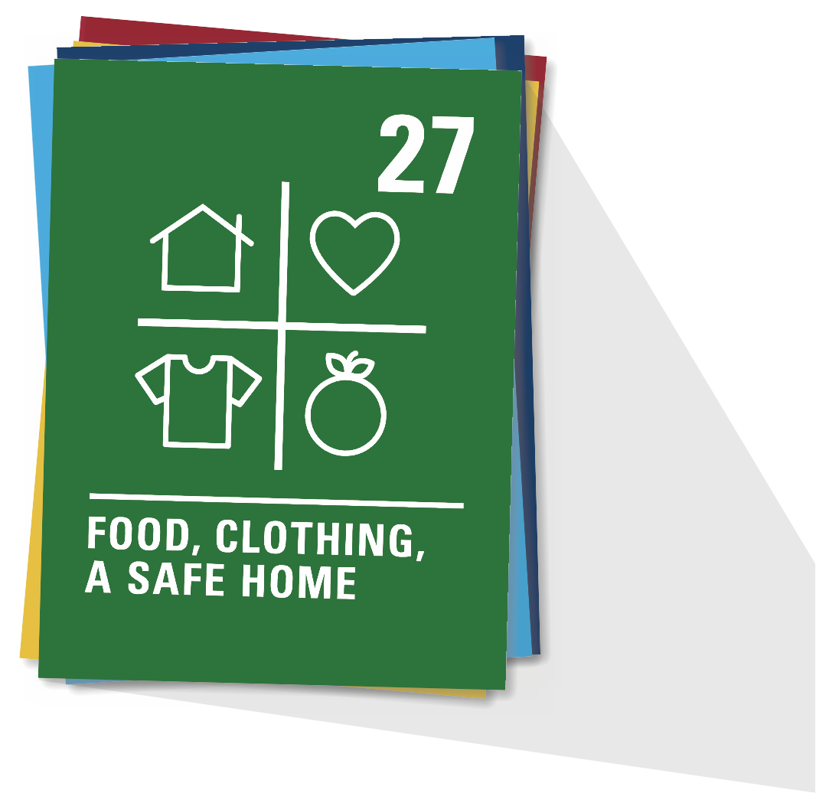
ARTICLE 27
Every child has the right to a standard of living that is good enough to meet their physical and social needs and support their development. Governments must help families who cannot afford to provide this.

Slide 8
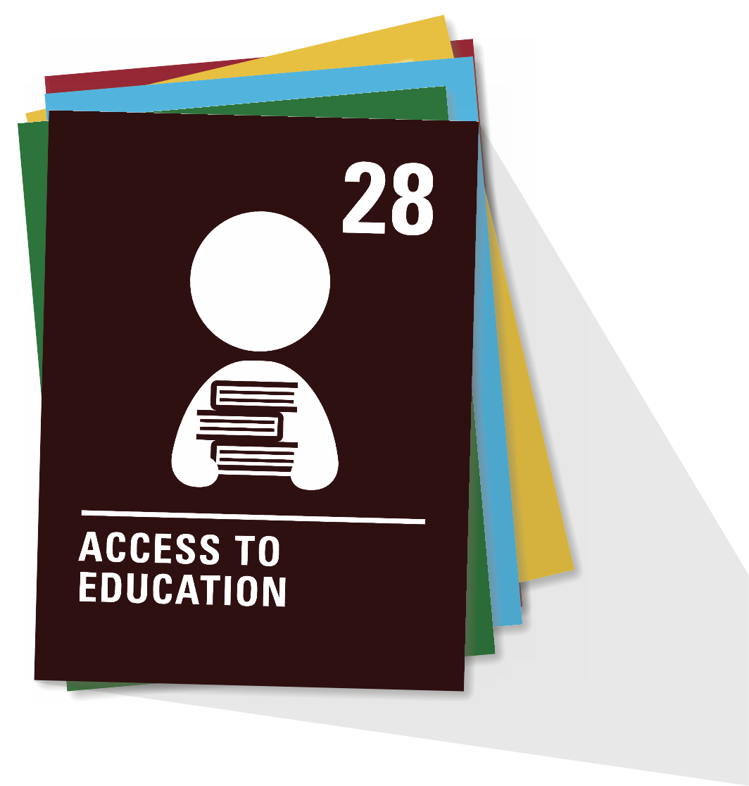
ARTICLE 28
Every child has the right to an education. Primary education must be free and different forms of secondary education must be available to every child. Discipline in schools must respect children’s dignity and their rights. Richer countries must help poorer countries achieve this.

Slide 9
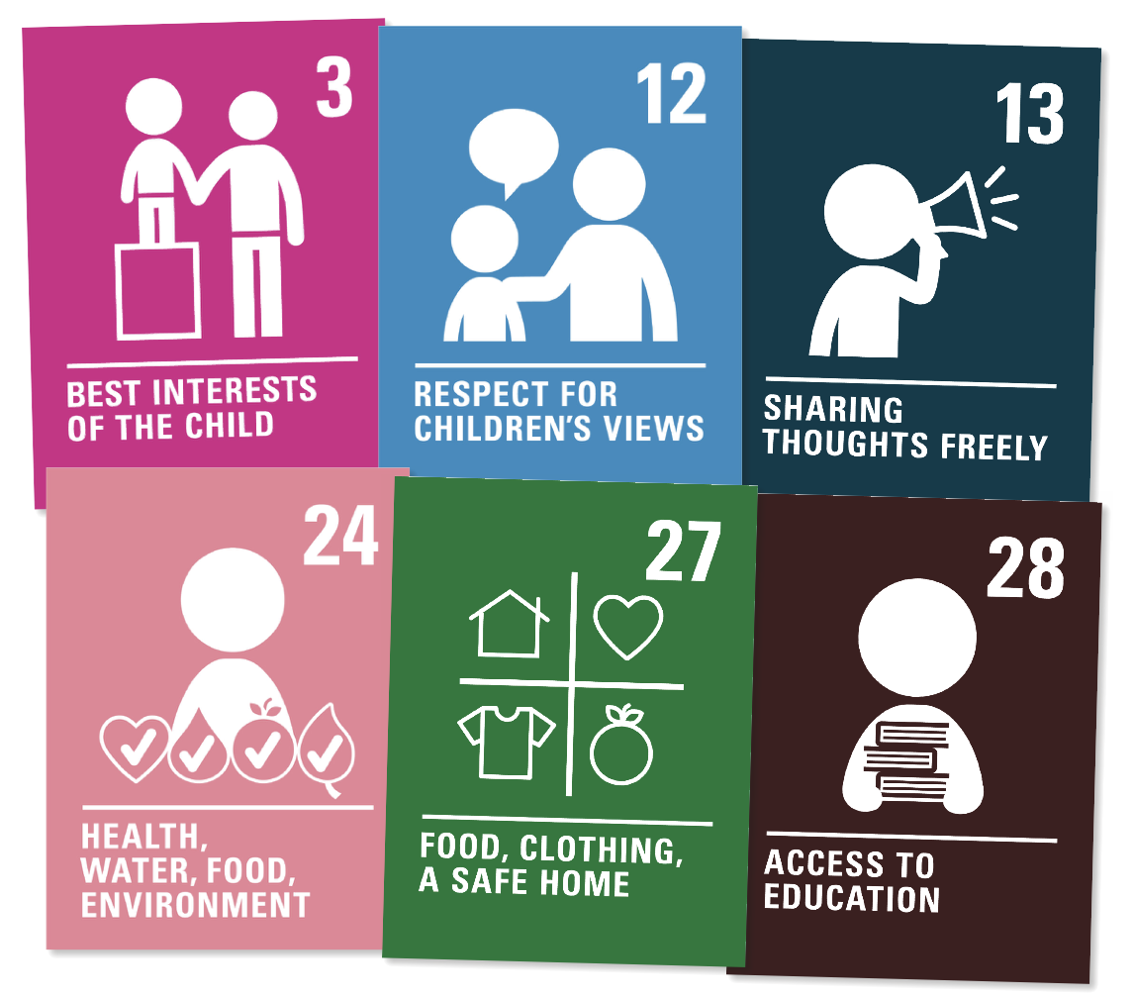
ARTICLE 3 ARTICLE 12
ARTICLE 13
ARTICLE 24
ARTICLE 27
ARTICLE 28
How do you think these six articles could be linked to climate change?

Slide 10
Part 2
© UNICEF/India Country Office
IT’S MY RIGHT
Do you know your rights?
At this school in Maharashtra, students learn about the importance of using natural resources responsibly and creatively.

Slide 11
Until you're 18 years old, you're considered to be a child and all the rights of the UN’s Convention on the Rights of the Child apply to you.
QUESTION
1
True
False

Slide 12
The UK Government decides what my rights are as a child because this is where I live.
QUESTION
2
True
False

Slide 13
I have the same rights as all other children in the world to health, education and protection from harm.
QUESTION
3
True
False

Slide 14
The UK Government must also consider the rights of children in other countries because the actions of my country can also impact children in other places.
QUESTION
4
True
False

Slide 15
It is my right to be loved, to have friends and to have access to the Internet to be able to find important information.
QUESTION
5
True
False

Slide 16
Children are growing up in a world with a changing climate because of human actions in the past, but children are not responsible for 'fixing' climate change.
QUESTION
6
True
False

Slide 17
It's my right to ask my government to make sure the environment is clean and healthy, to protect my health and the health of other children.
QUESTION
7
True
False

Slide 18
The government doesn't have to hear my opinion because I don't pay taxes.
QUESTION
8
True
False

Slide 19
It's the UK Government’s job to ensure I have access to healthcare and education because these are my rights.
QUESTION
9
True
False

Slide 20
Having access to clean water, nutritious food and a safe home are all rights for children that are threatened by global warming and climate change.
QUESTION
10
True
False

Slide 21
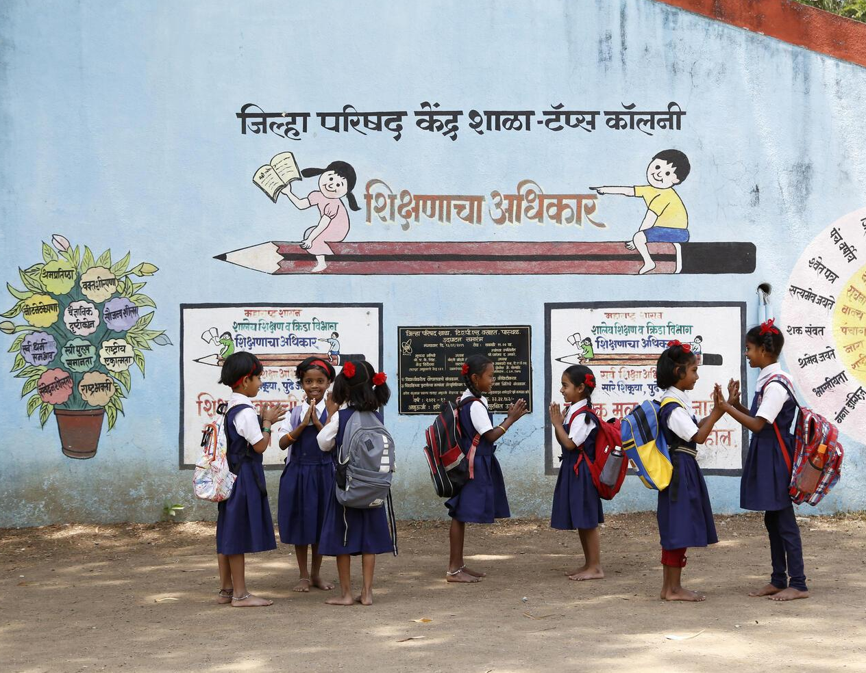
© UNICEF/India Country Office
How many questions did you get right?

Slide 22
Until you're 18 years old, you're considered to be a child and all the rights of the UN’s Convention on the Rights of the Child apply to you.
QUESTION
1
True

Slide 23
The UK Government decides what my rights are as a child because this is where I live.
QUESTION
2
False

Slide 24
I have the same rights as all other children in the world to health, education and protection from harm.
QUESTION
3
True

Slide 25
The UK Government must also consider the rights of children in other countries because the actions of my country can also impact children in other places.
QUESTION
4
True

Slide 26
It is my right to be loved, to have friends and to have access to the Internet to be able to find important information.
QUESTION
5
False

Slide 27
Children are growing up in a world with a changing climate because of human actions in the past, but children are not responsible for 'fixing' climate change.
QUESTION
6
True

Slide 28
It's my right to ask my government to make sure the environment is clean and healthy, to protect my health and the health of other children.
QUESTION
7
True

Slide 29
The government doesn't have to hear my opinion because I don't pay taxes.
QUESTION
8
False

Slide 30
It's the UK Government’s job to ensure I have access to healthcare and education because these are my rights.
QUESTION
9
True

Slide 31
Having access to clean water, nutritious food and a safe home are all rights for children that are threatened by global warming and climate change.
QUESTION
10
True

Slide 32
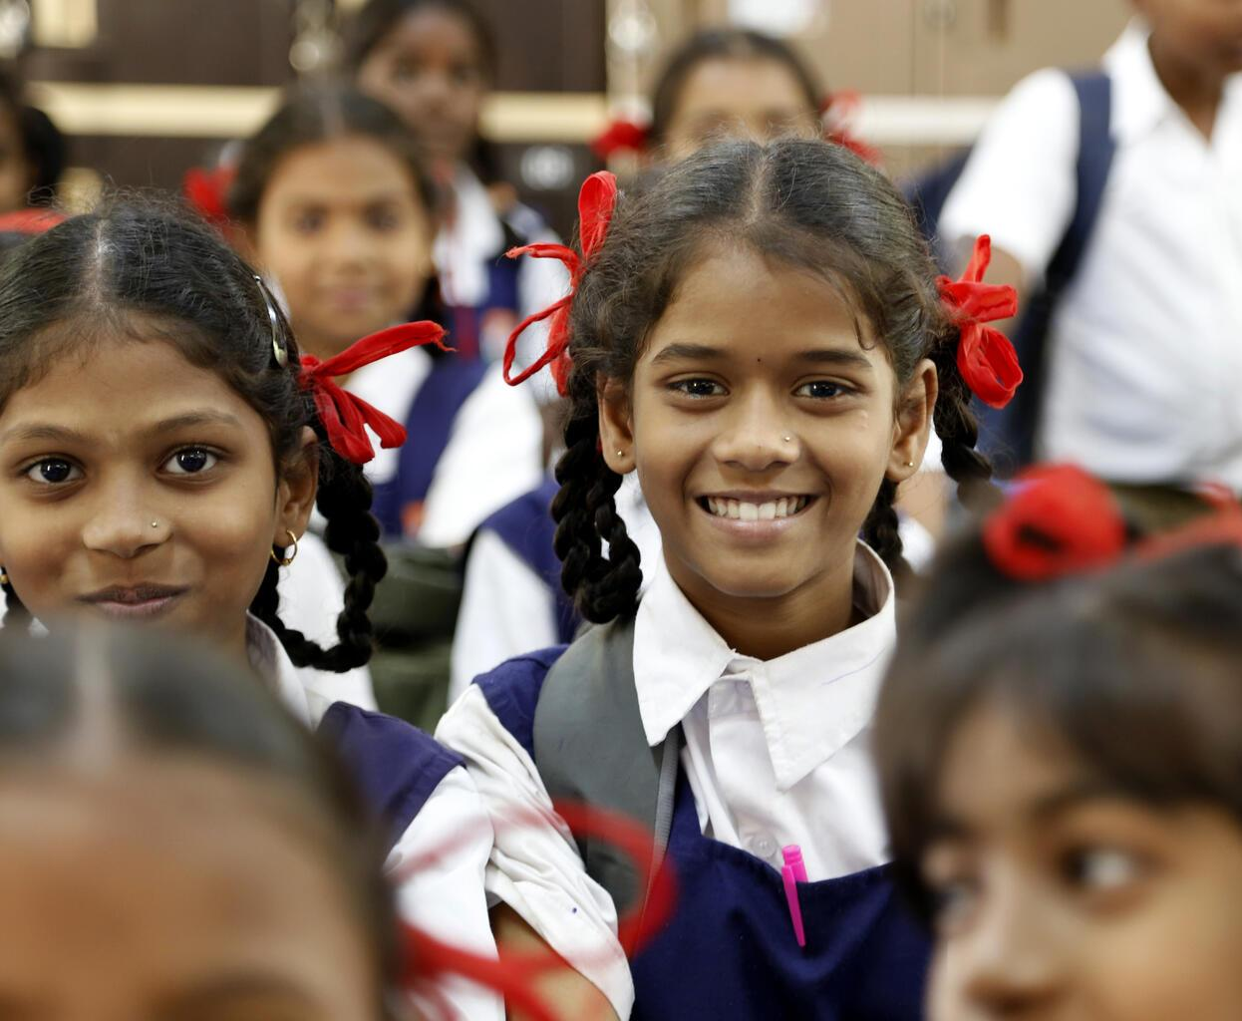
Part 3
© UNICEF/India Country Office
LINKING THE KEY RIGHTS TO CLIMATE

