Slide 1
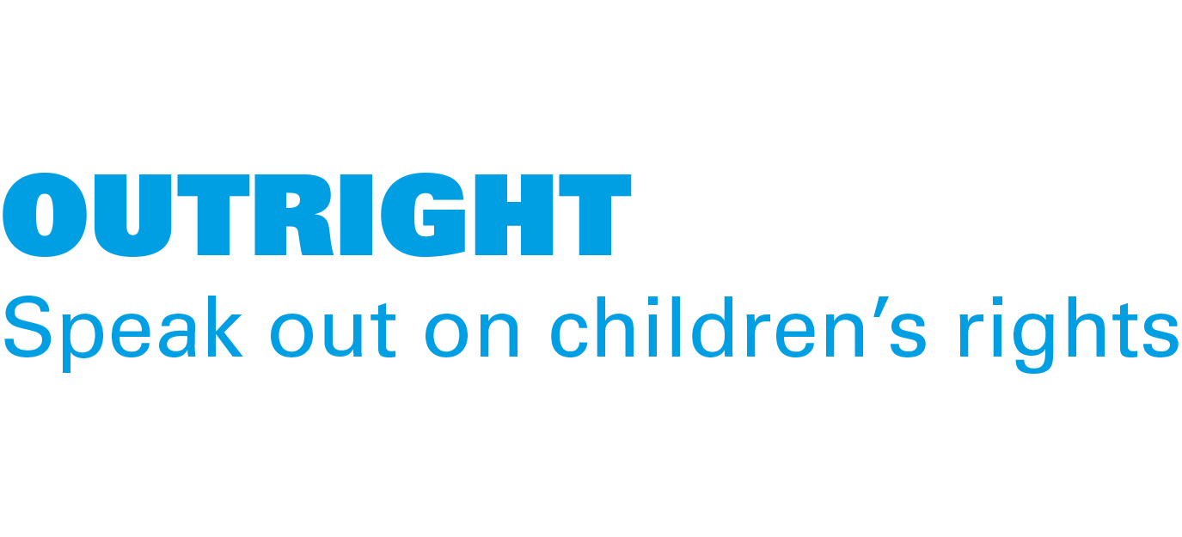
ACTIVITY 3 CLIMATE CHANGE AND ADAPTATION
Children playing in Alta Verapaz, Guatemala, where UNICEF works to help children get enough food and basic services like healthcare.
© UNICEF/Quintero

Slide 2
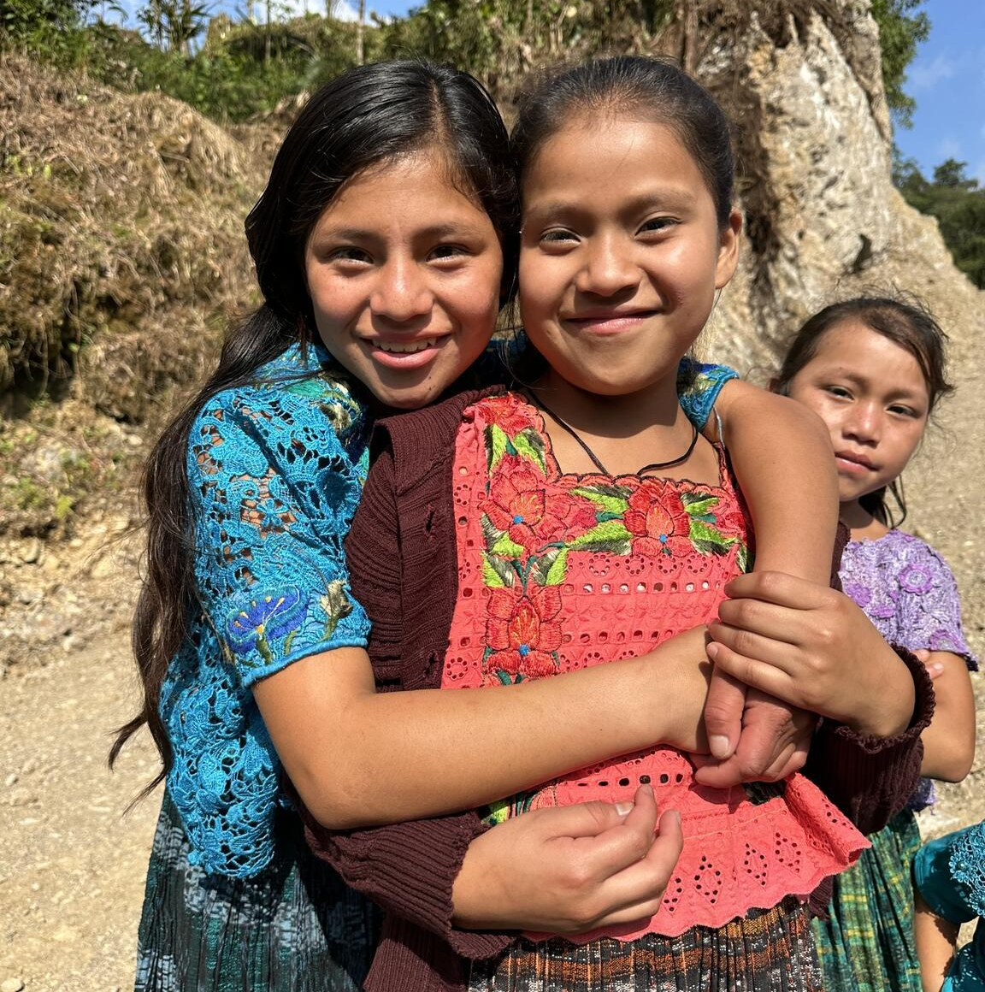
Part 1
© UNICEF/Quintero
TWO IMPORTANT KINDS OF CLIMATE ACTION
Mitigation: action to limit climate change.
For example, by reducing emissions of greenhouse gases or removing those gases from the atmosphere.
Adaptation: action to adjust to effects of climate change (now and in the future). For example, by protecting people/buildings/ crops from floods.
Friends smile for the camera in Alta Verapaz, Guatemala.

Slide 3
MITIGATIONS
Actions that help to limit climate change.
Individual actions
Community actions
Corporate actions
Government actions

Slide 4
ADAPTATIONS
Actions that help us live better and protect rights in the climate as it is now.
Individual actions
Community actions
Corporate actions
Government actions

Slide 5
Banning single use plastics
Mitigation?
or
Adaptation?

Slide 6
Riding your bike or walking to school or work instead of using a car
Mitigation?
or
Adaptation?

Slide 7
Building barriers or sea walls on islands to protect houses from rising seas
Mitigation?
or
Adaptation?

Slide 8
Building a floating school so children don’t lose their right to education in areas that regularly flood
Mitigation?
or
Adaptation?

Slide 9
Eating less meat and more plant-based foods
Mitigation?
or
Adaptation?

Slide 10
Designing an early warning system that helps track weather patterns and alerts people when there’s a possible extreme weather event coming
Mitigation?
or
Adaptation?

Slide 11
Moving cities to higher ground to prevent flood damage
Mitigation?
or
Adaptation?

Slide 12
Creating special seeds that will grow even when there is drought
Mitigation?
or
Adaptation?

Slide 13
Planting more trees
Mitigation?
or
Adaptation?

Slide 14
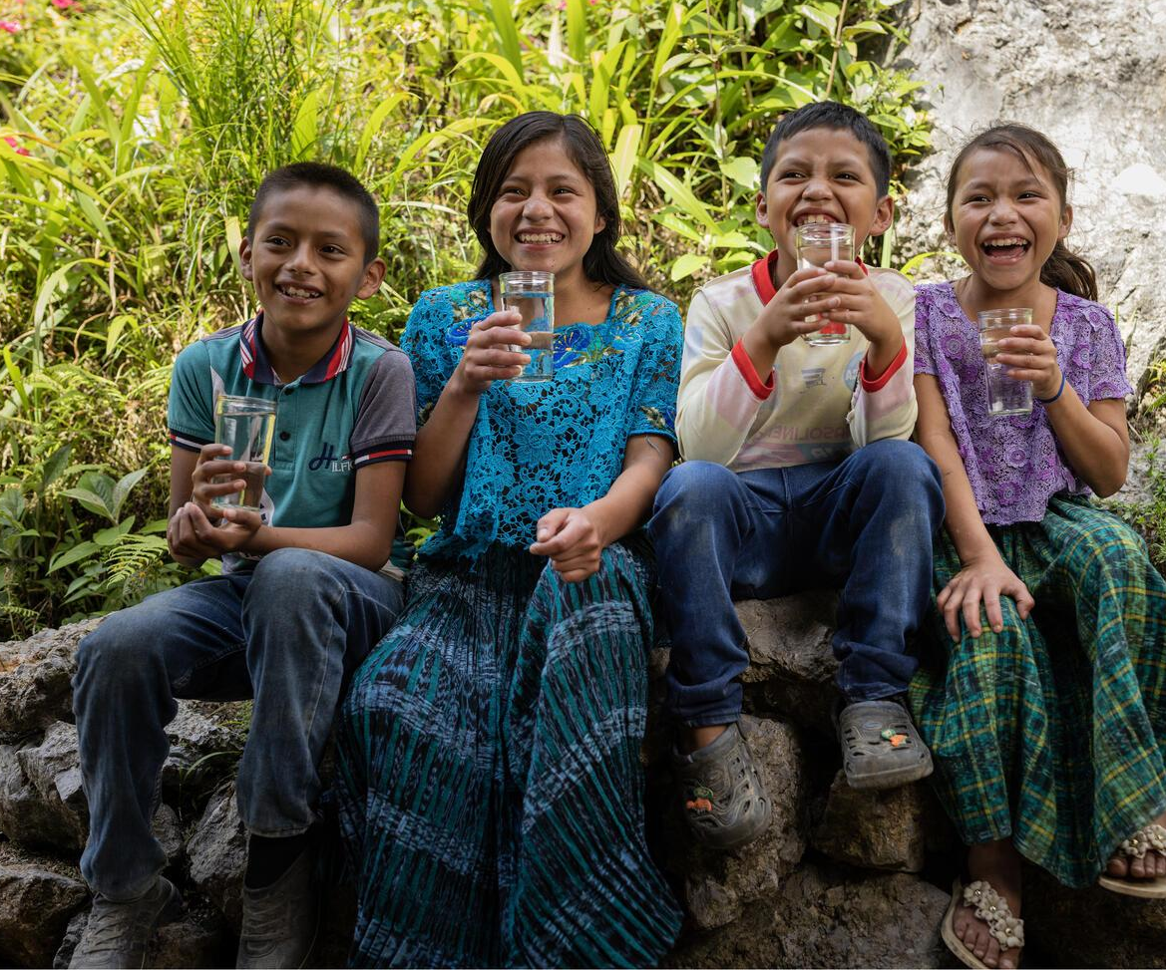
© UNICEF/Quintero
How many questions did you get right?
A group of children aged of 8–13, with glasses of safe water in Alta Verapaz, Guatemala. Only just over half of households here have a toilet and safe water supply.

Slide 15
Banning single use plastics
Mitigation

Slide 16
Riding your bike or walking to school or work instead of using a car
Mitigation

Slide 17
Building barriers or sea walls on islands to protect houses from rising seas
Adaptation

Slide 18
Building a floating school so children don’t lose their right to education in areas that regularly flood
Adaptation

Slide 19
Eating less meat and more plant-based foods
Mitigation

Slide 20
Designing an early warning system that helps track weather patterns and alerts people when there’s a possible extreme weather event coming
Adaptation

Slide 21
Moving cities to higher ground to prevent flood damage
Adaptation

Slide 22
Creating special seeds that will grow even when there is drought
Adaptation

Slide 23
Planting more trees
If you’re planting them to capture carbon dioxide and release oxygen it’s mitigation
If you’re planting them along a river to act as a barrier for flooding it’s adaptation
Mitigation
Adaptation

Slide 24
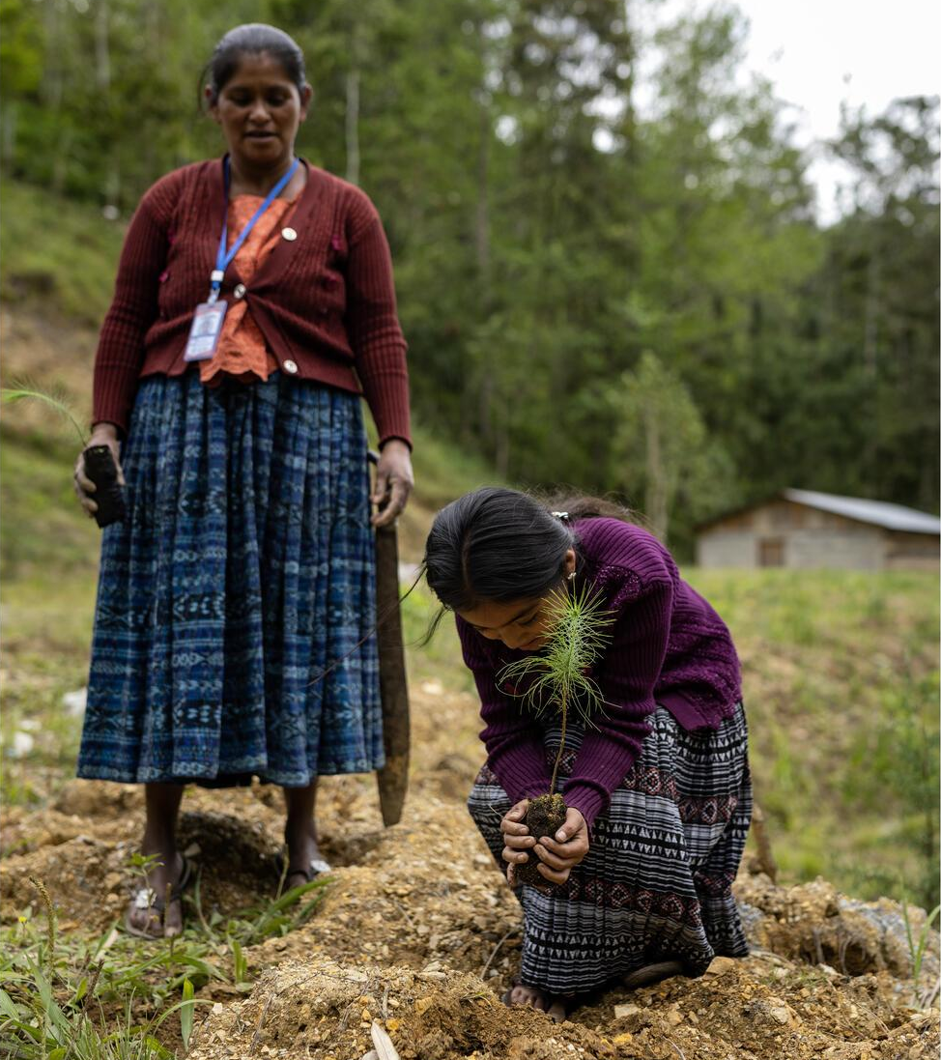
Part 2
© UNICEF/Quintero
ADAPTATIONS AROUND THE WORLD
A girl helps plant saplings in Alta Verapaz, Guatemala.

Slide 25
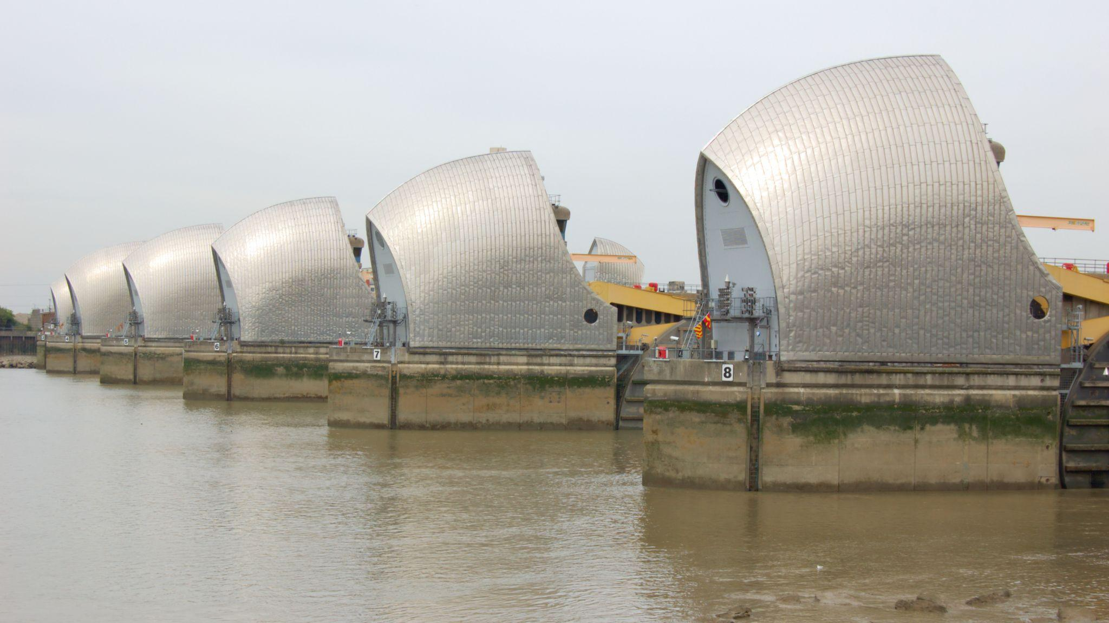
Thames River Barrier
Fact: the Thames River Barrier is one of the largest
movable flood control devices in the world.

Slide 26
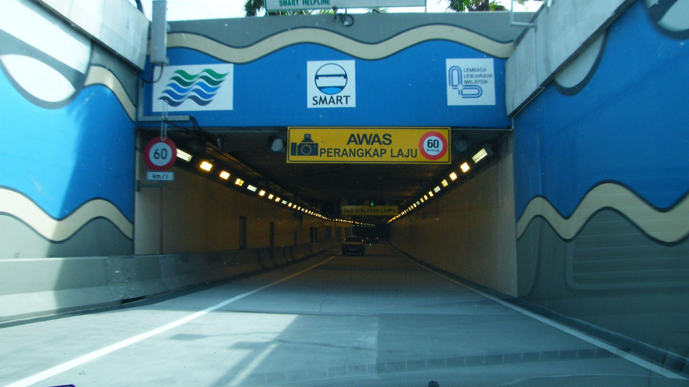
Malaysia’s SMART Tunnel
© www.flickr.com/photos/emrank
Fact: the longest tunnel in Southeast Asia – built to
manage peak hour traffic and storm water.

Slide 27
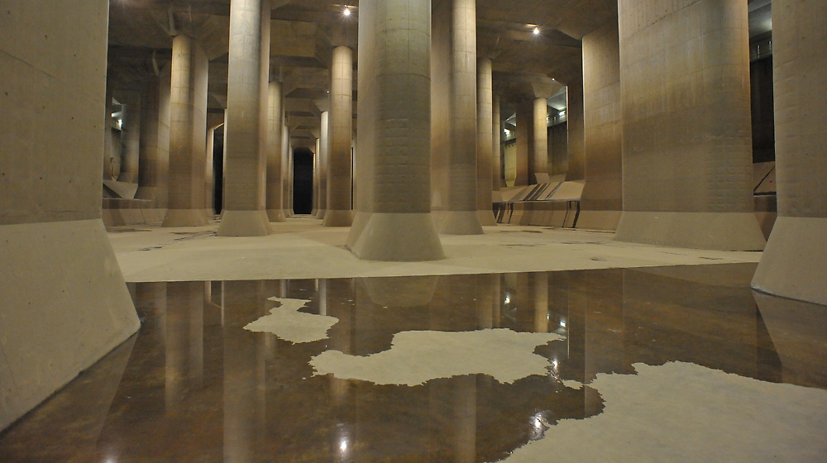
Disaster Prevention Underground Temple in Tokyo
Fact: the world’s largest human-made river is underneath the city of Tokyo to prevent flooding.

Slide 28
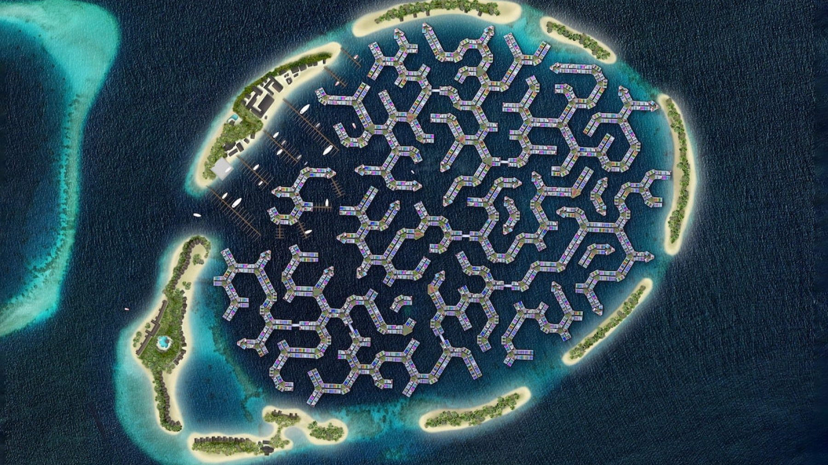
Adapting to rising sea levels in the Maldives
This is a computer-generated image of how the new city might look.
Fact: the Maldives will be home to the world’s first floating city

Slide 29
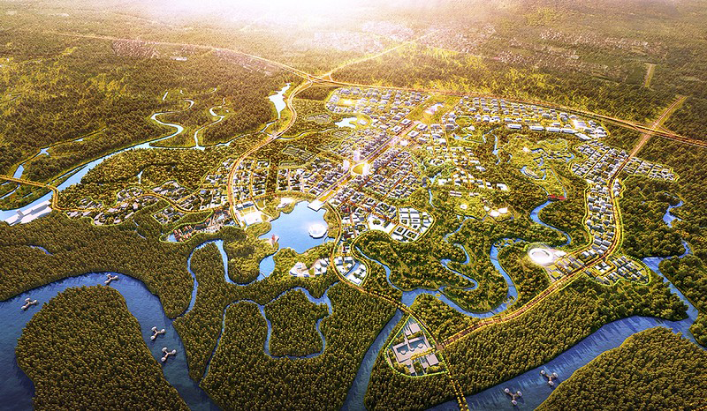
Nusantara: a future design for a capital city
This is a computer-generated image of how the new city might look.
Fact: Indonesia will have a new capital in 2024

Slide 30
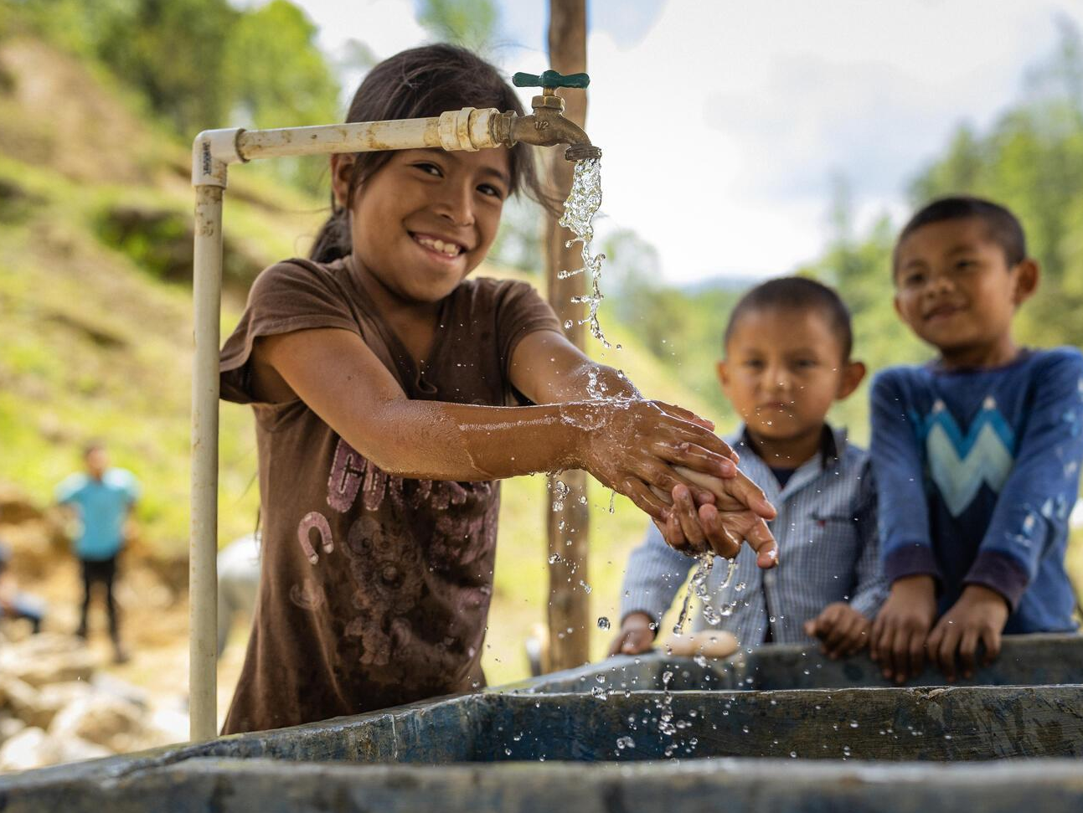
Part 3
© UNICEF/Quintero
WHOSE JOB IS IT?
Children wash their hands at a tap in Alta Verapaz, Guatemala.

Slide 31
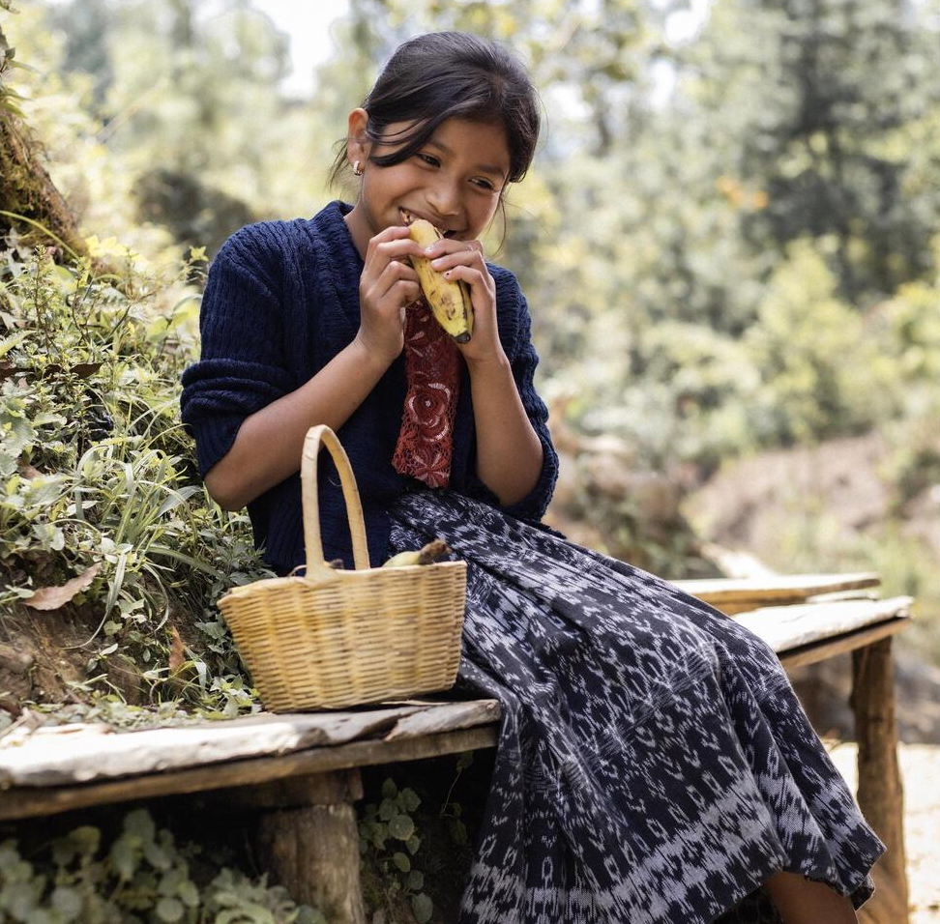
© UNICEF/Quintero
Who are the duty bearers who protect the rights of children?
A girl eats a banana on a bench in Alta Verapaz, Guatemala, a country with high rates of malnutrition.

Slide 32
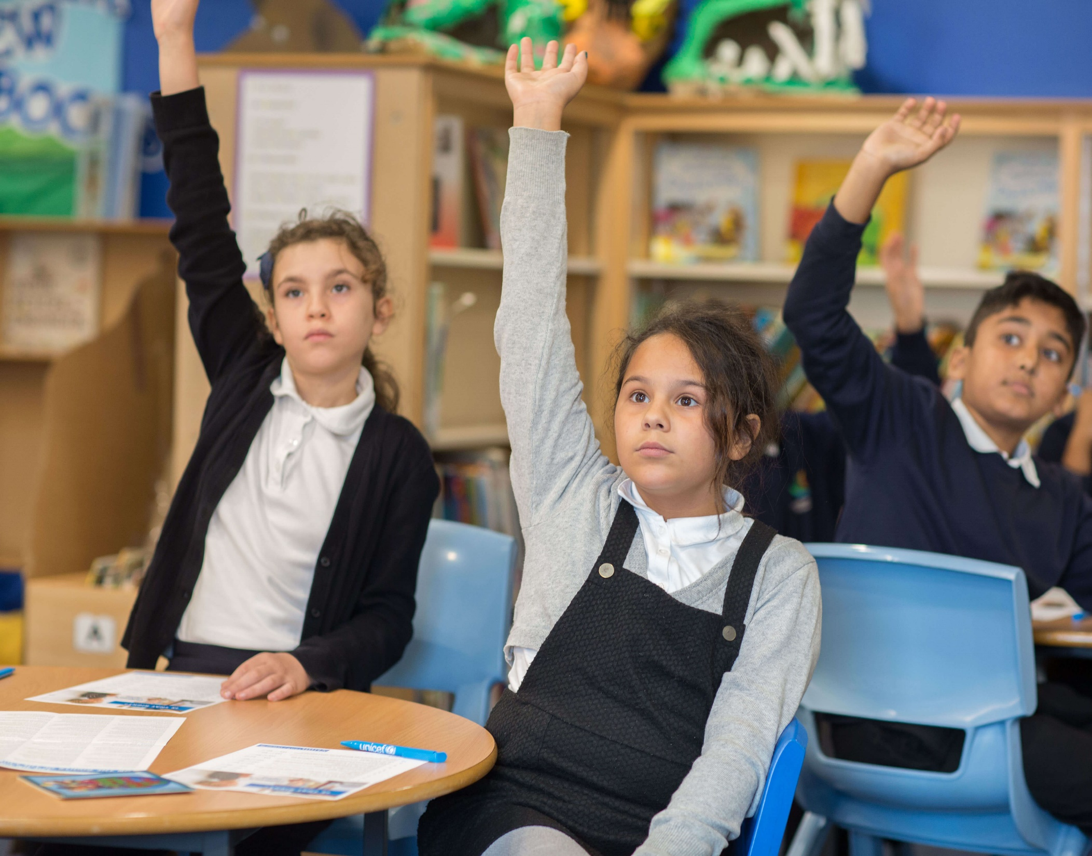
Part 4
© UNICEF/Dawe
HOW DID YOU DO?
Children in a UNICEF Rights Respecting School.

Slide 33
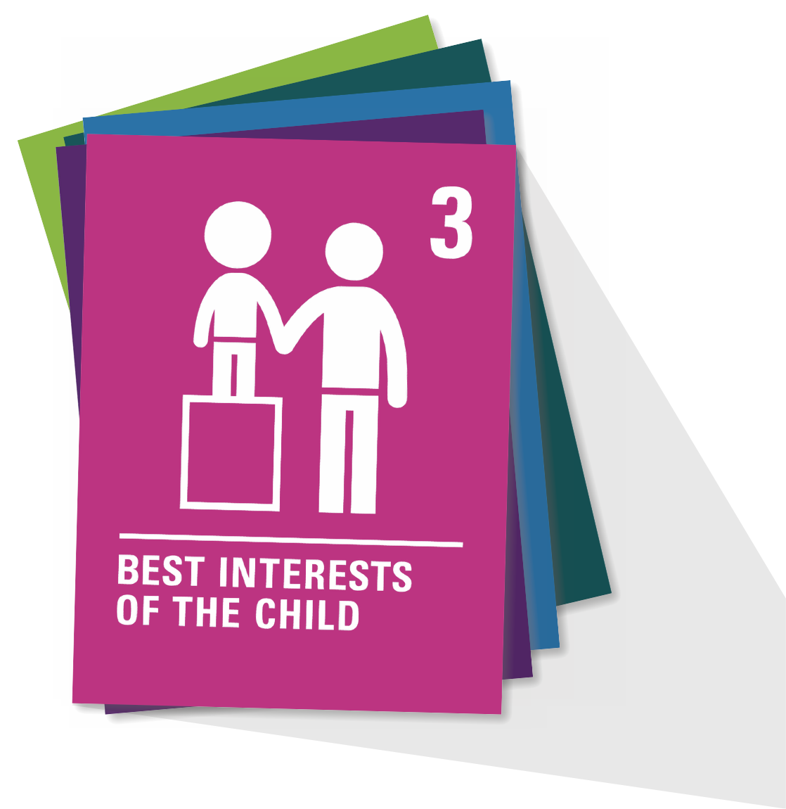
ARTICLE 3
Article 3
When adults make decisions, they should think about how their decisions will affect children. All adults should do what is best for children.
Governments should make sure children are protected and looked after by their parents, or by other people when this is needed.
Governments should make sure that people and places responsible for looking after children are doing a good job.

