Slide 1
ACTIVITY 4 PROTECTING CHILDREN’S RIGHT TO CLEAN WATER IN A CHANGING CLIMATE
A group of children beside a waterfall in Alta Verapaz, Guatemala.
© UNICEF/Quintero

Slide 2
Part 1
Paddingtonpassport
TM
© P&Co. Ltd./SC 2023

Slide 3
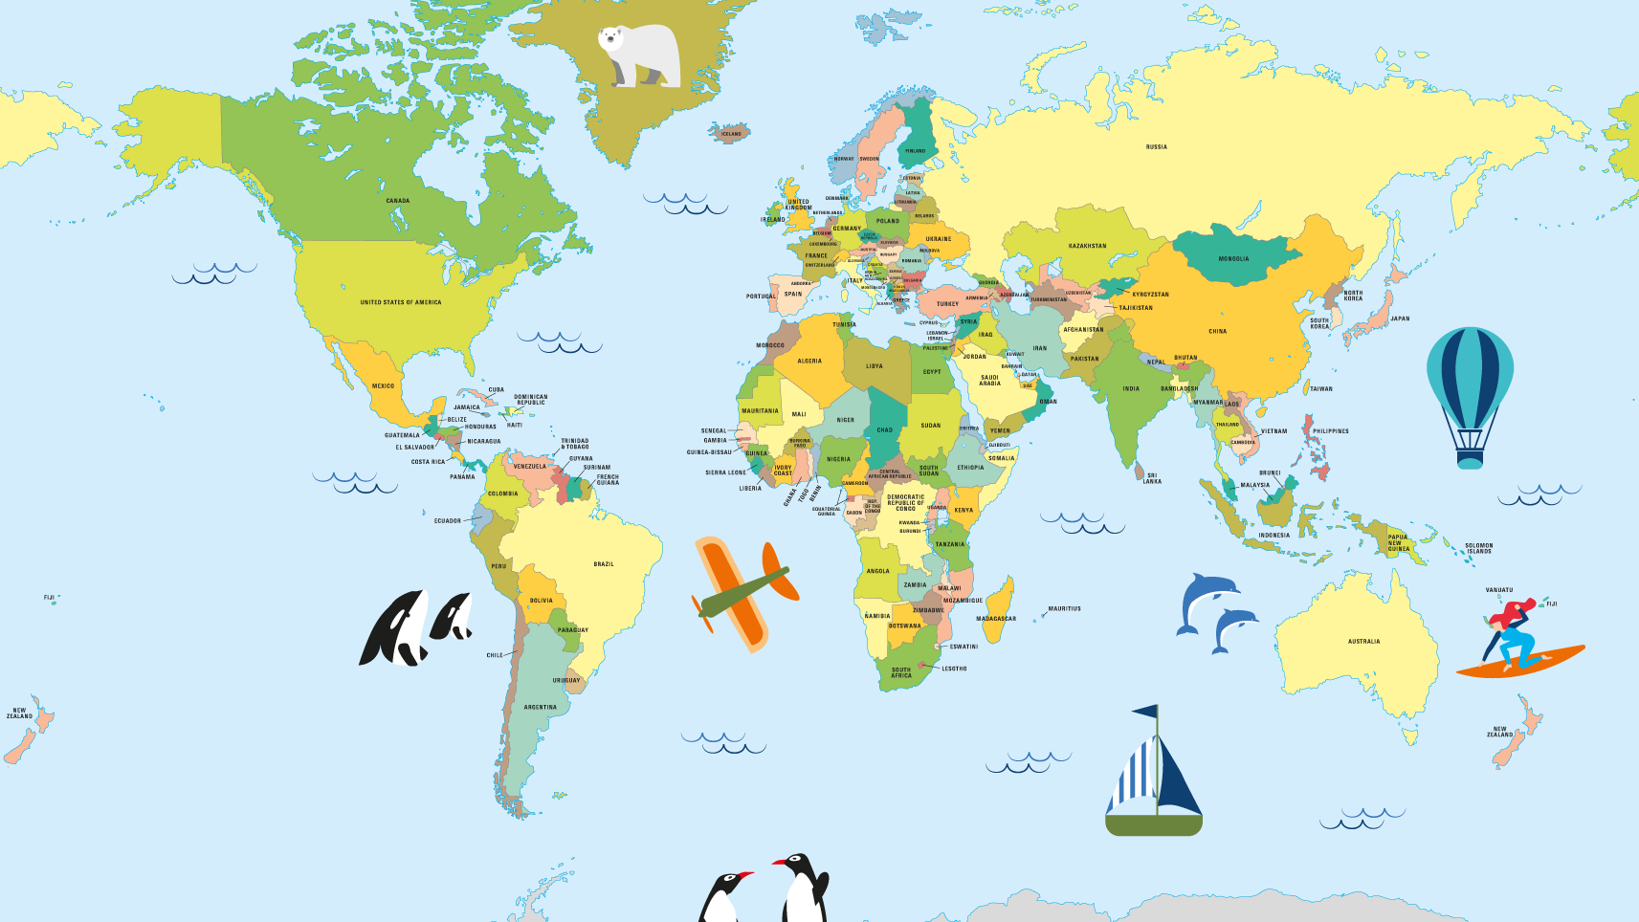
Part 2
Let’s explore our world together
© P&Co. Ltd./SC 2023

Slide 4
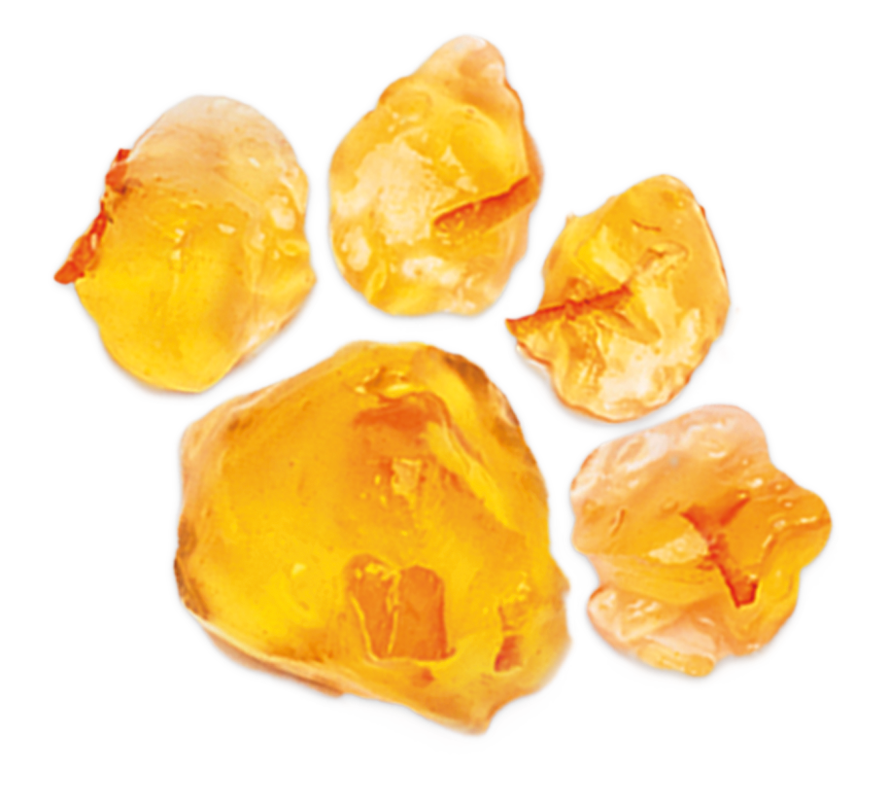
Part 3
Reviewing your rights
© P&Co. Ltd./SC 2023

Slide 5
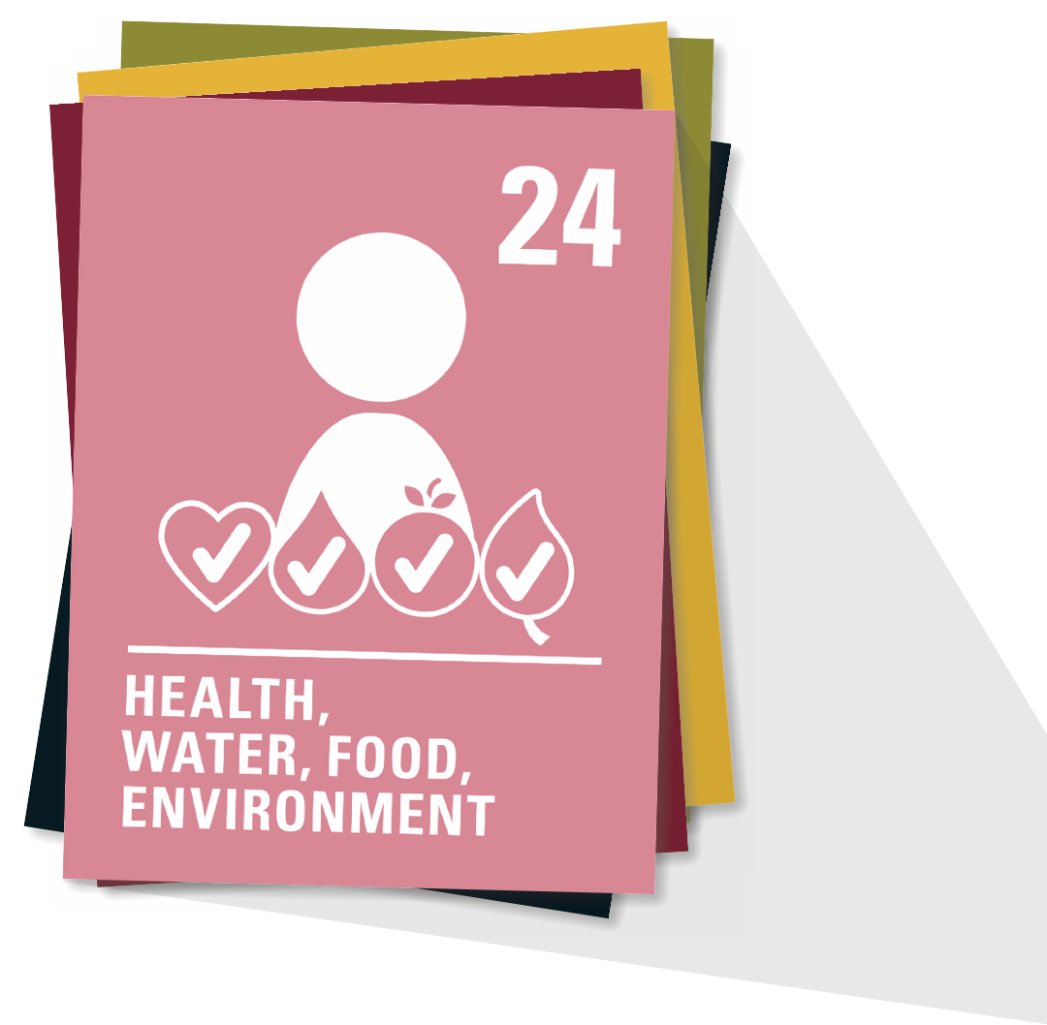
ARTICLE 24
Every child has the right to the best possible health. Governments must provide good quality healthcare, clean water, nutritious food and a clean environment and education on health and wellbeing so that children can stay healthy. Richer countries must help poorer countries achieve this.

Slide 6
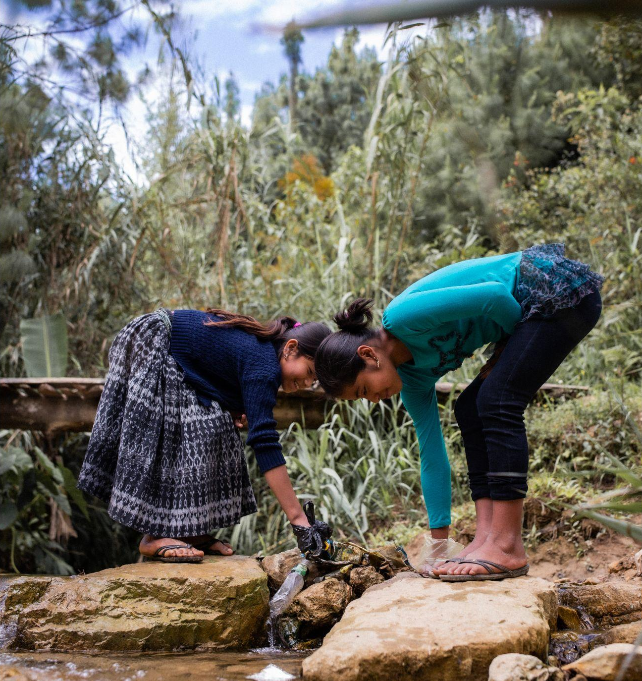
Two girls pick up rubbish from a river in Alta Verapaz, Guatemala.
Part 4
WATER, WATER, WATER
Too much – flooding
Too much – drought
Too dirty – polluted
© UNICEF/Quintero

Slide 7
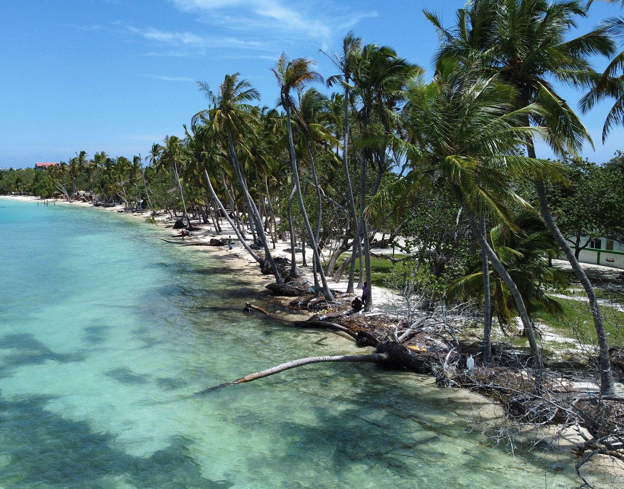
© UNICEF/Faheem
TOO MUCH
Flooding in Maldives
A stretch of severely eroded beach affected by rising sea levels in Dhiffushi island in the Maldives.

Slide 8
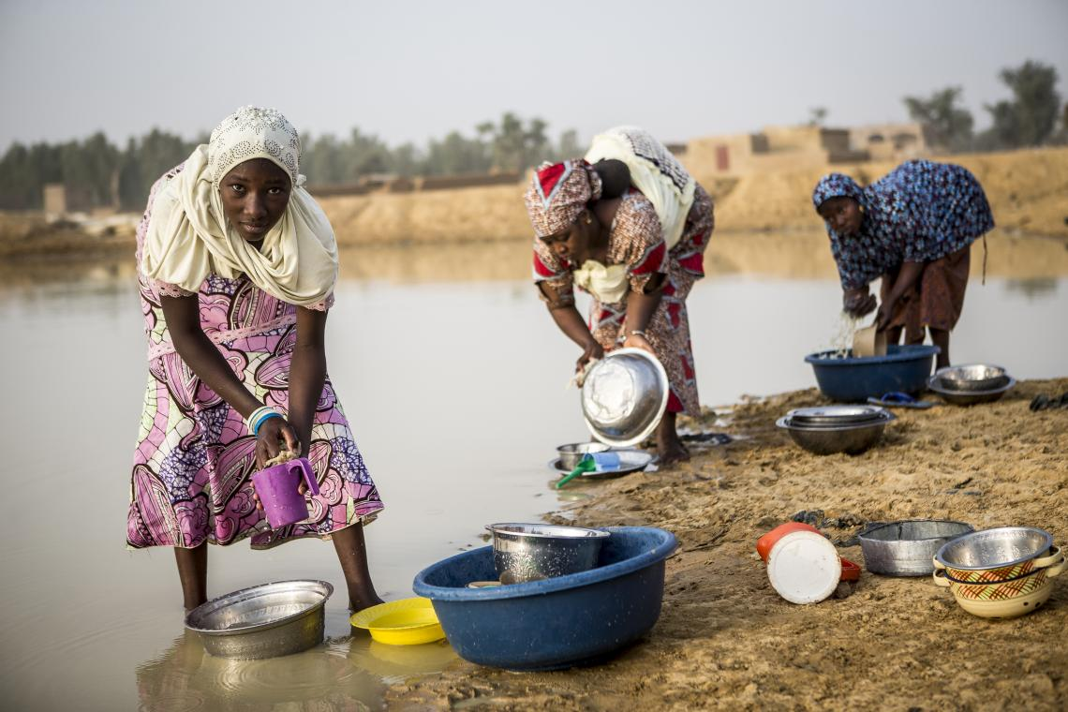
© UNICEF/Keïta
TOO LITTLE
Drought in Mali
Fatoumata, 13, with other women and girls at a pond that was her village's only source of water until a UNICEF water pump was installed next to her school.

Slide 9
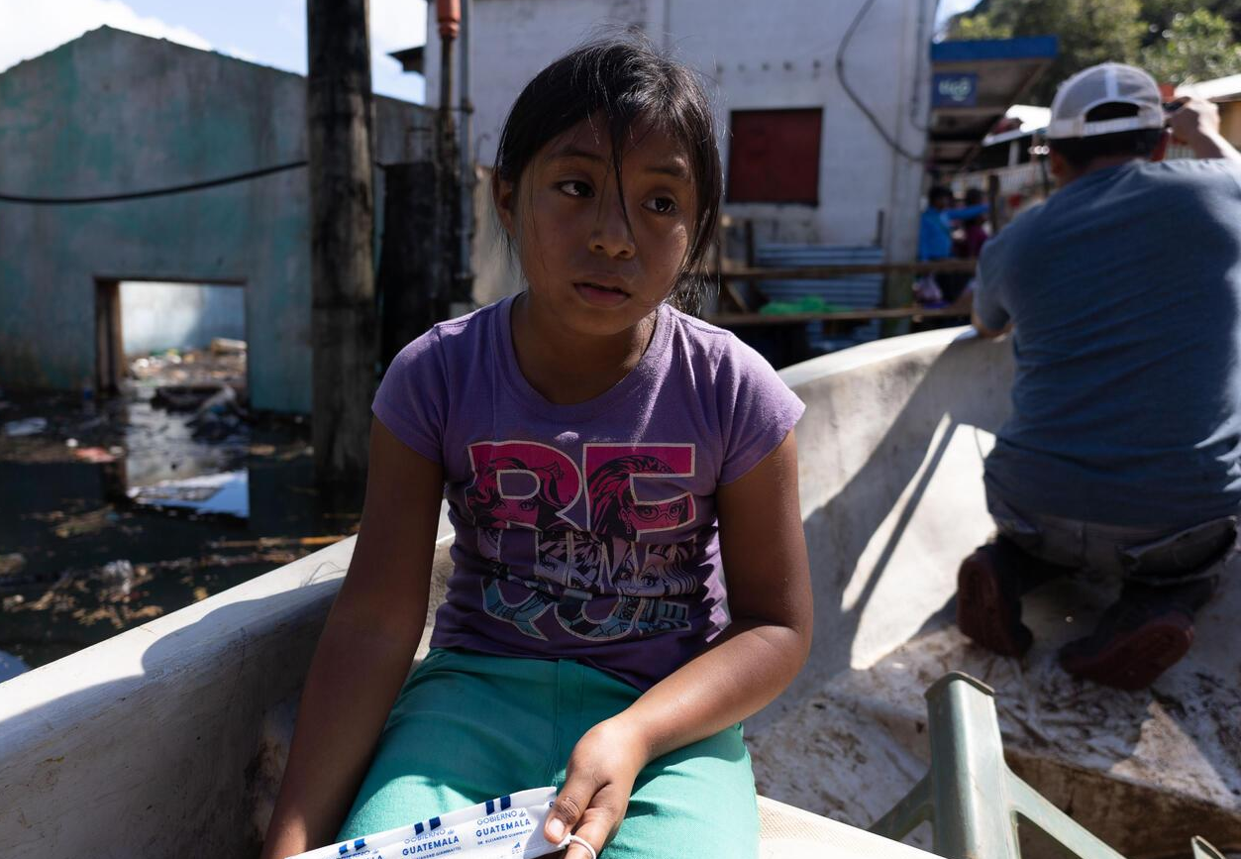
TOO DIRTY
Dirty water in Guatemala
In November 2020 hurricanes Eta and Iota struck Guatemala. Juana, 9, travels in a boat to where her school used to be before the hurricanes left her town under water.
© UNICEF/Billy/AFP-Services

Slide 10
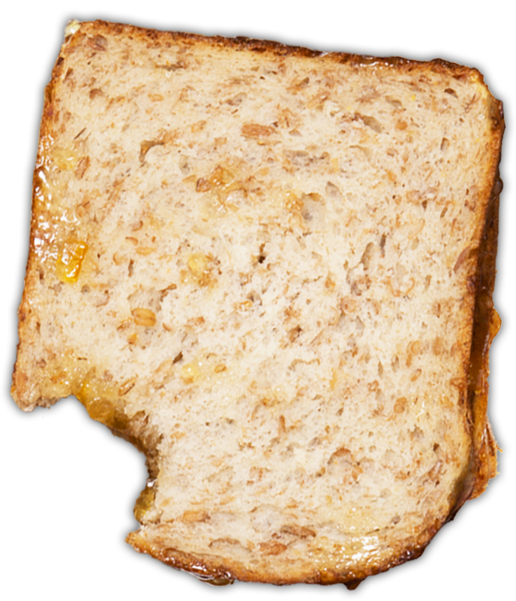
What new things did you learn about the countries we visited?
© P&Co. Ltd./SC 2023
What questions would you ask other children in this place if you were given the chance?

Slide 11
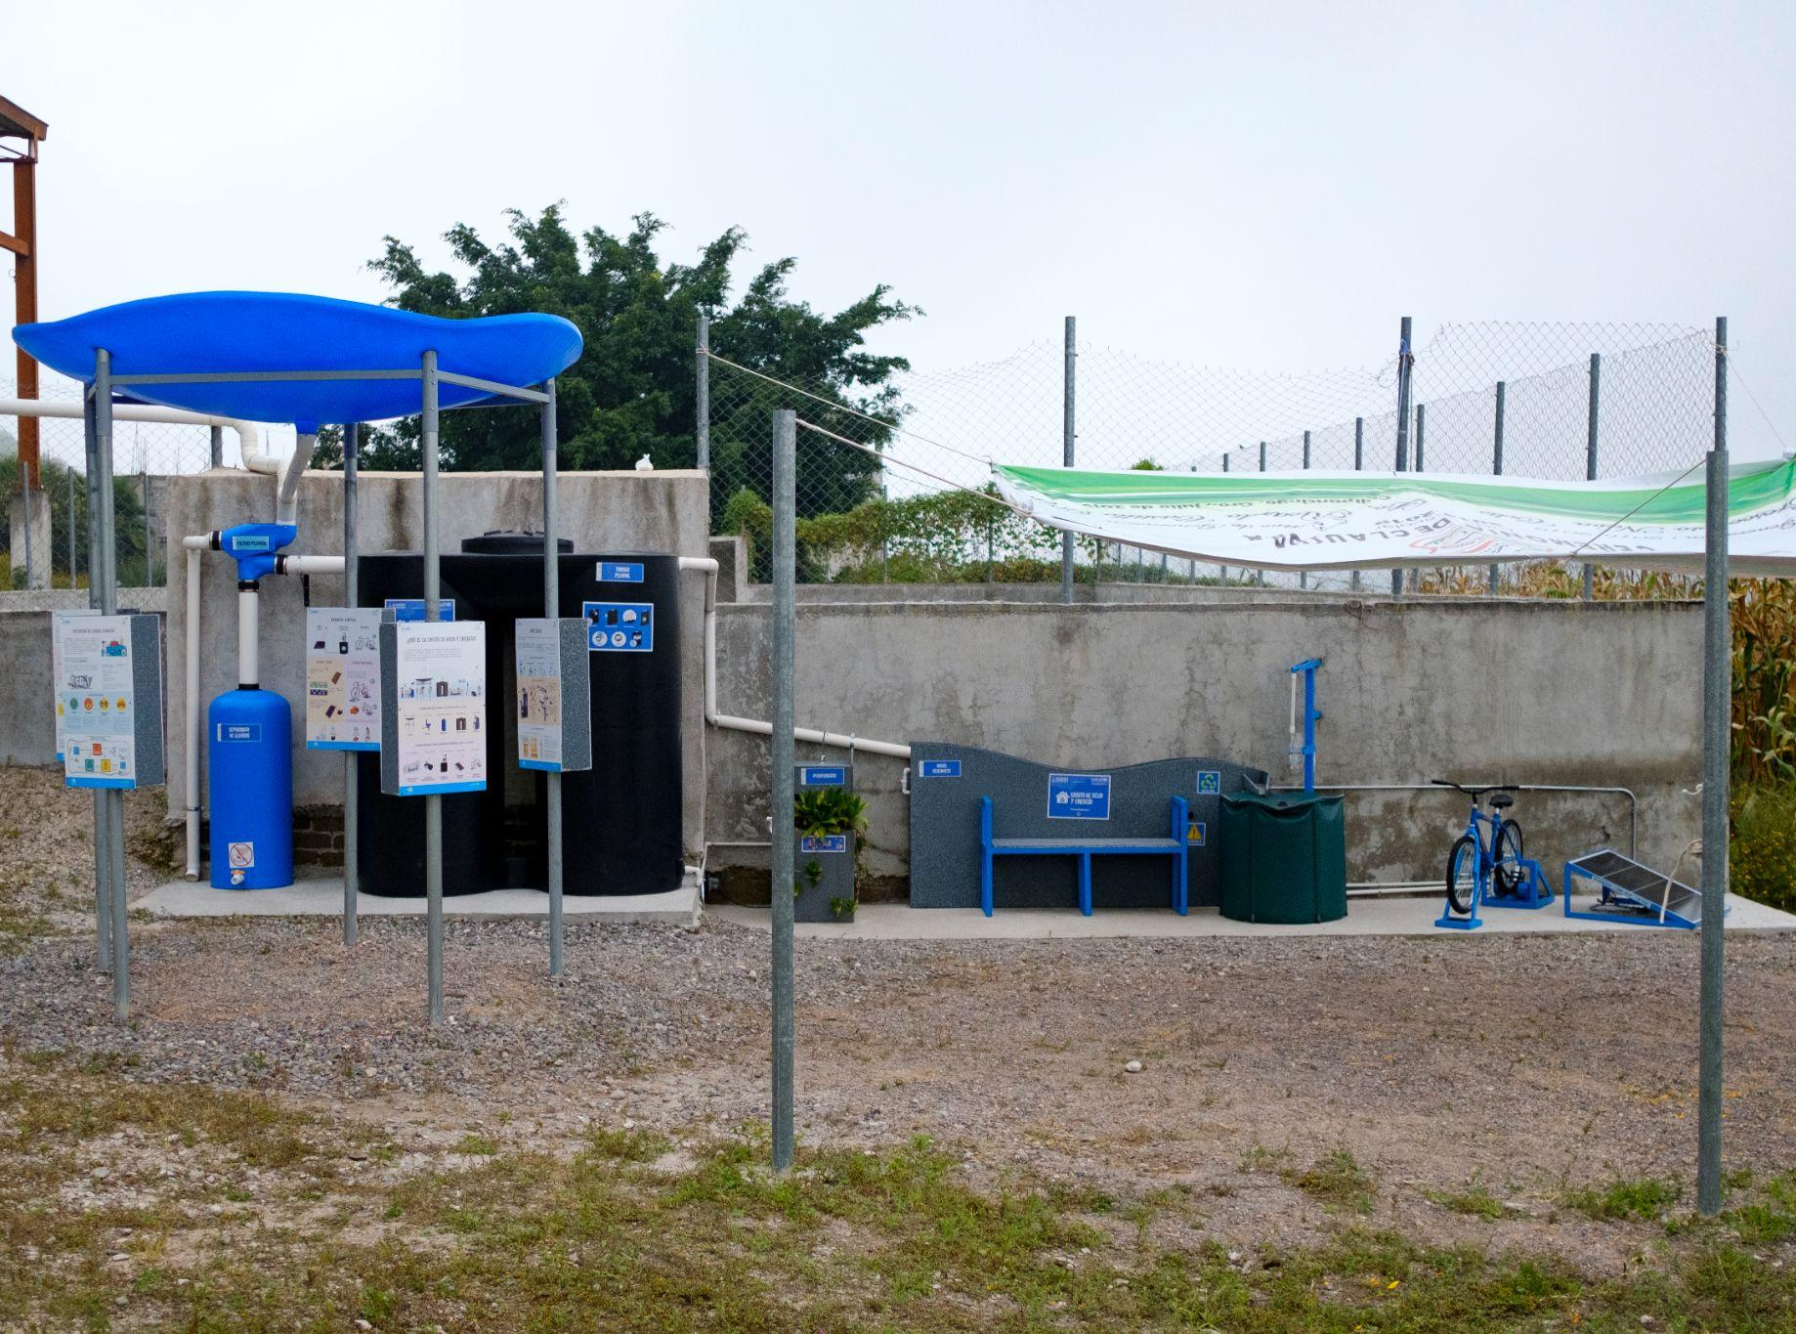
Part 5
© UNICEF/Balam-Ha'
INNOVATIVE ADAPTATION
La Casita del Agua y la Energia (the House of Water and Energy) is a rainwater harvesting and filtration system developed by UNICEF and its partners with schoolchildren and their communities in Mexico.

Slide 12
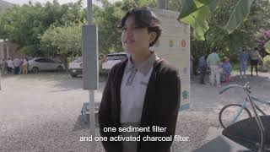
MEXICO
The House of Water and Energy

Slide 13
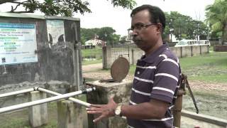
BANGLADESH
Storing water underground to protect resources

Slide 14
Part 6
© P&Co. Ltd./SC 2023
TO WRAP UP
One thing you've learned
One thing that surprised you
One question you still have

