Slide 1
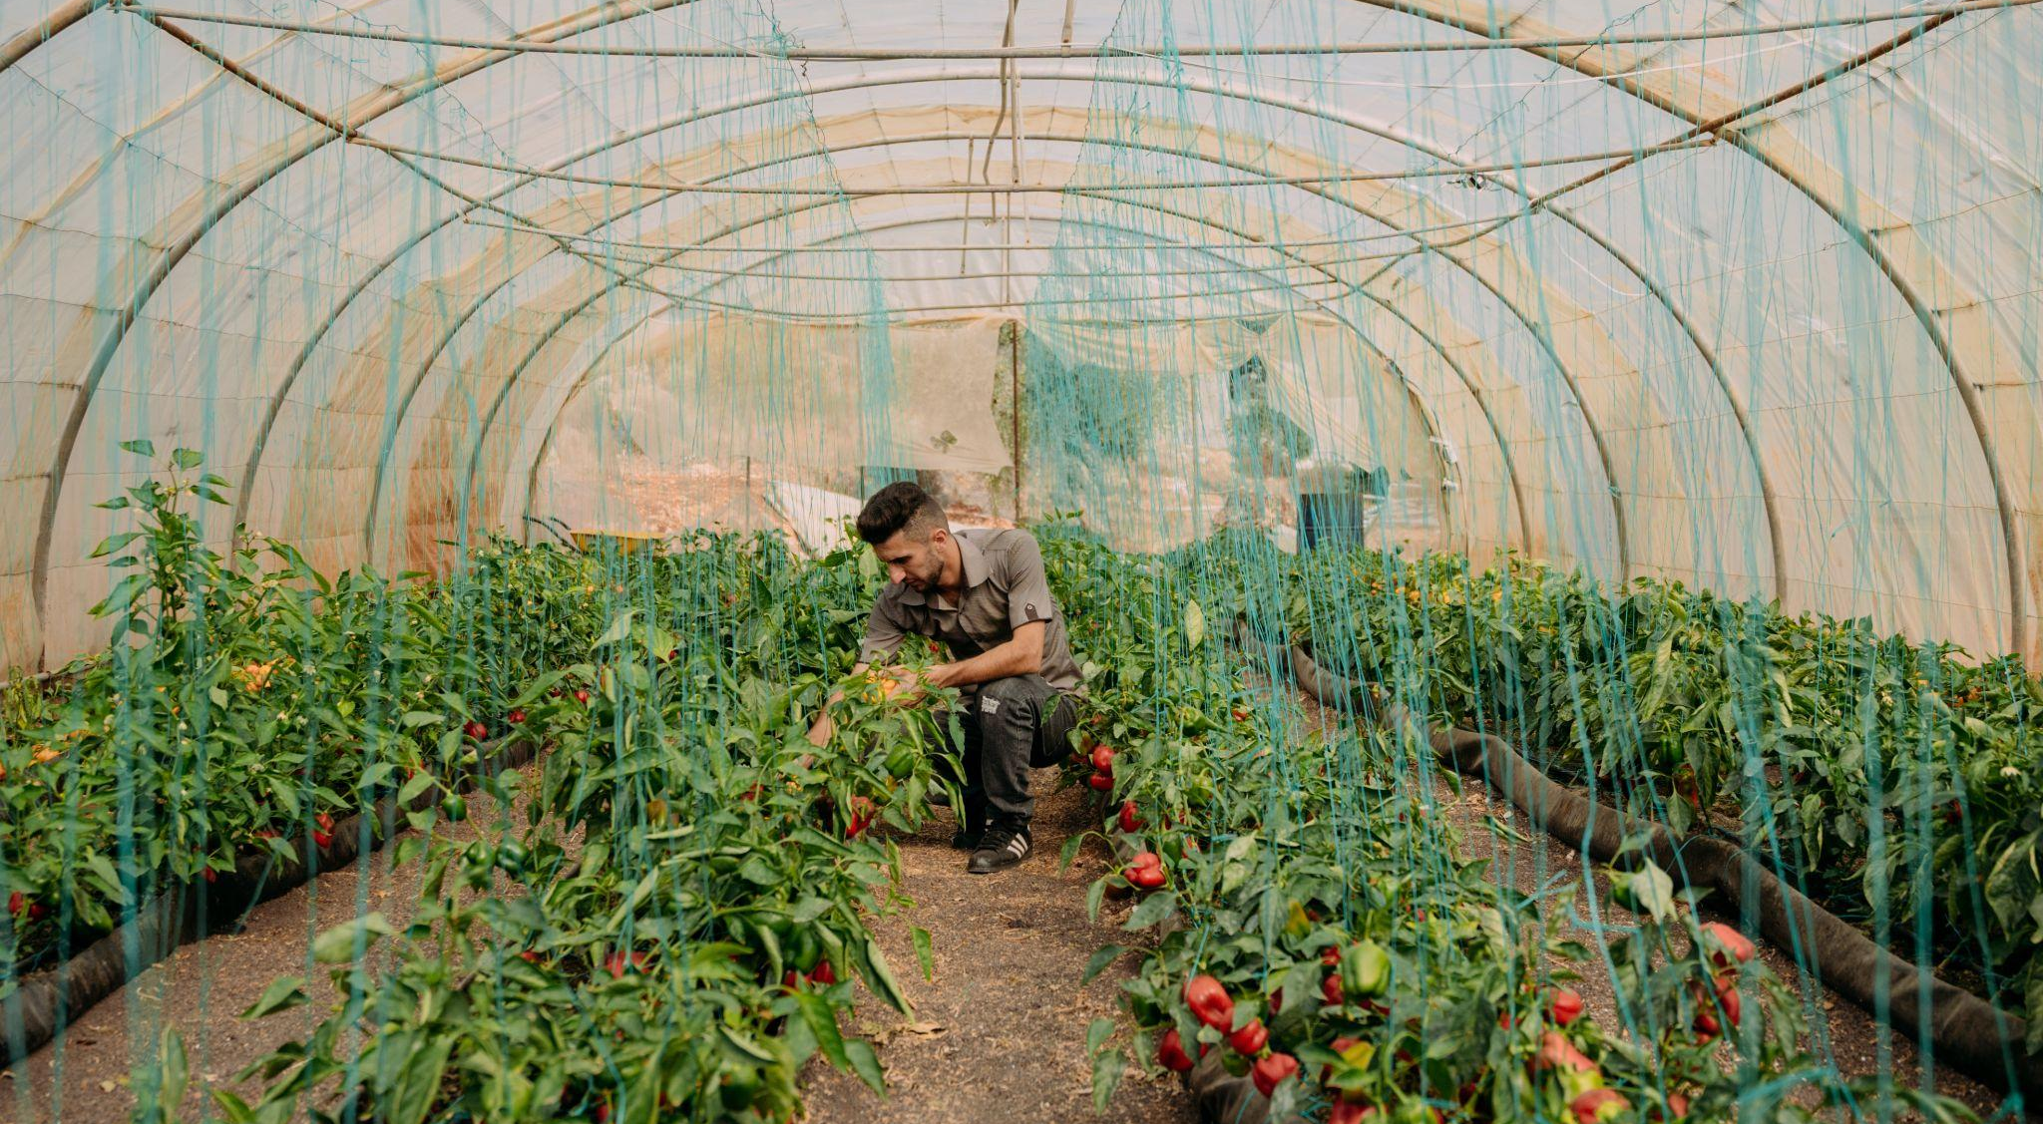
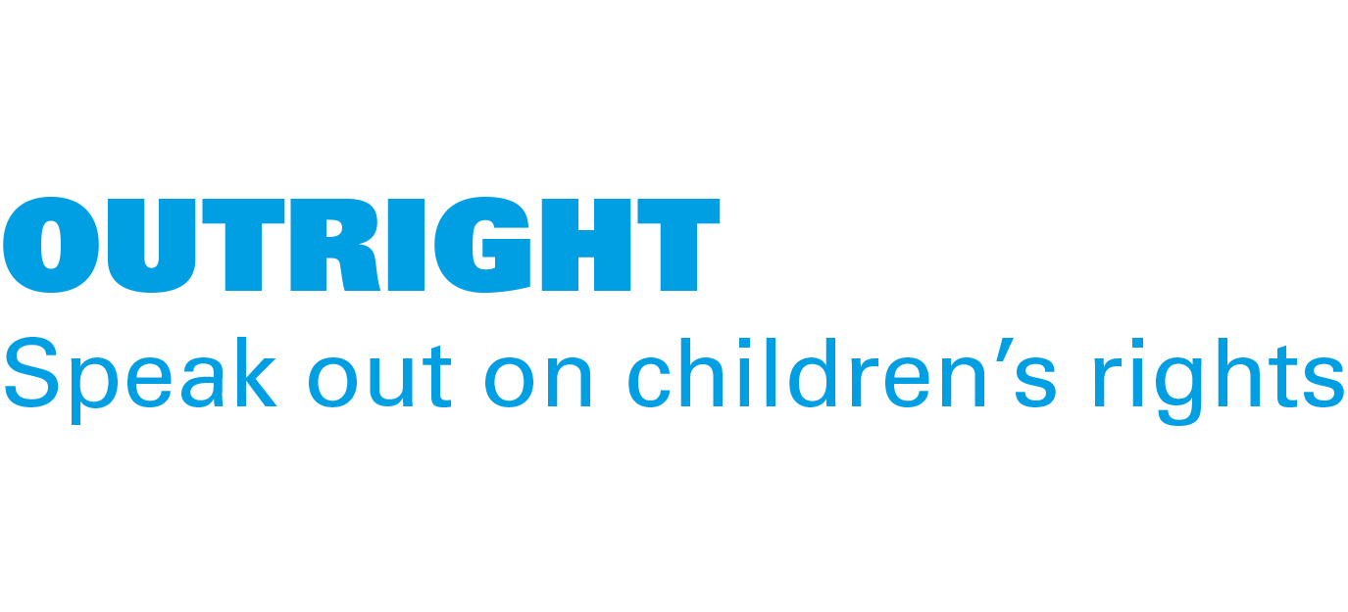
ACTIVITY 5 THE KNOCK-ON EFFECTS OF CLIMATE CHANGE TO HEALTH, NUTRITION AND ENVIRONMENT
Climate change has led to higher temperatures and lower rainfall in Jordan. Ahmed is a UNICEF-supported Climate Leader here and uses hydroponics to grow his crops.
© UNICEF/Qadari

Slide 2
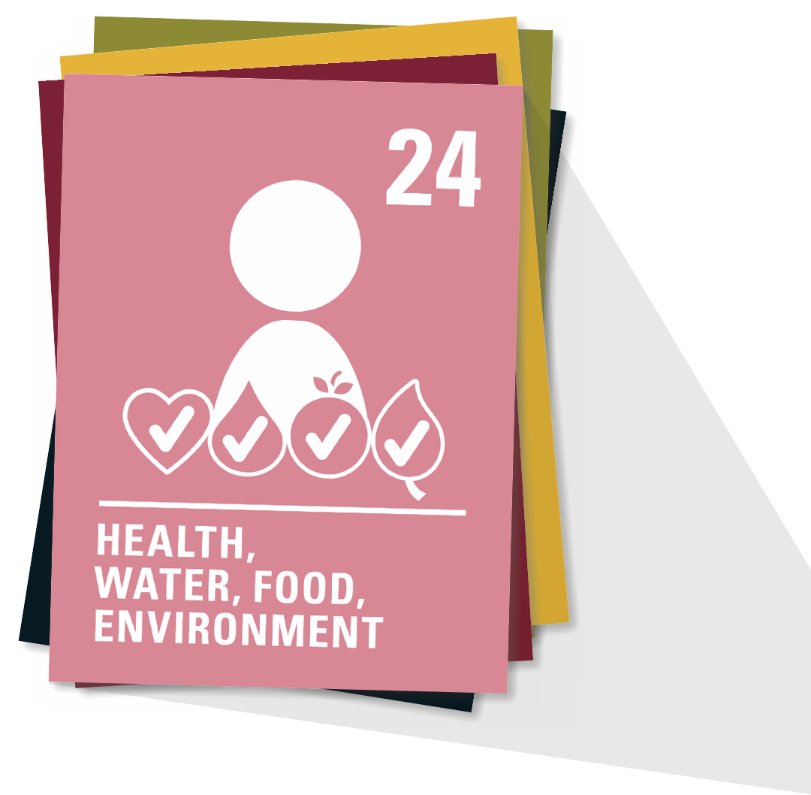
ARTICLE 24
Health and health services
Every child has the right to the best possible health. Governments must provide good quality healthcare, clean water, nutritious food and a clean environment and education on health and wellbeing so that children can stay healthy. Richer countries must help poorer countries achieve this.

Slide 3
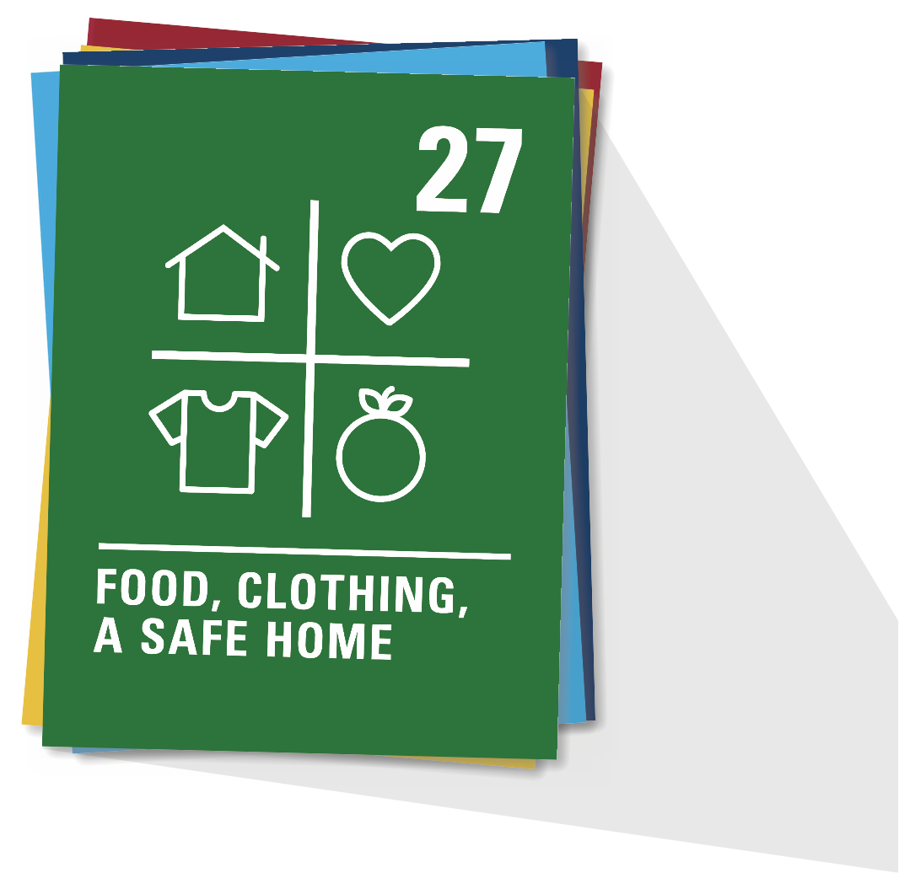
ARTICLE 27
Adequate standard of living
Every child has the right to a standard of living that is good enough to meet their physical and social needs and support their development. Governments must help families who cannot afford to provide this.

Slide 4
Part 2
A SERIES OF KNOCK-ON EFFECTS…
What happens next?

Slide 5
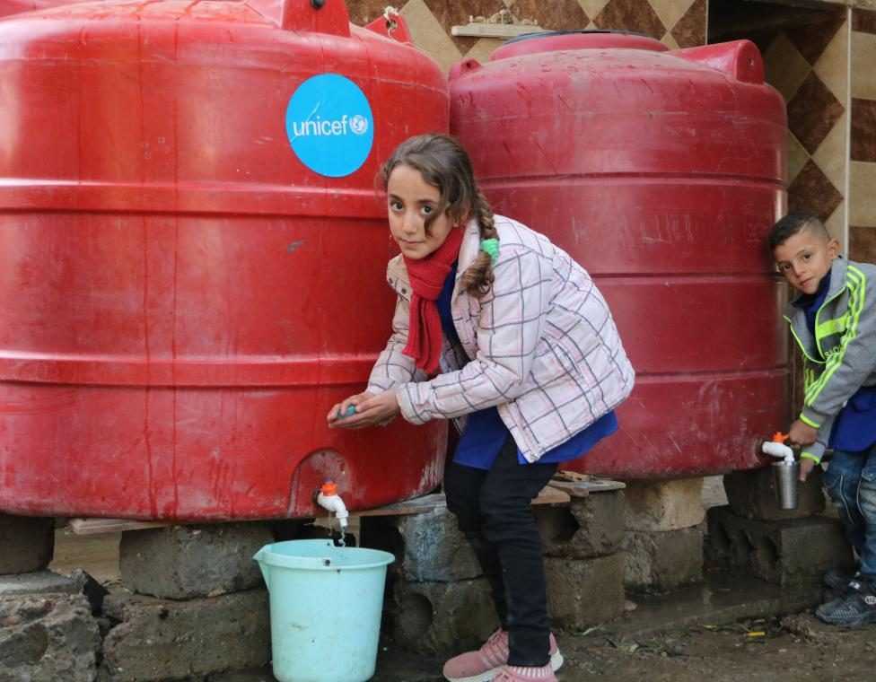
Part 3
A CHOLERA STORY
© UNICEF/Al-Kheder
Bayan, and Qusai, both 9, wash their hands at school in their village in Syria. Around 60% of people in their region rely on unsafe water sources. In 2022, UNICEF helped 83 schools here get clean, safe water.

Slide 6
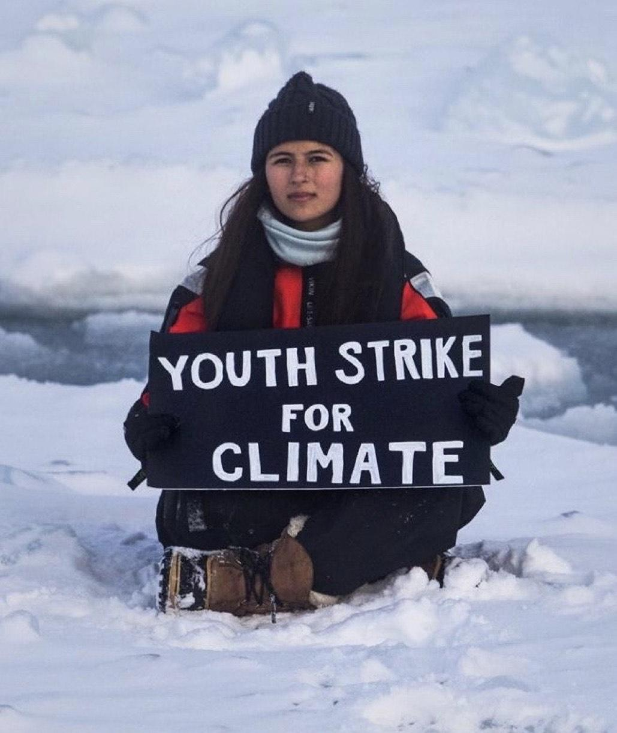
Part 4
GOING BACK THE OTHER WAY
The knock-on effect of climate adaptations

