Slide 1
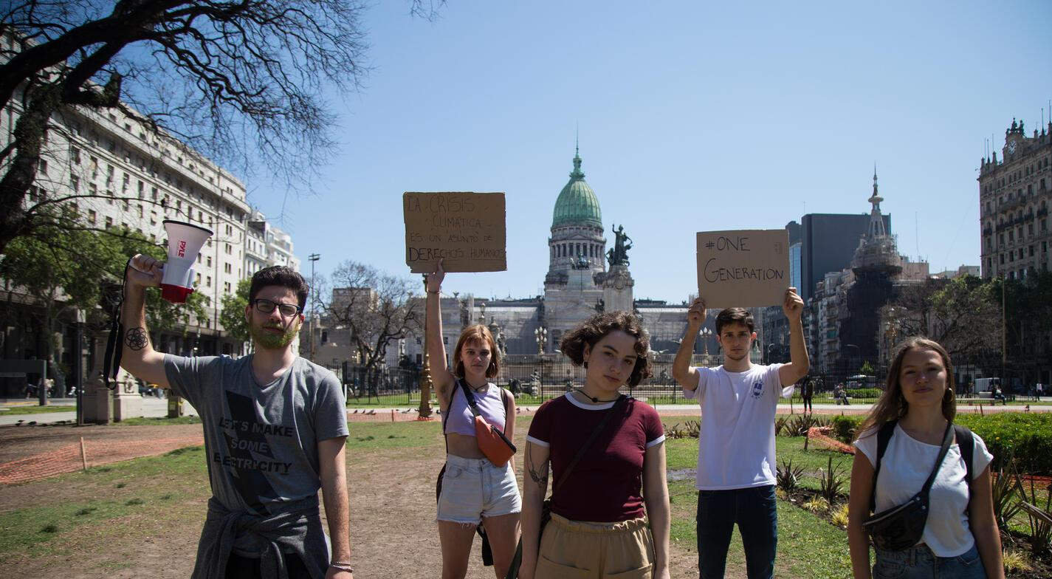
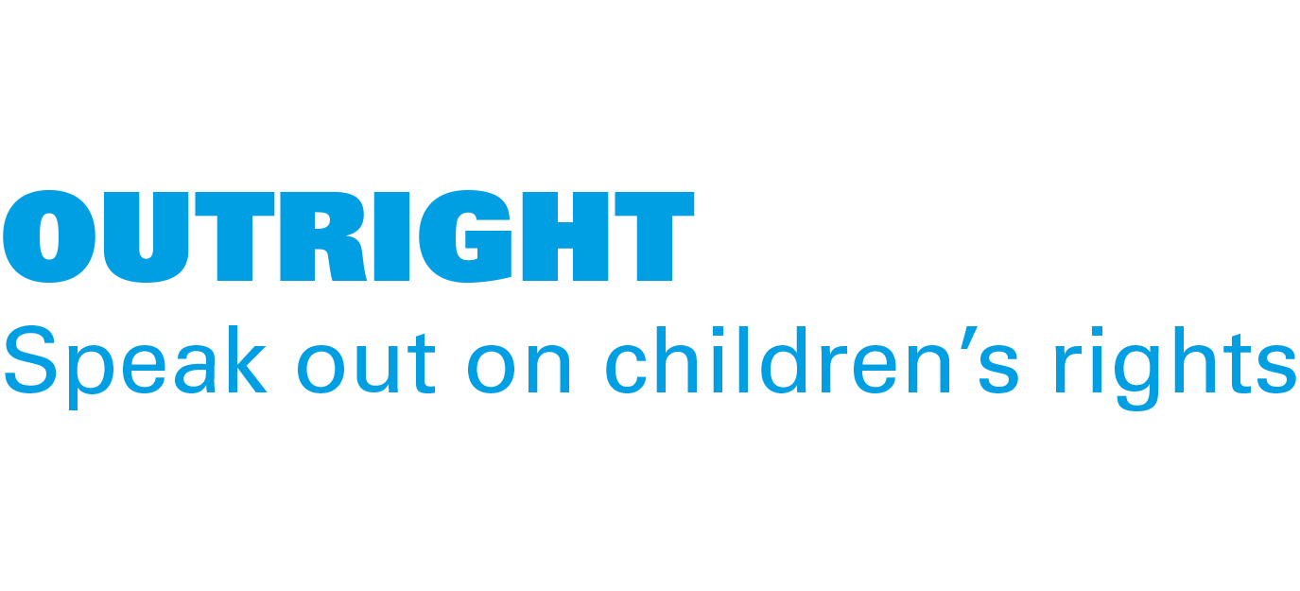
ACTIVITY 7 YOU HAVE VOICE! CHILDREN HAVE THE RIGHT TO ADVOCATE FOR CLIMATE ACTION.
Nicole Becker, 19, leads a group of environmental activists in Argentina.
© UNICEF/Gil

Slide 2
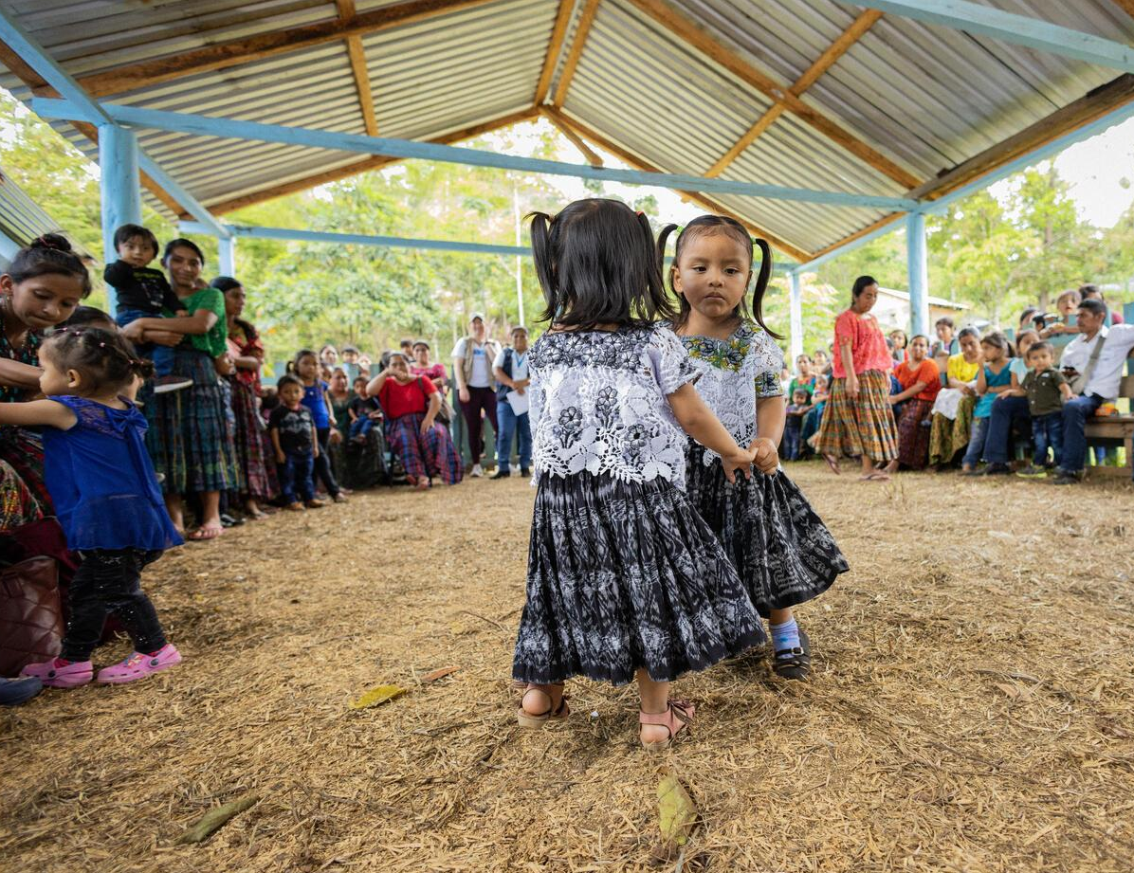
Part 1
REVIEWING OUR RIGHTS
Young girls dancing in Cobán, Alta Verapaz, Guatemala,
© UNICEF/Quintero

Slide 3
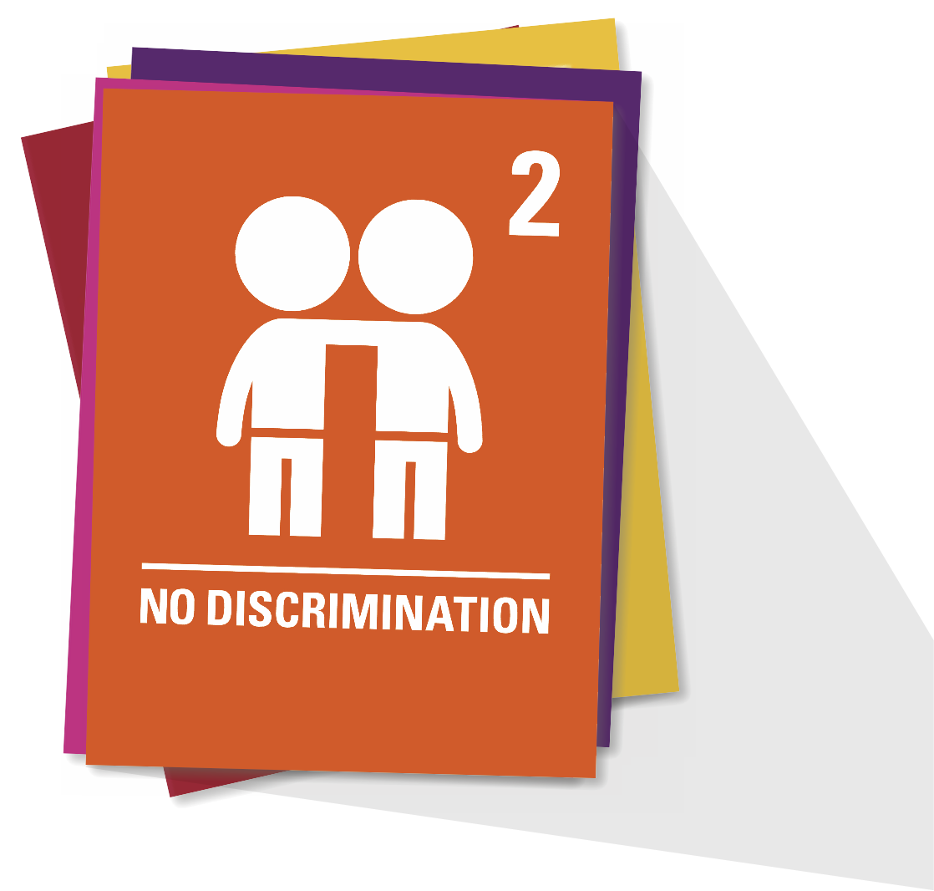
ARTICLE 2
Non-discrimination
The Convention applies to every child without discrimination, whatever their ethnicity, sex, religion, language, abilities or any other status, whatever they think or say, whatever their family background.

Slide 4
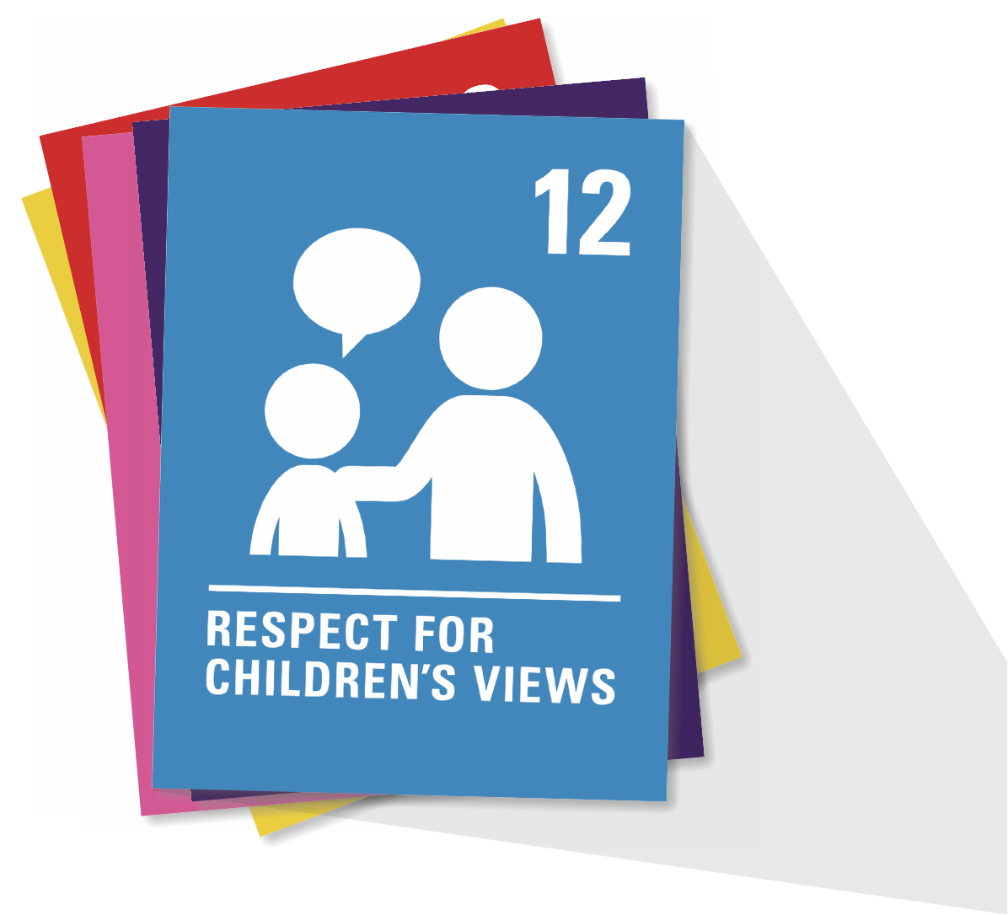
ARTICLE 12
Respect for the views of the child
Every child has the right to express their views, feelings and wishes in all matters affecting them, and to have their views considered and taken seriously. This right applies at all times, for example, during immigration proceedings, housing decisions or the child’s day-to-day home life.

Slide 5
ARTICLE 13
Freedom of expression
Every child must be free to express their thoughts and opinions and to access all kinds of information, as long as it is within the law.

Slide 6
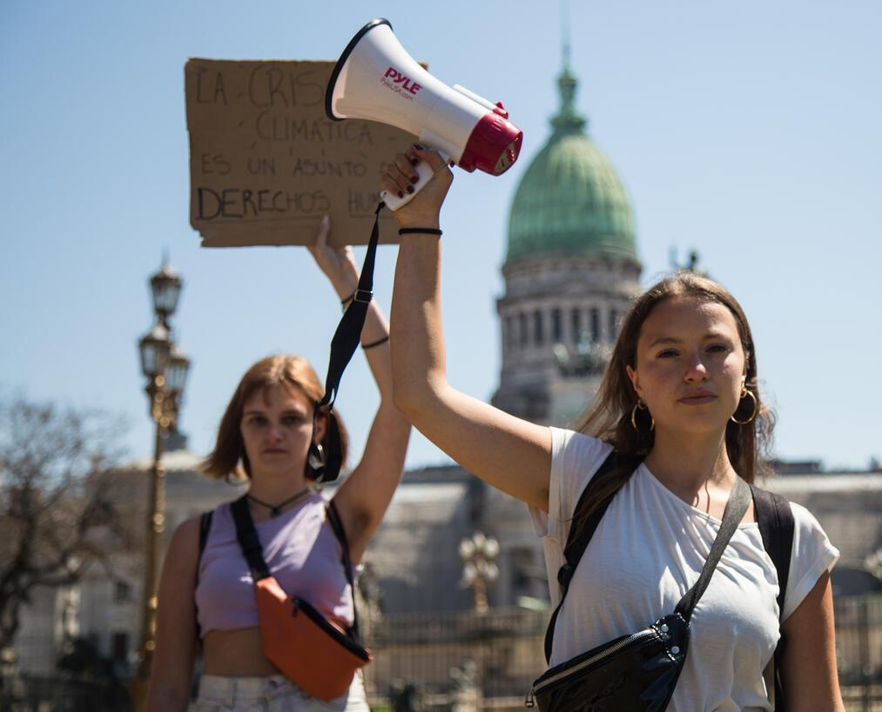
Part 2
© UNICEF/Gil
A MINDFUL MOMENT
Using your diamond nine
Nicole Becker, 19, leads a group of environmental activists in Argentina.

Slide 7
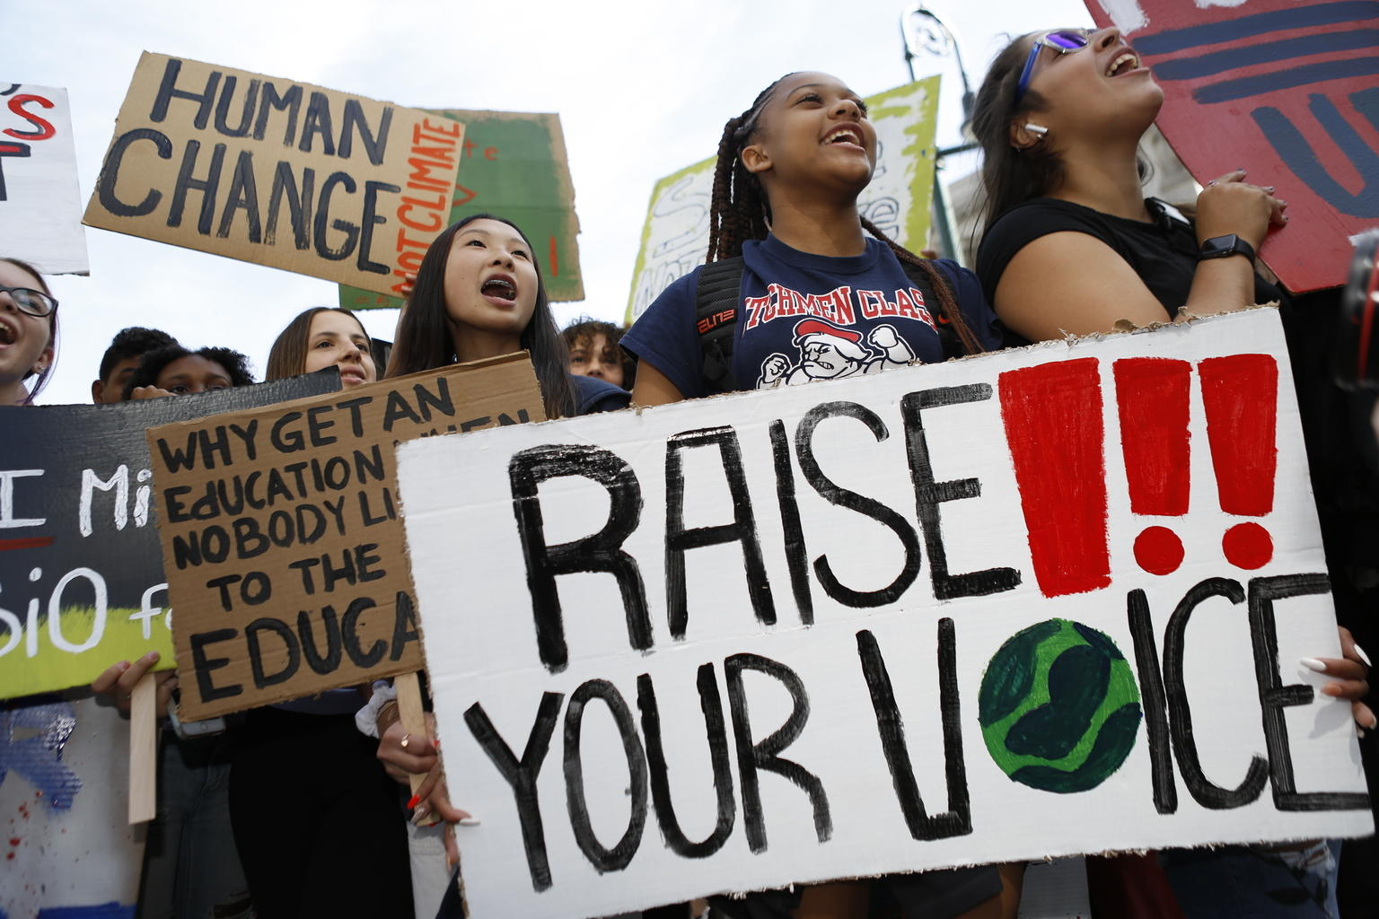
Part 3
© UNICEF/Chalasani
REFLECTING ON CHILDREN’S VOICES IN ACTION
On 20 September 2019 in New York City, youth climate activists join in a demonstration calling for global action to combat climate change.

Slide 8
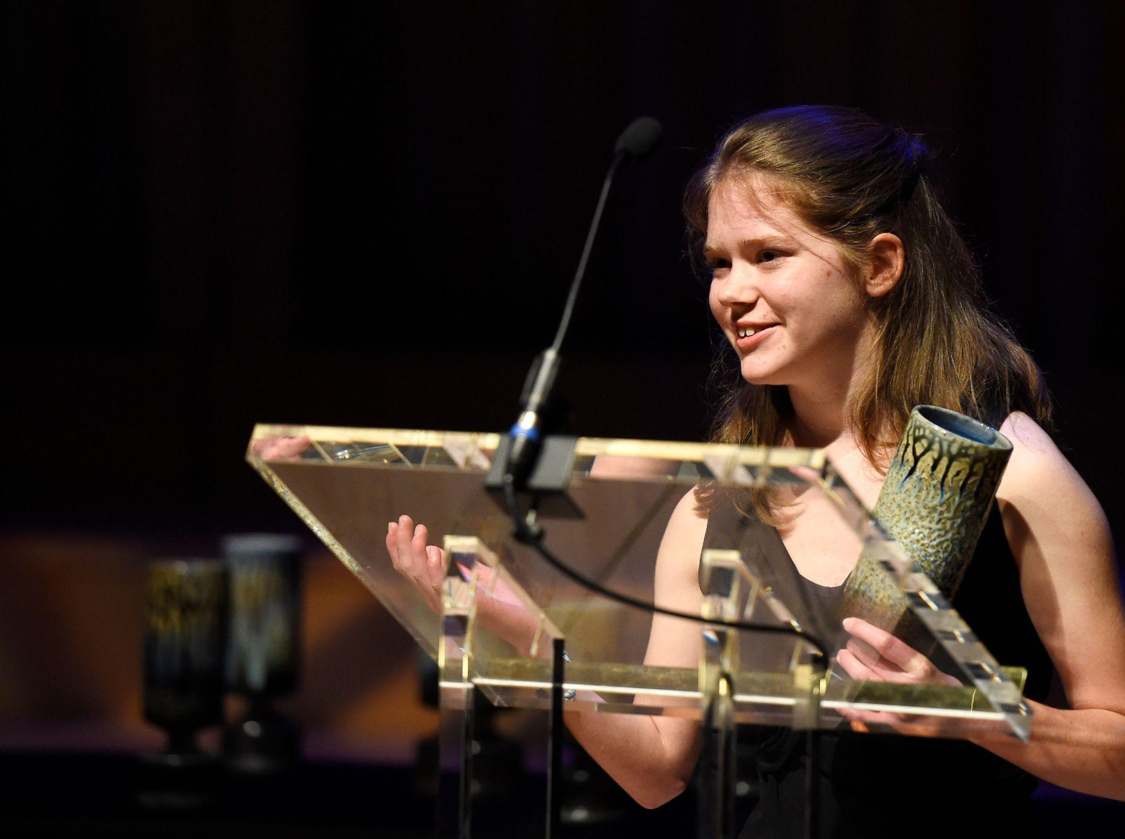
“I want publishers to realise this is not acceptable anymore.”
Skye Neville, Wales
©SkyeVeville

Slide 9
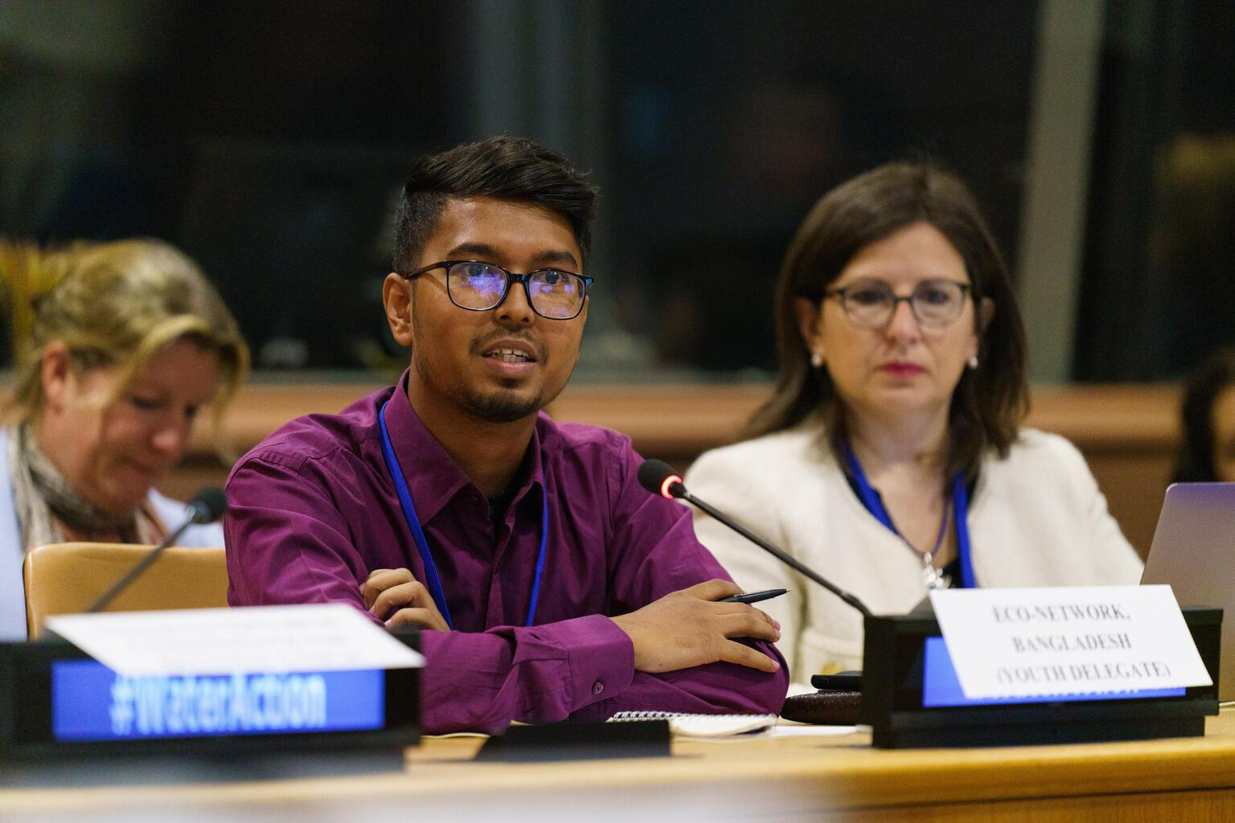
“Youth voices can hold power in the fight against climate change.”
Shamim Ahmed Mridha, Bangladesh
© UNICEFMcIlwaine

Slide 10
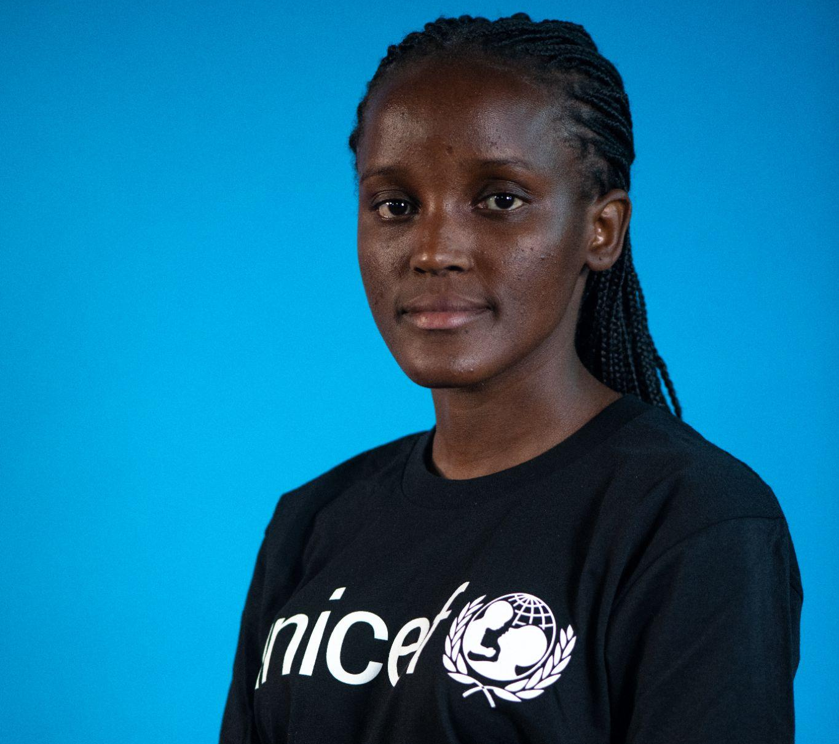
“Climate change is more than statistics… It’s about the people who are being impacted right now.”
Vanessa Nakate, Uganda
© UNICEF2023
© UNICEF

Slide 11
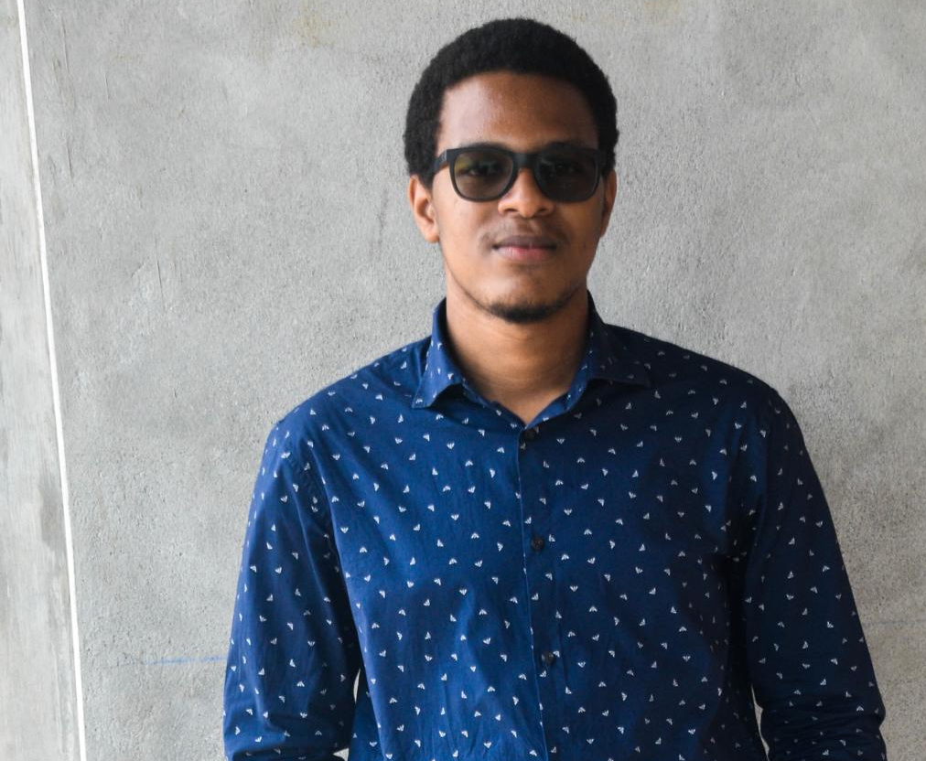
“Having shared my experiences with the world I hope to serve as a testimony to the future that is possible where climate change is less of a threat.”
Russell Raymond, Dominca
© UNICEF

Slide 12
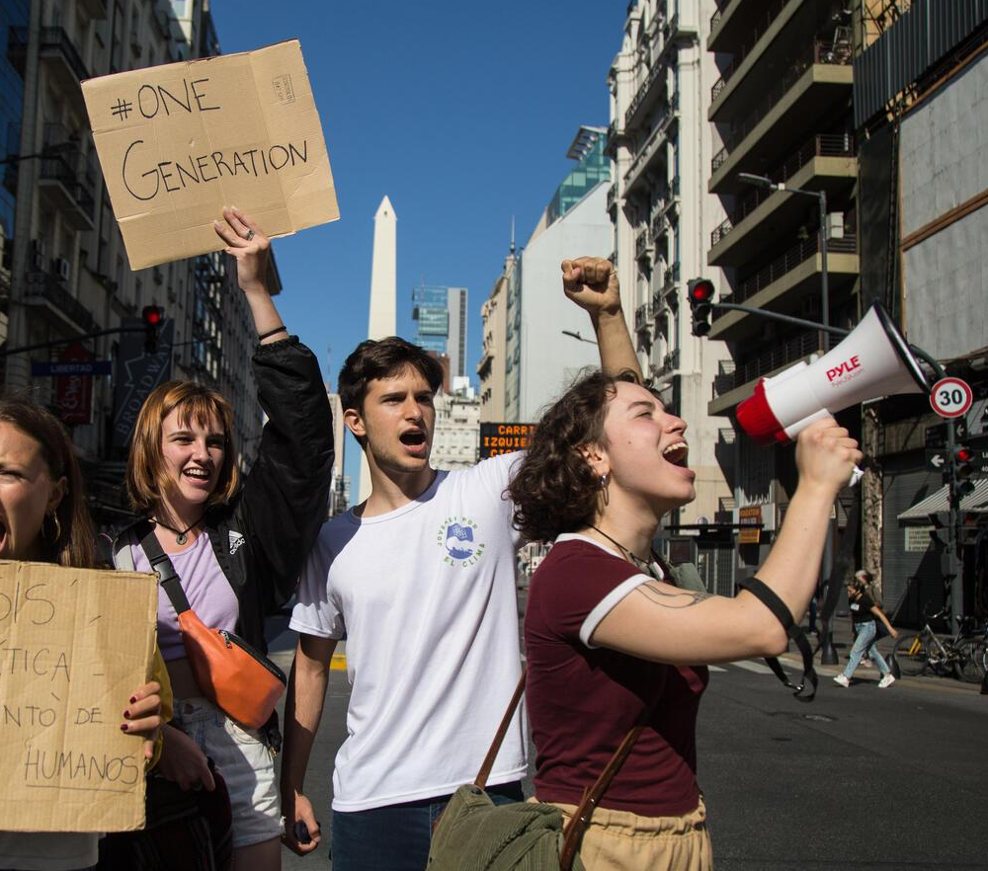
Part 4
CREATE YOUR OWN CLIMATE CHRONICLES
© UNICEF/Gil
A group of environmental activists in Argentina.

Slide 13
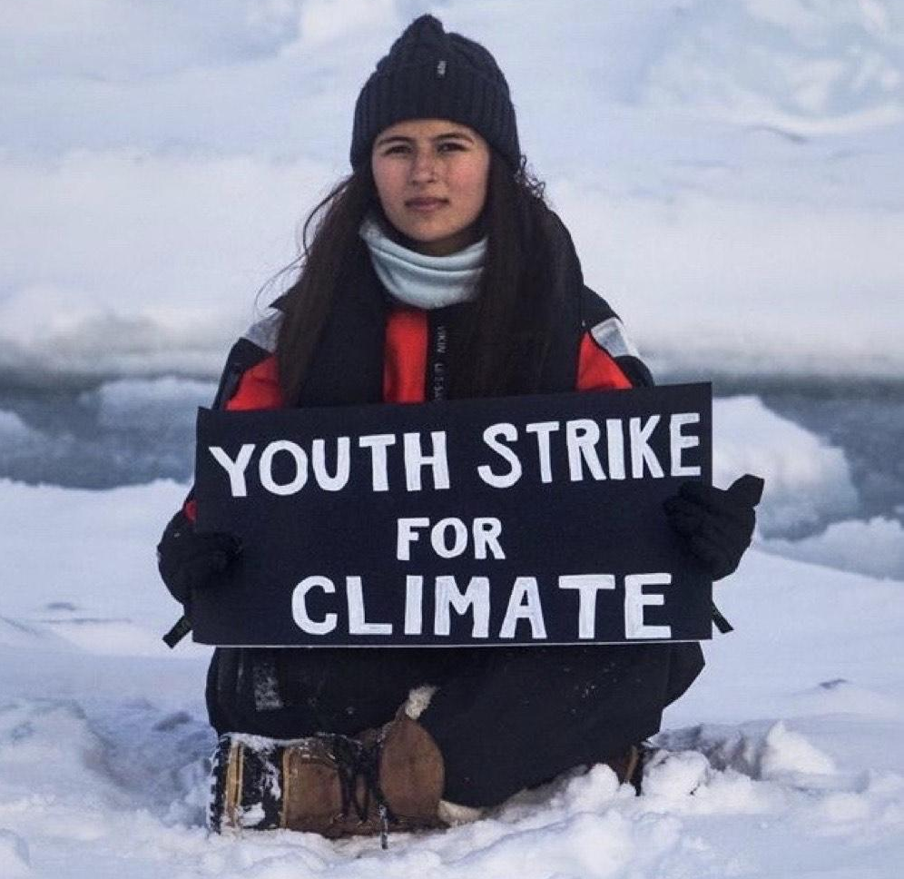
“There’s no such thing as being the perfect environmentalist.”
Mya-Rose Craig, ‘Birdgirl’, Chew Valley

