Slide 1
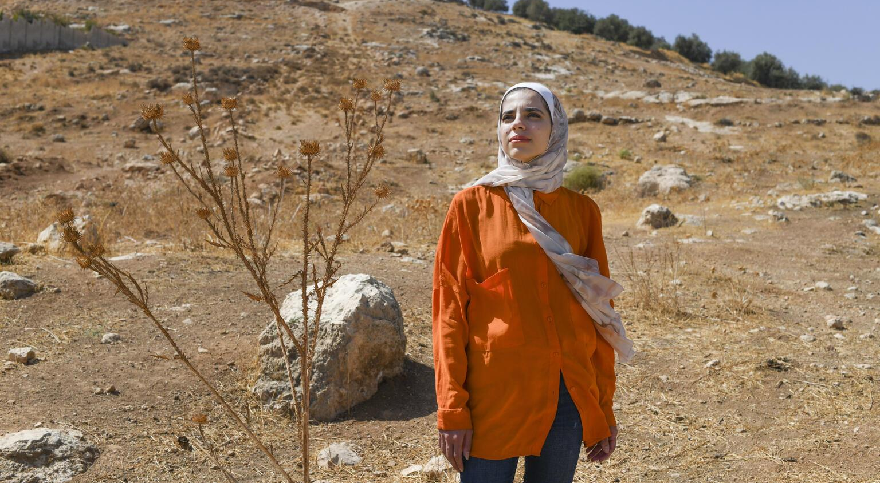
ACTIVITY 1 CLIMATE CHANGE
© UNICEF/Al-Safadi
Anwar, 25, a UNICEF-supported Youth Climate Leader from Jordan, developed a system to help her family grow more crops and make them more sustainable.
© UNICEF/Bseiso

Slide 2
QUESTION
1
All of the gases on the planet make up the earth’s…
a
Biosphere
b
Atmosphere
c
Barometer
d
Climate

Slide 3
QUESTION
2
The pattern of weather conditions over many years is called…
a
Forecast
b
Climate
c
Temperature
d
Atlas

Slide 4
QUESTION
3
The increase in the average temperature of the earth’s atmosphere is referred to by scientists as…
a
Global warming
b
Thermo- climate
Earth change
d
Core temperature change
c

Slide 5
QUESTION
4
What is the name of gas released into the atmosphere when we burn fossil fuel for energy like coal, oil and natural gas?
a
Carbon dioxide (CO₂)
b
Oxygen (O₂)
c
Hydrogen
d
Plutonium

Slide 6
QUESTION
5
Which could be a direct/indirect effect of climate change on children?
Lack of access to healthcare due to migration
Reduced food supply and poor nutrition
a
b
Limited access to clean water and increased waterborne illness
d
c
All of these

Slide 7
QUESTION
6
Which of these impacts of climate change can put a child’s rights at risk?
a
b
Extreme weather
Drought
c
Warming oceans
d
All of these

Slide 8
QUESTION
7
What are the gases called that become trapped in the earth’s atmosphere and are heating the planet?
a
b
Humidity
Precipitation
c
Greenhouse gases
d
Nitrates

Slide 9
QUESTION
8
Which of the below is a climate action that helps protect children's rights?
Building hospitals and schools to withstand extreme weather events
Creating new green energies and making them accessible
a
b
Creating new bike paths to help people cycle instead of drive
c
d
All of these

Slide 10
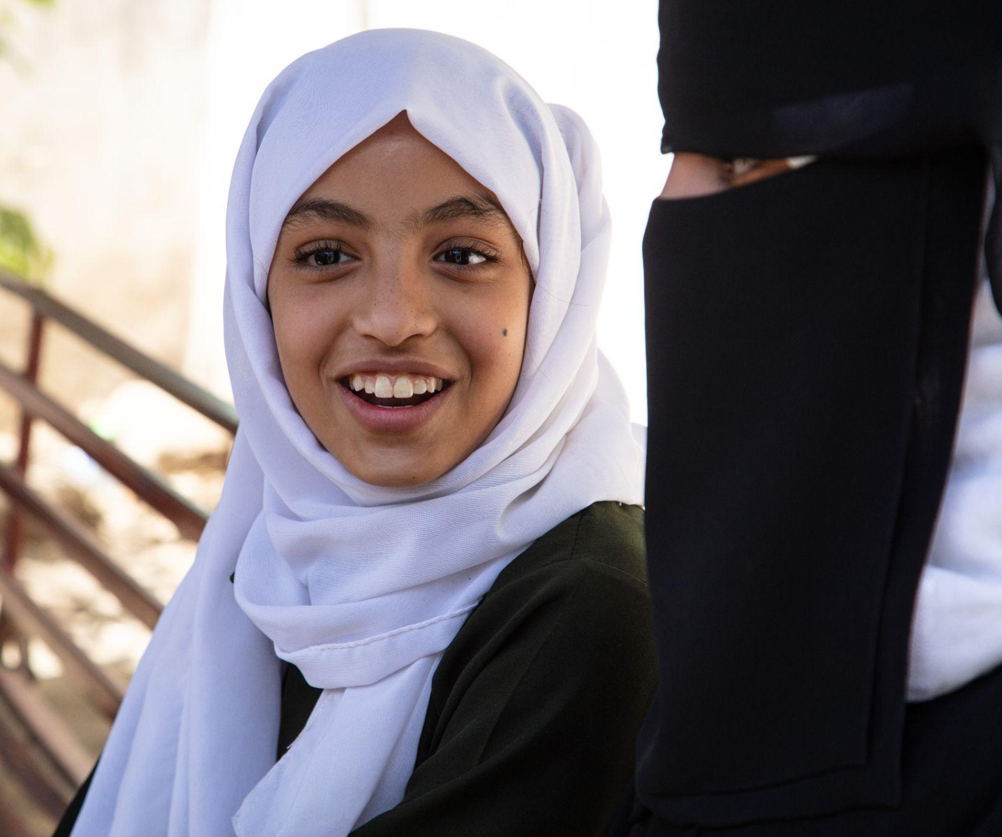
© UNICEF/Qadari
How many questions did you get right?
A student talks with her friends at break time in the yard of Al-Zahra'a School, Yemen, in February 2023.

Slide 11
QUESTION
1
All of the gases on the planet make up the earth’s…
a
a
b
Biosphere
b
Atmosphere
d
c
d
c
Barometer
Climate

Slide 12
QUESTION
2
The pattern of weather conditions over many years is called…
a
Forecast
b
Climate
c
Temperature
d
Atlas

Slide 13
QUESTION
3
The increase in the average temperature of the earth’s atmosphere is referred to by scientists as…
a
Global warming
b
Thermo- climate
Earth change
d
Core temperature change
c

Slide 14
QUESTION
4
What is the name of gas released into the atmosphere when we burn fossil fuel for energy like coal, oil and natural gas?
a
Carbon dioxide (CO₂)
b
Oxygen (O₂)
c
Hydrogen
d
Plutonium

Slide 15
QUESTION
5
Which could be a direct/indirect effect of climate change on children?
a
Lack of access to healthcare due to migration
b
Reduced food supply and poor nutrition
Limited access to clean water and increased waterborne illness
d
c
All of these

Slide 16
QUESTION
6
Which of these impacts of climate change can put a child’s rights at risk?
a
b
Extreme weather
Drought
c
Warming oceans
d
All of these

Slide 17
QUESTION
7
What are the gases called that become trapped in the earth’s atmosphere and are heating the planet?
a
b
Humidity
Precipitation
c
Greenhouse gases
d
Nitrates

Slide 18
QUESTION
8
Which of the below is a climate action that helps protect children's rights?
Building hospitals and schools to withstand extreme weather events
Creating new green energies and making them accessible
a
b
Creating new bike paths to help people cycle instead of drive
c
d
All of these

