Slide 1
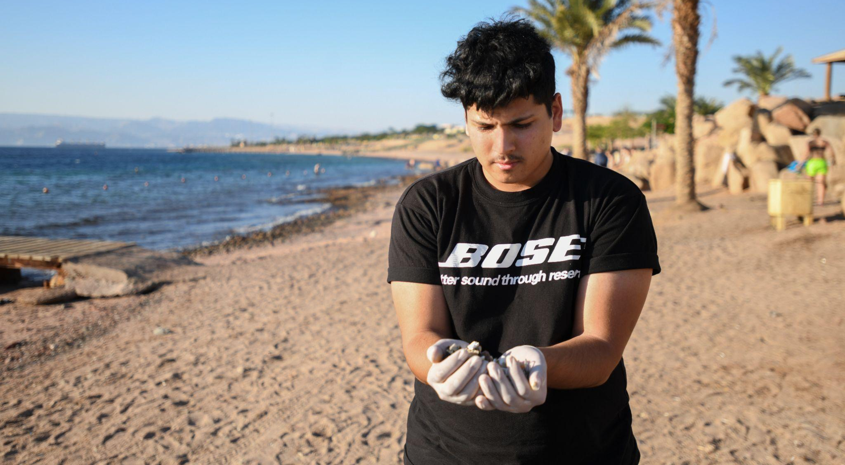
ACTIVITY 2 HOW DOES
CLIMATE CHANGE AFFECT CHILDREN’S
RIGHTS?
“We have a responsibility to our environment," says UNICEF-supported Youth Climate Leader Hamam, 20, who lives in Aqaba, a port city in Jordan. His family used to come to the beach every day, but now it's usually too hot here in the day time.
© UNICEF/Bseiso

Slide 2
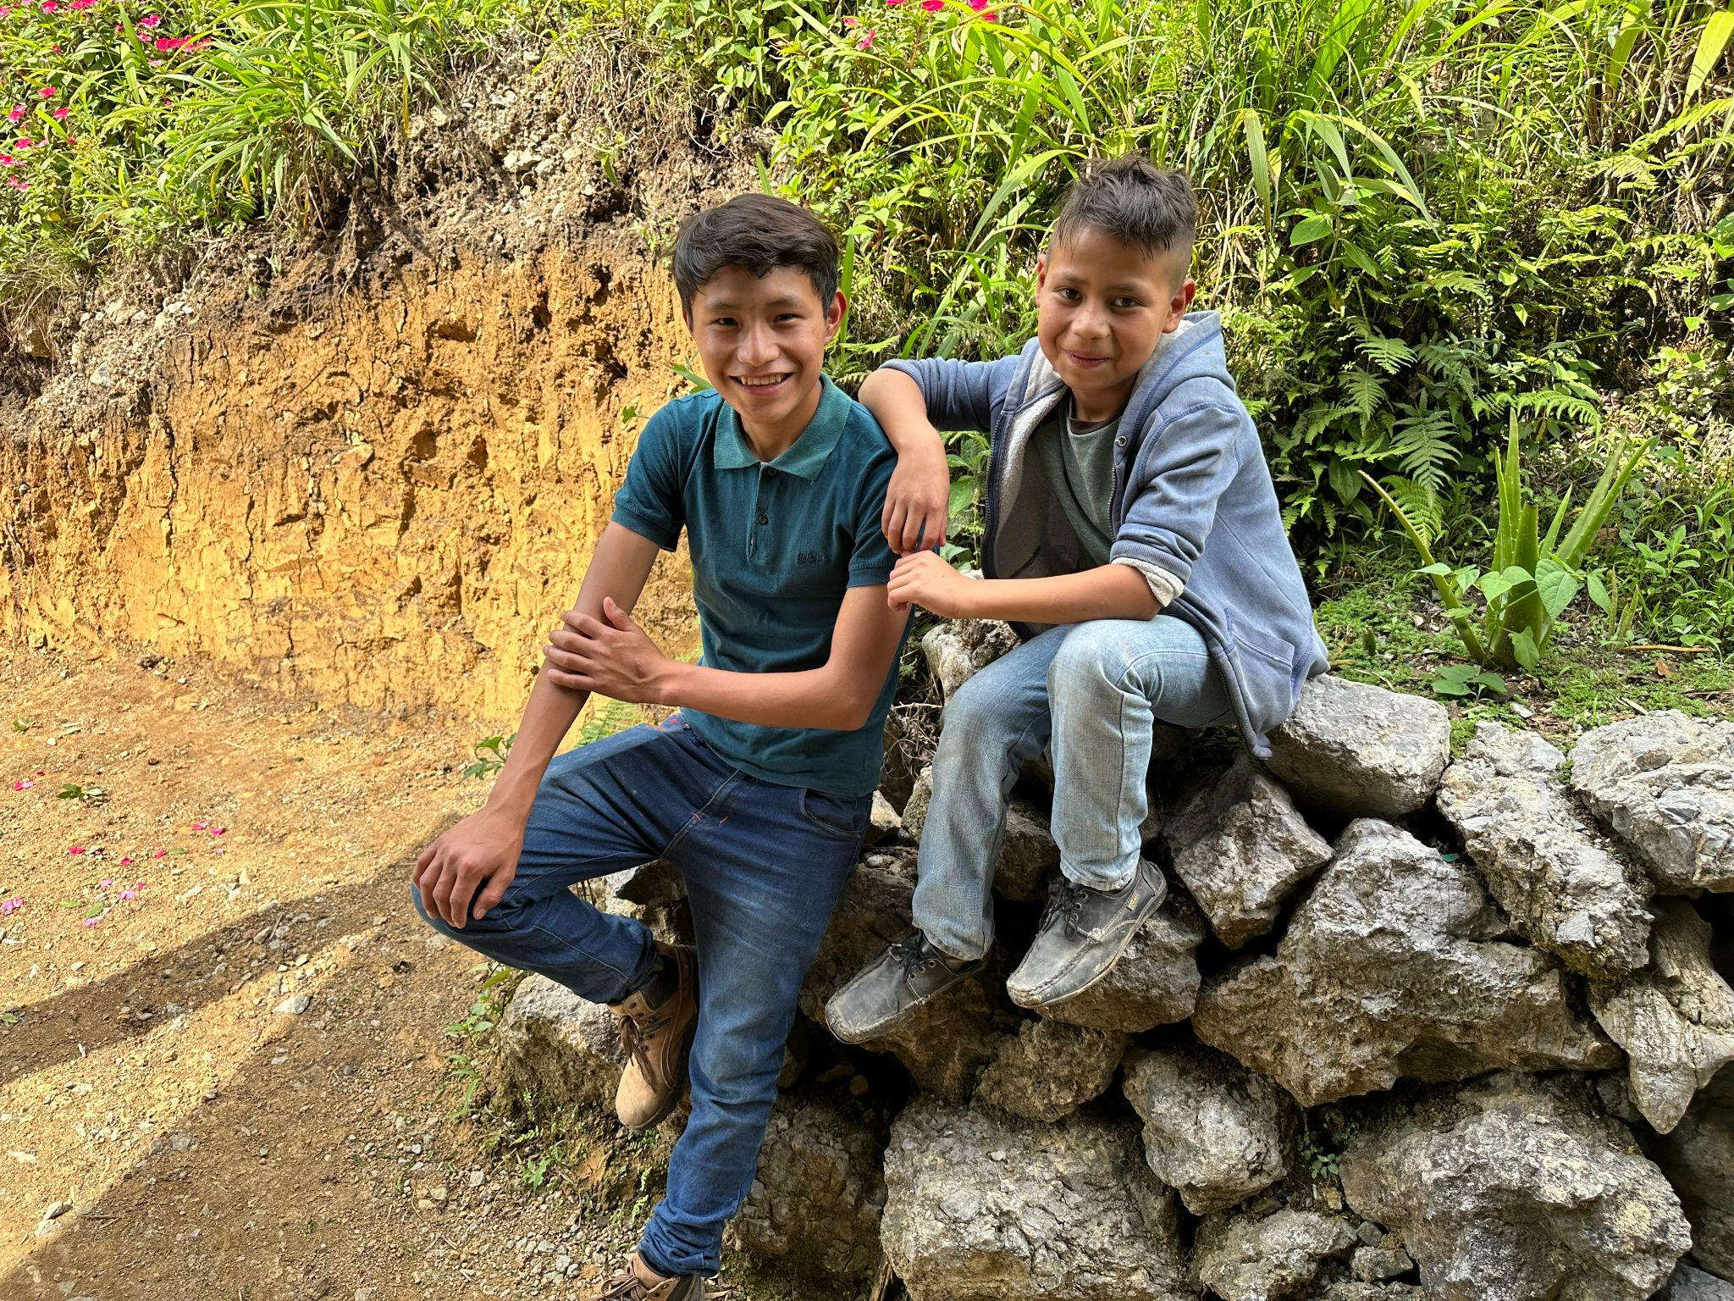
Part 1
RIGHTS
SUMMARY
13-year-old friends smile for the camera in Alta Verapaz, Guatemala, in March 2023.
© UNICEF/Baldizion

Slide 3
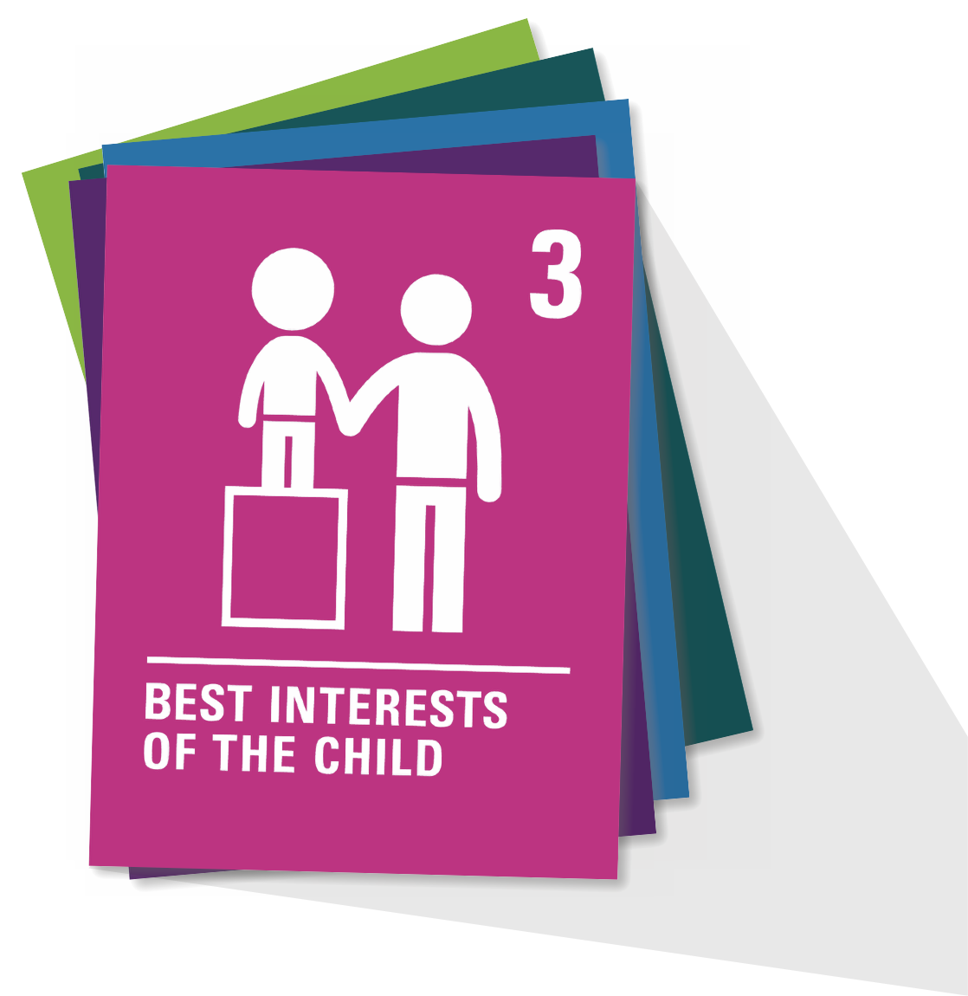
ARTICLE 3
Article 3
When adults make decisions, they should think about how their decisions will affect children. All adults should do what is best for children.
Governments should make sure children are protected and looked after by their parents, or by other people when this is needed.
Governments should make sure that people and places responsible for looking after children are doing a good job.

Slide 4
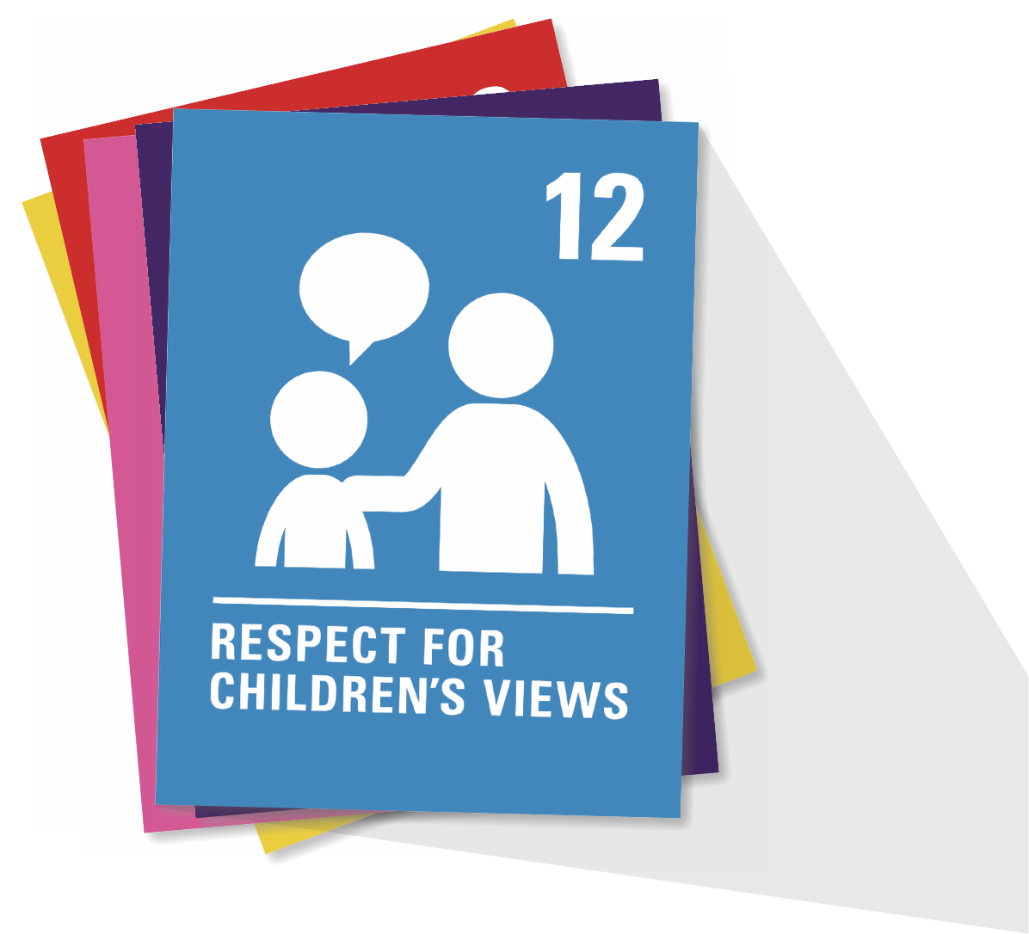
ARTICLE 12
Every child has the right to express their views, feelings and wishes in all matters affecting them, and to have their views considered and taken seriously. This right applies at all times, for example, during immigration proceedings, housing decisions or the child’s day-to-day home life.

Slide 5
ARTICLE 13
Every child must be free to express their thoughts and opinions and to access all kinds of information, as long as it is within the law.

Slide 6
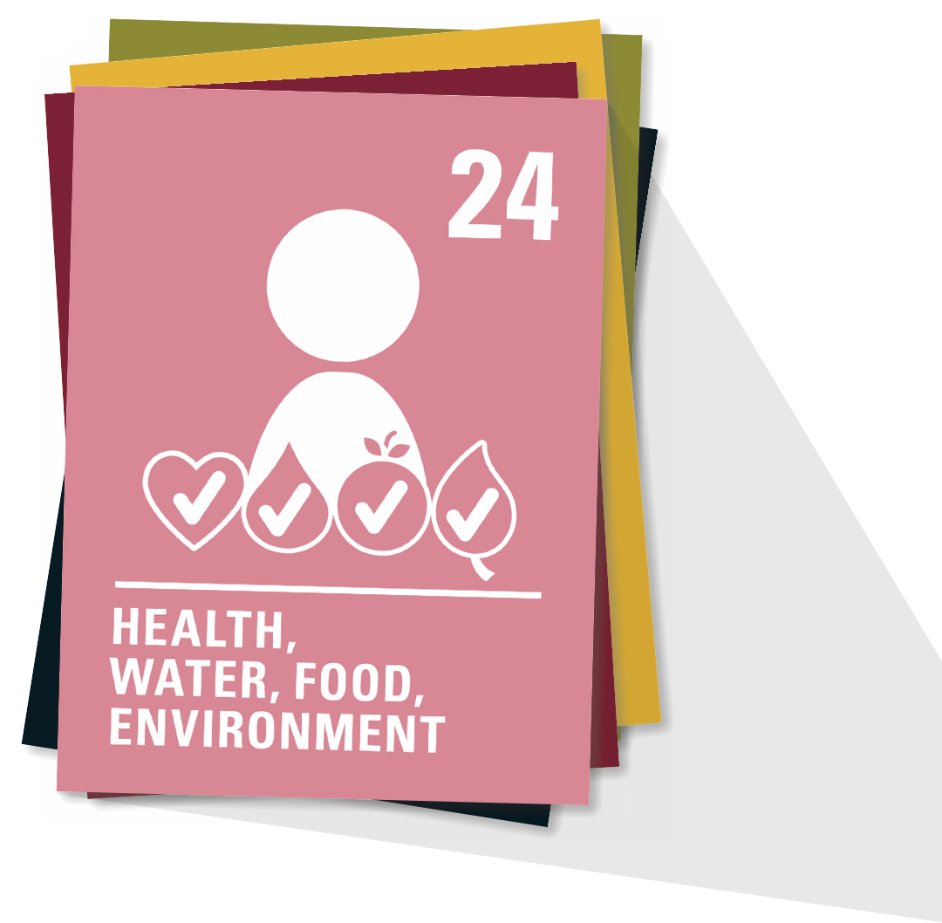
ARTICLE 24
Every child has the right to the best possible health. Governments must provide good quality healthcare, clean water, nutritious food and a clean environment and education on health and wellbeing so that children can stay healthy. Richer countries must help poorer countries achieve this.

Slide 7
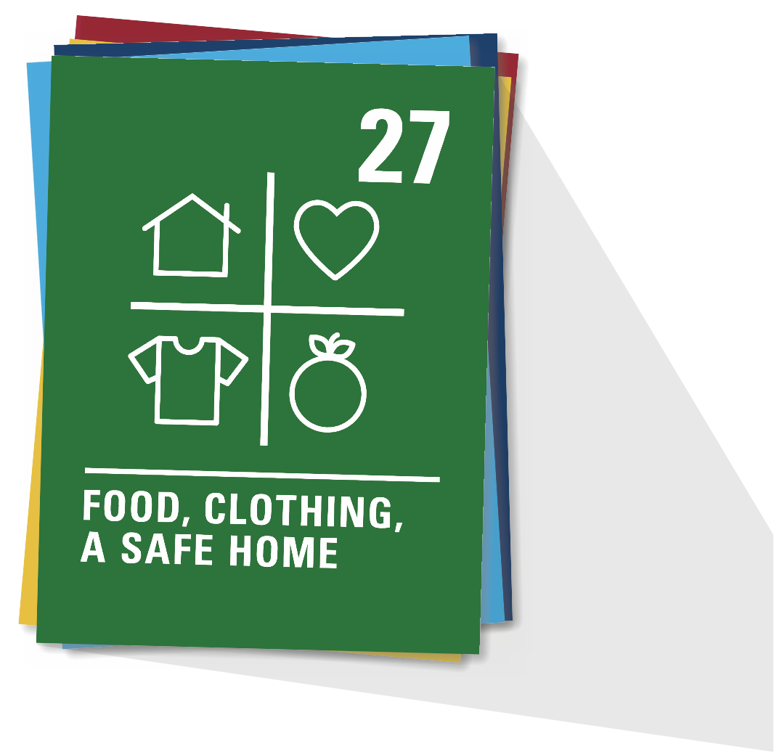
ARTICLE 27
Every child has the right to a standard of living that is good enough to meet their physical and social needs and support their development. Governments must help families who cannot afford to provide this.

Slide 8
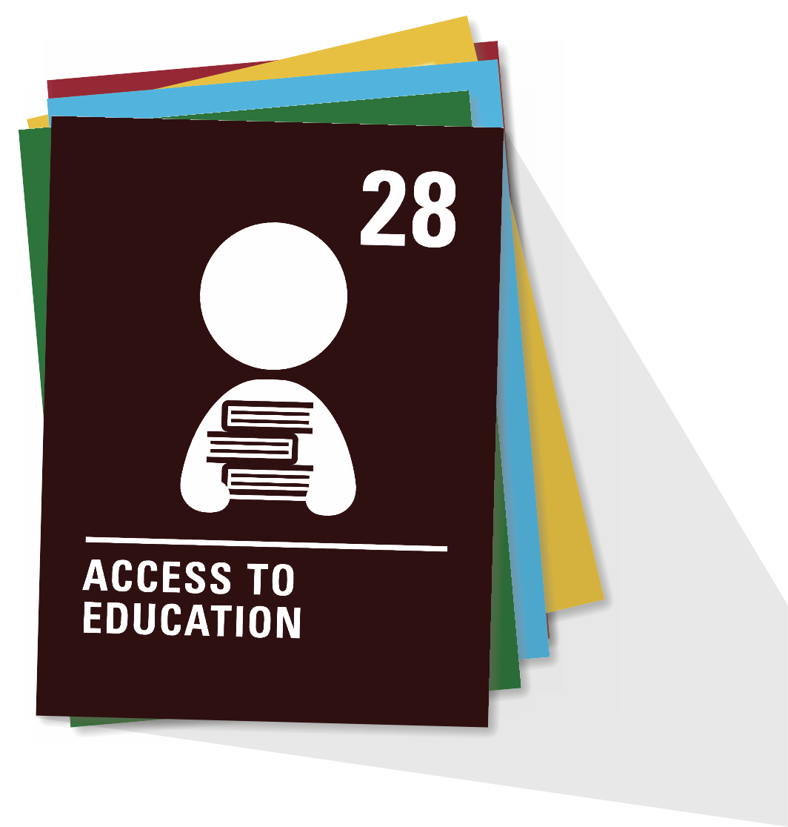
ARTICLE 28
Every child has the right to an education. Primary education must be free and different forms of secondary education must be available to every child. Discipline in schools must respect children’s dignity and their rights. Richer countries must help poorer countries achieve this.

Slide 9
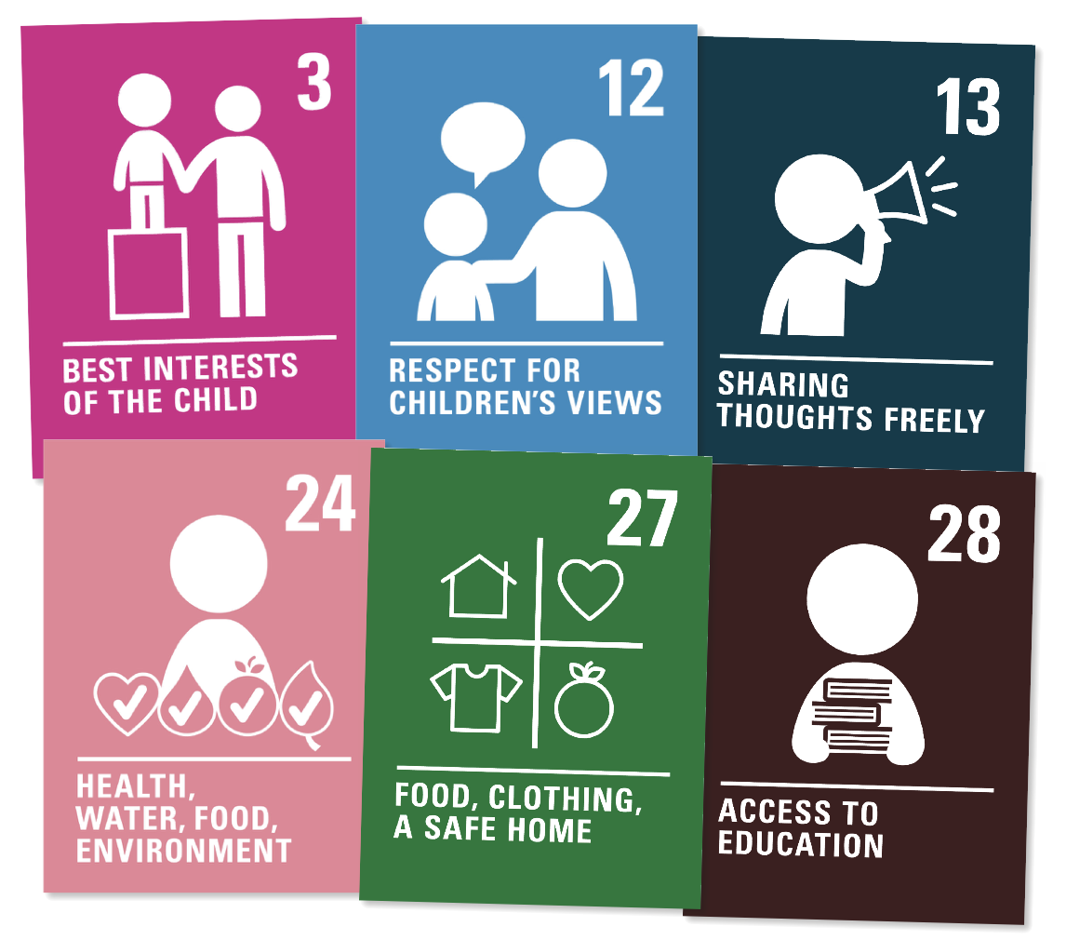
ARTICLE 3 ARTICLE 12
ARTICLE 13
ARTICLE 24
ARTICLE 27
ARTICLE 28
How do you think these six articles could be linked to climate change?

Slide 10
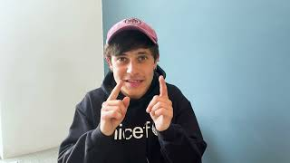
Part 2
SPEAKING OUT ON RIGHTS
A welcome message from Cel Spellman

Slide 11
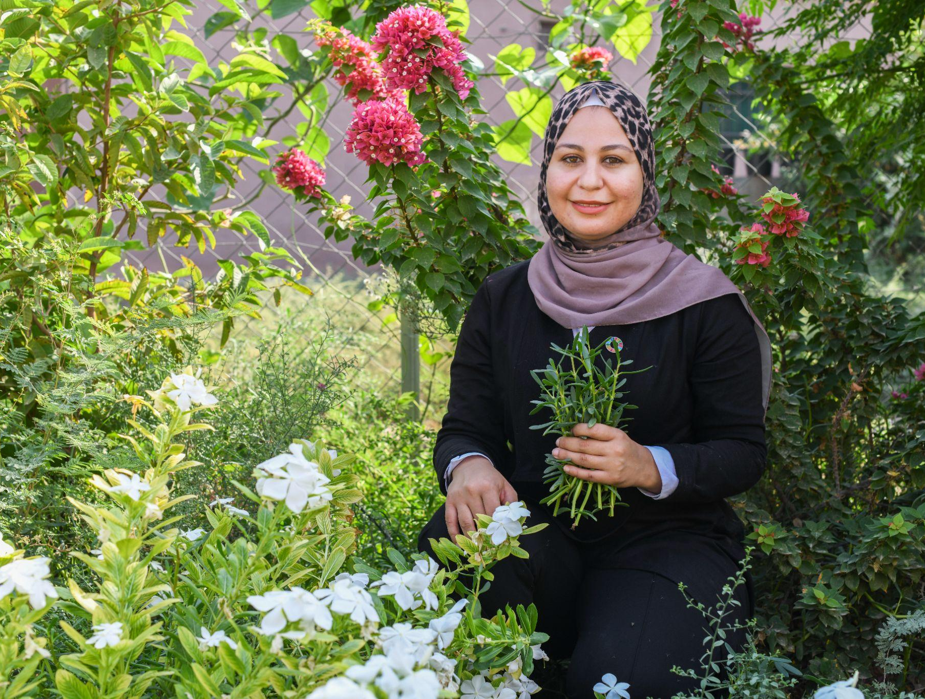
Part 3
OVER TO YOU
Linking the key rights to climate change
"Climate change makes me very sad... my family can’t grow the same products on our farm," says Sally, 28, a UNICEF-supported Youth Climate Leader from Balqa, Jordan, who has had specialised advocacy training in climate action.
© UNICEF/Bseiso

