Slide 1
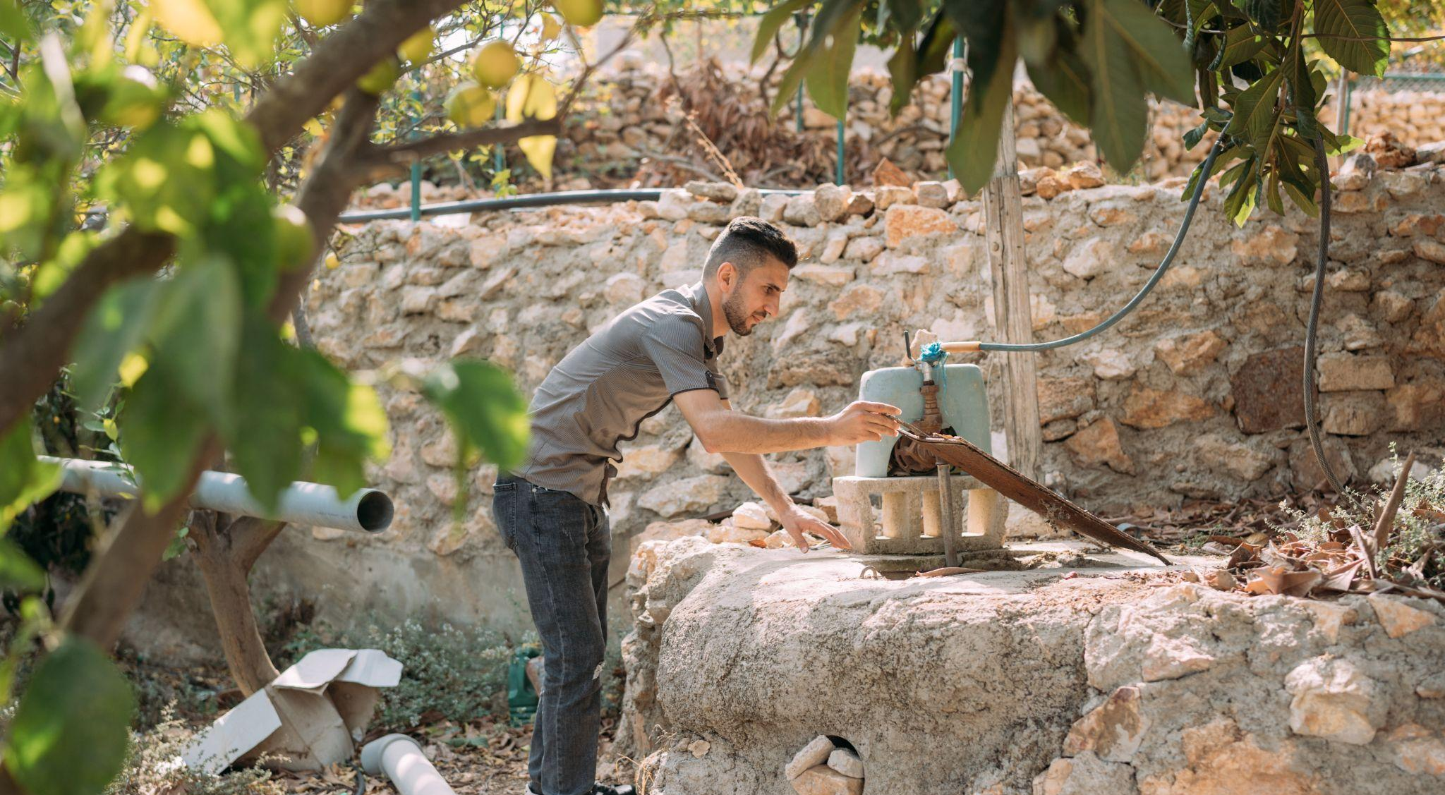
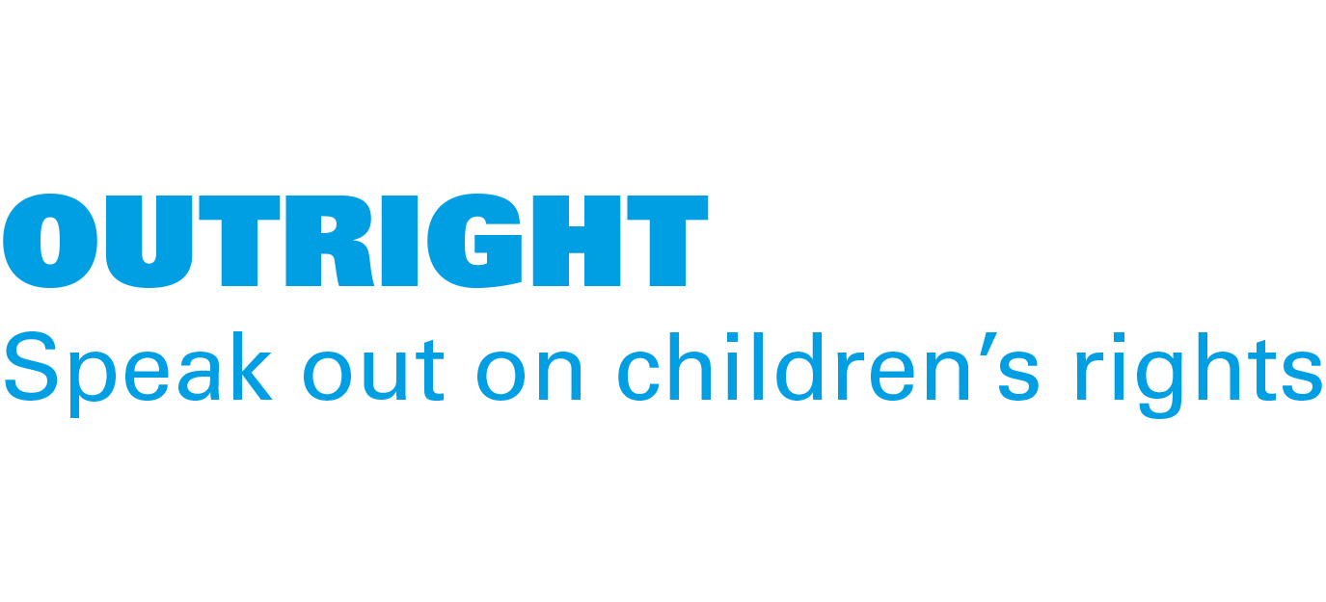
ACTIVITY 3 CLIMATE CHANGE AND ADAPTATION
Ahmad, 29, from Ajloun in Jordan, is a UNICEF-supported Youth Climate Leader.
© UNICEF/Al-Safadi

Slide 2
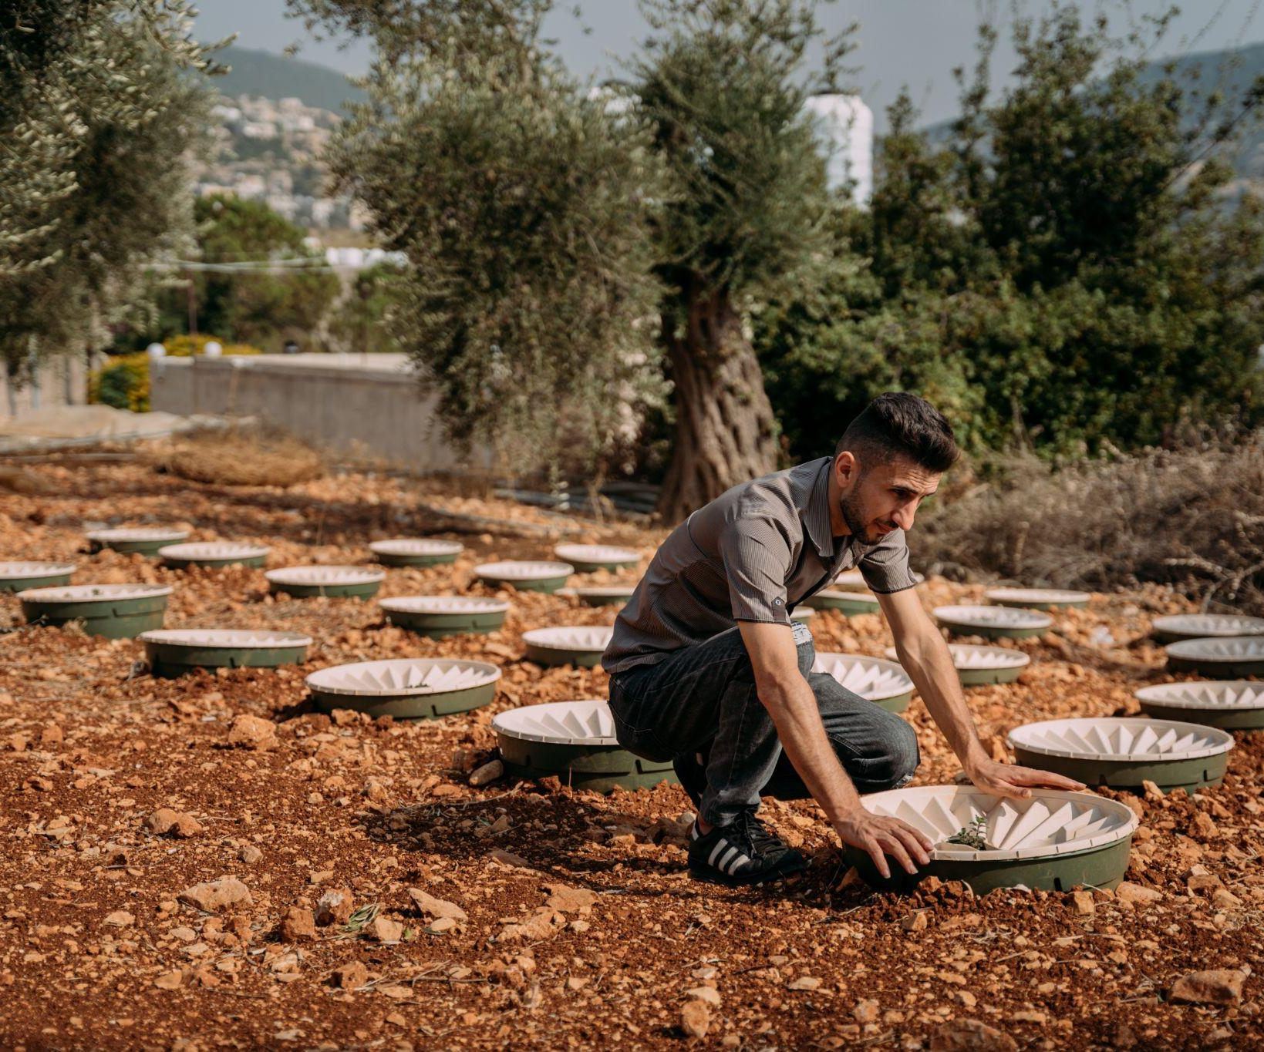
Part 1
© UNICEF/Al-Safadi
TWO IMPORTANT KINDS OF CLIMATE ACTION
Mitigation: action to limit climate change.
For example, by reducing emissions of greenhouse gases or removing those gases from the atmosphere.
Adaptation: action to adjust to effects of climate change (now and in the future). For example, by protecting people/buildings/crops from floods.
Ahmed is training in climate action and has inspired his community with projects like the hydroponics he uses to reduce water consumption on his farm: "There are now six projects like mine in our area, all led by young people," he says.

Slide 3
Building barriers or sea walls on islands to protect houses from rising seas
Mitigation?
or
Adaptation?

Slide 4
Building barriers or sea walls on islands to protect houses from rising seas
Adaptation

Slide 5
Eating more meat and plant-based foods
Mitigation?
or
Adaptation?

Slide 6
Eating more meat and plant-based foods
Mitigation

Slide 7
Planting more trees
Mitigation?
or
Adaptation?

Slide 8
Planting more trees
If you’re planting them to capture carbon dioxide and release oxygen it’s mitigation
If you’re planting them along a river to act as a barrier for flooding it’s adaptation
Mitigation
Adaptation

Slide 9
MITIGATIONS
Government actions
Actions that help to limit climate change.
Corporate actions
Community actions
Individual actions

Slide 10
ADAPTATIONS
Government actions
Actions that help us live better and protect rights in the climate as it is now.
Corporate actions
Community actions
Individual actions

Slide 11
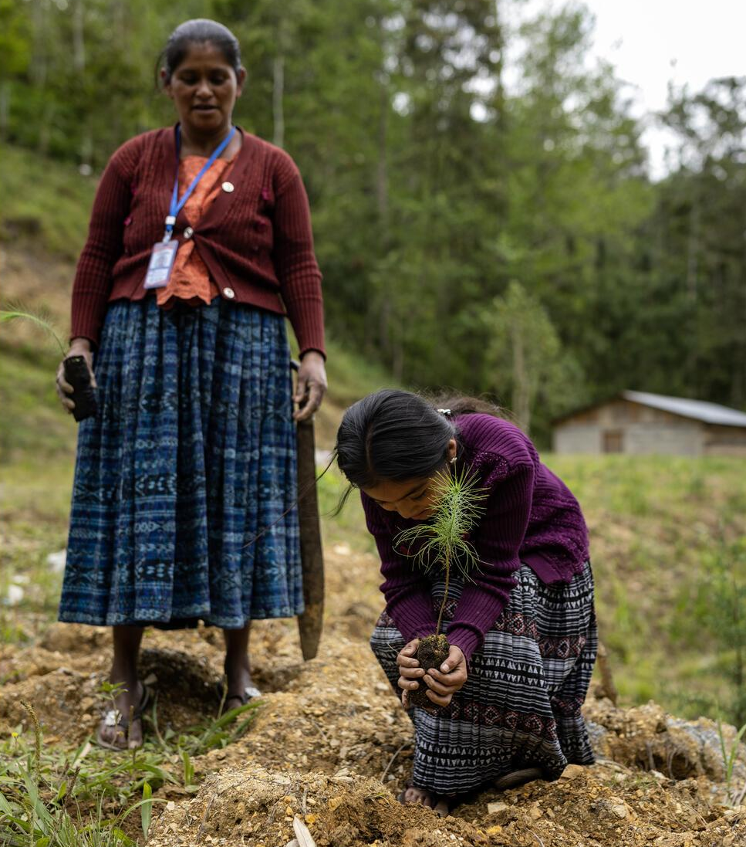
Part 2
© UNICEF/Quintero
ADAPTATIONS AROUND THE WORLD
A girl helps plant saplings in Alta Verapaz, Guatemala.

Slide 12
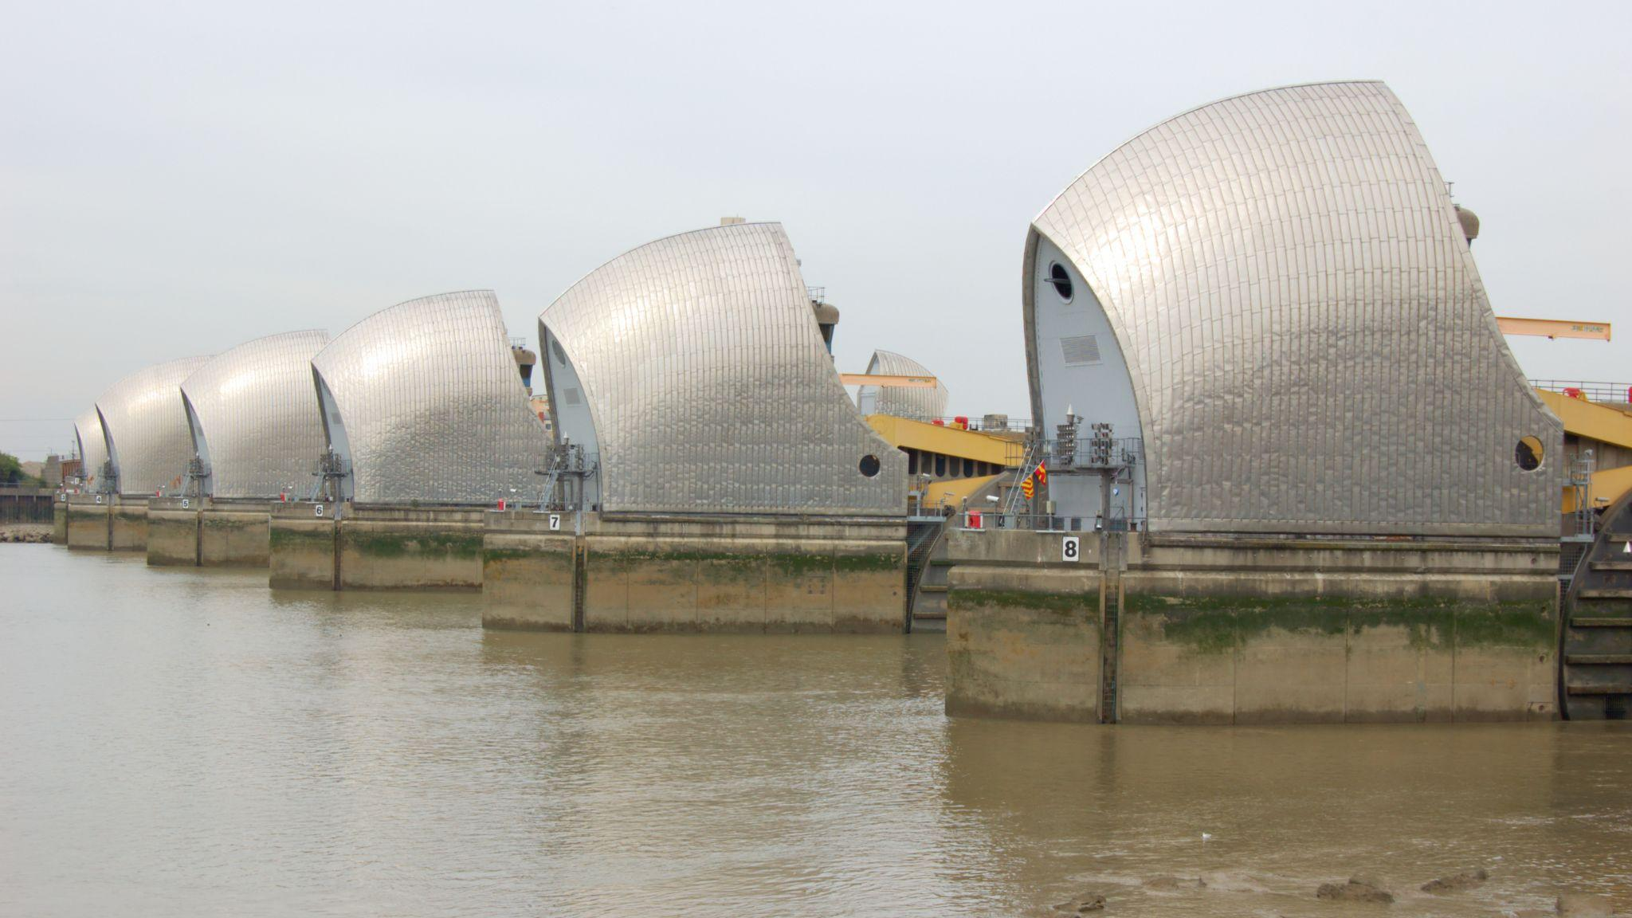
Thames River Barrier
Fact: the Thames River Barrier is one of the largest
movable flood control devices in the world.

Slide 13
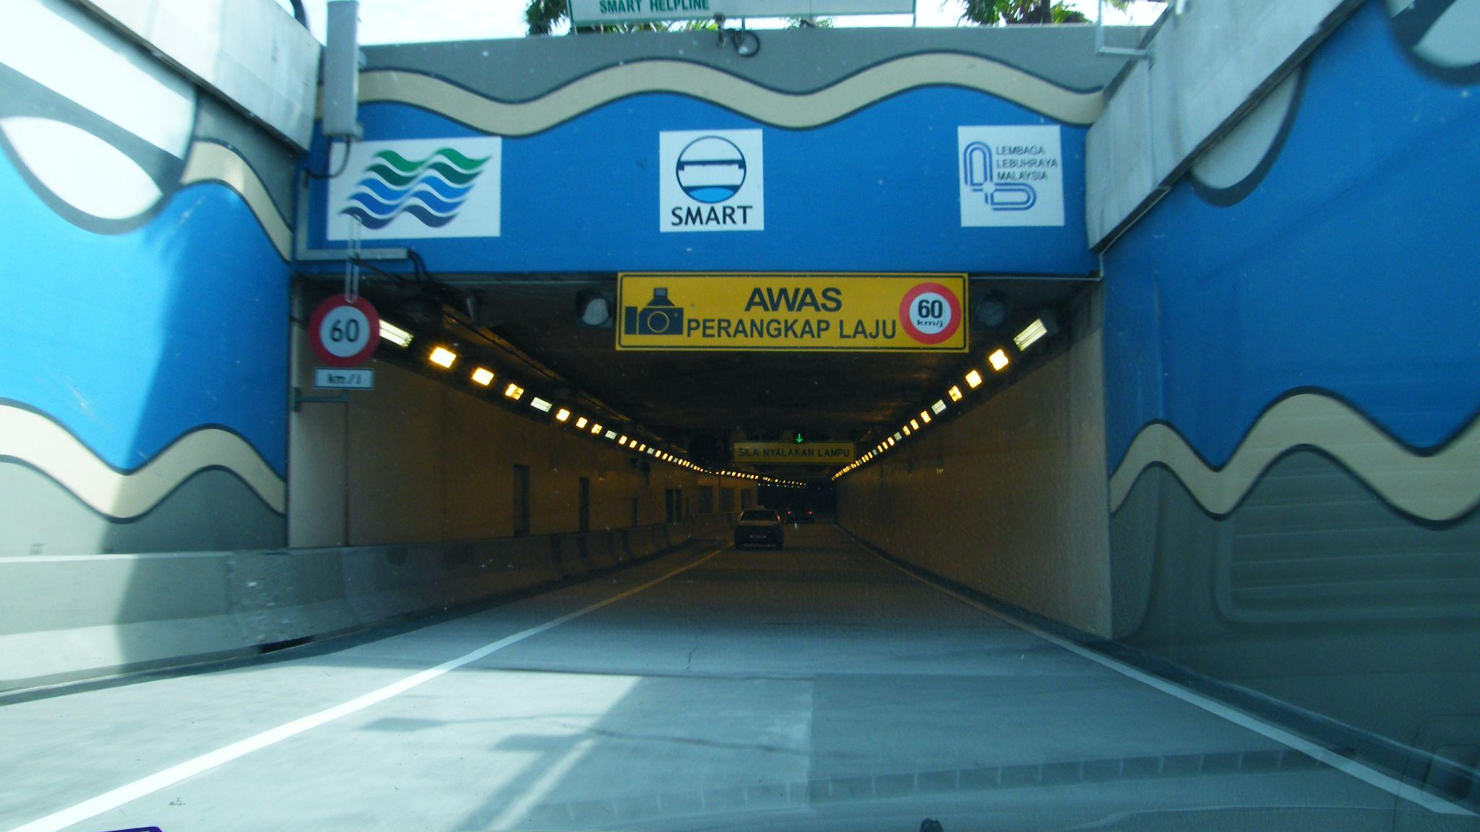
Malaysia’s SMART Tunnel
© www.flickr.com/photos/emrank
Fact: the longest tunnel in Southeast Asia – built to manage peak hour traffic and storm water.

Slide 14
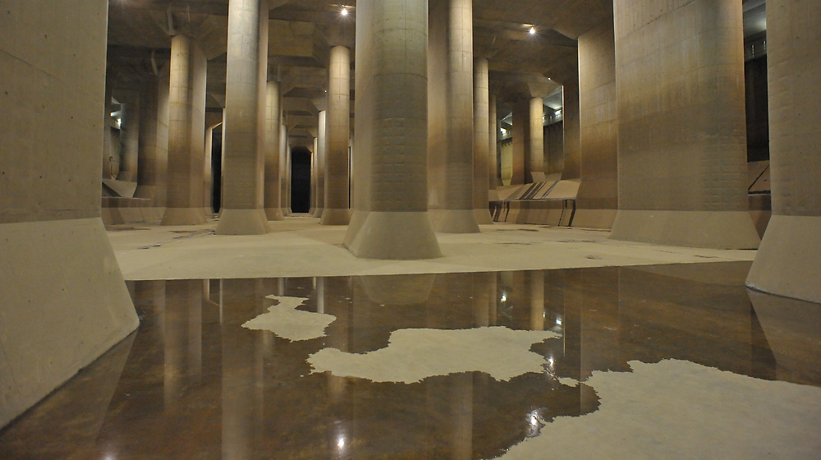
Disaster Prevention Underground Temple in Tokyo
Fact: the world’s largest human-made river is underneath the city of Tokyo to prevent flooding.

Slide 15
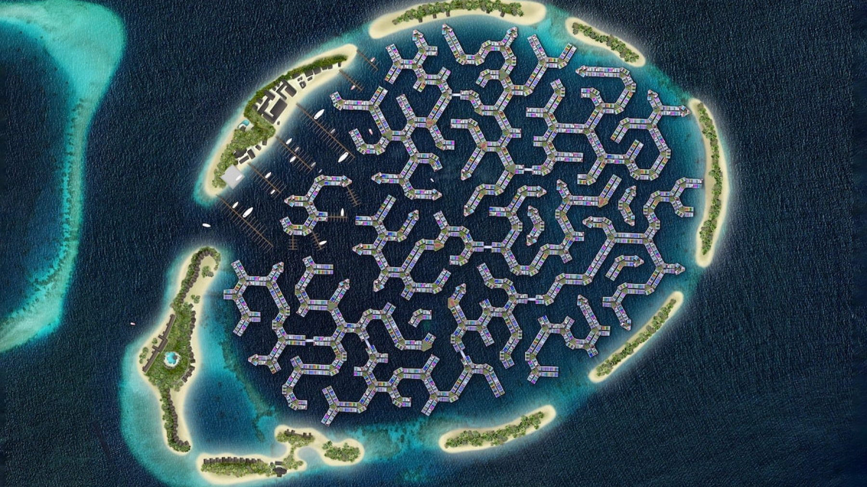
Adapting to rising sea levels in the Maldives
This is a computer-generated image of how the new city might look.
Fact: the Maldives will be home to the world’s first floating city

Slide 16
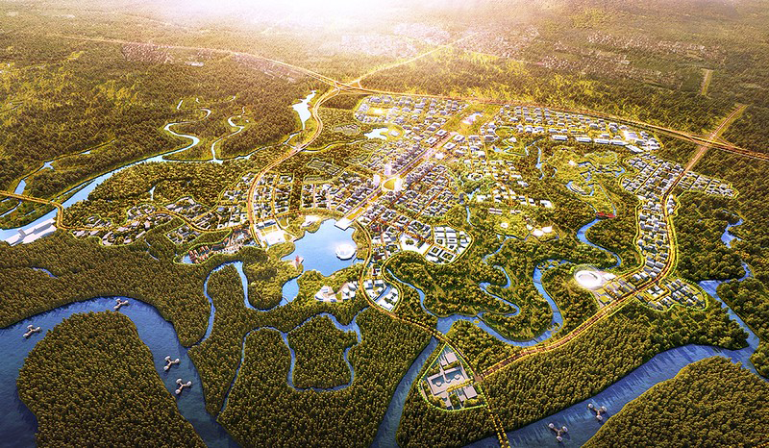
Nusantara: a future design for a capital city
This is a computer-generated image of how the new city might look.
Fact: Indonesia will have a new capital in 2024

Slide 17
Part 3
RESEARCH AND CREATE
1: Research and choose an adaptation you find interesting
2: Reflect. How does this adaptation help us live better in our changed climate? How are children’s rights better protected?
3: Create a poster to teach others about it.

Slide 18
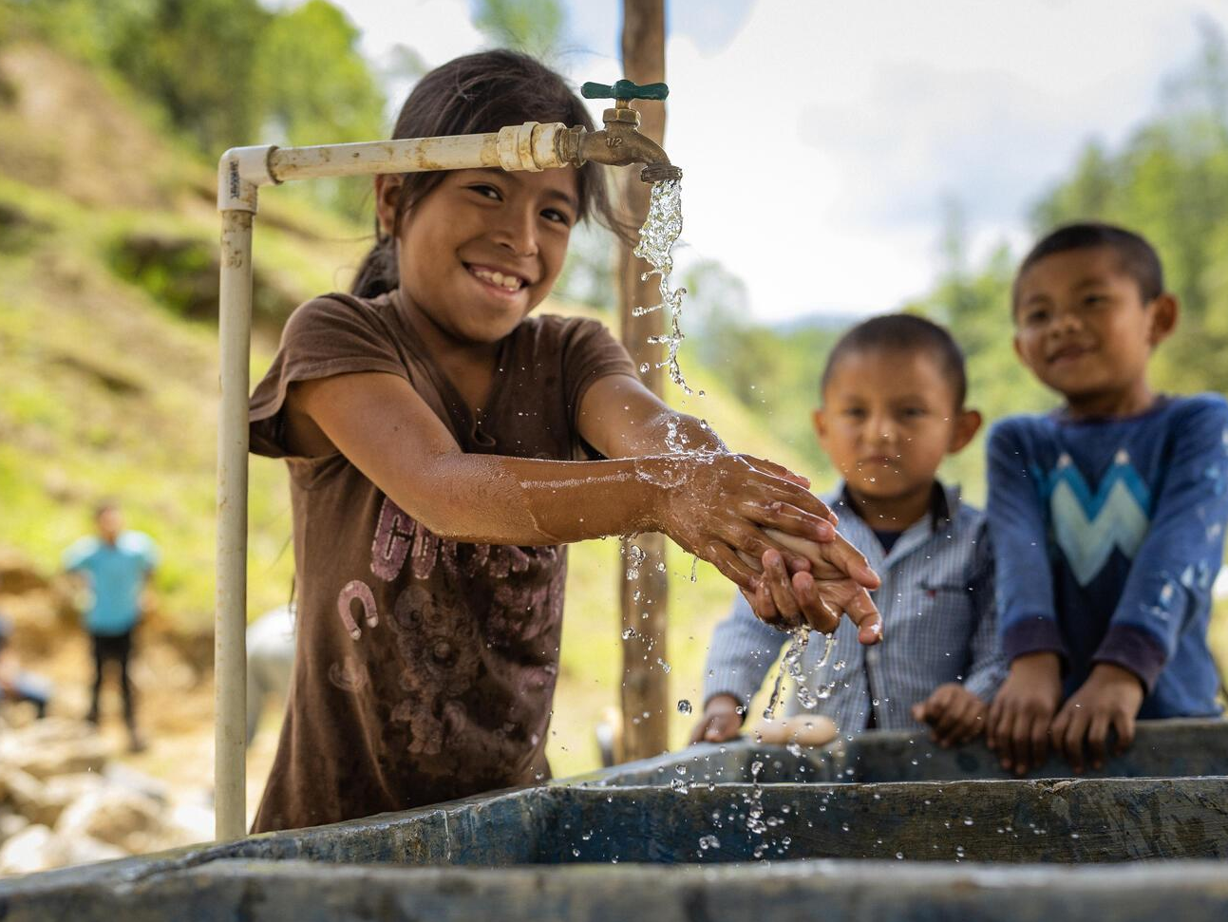
Part 4
© UNICEF/Quintero
WHOSE JOB IS IT?
Children wash their hands at a tap in Alta Verapaz, Guatemala.

Slide 19
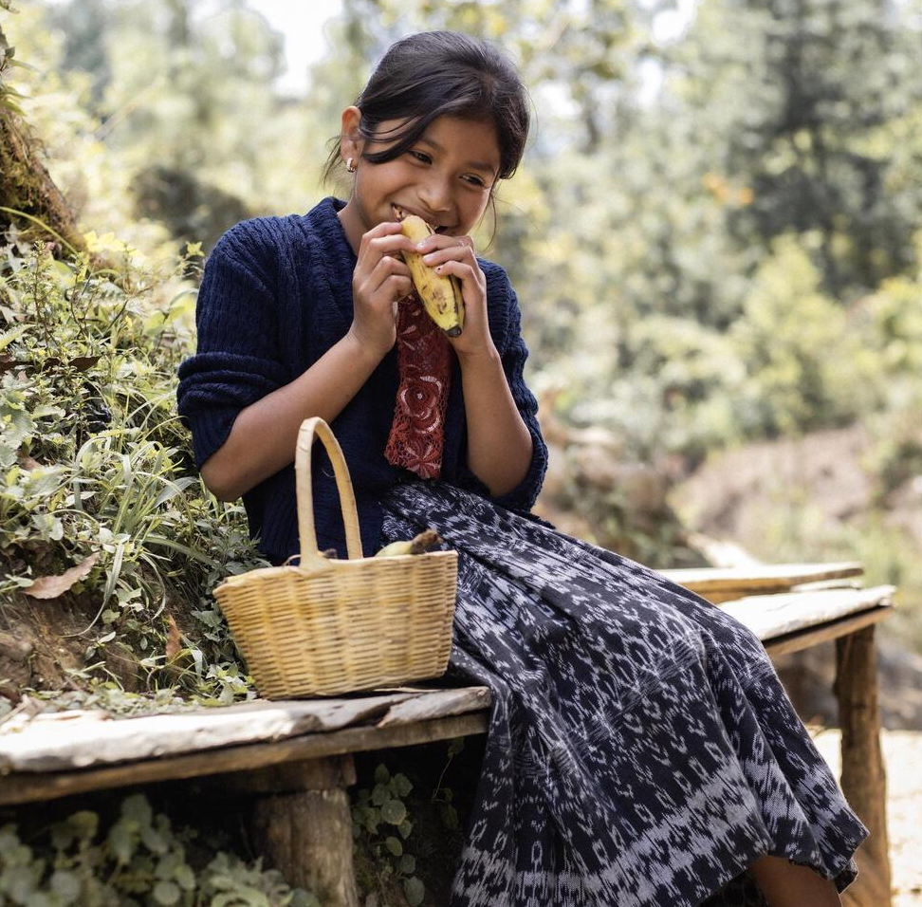
© UNICEF/Quintero
Who are the duty bearers who protect the rights of children?
A girl eats a banana on a bench in Alta Verapaz, Guatemala, a country with high rates of malnutrition.

Slide 20
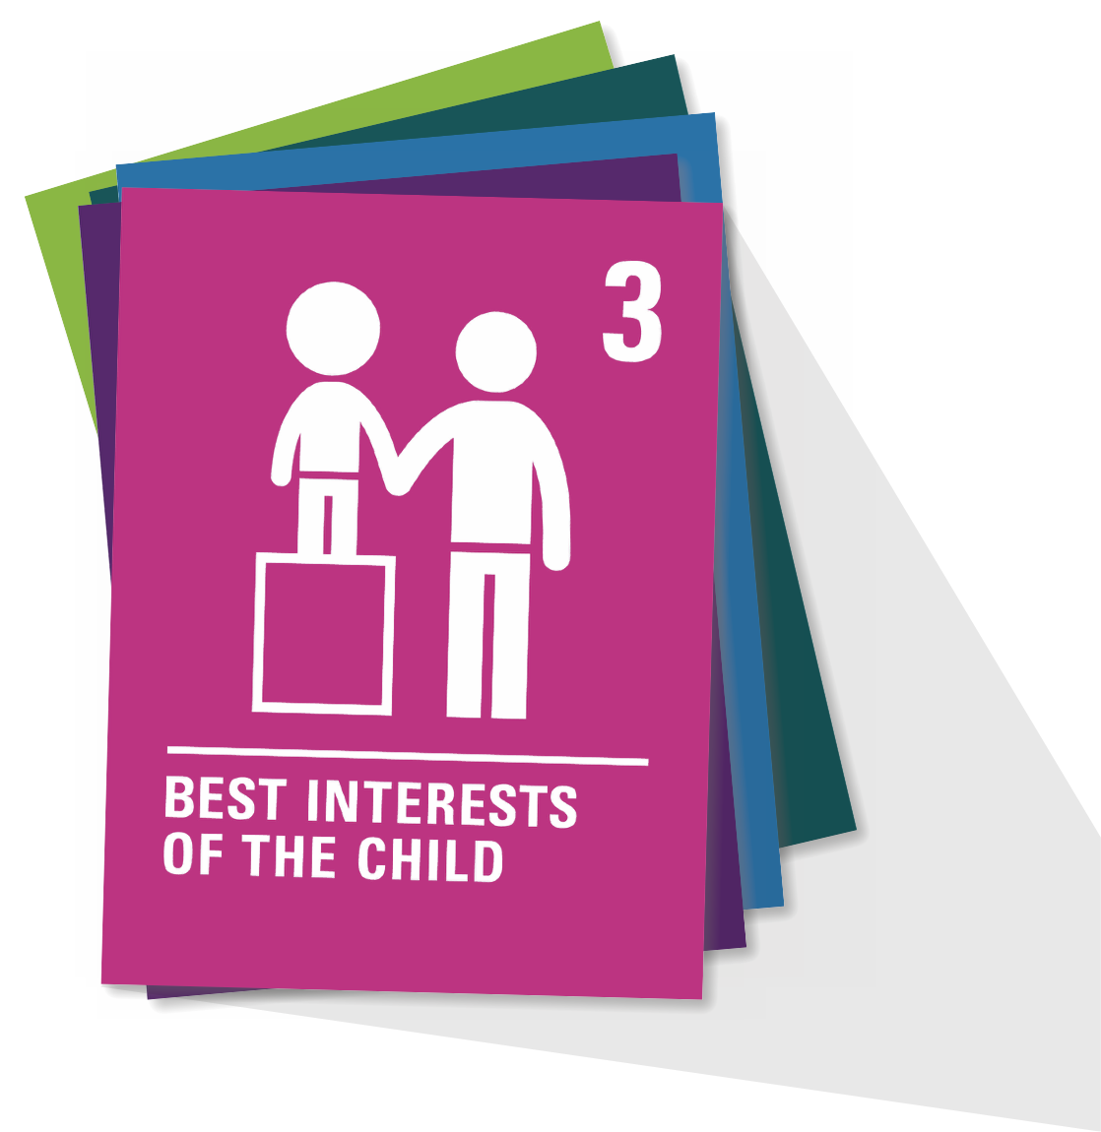
ARTICLE 3
Article 3
When adults make decisions, they should think about how their decisions will affect children. All adults should do what is best for children.
Governments should make sure children are protected and looked after by their parents, or by other people when this is needed.
Governments should make sure that people and places responsible for looking after children are doing a good job.

