Slide 1
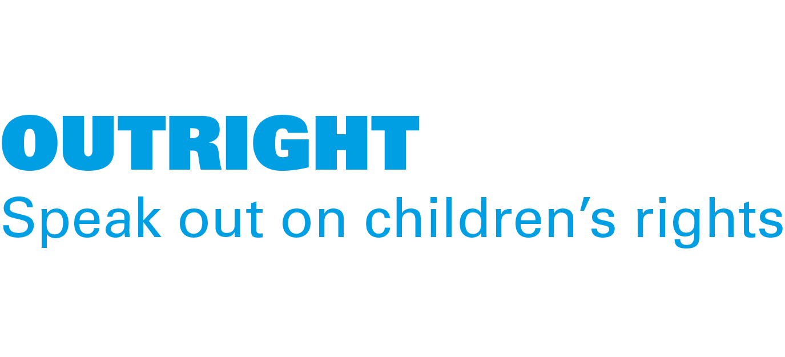
ACTIVITY 4 PROTECTING CHILDREN’S RIGHT TO CLEAN WATER IN A CHANGING CLIMATE
A woman and her teenage daughter on the rocks by a river, watching a waterfall, in Alta Verapaz, Guatemala, in March 2023.
© UNICEF/Quintero

Slide 2
Part 1
© UNICEF/Quintero
REVIEWING
YOUR RIGHTS
A girl stands in the branches of a tree in Alta Verapaz, Guatemala, in March 2023. The country faces the highest disaster risk in Latin America.
© P&Co. Ltd./SC 2023

Slide 3
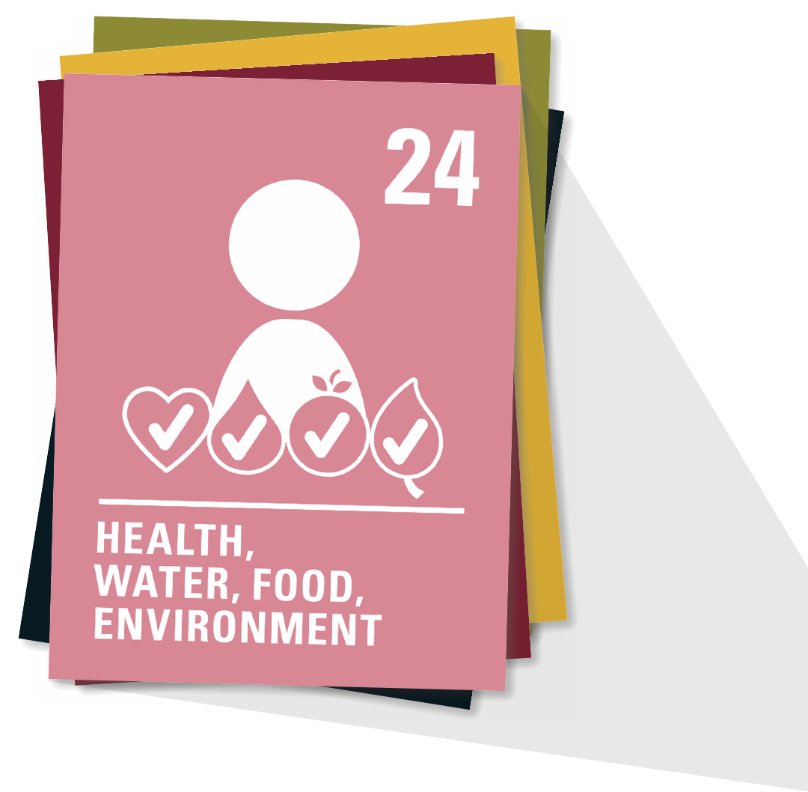
ARTICLE 24
Every child has the right to the best possible health. Governments must provide good quality healthcare, clean water, nutritious food and a clean environment and education on health and wellbeing so that children can stay healthy. Richer countries must help poorer countries achieve this.

Slide 4
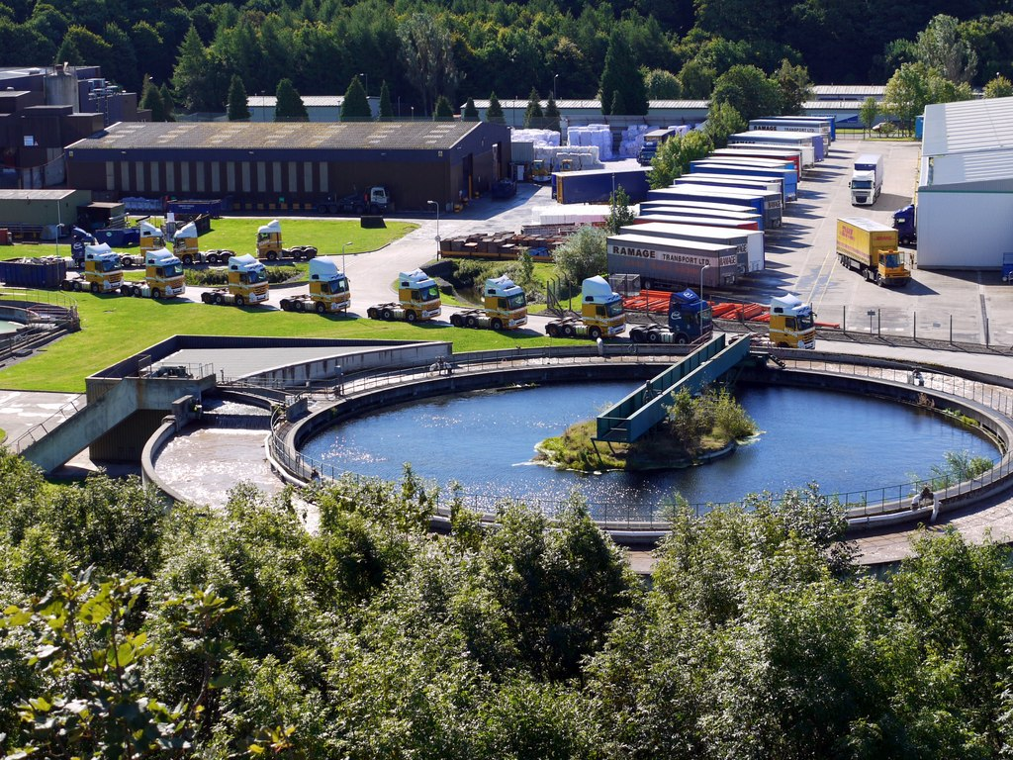
Part 2
WHERE DOES OUR WATER COME FROM?
Waste water treatment works and transport depot, Low Prudhoe
© P&Co. Ltd./SC 2023
© Andrew Curtis

Slide 5
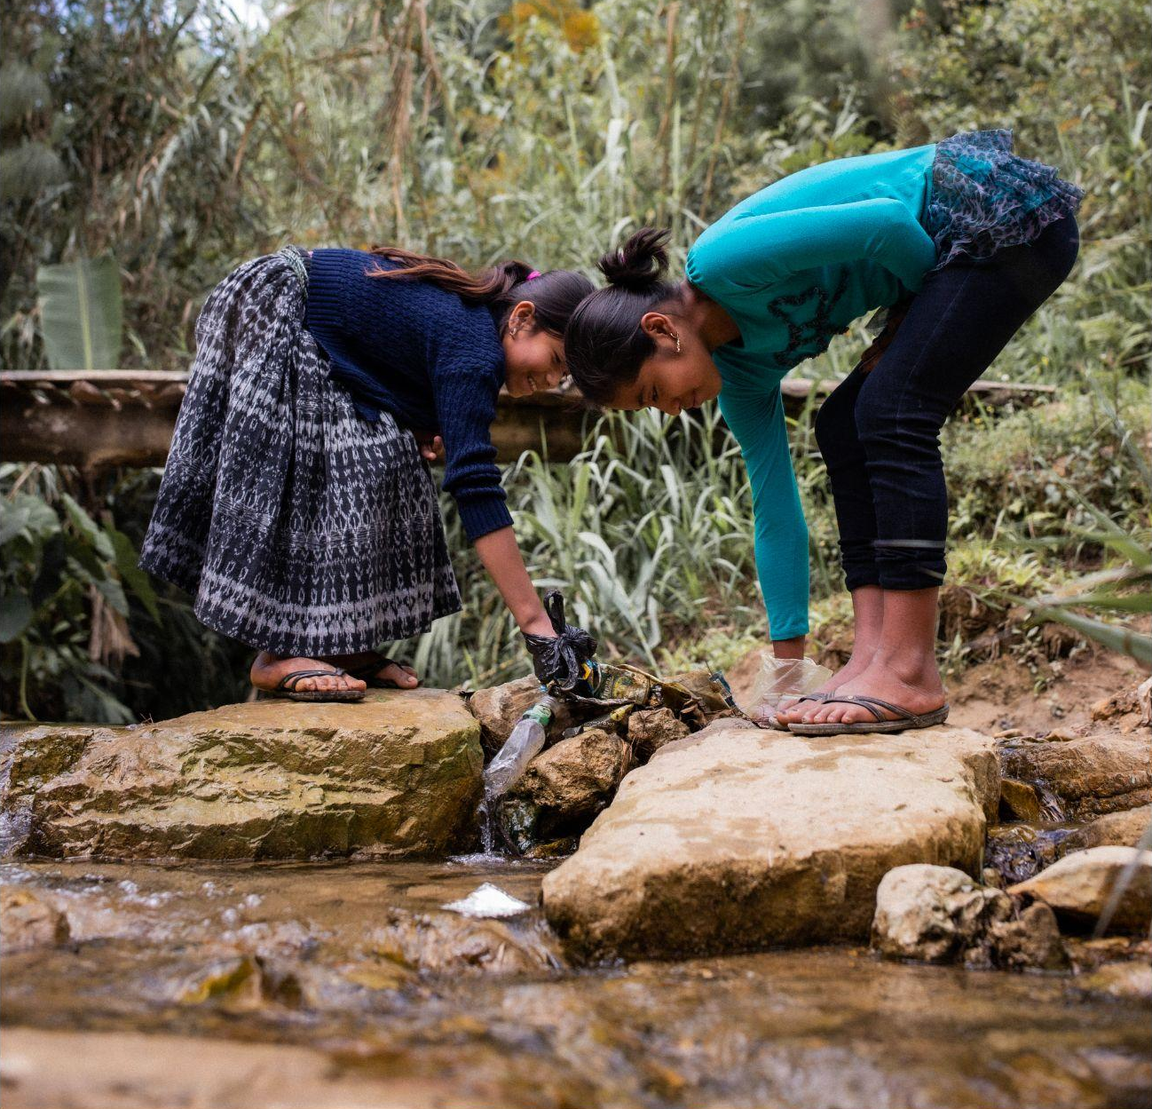
Part 3
TOO MUCH, TOO LITTLE, TOO DIRTY:
The global effects of climate on water
Two girls pick up rubbish from a river in Alta Verapaz, Guatemala.
© UNICEF/Quintero

Slide 6
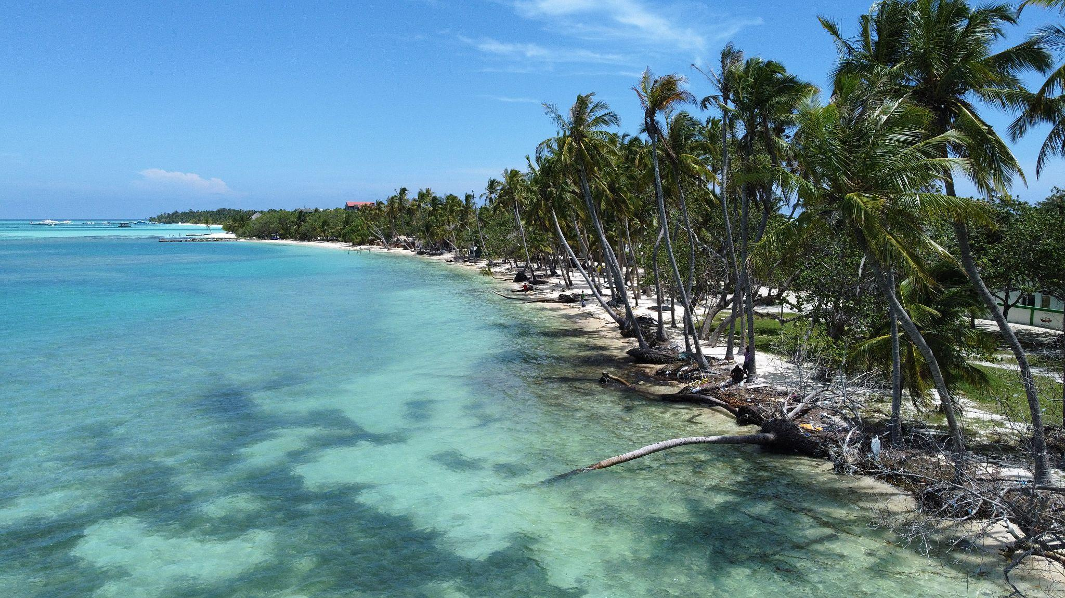
Too much: flooding in Maldives
© UNICEF/Faheem
A stretch of severely eroded beach affected by rising sea levels in Dhiffushi island in the Maldives.

Slide 7
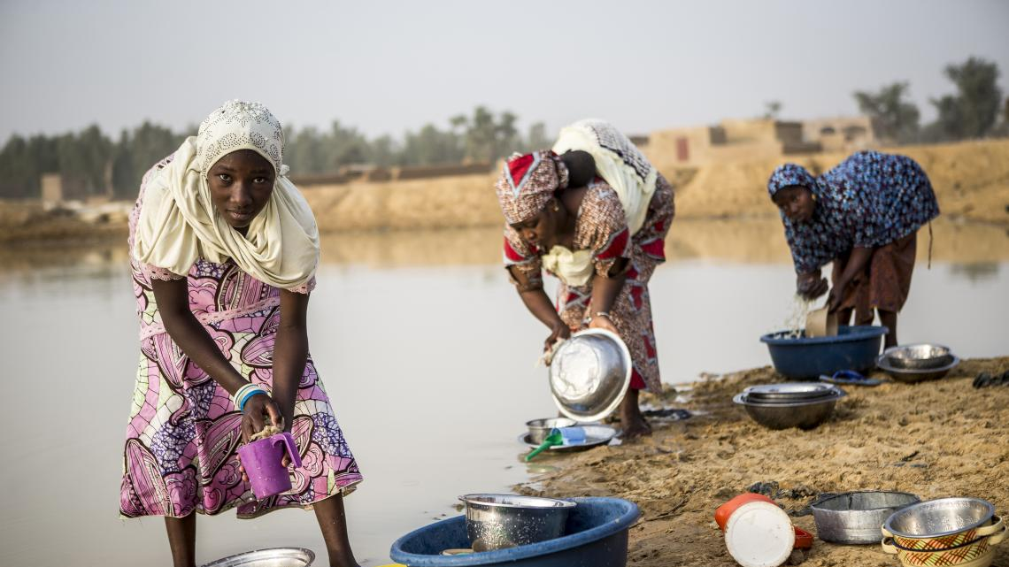
Too little: drought in Mali
© UNICEF/Keïta
Fatoumata, 13, with other women and girls at a pond that was her village's only source of water until a UNICEF water pump was installed next to her school.

Slide 8
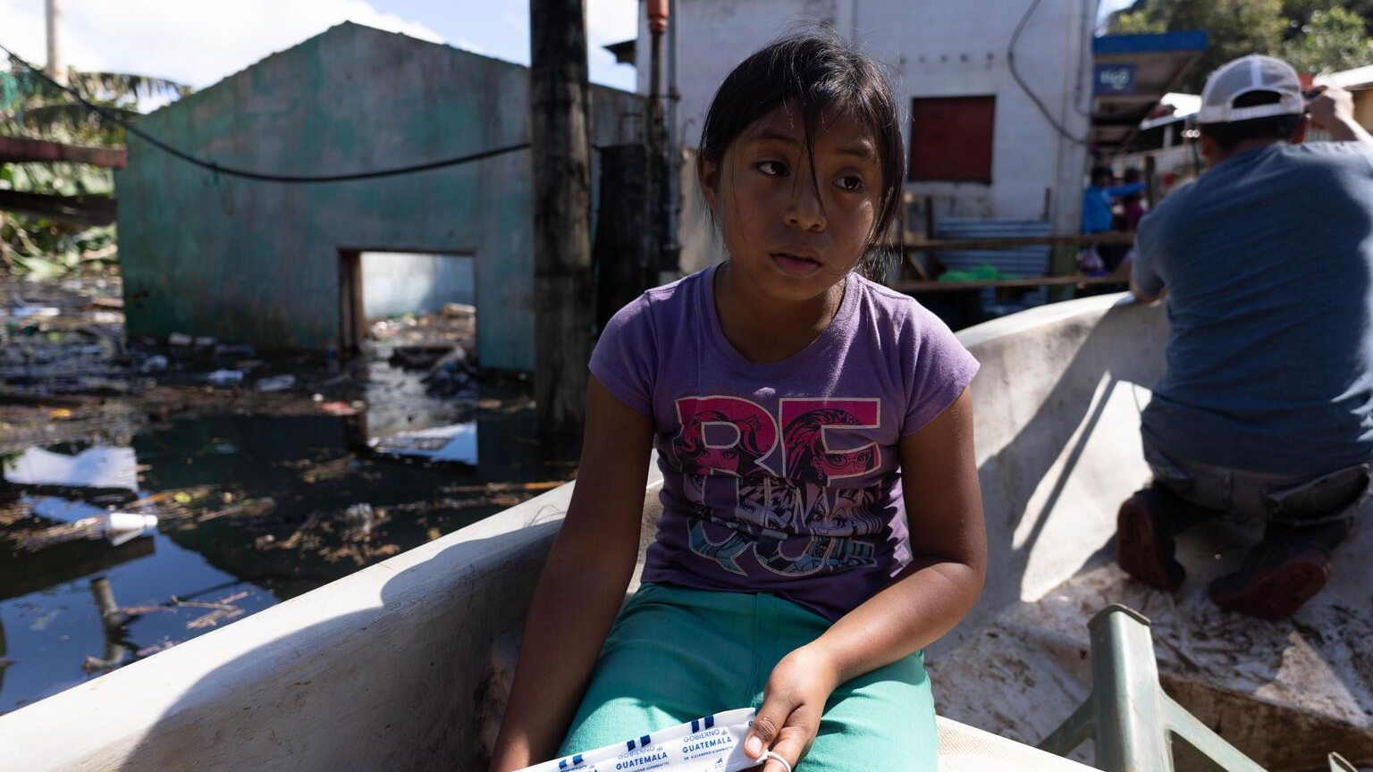
Too dirty: dirty water in Guatemala
In November 2020 hurricanes Eta and Lota struck Guatemala. Juana, 9, travels in a boat to where her school used to be before the hurricanes left her town under water.
© UNICEF/Billy/AFP-Services

Slide 9
Part 4
What new things did you learn about the countries we visited?
WRITE A LETTER
What questions would you ask the children and young people in this place if you were given the chance?

Slide 10
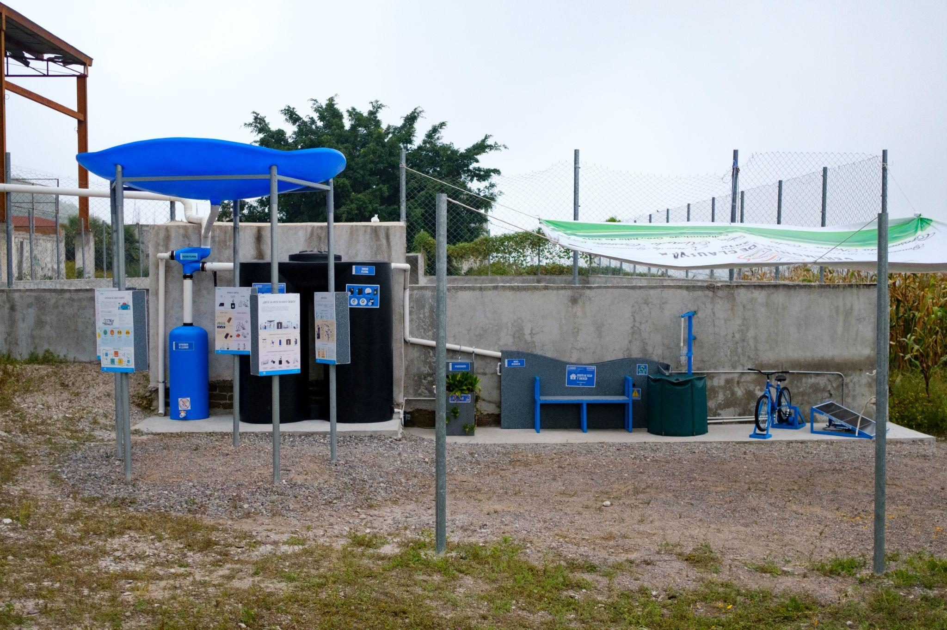
Part 5
INNOVATIVE ADAPTATION
© UNICEF/Balam-Ha'
La Casita del Agua y la Energia (the House of Water and Energy) is a rainwater harvesting and filtration system developed by UNICEF and its partners with schoolchildren and their communities in Mexico.

Slide 11
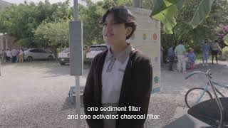
MEXICO
The House of Water and Energy

Slide 12
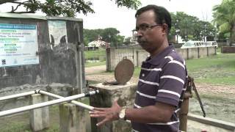
BANGLADESH
Storing water underground to protect resources

Slide 13
Part 6
© UNICEF/Quintero
WRAP-UP DISCUSSION
Children play at a waterfall, in Alta Verapaz, Guatemala, in March 2023.

