Slide 1
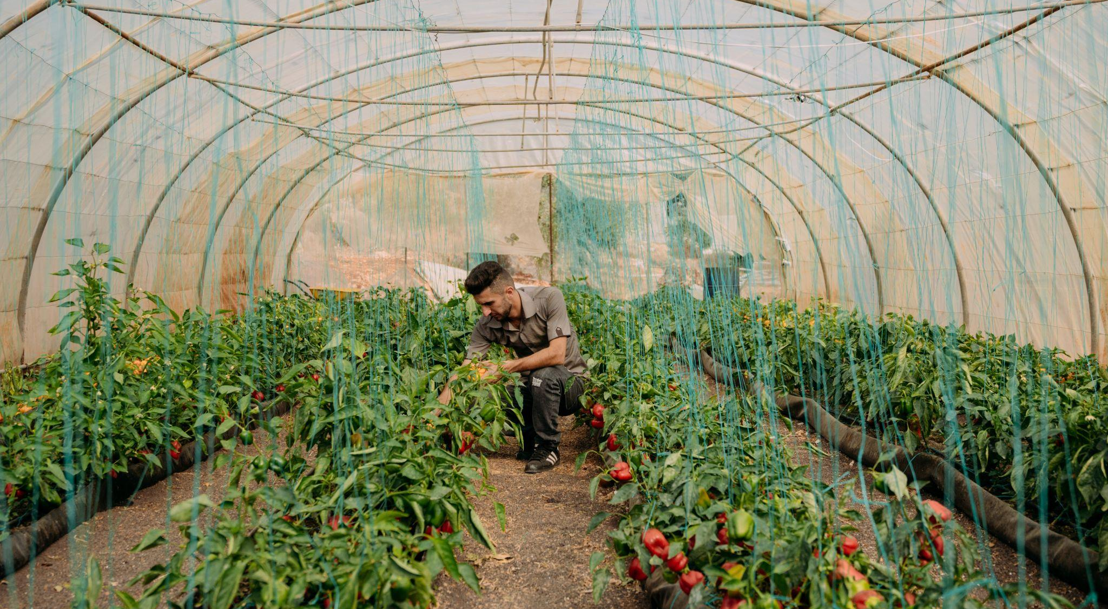
ACTIVITY 5 THE KNOCK-ON EFFECTS OF CLIMATE CHANGE TO HEALTH, NUTRITION AND ENVIRONMENT
Climate change has led to higher temperatures and lower rainfall in Jordan. Ahmed is a UNICEF-supported Climate Leader here and uses hydroponics to grow his crops.
© UNICEF/Qadari

Slide 2
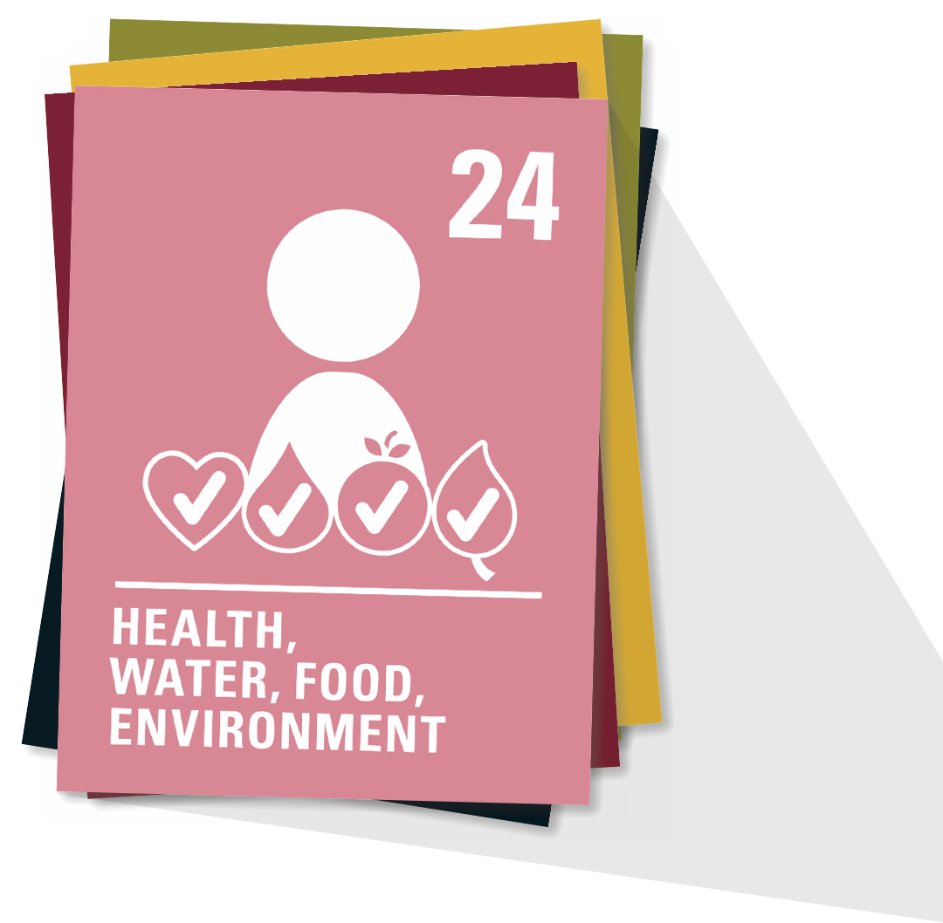
ARTICLE 24
Health and health services
Every child has the right to the best possible health. Governments must provide good quality healthcare, clean water, nutritious food and a clean environment and education on health and wellbeing so that children can stay healthy. Richer countries must help poorer countries achieve this.

Slide 3
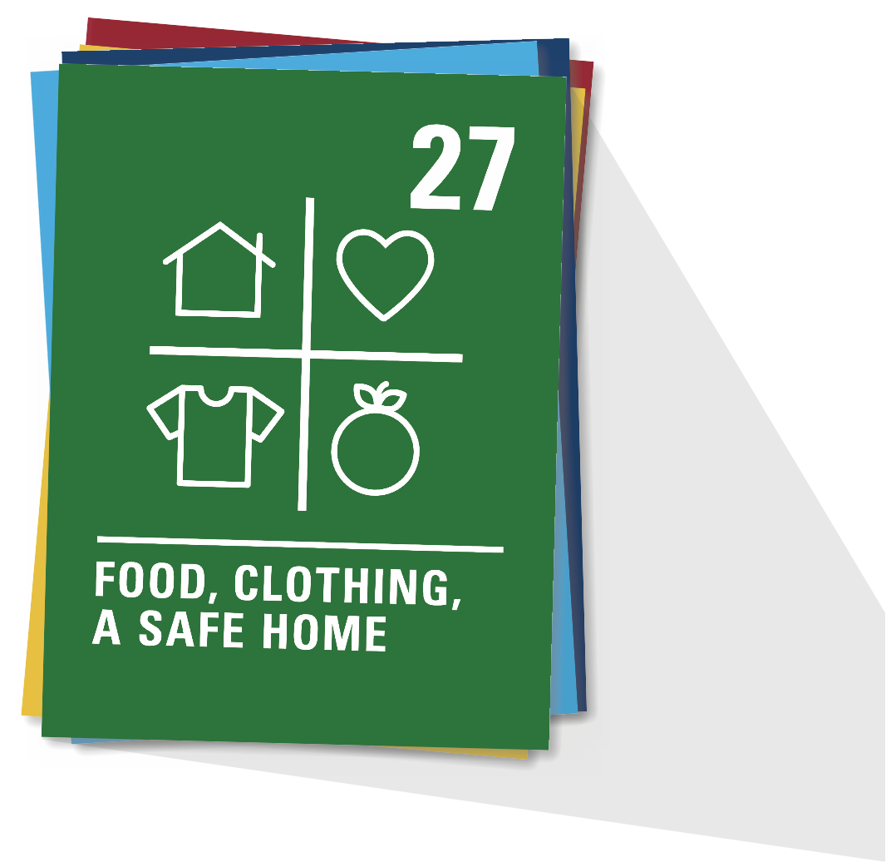
ARTICLE 27
Adequate standard of living
Every child has the right to a standard of living that is good enough to meet their physical and social needs and support their development. Governments must help families who cannot afford to provide this.

Slide 4
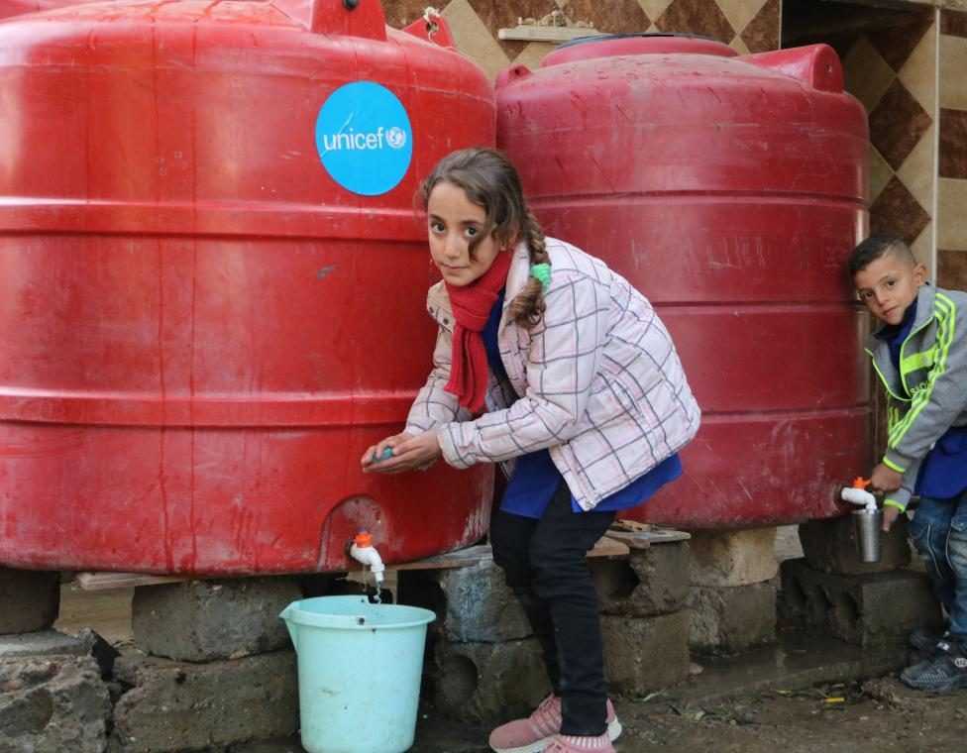
Part 2
A CHOLERA STORY
© UNICEF/Al-Kheder
Bayan, and Qusai, both 9, wash their hands at school in their village in Syria. Around 60% of people in their region rely on unsafe water sources. In 2022, UNICEF helped 83 schools here get clean, safe water.

Slide 5
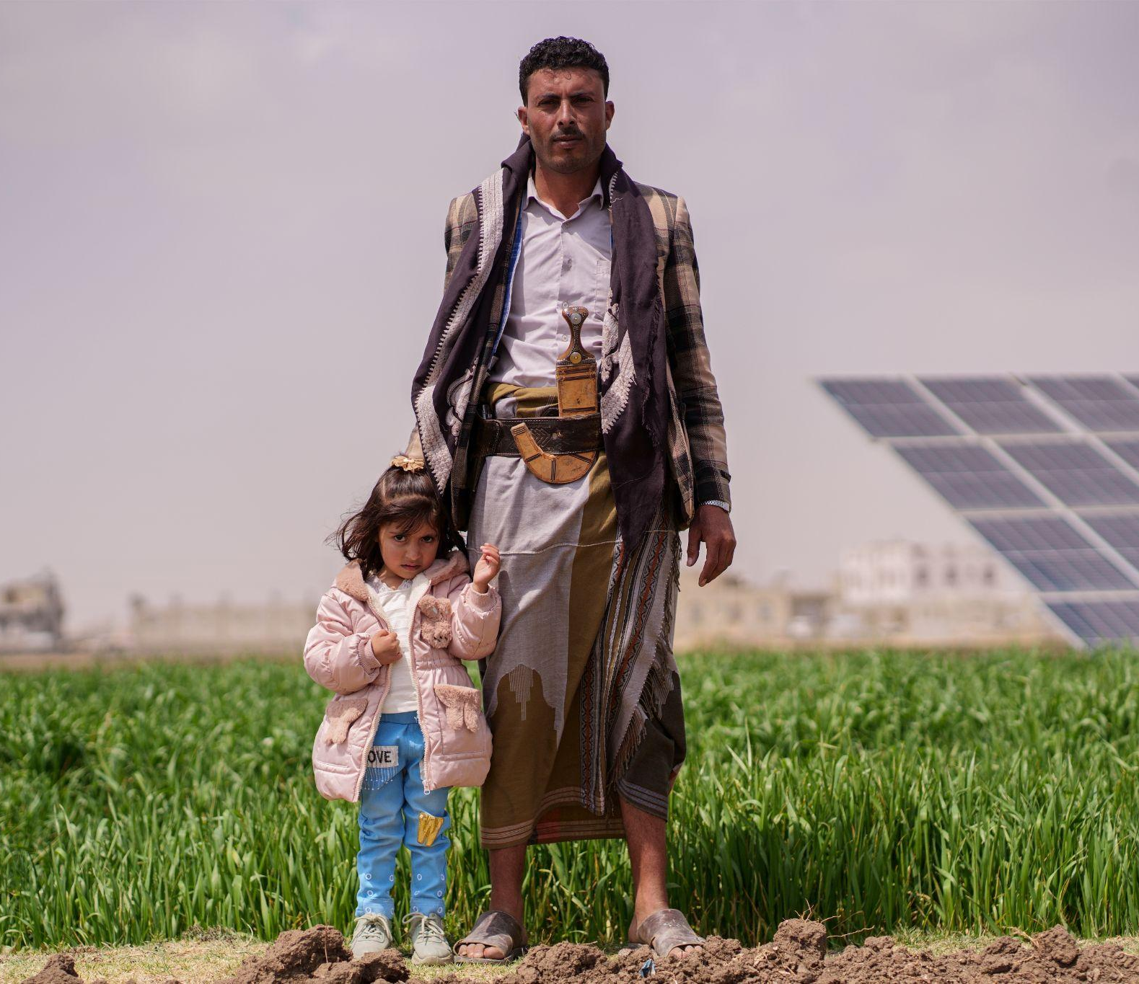
Part 3
WHAT HAPPENS NEXT
Farmer Hussein with his daughter on their farm in Yemen in February 2023. Their farm has benefitted from a UNICEF-supported solar powered water project that has brought clean water to 137,000 people in their area.
© UNICEF/Alsunaidar

Slide 6
Cause and effect example
Extreme weather causes flooding
Children’s right to the best possible health is affected
Children drink the water with bacteria
Water is contaminated
Dirty flood water gets into water systems
Bacteria grows in dirty water
Children get ill with Cholera

Slide 7
Cause and effect example
Because of climate change there are long seasons with no rain
Crops don’t grow
Families can’t afford school fees
Children are malnourished
Food shortage
Children’s right to the best possible health is affected
Children don’t have healthy food
Children’s right to education is affected
Food prices increase

Slide 8
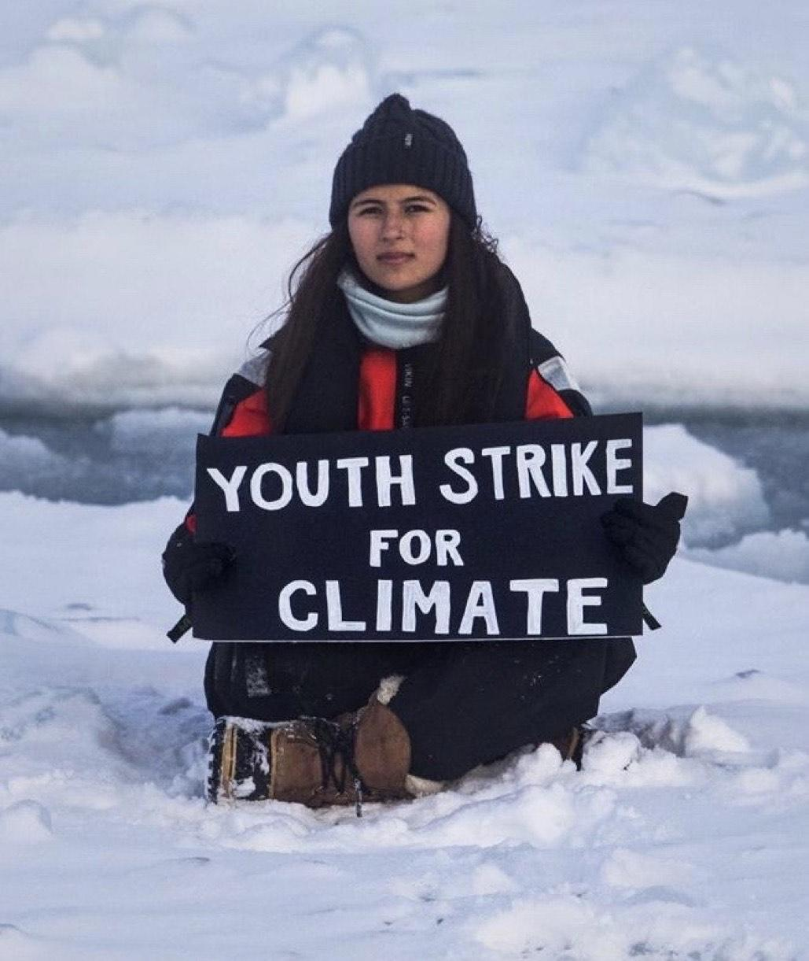
Part 4
GOING BACK THE OTHER WAY
The knock-on effect of climate adaptations

Slide 9
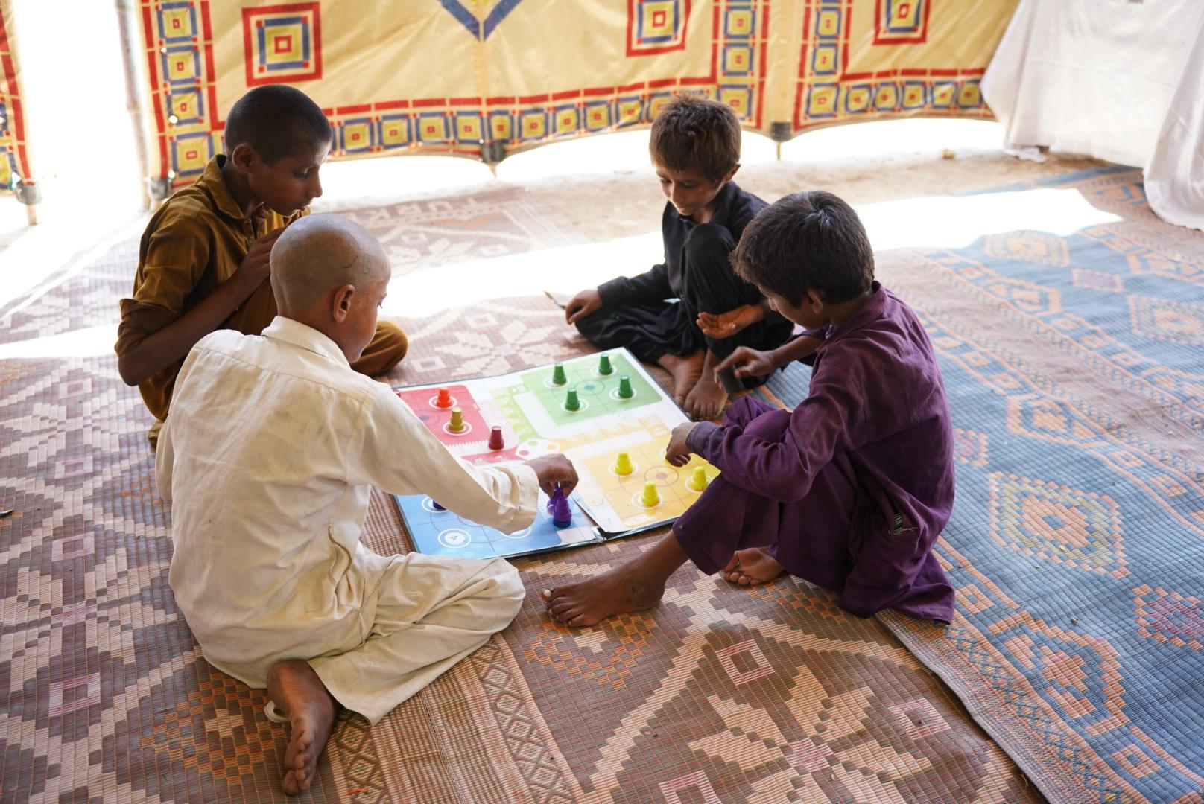
Part 5
© UNICEF
RACE FOR YOUR RIGHTS
Create your own game
Children play the board game Ludo in a UNICEF child-friendly space in a camp for flood-affected people in Sindh, Pakistan, in September 2022.

