Slide 1
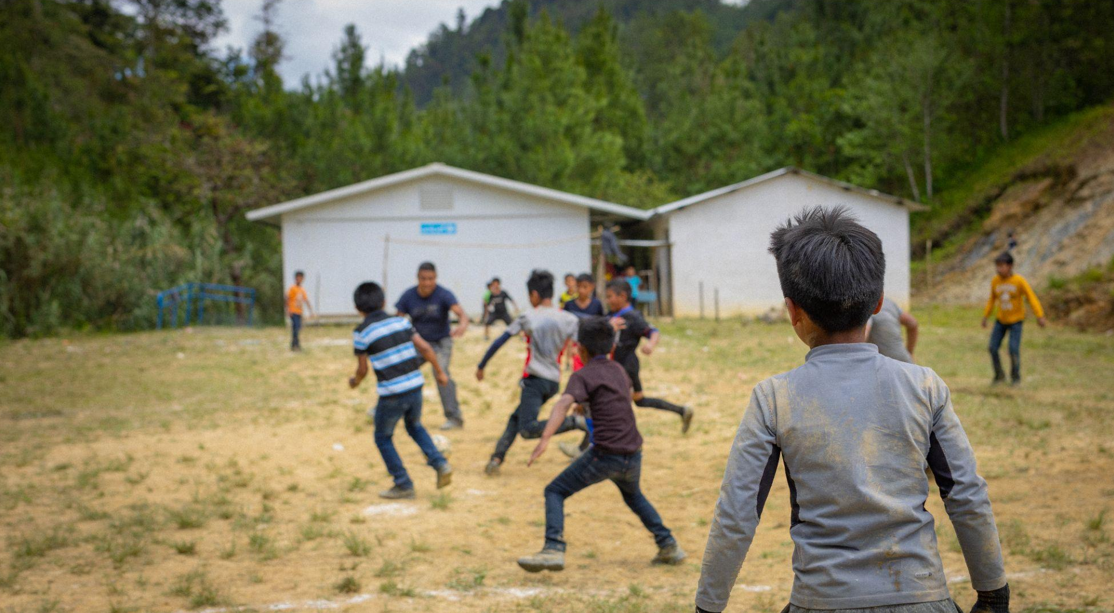
ACTIVITY 6 PROTECTING CHILDREN’S RIGHT TO EDUCATION IN OUR CHANGING CLIMATE
Children play football outside a temporary classroom that UNICEF helped build after their school was destroyed by hurricanes Eta and Iota.
© UNICEF/Quintero

Slide 2
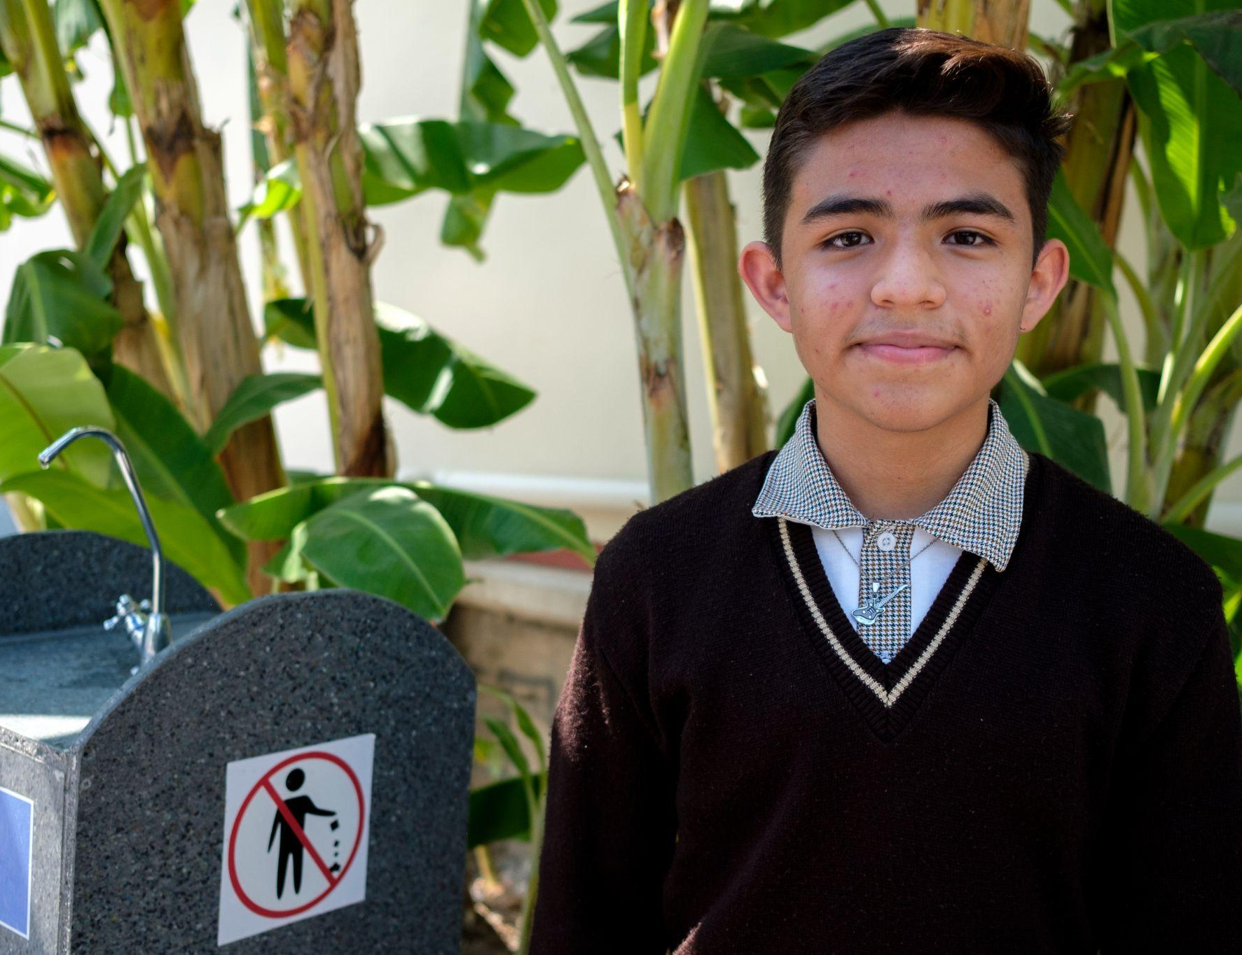
Part 1
© UNICEF/Balam-Ha'
REVIEWING OUR RIGHTS
Yohan, 13. His school in Mexico educates children about sustainability and reducing environmental impact. It uses solar, kinetic and mechanical energy to harvest and filter rainwater, and children collect plastic bottles to recycle into bricks.

Slide 3
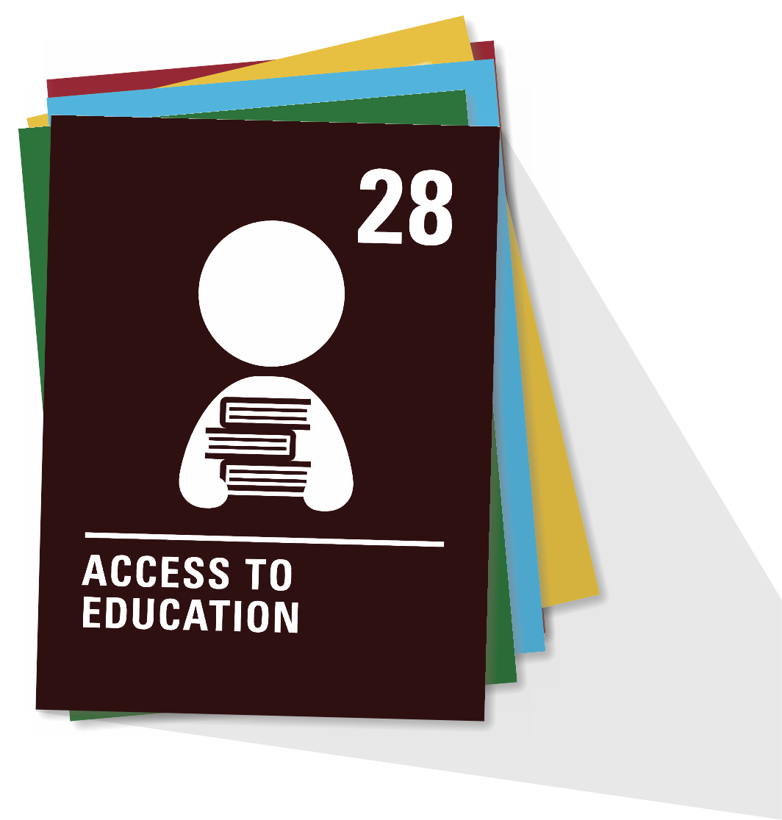
ARTICLE 28
Right to education
Every child has the right to an education. Primary education must be free and different forms of secondary education must be available to every child. Discipline in schools must respect children’s dignity and their rights. Richer countries must help poorer countries achieve this.

Slide 4
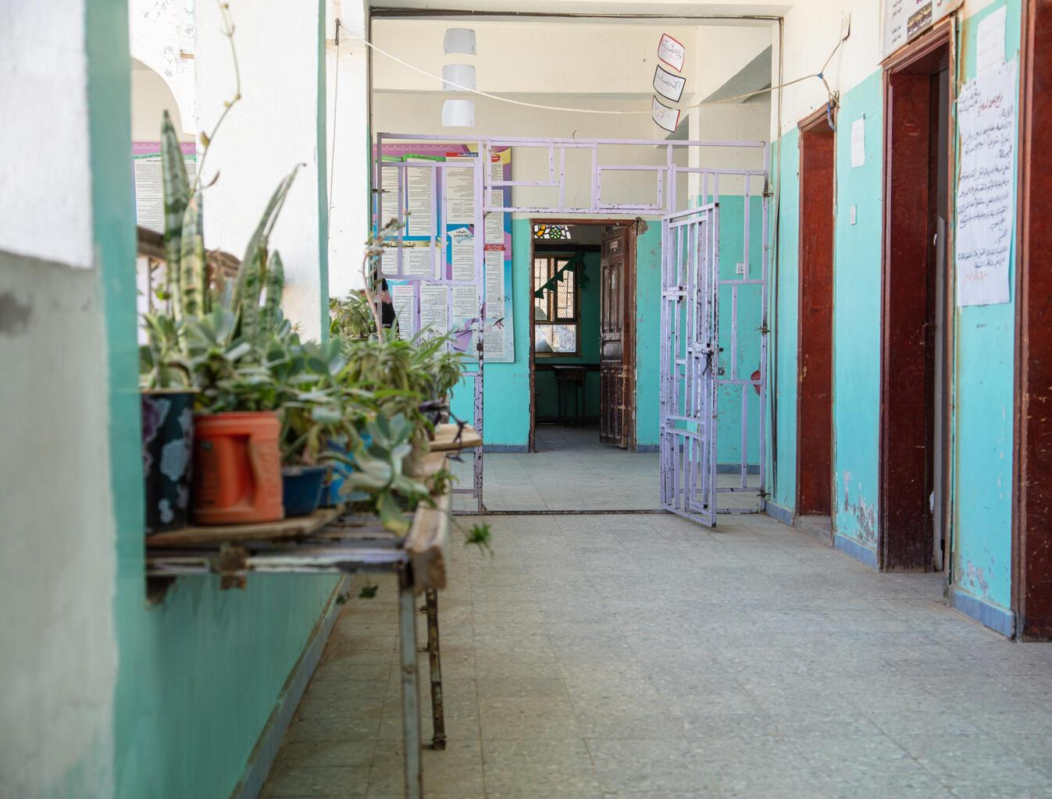
Part 2
EXPLORING EDUCATION AROUND THE WORLD
Al-Zahra'a School, Yemen, in February 2023
©UNICEF/Qadari

Slide 5
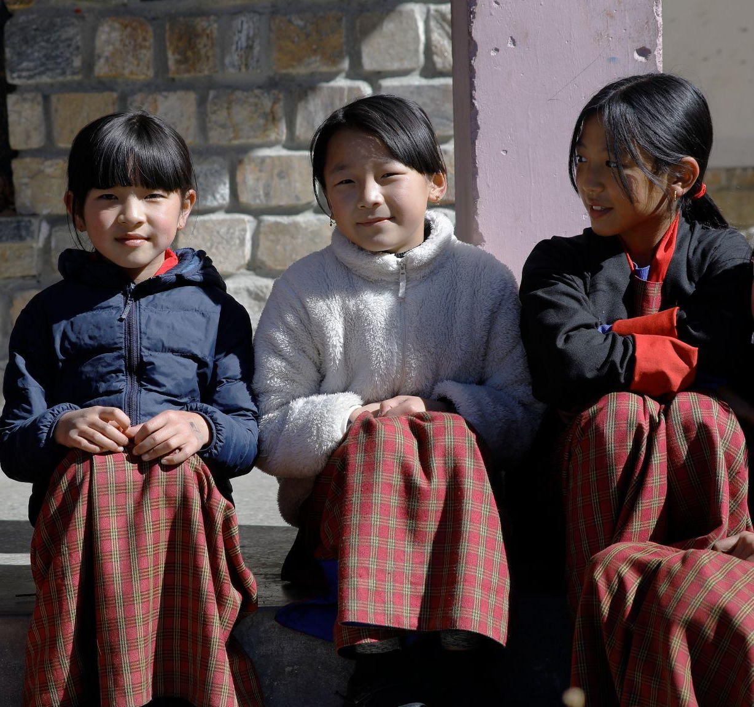
BHUTAN
Helping schools stand up to earthquakes
Children at school in Haa, western Bhutan.
© UNICEF/Samdrup

Slide 6
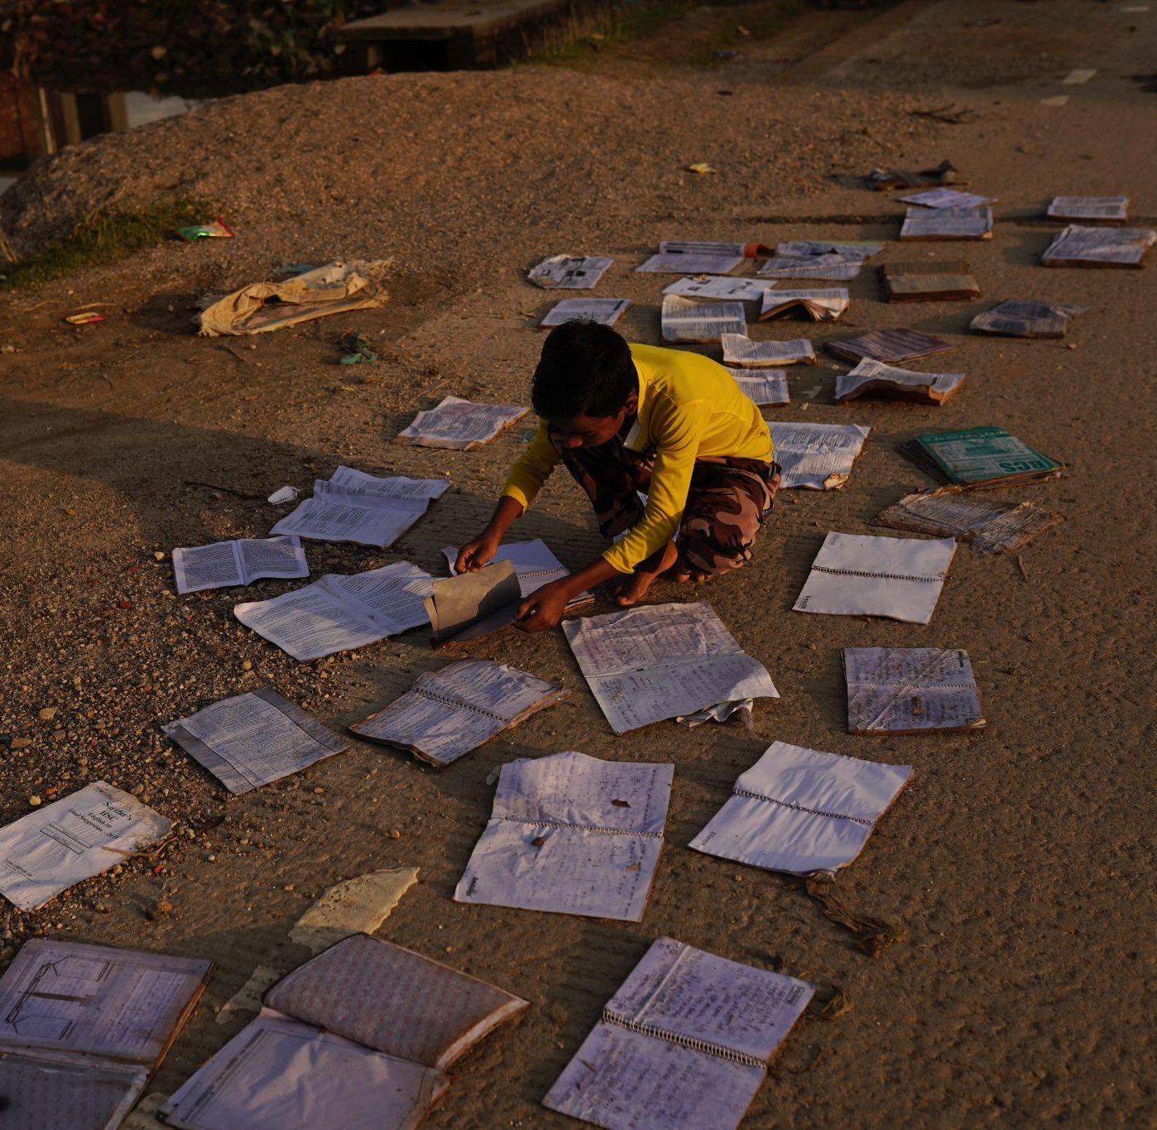
BANGLADESH
A solar-powered floating school
A child dries his school books in Sylhet, Bangladesh, after his house was flooded in June 2022.
© UNICEF/Mukut

Slide 7
Part 3
© UNICEF/Quintero
INNOVATION LAB
Design a future school
Children play football outside a temporary classroom that UNICEF helped build after their school was destroyed by hurricanes Eta and Iota.

Slide 8
INNOVATION LAB
How will your school work to protect the right of all children to access education?
Choose a climate effect that stops children from being able to go to school
Use your creativity to design a future school that adapts to this climate effect
Draw or create a model of this school to display

