Slide 1
© UNICEF/Dawe
Notes:
Welcome to Spotlight, our latest resource to support RRSA coordinators to develop Rights Respecting practice in school.
Unlike Article of the Week, Spotlight is aimed at colleagues and is intended to support you in staff briefings or continued professional development (CPD).
Please check guidance in subsequent slide notes.

Slide 2
CONTENTS
Topic: Being a Rights Respecting School
For each slide, please look at the presenter notes for delivery information.
Slide 3: Aims of the Session
Slide 4: Three ways to use this pack
Slide 5 : Introducing this month’s Spotlight
Slide 6: Links to RRSA Outcomes
Slide 7: Links to Articles
Slide 8 & 9: Case Studies
Slide 10 & 11: Let’s Discuss
Slide 12 & 13: Suggested Activities
Slide 14: Resources
Slide 15: Reflection

Slide 3
AIMS OF THE SESSION
To refresh understanding of the Rights Respecting Schools Award.
To recap the importance of the UN Convention on the Rights of the Child (CRC).
To reflect on why it is important for us to be a Rights Respecting School.
Notes:
Trainer notes: This session is intended to be used within schools, near the beginning of the school year, to encourage all staff to review their understanding of and commitment to children’s rights. It will be particularly useful if you have several new staff starting in your school. However, it is always good to have a regular opportunity to come together as a staff team and renew your commitment to children’s rights and consider what your school is already doing to promote and protect rights and share what your priorities are as RRSA lead for the year ahead.

Slide 4
THREE WAYS TO USE THIS PACK
DELETE THIS SLIDE BEFORE USING
Read through the slides and notes pages to identify the most relevant activities for your colleagues and any preparation or resources needed.
If time is tight, use the introduction slide and choose from the key discussion questions to explore with your colleagues.
If you have longer, you can also choose some of the activities to explore.
You may wish to cover the content over a number of staff meeting sessions.
Notes:
Trainer notes: Delete this slide before using.
It would be useful to have copies of the simplified CRC or the icons so that staff can refer to them throughout the session.
unicef.uk/CRC_Icons

Slide 5
SPOTLIGHT ON…
As a school involved in the RRSA, we have committed to respecting, protecting and promoting the rights of our pupils. Pupils at Rights Respecting Schools are empowered to know their rights, experience their rights in action and be involved in making a positive contribution to our school, local community and beyond.
It is helpful for us to take a step back and reflect on our ethos, culture and values, our aims as a school and the kind of education we want to provide for our children and young people.
Martin from the RRSA team introduces this month’s Spotlight.
Notes:
The video complements the content of this pack and can also be used separately, when introducing new staff to RRSA for example.

Slide 6
LINKS TO RRSA OUTCOMES
Strand A: TEACHING AND LEARNING ABOUT RIGHTS
The United Nations Convention on the Rights of the Child (CRC) is made known to children, young people and adults, who use this shared understanding to work for improved child wellbeing, school improvement, global justice and sustainable living.
Strand B: TEACHING AND LEARNING THROUGH RIGHTS – ETHOS AND RELATIONSHIPS
Actions and decisions affecting children are rooted in, reviewed and resolved through rights. Children, young people and adults collaborate to develop and maintain a school community based on equality, dignity, respect, non-discrimination and participation; this includes learning and teaching in a way that respects the rights of both educators and learners and promotes wellbeing.
Strand C: TEACHING AND LEARNING FOR RIGHTS – PARTICIPATION, EMPOWERMENT AND ACTION
Children are empowered to enjoy and exercise their rights and to promote the rights of others locally and globally. Duty bearers are accountable for ensuring that children experience their rights.
CONT…
Notes:
This slide can help you share the ‘structure’ of RRSA with your colleagues and provide and an overview of the programme. These three strands are not unique to the Award, they are recognised globally as the pillars for most human rights education.

Slide 7
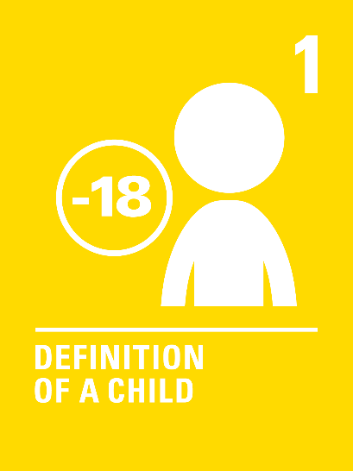
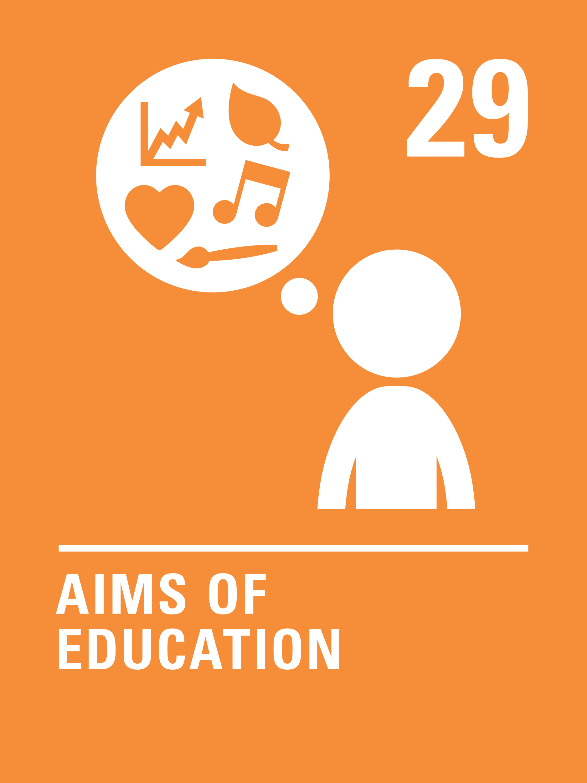
LINKS TO ARTICLES
Notes:
When we think about being a Rights Respecting School every article applies. However, the six articles identified here are particularly relevant to a shared understanding of what it is to be Rights Respecting.
Article 1: Everyone under the age of 18 has all the rights in the Convention.
Article 3: The best interests of the child must be a top priority in all decisions and actions that affect children.
Article 12: Every child has the right to express their views, feelings and wishes in all matters affecting them, and to have their views considered and taken seriously. This right applies at all times, for example during immigration proceedings, housing decisions or the child’s day-to-day home life.
Article 28: Every child has the right to an education. Primary education must be free and different forms of secondary education must be available to every child. Discipline in schools must respect children’s dignity and their rights. Richer countries must help poorer countries achieve this.
Article 29: Education must develop every child’s personality, talents and abilities to the full. It must encourage the child’s respect for human rights, as well as respect for their parents, their own and other cultures, and the environment.
Article 42: Governments must actively work to make sure children and adults know about the Convention.
You could ask your colleagues which articles they most strongly associate with being Rights Respecting… be prepared to hear Articles 19 and 31 mentioned!

Slide 8
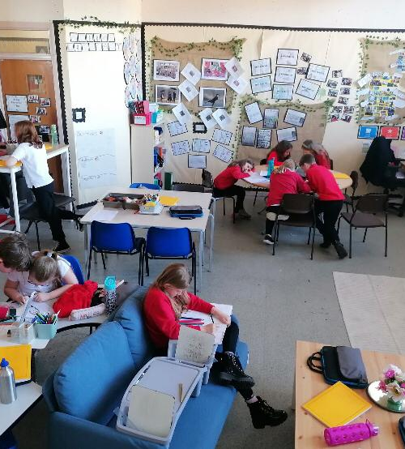
An example of decision making in action is the P6 flexible seating pilot. We invested in our children’s idea to drastically change their learning environment.
CASE STUDY
Look at this case study from Allan’s Primary School
Read the full case study online.
Placing children at the heart of decision making has been the core of our Rights Respecting work so far.
It is important to ensure that you create the right culture within your setting which is built on an accurate and clear understanding of what children’s rights are.
We talk and sing about children’s rights every week at assembly, and this helps to keep the focus up to date and responsive to what is going on in the wider world.
Notes:
The full case study is available on the RRSA website, where you can print it out and share with you staff.

Slide 9
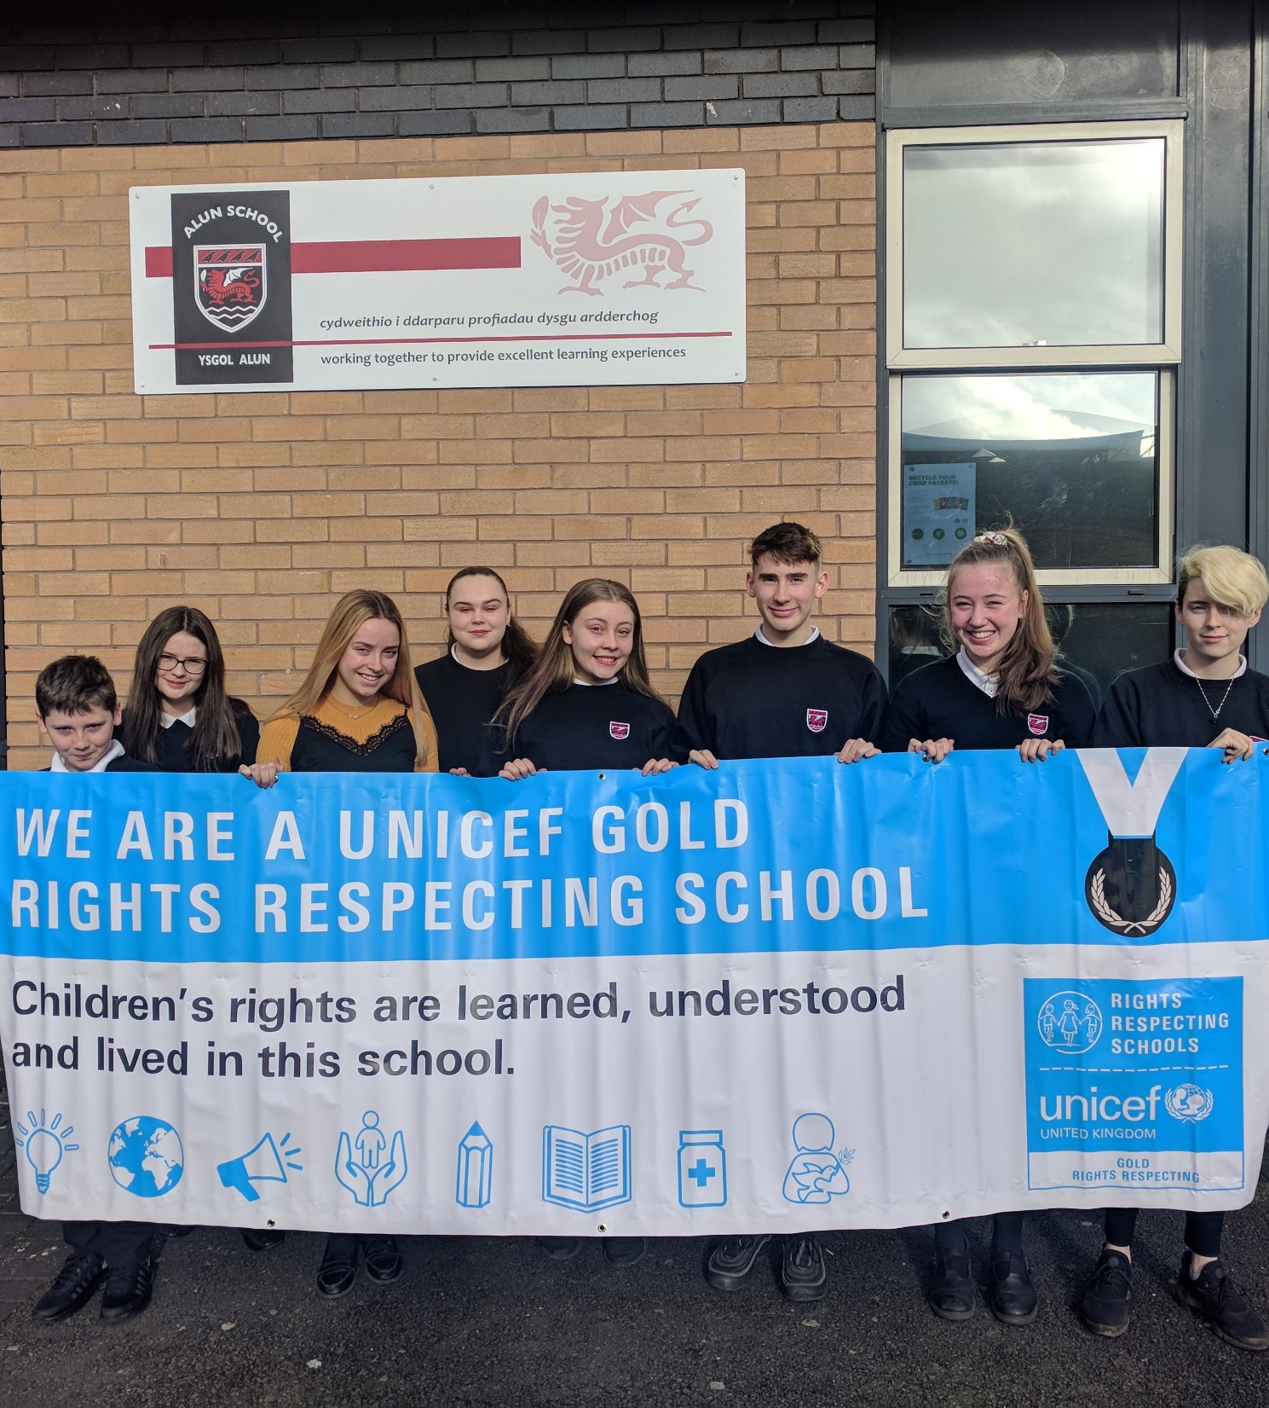
Young people from Alun School hold their Gold banner. No school journey ends at Gold, there are never-ending ways to incorporate rights.
CASE STUDY
Look at this case study from Alun School
Read the full case study online.
The RRSA framework progresses a whole school approach for promotion of UNCRC which is just what our community was looking for. A previous approach might have been delivering rights knowledge and understanding in PSE and Humanities, but rights apply to all subject areas and in everything we do as staff and adults as duty bearers, not just one discreet area.
Consistent messaging was important too, incorporating rights and respect language across everything we do.
Visual reminders in the school environment contribute to the ethos as does lesson content and the rights and respect language used every day.

Slide 10
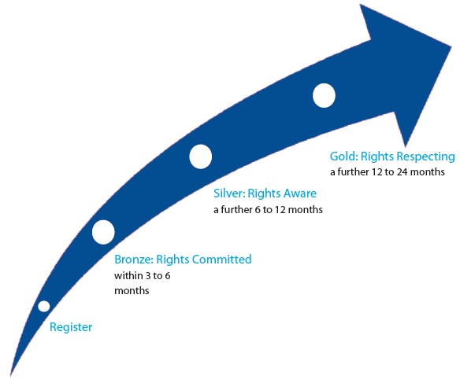
LET’S DISCUSS…
RRSA OUTCOMES
Notes:
Trainer notes: Talk through the RRSA journey and reflect on where your school is at this point. Where would you like to get to this year?
A few points to note:
The timings given by UNICEF are only a broad guide.
There is not a level beyond Gold. Gold reaccreditation happens after three years.
Use this slide if you wish to emphasise momentum and urgency with your rights respecting journey.

Slide 11
DISCUSSION QUESTIONS
What do we want our children to experience at school? Think about our school – do we meet this through our vision, values and actions?
Read the original text of Article 29. How does our school measure up to this right?
How does being a teacher in a Rights Respecting School impact on your practice?
Notes:
Trainer notes: The aim here is to encourage your colleagues to talk about being Rights Respecting and about the Convention. You might want colleagues to work in small groups, each addressing one question. You may wish to delete one or more of these questions or even add your own to focus on an aspect of RRSA which you know needs attention.
Here is the full text of Article 29:
Article 29 1. States Parties agree that the education of the child shall be directed to: (a) The development of the child’s personality, talents and mental and physical abilities to their fullest potential; (b) The development of respect for human rights and fundamental freedoms, and for the principles enshrined in the Charter of the United Nations; (c) The development of respect for the child’s parents, his or her own cultural identity, language and values, for the national values of the country in which the child is living, the country from which he or she may originate, and for civilizations different from his or her own; (d) The preparation of the child for responsible life in a free society, in the spirit of understanding, peace, tolerance, equality of sexes, and friendship among all peoples, ethnic, national and religious groups and persons of indigenous origin; (e) The development of respect for the natural environment. 2. No part of the present article or Article 28 shall be construed so as to interfere with the liberty of individuals and bodies to establish and direct educational institutions, subject always to the observance of the principle set forth in paragraph 1 of the present article and to the requirements that the education given in such institutions shall conform to such minimum standards as may be laid down by the State.

Slide 12
SUGGESTED ACTIVITIES 1
In groups, draw a Rights Respecting classroom onto large pieces of flipchart paper. What do you see, hear and feel in a Rights Respecting classroom?
1. In groups, draw a Rights Respecting classroom onto pieces of flipchart paper. What do you see, hear and feel in a Rights Respecting classroom? You could print and share out this resource to help.
3. In groups, look at our vision statement and/or school values. Think about how these link with CRC articles. Share and discuss. You could write your school vision out onto flipchart paper or slide ahead the sessions with ‘sticky notes’ available.
2. Walk around the room looking at the posters illustrating CRC articles. Which articles particularly resonate with you today? Stand next to this poster and be ready to share with your colleagues.
Notes:
Trainer notes: You can delete or modify activities to suit your session.
Activity information:
This activity could also be done with groups of children.
Have rights posters up around the room in advance of the session. Order posters from here: https://www.unicef.org.uk/rights-respecting-schools/resources/teaching-resources/child-rights-poster-set/
You could write your school vision out onto flipchart paper in advance of the sessions and have post its available.

Slide 13
SUGGESTED ACTIVITIES 2
4. List all of the things we are doing well to respect and promote rights. Now list the areas where we could make improvements.
5. Look at the flipcharts labelled Safeguarding, Wellbeing, Equality, Diversity and Inclusion, Pupil Voice. Note down how these areas link to the CRC.
6. You get to choose which articles you would like people to look at! Display or print out some key articles from the Convention for your colleagues to reflect on. It is good for them to have the summary wording too.
Notes:
Trainer notes:
4. This is another activity that would work well with your RRSA Steering group.
5. Have flipcharts labelled Safeguarding, Wellbeing, Equality, Diversity and Inclusion, Pupil Voice. Ask colleagues to think about how these areas link to the CRC.
6. Choose some key articles from the Convention for your colleagues to reflect on.

Slide 14
RESOURCES
If you have time, please explore these links ahead of your session with colleagues. You may well find a particular resource that you want to highlight to all as part of your input. There may be links you want to share with the team ahead of or as follow up to your input with them.
Charter Guidance
Articles in Action
Myths and Misconceptions
Child-friendly CRC and Icons
Features of a Rights Respecting Classroom
Case study 1 – Alun School
Case study 2 – Allan’s primary and Nursery School
Don’t forget that all back copies of Article of the Week can be found here – Article 29 is particularly relevant to this month’s Spotlight.
Notes:
Trainer notes: Encourage your colleagues to explore the RRSA website to find additional resources. If you have time, please explore these links ahead of your session with colleagues. You may well find a particular resource that you want to highlight to all as part of your input. There may be links you want to share with the team ahead of or as follow up to your input with them.

Slide 15
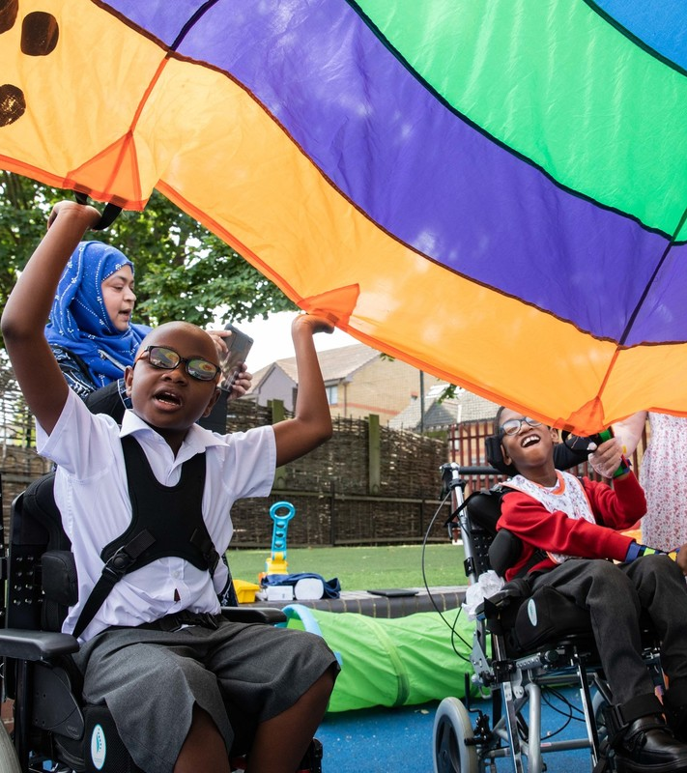
REFLECTION
© UNICEF/Dawe
Write down three things that you, personally, are going to do this year to bring rights to life within your role.
Share your intentions with a colleague.
How might you support each other to realise these commitments?
Notes:
Trainer notes: You could collect these in and come back to them at the start of the next term to remind colleagues of their commitment and celebrate any progress.

