Slide 1
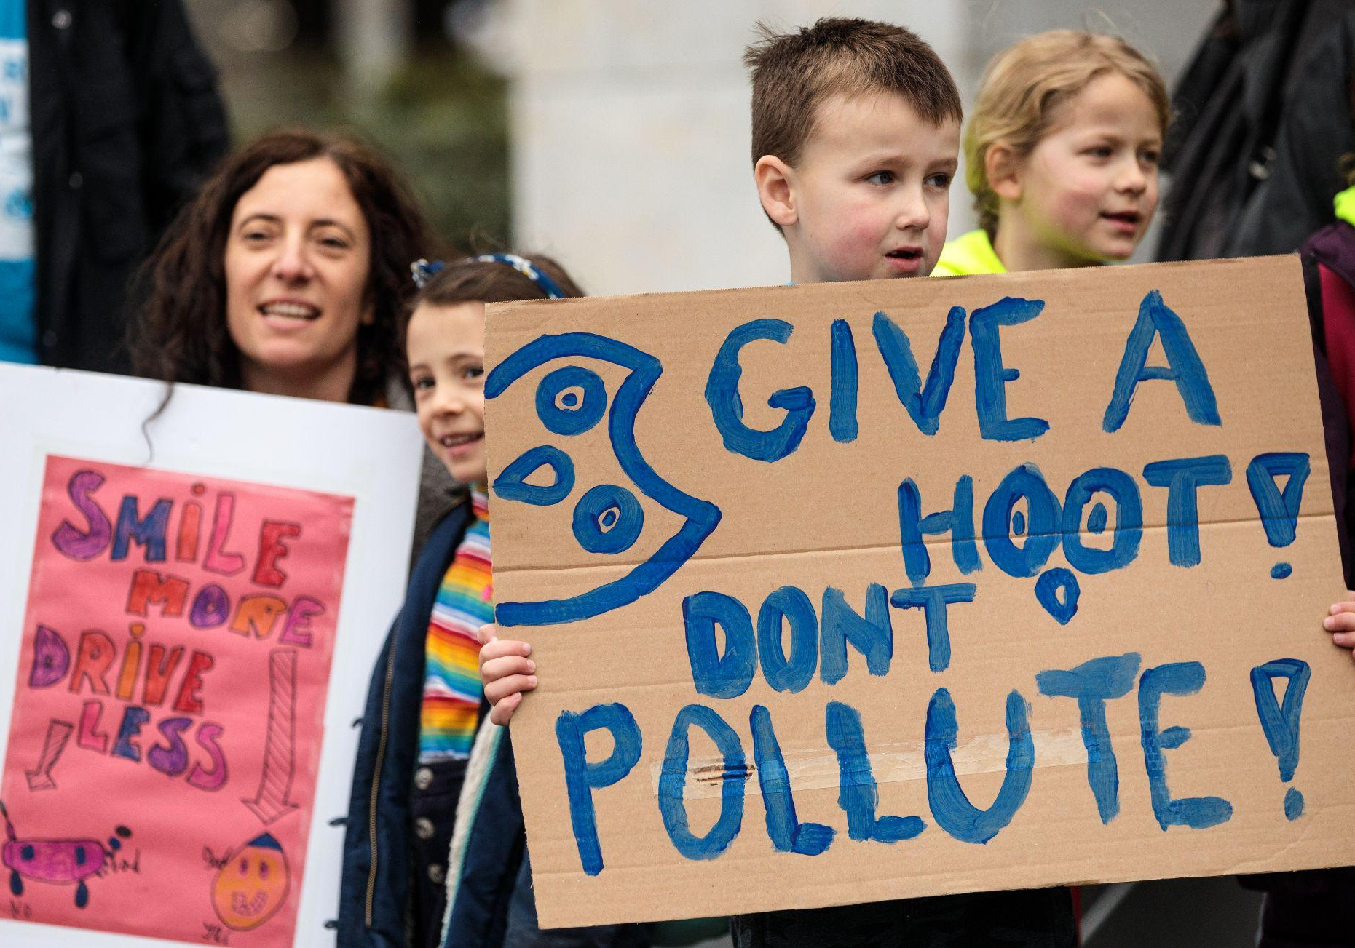

WELCOME
TO OUTRIGHT!
© UNICEF/Sutton-Hibbert
Families take part in the UNICEF UK Action Day: Protecting Children from Toxic Air demonstration in London, England on March 16, 2019.

Slide 2
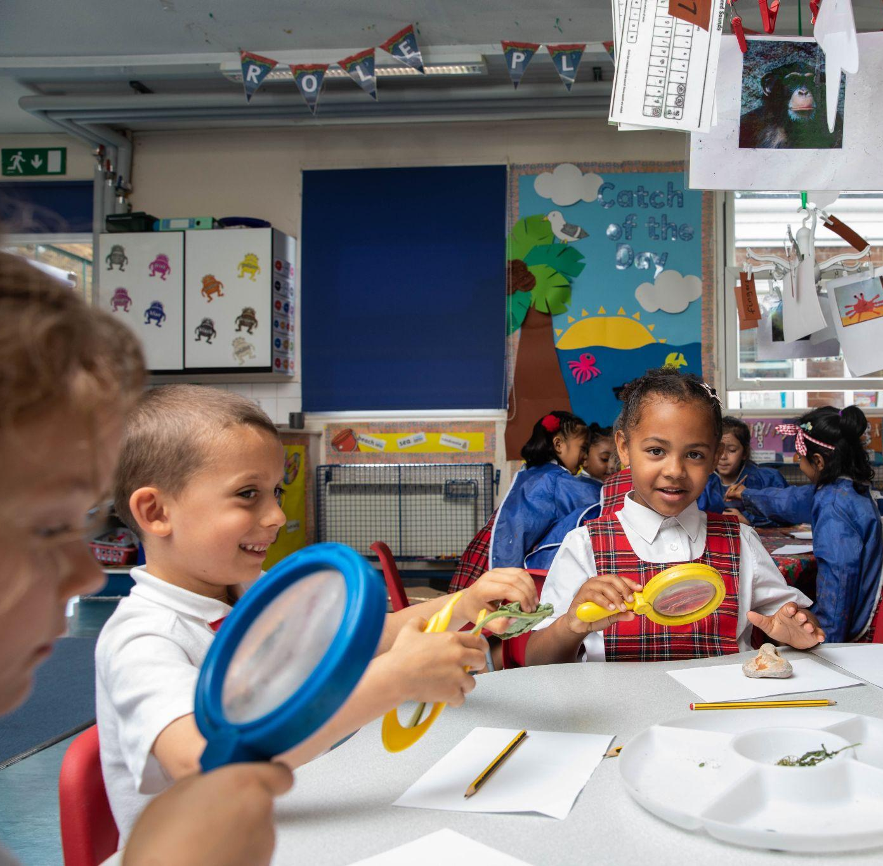
WHAT IS OUTRIGHT?
© UNICEF/Dawe
OutRight is a youth campaign run by UNICEF UK that helps children and young people learn about and speak out on children’s rights across the world.
It’s a campaign by children, for children.
Children in the classroom at a Rights Respecting school in London in June 2022.

Slide 3
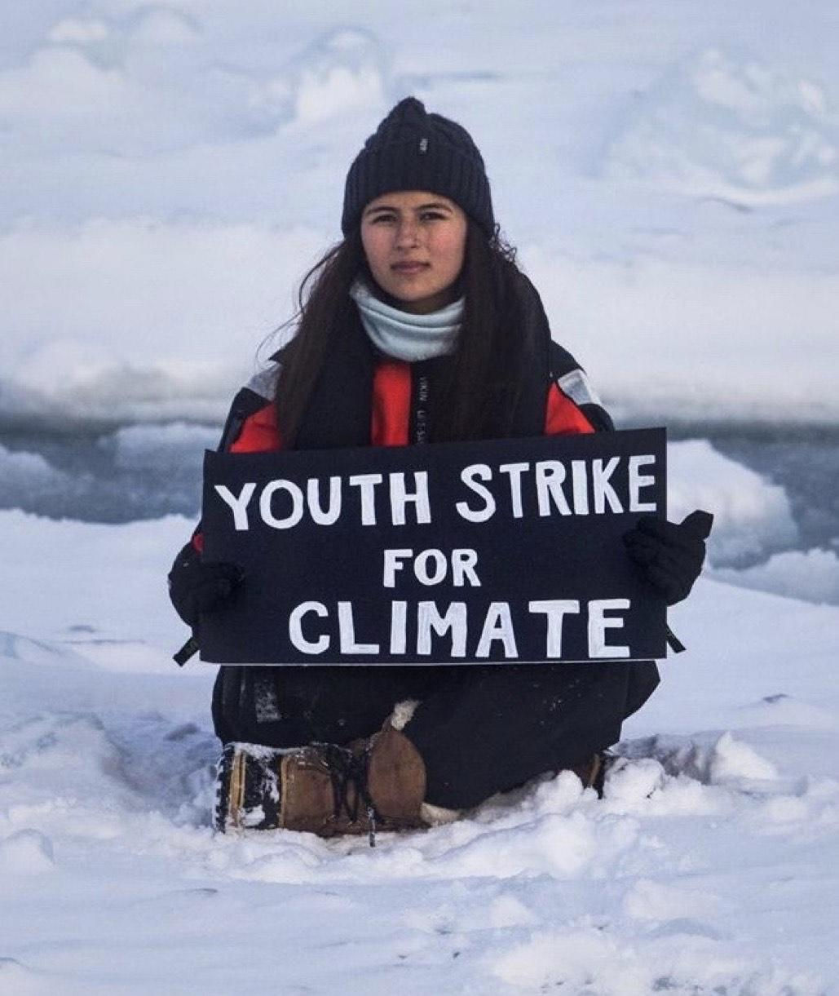
MAKE YOUR VOICE HEARD!
OutRight will help children and young people to stand up for the rights of children in the UK and around the world, with the support of our campaign champion, Paddington Bear.
This year, OutRight is all about all children’s right and our changing climate.

Slide 4
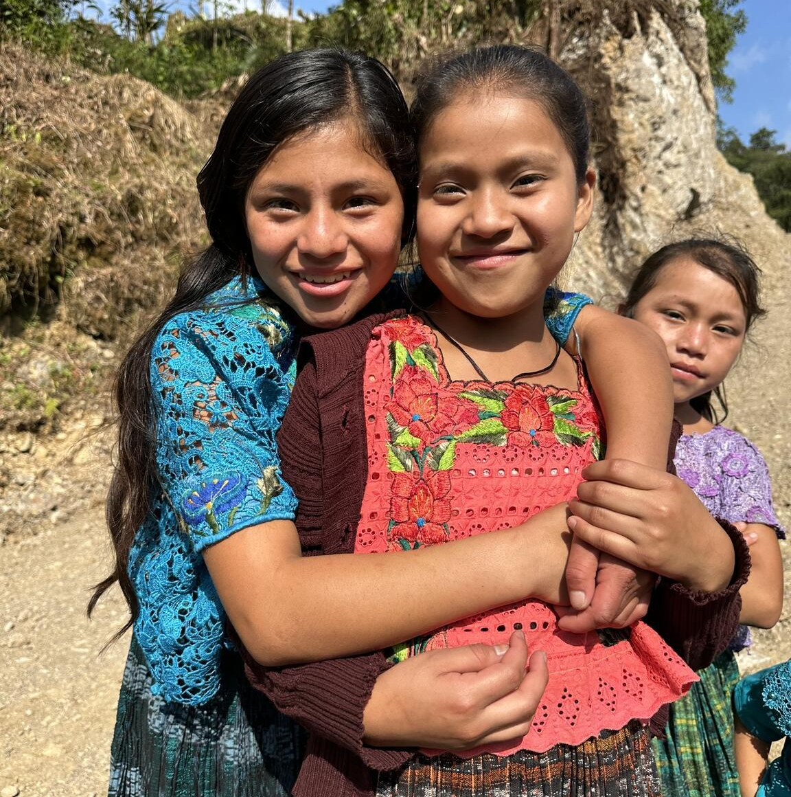

TAKING PART IN OUTRIGHT
© UNICEF/Quintero
We will:
Learn about how climate change is affecting children’s rights
Learn how we can protect children’s rights in a changing climate
Speak out and take action, and hear about other children and young people who are doing the same
Friends smile for the camera in Alta Verapaz, Guatemala.

Slide 5
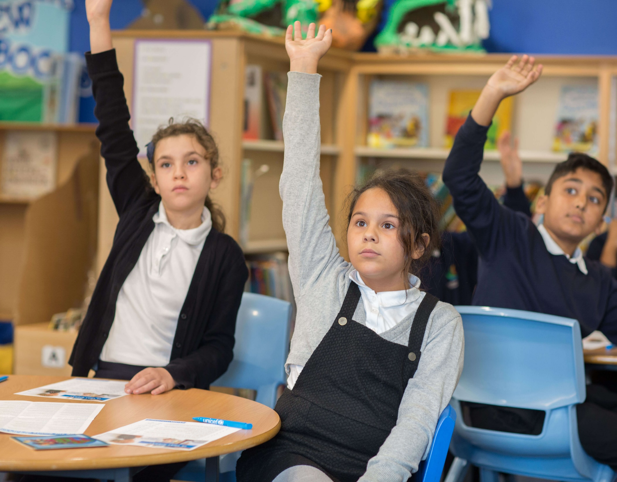
WHAT IS CAMPAIGNING?
Campaigning is about taking specific and organised actions (like taking part in OutRight!) to bring about positive change on an issue, and influence those in power to act.
© UNICEF/Dawe
Going to a march, writing to your
MP or local councillor, or signing a petition are all ways we can campaign for change.
Children in a UNICEF Rights Respecting School.

Slide 6
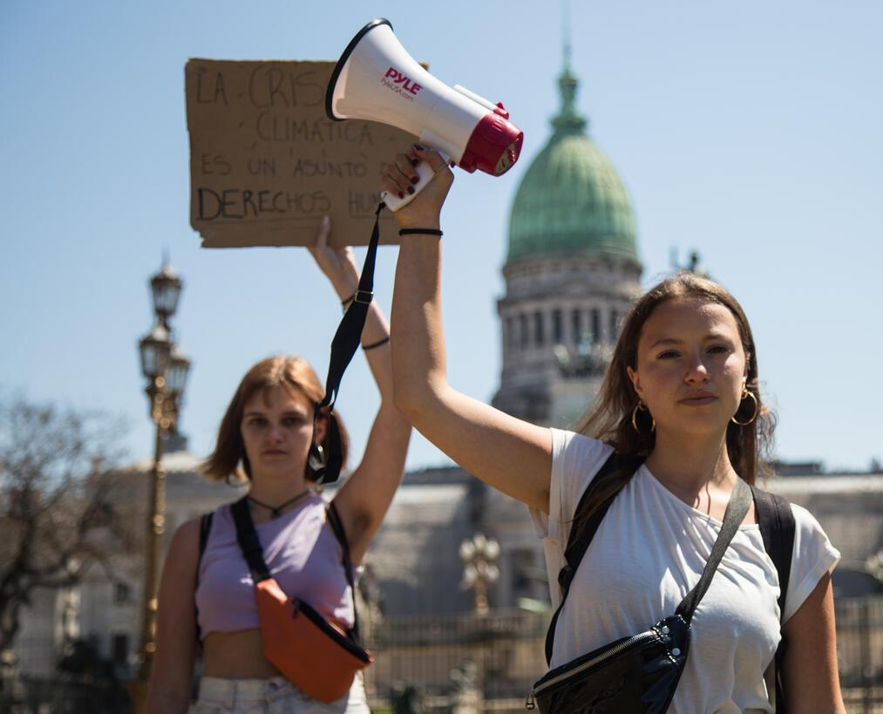
WHY CAMPAIGN?
© UNICEF/Gil
Children like you have an important role to play in campaigning to create change. Your voices matter and can make a difference!
UN Convention on the Rights of the Child: Article 12
Every child has the right to say what they think in all matters affecting them, and to have their views taken seriously.
Nicole Becker, 19, leads a group of environmental activists in Argentina.

Slide 7

MAKE YOUR VOICE HEARD
Write to the Minister for Energy Security and Net Zero at the UK Government before they go to COP28.
Join our World Children’s Day live event!
Share how your campaign is going and hear what others are doing.
Calling all reporters! Take a look at our guide to getting local journalists involved in your campaign.

Slide 8
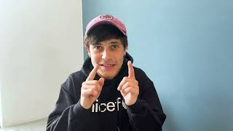
A MESSAGE FROM CEL SPELLMAN
Actor and UNICEF UK High Profile Supporter Cel Spellman has this message for you about taking part in OutRight this year…

Slide 9
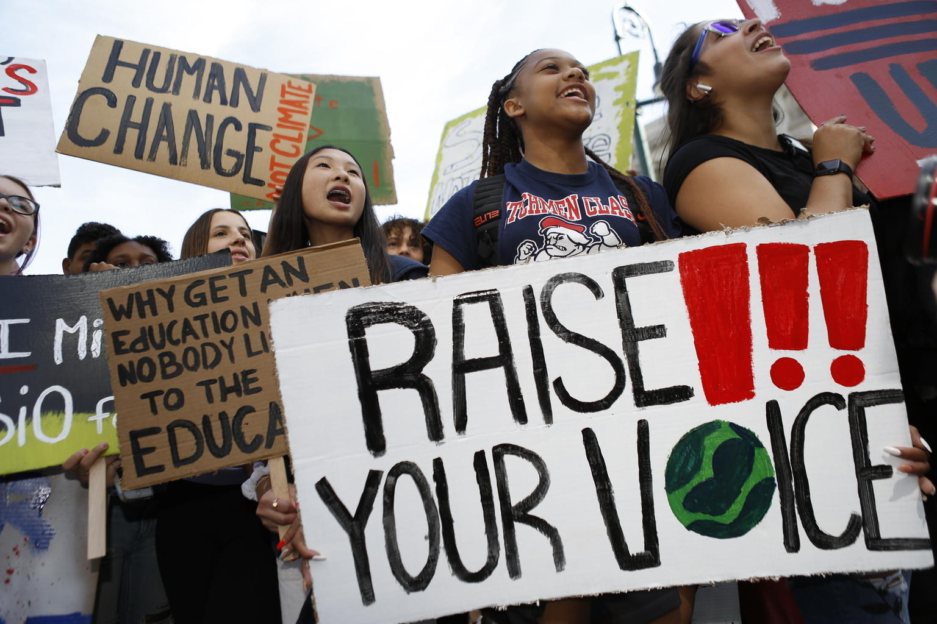
THANK YOU
Thank you so much for taking part in OutRight this year and for making your voice heard.
© UNICEF/Chalasani
On 20 September 2019 in New York City, youth climate activists join in a demonstration calling for global action to combat climate change.

