Slide 1
© UNICEF/Dawe
Notes:
Welcome to Spotlight, our latest resource to support RRSA coordinators to develop Rights Respecting practice in school.
Unlike Article of the Week, Spotlight is aimed at colleagues and is intended to support you in staff briefings or continued professional development (CPD).
Please check guidance in subsequent slide notes.

Slide 2
CONTENTS
Topic: Equality, Diversity & Inclusion
For each slide, please look at the presenter notes for delivery information.
This pack is being published ahead of Black History Month in October. We know that many schools use that time to explore wider aspects of diversity and inclusion and this content is intended to help you with this.
Slide 3: Aims of the Session
Slide 4: Three ways to use this pack
Slide 5 : Introducing this month’s Spotlight
Slide 6: Links to Articles
Slide 7: Links to RRSA Outcomes
Slide 8: Case Study
Slide 9 & 10: Let’s Discuss
Slide 11 & 12: Activities
Slide 13: Reflection
Slide 14: Resources
Notes:
Presenter notes: For each slide, please look at the presenter notes for delivery information. You may wish to amend or delete this slide when you deliver the session in your school.

Slide 3
AIMS OF THE SESSION
To identify existing good practice that celebrates diversity and promotes equality and inclusion.
To have a shared understanding of terminology including diversity, inclusion, equality and equity.
To understand how RRSA and a child rights perspective can provide a clear context for our inclusive practice.
To challenge current inclusive practice and identify next steps to further develop all areas of inclusion.
Notes:
Presenter notes: Please edit the aims of the session to suit the time you have available for your session.
This session is intended to support you in using the CRC to underpin what you already do around Equality, Diversity and Inclusion and also to empower and challenge you to progress further in this area.
The whole Spotlight series is about embedding children’s rights within a wide range of school priorities and practices.

Slide 4
WAYS TO USE THIS PACK
DELETE THIS SLIDE BEFORE USING
If your time is tight, use the introduction slide and choose from the key discussion questions to explore with your colleagues.
If you have longer, you can also choose some of the activities to explore.
You may wish to cover the content over several staff meeting sessions.
There are trainer notes for each slide – please do have a look at these for further guidance.
There
Notes:
Presenter notes: Delete this slide before using.
It would be useful to have copies of the simplified CRC or the icons so that staff can refer to them throughout the session.
unicef.uk/CRC_Icons

Slide 5
SPOTLIGHT ON…
As a school involved in the RRSA, we have committed to respecting, protecting and promoting the rights of our learners.
Children at Rights Respecting Schools know that “The Convention applies to every child without discrimination, whatever their ethnicity, sex, religion, language, abilities or any other status, whatever they think or say, whatever their family background.” (Article 2)
Let’s give ourselves some time to take a step back and reflect on how all children and young people in our school experience this commitment.
Emma, UNICEF UK’s Diversity and Inclusion Lead introduces this month’s Spotlight.
Notes:
The video complements the content of this pack and can also be used separately.
Presenter notes: Our Rights Respecting journey can help us recognise and value diversity and embrace an inclusive approach. This is a fast moving and important part of society and school life. We want all our pupils and staff to feel a sense of belonging and to feel like they are treated with dignity and worth in line with Article 2: Non-Discrimination.
We probably have different levels of confidence when talking about diversity and inclusion and probably have many questions to ask. This session will allow us to share some thoughts about how we can challenge ourselves to develop our rights respecting inclusive practice.

Slide 6
LINKS TO ARTICLES
Look at the summary of the CRC with a partner – which articles do you think are particularly relevant to our work on inclusion?
When ready click to reveal.
In fact, ALL the other articles relate to ‘non-discrimination’ because Article 2 is one of the ‘general principles’ of the Convention, which means it underpins every other article. The ones shown here perhaps have the most obvious connection to Article 2 and to Equality, Diversity and Inclusion.
Notes:
Presenter notes: When showing this slide in presenter mode the articles and the text at the bottom of the slide will appear on click 1 and 2.
Look at the summary of the CRC with a partner – which articles do you think are particularly relevant to our work on inclusion? Give good time for people to think about and discuss the links. Your colleagues may identify different articles to the ones displayed. If time permits, encourage staff to explain their choices.
CRC Summary: unicef.uk/CRC_Icons

Slide 7
LINKS TO RRSA OUTCOMES
Strand B: TEACHING AND LEARNING THROUGH RIGHTS – ETHOS AND RELATIONSHIPS
The descriptor for Outcome 6 at Silver:
Many children and young people can describe how they are included and valued at school and can describe how their actions and those of others contribute to this.
The descriptor for Outcome 6 at Gold:
Nearly all children and young people interviewed describe how everyone is included and valued and can describe how becoming rights respecting contributes to this. The school is actively working towards (or is sustaining) a strong culture of inclusion and can show how this is underpinned by non-discrimination.
Notes:
Presenter notes: If you choose to use this slide, it’s an opportunity to remind colleagues of the ‘structure’ of RRSA - Three strands: Teaching about rights… through rights… for rights…
If you have time, it may be useful to explore with your colleagues how your school’s work on EDI fits within the RRSA framework. Strand B is about how children experience their rights being respected at school, and this explicitly mentions building a school community built on equality, dignity, respect and non-discrimination which links directly to your school’s work on EDI.
Drilling down, Outcome 6 ties closely with EDI. If you are working towards Bronze or Silver, it will be useful to look at the outcome descriptor for Silver and ask your colleagues how well they think you meet this outcome descriptor and to have this in mind for the remainder of the session. If you are working towards Gold or Gold reaccreditation, it will be useful to look at the outcome descriptor for Gold and ask your colleagues how well they think you meet this outcome descriptor and to have this in mind for the remainder of the session.

Slide 8
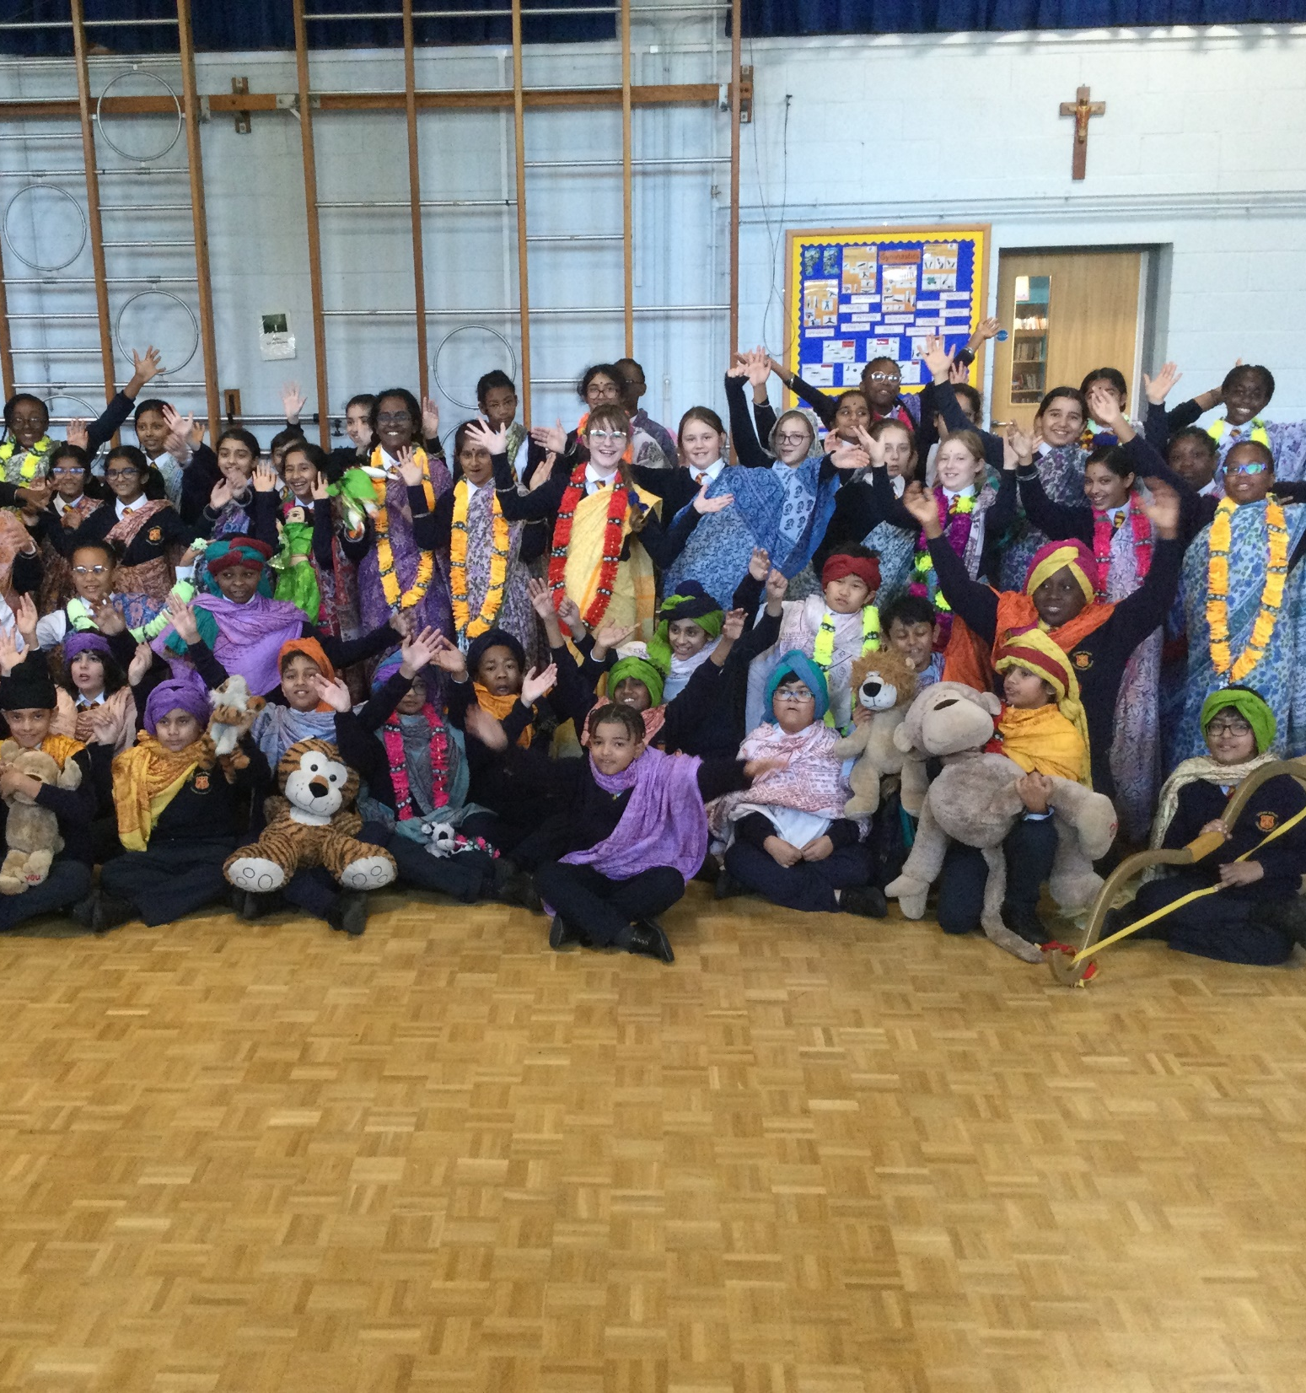
A Hinduism workshop at SS Peter and Paul’s Catholic Primary School.
CASE STUDY
Look at this case study from SS Peter and Paul’s Catholic Primary School
Read the full case study online.
The school has been working with the Redbridge Education Wellbeing Team on their Race and Equality Awareness (REA) Scheme. This has been a process whereby we have focused on our school’s racial awareness, our areas of strength and needs with regards to this and how we go about promoting racial equality.
The speed at which terminology and language surrounding race and diversity can change is something we can find hard to keep up with. The embedded, unchanging nature of the CRC and being a Rights Respecting School, along with our faith values, means we have something concrete to return to which always puts the interests of all children at its heart.
Notes:
Presenter notes: The full case study is available on the RRSA website, where you can print it out and share with your staff if you are choosing to focus on this as part of your session. your colleagues. Encourage staff to consider whether there are any examples of good practice within this case study that your school could draw on and learn from.

Slide 9
LET’S DISCUSS
How do we ensure all children feel welcomed and that they belong when they first join our school? How do we value and celebrate the differences our children bring to our school?
Do we have a shared understanding of the terms: diversity, inclusion, equality and equity? Discuss in small groups and then share your thoughts. This document might be useful as a basis for discussion.
Is there an area of inclusion that we feel is a strength of our school? How can we apply this good practice to areas of inclusion that we know we need to further develop?
Notes:
Presenter notes: There are six discussion questions available. Choose the questions that are most relevant to your setting and experience. You may decide to choose only one or two questions to focus on or you could put participants into groups with each group discussing a different question. If you are focussing on Black History Month, please select and modify accordingly.
Collect some of the ideas from your colleagues and add them to your RRSA action plan/evidence.
Remember to encourage staff to consider all aspects of inclusion and diversity which might include but are not limited to disability, culture, religion, gender, different types of families and socio-economic backgrounds and any other elements of diversity.
The document that forms part of the second discussion question can be found here:
https://www.unicef.org.uk/rights-respecting-schools/wp-content/uploads/sites/4/2023/09/EDI-definitions-one-pager.pdf You may wish to print it in advance.

Slide 10
LET’S DISCUSS
How important is language in creating an inclusive school? How do we recognise and challenge any form of discriminatory language? How can we support staff and students? Do we have or need to review an Inclusive Language Policy?
What opportunities do we give young people to listen to, and learn from the stories of their peers to better understand different perspectives and value difference?
When ensuring that all children feel valued and included (RRSA Outcome 6) do we consider all forms of diversity? How confident are we in our knowledge of the 9 protected characteristics of the Equalities Act 2010? Would all children at our school see themselves represented in curriculum resources, displays, celebrations and whole school activities?
Notes:
Presenter notes: There are six discussion questions available. Choose the questions that are most relevant to your setting and experience. You may decide to choose only one or two questions to focus on or you could put participants into groups with each group discussing a different question. If you are focussing on Black History Month, please select and modify accordingly.
Collect some of the ideas from your colleagues and add them to your RRSA action plan/evidence.
For more information on the protected characteristics of the Equalities Act 2010 see https://www.equalityhumanrights.com/en/equality-act/protected-characteristics

Slide 11
ACTIVITIES
In groups, draw a Rights Respecting classroom onto large pieces of flipchart paper. What do you see, hear and feel in a Rights Respecting classroom?
1. What would a truly inclusive curriculum look like? What topics might be explored? How are different perspectives and viewpoints explored? How are students consulted?
2. What opportunities already exist for our young people to be involved in helping to create an inclusive environment in our school? How could they be even more involved?
3. Look at the school’s vision/aims/values. Do they explicitly mention the school’s drive towards non-discrimination? Are any changes needed?
Notes:
Presenter notes: There are six suggestions for activities. Depending on the time you have available, choose one or more activities for your colleagues to work on together to further explore the topic. Different groups could explore different activities. The activities that you do not wish to use can be deleted.
Activity 1: You could further develop this activity by asking staff to work in their respective faculty/year teams to look at medium term planning or a scheme of work through different lenses (SEND/background/gender etc.)

Slide 12
ACTIVITIES
4. Walk around the school, looking at the images, displays and resources. Does the school environment reflect the inclusive ethos and environment you are trying to create?
5. Watch the first 11 mins of ‘The Power of Belonging’ by Pat Wadors. What can we learn about the importance of belonging that is relevant to our inclusive practice in school?
6. Display flipcharts round the room with the categories listed in Article 2 of the CRC. For each category, write down examples of our good practice and suggest where we can further improve.
Notes:
Presenter notes: There are six suggestions for activities. Depending on the time you have available, choose one or more activities for your colleagues to work on together to further explore the topic. Different groups could explore different activities. The activities that you do not wish to use can be deleted.
Activity 4: This may also be a good activity for your RRSA Steering Group or equivalent to do.
Activity 6: The simplified text of Article 2 of the CRC states: The Convention applies to every child without discrimination, whatever their ethnicity, sex, religion, language, abilities or any other status, whatever they think or say, whatever their family background.

Slide 13
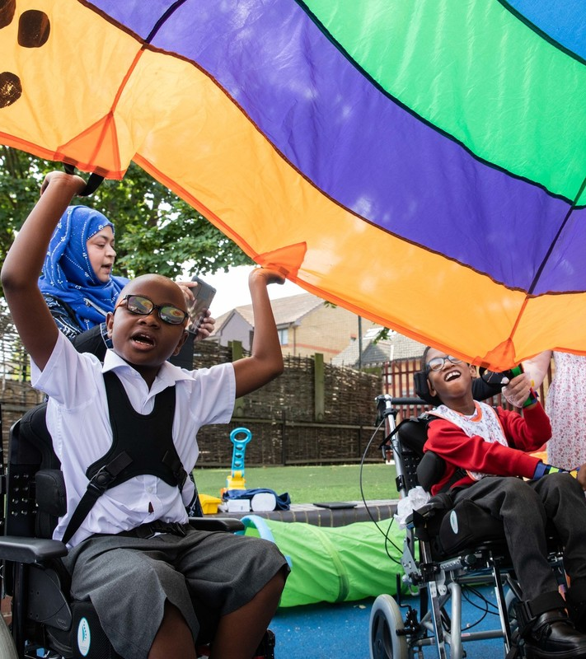
REFLECTION
© UNICEF/Dawe
Fairlawn Primary School in Lewisham
described how they are…
“embracing the uncomfortable”
…and learning from their school community to further develop their inclusive practice.
What might this phrase mean for us?
How can we learn with and from our school community?
Notes:
Presenter notes: You could ask people to write down personal commitments in the light of this reflection and collect these in and come back to them at the start of the next term to remind colleagues of their commitment and celebrate any progress.

Slide 14
RESOURCES
You may find the following resources useful for your work on Equality, Diversity and Inclusion:
A training resource exploring LGBTQIA+ inclusion
An article about embedding inclusion in schools through rights
RRSA Resource: Articles in Action
Transitioning Through Education for Refugee and Asylum-seeking young people in the UK
There are many organisations and materials that will help you explore diversity and inclusion further such as:
Stonewall School and College Champions
Oxfam’s Inclusive Language Guide
Diversity Role Models
Books
A Little Guide for Teachers: Diversity in Schools by Bennie Kara
Story book: Something Else by Kathryn Cave and Chris Riddell
Please note that resources and content from other organisations often don’t refer to the Convention.
Notes:
Presenter notes: If you have time, please explore these links ahead of your session with colleagues. You may well find a particular resource that you want to highlight to all as part of your input. There may be links you want to share with the team ahead of or as follow up to your input with them.
Encourage your colleagues to explore the RRSA website to find additional resources. If you have time, please explore these links ahead of your session with colleagues. You may well find a particular resource that you want to highlight to all as part of your input. There may be links you want to share with the team ahead of or as follow up to your input with them.

