Slide 1
Notes:
Opening slide

Slide 2
LEARNING OUTCOMES
Understanding what relationships and sex education requirements are in England, Scotland, Wales and Northern Ireland.
Understand what the UN Convention on the Rights of the Child has to say in relation to inclusion, diversity and LGBTQIA+ teaching and learning.
Take a first step towards creating an action plan for inclusion in your school.
Notes:
Outline the learning outcomes for the session.

Slide 3
A note on Language
UNICEF UK uses LGBTQIA+ (Lesbian, Gay, Bi/Bisexual, Trans/Transgender, Questioning or Queer, Intersex and Ace/Asexual) and Stonewall use LGBTQ+ as terms to imply inclusivity beyond the letters that make up the acronyms.
+ indicates an umbrella term that can include intersex, queer/questioning, asexual, non-binary, pansexual and many other terms
You should choose the acronym that works best for your students and your context. Always seek guidance from students on your choice.
To inform your use of language in this area, look at Stonewall’s Glossary and Getting Started Primary for age-appropriate definitions:
Notes:
A note on language and which acronyms you may wish to use.

Slide 4
Notes:
Where are we now?

Slide 5
Rse across the uk
England – All primary schools are required to teach Relationships Education and the Government recommends that they teach Sex Education, too. All secondary schools are required to teach Relationships and Sex Education. In primary Relationships Education, schools are required to teach about different families, and the Government 'strongly encourages' schools to include LGBT families in this teaching. Statutory guidance for teaching these subjects covers a range of topics including LGBT inclusivity, consent and social media.
Scotland – The Scottish Government published guidance on relationships, sexual health and parenthood education in 2014, which is currently being reviewed, but it's not compulsory and faith schools can follow their own guidance.
Wales – Compulsory, comprehensive and inclusive relationships and sexuality education for children from the age of three was introduced in Wales in 2022. This includes “LGBTQ+ experiences and lives”.
Northern Ireland - Relationships and Sexuality Education is mandatory for all pupils of compulsory school age within the Northern Irish curriculum. Although, “It is the responsibility of the Board of Governors of each school to ensure that a comprehensive programme is delivered which meets the needs of its pupils and aligns with its RSE policy.”
Notes:
Relationship and Sex Education
RSE in each devolved nation. In preparation for this session you may wish to expand upon the information provided for your nation or reflect on the progress you have made in developing an RSE curriculum in your school.
England
https://www.gov.uk/government/publications/relationships-education-relationships-and-sex-education-rse-and-health-education
Scotland
https://www.gov.scot/publications/conduct-relationships-sexual-health-parenthood-education-schools/
Wales
https://www.gov.wales/sites/default/files/publications/2022-01/curriculum-for-wales-relationships-sexuality-education-code.pdf
Northern Ireland
https://www.education-ni.gov.uk/articles/relationship-and-sexuality-education-rse

Slide 6
The equality act 2010
The Equality Act 2010 covers all aspects of school life including how a school treats students, parents, carers, staff and the wider community.
Everything a school does must be fair, non-discriminatory and not put individuals or groups at a disadvantage.
The Act defines several types of unlawful behaviour, including:
Direct discrimination.
Indirect discrimination.
Failing to make reasonable adjustments for disabled pupils or staff.
Discrimination arising from disability.
Harassment related to a protected characteristic.
Victimisation of someone because they have made, or helped with, a complaint about discrimination.
Notes:
The Equality Act 2010.

Slide 7
Why child rights & inclusion?
The UN Convention on the Rights of the Child can be a useful tool in creating a culture of inclusion.
The Convention is an international legal document so it is neutral but also a document the UK has ratified so there are expectations that the articles will be upheld.
The full text of the Convention discusses non-discrimination and lists a selection of groups. However, protected against discrimination on any basis should be interpreted to include LGBTQIA+ groups.
The language of rights is neutral in tone; it’s not about one group or a particular protected characteristic.
Rights are for ALL children and young people across the world.
They are universal, inherent, inalienable, unconditional and indivisible.
Notes:
Why Child Rights and Inclusion?
The Convention is an internationally ratified treaty and child rights are neutral - they are for no one group. At their core they are simply what is best for every child.

Slide 8
Which rights?
ACTIVITY
Look at the summary copy of the UN Convention on the Rights of the Child.
In groups, decide which articles are the most important to consider when thinking about inclusion and diversity in relation to LGBTQIA+ teaching and learning.
Choose your top six most relevant articles and come back together as a group to discuss your choices.
Notes:
Which Rights? Activity
Hand out summary copies of the Convention and large sheets of paper and pens. Divide participants into groups and ask them to decide which six articles are the most important to consider when thinking about inclusion and diversity in relation to LGBTQIA+ teaching and learning. Allow a few minutes to read through the Convention before moving on to discussion and writing down their chosen articles. After enough time has passed ask participants to come back together to discuss their articles and justify why they chose them.

Slide 9
Which rights?
Key rights to consider:
Article 2 of the Convention outlines that every child should be protected against discrimination on any basis.
Article 12 asserts that children should be able to express their views in matters that affect them and for those views to be taken seriously.
Article 13 defines children’s right to freedom of expression.
Article 16 articulates every child’s right to privacy, including protection against reputational attacks.
Article 29 sets out that education should prepare children and young people for life in a free society in the spirit of peace and tolerance amongst people from all groups.
Article 42 requires states to make children aware of the Convention and the rights enshrined therein.
The Convention also sets out the rights of parents.
Article 5 obliges states to respect the responsibilities, rights and duties of parents and guardians, in line with the evolving capacity of the child.
Article 14 articulates the right of parents and legal guardians to provide direction for children.
Notes:
Which Rights? Continued.
These are the articles the Unicef felt where the most important to consider in relation to LGBTQIA+ teaching and learning. The articles of the Convention apply to all children, whatever their race, religion or abilities; whatever they think or say, whatever type of family they come from or any other protected characteristic, including gender and sexuality. No child should be treated unfairly on any basis.
Article 2 says that children should be protected against discrimination on any basis and the full text outlines an inexhaustive list of groups – protection against discrimination on ANY basis should be interpreted to include LGBTQIA+ groups within this.

Slide 10
Action on inclusion: starter ideas
Article | LGBT inclusion idea
Article 2 – non-discrimination | Supporting staff to be out and proud if they want to be; visible role models can be very important for students. Ensuring policies and practices explicitly and specifically support LGBTQIA+ students and staff and are clear on what constitutes homophobic, biphobic and transphobic bullying and how the school prevents and tackles this. Gender-neutral awards ceremonies and ungendered student positions e.g. head boy or girl replaced by head student(s). Support girls and women into positions of leadership and encourage uptake in STEM subjects to redress gender stereotyping.
Article 12 – respect for the views of the child | Make the views of children and young people central to your work in this area and consult them at every stage. Form a specific Diversity and Inclusion Group to work with and actively seek to recruit students who are less heard from into this group. Carry out a survey to see what students see as the current issues in this area and what actions might be carried out to make improvements. Communicate with students how decisions where rights might seem to compete will be resolved (i.e. through discussion, balancing rights and values). Use regular surveys to find out what students' experiences are and use their responses to set your equality objectives and plan your inclusion work.
Notes:
Action on inclusion starter ideas linked to rights
As you present the starter ideas, ask for feedback and reflections from the group.

Slide 11
Action on inclusion: starter ideas
Article | LGBT inclusion idea
Article 13 – freedom of expression | Ask whether your uniform policy is gendered? Consider a neutral uniform policy with options for all pupils (i.e. beyond simply allowing girls to wear trousers). Welcome open discussions about LGBTQIA+ issues within lessons and invite students to run assemblies on issues that are important to them to build knowledge, awareness and inclusion. Use creative subjects like art, music, dance and drama to support freedom of expression. Consider visibility through badges, lanyards and posters. Consider offering pronoun badges. Celebrate visibility days and LGBT History Month in February in a calendar which features celebrations of a wide range of groups.
Article 16 – right to privacy | Audit spaces for gender inclusivity. Provide gender-neutral toilet facilities and sensitive changing spaces in consultation with young people throughout.
Notes:
Action on inclusion starter ideas linked to rights

Slide 12
Action on inclusion: starter ideas
Article | LGBT inclusion idea
Article 29 – goals of education | Be clear on what is expected under RSE guidance within your jurisdiction at primary and secondary. Explore LGBTQIA+ history and leading figures in lessons. Celebrate diversity and inclusion in all its forms through a weekly or termly ‘spotlight’. Have a flagpole and change the flag to reflect the ‘spotlight’ (eg Black History Month, pride, St David's Day etc.) and then using posters or display screens explore the meaning of the flag. Proactively promote mixed gender sport opportunities, and support trans and non-binary students to play the sports they feel most comfortable doing in PE kit that enables them to feel comfortable. Make sure that everyone is included. Help students learn about hate speech and discriminatory language. Having an opinion is allowed under British law but hate speech or discrimination is not!
Article 42 – knowledge of rights | Repeat the exercise on slide 8 and 9 with your School Student Council, your Diversity and Inclusion Group or a wider group of students to develop an inclusivity charter or incorporate articles on inclusivity and diversity into your existing school charter. Ensure students understand that school is an inclusive space where all students will be supported and their rights upheld. Ensure that inclusivity, diversity and children's rights are woven into your school’s policies.
Notes:
Action on inclusion starter ideas linked to rights

Slide 13
Action on inclusion: starter ideas
Article | LGBT inclusion idea
Article 14 – freedom of thought belief and religion | Make sure that the students know they are free to express their ideas but not to use language or behave in a way that is unkind to others. Strive to create an atmosphere where students feel safe to express their opinions. Be clear that staff and students understand how homophobic, transphobic and biphobic bullying are dealt with in school.
 | The Convention also sets out the rights of parents.
Article 5 – parental guidance and a child's evolving capacity | Recognise that there might be differing views at home and acknowledge that school is a distinct space and support sensitive discussion around this. Inclusive school policies are important and helpful in establishing school as a distinct space. Use a rights-based charter as part of your home school agreement, making sure the principles of celebrating inclusivity and diversity are clearly stated from the time children join the school. Be visible about your school’s support of LGBTQIA+ students so that this aspect of school life is clear to parents when a student joins.
Notes:
Action on inclusion starter ideas linked to rights

Slide 14
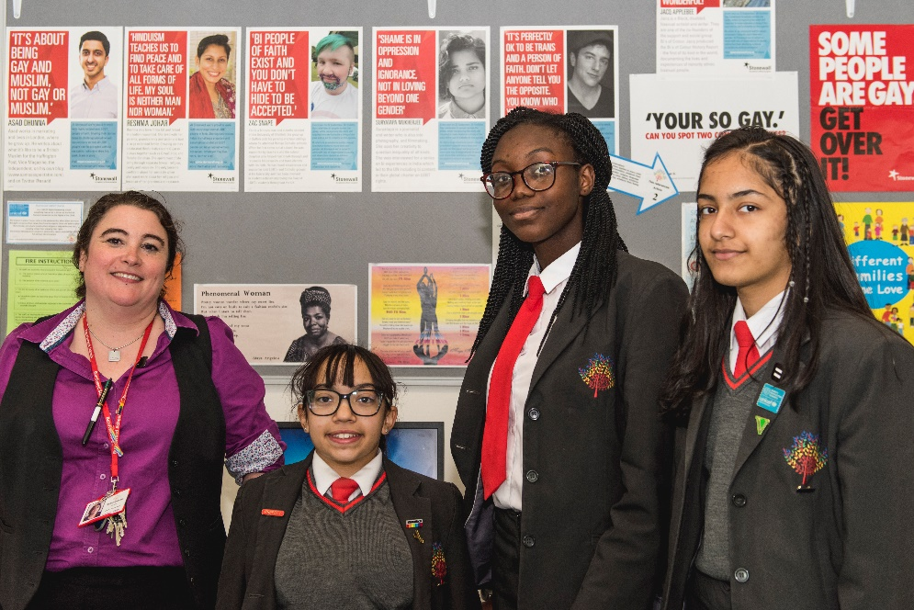
Case study:
burntwood school
Context: all girls secondary with mixed 6th Form
Pupils: 1750 on roll
Initiatives: Bronze Stonewall School Champions, Gold Rights Respecting School
Teacher: Katelyn, Assistant Principal, Stonewall School Champion and RRSA lead
“If your school is just starting out, set up a student equalities or equities group considering equality, equity and diversity for all, rather than one particular group.”
“Invite lots of different speakers with all kinds of protected characteristics. If you are in an environment where you might perceive opposition then by rooting your work in inclusion and rights, you are supporting all groups and everyone is included.”
“It helps if you have strong student voice within your school. It’s great if you have a forum where students can contribute to celebrating different days or periods of awareness, so they can ask to celebrate Black History Month, Odd Socks Day or Coming Out Day if the school doesn’t already do so.”
“Another thing we do to empower students is to fly daily-changing flags; each flag is chosen by the students and is flown in our central courtyard. Every building has a display screen on each floor and every day that has a dedicated section to explain what the flag represents. We have over 350 flags including the rainbow flag, the pansexual flag, the trans flag, the Unicef flag and any number of country and county flags. It’s a focal point for conversation and celebrating diversity. “
“We also have a home-school agreement which clearly and proudly states we are a Rights Respecting school and students are expected to behave in a way that enables everyone to enjoy their rights and treat everyone in line with our diversity policy.”
Notes:
Case study
Present the case study as it appears on the slide.
You may also choose to hand out printed out copies of longer case study (see link in Preparation section of presenters notes pdf).
You may want to build in time for ask for reflections from the group on what they have read, are there any ideas that the school undertook that could be used in your school context? Are there any aspects of Katelyn’s or the school’s approach that resonate?

Slide 15
ACTIVITY: CREATE YOUR INCLUSIVITY ACTION PLAN
You will need:
A flip chart page for each of the areas listed opposite.
Flip chart pens.
To get started:
Either in subgroups or as a whole group, discuss and note down ideas for each of the areas listed opposite and link them to an article of the Convention.
Give between 10 and 15 minutes to list actions for each area.
Bring the group back together and review the actions listed as a group and assign someone to carry each action forward.
Don’t forget to involve and consult young people on your approach to inclusion.
Consider:
Areas such as: school policies, tackling bullying and language use, curriculum and support, wider school community and school culture.
Link these actions back into the RRSA Strand B Outcomes where ‘actions and decisions involving children are rooted and resolved through rights.’
You might choose to create a separate plan for Inclusion and Diversity and have a member of staff champion that plan.
Alternatively you can include these actions within your RRSA plans at Silver and Gold and have the RRSA Lead oversee that these actions are carried out.
Notes:
Activity: Create your inclusivity action plan
Either in subgroups or as a whole group discuss and note down ideas for each of the areas listed and link them to an article of the Convention.
Give between 10 and 15 minutes to list actions for each area.
Bring the group back together and review the actions listed as a group and assign someone to carry each action forward.

Slide 16
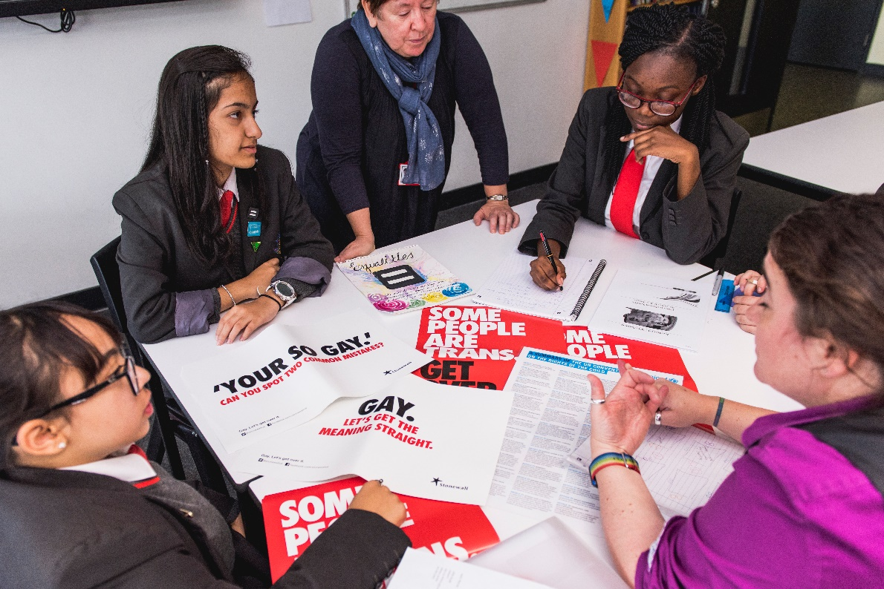
NEXT STEPS
Finalise your inclusivity action plan or incorporate your actions into your RRSA Gold or Silver Action Plan.
Consult with your students to benchmark where you are now and what might need to change. Feed these actions into your planning.
Put your action plan into practice!
If you are in England you can take the work further through Stonewall School & College Champion Awards. The programme allows schools to benchmark their progress and give direction to their ongoing work to tackle homophobic, biphobic and transphobic bullying and celebrate diversity.
Find out more: unicef.uk/stonewall_school_champions
Notes:
Next steps – plan to follow up on the progress you have made today and don’t forget to involve and consult young people on your approach to inclusion.

Slide 17
THANK YOU!
Notes:
Thank you.
Stonewall have a Relationship and Sex Education hub on their website with useful information and FQAs. To get in touch with Stonewall with any questions related to RSE or any issues raised by this resource at education@stonewall.org.uk

