Slide 1
Campaigning at UNICEF UK
Notes:
Intro me, my experience.

Slide 2
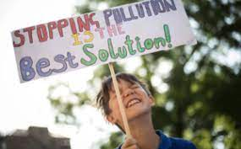
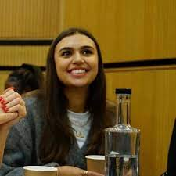
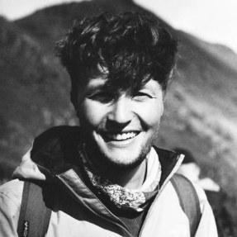
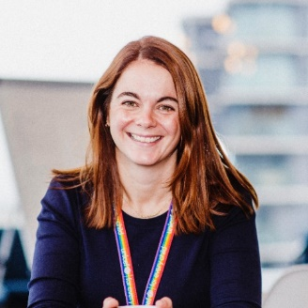
What is campaigning?
“To work in an organized and active way towards a particular goal, typically a political or social one, and influence those in power to act”
UNICEF UK’s campaigns team
Notes:
Campaigning, activism, advocacy, speaking up, using your voice, protesting, raising awareness and creating change... Together, we can achieve the change we want in our local communities, our country and across the world. Campaigning is about taking specific and organised actions (like taking part in OutRight!) to bring about positive change on an issue, and influence those in power to act.
At UUK I lead a Campaigns team that work to make policy and political change with and for children. We do that by developing inspiring and effective campaigns, and building a movement of active citizens – children and adults as allies – who champion children’s rights, and use their voice to make the world better for and with children. Our role involves lots of working across the organisation, with our network of 160,000 activists, with colleagues that work in media, ambassador relations, policy, political affairs, and marketing, and with young people through OutRight to create an environment whereby people in power are empowered, emboldened and informed to make changes that protect or advance children’s rights.

Slide 3
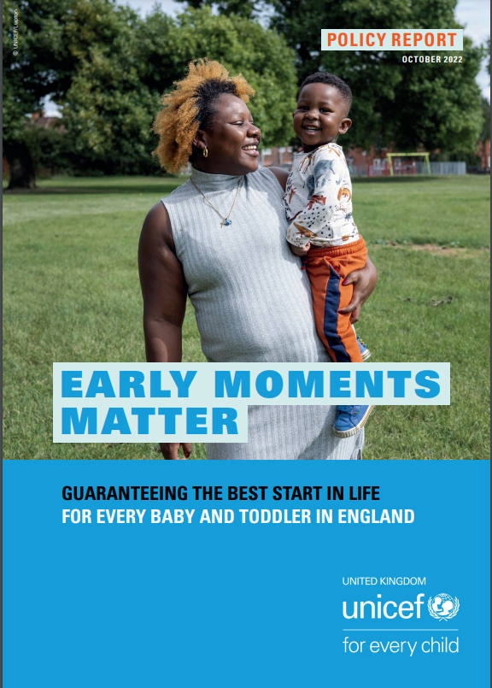
Our current campaigns
Early Moments Matter
We’re calling on the UK Government for a Baby and Toddler Guarantee, setting out what services all babies and toddlers are entitled to, wherever they are born, with accountability mechanisms to ensure they receive it. It includes midwifery, health visiting, infant feeding, mental health support and early education.
Futures at Risk:
COVID, conflict, climate change and spending cuts continue to impact the lives of children around the world and risk decades of progress on protecting children’s health being undone.
We are campaigning for the UK Government to fund and prioritise supporting countries to deliver, healthcare services around the world – including nutrition support and vaccinations

Slide 4
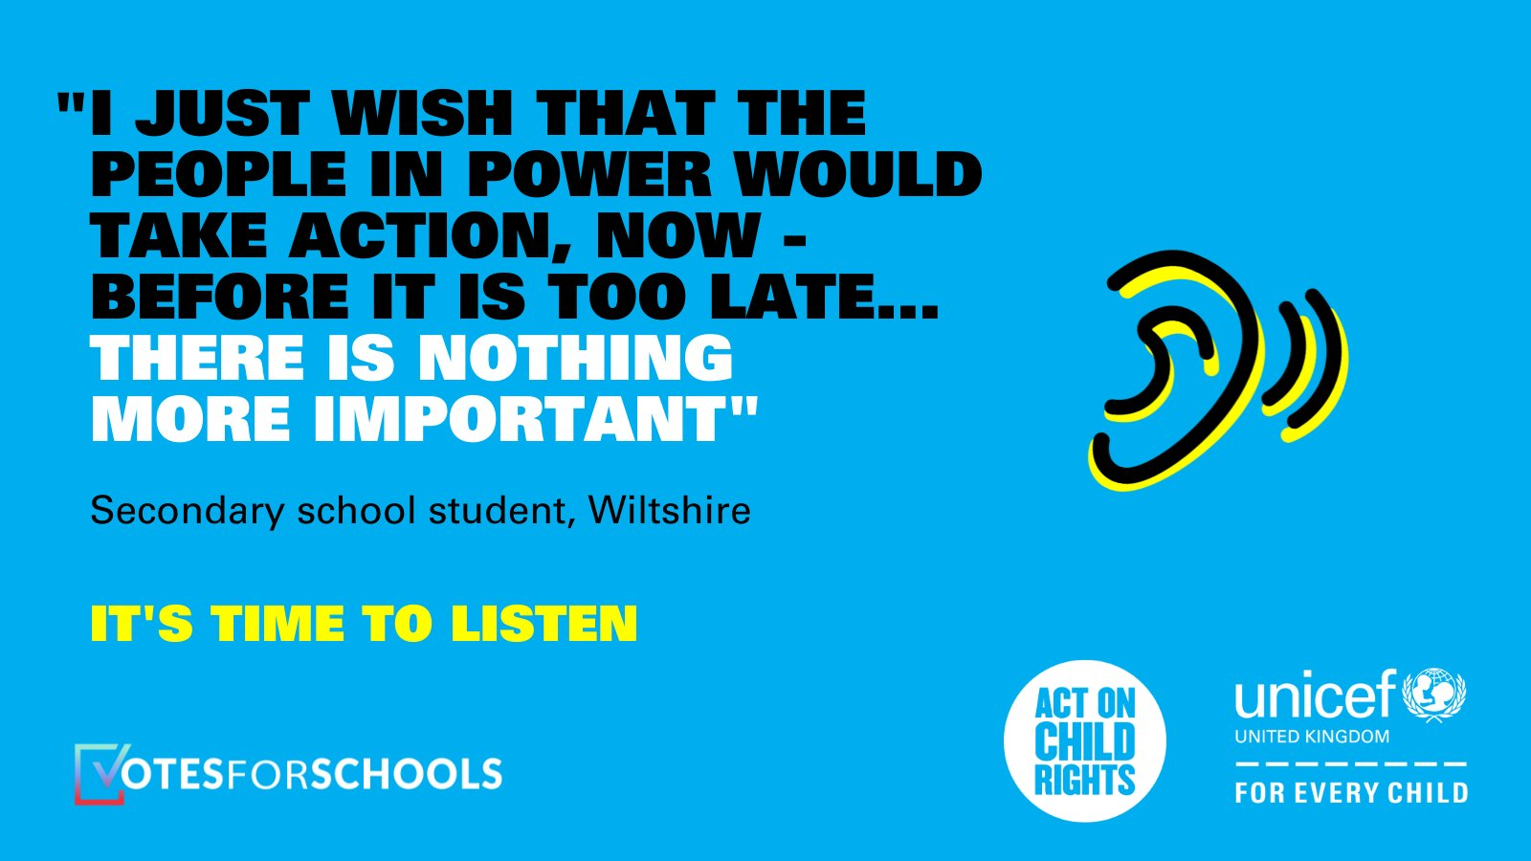
Our current campaigns
Climate change:
We are starting to develop our work on climate change now, that will last until 2026.
We are calling on the UK Government to acknowledge the scale of the problem facing children globally in relation to climate change, and show commitment to becoming a champion for children affected by climate change.
OutRight:
Our advocacy campaign for young people, OutRight, provides learning materials to empower children to take action on children’s rights.
This year’s theme is adaptation, and participants will be sharing their views with MPs, the public and the media ahead of COP28 in November

Slide 5
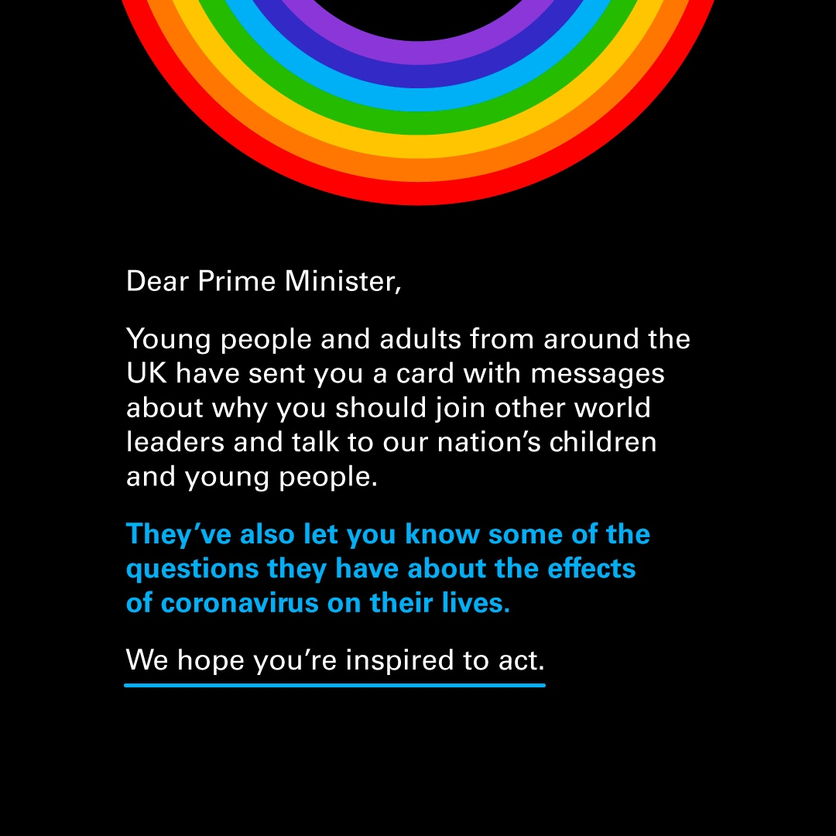
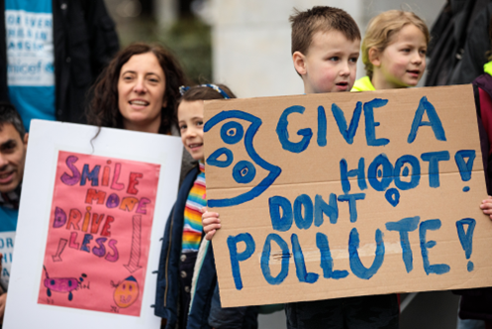
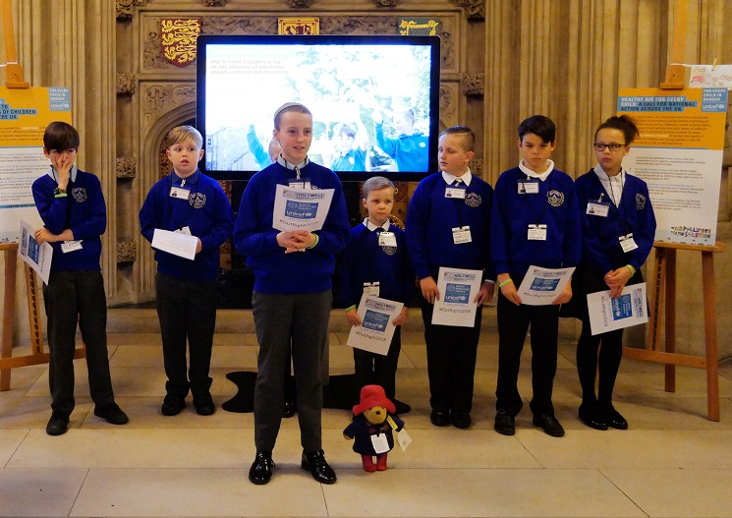
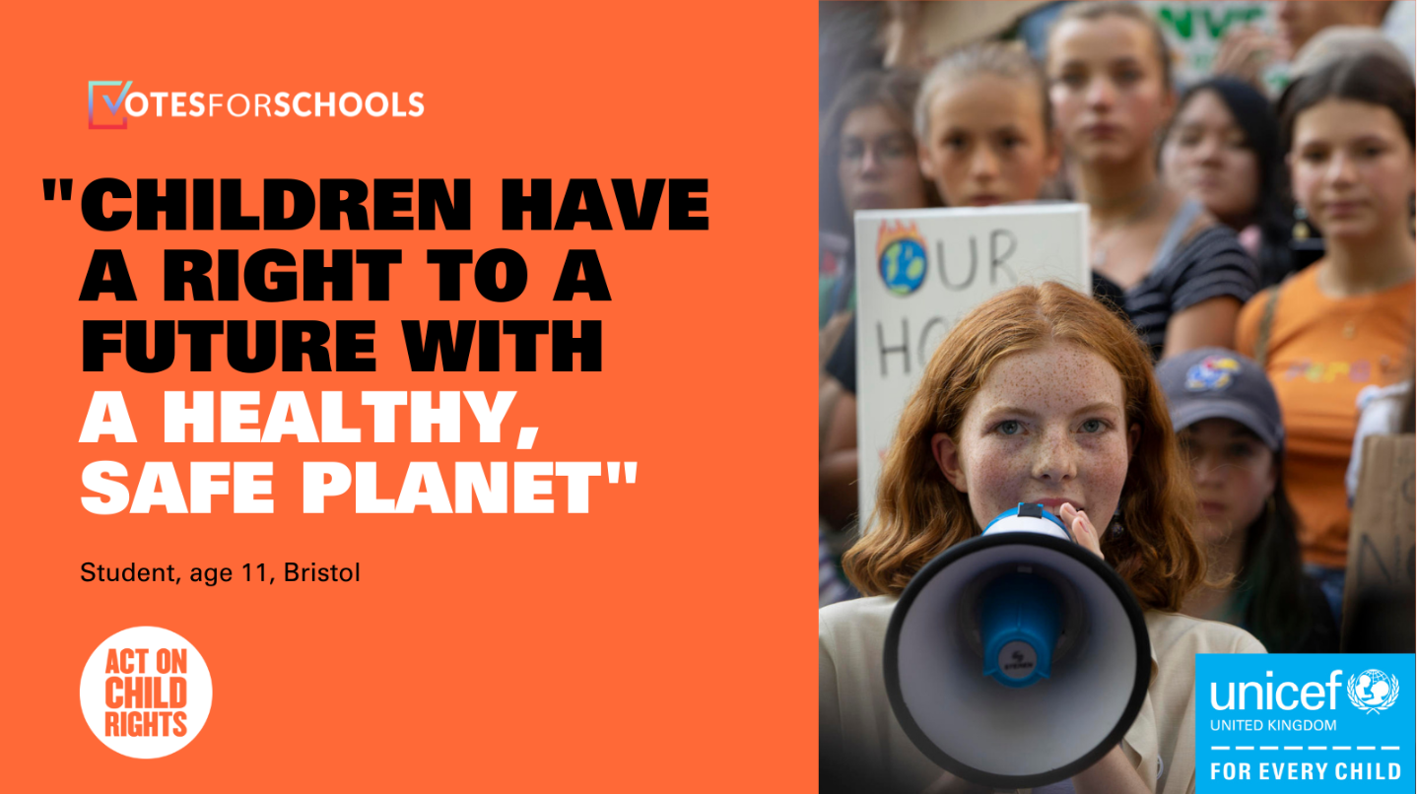
Why should children campaign?
Why its important…
They can make a difference to their life, their family, their community, their world;
They can hold their government accountable for protecting their rights and the rights of their peers.
They can support children’s rights by speaking directly to decision-makers like MPs, in their own words
They can help UNICEF UK show there is a mass of support for what we’re asking – both across the UK and in their constituencies
And it helps them develop skills…
Strategic thinking
Communication
Teamwork
Confidence
Creativity
Resilience
Notes:
Children have an important role to play in campaigning to create change. Their voices matter and they have the right to say what they think. Its important that they explore campaigning.
Firstly - Campaigning on issues that affect them can make a real difference. By signing petitions, making videos, writing blogs and speaking to representatives and decision-makers (like an MP or councillor) and the media, children can show those in power just how much they care about children’s rights here and around the world.
Under the CRC, governments are duty-bearers. This means they must fulfil the obligations set out in the convention so that the rights of children and young people are met. As rights holders, it’s important that children and young people are supported to speak out on the issues that affect them, and are heard by key decision-makers at every level. While duty-bearers hold the responsibility of making sure rights are met, children and young people can promote their rights as well, for example by raising their voices to ask for change, including through the activities in this pack. OutRight empowers children to speak out about their rights, inspiring them to stand up for their own rights and those of other children, in the UK and around the world, and strengthening their knowledge and understanding of children’s rights.
But secondly, it builds important skills for them too. Campaigning takes a long time, and you get knocked back along the way. It build resilience. It builds communication skills as you have to make your same point over and over.

Slide 6
How does UNICEF UK develop a campaign?
Deciding where to focus our energy: the big questions:
What do children care about? How are children are affected by this issue? How widespread is the impact?
Does the UK Government have the mandate to make a change on this issue?
Do the UK public care about this issue? Can we get them to care?
What is UNICEF’s USP on this issue?
And once we’ve decided on a topic we ask:
What do we want the UK Government to do?
Who is responsible for that decision?
Why are they not doing what we want them to do already? (e.g. they haven’t heard our solution, they don’t believe the public care enough, it costs too much money, they don’t know there’s a problem)
What can UNICEF UK do to convince them? E.g. finding and sharing evidence with the right people, having direct conversations with decision-makers, supporting children, young people, and the public to speak out, getting information into the media
Notes:
We have various tools to do answer that last question. From things called barrier analysises, to problem trees. We route out how we can create change and develop a theory of change.

Slide 7
Notes:
That top line looks something like this…

Slide 8
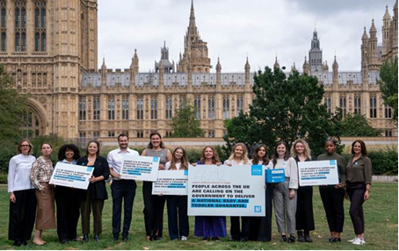
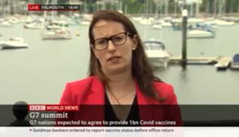
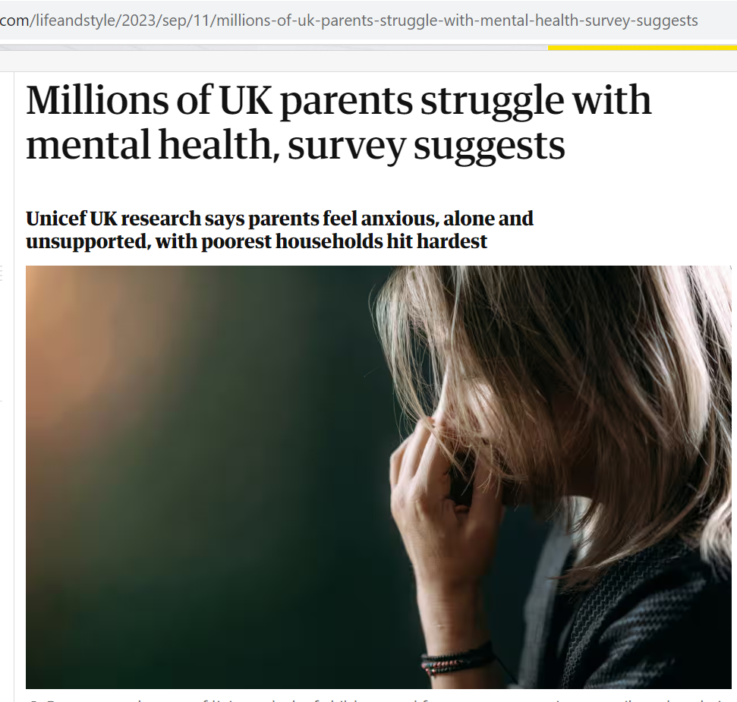
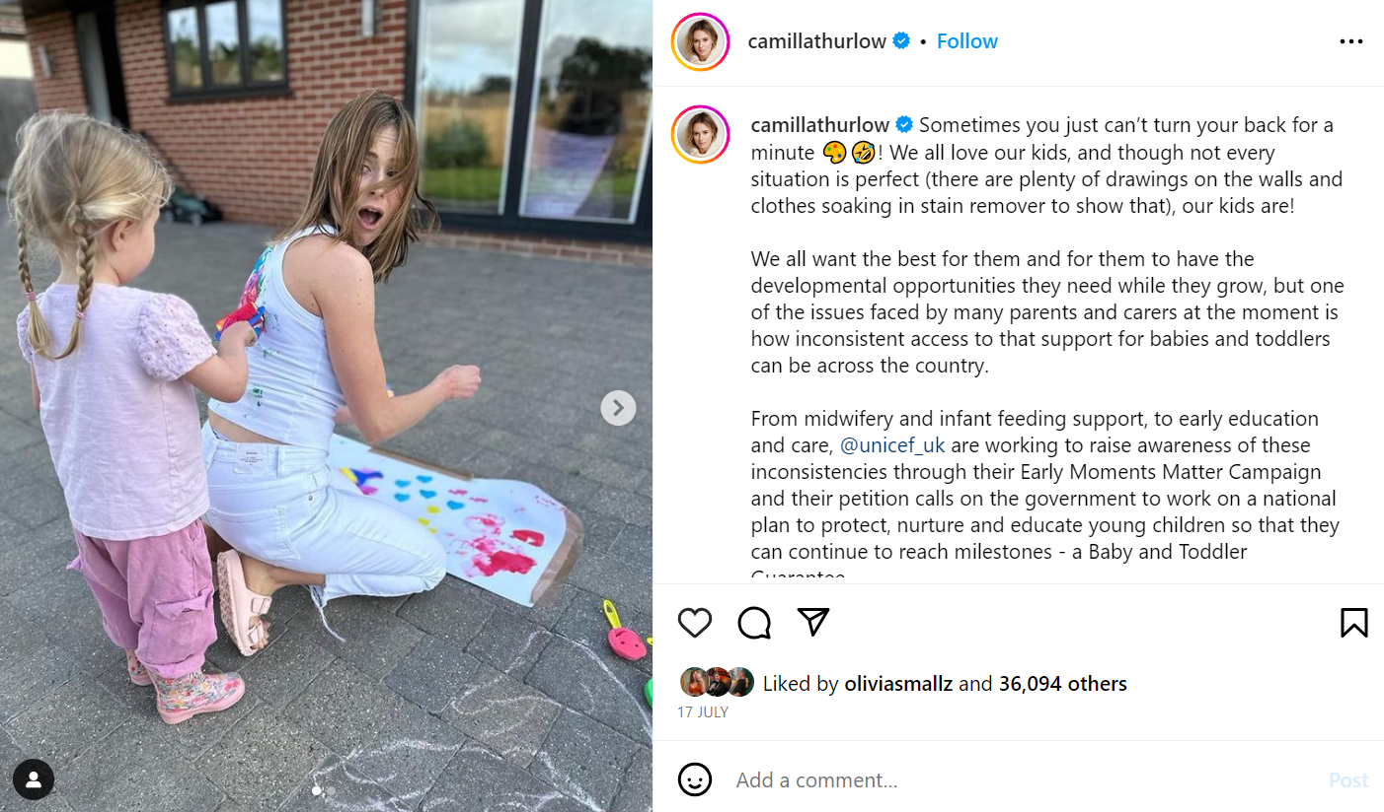
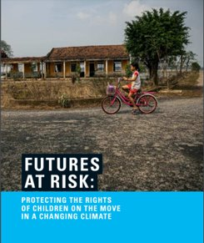
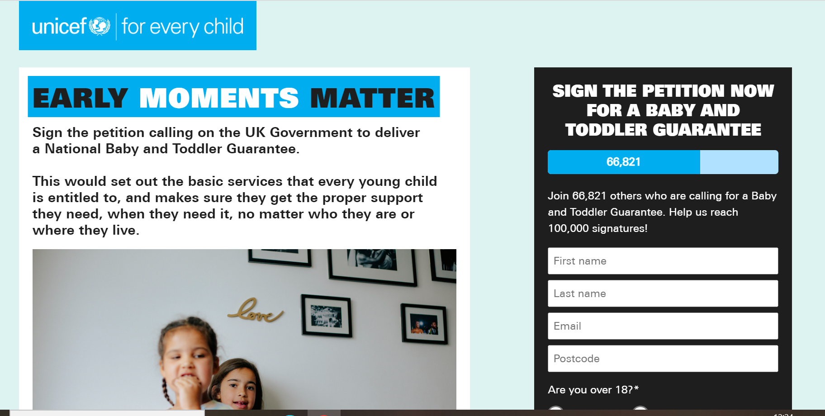
Notes:
And from there, we decide activities that can support our work. These can be petitions, asking people to write to their MP, engaging the media – both as UUK and campaigners doing so themselves, social media campaigns, exhibitions and events in Parliament, policy reports, meetings with key stakeholders, building relationships with the sector. And importantly, engaging rightsholders, like the children you work with, to engage with our campaigns – either through contributing to what they look like, or using their voice to amplify them.

