Slide 1
© UNICEF/Dawe
CAMPAIGNING IN SCHOOL
Notes:
Welcome to Spotlight, our latest resource to support RRSA coordinators to develop Rights Respecting practice in school.
Unlike Article of the Week, Spotlight is aimed at colleagues and is intended to support you in staff briefings or continued professional development (CPD).
Please check guidance in subsequent slide notes.

Slide 2
CONTENTS
For each slide, please look at the presenter notes for delivery information.
We know that many schools participate in the UNICEF UK OutRight campaign to support their work on campaigning, but this pack is intended to support you with developing your campaigning work more broadly.
Slide 3: Aims of the Session
Slide 4: Three ways to use this pack
Slide 5 : Introducing this month’s Spotlight
Slide 6: Links to RRSA Outcomes
Slide 7: Links to Articles
Slide 8: Case Study 1 - Alexandra Primary School
Slide 9: Case Study 2 - Duncow Primary School
Slide 10 & 11: Let’s Discuss
Slide 12 & 13: Activities
Slide 13: Reflection
Slide 14: Resources
Notes:
Presenter notes: For each slide, please look at the presenter notes for delivery information. You may wish to amend or delete this slide when you deliver the session in your school.

Slide 3
AIMS OF THE SESSION
To understand what campaigning is, how to do it, and your role as a facilitator.
To understand how campaigning can empower and engage children and young people.
To understand how campaigning fits into the RRSA framework.
Notes:
Presenter notes: Please edit the aims of the session to suit the time you have available for your session.
This session is intended to support you in supporting staff to develop their understanding of what campaigning is, why it is something that you should be supporting children and young people to engage with as part of your Rights Respecting Schools journey and their role in facilitating young people to engage with campaigning.
The whole Spotlight series is about embedding children’s rights within a wide range of school priorities and practices.

Slide 4
WAYS TO USE THIS PACK
DELETE THIS SLIDE BEFORE USING
If your time is tight, use the introduction slide and choose from the key discussion questions to explore with your colleagues.
If you have longer, you can also choose some of the activities to explore.
You may wish to cover the content over several staff meeting sessions.
There are trainer notes for each slide – please do have a look at these for further guidance.
There
Notes:
Presenter notes: Delete this slide before using.
It would be useful to have copies of the simplified CRC or the icons so that staff can refer to them throughout the session.
unicef.uk/CRC_Icons

Slide 5
SPOTLIGHT ON…
We know when children and young people are familiar with their rights and understand rights are unconditional and universal it empowers them to speak out and act if their own rights or the rights of others are not being met.
In a Rights Respecting School, pupils have their voice heard and are involved in decisions that affect their lives.
Opportunities for them to facilitate and support campaigning will arise through the curriculum, exploring current affairs and personal experience.
Nancy, UNICEF UK Campaigner, introduces this month’s Spotlight.
Notes:
The video complements the content of this pack and can also be used separately.
Presenter notes:
OutRight is UNICEF UK’s annual campaign and is a great way to engage in a national campaign with the support of resources and activities. Find out more about the current campaign on the RRSA website:
www.unicef.org.uk/rights-respecting-schools/resources/teaching-resources/outright/
Previous campaign details and resources can be found here:
www.unicef.org.uk/rights-respecting-schools/resources/teaching-resources/outright/outright-archive/
UNICEF UK has a helpful Youth Advocacy Toolkit which outlines a straightforward process for creating an impactful campaign: https://downloads.unicef.org.uk/wp-content/uploads/2019/03/Youth-Advocacy-Toolkit.pdf
It uses a series of step-by-step prompts such as:
Explore. What’s the problem? What would you like to change?
Think. Break down the problem, consider what needs to happen and whose responsibility it is to make the changes (e.g. your local council)
Act. What do you need to do? Think carefully about what actions are most likely to support change.
Evaluate. Did it work? What did you learn? Is there more to do?
It’s important to remember that campaigning isn’t about just doing more good things, it’s about trying to make a difference. Your role in it is to support children and young people to develop agency, ensuring they feel able to affect the things that matter to them in their world.

Slide 6
LINKS TO RRSA OUTCOMES
Strand A: TEACHING AND LEARNING ABOUT RIGHTS
Outcome 1: Children, young people and the wider school community know about and understand the United Nations Convention on the Rights of the Child and can describe how it impacts on their lives and on the lives of children everywhere.
Strand C: TEACHING AND LEARNING FOR RIGHTS
Outcome 9: Children and young people have taken action to claim their rights and promote the rights of others, locally and globally.
Notes:
Presenter notes:
This slide provides an opportunity to remind colleagues of the ‘structure’ of RRSA which includes three strands: Teaching about rights; through rights; and for rights.
Campaigning is linked with both Outcome 1 in Strand A and Outcome 9 in Strand C.
Strand A, Outcome 1:
Pupils need to develop knowledge and understanding of children’s rights and how children and young people can access their rights, or not, in their own community and the wider world. This knowledge of the wider world can be developed through assemblies, curriculum topics and subject areas, access to news programmes such as Newsround and Picture News and awareness of the Sustainable Development Goals. Their knowledge of global and local issues and how they impact on rights will start them thinking about areas they want to take action on.
Strand C, Outcome 9:
As your school moves through Silver to Gold, it is expected that more and more pupils will have the opportunity to engage in taking action for the rights of others. This includes advocacy and fundraising, but also campaigning. Campaigning activities within this strand could include any work you do on UNICEF UK’s Outright campaign, other campaigns such as Send My Friend to School, and/or campaigns initiated by your pupils themselves on issues they are passionate about.
The full text of the Strands and Outcomes of the Award can be found here:
www.unicef.org.uk/rights-respecting-schools/wp-content/uploads/sites/4/2015/06/RRSA-Strands-and-Outcomes-at-Silver-and-Gold-1.pdf

Slide 7
LINKS TO ARTICLES
Look at the summary of the CRC with a partner – which articles do you think are particularly relevant to our work on campaigning?
When ready click to reveal.
Although many other articles may also be linked depending on the campaign topic that the learners choose to focus on.
Notes:
Presenter notes: When showing this slide in presenter mode the articles will appear on click.
Look at the summary of the CRC with a partner – which articles do you think are particularly relevant to our work on campaigning? Give good time for people to think about and discuss the links. Your colleagues may identify different articles to the ones displayed. If time permits, encourage staff to explain their choices.
CRC Summary: unicef.uk/CRC_Icons

Slide 8
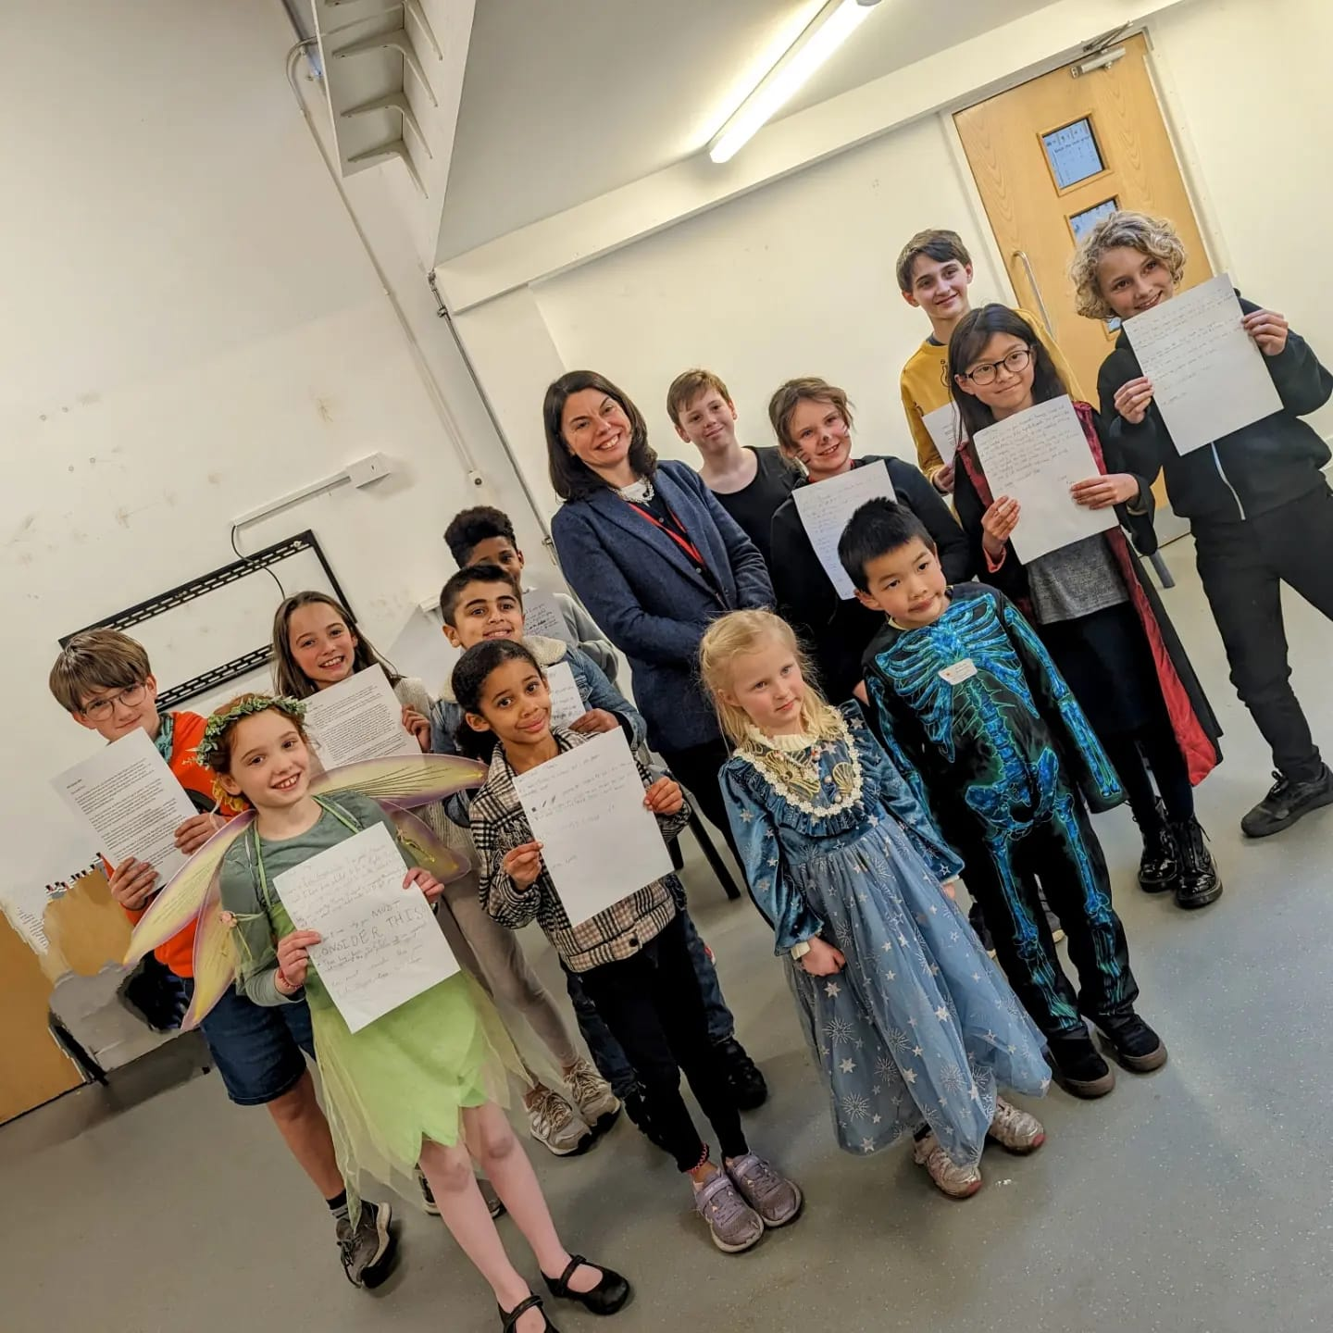
MP Sarah Olney visited students at Alexandra Primary School after they wrote to her, urging her to support their campaign on food poverty.
CASE STUDY
Look at this case study from Alexandra Primary School
Read the full case study online.
Campaigning is pupil-led and involves children taking leadership roles, engaging with the community, supporting external campaigns, and advocating for social and health-related issues.
Being part of the UNICEF UK OutRight campaign had a profound impact, extending beyond our student council to all students. It made every child conscious of the need to safeguard children's rights through robust healthcare systems worldwide. This awareness ignited a passionate student commitment to support those in need.
MP, Sarah Olney’s visit instilled in the children a sense of participating in a broader change and realising their potential for far-reaching impact.
Notes:
Presenter notes: The full case study is available on the RRSA website, where you can print it out and share with your colleagues if you are choosing to focus on this as part of your session. Encourage staff to consider whether there are any examples of good practice within this case study that your school could draw on and learn from.

Slide 9
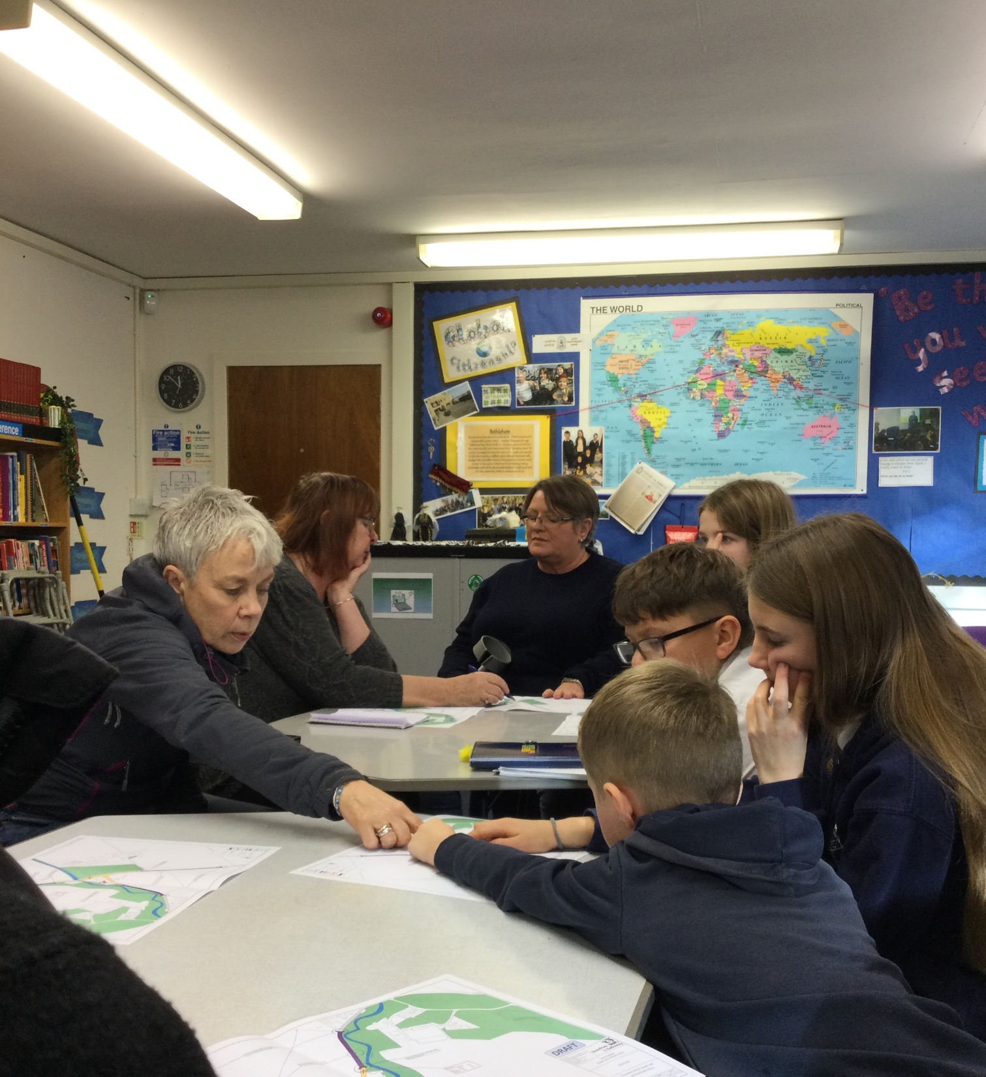
Pupils at Duncow Primary School discuss plans to make the roads around their school safer.
CASE STUDY
Look at this case study from Duncow Primary School
Read the full case study online.
The students wrote to local councillors, the roads department, families and the local community. They wrote an article for the community magazine and asked our community police officer to come and speak to pupils.
Each year, the student group took on the aim to ‘lower the speed limit’. Pupils made their case to all who would listen, culminating in a meeting with local councillors, roads department, parent council and our students.
​Together with the local community, the students had secured change, and they knew their voice had been heard. It may have taken a while, but the outcome was better than we imagined.
Notes:
Presenter notes: The full case study is available on the RRSA website, where you can print it out and share with your colleagues if you are choosing to focus on this as part of your session. Encourage staff to consider whether there are any examples of good practice within this case study that your school could draw on and learn from.

Slide 10
LET’S DISCUSS
3. What are our learners already doing that is making a difference locally, globally?
2. Why should we create opportunities for our pupils to campaign?
1. How do you define ‘campaigning’?
Notes:
Presenter notes: Choose the questions that are most relevant to your setting and experience. Collect some of the ideas from your colleagues and add them to your action plan/evidence.
Whilst there’s no single definition of a campaign, a good rule of thumb might be to think of it as ‘an organised course of action to bring about positive change and influence those in power to act.’ In the context of RRSA this should focus on supporting children to access their rights. Encourage your colleagues to think about what sets it apart from pupils simply taking part in one-off helpful activities.
Encourage colleagues to think about the potential benefits for pupils. You may wish to reflect on the case studies which discuss the impact that campaigning has had on pupils in their school. Positive benefits may include increased confidence, strategic thinking, communication skills, teamwork, creativity and resilience, and also the sense of empowerment, that they are able to make a positive change in the world.
Have a think about what is already happening around the school that may link to campaigning or making a difference, e.g. Fairtrade group, Eco Group, Anti-racist/inclusion groups. How could we raise awareness of these and encourage wider participation?

Slide 11
LET’S DISCUSS
6. Can you think of any challenges in involving learners in campaigning? How can they be overcome?
4. How can we support our learners to explore global issues so that they can make informed decisions about what to campaign about?
5. How can we create more opportunities for campaigning?
Who? When? What?
Notes:
Presenter notes: Choose the questions that are most relevant to your setting and experience. Collect some of the ideas from your colleagues and add them to your action plan/evidence.
4. It is important that children and young people are well informed about the issues they are campaigning on if the campaigning work they do is to be meaningful and non-tokenistic. Are there opportunities within the school day for children and young people to explore global issues, issues that impact on people across the world? Are learners encouraged to consider how these issues link to children’s rights being respected or denied? How could we ensure that this is happening systematically across our setting?
5. Encourage colleagues to discuss this question in phase/year teams or subject teams/faculties. Consider the following:
Who could be involved in campaigning? Think about whether it could be whole school, or certain subjects/year groups/pupil voice groups. Which staff would need to be involved?
When? Should this be part of the taught curriculum or part of an extra-curricular club? Could we deliver this in a drop down day or special week or should it be ongoing throughout the year? Is there a time when it would be particularly good for learners to be involved in campaigning?
What? What resources will we need to support the process? Consider time, space, budgets…
6. What challenges might involving learners in campaigning present? List some of these challenges and for each one, consider how this could be overcome. One important thing to consider is the legal requirement for schools in England to be politically impartial. This does not prevent young people campaigning but it is important for teachers to be aware of the legislation. https://www.gov.uk/government/publications/political-impartiality-in-schools/political-impartiality-in-schools

Slide 12
ACTIVITIES
In groups, draw a Rights Respecting classroom onto large pieces of flipchart paper. What do you see, hear and feel in a Rights Respecting classroom?
2. What issues are pupils passionate about? Plan an activity to be used with the school council, RRSA group, classes or the whole school to identify issues children could lead a campaign on.
3. How can you campaign in a creative way? As a group, choose a topic and mind map creative ways to campaign on this issue.
1. Consider your entire curriculum. Carry out a quick audit to explore where existing content might provide opportunities for learner led campaigning.
Notes:
Presenter notes: There are six suggestions for activities. Depending on the time you have available, choose one or more activities for your colleagues to work on together to further explore the topic. Different groups could explore different activities. The activities that you do not wish to use can be deleted.
Activity 1: This is an opportunity to reflect on your existing curriculum offer and identify areas where you could build in opportunities for children and young people to campaign for change. Consider topics and learning that could be extended to allow for a campaign to be planned and carried out. How can you incorporate these into plans for this year or the following academic year?
Activity 2: This may be gathered from questionnaires, pupil voice focus groups, PSHE lessons or tutor time, or through the school council. How can you decide which issue to work on?
Activity 3: Encourage your colleagues to consider how music, art, crafts, sports or another activity could be linked to campaigning on an issue.

Slide 13
ACTIVITIES
In groups, draw a Rights Respecting classroom onto large pieces of flipchart paper. What do you see, hear and feel in a Rights Respecting classroom?
4. When students engage in campaigning, many learning attributes and outcomes are at play. Work together to map these to help everyone see potential educational ‘spin offs’ from quality campaigning.
5. Look through the OutRight resources. How can you use in school? Would you need to adapt anything? Plan your involvement in the OutRight campaign.
6. Using the Problem and Solution Tree* explore an issue important to you or your community. How could you use this model with learners?
Notes:
Presenter notes: There are six suggestions for activities. Depending on the time you have available, choose one or more activities for your colleagues to work on together to further explore the topic. Different groups could explore different activities. The activities that you do not wish to use can be deleted.
Activity 4: This activity will support your colleagues to think through the benefits of campaigning and consider how campaigning will support your pupils to develop a range of skills.
Activity 5: This is a perfect time to get your colleagues to plan out your involvement in the annual UNICEF UK OutRight Campaign or a similar campaign such as Send My Friend to School.
Activity 6: Encourage your colleagues to go through the process of identifying a problem and then a solution. Once you have done this, reflect on how you could best facilitate learners to work through this process.
*The Problem and Solution Tree can be found on pages 8 & 9 of the Youth Advocacy Toolkit. You find the pdf and print from here: https://downloads.unicef.org.uk/wp-content/uploads/2019/03/Youth-Advocacy-Toolkit.pdf

Slide 14
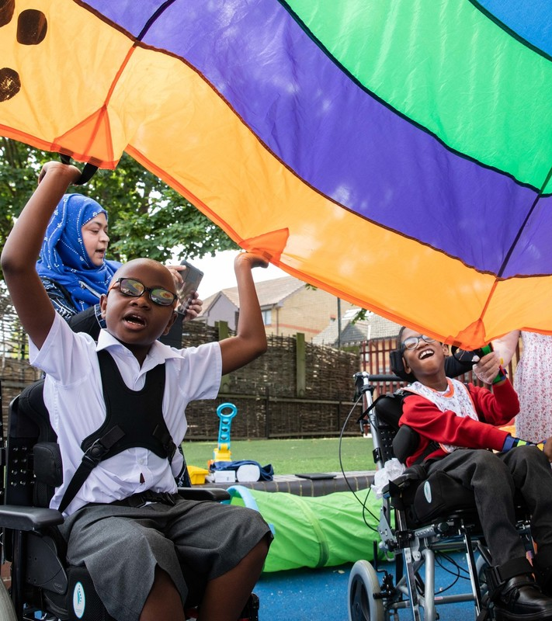
REFLECTION
© UNICEF/Dawe
Children in Gold: Rights Respecting schools sometimes describe themselves as ‘changemakers’ – in fact, Bonner Primary School in East London renamed their school council just that!
Do you think the pupils you work with could be, or are changemakers?
If not what is needed to make this possible?
Notes:
Presenter notes: You could ask people to write down personal commitments in the light of this reflection and collect these in and come back to them at the start of the next term to remind colleagues of their commitment and celebrate any progress.

Slide 15
RESOURCES
You may find the following resources useful for your work on campaigning:
Youth Advocacy Toolkit
UNICEF UK’s OutRight Campaign
Guide to Global Citizenship
The Power of Campaigning | RRSA Conference 2023
UNICEF UK’s RRSA Team provide training which may be of use to you or colleagues:
Introduction to Global Citizenship training course
Strengthening Global Citizenship training course
RRSA E-learning: Global Citizenship in a Rights Respecting School
There are many other organisations and materials that will help you explore campaigning further such as:
Send My Friend to School campaign
Global Goals and the World’s Largest Lesson
Books
Art of Protest: What a Revolution Looks Like by De Nichols
Children Who Changed the World by Marcia Williams
Notes:
Presenter notes: If you have time, please explore these links ahead of your session with colleagues. You may well find a particular resource that you want to highlight to all as part of your input. There may be links you want to share with the team ahead of or as follow up to your input with them.
Encourage your colleagues to explore the RRSA website to find additional resources. If you have time, please explore these links ahead of your session with colleagues. You may well find a particular resource that you want to highlight to all as part of your input. There may be links you want to share with the team ahead of or as follow up to your input with them.

