Slide 1
Safeguarding at UNICEF UK
Notes:
© UNICEF/UN0637589/Bashizi Dorcas 2022
https://weshare.unicef.org/archive/-2AMZIFFXVND1.html
CAPTION OPTIONS:
Dorcas, 10, in Democratic Republic of Congo, says "I'm going to go on to secondary school to be a boat captain."
Dorcas, 10, in her school near Goma, Democratic Republic of Congo, which was rebuilt following a volcanic eruption.
Dorcas, 10, says "I'm going to finish my primary education soon and go on to secondary school to be a boat captain." Her school near Goma, Democratic Republic of Congo, was rebuilt following a volcanic eruption.

Slide 2
Safeguarding through a child rights lens.
Non – discrimination (Article 2)
Best Interest of the child (Article 3)
Right to life survival and development (Article 6)
Right to be heard (Article 12)
As the custodian of the United Nations Convention on the Rights of the Child (UNCRC), we embed the General Principles and Articles of the UNCRC in all we do.
We are committed to upholding Article 19 of the UNCRC. This declares all children, wherever they may live and whatever their circumstances, have the right to be protected, nurtured and to be free from all forms of violence, abuse, neglect, maltreatment, and exploitation. At UNICEF UK we endeavour to make this a reality for all children.
Notes:
©UNICEF/Mette Nambia 2022
Resource Space: 202485 https://unicef.resourcespace.com/?r=202485&k=12cb2f55d1
Caption:
Kuhatjiua and Nopoo take part in Galz and Goals, a partnership between the Namibia Football Association and UNICEF, that empowers girls through sport.

Slide 3
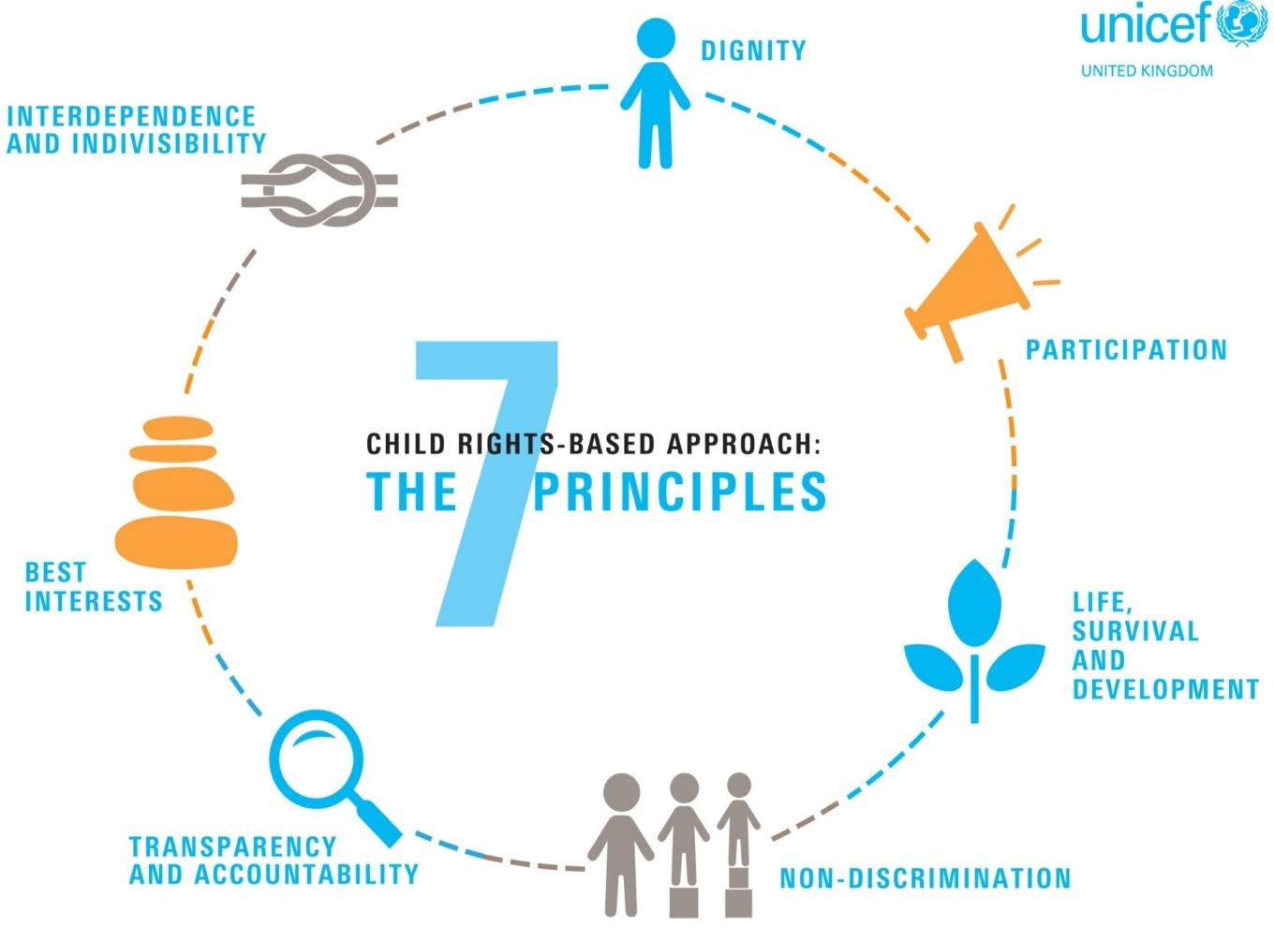

Slide 4
Understanding safeguarding through a child rights lens.
Creates a shared language and common understanding.
Provides foundations for children to express themselves and have a voice.
Helps to break down what safeguarding is and supports effective implementation of safeguarding practices.
Supports the creation of a child centred and holistic safeguarding approach.
Supports co-creation of safeguarding practices and mechanisms.
Notes:
© UNICEF/Catu
Romania 2022
Resource Space: 195626 https://unicef.resourcespace.com/?r=195626&k=e5823c9b8d
CAPTION:
Inga, 6, attends the UNICEF Blue Dot centre in Romania, that supports families who have fled the war in Ukraine.

Slide 5
Do pupils in English schools feel safe?
In Autumn 2022, Edurio and The Key carried out England’s largest review of children’s own feelings of safety in school and beyond.
Together they surveyed 70,000 pupils across 373 schools and 41 trusts, and found that:
Overall feelings of safety: Whilst the majority of pupils feel safe in school, around a quarter felt only fairly safe, not very safe, or not safe at all.
One in ten pupils (10%) reported that they had missed school recently because they felt unsafe at school.
For pupils who felt unsafe in school, other pupils were the most likely to make them feel unsafe
Notes:
© UNICEF/UN0658408/Bunsak
Cambodia 2022
https://weshare.unicef.org/archive/-2AMZIF9XTQ0R.html
CAPTION:
Heng, 12, a Grade 6 student at school near Phnom Penh, Cambodia. UNICEF is working with schools to help children catch-up on the learning lost during the COVID-19 school closures.

Slide 6
Peer-on-Peer Abuse
Baseline data was collected by the Anti-Bullying Alliance from 29,308 pupils aged between 5 to 18 years old, who attended 208 schools throughout England, between November 2021 to February 2022.
Key findings include that:
• 24% of pupils report being frequently bullied.
• Pupils in receipt of Free School Meals (30%), and those with SEND (31%) are significantly more likely to be frequently bullied.
ONLINE BULLYING
The Office for National Statistics Online bullying in England and Wales: year ending March 2020, found that:
Around one in five (19%) 10- to 15-year-olds experienced at least one type of online bullying behaviour.
Equivalent to 764,000 children are impacted.
Equivalent to 764,000 children.

Slide 7
HARMFUL SEXUAL BEHAVIOUR
Ofsted found, in its Review of sexual abuse in schools and colleges, June 2021, that the girls who responded to its questionnaire indicated that the following types of harmful sexual behaviour happened ‘a lot’ or ‘sometimes’ between people their age:
sexist name-calling – 92%
rumours about their sexual activity – 81%
unwanted or inappropriate comments of a sexual nature – 80%
being sent pictures or videos they did not want to see – 88%
being put under pressure to provide sexual images of themselves – 80%
Unwanted touching – 64%
Sexual Assault of any kind – 79%

