Slide 2
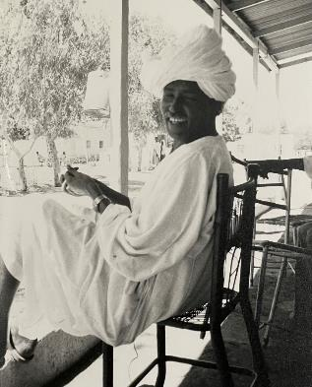
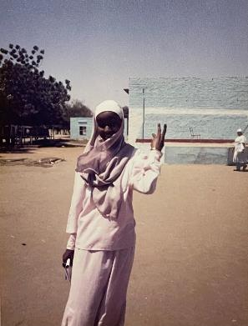
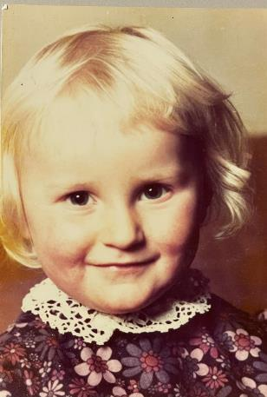
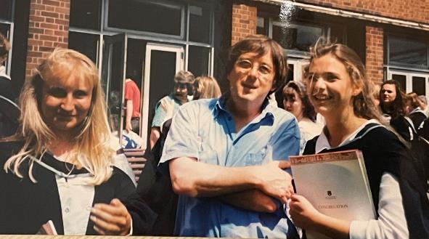
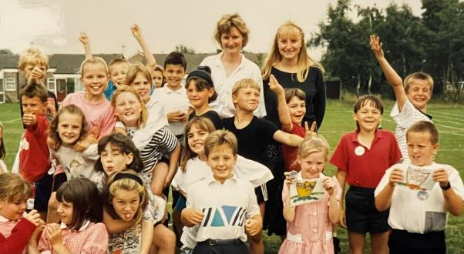
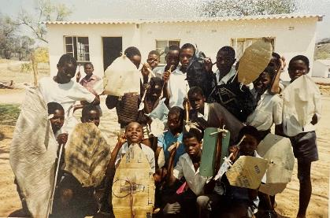

Slide 3
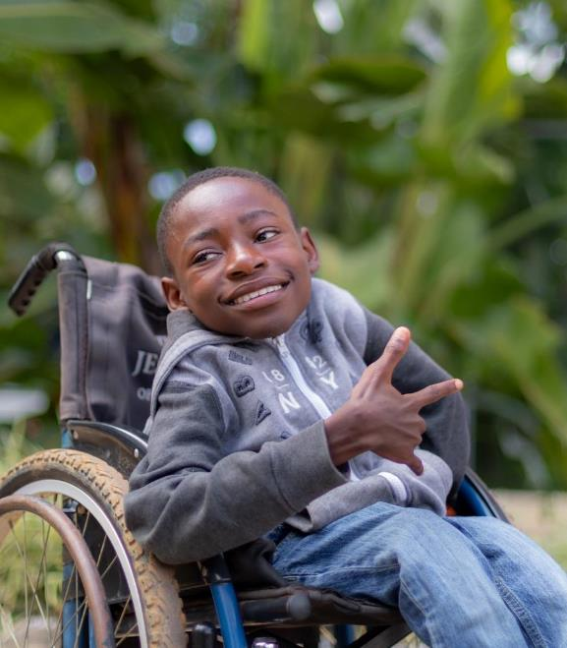
The learning crisis
Even before COVID-19 hit, the world was already experiencing a learning crisis…
Before the pandemic, 53 per cent of 10-year-old children were either out of school or in school but not learning.
Now an estimated 7 in 10 children globally are learning poor - unable to read a simple sentence for meaning.
There were wide disparities in education attendance and attainment between rich and poor countries.
Rwanda
“Although my body is disabled, my heart is not,” says Pacifique, age 15, an advocate for children with disabilities. “I have not missed a single milestone in school.”

Slide 4
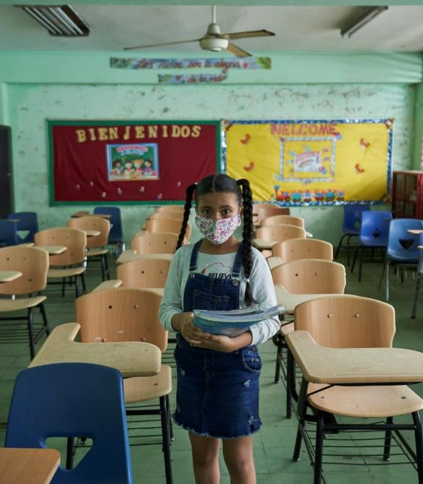
The long impact of COVID-19
At one point in the pandemic, more than 9 out of 10 students (1.6 billion) lost access to school.
2 trillion hours of in-person schooling were lost due to the COVID-19 pandemic.
Students in over 80 pеr cent of countries fell behind in their learning.
The legacy of lost services provided through schools – immunization, nutrition, mental health, psychosocial support and protection
Panama
A student stands in an empty classroom in Panama during the COVID-19 pandemic.

Slide 5
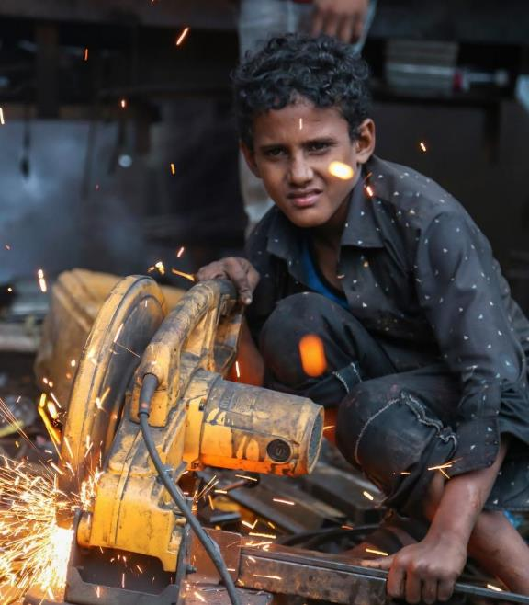
The funding crisis
Today’s financial landscape is bleak, putting a strain on funding for education…
The number of children living in multidimensional poverty soared to approximately 1.2 billion in 2020, while an estimated additional 100 million children were projected to have fallen into multidimensional poverty in 2021.
Yemen
Anas, age 12, works as a metalsmith to support his family. Amidst economic crisis, children are at greater risk of dropping out of school and falling into child labour.

Slide 6
Digital learning
Unequal access to digital learning opportunities has led to widened inequalities and a ‘digital divide’.
Children with disabilities face extra barriers
Children with disabilities are falling behind because education systems are not inclusive of their needs.
School environments are inadequate
Schools aren’t just places of education. They should also provide meals, health care and protection services. But many don’t.
Education in emergencies
Children affected by conflict and disaster are less likely to attend school, missing out on education and protection services.
Data on education
We need the right data on education attendance and achievement to inform the most effective responses.
Nine challenges
Early childhood education
Early education sets a vital foundation for lifelong learning. But too many children are missing out.
Literacy and numeracy
While school attendance has improved, not all children are learning equally, with big gaps in basic literacy and numeracy.
Adolescent skills
Many adolescents are not gaining the skills they need for the future and to enter the workforce.
Girls’ education
Girls do not always enjoy their right to a safe and quality education, especially in low-income countries and fragile contexts.

Slide 7
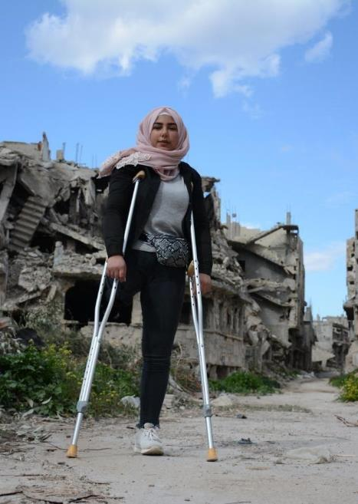
Children with disabilities face additional barriers to quality education
The widening inequities between children with and without disabilities are threatening to leave 240 million children with disabilities behind.
Children with disabilities are 49% more likely to have never attended school and are 42% less likely to have foundational reading numeracy skills, even when in school.
Syrian Arab Republic
“I will never set boundaries for my ambitions,” says Nour, age 16.

Slide 8
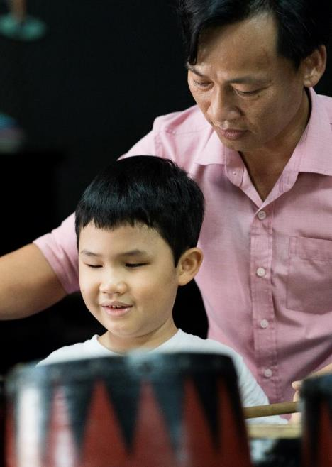
Ensuring inclusion of children with disabilities in education
Advocating for inclusive education systems for children with disabilities.
Supporting the development of inclusive and human-rights-based policy and legislation that places learners with disabilities at the centre.
Viet Nam
Tung, age 7, who is visually impaired, plays the drums with a teacher at the Inclusive Education Resource Centre.

Slide 9
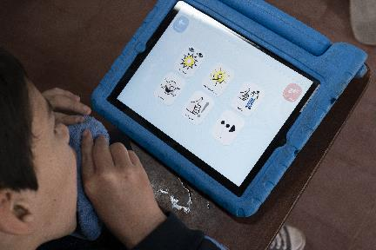
Inclusive education for children with disabilities
https://www.unicef.org/lac/en/regional-initiative-accessible-digital-textbooks-all
https://www.accessibletextbooksforall.org/

Slide 10
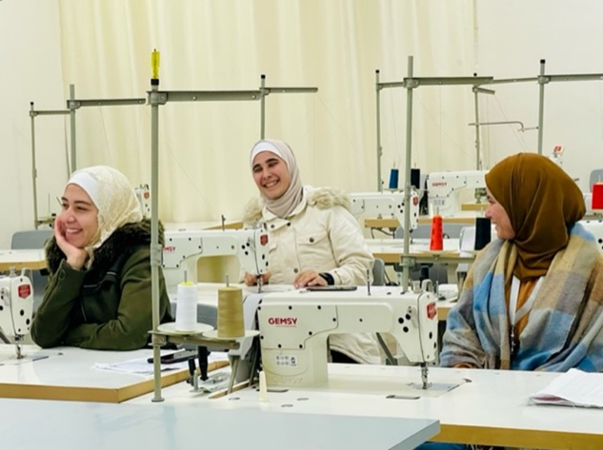
Adolescents lack the skills needed for their futures
Even before the pandemic, around 750 million youth (over 60 per cent) did not possess secondary education level skills or digital skills.
By 2030, it is estimated that another 825 million children will not acquire the basic secondary-level skills – like transferable, digital and job-specific skills – needed to support lifelong learning and employment.

Slide 11
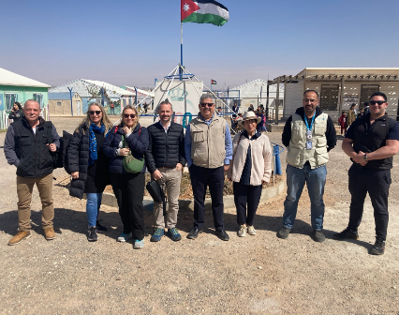
AZRAQ REFUGEE CAMP
Hosts 42,000 Syrian refugees
60% children
70% of children attend school
5 villages/9000 shelters/15 schools
9 UNICEF Makani Centres

Slide 12
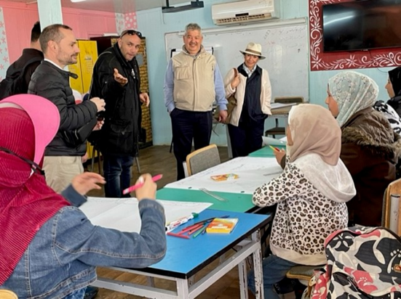
AZRAQ REFUGEE CAMP
Makani Centre
Girls learn about their rights

Slide 13
AZRAQ REFUGEE CAMP
Youth Centre

Slide 14
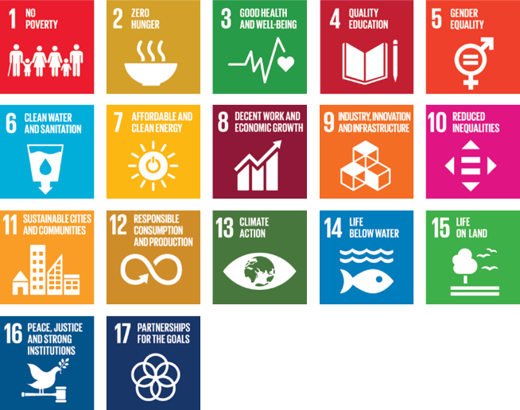
A global response
Children and young people’s participation
https://worldslargestlesson.globalgoals.org/

Slide 15
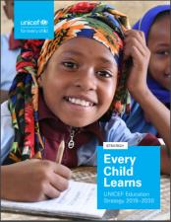
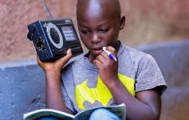
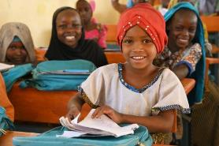
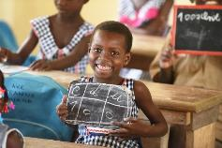
RESOURCES
Unicef stories
Unicef education main landing page
Unicef Education Strategy Every Child Learns
Unicef global education results 2022
Unicef reports

