Slide 1
The Power of Campaigning Our Approach to Empower Pupils

Slide 2
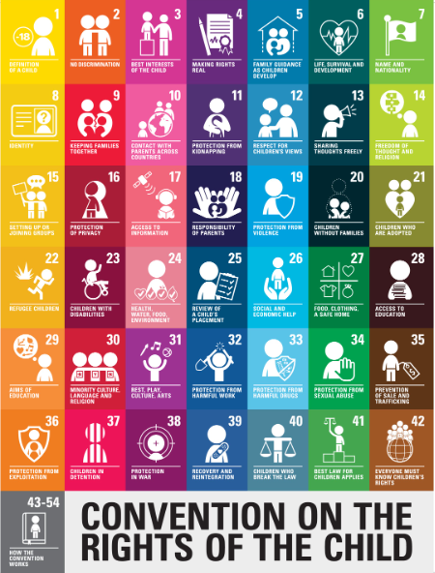
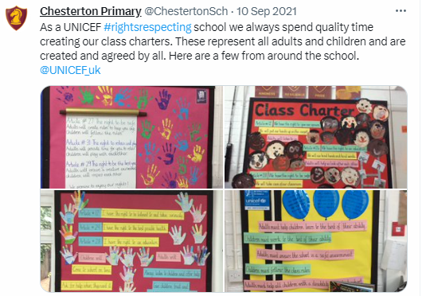
Where our journey started….
Notes:
developed over time (existing campaigns nationally/globally, making whole school links)
- made curriculum links to enable all pupils to take part in activism
- pupils empowered to bring forward important issues

Slide 3
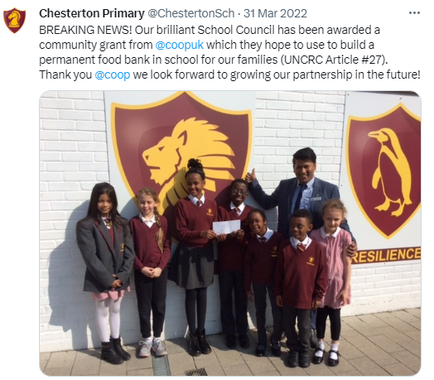
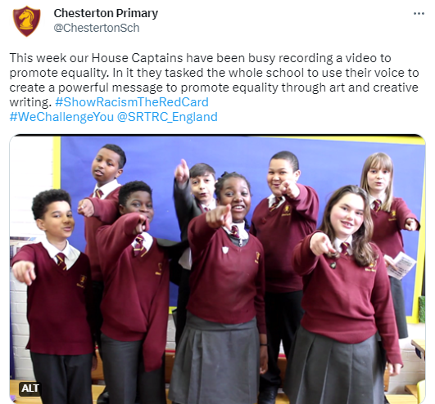
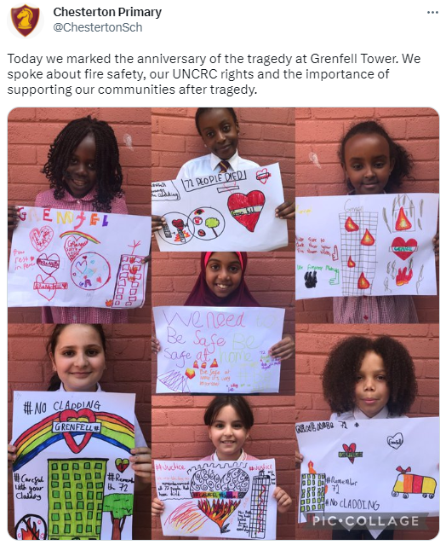
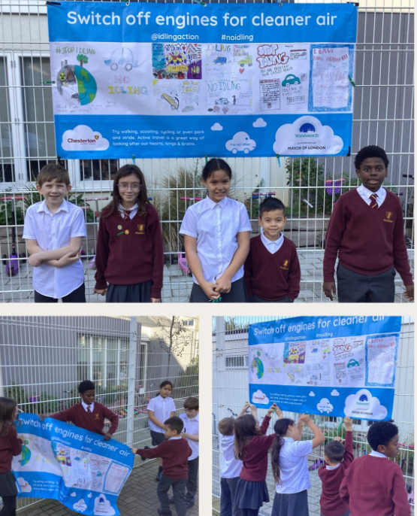
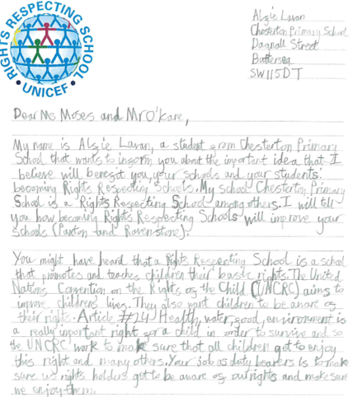
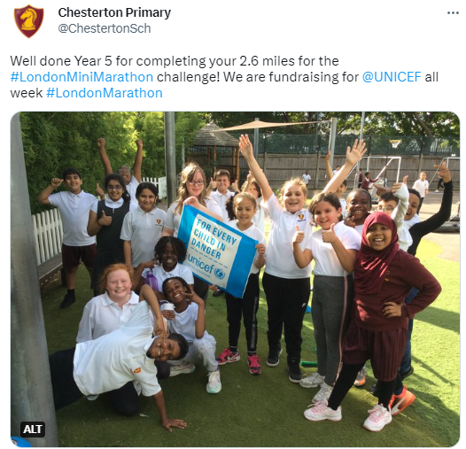
….where we are now!
Notes:
HOW did we get there???

Slide 4
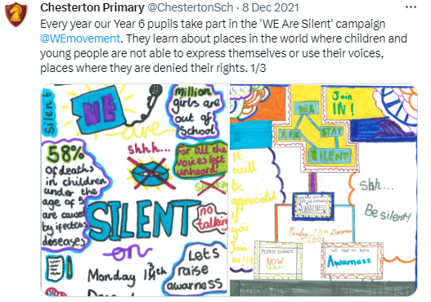
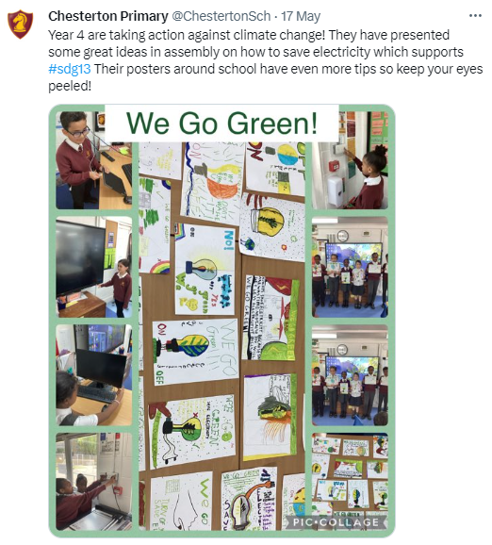
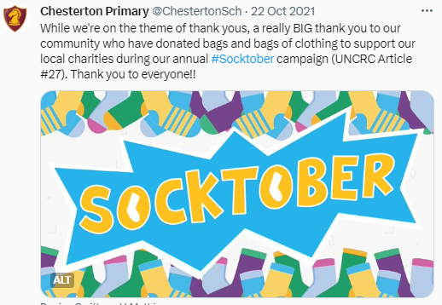
Whole School Planning
Sept – WE Scare Hunger
Oct – Soctkober
Nov – Y2 We Volunteer
Dec – Y6 We Are Silent
Jan – Y5 We Rise Above
Feb – We Won’t Rest
Mar – Y3 We Feel Good
April – Y4 We Go Green
May – We Walk for Water
June – Y1 We Read Together
July – N This is Me
Notes:
-
-linking to existing curricular content where appropriate
-understanding our community and what is important to them
- being flexible to make changes (what is relevant for the cohort)
September: WE Scare Hunger, The World’s Largest Lesson (whole school)
October: ‘Sock-Tober’ Clothing Drive, World Mental Health Day (whole school)
November: Year 2 - WE Volunteer Now (Making positive impacts in your community)
December: Year 6 - WE Are Silent (Vow of silence to stand up for those struggling to have their basic human rights met)
January - Year 5 - WE Rise Above (Tackling Cyber Bullying)
February: WE Won’t Rest (Sleep-Out to raise awareness about homelessness - Yr 4/5/6 selected pupils)
March: Year 3 WE Feel Good (Positive Mental Health and Well-being)
April: Year 4 - WE Go Green (Sustainability and Climate Change)
May: WE Walk for Water (Whole School)
June: Year 1 WE Read Together (Advocacy for Education and Literacy)
July: Nursery Project on Identity

Slide 5
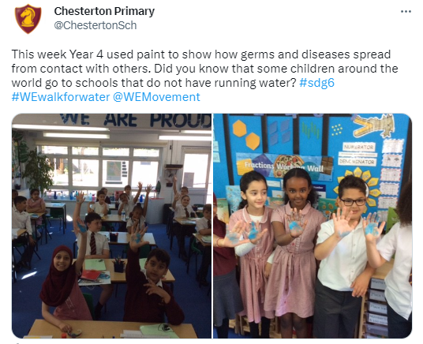
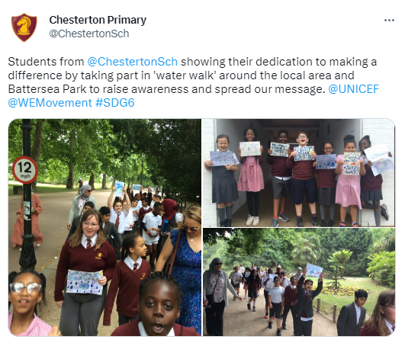
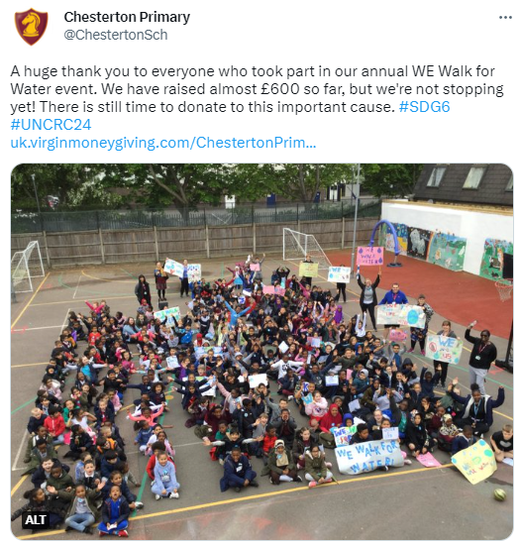
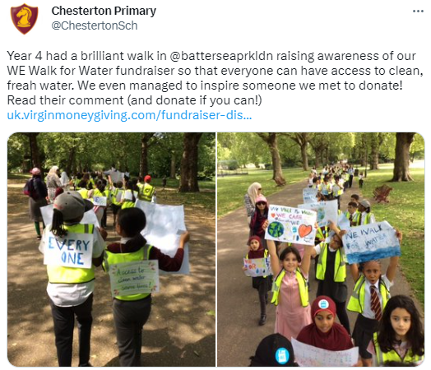
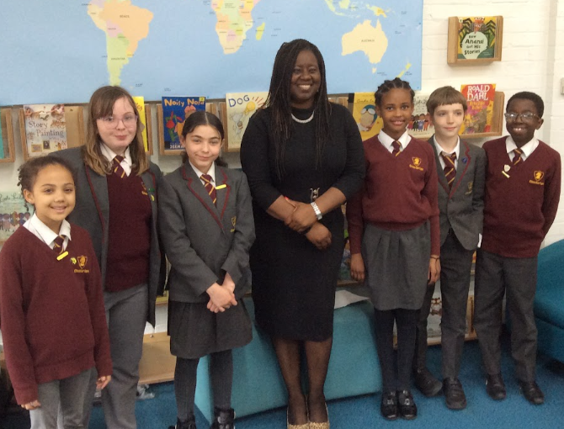
We Walk for Water

Slide 6
Progressive Planning
N: I can talk about the differences between clean and dirty water (what can they see/smell, would they want to drink it/why not?
R: I can explain how I enjoy my right to clean water (drinking, bathing, washing, cooking, at home/school)
1: I understand that clean water keeps us healthy and is our right
2: I understand and that some children do not enjoy their right to clean water. I understand the effects of drinking dirty water on health and wellbeing.
3: I can explain some of the reason why children are forced to drink contaminated water
4: I understand that where you live can determine your access to clean water and sanitation (geography, rural, developed nations and infrastructure)
5: I can discuss the impact lack of access to clean water and sanitation can have on children (hygiene, health, gender inequality, education)
6: I can discuss the moral obligation global communities have to provide all citizens with their basic needs (clean water, sanitation)
Notes:
Careful planning through PSHCE allows us to ensure that we are teaching about the issues, not just ‘joining in’ on a ‘special day’
Building in key learning opportunities across the years ensures that pupils are being exposed to age appropriate information and challenge about these issues which they can then build upon year on year.
We ensure we are linking in the relevant UNCRC articles across year groups to build on prior knowledge and deepen their understanding of these articles as they grow.
Creating a ‘mental model’ (similar to that described in the new reading framework published this year)– building on prior experiences (and providing some), key vocabulary, pause points – all allow pupils to draw on prior knowledge and vocabulary and make links and inferences to new learning.
This approach is imperative to ensure children understand WHY they are taking part in something and how it impacts others ability to enjoy their rights.

Slide 7
So What?
Notes:
It makes a huge impact!!
- spiralled approach (like all learning, embedded into long term memory)
pupils are empowered to use their voice (Grenfell, in school food back – money from coop)
Believe their voice has value and that adults will take them seriously

