Slide 1
©UNICF/UN0689532/Gilbertson
Notes:
Image: Amid relentless violence, families flee their shattered homes in Tal al-Hawa neighbourhood, seeking refuge in the southern Gaza Strip October 2023.

Slide 2
GUIDANCE FOR TEACHERS
War and conflict are incredibly difficult subjects for people of any age.
Working with children to try to help them untangle complicated thoughts and feelings is not easy. However, safe spaces in which to gently explore disturbing world events can provide huge reassurance to children and young people, and prompt them to seek help when they need it.
You know your children and young people best. Everything provided here is intended to be interpreted in the light of your professional judgement.
When speaking to children and doing activities from this pack, keep in mind different lived experiences children in your school might have in relation to war and conflict, fleeing violence or other trauma in their lives.
It is almost always the case that conflict, and rights violations go hand in hand. This may cause some children to question the value of rights or to lose trust in duty bearers to deliver.
It is important to balance discussion about war and conflict with hope and optimism.
Remember that despite everything, the world is better for children today than it was when the CRC was adopted in 1989.
See the next slide for a few pointers on how to approach this topic.
This Guide from UNICEF is aimed at parents, but it is relevant to staff in schools too.

Slide 3
GUIDANCE FOR TEACHERS
Does your class already have an agreement for working together respectfully, or do you need to agree some ground rules for this work?
Have an open dialogue with your learners. Actively encourage children to share their own perspectives and ideas. A reminder about the right to freedom of expression (Article 13) and the importance of respecting other views might be helpful here. Be receptive to verbal and non-verbal cues that show children have been moved emotionally. ­
Stress that you understand learners may be upset and confused when thinking about what is happening in war and conflict. Remind them of the people and places offering support to children within and outside of their school.
Underline the fact that the CRC states the best interests of the child must always be a primary consideration, All children should receive the care, respect and protection to which they are entitled, no matter who they are and where they are from. The CRC enables us to see when rights are not being accessed and children and those who care for them can speak up for their rights.
Consistently emphasise that human rights are a collective promise made by all countries of the world, including those currently in conflict. This promise can be summarised as everyone being able to enjoy a safe, happy and fulfilling life, where their dignity and worth is equally valued. You can also emphasise that the international system of refugee protection is founded on the principle of every country helping fellow human beings in times of need.

Slide 4
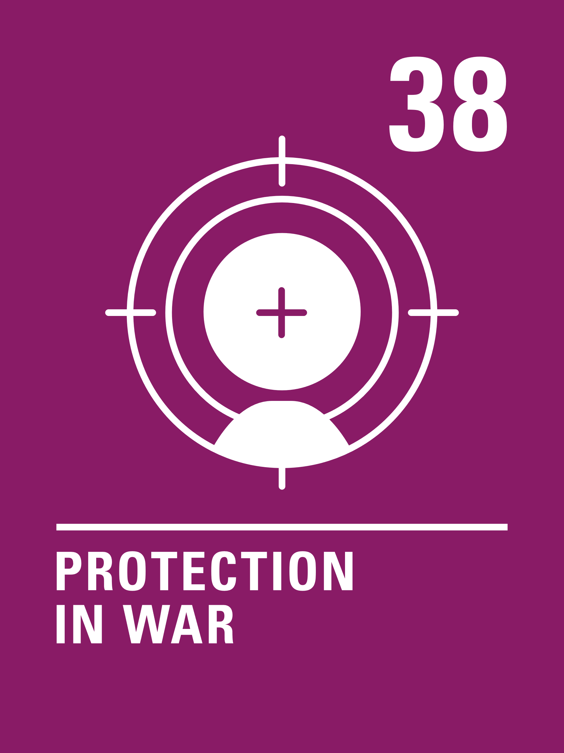
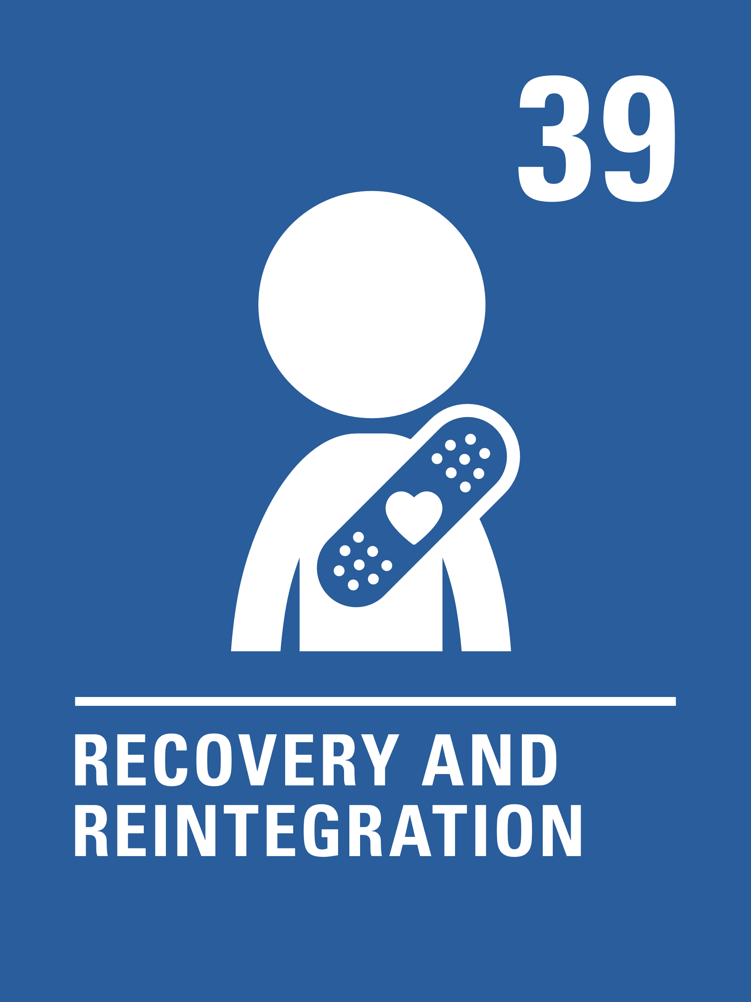
LINKED CRC ARTICLES
Many articles of the CRC relate to the theme of war and conflict, but the activities here link in particular to the following articles:
Article 38 (war and armed conflicts)
Governments must not allow children under the age of 15 to take part in war or join the armed forces. Governments must do everything they can to protect and care for children affected by war and armed conflict.
Article 39 (recovery from trauma and reintegration)
Children who have experienced neglect, abuse, exploitation, torture or who are victims of war must receive special support to help them recover their health, dignity, self-respect and social life.

Slide 5
EXPLORING ARTICLES 38 & 39
Why is it important to protect children and young people from war and conflict?
Have a think and write down some answers.
©UNICEF/UNI453255/El Baba
Notes:
Image: On 17 August 2022 in Ukraine, a playground sits empty, near a heavily damaged apartment complex in Saltivka, a suburb of Kharkiv.

Slide 6
DID YOU THINK OF THESE?
War is dangerous. You can be seriously injured or killed and participation in war can have a life-long impact on a person. Children and young people should not be forced to take part in wars.
Children should enjoy all their rights in the Convention and war will impact on their ability to enjoy many of these rights.
Adults cause wars, why should children, who have not caused the conflict, be affected?
If children see fighting and war as the answer to problems this may affect their whole lives.
Children may not have the physical or emotional maturity to cope with war and conflict.
Children may not be able to understand what the war is about.
Adults choose to join the armed forces as a profession, and they receive training and support to do their work. Child soldiers are often coerced or forced to take part and receive no training or support.
What else did you think of?

Slide 7
When something bad has happened to someone, it is important that children feel safe. Think about where you feel safe. Draw a picture of your safe place and share it with a friend. Create a ‘cosy corner’ in your classroom where people can go to feel safe and secure.
Watch this video of the book The Journey by Francesca Sanna about a family fleeing war. What difficult things does the family experience? When they finally arrive in a safe place, what will they need to ‘begin their story again’?
Every child has the right to grow up being safe and protected from harm. Draw a baby and around the baby, write or draw things that you think the baby needs to grow up happy and safe. You might think of things like cuddles and lots of rest. What else can you think of?
If someone is worried about what is happening, who can they tell? Talk about the different people that you can talk to if you have a worry or don’t feel safe. Discuss support both in school and out of school

Slide 8
Watch this video of Onjali Q Raúf reading from The Boy at the Back of the Class, which is a story about a refugee from Syria joining a new school. Sometimes, people joining a new school have experienced difficult events. What can you do to make someone joining your class feel comfortable and welcomed? Work in a group to produce a ‘welcome plan’ setting out all the different things you could do to make new children welcome.
If there was peace all over the world, all children would be safe from war. That’s one of the goals of the United Nations. Work with a partner to design a poster to promote peace. You could include why war is so dangerous for children and emphasise that children have the right to be protected from war.
Do you think you are a good peacemaker? Can you think of a time when you helped to solve a disagreement between two people? What did you do? What did you say? How do Articles 12 & 13 and respecting each other’s opinion help when solving a problem? Write a list of things to say or do to help resolve disagreements.

Slide 9
Several children and young people joining schools in the UK are refugees fleeing from countries where life is not safe. How can schools support such pupils and help them to feel welcome? What role could students play in this? Work in a group to create a plan and share your ideas with the School Council.
“Children bear no responsibility for war.
Yet they suffer its consequences for life.”
Can you explain why UNICEF uses this statement? How do you feel about it?
The rights within the Convention are indivisible – a child should have all their rights, all the time. Look at the Convention and try to identify how many other rights might be affected when a child or young person’s life is disrupted by armed conflict or war.
Read Vishi’s poem about war. Write your own response to what is happening in the world right now and make sure you refer to CRC Articles where you can.

Slide 10
Do you think you are a good peacemaker? Can you think of a time when you helped to solve a disagreement between two people? What did you do? What did you say? How do Articles 12 & 13 and respecting each other’s opinion help when solving a problem? Write a list of things to say or do to help resolve disagreements.
Traumatic childhood experiences, including war and conflict can impact on the development of a child. What does your school do to help you with feelings of stress and anxiety? Create a poster to make sure that all young people in your school know how to access support if they need it. Don’t forget to include external agencies such as Childline and NSPCC.
The video My name is Younis - I am a child, not a solider shows how poverty led one child in Sudan to be caught up in conflict at a young age. While you watch it think about which rights were denied to Younis, then read articles 38 and 39 again. Discuss what role organisations like UNICEF have in working with young people like Younis to turn lives around. What do you think governments should be doing?
Watch Poems for Peace and listen to children and young people living in conflict using poetry to call for peace. While you watch, pick out a line or a phrase that really sticks in your mind. Use it to help you create a poem of your own about peace.

Slide 11
REFLECTION
You may like to take time reflect as a class or in an assembly.
When there is war and conflict we often try to think of peace:
What makes you feel peaceful and calm?
How can your thoughts, words and actions bring a sense of peace to your friends and family?
What does it take to be a peace maker?
In these difficult days could your class or school create a focal point with symbols of peace – perhaps images of doves, candles or hands reaching out in friendship?
Take some time to get creative and use this activity to share some positivity and hope, together.
© UNICEFF/Unruh
Notes:
Image: 'Beads for peace' ("Perlen für den Frieden") was the motto of Emilia, Svea and Yolanda. Over a longer period of time, the three girls made beaded jewellery together and individually at home. In March 2022, the girls gave away their self-made beaded jewellery and sorted-out toys at the marketplace in Warendorf in exchange for a donation to UNICEF. Later, their younger siblings joined them and supported them in their action.

Slide 12
©UNIEF/UN0716817/Al-Haj
Notes:
Image: Taleen, 9 months, came to get medical attention from the mobile clinic and the MUAC tape measurements with her father Mohammed, Raymah Governorate, Yemen. After years of conflict the systems that many families reply on remain under severe pressure. UNICEF is on the ground in Yemen, providing life-saving health and nutrition support through community-based activities like the early detection and treatment of child malnutrition.

