Slide 1
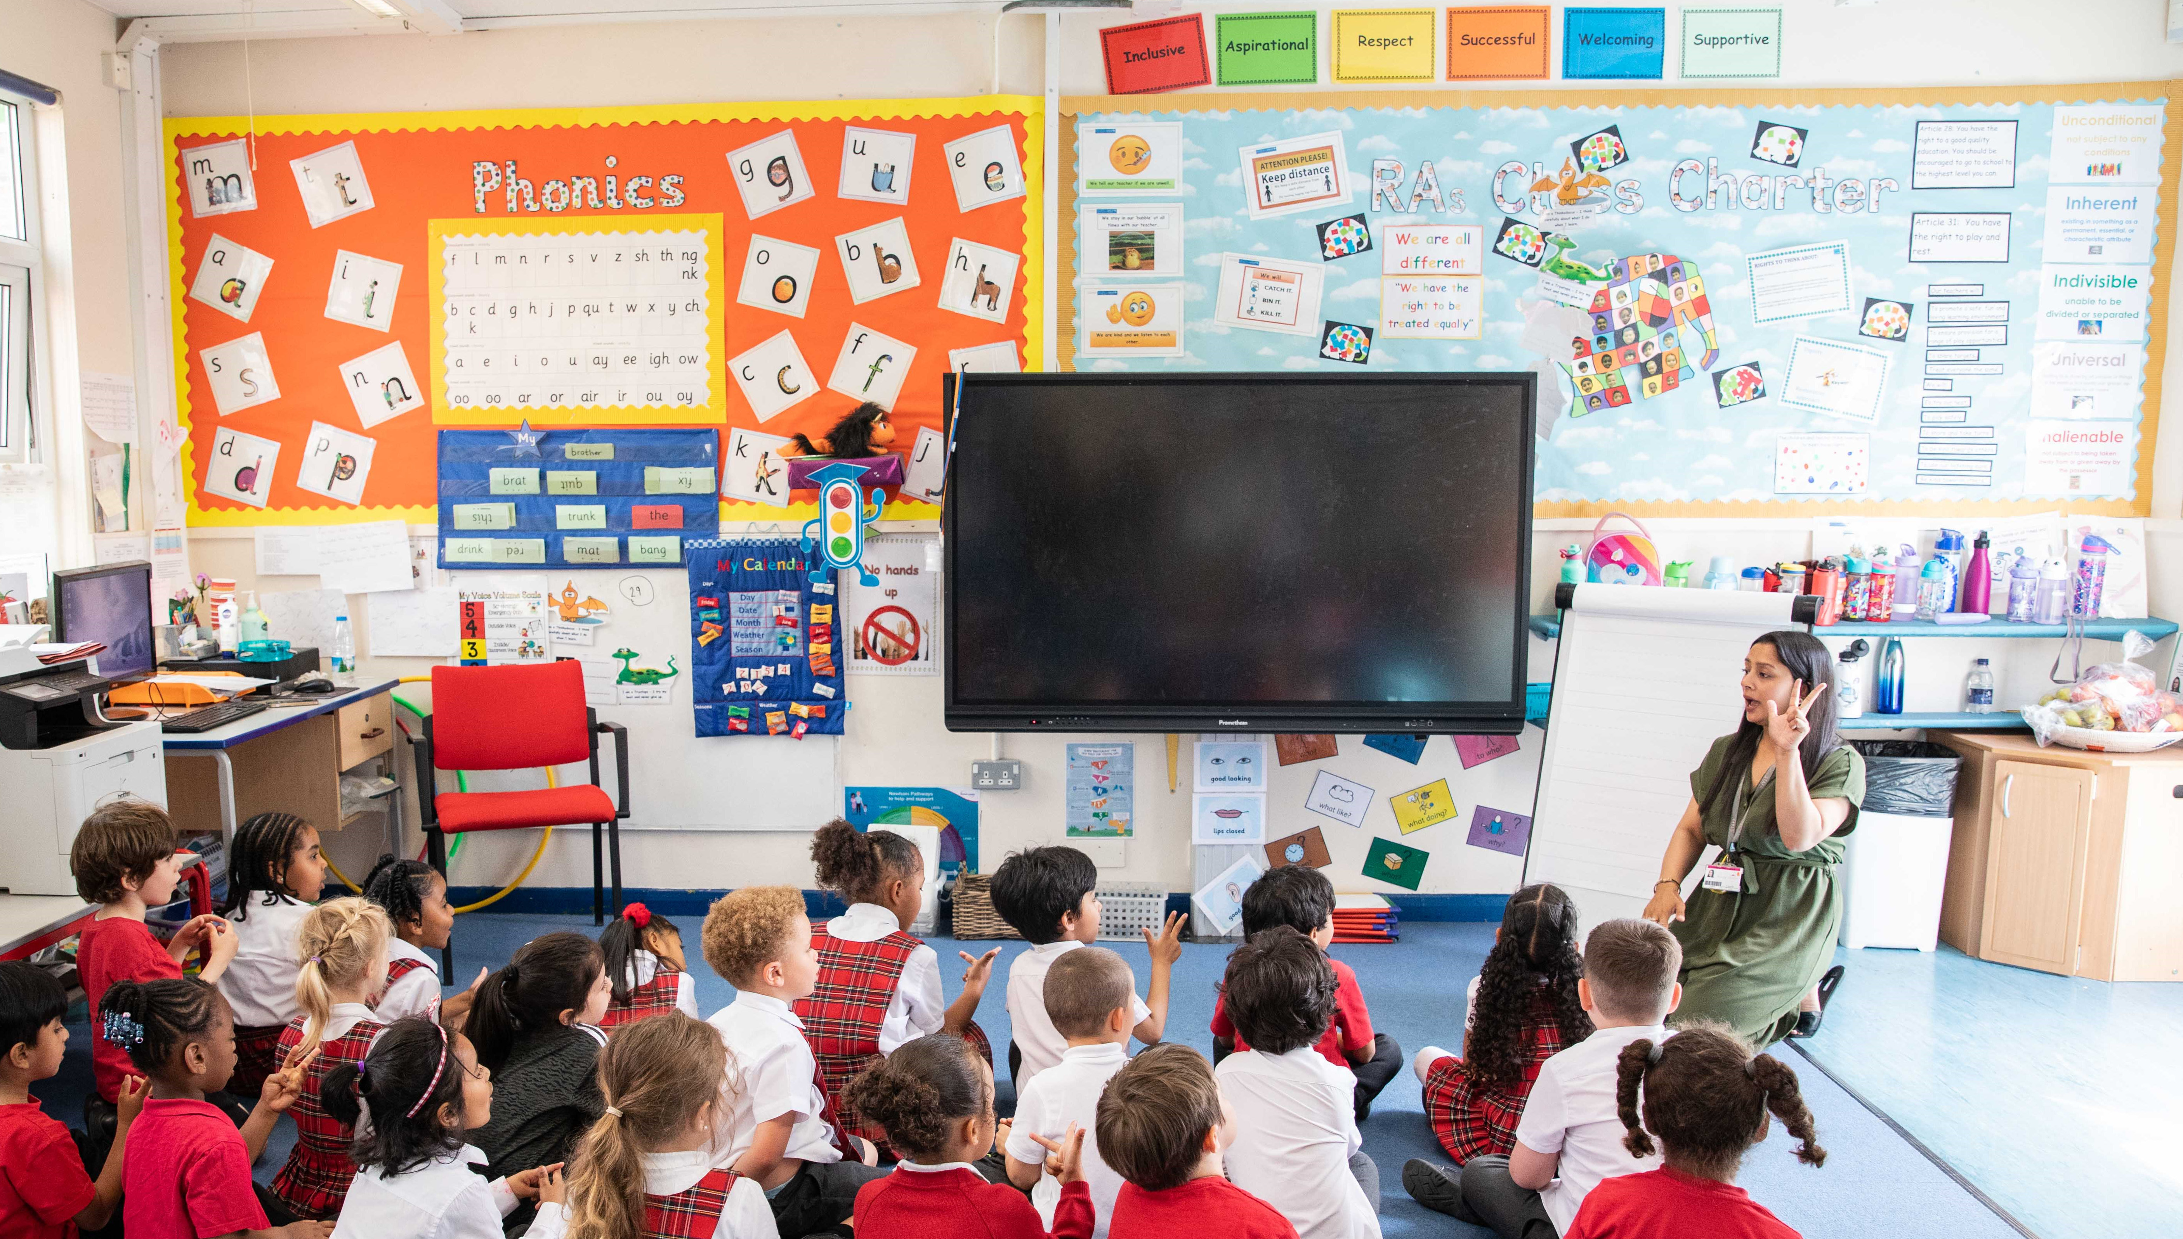
© UNICEF/Dawe
CAMPAIGNING IN SCHOOL
RIGHTS RESPECTING LANGUAGE
Notes:
Welcome to Spotlight, our latest resource to support RRSA coordinators to develop Rights Respecting practice in school.
Unlike Article of the Week, Spotlight is aimed at colleagues and is intended to support you in staff briefings or continued professional development (CPD).
Please check guidance in subsequent slide notes.

Slide 2
CONTENTS
For each slide, please look at the presenter notes for delivery information.
Slide 3: Aims of the Session
Slide 4: Three ways to use this pack
Slide 5 : Introducing this month’s Spotlight
Slide 6: Links to RRSA Outcomes
Slide 7: Links to Articles
Slide 8: Case Study 1 – Meadows First School
Slide 9: Case Study 2 – Uplands Junior School
Slide 10 & 11: Let’s Discuss
Slide 12 & 13: Activities
Slide 14: Reflection
Slide 15: Resources
Notes:
Presenter notes: For each slide, please look at the presenter notes for delivery information. You may wish to amend or delete this slide when you deliver the session in your school.

Slide 3
AIMS OF THE SESSION
Explore language around the CRC and the RRSA
Understand the importance of rights language
Feel more confident in using this rights language
Identify ways that rights language can be embedded across the school community
Notes:
Presenter notes: Please edit the aims of the session to suit the time you have available for your session.
This session is intended to help you in supporting staff to develop their knowledge and understanding of the language that is contained within the Convention on the Rights of the Child and the Rights Respecting Schools Award programme.
The whole Spotlight series is about embedding children’s rights within a wide range of school priorities and practices.

Slide 4
WAYS TO USE THIS PACK
DELETE THIS SLIDE BEFORE USING
If your time is tight, use the introduction slide and choose from the key discussion questions to explore with your colleagues.
If you have longer, you can also choose some of the activities to explore.
You may wish to cover the content over several staff meeting sessions.
There are trainer notes for each slide – please do have a look at these for further guidance.
There
Notes:
Presenter notes: Delete this slide before using.
It would be useful to have copies of the simplified CRC or the icons so that staff can refer to them throughout the session.
unicef.uk/CRC_Icons

Slide 5
SPOTLIGHT ON…
The language we use is important. When you become a Rights Respecting School there is new vocabulary to learn. In Rights Respecting Schools, children talk about articles, they talk about rights being universal, inherent and unconditional, you will hear people refer to rights holders and duty bearers and talk about the importance of the principles of fairness, equity and dignity. It is important that we, as staff in school, take time to look at this vocabulary, so that we can model its use with confidence.
.
Hilary, Professional Adviser, introduces this month’s Spotlight.
Notes:
The video complements the content of this pack and can also be used separately.
Presenter notes:
This CPD session on rights language will be further supported by an upcoming Spotlight (March 2024) on Using Rights to Strengthen Positive Relationships where staff will be encouraged to consider how to use this language within the classroom, playground and around the school to strengthen positive relationships.
It will also be supplemented by a Spotlight with a specific focus on the concept of Dignity in April 2024.

Slide 6
LINKS TO RRSA OUTCOMES
Strand A: TEACHING AND LEARNING ABOUT RIGHTS
The United Nations Convention on the Rights of the Child (CRC) is made known to children, young people and adults, who use this shared understanding to work for improved child wellbeing, school improvement, global justice and sustainable living.
Strand B: TEACHING AND LEARNING THROUGH RIGHTS
Actions and decisions affecting children are rooted in, reviewed and resolved through rights. Children, young people and adults collaborate to develop and maintain a school community based on equality, dignity, respect, non-discrimination and participation; this includes learning and teaching in a way that respects the rights of both educators and learners and promotes wellbeing.
Strand C: TEACHING AND LEARNING FOR RIGHTS
Children are empowered to enjoy and exercise their rights and to promote the rights of others locally and globally. Duty bearers are accountable for ensuring that children experience their rights.
Notes:
Presenter notes:
This slide provides an opportunity to remind colleagues of the ‘structure’ of RRSA which includes three strands: Teaching about rights; through rights; and for rights.
Using rights language cuts across all of the strands and outcomes. You could ask colleagues to have a look at the Outcomes at Silver and Gold document and highlight any language that they are unfamiliar with and would like to explore further through the session.
The full text of the Strands and Outcomes of the Award can be found here:
www.unicef.org.uk/rights-respecting-schools/wp-content/uploads/sites/4/2015/06/RRSA-Strands-and-Outcomes-at-Silver-and-Gold-1.pdf

Slide 7
LINKS TO ARTICLES
Look at the summary of the CRC with a partner – which articles do you think are particularly relevant to our work on Rights Respecting Language?
When ready click to reveal.
Although many other articles may also be linked.
Notes:
Presenter notes: When showing this slide in presenter mode the articles will appear on click.
Article 4 is about making rights real for children, and the understanding and use of rights language across a school will support the realisation of this right.
Article 42 is about everyone knowing about children’s rights, and again, staff within a school having a good understanding of rights language and being supported and encouraged to use rights language is part of this.
However, you will want to explain that rights language cuts across all articles of the CRC. It is important that colleagues understand what the CRC articles say, and this may be a good opportunity to explore any articles that staff are less familiar with. Activity 1 on slide 12 links to a glossary where words such as ‘article’ and ‘right’ are explored.
CRC Summary: unicef.org.uk/wp-content/uploads/2019/10/UNCRC_summary-1_1.pdf
CRC full text: unicef.org.uk/wp-content/uploads/2016/08/unicef-convention-rights-child-uncrc.pdf
CRC icons: unicef.uk/CRC_Icons
RRSA Glossary: www.unicef.org.uk/rights-respecting-schools/resources/teaching-resources/guidance-assemblies-lessons/rrsa-glossary/

Slide 8
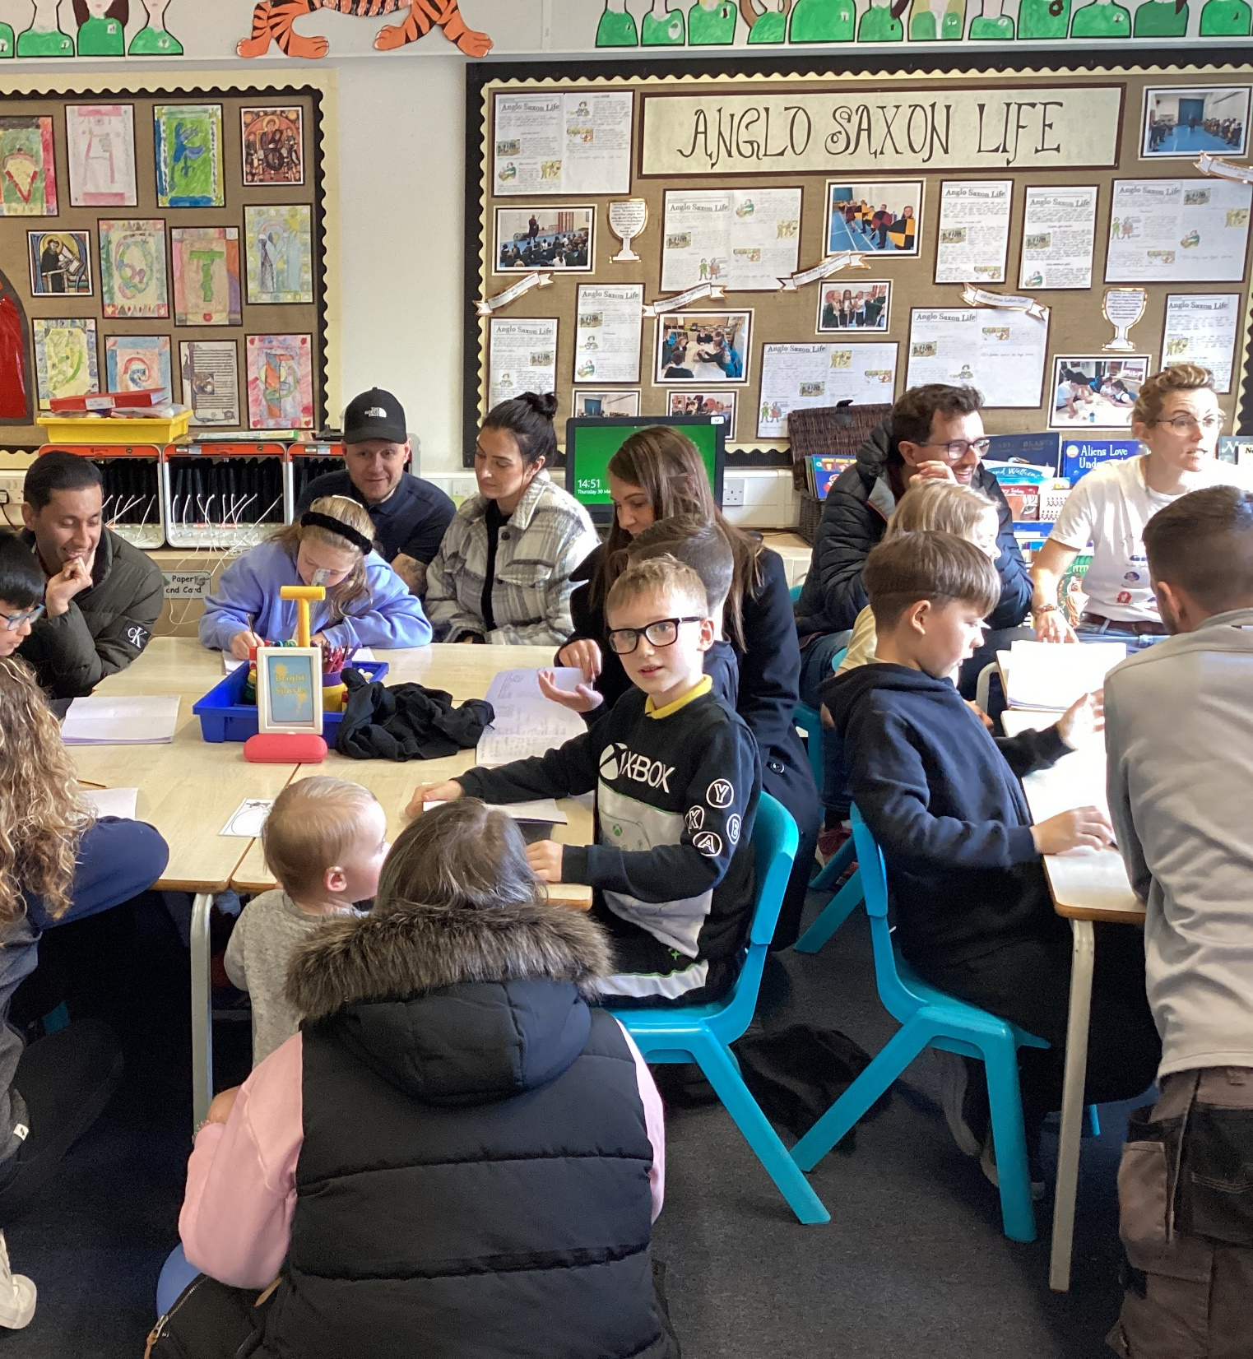
Children with their adults during a learning session about children's rights and rights language.
CASE STUDY
Look at this case study from Meadows First School
Read the full case study online.
At the start of every year, each class has a rights language session where we recap children’s rights and the language that is used to embed their understanding.
All staff are trained annually on the use of rights language, including office, catering and lunchtime supervisors. Any new staff are also encouraged to complete the RRSA e-learning modules and staff are regularly sent on RRSA training.
The language of rights is embedded into everything we do. It flows through out school development plan, our behaviour policy and our curriculum maps. It brings parents, governors, pupils and staff together and most importantly gives pupils a voice, raises their confidence and makes them aware of the world they live.
Notes:
Presenter notes: The full case study is available on the RRSA website, where you can print it out and share with your colleagues if you are choosing to focus on this as part of your session. Encourage staff to consider whether there are any examples of good practice within this case study that your school could draw on and learn from.

Slide 9
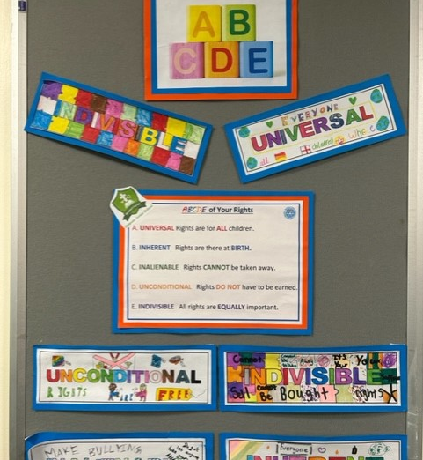
The ABCDE of Rights resource was invaluable in helping staff to understand and teach important concepts about the nature of rights.
CASE STUDY
Look at this case study from Uplands Junior School
Read the full case study online.
One of the first obstacles to overcome was our linking rights to responsibilities. One of the first obstacles to overcome was our linking rights to responsibilities. The two concepts had always gone hand in hand in PSHE and Citizenship and needed to be decoupled.
As we have become more confident in our knowledge of rights, our use of Rights Respecting language has become more natural and embedded. A good example is a Year 6 RE unit. Including concepts such as ‘dignity’ and ‘equity’ has certainly deepened the learning. Ensuring the language is in the planning and knowledge organisers means we have continuity when staff change, or supply teachers cover.
​Reminding pupils of the promises in their class charter helps us to explore how they may be affecting others with their actions. The sort of language we use has helped us to build more positive relationships with a solid foundation of shared values.
Notes:
Presenter notes: The full case study is available on the RRSA website, where you can print it out and share with your colleagues if you are choosing to focus on this as part of your session. Encourage staff to consider whether there are any examples of good practice within this case study that your school could draw on and learn from.

Slide 10
LET’S DISCUSS
2. Why is it important for us to model the use of child rights language as part of our Rights Respecting journey?
3. How can we begin to share our child rights language with parents and the wider community?
1. What child rights language do you already know and/or use and when do you use it?
Notes:
Presenter notes: Choose the questions that are most relevant to your setting and experience. These questions are intended to be progressive but consider where your school is now and choose ones that you think will generate the most useful discussion with your colleagues. Collect some of the ideas from your colleagues and add them to your action plan/evidence.
Encourage colleagues to have copies of the CRC and the RRSA Outcomes at Silver and Gold in front of them to support discussion about language.
If you choose this question, you may wish to follow it up by looking at one or more of the case studies that follow to demonstrate the power that a focus on rr language can have.
Encourage staff to consider displays around the school, the website, class newsletters, policy reviews, within homework tasks, class assemblies, links to charitable events.

Slide 11
LET’S DISCUSS
4. How does using the language of rights help to make rights real within our school community?
5. In what ways is child rights language being used in school either in classrooms or beyond the classroom?
6. How could we further embed the use of child rights language across the school/wider community?
Notes:
Presenter notes: Choose the questions that are most relevant to your setting and experience. Collect some of the ideas from your colleagues and add them to your action plan/evidence.
4. If you are a school that has been working on RRSA for a while, reflect on the impact of using rights language..
5. Have colleagues heard the use of child rights language by other teachers, TAs, office staff, non-teaching staff, lunchtime supervisors…? How is this language being used? How does the language of rights help to make rights real within our school community?
6. This is a chance to think about how the use of language could be further embedded. Could rights language become part of vocabulary lists, used on displays, in scripts used to resolve any conflicts? Some schools create lanyards for staff to wear with reminders of key words and phrases that can be used. Would this be useful in your context?

Slide 12
ACTIVITIES
In groups, draw a Rights Respecting classroom onto large pieces of flipchart paper. What do you see, hear and feel in a Rights Respecting classroom?
1. Share the words within the RRSA Glossary. How would you describe this language? Compare this with the RRSA explanation
2. Look at the Myths and Misconceptions document. Choose some myths and ask staff to discuss.
3. Look at the ABCDE of Rights. How could you support children to develop their understanding of these terms.
Notes:
Presenter notes: There are six suggestions for activities. Depending on the time you have available, choose one or more activities for your colleagues to work on together to further explore the topic. Different groups could explore different activities. The activities that you do not wish to use can be deleted.
Activity 1: Download the RRSA Glossary and used the pdf print out as the basis for this activity.
Activity 2: When talking about rights, there are often myths and misconceptions. In groups, your colleagues could look at this document and discuss. Are there any other misconceptions that you need to address?
Activity 3: Developing an understanding of the principles that underpin rights is an important part of your work as a rights respecting school. Look at the ABCDE of rights resource and consider how it could be used to support children to develop their understanding of these concepts.

Slide 13
ACTIVITIES
In groups, draw a Rights Respecting classroom onto large pieces of flipchart paper. What do you see, hear and feel in a Rights Respecting classroom?
4. Reflect on the RRSA Glossary. How could these words be incorporated within policy and everyday practice across the school community?
5. Reflect on your specific role within the school and consider your responsibilities as a duty bearer. Write down articles from the CRC that you could refer to regularly.
6. What practical steps will we take to make child rights language as inclusive as possible for all of our learners, for our staff, for our school community. Consider using symbols or icons, sign language, the CRC in different languages to make the rights as accessible as possible to your entire community.
Notes:
Presenter notes: There are six suggestions for activities. Depending on the time you have available, choose one or more activities for your colleagues to work on together to further explore the topic. Different groups could explore different activities. The activities that you do not wish to use can be deleted.
Activity 4: This activity will support your colleagues to think about how the use of rights language could be further embedded in practical ways across the school. In groups, note down how rights language is already being used and then consider any opportunities to embed this further. Think about building rights language into existing policies and practices rather than creating additional processes.
Activity 5: This activity encourages staff to consider their roles as duty bearers. Some articles will be more relevant to some colleagues than others. This is a chance to really explore the CRC and think about which articles could be referred to in different roles. For example, an attendance officer could be using the language of Article 28, access to education in their conversations with parents and carers, a site manager could refer to Article 24, a clean and safe environment in their role. A parent liaison officer could be supporting families to realise Article 27, the right to an adequate standard of living.
Activity 6: Widgets, sign language, CRC in different language This may be as simple as putting posters up, using the icons, widgets, rights in different languages. Consider using symbols or icons, sign language, the CRC in different languages to make the rights as accessible as possible to your entire community.

Slide 14
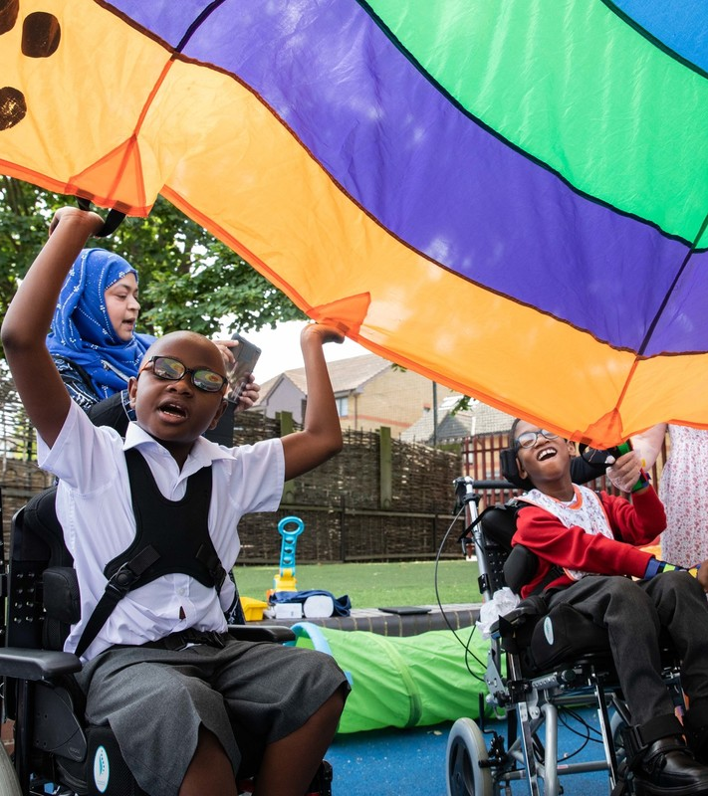
REFLECTION
© UNICEF/Dawe
What will you do differently because of this session:
tomorrow?
this term?
this year?
Notes:
Presenter notes: You could ask people to write down personal commitments in the light of this reflection and collect these in and come back to them at the start of the next term to remind colleagues of their commitment and celebrate any progress.

Slide 15
RESOURCES
You may find the following resources useful for your work on Rights Respecting language:
RRSA Glossary
ABCDE of Rights
Myths and Misconceptions
Books
The Little Book of Words that Matter by Joanne Ruelos Diaz
Notes:
Presenter notes: If you have time, please explore these links ahead of your session with colleagues. You may well find a particular resource that you want to highlight to all as part of your input. There may be links you want to share with the team ahead of or as follow up to your input with them.
Encourage your colleagues to explore the RRSA website to find additional resources. If you have time, please explore these links ahead of your session with colleagues. You may well find a particular resource that you want to highlight to all as part of your input. There may be links you want to share with the team ahead of or as follow up to your input with them.

