Slide 1
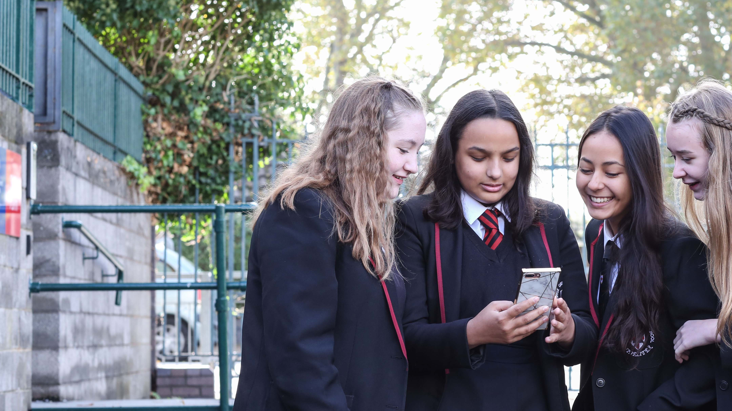
Welcome! We are delighted to see so many of you here already. We will start promptly at 1.30pm so why not say hi in the Q&A function while you wait, and let us know the name of your school.
You can use the Q&A during the webinar to ask questions, share comments or ideas.​
Please do not record this event in any way, including taking screenshots.
OUTRIGHT WORLD CHILDREN’S DAY EVENT 2023

Slide 2
Welcome from Cel Spellman!
Cel Spellman is a huge supporter of the OutRight campaign and he can’t wait to hear how we get on today!

Slide 3
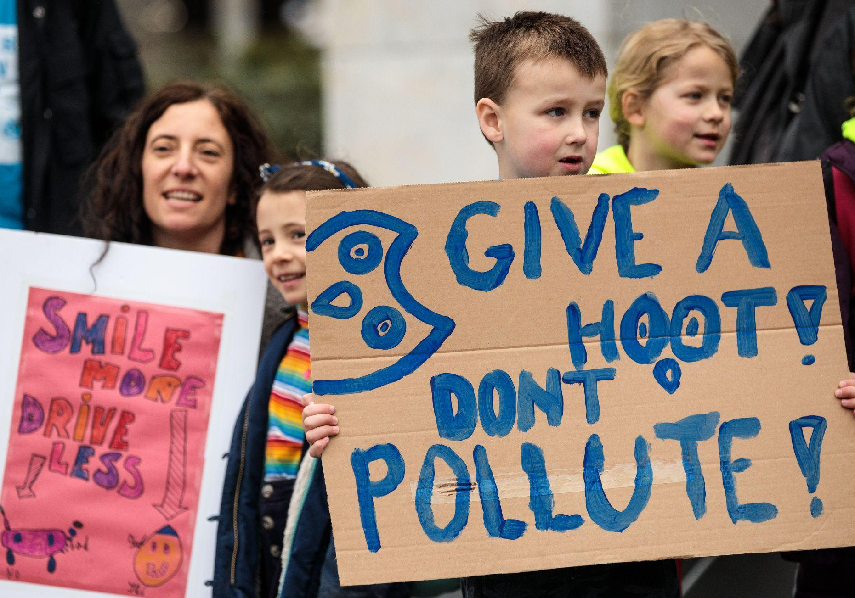
WELCOME:
Happy World Children’s Day!
© UNICEF/Sutton-Hibbert
Families take part in the UNICEF UK Action Day: Protecting Children from Toxic Air demonstration in London, England on March 16, 2019.

Slide 4
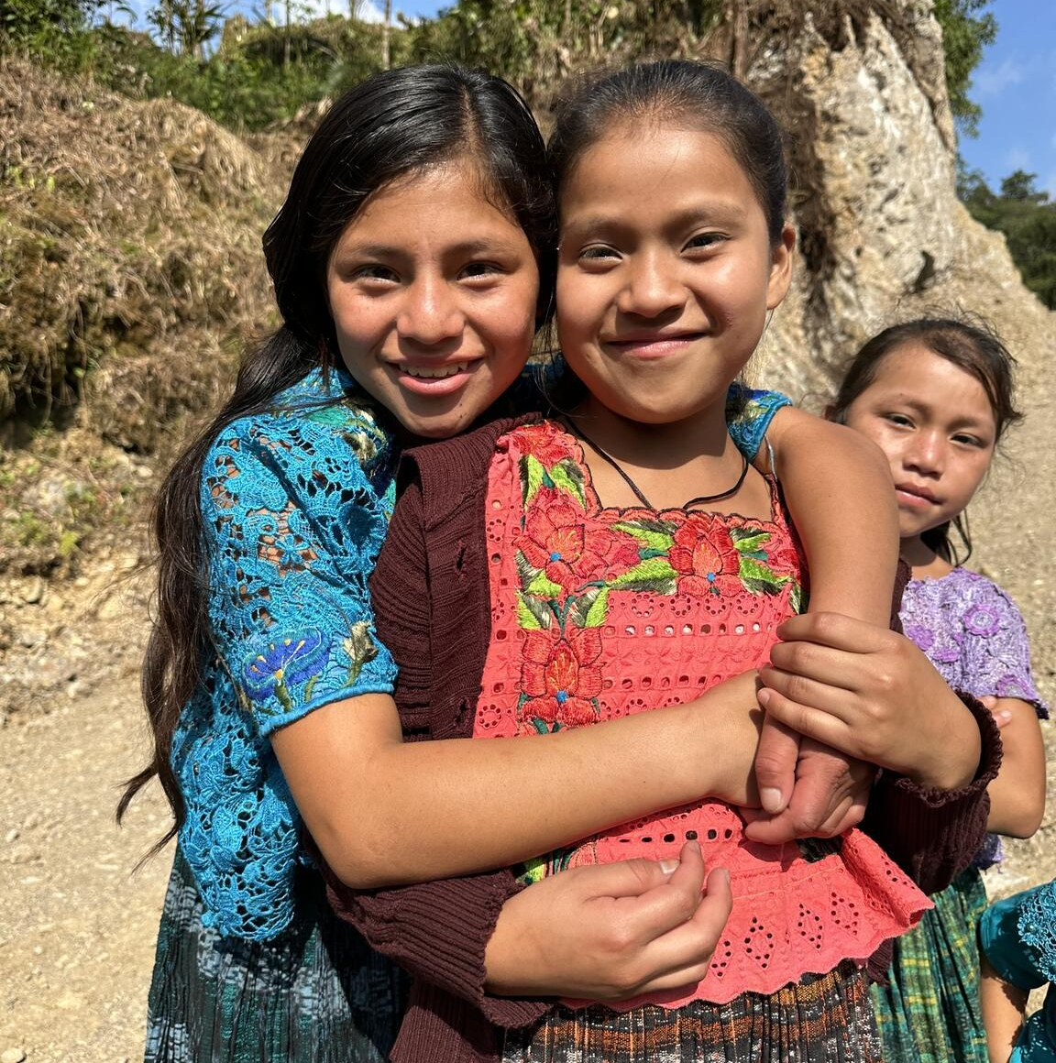
TODAY we will:
Remind ourselves what climate change adaptation is all about
Hear from some young people already using their voices on climate change and children’s rights
Meet Debora Leao who will answer your questions about children’s rights in a changing climate
© UNICEF/Quintero
Friends smile for the camera in Alta Verapaz, Guatemala.

Slide 5
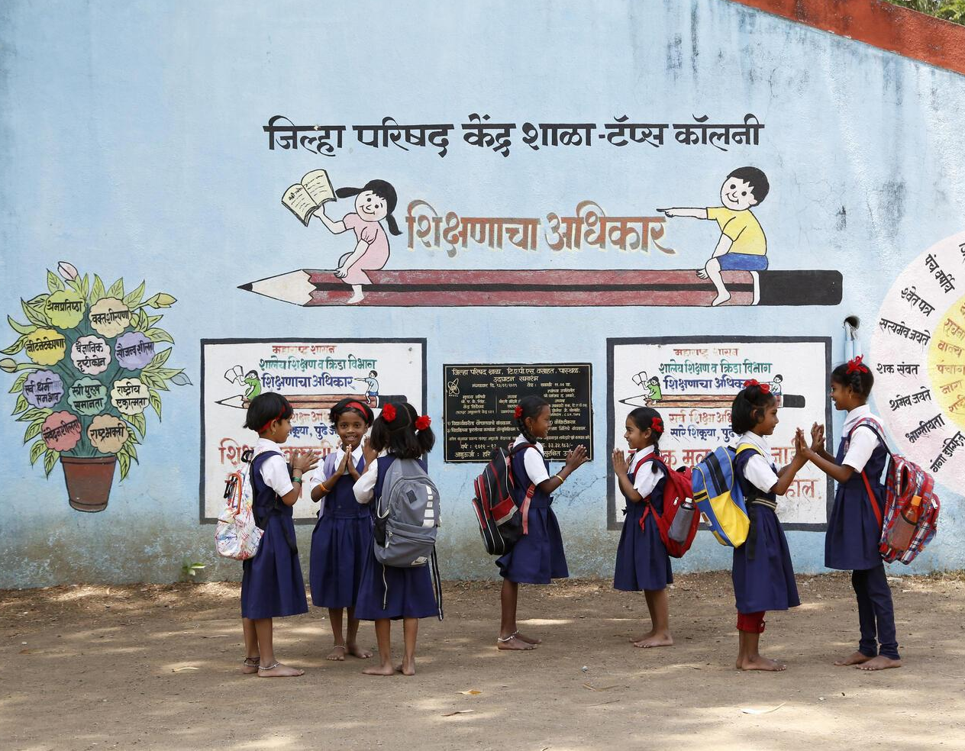
© UNICEF/India Country Office
YOUTH VOICE
IN ACTION

Slide 6
Graeme High School
What are we doing?
How are we doing it?
Why are we doing it?
“Aspire Attain Achieve”

Slide 7
What are we doing?
Participating in the Falkirk Council Cross Party Working Group on Climate Change
Formed the Green Team Eco Group who have hosted and attended different events in our area to promote our fight for the climate
Focusing our Outright campaign on tackling litter both in school and in our local community
Aiming to achieve our Ocean Friendly School Award from the Marine Conservation Society by April 2024!

Slide 8
How are we doing this?
Demanding that we get more bins in our local area by reaching out to the council and local businesses.
Getting our whole school involved in local litter picks as well as art sessions which focus on the source to the sea journey of litter.
Our leadership team of school Captains and Vice Captains are teaming up and campaigning for our rights and the fight against climate change!

Slide 9
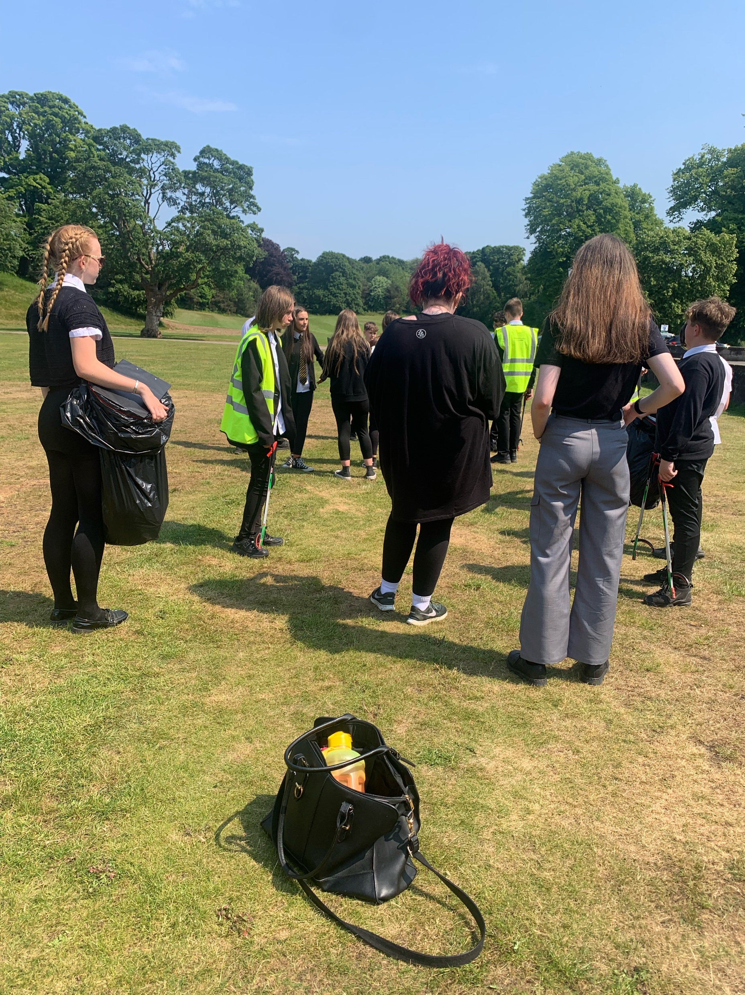
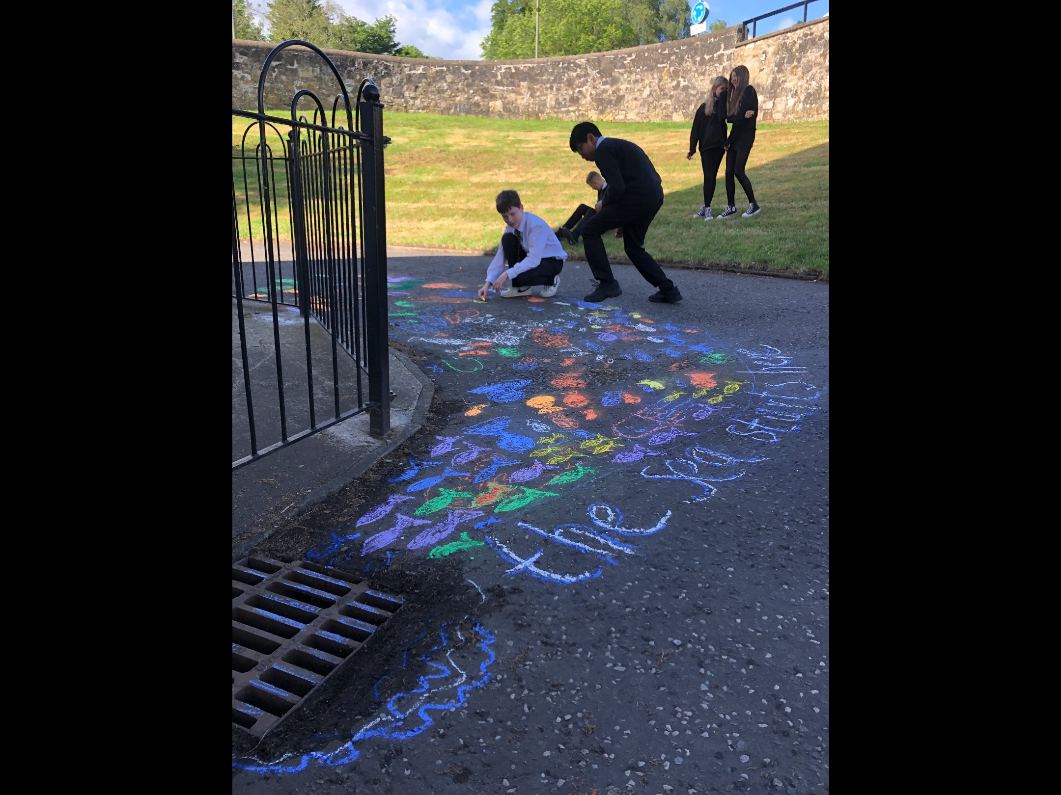
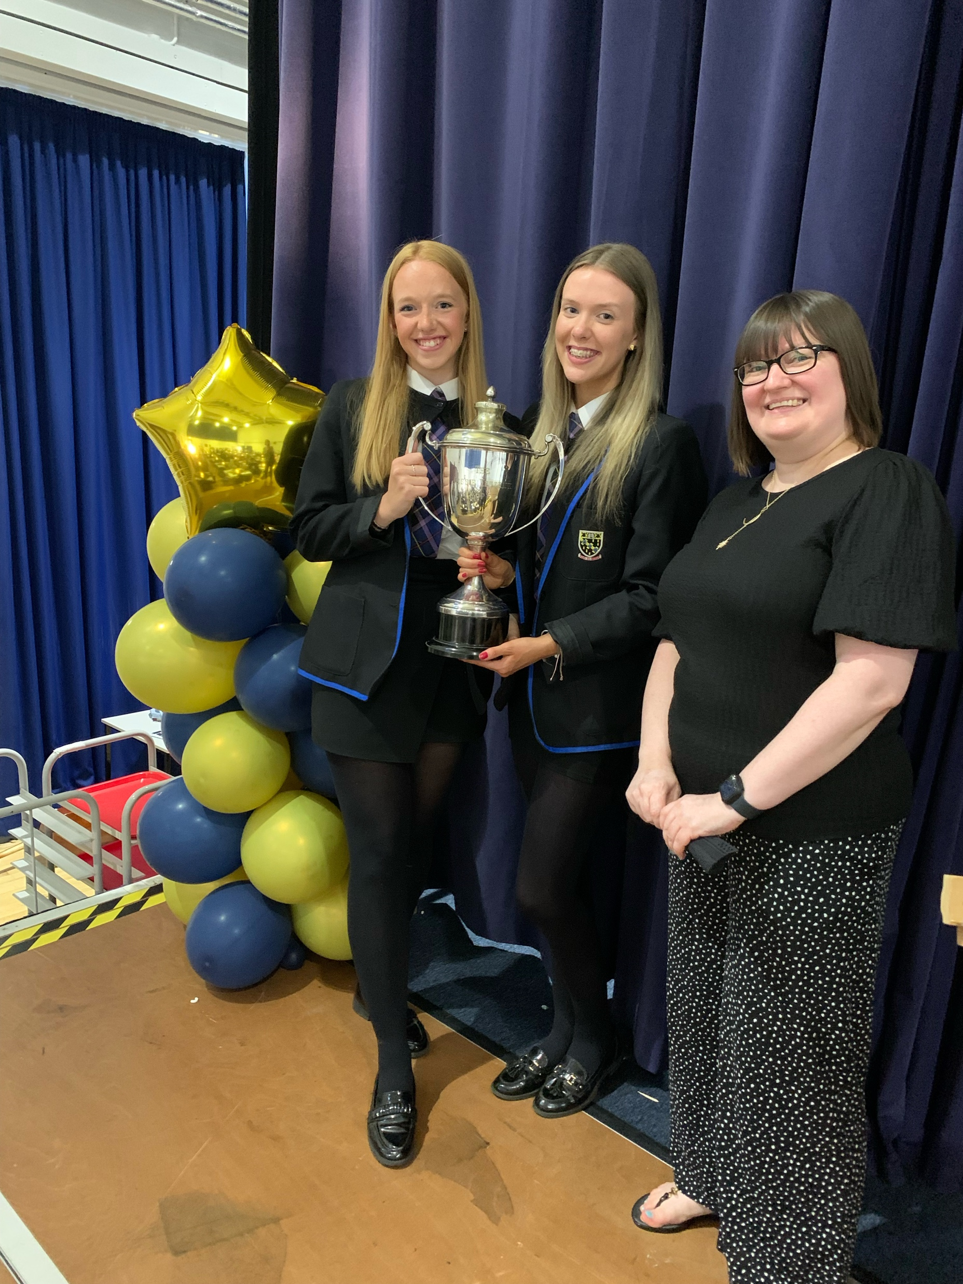
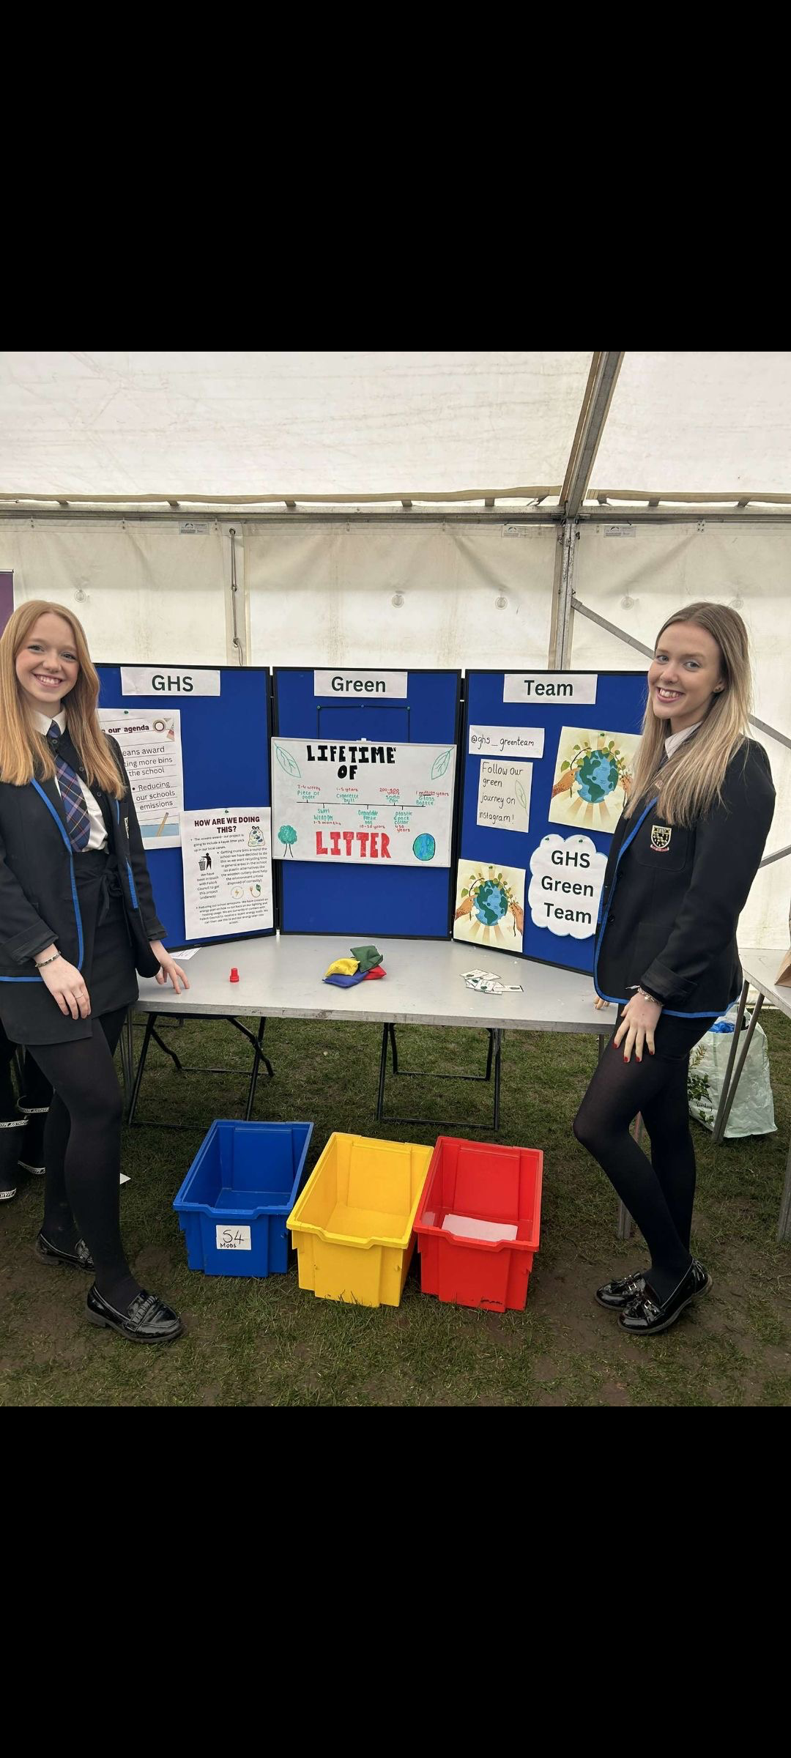
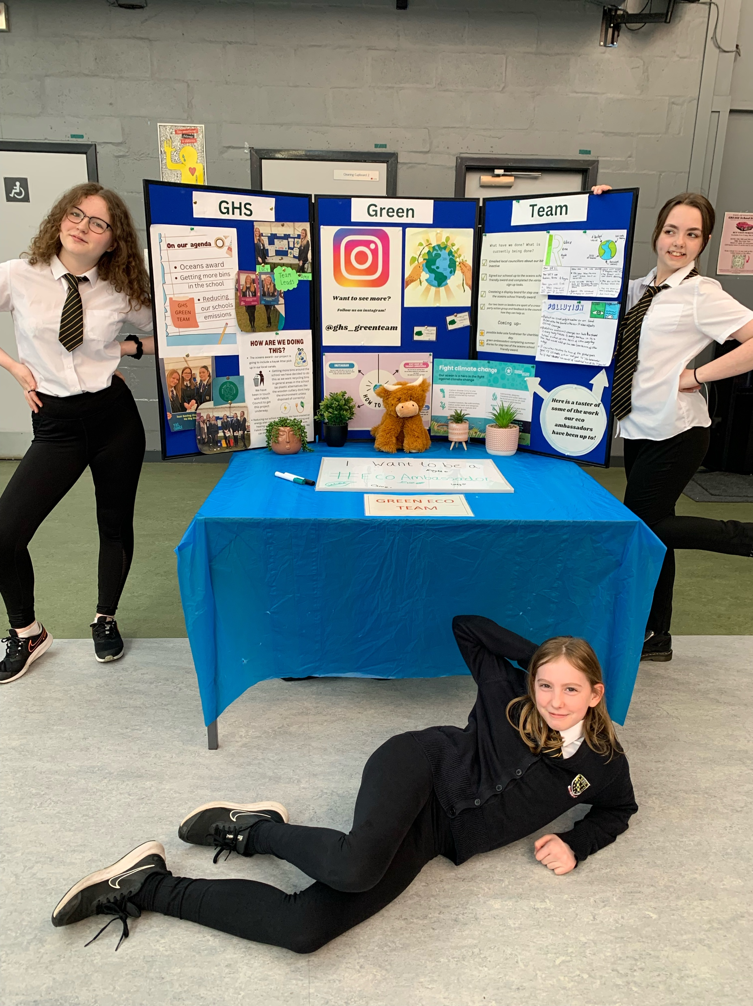
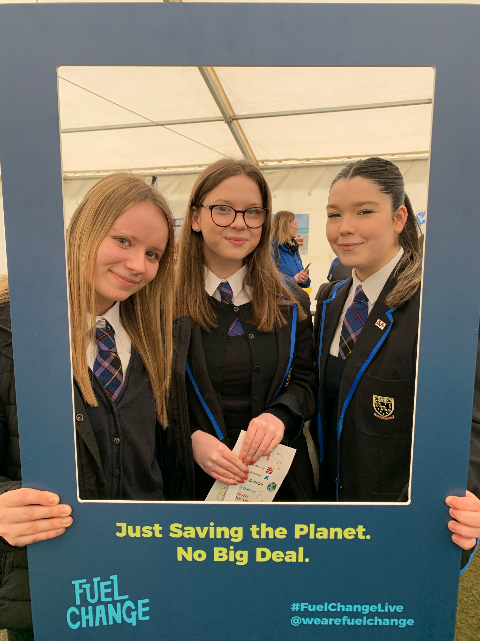
SCHOOL WIDE LITTER PICKS AND ART CLASSES!
KNOW YOUR ECO COMMUNITY EVENT!
ACESS ALL AREAS AND TRANSITION EVENTS

Slide 10
Why are we doing this?
THE CLIMATE CRISIS IS A CHILDS RIGHTS CRISIS
Our lives are impacted and surrounded by the ‘big’ problem of climate change. However, if we demand action for our community we can make a difference.

Slide 12
The campaign action
What is it?
Send a Good Luck card to the Minister for Energy Security and Net Zero
When should we do it?
Post your card before 24 November, so the Minister sees it before they travel to COP28 in the UAE
Why should we do it?
So the Minister understands why children and young people care about climate change and adaptation and champions children’s rights while at this global conference.

Slide 13
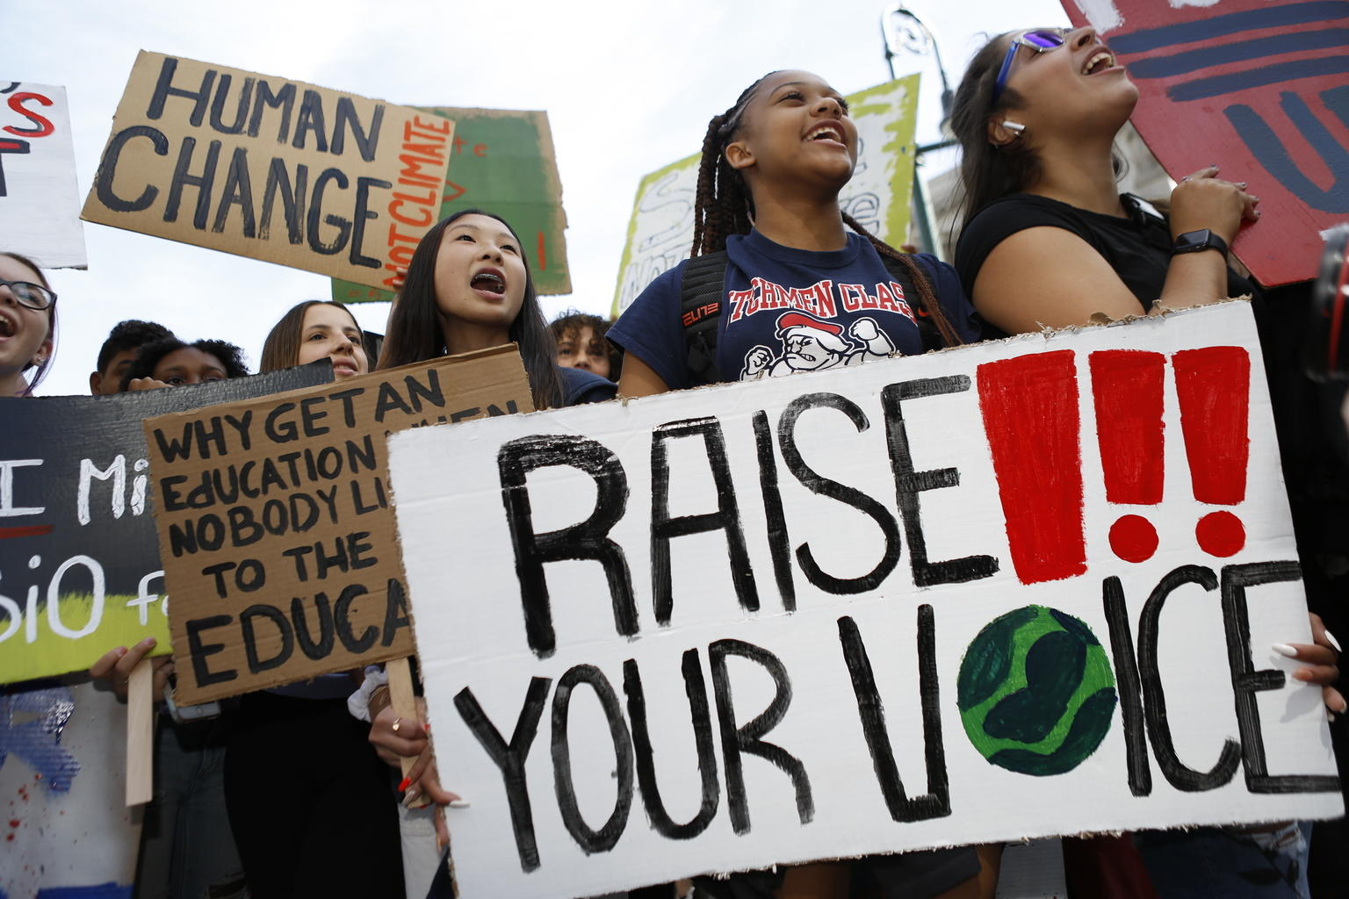
THANK YOU FOR JOINING – Happy World Children’s Day!
© UNICEF/Chalasani
On 20 September 2019 in New York City, youth climate activists join in a demonstration calling for global action to combat climate change.

