Slide 1
Parents and Governors Introduction to RRSA

Slide 2
Introducing RRSA
Notes:
Explain that the school has signed up to work with UNICEF UK to become a Rights Respecting School.​
​
UNICEF is the world’s leading organisation working to ensure that children across the world access and enjoy their full range of human rights as set out in the 1989 UN Convention on the Rights of the Child. UNICEF stands for the United Nations Childrens Fund. ​
​
UNICEF UK is working with around 5,000 schools through the Rights Respecting Schools Award. So our school is joining a significant and growing body of schools changing the way children experience education and childhood.​
​
The next fifteen to twenty minutes will help you to see why this is so important and how it supports our vision as a school and the aspirations of our children and young people.​
​

Slide 3
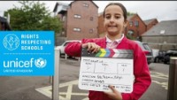
Notes:
If you have time during your session this video explains what the Award is, what children’s rights are and why it is important for children, young people and the whole school community. 8mins.

Slide 4
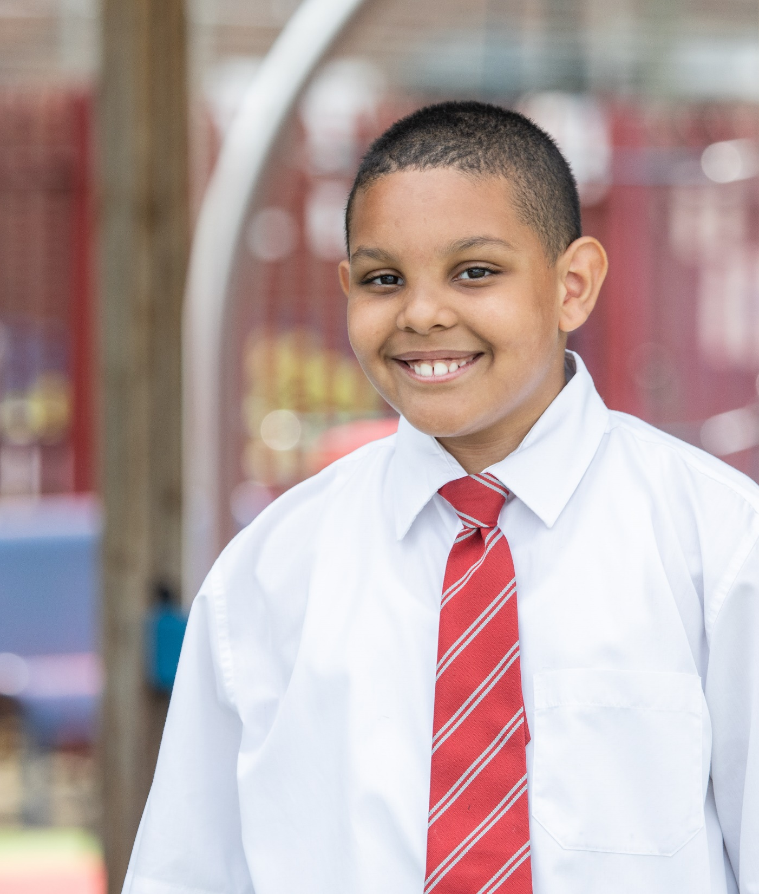
RRSA
@UNICEF/Dawe
What is the Rights Respecting Schools Award all about?​
What does it involve?​
Why engage with this programme?​
Impact?​
All schools are striving for improvement, how does RRS add value?​
RRSA membership
Notes:
At this stage it is possible you will have at least some of these questions in your mind.​
​
Hopefully these will be addressed in what follows.​
​
Chose one of the following approaches depending on how your meetings generally work:​
​
EITHER – ask questions as we go along and I’ll do my best to respond​
​
OR - You may have other questions as we go along… if you don’t mind holding on ​
these as they may be answered by later slides and there will be time at the ​
end for further questions.​
​

Slide 5

Notes:
Martin Russell, Programme Director for RRSA, introduces the Award.

Slide 6
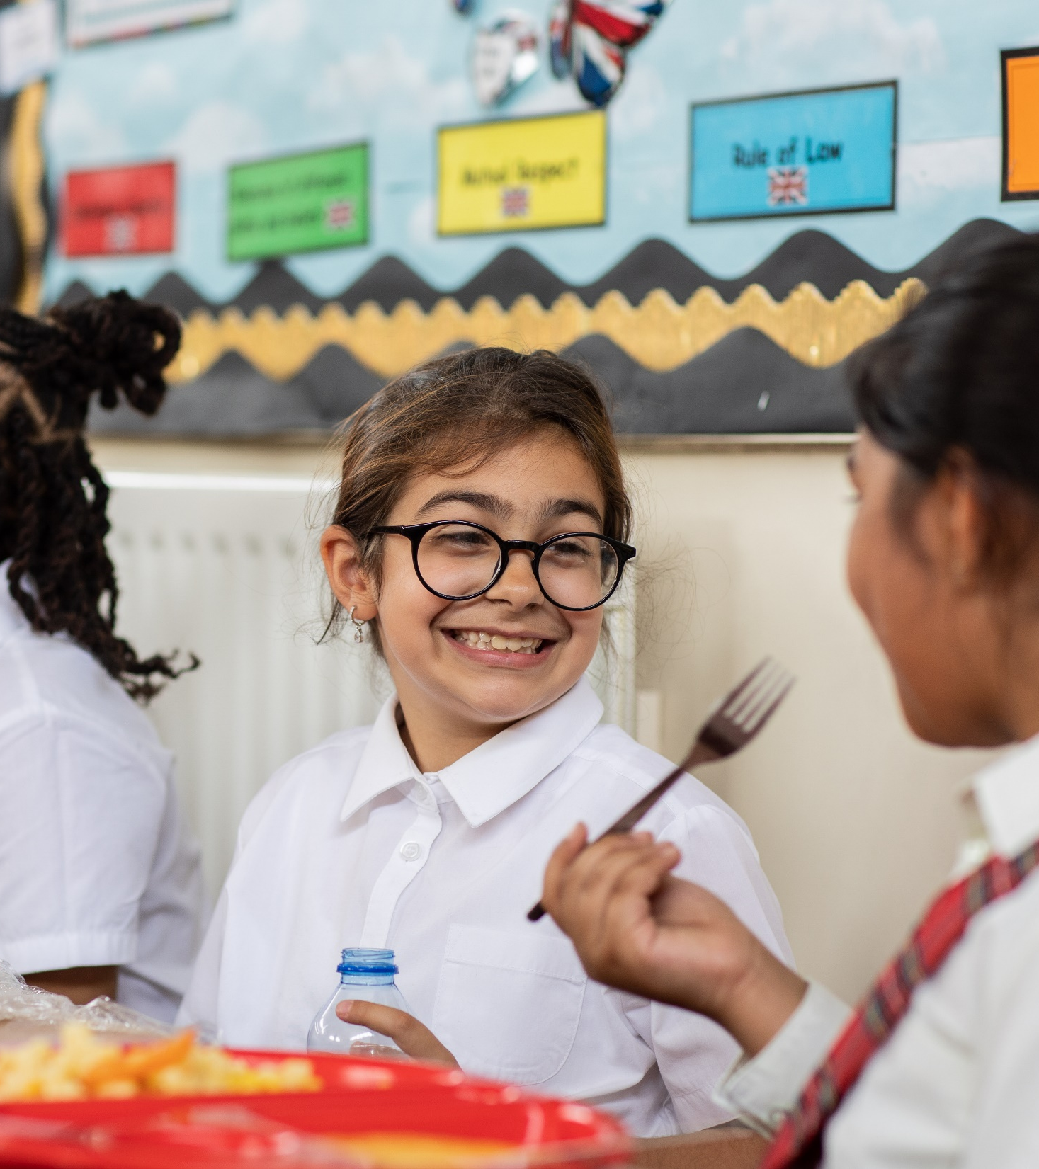
What’s it all about?
@UNICEF/Dawe
The UNICEF UK RRSA supports schools across the UK to embed children’s human rights in their ethos and culture.​
The Award recognises achievement in putting the UN Convention on the Rights of the Child (CRC) at the heart of a school’s practice to improve well-being and outcomes for every child and to help all children realise their potential.
Notes:
The Award is based on principles of equality, dignity, respect, non-discrimination and participation.
The programme started as a pilot programme in 2006.
Since schools that have progressed through the Award have reported a positive impact on relationships and well-being, leading to better learning and relationships, improved academic achievement and a reduction in bullying. It complements and adds to other school improvement strategies and interventions.​
​
The Award is for schools based in the UK and Channel Islands. UNICEF UK currently work with approx. 5,000 primary and secondary schools, schools for children with special educational needs, and pupil referral across England, Northern Ireland, Scotland and Wales.
Schools need to register with RRSA to get started.
The Rights Respecting Schools Award is a membership programme with an annual subscription charge. Membership provides all the support that schools need to succeed in becoming Rights Respecting, including online training and workshops, e-Learning, resources and guidance materials, support from a Professional Adviser, accreditation visits and more.​
​
RRSA is widely being recognised by headteacher’s and senior leaders as a contributing factor to school improvement. Children and young people say that being in a Rights Respecting school helps them to feel safer, listened to, respected and creates a sense of belonging. ​
You can find out more about the impact of the RRSA including our latest report here: www.unicef.org.uk/rights-respecting-schools/the-rrsa/impact-of-rrsa/

Slide 7
What does it involve?
The whole school community learns about rights and sees them as underpinning our values, vision and mission​.
Mutual respect for rights informs all practice and relationships in school​.
External validation recognises that we have embedded children’s rights into our school’s practice and ethos.
Notes:
Many people in the UK have very little knowledge of the UN Convention on the Rights of the Child. Many children don’t really know what their rights are.​
​
As the school community – adults, children and young people learn about rights. They also explore why it is so important to respect and value your rights and, equally, the rights of those around you. ​
​
We will explore together as a school how the rights of the child relate to and support our aims and values as a community – and how they underpin our practice.​
​
As the CRC begins to be embedded in some aspects of learning and it starts to influence our thinking and relationships around school, we will move towards a Silver: Rights Aware assessment visit.
Probably in around 12-15 months from now. The Silver Accreditation is a virtual visit and takes around 2 hours. ​
​

Slide 8
Three Stands of the Award
Strand A ​
Teaching and learning about rights​
Strand B ​
Ethos and relationships through rights ​
Strand C​
The empowerment and participation of children and young people for others locally and globally.
Notes:
Explain that there are three strands for the Award grouped under the three Strands outlined here. ​
​
There are 9 outcomes under these three strands and when the school is ready, an assessment visit by UNICEF UK takes place involving detailed discussion with children and adults in the school.
This is a supportive learning visit with an emphasis on celebrating progress to date and sharing ideas and recommendations to progress to Gold: Rights Respecting which is the highest stage of the programme. ​
​
The UNICEF UK team understand that school are busy places with lots of commitments. Rather than seeing the journey to Rights Respecting status as additional other work, schools tell us that:​
​
‘It underpins everything else’……..’It brings it all together’….. ‘It makes sense of everything we do, it provides a framework’ ​
​

Slide 9

THE RRSA JOURNEY
Register
Bronze: Rights Committed
3-6 months
Silver: Rights Aware
A further
6-12 months
Gold:
Rights
Respecting
A further
12- 24 months
‘Typical’ time scales but these vary.
Silver and Gold accreditation lasts 3 years.
Notes:
Explain that there is flexibility but the UNICEF UK team try to encourage pace and is encouraged.… MOMENTUM is key – usually driven by pupils’ enthusiasm and commitment by senior leaders and staff!
Explain the ‘urgency’ by saying that simply registering for RRS makes no difference for children. Need to act. The change happens as you progress through the award,
Knowing that you have rights and what they mean is, itself, a right.
Article 42 says that Governments should actively tell children and adults about the convention so that everyone knows about children’s rights. As school leaders, we are duty bearers and it is our responsibility to make sure that children and young people know their rights, and that mutual respect underpins our ethos. As part of the journey, staff and school leaders will be looking at our decision making, ensuring is underpinned by the CRC.
Schools engaging in this process are making a fundamental change for and with children and young people.

Slide 10
In our part of the world…
The RRSA supports and contributes to all other school priorities - for example:.
England​ ​ SMSC​ ‘British Values’​ Narrowing the gap​ ‘Prevent Duty’​ ​ | Northern Ireland​ ​ Every School a Good School​ Shared Education​ ​ ​
Scotland​ ​ GIRFEC​ CfE​ Pupil Progress​ Learning for Sustainability​ 2014 Act​ | Wales​ ​ New Curriculum​ Raising attainment​ 2011 Measure​ ​
Eco schools
Safeguarding
E-Safety
Fair Trade
Fitness/Health/
Wellbeing.
Notes:
​There is a connection between the CRC and the Government and Education Department priorities in our area.
RRSA will help to address all other educational priorities and developments. ​
​
The ones in the middle are an ever growing list that apply in all four UK jurisdictions ​
​

Slide 11
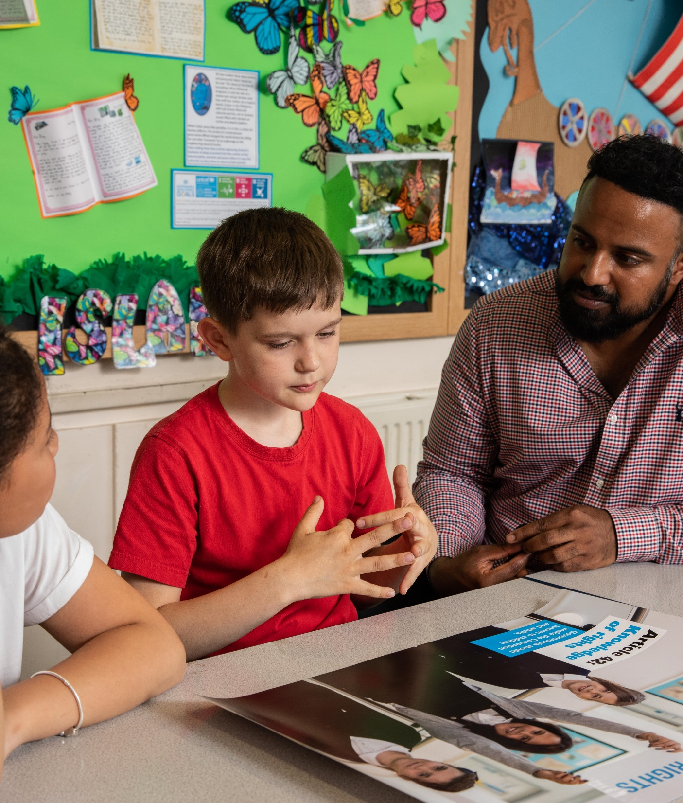
How will this benefit us?
Children and the whole school community will learn about children’s rights, how they can influence and shape relationships and how to advocate for their own, and the rights of others.​
It is a catalyst for further school improvement.​
It builds upon excellent practice and supports schools to move to a Rights Based Approach. ​
The whole school community will learn about rights… through rights……. and for rights.​
It is increasingly recognised positively in school inspection reports.​
It provides a platform for learning about global citizenship and sustainable development.
@UNICEF/Dawe
Notes:
​You can find out more about the impact of the RRSA including our latest report here: www.unicef.org.uk/rights-respecting-schools/the-rrsa/impact-of-rrsa/
The bullet points here are revealed on individual clicks:​
CLICK 1​
Although the word ‘Award’ is in the title we won’t talk about DOING the RRSA – instead it is about BECOMING and BEING a rights-based community.​
CLICK 2​
The journey should challenge and enhance HOW WE ARE AS A SCHOOL​
CLICK 3​
Much of our best practice is already consistent with a rights respecting approach but we don’t connect it to the CRC or use the language of rights and respect to underpin what we are doing.​
CLICK 4​
It will involve us all​
CLICK 5​
This is not why we are embarking on this journey ….. ​
CLICK 6​
Preparing our pupils for their place in an ever-changing world – both now and as adults is at the heart of what we are about as educators.​
​
Important to convey that RRS, in fact, links to all other school ‘Awards’ BUT it is equally about:​
narrowing the attainment gap, ​
teaching and learning, ​
restorative practice, ​
better relationships and engagement,​
improved pupil participation​
The many things that good schools are trying to achieve are, in fact, underpinned by the CRC – RRSA makes this explicit.​
​

Slide 12
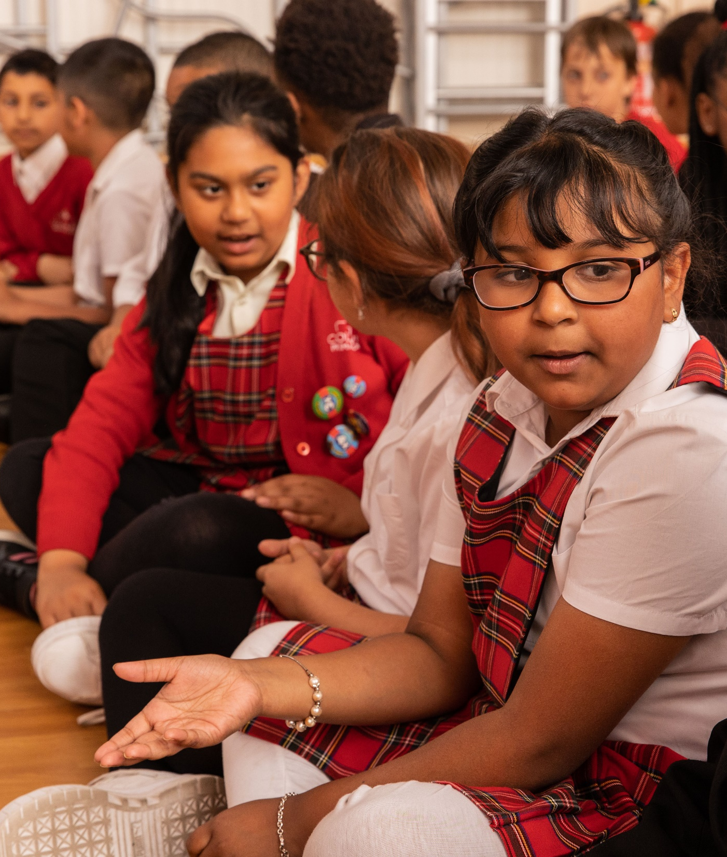
Next Steps
Form a steering group of young people and adults​
Training / E-learning / INSET​
Create an action plan as part of the Bronze Application Form. ​
More information on the website:​ unicef.org.uk/rrsa​
@UNICEF/Dawe
Notes:
As a school community we are hoping that there will be wide engagement in our rights-respecting journey with UNICEF UK.​
​
Our Steering Group will lead the work. This will be a group of pupils working collaboratively with some adults. The group should include a member of SLT and ideally a Governor / Parent Council representative. We may be looking for community representation too. (Please speak with me if you would like to be involved.)​
​
We have the option to create a baseline audit (see surveys on website) which will help shape your planning and future training. ​
​
Encourage people to visit the website.​
​

