Slide 1
Primary Introduction Pack for RRSA

Slide 2
Rights Respecting Schools:
Are you ready?
Notes:
Explain that the school is starting something new that involves everyone in the school.
You would like them to watch the video on the next slide as this will give them a clue about what is going to be happening.

Slide 3


Slide 4
We are becoming a
UNICEF UK Rights Respecting School!
Notes:
Blank screen to begin… ​
​
Explain that they will be learning about something that is important to every one of them and EVERY other child in the world.​
​
Emphasis that this is something that connects all children. It is something that all children are entitled to. ​
​
Explain that they will be learning about how all children are special and have something called Children’s RIGHTS that help them have the best possible childhood in which they are safe, listened to, have good food, learn and have time to play.​
​
All children have rights, and they need to be protected and respected by everyone. ​
​
It is the role of adults to make sure that children enjoy these rights. (Duty Bearers) ​

Slide 5
OUR SCHOOL
Notes:
Learning about children’s rights will involve them exploring how to make their school the best possible place for children to learn, play and grow – a place where everyone respects each other and treats each other fairly.​
​
Ask them for ideas:​
What would their ideal school look like? Feel like?:​
How would children treat each other? ​
How would adults treat children?​
How would children treat adults?​
How could they be more involved in their learning and life in school? ​
​
Learning about rights and respecting the rights of others will take them on a journey to be a Rights Respecting School.

Slide 6
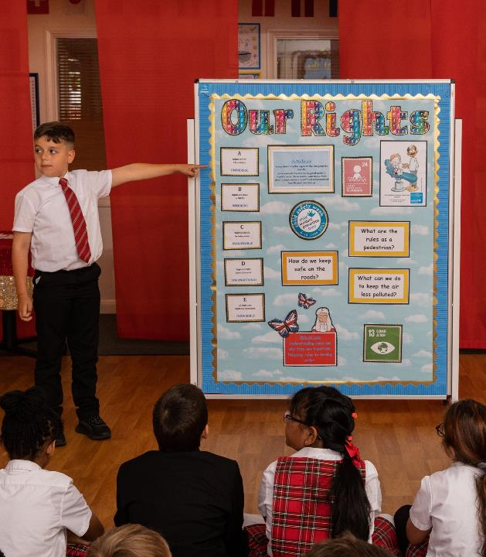
Add your message
@UNICEF/Dawe
Personalise your message to children by asking questions like:
Who would like to know more?
Who would like to be involved?
Who might like to be part of the Rights Respecting group/team at…. (name of school)?
The RRSA website has lots of information: www.unicef.org.uk/rrsa
Notes:
Personalise your message at the end – e.g. by asking who would like to be involved; when the first meeting will be etc.​
​
The RRSA website has lots of information: www.unicef.org.uk/rrsa

Slide 7
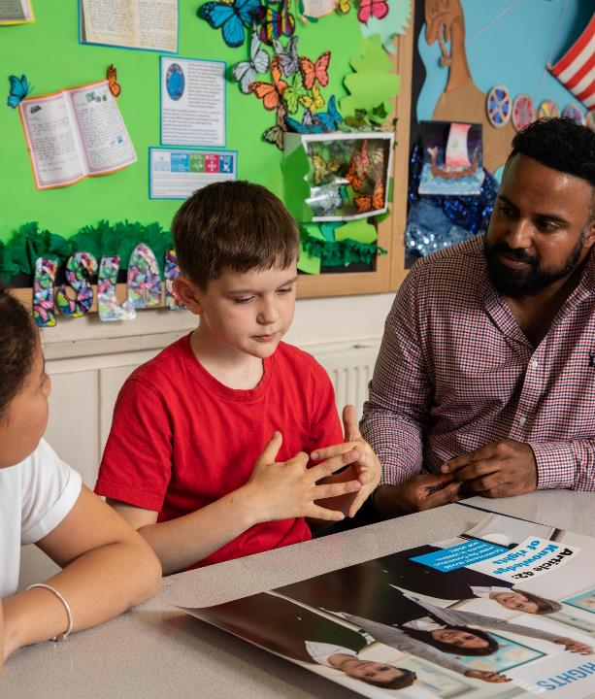
What will happen next?
Adults will get support and training from the RRSA team at UNICEF UK.
You will be involved! There will be a group of children that will form a steering group to make decisions but everyone is part of this.
We will work with UNICEF UK for several years. It’s a journey to becoming Rights Respecting - it won't happen overnight.
The first stage of the Award is Bronze, but in time we will get to Silver and then Gold!
@UNICEF/Dawe
Notes:
Customise to fit with the place you at with your RRSA work but emphasize that children have a part to play about in this and the work is about empowering them and raising their voice.

