Slide 1
Secondary Introduction Pack for RRSA

Slide 2
Rights Respecting Schools Award: What’s it all about?
Notes:
Explain that your school is starting out on a new journey working with Unicef UK , the world’s leading charity working for children and young people across the world. The goal is to be recognised as a Rights Respecting School - a school where children and young people learn about their rights, rights are respected, promoted and protected by everyone.​
The UK Committee for UNICEF (UNICEF UK): Go on to explain that UNICEF UK works with governments and communities around the world and in the UK to help children and young people have the best possible childhood and help them to know about and claim their rights ( health, education, protection, non-discrimination etc.) while respecting the rights of others. Unicef stands for the United Nations Childrens Fund
.

Slide 3
WHAT DOES THIS MEAN FOR OUR SCHOOL?
ABOUT rights
THROUGH rights
FOR the rights of others
Notes:
You might like to ask them this questions. ​
​
From your point of view, what would a good school look and feel like? ​
​
Encourage to think of how people are treated, listened to and included. ​
​
The Rights Respecting Schools Award involves adults and young people teaching and learning:​
ABOUT the rights set out in the United Nations Convention on the Rights of the Child​
THROUGH rights so that everyone respects the rights of others so that everyone feels included respected and safe. ​
FOR the rights of others so that we stand up for rights and help make our school, our local and our global community a fairer place.​
​
Learning about children’s rights will involve everyone exploring how to make their school the best possible place in which to learn, be safe and reach their potential. ​
​
In Rights Respecting Schools students have a real say in what happens in school. ​
​
They are treated with dignity and mutual respect is at the heart of becoming a RRS. ​
​
They learn about being rights respecting global citizens standing up for the rights of children everywhere.​
​
​

Slide 4
SO WE WILL BE…
Learning about the CRC and rights in our lessons, assemblies and special events
Exploring what “respect” means and how adults and young people model it everyday
Looking for ways in which students can be actively involved in decision- making in school

Slide 5
Notes:
This video gives you more information about children’s rights, what a Rights Respecting School is and why it is important that we become one.

Slide 6
Global Citizens
Notes:
And … on our journey to be a Rights Respecting School, we will be finding out what it means to be a rights respecting global citizen and how to make a difference to children’s lives in the UK and around the world, so more children can enjoy their basic rights to be healthy, educated, safe and protected.​
​
​
Now we are going to hear from the Rights Respecting Schools Award Programme Director (next slide)

Slide 7
Notes:
This video is a short introduction for secondary learners from RRSA Programme Director, Martin Russell.

Slide 8
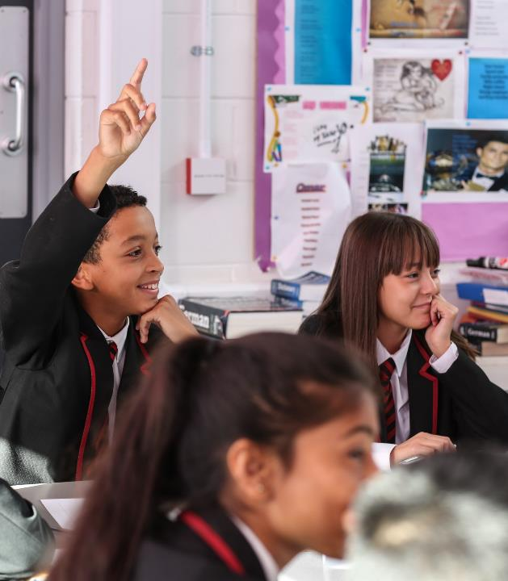
Add your message
@UNICEF/Dawe
Personalise your message to children by asking questions like:
Who would like to know more?
Who would like to be involved?
Who might like to be part of the Rights Respecting group/team at…. (name of school)?
The RRSA website has lots of information: www.unicef.org.uk/rrsa

Slide 9
What will happen next?
Adults will get support and training from the RRSA team at UNICEF UK.
You will be involved! There will be a group of young people that will form a steering group to make decisions but evey one is part of this.
We will work with UNICEF UK for several years. It’s a journey to becoming Rights Respecting - it won't happen overnight.
The first stage of the Award is Bronze, but in time we will get to Silver and then Gold!
@UNICEF/Dawe
Notes:
Customise to fit with the place you at with your RRSA work but emphasize that young people have a part to play about in this and the work is about empowering them and raising their voice.

