Slide 1
© UNICEF/Dawe
ENGAGING FAMILIES & COMMUNITY
CAMPAIGNING IN SCHOOL
Notes:
Welcome to Spotlight, our latest resource to support RRSA coordinators to develop Rights Respecting practice in school.
Spotlight is aimed at colleagues and is intended to support you in staff briefings or continued professional development (CPD).
Please check guidance in subsequent slide notes.

Slide 2
CONTENTS
For each slide, please look at the presenter notes for delivery information.
Slide 3: Aims of the Session
Slide 4: Three ways to use this pack
Slide 5 : Introducing this month’s Spotlight
Slide 6: Links to RRSA Outcomes
Slide 7: Links to Articles
Slide 8: Case Study 1 – Boghall Nursery and Primary
Slide 9: Case Study 2 – Bridgelea Primary PRU
Slide 10: Let’s Discuss
Slide 11 & 12: Activities
Slide 13: Reflection
Slide 14: Resources
Notes:
For each slide, please look at the presenter notes for delivery information. You may wish to amend or delete this slide when you deliver the session in your school.

Slide 3
AIMS OF THE SESSION
To consider why it is important to raise awareness of the CRC with parents, carers and the wider community.​
To develop a range of different strategies to engage parents, carers and the wider community with our rights respecting work.​
To understand how engaging the wider school community fits in the RRSA framework.
Notes:
Welcome to Spotlight, a resource to support RRSA coordinators develop Rights Respecting practice in school.​
​
Spotlight is aimed at colleagues and is intended to support you in staff briefings or continued professional development (CPD). ​
​
This month’s Spotlight explores engaging parents, carers and the wider community in your rights respecting journey.​
​
Please check guidance in subsequent slide notes.​
​

Slide 4
WAYS TO USE THIS PACK
DELETE THIS SLIDE BEFORE USING
If your time is tight, use the introduction slide and choose from the key discussion questions to explore with your colleagues.
If you have longer, you can also choose some of the activities to explore.
You may wish to cover the content over several staff meeting sessions.
There are trainer notes for each slide – please do have a look at these for further guidance.
There
Notes:
Delete this slide before using.
It would be useful to have copies of the summary CRC so that staff can refer to them throughout the session.
www.unicef.org.uk/wp-content/uploads/2019/10/UNCRC_summary-1_1.pdf

Slide 5
SPOTLIGHT ON…
As part of your Rights Respecting Schools journey, we encourage you to promote awareness of rights with your wider school community.
It is great for parents and carers and other school partners to become familiar with children’s rights and for agencies you work with such as police, social care and other statutory professionals to be reminded that they are duty bearers.
This month’s Spotlight pack will give you ideas to share with colleagues about how you might extend the reach of your Rights Respecting work.
.
Stuart from the RRSA team introduces this month’s Spotlight.
Notes:
You may wish to amend or delete this slide when you deliver the session in your school. ​
​​
​
​
​
​

Slide 6
LINKS TO RRSA OUTCOMES
Strand A: TEACHING AND LEARNING ABOUT RIGHTS
Outcome 1: Children, young people and the wider school community know about and understand the UN Convention on the Rights of the Child and can describe how it impacts on their lives and on the lives of children everywhere.
Strand C: TEACHING AND LEARNING FOR RIGHTS
Outcome 8: Children and young people know that their views are taken seriously.​
Outcome 9: Children and young people have taken action to claim their rights and promote the rights of others, locally and globally.
Notes:
This slide provides an opportunity to remind colleagues of the structure of RRSA which includes three strands: teaching about rights, through rights and for rights.​
​
Engaging with parents, carers and the wider community is linked with both Strand A, Outcome 1 and in Strand C, Outcomes 8 and 9.
Strand A, Outcome 1: ​Pupils need to develop knowledge and understanding of children’s rights and how children and young people can access their rights, or not, in their own community and the wider world. By engaging with parents, carers and the wider school community, children are young people are empowered to see how rights are part of life beyond the school gates. ​
​
Strand C, Outcome 8:​ Children and young people know that their views are taken seriously. Engaging with the wider school community shows how their voices can have impact outside of school. ​
​
Strand C, Outcome 9: ​Children and young people will have taken action to claim their rights and promote the rights of others. This outcome has more of an impact of the wider school community can get involved at spreading the learning about rights and advocating for the rights of others. ​
​
The full text of the Strands and Outcomes of the Award can be found here:​ www.unicef.org.uk/rights-respecting-schools/wp-content/uploads/sites/4/2015/06/RRSA-Strands-and-Outcomes-at-Silver-and-Gold-1.pdf​
​

Slide 7
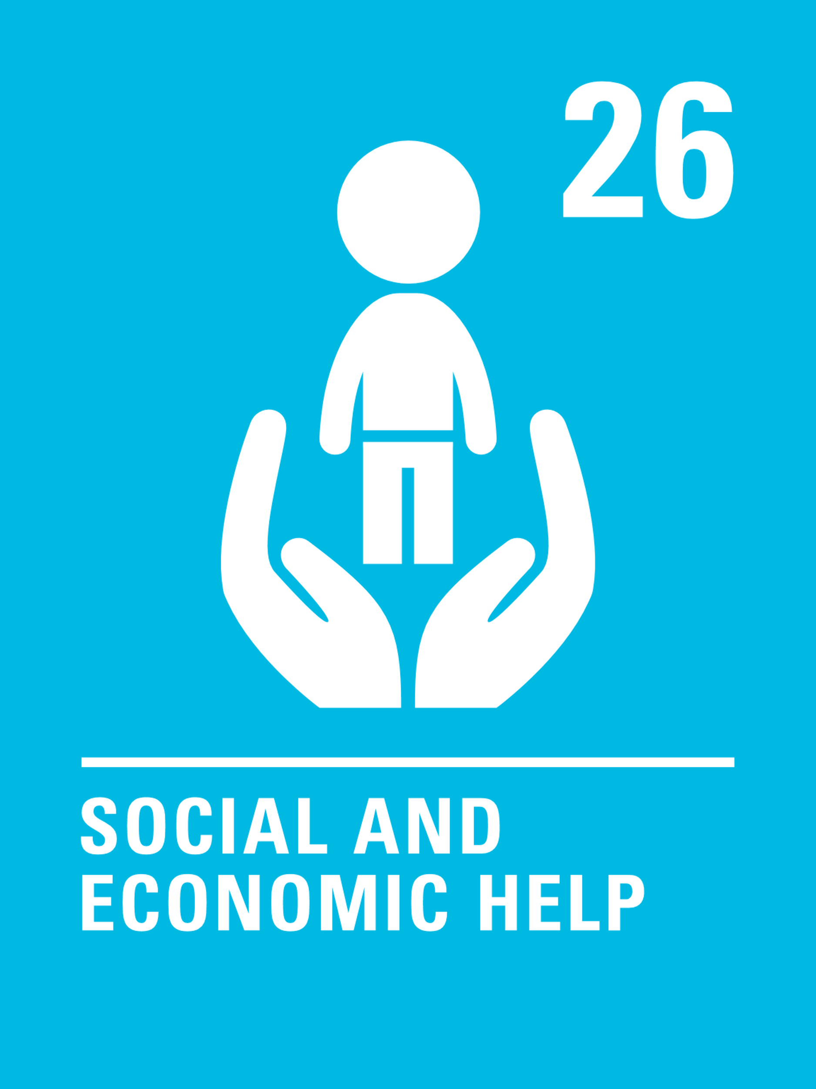
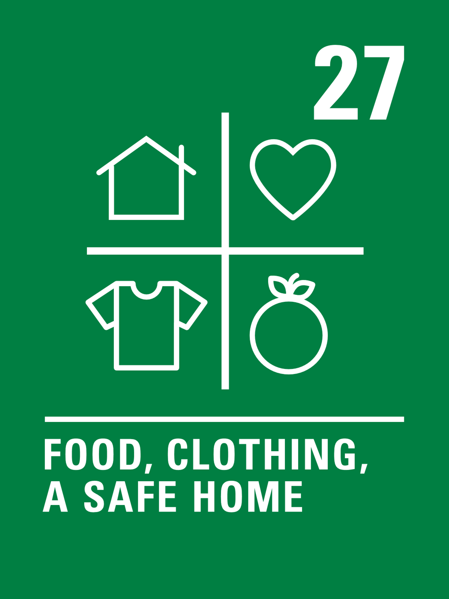
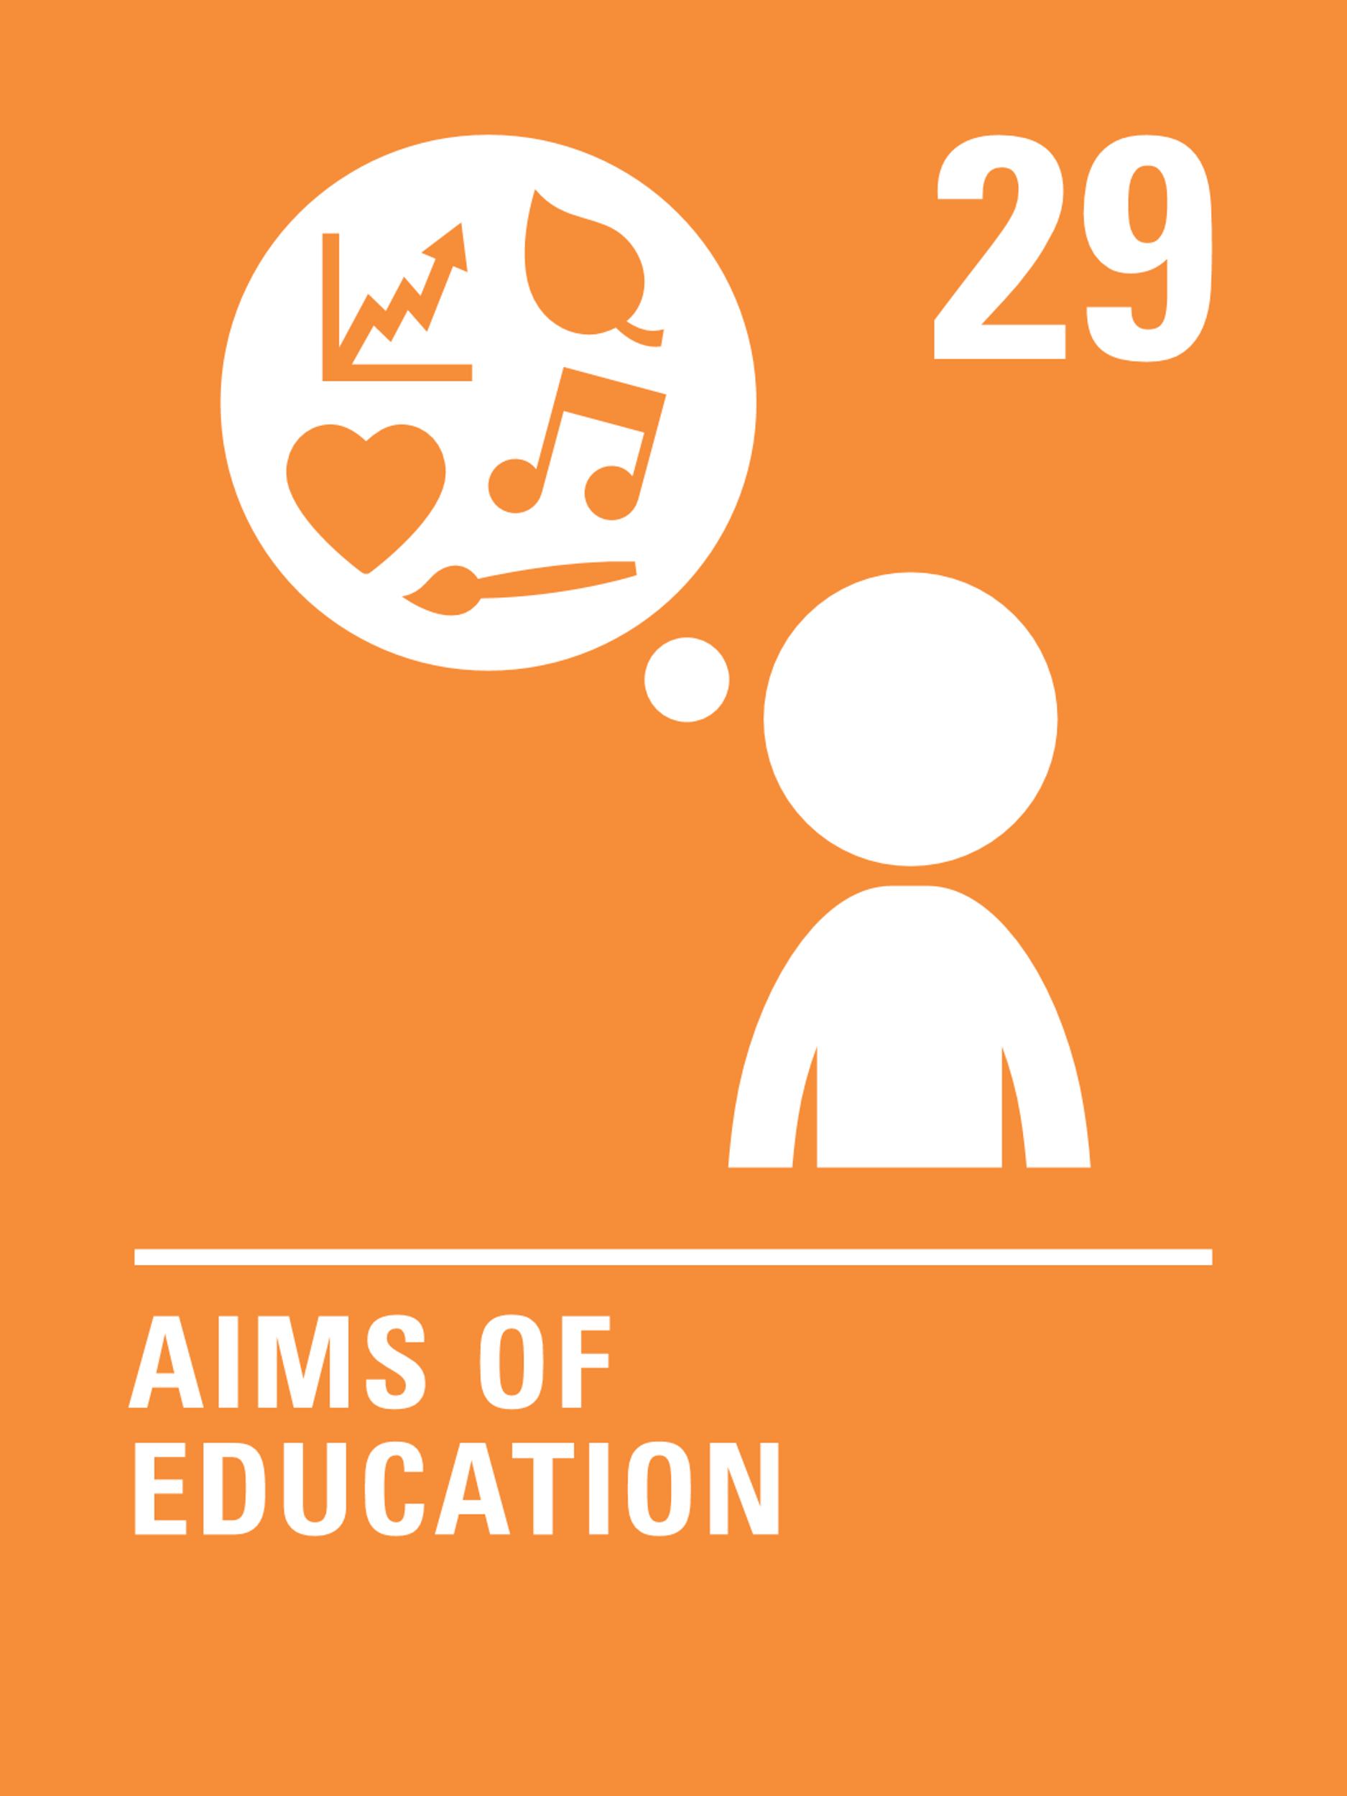
LINKS TO ARTICLES
Look at the summary of the CRC with a partner – how many times are parents, carers and families mentioned?
When ready click to reveal.
Importantly, Article 42 states that all adults and children should know about the CRC.
Notes:
When showing this slide in presenter mode the articles will appear on click.
The summary version of the CRC can be found here: www.unicef.org.uk/rights-respecting-schools/wp-content/uploads/sites/4/2017/01/uncrc_summary-1_1.pdf​
​
Parents and carers are mentioned many times in the CRC which shows what a fundamental role they play in ensuring that children’s rights are met.
They are also rights holders themselves under the CRC. They are entitled to assistance from the state in raising their children and should also provide their children with advice and guidance.
Article 42 ​​states: All adults and children should know about the convention. Children have a right to learn about rights and adults should learn about them too​.​
For further information on parents as rights holders this see the following video from Queens University Belfast: www.youtube.com/watch?v=TFMqTDIYI2U&t=11s ​
​​​​
CRC Summary: unicef.org.uk/wp-content/uploads/2019/10/UNCRC_summary-1_1.pdf​
​CRC full text: unicef.org.uk/wp-content/uploads/2016/08/unicef-convention-rights-child-uncrc.pdf​
​CRC icons: unicef.uk/CRC_Icons​
​RRSA Glossary: www.unicef.org.uk/rights-respecting-schools/resources/teaching-resources/guidance-assemblies-lessons/rrsa-glossary/​

Slide 8
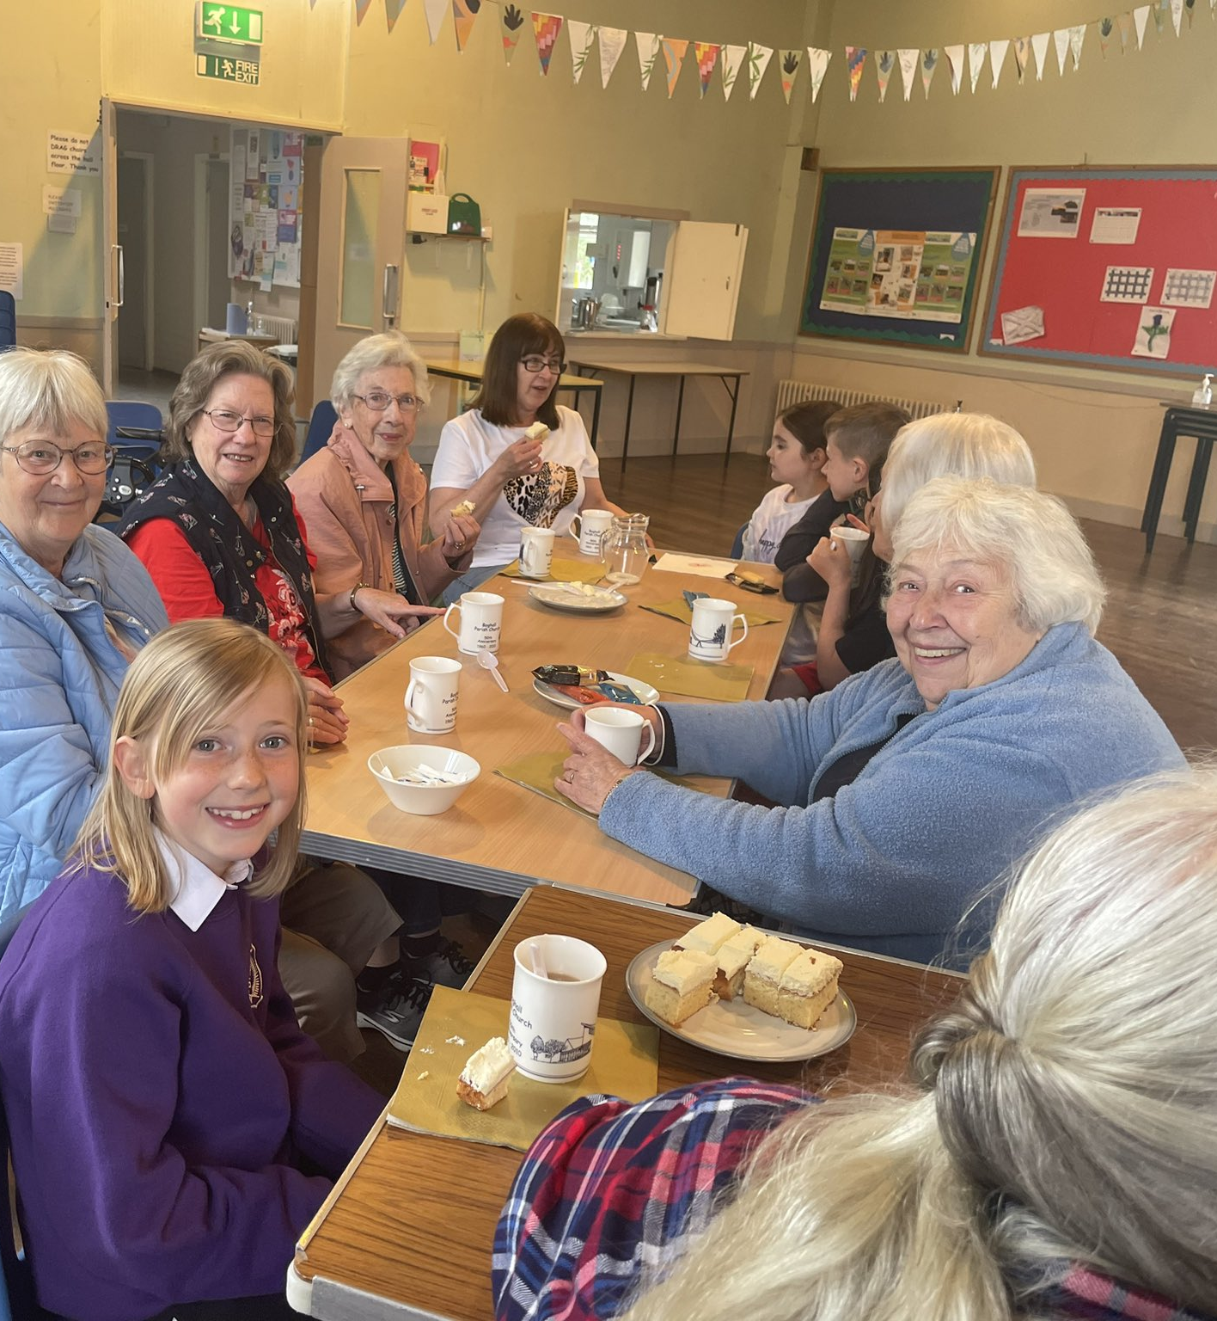
Friendship Café - a weekly intergenerational project that involves both pupils and members of our local church.
CASE STUDY
Look at this case study from Boghall Nursery and Primary
Read the full case study online.
We use a large part of our Public Equity Fund budget to employ a Family Link Worker, who responds to the needs of the families within our school and to promote children’s rights.
Our Positive Relationships Framework is central to all of the work we do in this area. We have lots of activities through which we promote our vision, and we often tweet about these activities to let our community know what we are doing.
Friendship Café is a weekly intergenerational project that involves both pupils and members of our local church that have felt lonely since COVID. Pupils and church members play games and chat over tea and cake. Pupils develop life skills such as washing dishes, taking drinks orders, and setting up tables.
Notes:
The full case study is available on the RRSA website, where you can print it out and share with your colleagues if you are choosing to focus on this as part of your session. Encourage staff to consider whether there are any examples of good practice within this case study that your school could draw on and learn from.

Slide 9
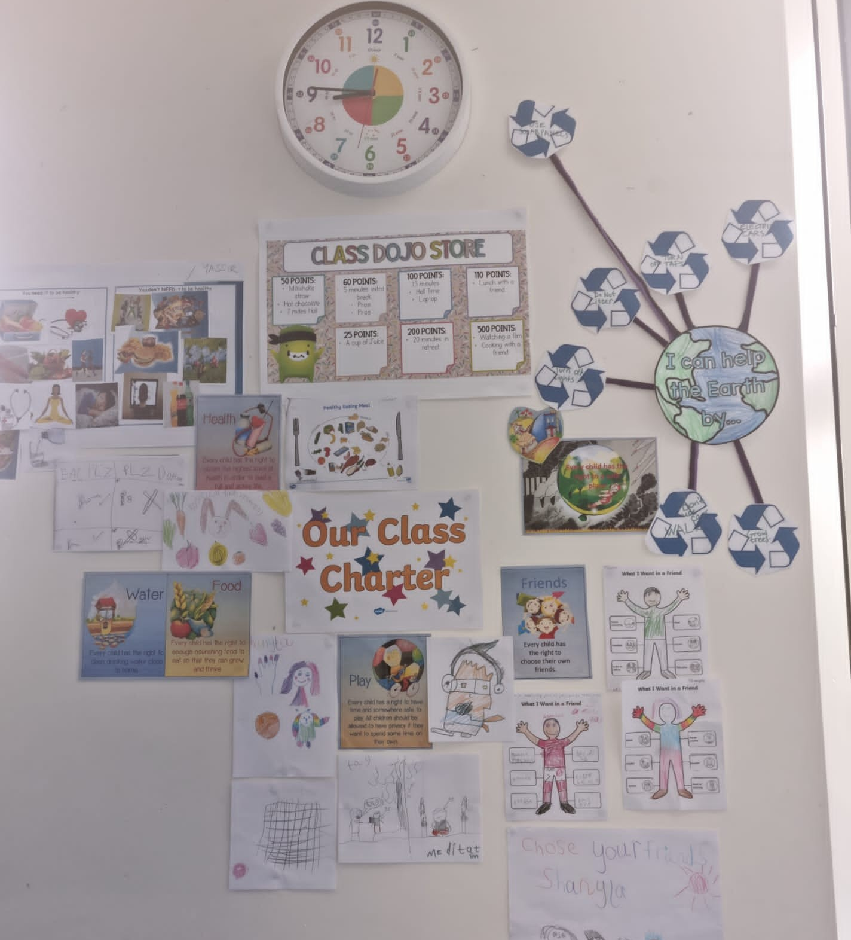
Engaging families through Class Dojo has transformed practice and parental engagement.
CASE STUDY
Look at this case study from Bridgelea Primary (specialist SEMH provision)
Read the full case study online.
Our school is a part of the Manchester Pupil Parliament […] Experiences like this are empowering for our children and enable them to be heard. Adults at our school are constantly searching for opportunities for children to access and engage in wider projects.
We have a widespread community across Manchester. Engaging families through Class Dojo has transformed practice and parental engagement. Parents are able to see their child completing fun and positive activities in school where they are happy and have friends.
​Parents are regularly invited to school for activities to complete with their children. We support them with transport as this is often a barrier to participation for our families. We have employed a pastoral higher level teaching assistant who works hard to engage parents and support them to access resources they need to improve their lives and wellbeing.
Notes:
The full case study is available on the RRSA website, where you can print it out and share with your colleagues if you are choosing to focus on this as part of your session. Encourage staff to consider whether there are any examples of good practice within this case study that your school could draw on and learn from.

Slide 10
LET’S DISCUSS
1. Why is it important we inform family and the community about children’s rights and our rights respecting journey?
2. What opportunities already exist in school for the wider community to find out about school life?
3. How can we further develop these opportunities to explicitly link with rights?
Notes:
Choose the questions that are most relevant to your setting and experience. Collect some of the ideas from your colleagues and add them to your action plan and evidence. ​
​
1: Reflect on the number of times parents, carers and families are mentioned in the CRC itself (see slide 4). Why is engaging the wider school community important as a Rights Respecting School?​
​
2: What communication channels are available to you to inform the wider community about rights? Social media: school website/Class Dojo/Facebook/X/Google Classroom. Do you have a school newsletter/newspaper? Are parents, carers and the wider community invited into school for assemblies/workshops/Fantastic Finishes/Open Afternoons etc? ​
​
3: Are there opportunities for children to link to rights when they have a class assembly/Parents’ Evening/visiting schools? For example a class assembly about Hinduism could mention Article 14. Parents’ Evening could include a reminder about Article 28. Letters about safeguarding could mention Article 19. Could questionnaires/challenges/games/homework activities be sent out?​
​
​

Slide 11
ACTIVITIES
In groups, draw a Rights Respecting classroom onto large pieces of flipchart paper. What do you see, hear and feel in a Rights Respecting classroom?
1. Look at your current calendar of events where families are invited into school. Is there an opportunity to add a child rights dimension to this?
2. Look at your home-school learning agreements. Consider how you could use these to engage your families with upholding rights for all. Could you create a home-school charter? ​
3. Create a plan for increasing the visibility of RRSA around the school. This could be displays in school, the wider school grounds, website, newsletters and on any social media platforms.
Notes:
Depending on the time you have available, choose one or more activities for your colleagues to work on together to further explore the topic. Different groups could explore different activities. The activities that you do not wish to use could be deleted. ​
​
Activity 1: Examples could include Macmillan coffee mornings, assemblies, parents’ evening, summer or winter fairs. Plan a pupil-led event/fair with community involvement. ​
​
Activity 2: You could send home copies of the CRC (or provide a link to it on the website) to aid discussion. One school created a mascot that went home with a copy of the CRC for children to explore with parents and carers. You could use ‘Talk Homework’ to encourage children to discuss rights outside of school.​
​
Activity 3: You could also add photos of RRSA displays/work/meetings to Class Dojo/SeeSaw etc. We want you to celebrate and share what is already going on in school. Children and young people could get involved in this too and could take ownership of certain activities e.g. RRSA Monitor(s) who take photos of RRSA activities around school each week and uploads to school social media channels (whilst adhering to the school’s social media guidelines). Ask staff to use a hashtag and article numbers on Tweets and social media posts to highlight which articles activities are linked to. ​

Slide 12
ACTIVITIES
In groups, draw a Rights Respecting classroom onto large pieces of flipchart paper. What do you see, hear and feel in a Rights Respecting classroom?
4. If your school uses diaries or planners, what opportunities are there to include rights? Consider explicit article links on timetables, information about external agencies like Childline or wellbeing resources.
5. Look at the list of school policies on your school website. Parents and carers will refer to these at different points in their child’s school life. Consider how to strengthen the links to CRC articles.
6. Work with children and young people to design posters or leaflets to inform and engage the wider school community about rights.
Notes:
Depending on the time you have available, choose one or more activities for your colleagues to work on together to further explore the topic. Different groups could explore different activities. The activities that you do not wish to use can be deleted. ​
​
Activity 4: Discuss how school documents that children take home could be enhanced to include a rights element. This will increase the visibility of rights for parents and support them to see how the school is making rights real for their children.​ Explicit links to articles can be a note or a reference, for example, on a timetable in a school diary you may wish to note what right this timetable supports, Article 28 and 29.
​
Activity 5: Encourage your SLT/Governing board/parent council to build in stronger links to rights as they review policies on a rolling basis. Articles in Action provides useful tips and advice on how to link policies to CRC articles: www.unicef.org.uk/rights-respecting-schools/the-rrsa/about-the-rrsa/coronavirus-resources/articles-in-action/ ​
​
Activity 6: Consider how you could share the leaflets and posters created. Are there any opportunities to link with external school contacts and raise awareness in other areas e.g. playgroups/churches/PCSO/libraries/local businesses? Consider contacting local schools and sharing information about the CRC and RRSA.

Slide 13
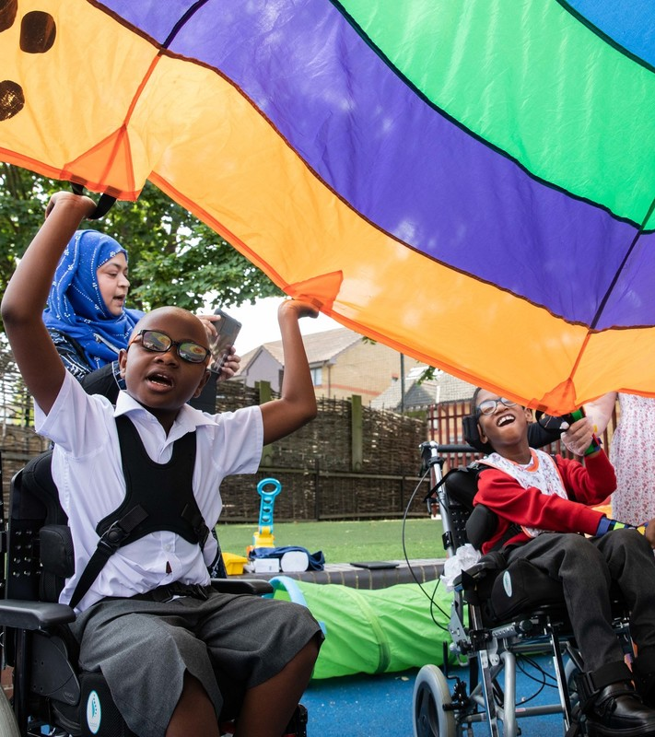
REFLECTION
© UNICEF/Dawe
Write down three things that you are going to do this year to inform families and the wider community about the rights work happening in school.​
Which of these actions can be led by learners?
Notes:
You could ask people to write down personal commitments in the light of this reflection and collect these in and come back to them at the start of the next term to remind colleagues of their commitment and celebrate any progress.

Slide 14
RESOURCES
You may find the following resources useful for your work on engaging families and community:
Informing the School Community: find three PowerPoint packs and a letter template for different members of your community​
Articles in Action​
Copies of the CRC in several different languages including British Sign Language and Braille: CRC​
Parents club – Scotland ​
Niccy – Northern Ireland​
Children’s Commissioner for Wales – Parents Guide
Notes:
If you have time, please explore these links ahead of your session with colleagues.
You may well find a particular resource that you want to highlight to all as part of your input. There may be links you want to share with the team ahead of, or as follow up, to your input with them.​
​
Encourage your colleagues to explore the RRSA website to find additional resources.

