Slide 1
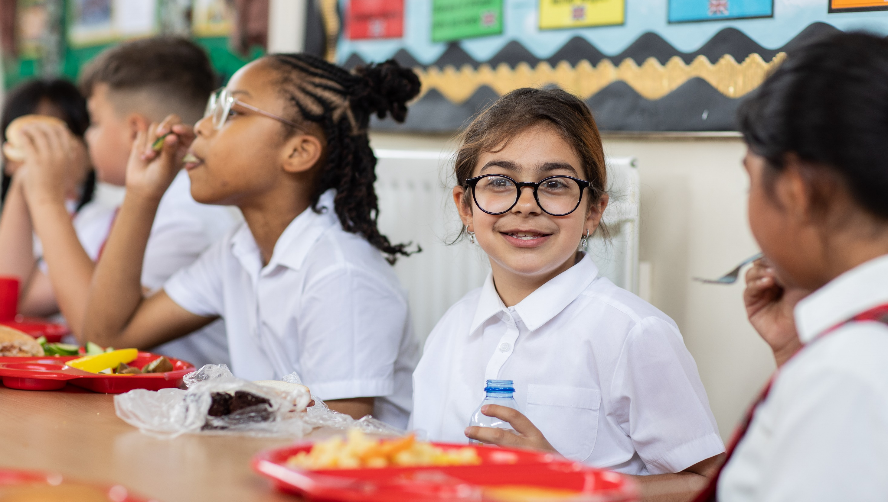
© UNICEF/Dawe
WELLBEING
CAMPAIGNING IN SCHOOL
Notes:
Welcome to Spotlight, our latest resource to support RRSA coordinators to develop Rights Respecting practice in school.
Spotlight is aimed at colleagues and is intended to support you in staff briefings or continued professional development (CPD).
Please check guidance in subsequent slide notes.

Slide 2
CONTENTS
For each slide, please look at the presenter notes for delivery information.
Slide 3: Aims of the Session
Slide 4: Three ways to use this pack
Slide 5 : Introducing this month’s Spotlight
Slide 6: Links to RRSA Outcomes
Slide 7;: Links to Articles
Slide 8: Case Study 1 – Pantysgallog Primary School;
Slide 9: Case Study 2 - Alun Secondary School
Slide 10: Let’s Discuss
Slide 11: Activities
Slide 12: Reflection
Slide 13: Resources
Notes:
For each slide, please look at the presenter notes for delivery information. You may wish to amend or delete this slide when you deliver the session in your school.

Slide 3
AIMS OF THE SESSION
To develop a shared understanding of wellbeing.
To explore how to use the CRC to strengthen and support children’s wellbeing.
To explore current wellbeing practice and language in relation to our work as a Rights Respecting School.
Notes:
Presenter notes: Please edit the aims of the session to suit the time you have available for your session.
This session is intended to help you to support staff to develop their understanding of what wellbeing is, how children’s rights can support wellbeing practice in your setting and provide time to explore your practice in relation to your Rights Respecting Schools journey.
The whole Spotlight series is about embedding children’s rights within a wide range of school priorities and practices.
.​
​

Slide 4
WAYS TO USE THIS PACK
DELETE THIS SLIDE BEFORE USING
If your time is tight, use the introduction slide and choose from the key discussion questions to explore with your colleagues.
If you have longer, you can also choose some of the activities to explore.
You may wish to cover the content over several staff meeting sessions.
There are trainer notes for each slide – please do have a look at these for further guidance.
There
Notes:
Delete this slide before using.
It would be useful to have copies of the summary CRC so that staff can refer to them throughout the session.
www.unicef.org.uk/wp-content/uploads/2019/10/UNCRC_summary-1_1.pdf

Slide 5
SPOTLIGHT ON…
Wellbeing is a focus in every school whether they are involved in RRSA or not, but in Rights Respecting schools all the great practice to support wellbeing explicitly links to children’s rights and is underpinned by the CRC.
Rights Respecting Schools look at wellbeing through the lens of children’s rights in terms of equality, equity, fairness, dignity, and participation.
Jenny from the RRSA team introduces this month’s Spotlight.
Notes:
The video complements the content of this pack and can also be used separately.
Presenter notes:
Through this pack we want to support you to, with colleagues, build an understanding of wellbeing across your school community and develop an understanding of how a rights-based approach can support pupil and staff wellbeing. Through embedding rights into your school ethos and values and supporting children to experience fairness, equity, dignity and engage in the realisation of their rights you will create effective conditions for positive wellbeing.​​
​
​
​
​

Slide 6
LINKS TO RRSA OUTCOMES
Strand B: TEACHING AND LEARNING THROUGH RIGHTS
Outcome 5: Children’s social and emotional wellbeing is a priority. They learn to develop healthy lifestyles.
At Silver: Rights Aware
Many children describe how the school supports them with their physical and mental health, social and emotional needs.
At Gold: Rights Respecting
Most children and young people describe how the school provides information and support for a range of physical, mental, social and emotional needs.
Notes:
Presenter notes:
This slide provides an opportunity to remind colleagues of the ‘structure’ of RRSA which includes three strands: Teaching about rights; through rights; and for rights.
Wellbeing is linked with Outcome 5 in Strand B: see text on slide
The full text of the Strands and Outcomes of the Award can be found here:
www.unicef.org.uk/rights-respecting-schools/wp-content/uploads/sites/4/2015/06/RRSA-Strands-and-Outcomes-at-Silver-and-Gold-1.pdf

Slide 7
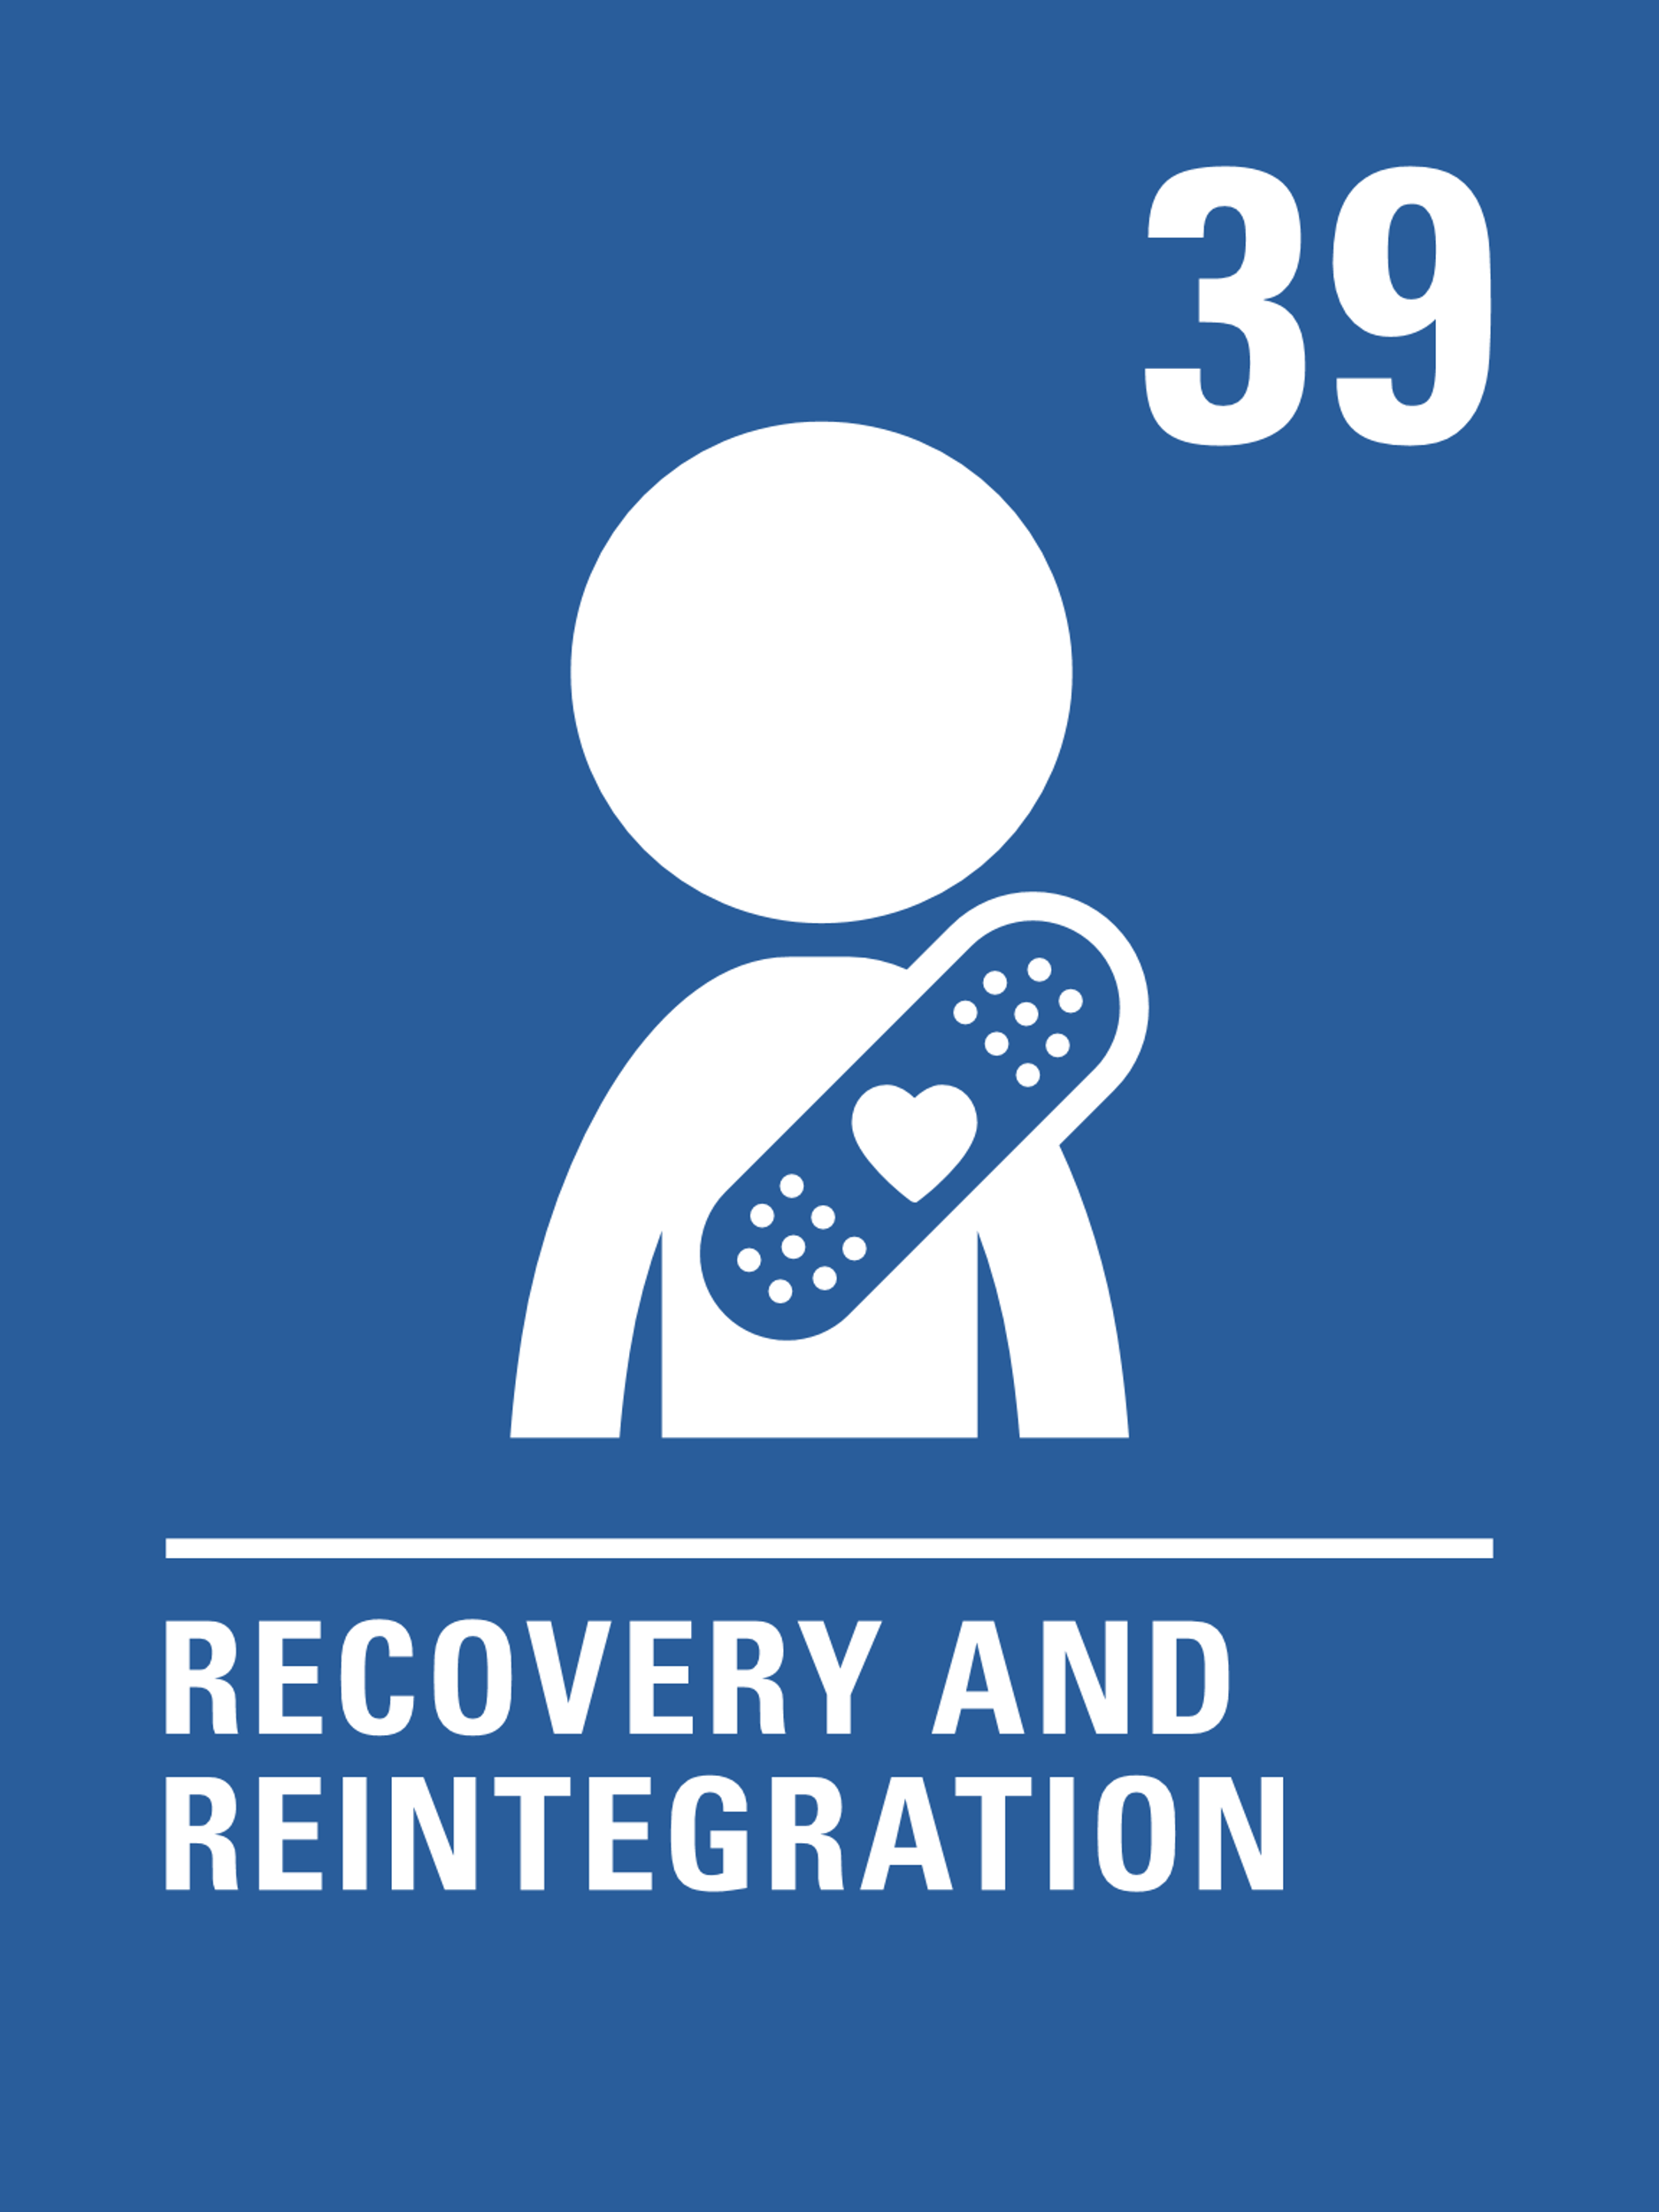
LINKS TO ARTICLES
Look at the summary of the CRC with a partner – which articles do you think are particularly relevant to our work on wellbeing?
When ready click to reveal.
Notes:
Presenter notes: When showing this slide in presenter mode the articles will appear on click.
Look at the summary of the CRC with a partner – which articles do you think are particularly relevant to our work on wellbeing? Give good time for people to think about and discuss the links. Your colleagues may identify different articles to the ones displayed. If time permits, encourage staff to explain their choices. Many children and young people link their wellbeing to Article 24, but it is important to see that wellbeing links with a wide range of rights.
CRC Summary: unicef.uk/CRC_Icons

Slide 8
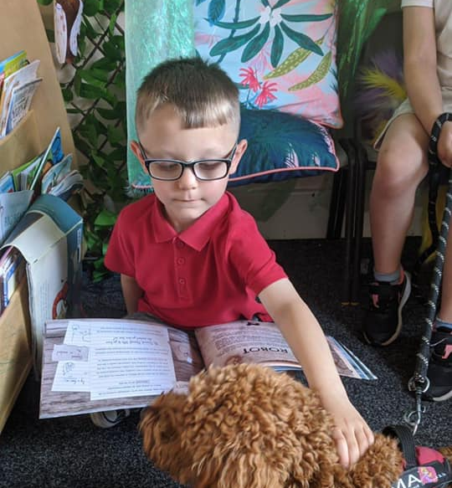
Wellbeing dog, Max, accompanies the headteacher every morning to greet pupils arriving to school, he attends lessons and assemblies and plays a vital role in sessions of emotional support for some pupils.
CASE STUDY
Look at this case study from Pantysgallog Primary School
Read the full case study online.
We found as children’s rights became more embedded, pupils showed an increased level of resilience in response to the normal pressures of school life […] A culture of mutual respect developed.
[During Covid-19 school closures] Pupils and staff had become adept at using technology as a means of communicating during school closure. The MiHealth App project was a natural opportunity to harness technology skills and have a sustainable impact on wellbeing.
​As part of our strategic approach to wellbeing we also introduced Max, the wellbeing dog. [...] To introduce a dog into the provision it was important that everyone was consulted. The consultation period involved feedback from all stakeholders but most importantly pupils. The school received resounding approval and Max was introduced during the Christmas period of 2021. Max is now a daily presence in school.
Notes:
The full case study is available on the RRSA website, where you can print it out and share with your colleagues if you are choosing to focus on this as part of your session. Encourage staff to consider whether there are any examples of good practice within this case study that your school could draw on and learn from.

Slide 9
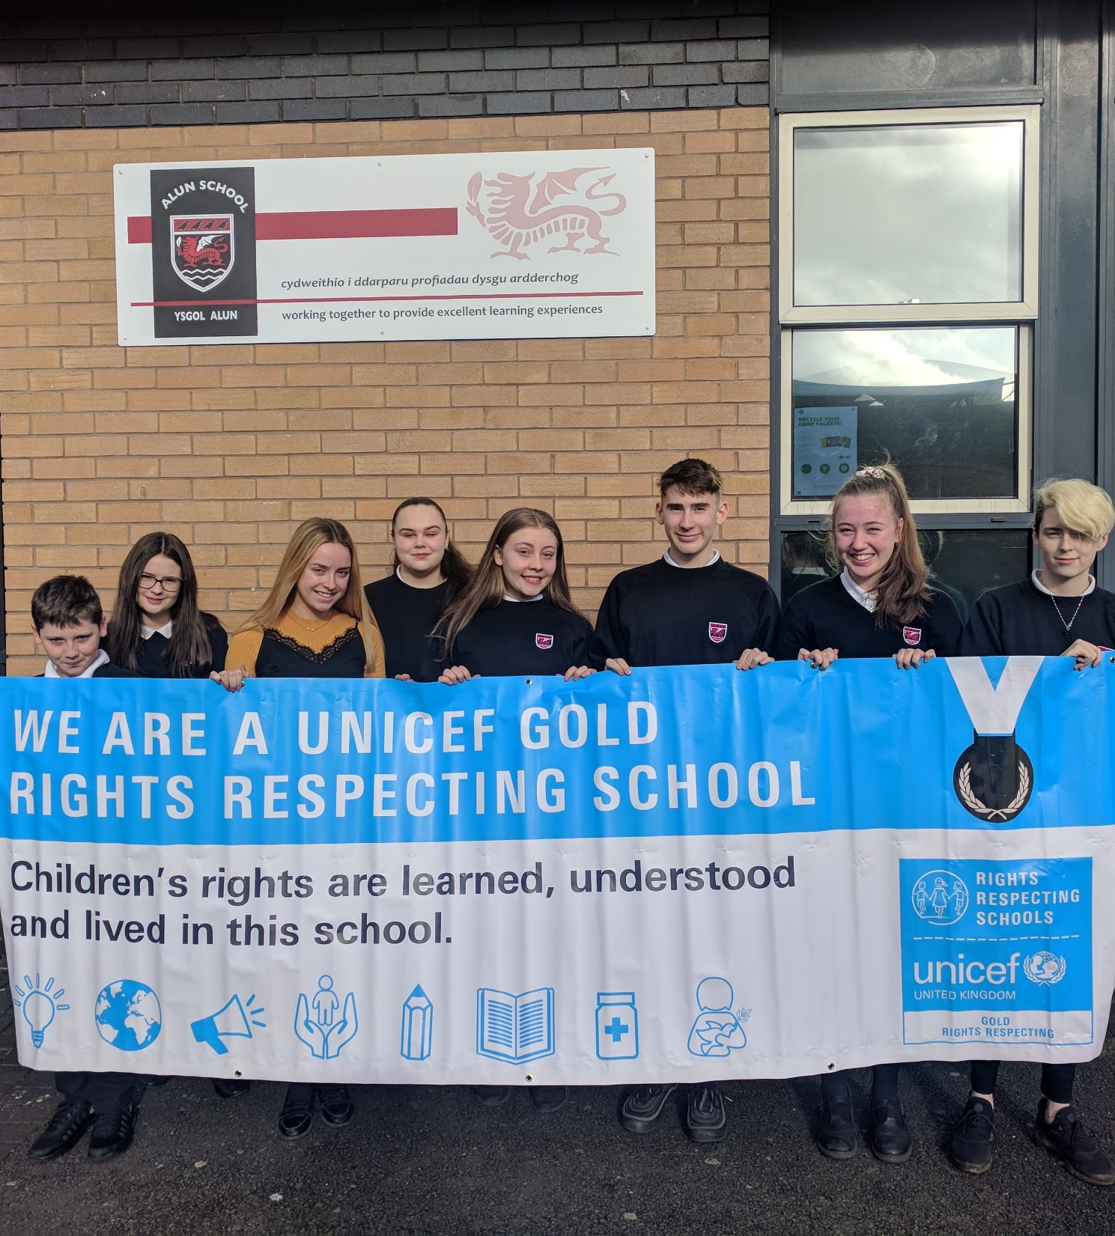
Young people from Alun School hold their Gold banner. No school journey ends at Gold, there are never-ending ways to incorporate rights.
CASE STUDY
Look at this secondary school case study from Alun School
Read the full case study online.
The Alun school used RRSA and children’s rights as a driver to improve health and wellbeing. They make the point that, just like a school’s work on wellbeing, RRSA is also a whole school approach.
Consider their emphasis on maximising the voice of young people. Knowing that your opinions are not only welcomed but valued and can make e difference is hugely impactful on wellbeing.
Visual reminders such as their Wellbeing Wall in the school entrance and the empowerment of learners to become Wellbeing Champions, may not work for your setting but have a think about other creative approaches you could adopt.
Notes:
If you are a Spotlight regular, you may have noticed this case study was used before, in the context of ‘being a rights Respecting School.
The school’s emphasis on health and wellbeing makes it worthy of a second look, in relation to this month’s theme.
The School Health Research Network is a Welsh Government initiative – If you are elsewhere in the UK, their website may still be of interest: https://www.shrn.org.uk/

Slide 10
LET’S DISCUSS
1. How do you define ‘wellbeing’?
2. How can rights within the CRC support children’s wellbeing?
3. Reflect on the role of duty bearers (both in school and externally) in supporting children’s wellbeing?
Notes:
Presenter notes: Choose the questions that are most relevant to your setting and experience. Collect some of the ideas from your colleagues and add them to your action plan/evidence.
Whilst there’s no single definition of wellbeing it can be useful to reflect on what it means to individuals and in the context of your school community. Encourage colleagues to consider physical, mental, social and emotional wellbeing. The Mental Health Foundation highlight wellbeing as defined by the Oxford English Dictionary as “the state of being comfortable, healthy, or happy.” However, it is important to realise that wellbeing is a much broader concept than moment-to-moment happiness. While it does include happiness, it also includes other things, such as how satisfied people are with their life, their sense of purpose, and how in control they feel. Source
Share copies of the CRC with staff (Child Friendly icons and text: https://www.unicef.org.uk/rights-respecting-schools/wp-content/uploads/sites/4/2019/11/UN0332751.pdf) Ask them in groups to look at the articles (consider splitting the convention into parts) and highlight those most relevant to pupil wellbeing. Gather feedback and reflections.
Share a definition of rights holder and duty bearers if needed (see RRSA Glossary: https://www.unicef.org.uk/rights-respecting-schools/resources/teaching-resources/guidance-assemblies-lessons/rrsa-glossary/). Encourage colleagues to think about their role as a duty bearer and the role of colleagues both within and outside of school, in supporting children’s wellbeing. Share any good practice already in place in your setting, making links to children’s rights where relevant.

Slide 11
ACTIVITIES
In groups, draw a Rights Respecting classroom onto large pieces of flipchart paper. What do you see, hear and feel in a Rights Respecting classroom?
2. Using the wellbeing indicators on the SHANARRI wheel template , plot relevant articles from the CRC and consider how you can make explicit connections between them.
3. Identify current wellbeing practice and how this links to the CRC. Complete a SWOT analysis to support your understanding of current provision and next steps.
1. Create a wellbeing definition to share across your setting based on discussion from the previous slide.
Notes:
Presenter notes: There are three suggestions for activities. Depending on the time you have available, choose one or more activities for your colleagues to work on together to further explore the topic. Different groups could explore different activities. The activities that you do not wish to use can be deleted from the slide but do use them at another time if they are useful.
Activity 1: This is an opportunity to build on discussion question 1 from the previous slide and create a definition of wellbeing that you can share with your whole school community and use to support understanding of wellbeing for staff and pupils. Ensure you consider how articles from the CRC may inform and support this definition. When developing your definition consider using the Glossary. How can children be involved in the development of this definition? Consider how you could share this definition – whether in an assembly, a newsletter for parents or on your website.
The RRSA Vocabulary document can be found here: https://www.unicef.org.uk/rights-respecting-schools/wp-content/uploads/sites/4/2023/11/RRSA-Vocabulary_Final_Nov-2023.pdf
Activity 2: The Scottish Government has described wellbeing in terms of eight indicators, which are Safe, Healthy, Achieving, Nurtured, Active, Respected, Responsible and Included. These are sometimes abbreviated to the acronym known as SHANARRI. The SHANARRI wheel is a useful tool (whether you are in Scotland or not), to help consider how well you support different areas of wellbeing.
SHANARRI wheel can be found here: https://www.unicef.org.uk/rights-respecting-schools/wp-content/uploads/sites/4/2024/01/SHANARRI-WHEEL.pdf
Activity 3: You can use the work you may have just done with the SHANARRI wheel or use your own mind map to identify strengths and any gaps in provision – consider using a strengths, weaknesses, opportunities, threats (SWOT) analysis approach to support your understanding of current provision and help plan to strengthen your offer.
A SWOT analysis template can be found here: https://www.unicef.org.uk/rights-respecting-schools/wp-content/uploads/sites/4/2024/01/SWOT.pdf

Slide 12
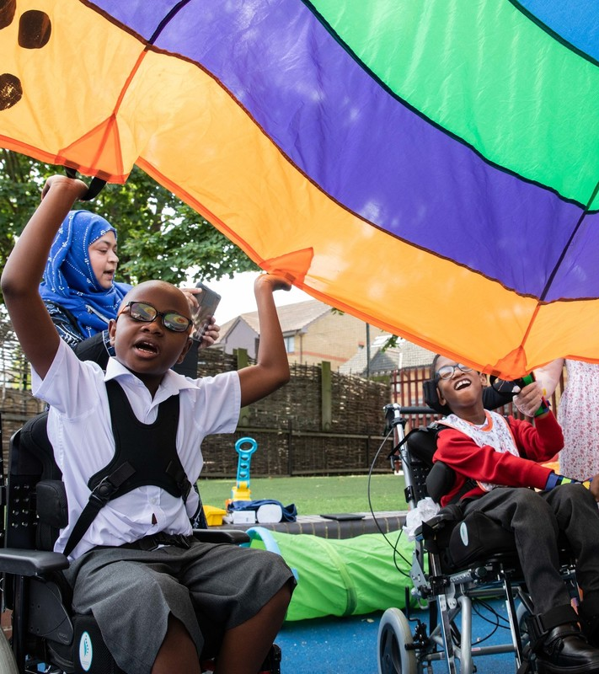
REFLECTION
© UNICEF/Dawe
As schools develop a rights respecting approach, there is evidence that this impacts positively on both pupil and staff wellbeing.
What do you do personally to support your own wellbeing?
What support is in place for you and colleagues in school?
Could this be further strengthened and if so how could this be done?
Notes:
Presenter notes: Being sensitive to colleagues and the situation in school, you could ask people to share their ideas.
Check out our impact report for further evidence on positive impact on staff and pupil wellbeing: https://www.unicef.org.uk/rights-respecting-schools/the-rrsa/impact-of-rrsa/

Slide 13
RESOURCES
You may find the following resources useful for your work on wellbeing:
Children’s Mental Health Week - Article of the Week
Mental Health Week - Article of the Week
UNICEF UK’s OutRight Campaign 2020/21 - Mental Health and Wellbeing
RRSA Glossary: explore the language associated with rights and being Rights Respecting
UNICEF UK’s RRSA Team provide training which may be of use to you or colleagues:
Strengthening Pupil Participation in a Rights Respecting School
There are many other organisations and materials that will help you explore wellbeing further such as:
Young Minds
NSPCC – PANTS
Emotion Works
Zones of Regulation
Respect Me (Scotland)
ELSA
Children's Mental Health Week
Notes:
Presenter notes: If you have time, please explore these links ahead of your session with colleagues. You may well find a particular resource that you want to highlight to all as part of your input. There may be links you want to share with the team ahead of or as follow up to your input with them.
Encourage your colleagues to explore the RRSA website to find additional resources. If you have time, please explore these links ahead of your session with colleagues. You may well find a particular resource that you want to highlight to all as part of your input. There may be links you want to share with the team ahead of or as follow up to your input with them.

