Slide 1
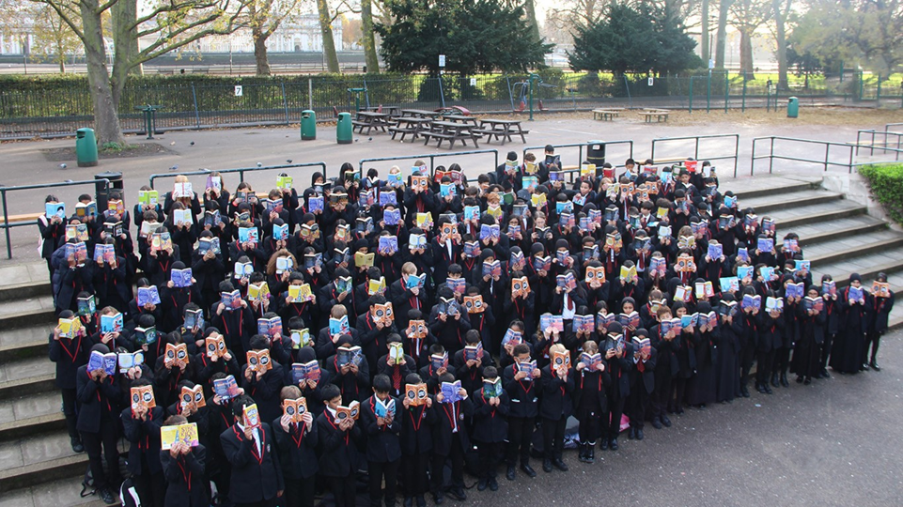
© UNICEF/Dawe
LINKING READING
TO RIGHTS
CAMPAIGNING IN SCHOOL
Notes:
Image credit: George Green’s Secondary School
“Events like the Book Trust's Bookbuzz programme, help ensure that 100% of year 7 students own a book of their choosing. Creating a strong reading community amongst staff and students, providing access to high quality fiction and non-fiction texts and empowering our students through the process of reading, must be part of our Rights Respecting ethos.”
Welcome to Spotlight, our latest resource to support RRSA coordinators to develop Rights Respecting practice in school.
Spotlight is aimed at colleagues and is intended to support you in staff briefings or continued professional development (CPD).
Please check guidance in subsequent slide notes.

Slide 2
CONTENTS
For each slide, please look at the presenter notes for delivery information.
Slide 3: Aims of the Session
Slide 4: Three ways to use this pack
Slide 5 : Introducing this month’s Spotlight
Slide 6: Links to RRSA Outcomes
Slide 7: Links to Articles
Slide 8: Introductory Activity
Slide 9: Case Study 1 – George Green's School
Slide 10: Case Study 2 – St Mary’s Primary School
Slide 11: Case Study 3 – Bar Hill Primary School
Slide 12: Let’s Discuss
Slide 14: Activities
Slide 16: Reflection
Slide 17: Resources
Notes:
For each slide, please look at the presenter notes for delivery information. You may wish to amend or delete this slide when you deliver the session in your school.

Slide 3
AIMS OF THE SESSION
To consider why it is helpful to use books to embed rights learning in our school.
To explore how to strengthen the links to rights when using books in our current curriculum.
To consider how we could further develop this work creatively through new ideas and texts.
Notes:
Presenter notes: Please edit the aims of the session to suit the time you have available for your session.
This session is intended to support staff within Rights Respecting Schools to develop their understanding of how to use books as a powerful tool for teaching children about rights and also for exploring complex issues through a rights lens.
The whole Spotlight series is about embedding children’s rights within a wide range of school priorities and practices.
​
​

Slide 4
WAYS TO USE THIS PACK
DELETE THIS SLIDE BEFORE USING
If your time is tight, use the introduction slide and choose from the key discussion questions to explore with your colleagues. If you have longer, you can also choose some of the activities to explore.
Please ask colleagues to bring some examples of books that are used within your curriculum when delivering this session.
You may wish to cover the content over several staff meeting sessions. Secondary schools may wish to ask Literacy Coordinators or Year Group teams/Form Tutors to explore this resource in their meetings.
There are trainer notes for each slide – please do have a look at these for further guidance.
There
Notes:
Delete this slide before using.
It would be useful to have copies of the summary CRC so that staff can refer to them throughout the session. Please also ask your colleagues to bring some of the key texts that are used in their year group or subject along to the meeting, as this will be needed for some of the activities.
www.unicef.org.uk/wp-content/uploads/2019/10/UNCRC_summary-1_1.pdf

Slide 5
SPOTLIGHT ON…
Literature has long played an important role in supporting the delivery of the curriculum in schools. Books and stories can also be a fantastic way to explore trickier topics in a safe way. In this session we will be looking at the books we currently have in school and how we can use literature to strengthen teaching and learning about rights. There are many rich opportunities to link literature to articles from the CRC and the outcomes of the RRSA and we will consider ways in which we already do this and how we can strengthen our practice.
Sarah from the RRSA team introduces this month’s Spotlight.
Notes:
The video complements the content of this pack and can also be used separately. ​
​
​
​

Slide 6
LINKS TO RRSA OUTCOMES
Strand A: TEACHING AND LEARNING ABOUT RIGHTS
Outcome 1: Books can support children to learn about a range of articles and also to explore concepts such as dignity, equity, equality and fairness. Books can also support children to explore global issues.
Strand B: TEACHING AND LEARNING THROUGH RIGHTS
Outcomes 2-7: Books can support children to develop empathy and use rights language across the curriculum and in day-to-day life. Books can support even the youngest learners to explore complex topics in a meaningful way and children can be involved in choosing books across the school.
Strand C: TEACHING AND LEARNING FOR RIGHTS
Outcome 9: Topics and themes within books can inspire children to take action on a range of issues. Following on from discussions, young people may want to fundraise, raise awareness or campaign locally and/or globally linked to rights.
Notes:
Presenter notes:
This slide provides an opportunity to remind colleagues of the ‘structure’ of RRSA which includes three strands: Teaching about rights; through rights; and for rights.
Books can be used in different ways to support all three Strands of the Rights Respecting Schools Award.
Strand A, Outcome 1:
Pupils need to develop knowledge and understanding of children’s rights and how children and young people can access their rights, or not, in their own community and the wider world. Books provide a fantastic opportunity for children to learn about rights in an engaging and inspiring way.
Strand B, Outcomes 2-7:
A diverse selection of books throughout the school enables all learners, regardless of age and ability, to explore complex topics that are linked to children’s rights. Linking books to CRC articles will encourage rich discussion about how rights are lived on a day to day basis and will allow children to experience rights issues from different perspectives. Books can be used to explore areas such as safety, wellbeing and inclusion as well as relationships and the importance of education, and so can be linked to all Outcomes within Strand B.
Strand C, Outcome 9:
Books can inspire children and young people to take action to claim their rights and promote the rights of others locally and globally.
The full text of the Strands and Outcomes of the Award can be found here:
www.unicef.org.uk/rights-respecting-schools/wp-content/uploads/sites/4/2015/06/RRSA-Strands-and-Outcomes-at-Silver-and-Gold-1.pdf

Slide 7
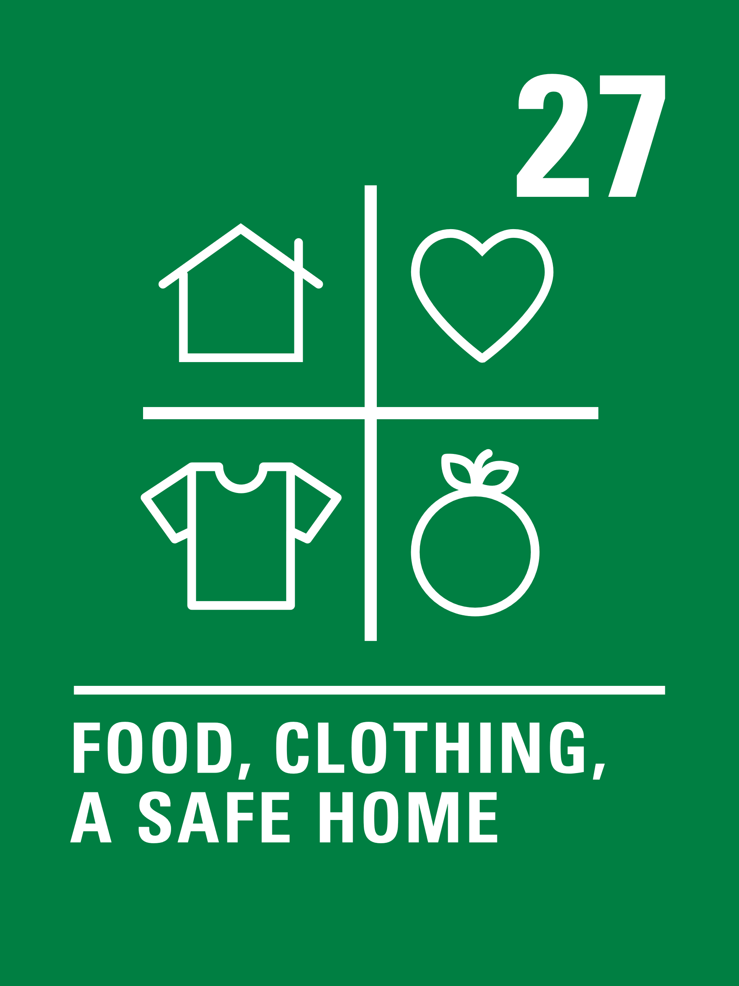
LINKS TO ARTICLES
Look at the summary of the CRC with a partner – Look at the selection of Articles from the CRC below. In pairs or threes, discuss which books (including subject textbooks) might relate to these selected articles. How could you make these links more explicit for your learners?
Notes:
Presenter notes: Ask colleagues to look at the CRC articles with a partner – which articles can they link to texts that are already used in school? Or texts that they know? Encourage groups to share their ideas. How easy was it to think about a book linked to a particular article?
CRC Summary: unicef.uk/CRC_Icons

Slide 8
INTRO REFLECTION: WINDOWS, MIRRORS AND SLIDING DOORS
“Books are mirrors when readers see their own lives reflected in the pages.
“Books are windows when they allow readers a view of lives and stories that are different from their own.
“Books become sliding glass doors when readers feel transported into the world of the story and when they feel empathy for the characters.”
Taken from Great School Partnerships. Mirrors, Windows and Sliding Doors: a metaphor for reading and life.
Notes:
Presenter notes: Ask colleagues to reflect on this slide and reflect on their practice as an educator within a Rights Respecting School. How can the idea of books as windows, mirrors and sliding doors support the work that you do to teach children about, through and for rights as a Rights Respecting School?

Slide 9
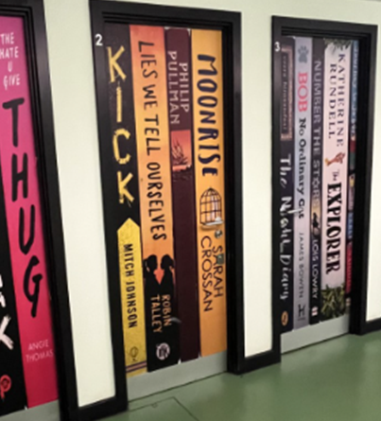
A few of the 18 wrapped doors, displaying popular reads including Staff YA Book Club and Tutor group reads.
CASE STUDY
Look at this case study from George Green’s Secondary School
Read the full case study online.
​​We involve students in choosing, curating, and promoting books as well as an active involvement in competitions and events. We have student librarians who curate bookshelves; student-led book clubs; a book request email system; all Year 7 students, when they join, choose a book to keep; a reading corner in the school magazine written by students and a dedicated reading website for students and staff to share book reviews.
​We know that reading improves wellbeing and positive thinking and to this end, have a ‘shelf-care’ area in the library.
​Find ways to introduce students to new perspectives and voices through form time reads (extracts or novels and non-fiction), PSHCE and through book clubs. And, all the way, listen to students to find out what they like to read, and what’s trending!.
Notes:
The full case study is available on the RRSA website, where you can print it out and share with your colleagues if you are choosing to focus on this as part of your session. Encourage staff to consider whether there are any examples of good practice within this case study that your school could draw on and learn from.

Slide 10
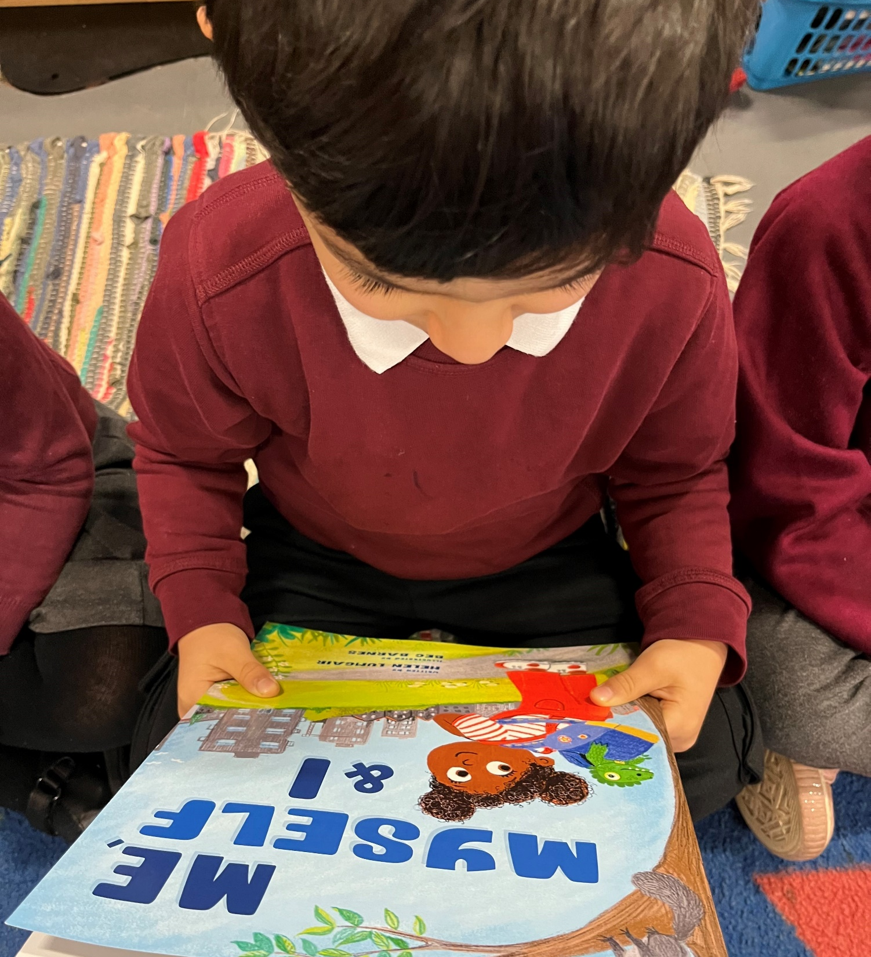
As a school, St Mary's ensure that books reflect the children and their families, and this runs from Nursery through to Year 6.
CASE STUDY
Look at this school case study from St Mary’s CE Primary School Moss.
Read the full case study online.
As we are a very diverse school with many different religions and backgrounds, we use books to serve as a wonderful conversation starter for children to speak about their faith, their culture and how they celebrate with their families. We often have brilliant discussions about the ways in which we are similar and the ways we might be different but always ensure we talk about each other with kindness and respect.
In Reception, we have a variety of books that cover topics such as children with disabilities (Article 23) children from different types of families and also information books (Article 17) about different countries, cultures and religions (Articles 14 & 31).
If you want to improve links between reading and rights in your school I would start by doing an audit of books to check they are diverse and representative of the children in your school.
Notes:
The full case study is available on the RRSA website, where you can print it out and share with your colleagues if you are choosing to focus on this as part of your session. Encourage staff to consider whether there are any examples of good practice within this case study that your school could draw on and learn from.

Slide 11
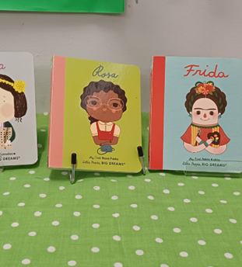
Image of three of the 'Little People, Big Dreams' books that children at Bar Hill primary school secured funding to add to their school library.
CASE STUDY
Look at this school case study from Bar Hill Primary School
Read the full case study online.
We often use fiction as a focus point for a lesson and we will explore the book in depth to find answers to questions we may have. The children love seeing how the stories can relate to their own lives. We encourage them to think about the message behind that story and how it links to the rights that children are entitled to.
​​Our School Council were keen to find books about a diverse group of people who had achieved great things in their lives [...] The School Council worked together to write a persuasive letter to the PTA explaining their ideas and asking for funding for the book series. The PTA were convinced by their arguments and agreed to buy the books for the school.
Think about what you would like to celebrate within your school. We spent time looking online at different book types and had discussions about what we liked about the different books.
Notes:
The full case study is available on the RRSA website, where you can print it out and share with your colleagues if you are choosing to focus on this as part of your session. Encourage staff to consider whether there are any examples of good practice within this case study that your school could draw on and learn from.

Slide 12
LET’S DISCUSS
2. Why is it powerful to explore rights issues through fiction texts?
3. How could non-fiction texts support the exploration of rights topics within our curriculum?
1. How do we currently use books across our curriculum to talk about rights?
Notes:
Presenter notes: These are initial discussion questions that are intended to get colleagues thinking. They lead onto some of the activities in the next section. Choose the questions that are most relevant to your setting and experience. The questions that you do not wish to use can be deleted
Encourage colleagues to think about books recently shared with their pupils. Has there been any discussion about rights resulting from these texts? If not, can you think of any links that could be made with these texts for future lessons?
Consider how books can help even the youngest learners to understand complex issues in an age-appropriate way. Consider how using characters in books experiencing certain issues offers a way to discuss potentially controversial and/or sensitive issues in a less direct way.
Encourage colleagues to consider what non-fiction texts they currently use in class and what rights these link to. Could there be more explicit links to rights made in books that are used as part of teaching across the curriculum, such as in history, geography or science?

Slide 13
LET’S DISCUSS
4. How can we use texts to support our learners to become global citizens?
5. Do the texts that we use reflect our diverse community?
6. How are children involved in choosing the texts that they read?
Notes:
Presenter notes: These are initial discussion questions that are intended to get colleagues thinking. They lead onto some of the activities in the next section. Choose the questions that are most relevant to your setting and experience. The questions that you do not wish to use can be deleted
4. Consider to what extent the books available in school prompt children and young people to engage with worldwide issues. How can we challenge stereotypes through the books we read? Remind colleagues to reflect on the idea of books as windows.
5. Encourage colleagues to reflect upon the texts used in school or available in the library and whether they are a reflection of the diverse community that we live in. Remind colleagues of the idea of books as mirrors.
6. Do children and young people have the opportunity to select texts that they are going to read? For younger children this could be a book vote for a story at the end of the day and for older children this could be an opportunity to vote on the text that they will study next, or available within the school library or book corners. What opportunities are there to strengthen pupil voice in terms of the books available in school?

Slide 14
ACTIVITIES
In groups, draw a Rights Respecting classroom onto large pieces of flipchart paper. What do you see, hear and feel in a Rights Respecting classroom?
2. Create a bookmark, poster or crib sheet which could be used to encourage children to make links to rights and encourage rich rights discussion whilst reading.
3. Look again at the books that you have brought with you. Does our current book stock offer children 'windows and mirrors’? Create a plan for strengthening this.
1. Look at the books you have brought along with you and identify which articles could be explored.
Notes:
Presenter notes: There are six suggestions for activities. Depending on the time you have available, choose one or more activities for your colleagues to work on together to further explore the topic and create some practical ways forward. Different groups could explore different activities. The activities that you do not wish to use can be deleted.
Activity 1: Encourage staff to see that we don’t need to change our books – most if not all of the books that we currently use will have links to rights. How could you make this more explicit? You could also repeat this activity with a group of children. You could ask your steering group to ‘sticker’ books that link to certain rights. Look at the ideas from George Spicer Primary School in the resources section for ideas on strengthening links to rights using books.
Activity 2: Challenge staff to come up with a bookmark, poster or crib sheet that could be used across the school to encourage children to make links with rights. These could be used in whole-class reading sessions or in independent reading. This could also be a steering group activity or a whole-school challenge/activity.
Activity 3: Mirrors and Windows is a metaphor originally coined by Emily Style in 1988 and then applied specifically to children's books by Rudine Sims Bishop in her 1990 article "Mirrors, Windows and Sliding Glass Doors“ The link to this research is included in our padlet in the ‘resources’ section of this PowerPoint. Diversity in children's books is increasing, with the 2023 Reflecting Realities report by CLPE reporting that 30% of the children’s titles published in 2022 featured racially minoritised characters, up from 4% in the first report in 2017. There is still a way to go to ensure that children have a sense of the 'windows and mirrors' that are important. Spend time considering this as a staff team, and then create a plan if any areas for development are identified. You may wish to provide staff with the suggested booklists (see resources) and explore which of these books would be useful additions to your collection.

Slide 15
ACTIVITIES
In groups, draw a Rights Respecting classroom onto large pieces of flipchart paper. What do you see, hear and feel in a Rights Respecting classroom?
4. Create a plan for strengthening pupil voice in relation to the books that we have available in our library/book corners, and in choosing books that are used across the curriculum and in assemblies.
5. Consider how books could be used in your class/year group to inspire rights related action.
6. Plan a World Book Day event linking books and children’s rights.
Notes:
Presenter notes: There are six suggestions for activities. Depending on the time you have available, choose one or more activities for your colleagues to work on together to further explore the topic. Different groups could explore different activities. The activities that you do not wish to use can be deleted.
Activity 4: Consider establishing a suggestion box in your library or asking your steering group to carry out a survey of the children and their thoughts on the books in school. In Early Years settings, consider how children could make choices about texts, for example through voting for the book to be read at story time using named pebbles.
Activity 5: How could you use books to inspire children to develop their skills as active global citizens. For example, children may read a book about refugees such as The Boy at the Back of the Class and go on to create a campaign on refugee rights or write to a decision-maker to express their views on refugee rights. Or children may read a book such as It’s a No Money Day and decide to learn more about a local foodbank and organise a collection of food items. How can you encourage children to explore issues and make their own decisions about the best way to take action?
Activity 6: You might want to choose one book to focus on throughout the whole school and carefully select age-appropriate activities to accompany the learning. Consider linking up with your local library who can offer support with book lists and book boxes.

Slide 16
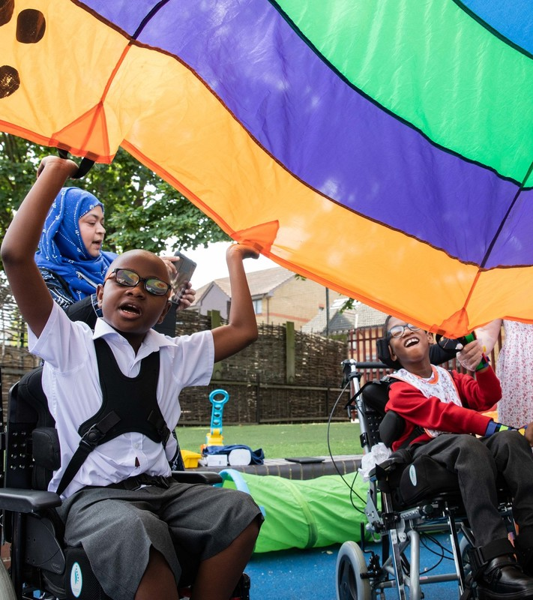
REFLECTION
© UNICEF/Dawe
Books can convey messages in a powerful way.
Think of one of your favourite childhood books. What lessons did you learn from this book?
Notes:
Presenter notes: You could ask people to write down their ideas and share them with pupils. Ask pupils to share their favourite books and consider if there are any rights linked to them.

Slide 17
RESOURCES
You may find the following resources useful for your work on linking reading to rights:
Rights-linked reading list suggestions for groups: 3 to 7; 7 to 11; 11 to 18.
Simple ideas on linking reading to rights from Geroge Spicer Primary
Padlet: A collection of resources and ideas from a range of organisations to help you to use books effectively to explore children's rights as part of your work as a Rights Respecting School.
Notes:
Presenter notes: If you have time, please explore these links ahead of your session with colleagues. You may well find a particular resource that you want to highlight to all as part of your input. There may be links you want to share with the team ahead of or as follow up to your input with them.
Encourage your colleagues to explore the RRSA website to find additional resources. If you have time, please explore these links ahead of your session with colleagues. You may well find a particular resource that you want to highlight to all as part of your input. There may be links you want to share with the team ahead of or as follow up to your input with them.

