Slide 1
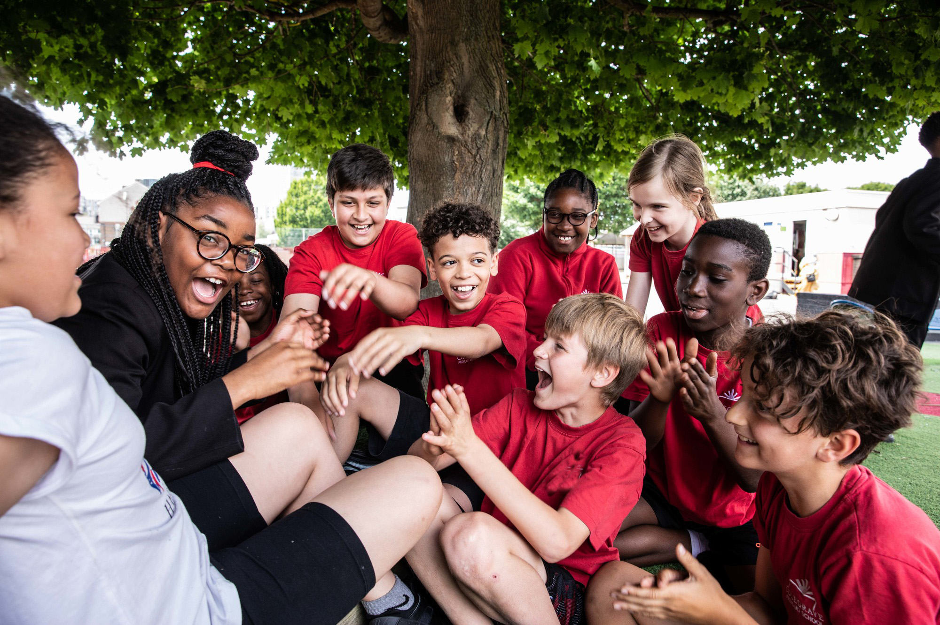
© UNICEF/Dawe
RELATIONSHIPS
CAMPAIGNING IN SCHOOL
Notes:
Image credit: UNICEFUK/DAWE
Please check guidance in subsequent slide notes.

Slide 2
CONTENTS
For each slide, please look at the presenter notes for delivery information.
Slide 3: Aims of the Session
Slide 4: Three ways to use this pack
Slide 5 : Introducing this month’s Spotlight
Slide 6: Links to RRSA Outcomes
Slide 7: Links to Articles
Slide 8: Case Study 1 – Grange School SEND.
Slide 9: Case Study 2 – Bunbury School and Nelson Mandela Primary School
Slide 10: Let’s Discuss
Slide 12: Activities
Slide 14: Reflection
Slide 15: Resources
Notes:
For each slide, please look at the presenter notes for delivery information. You may wish to amend or delete this slide when you deliver the session in your school.

Slide 3
AIMS OF THE SESSION
To reflect on relationships throughout the whole school community.
To consider how to incorporate or strengthen the use of a rights respecting approach to relationships across the school.
To consider how to use the language of rights when resolving conflict.
To consider to what extent adults and children are treated with mutual respect and how to strengthen this.
Notes:
Presenter notes: Please edit the aims of the session to suit the time you have available for your session.
What does respect mean to you?
What does a respectful relationship look like? What are the key features of a respectful classroom?
Consider relationships in different parts of the school and when different adults are in charge. Are these relationships consistent?
​
​

Slide 4
WAYS TO USE THIS PACK
DELETE THIS SLIDE BEFORE USING
This pack is appropriate for use with the whole staff team who interact with pupils regularly such as playground assistants, lunchtime supervisors, office staff, learning mentors and student support teams.
If your time is tight, use the introduction slide and choose from the key discussion questions to explore with your colleagues. If you have longer, you can also choose some of the activities to explore.
You may wish to cover the content over several staff meeting sessions. There are trainer notes for each slide – please do have a look at these for further guidance.
There
Notes:
Delete this slide before using.
It would be useful to have copies of the summary CRC so that staff can refer to them throughout the session. Please also ask your colleagues to bring some of the key texts that are used in their year group or subject along to the meeting, as this will be needed for some of the activities.
Please note that the Spotlight pack for April (on dignity) may be a good follow up to this session as it has many links with developing positive relationships.
www.unicef.org.uk/wp-content/uploads/2019/10/UNCRC_summary-1_1.pdf

Slide 5
SPOTLIGHT ON…
We are going to take a closer look at relationships across our school community and how our rights respecting approach can further strengthen these.
We will explore the concept of mutual respect and what this looks like in our school.
We will consider what we do well to encourage positive relationships and how we can strengthen our existing systems to address disagreements and conflict.
Sarah from the RRSA team introduces this month’s Spotlight.
Notes:
The video complements the content of this pack and can also be used separately.
Please note that the Spotlight pack for April (on dignity) may be a good follow up to this session as it has many links with developing positive relationships.
This pack is particularly appropriate to use with support staff and non-teaching staff who interact with pupils regularly such as playground assistants, lunchtime supervisors, office staff, learning mentors and student support teams.
​
​
​

Slide 6
LINKS TO RRSA OUTCOMES
Strand B: TEACHING AND LEARNING THROUGH RIGHTS
Outcomes 3: Relationships are positive and founded on dignity and a mutual respect for rights.
At Silver: Many children and young people speak with confidence about how positive relationships are encouraged. Rights are used to clarify moral dilemmas and consider rights respecting approaches.
At Gold: Relationships are identified by most children, young people and adults as mutually respectful. There is evidence that respectful relationships are strengthening consistently over time. Many children and young people can talk about the concept of dignity. They can explain how dignity and rights explicitly inform life in school. School systems to address disagreements, conflict and prejudicial attitudes and actions are perceived as transparent, fair and effective by children and adults.
Notes:
Presenter notes:
This slide provides an opportunity to remind colleagues of the ‘structure’ of RRSA which includes three strands: Teaching about rights; through rights; and for rights.
Relationships are a fundamental part of rights respecting schools. The most explicit link is in Strand B, Outcome 3. You could ask your colleagues to reflect on the difference between Outcome 3 at Silver and Gold and encourage them to consider where they think your school is currently for this outcome.
The full text of the Strands and Outcomes of the Award can be found here:
www.unicef.org.uk/rights-respecting-schools/wp-content/uploads/sites/4/2015/06/RRSA-Strands-and-Outcomes-at-Silver-and-Gold-1.pdf

Slide 7
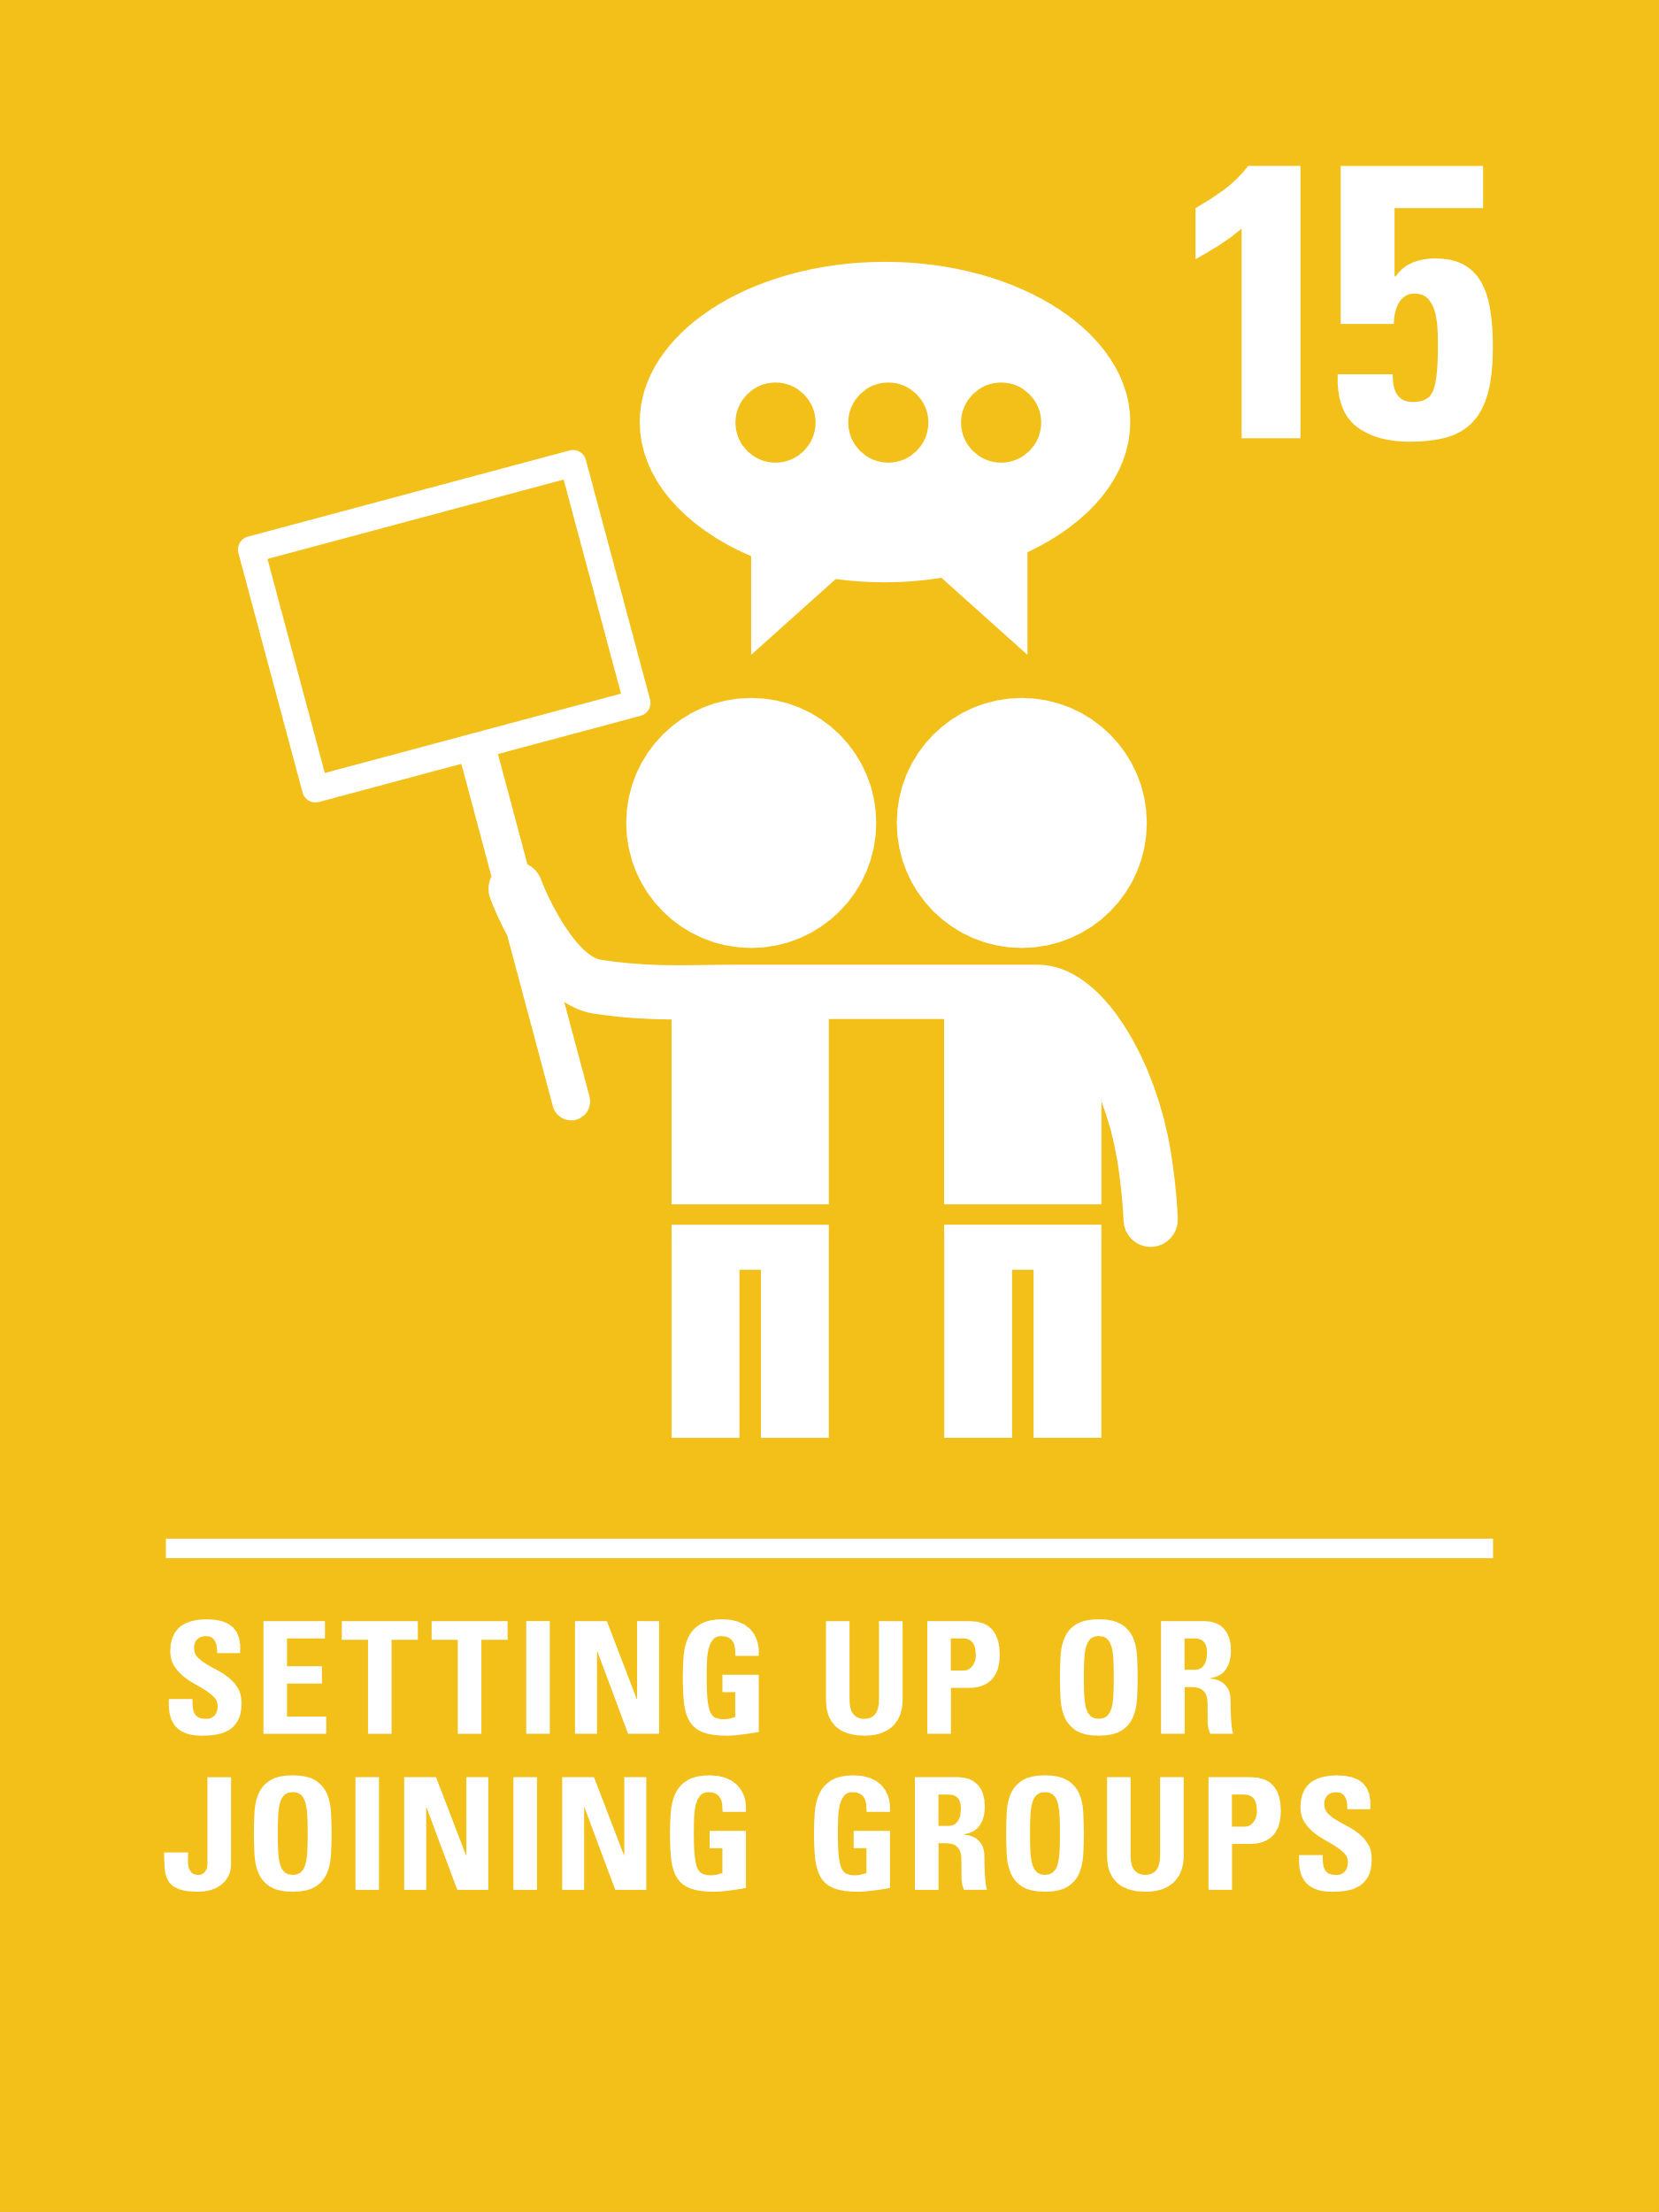
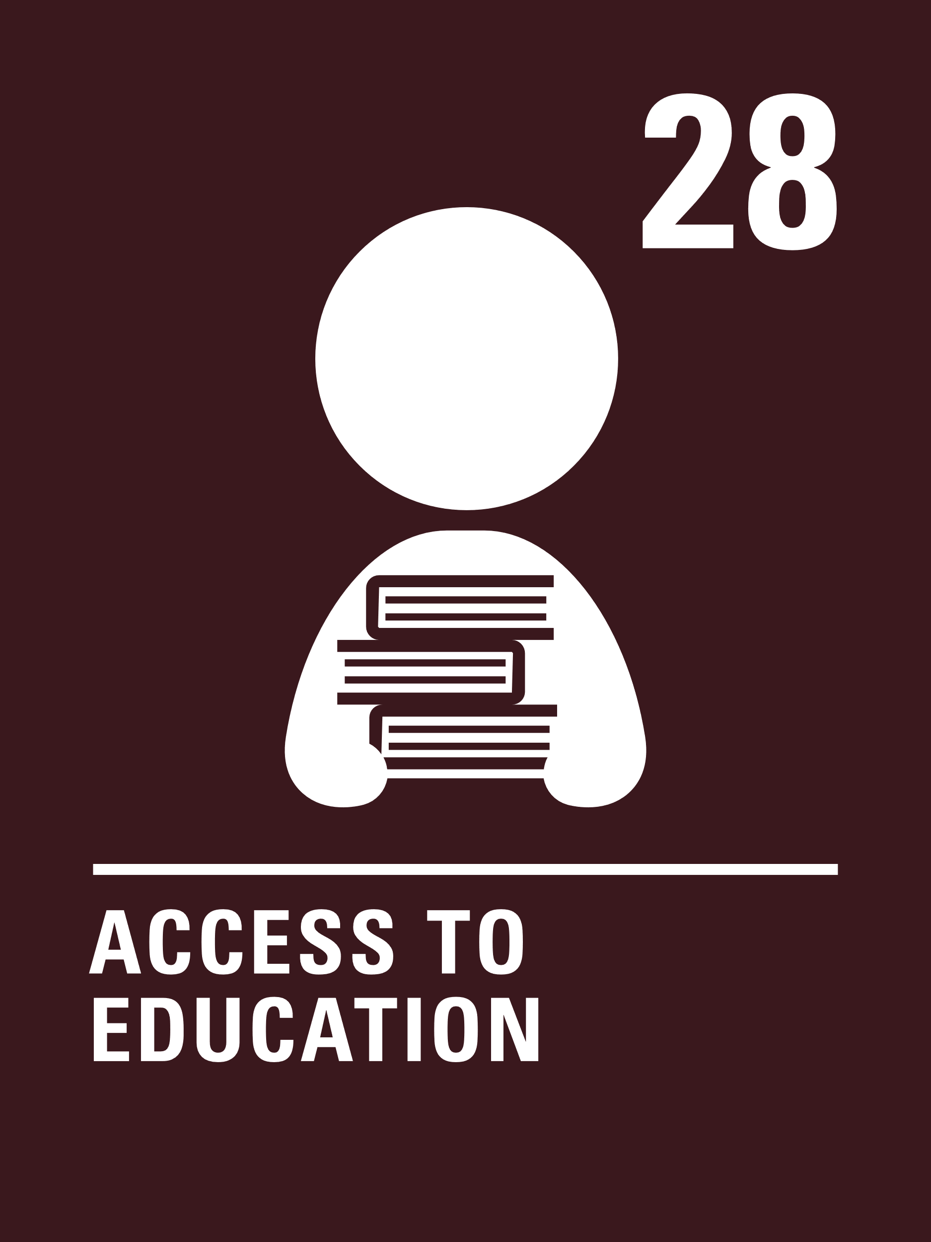
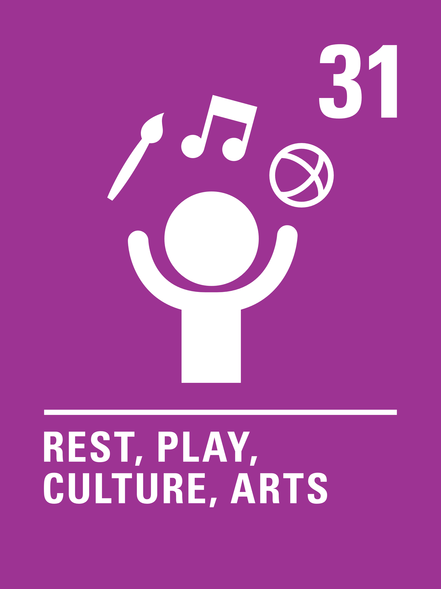
LINKS TO ARTICLES
Look at the summary of the CRC with a partner – which articles do you think are particularly relevant to our work on relationships?
When ready click to reveal.
Notes:
Presenter notes: When showing this slide in presenter mode the articles will appear on click.
Article 2: Non-discrimination
Article 6: Life, survival and development
Article 12: Respect for children’s views
Article 15: Setting up or joining groups
Article 23: Children with disabilities
Article 28: Access to education
Article 28: Right to education.
Article 30: Minority culture, language and religion
Article 31: Rest, play, culture, arts
CRC Summary: unicef.uk/CRC_Icons

Slide 8
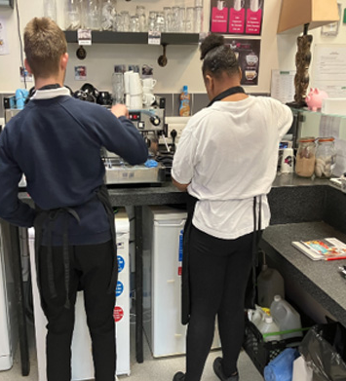
Children from Grange School working in the school's café where they learn valuable skills and interact with the wider community.
CASE STUDY
Look at this case study from Grange School.
Read the full case study online.
​​Despite barriers existing around verbal communication skills, pupils have learnt how to develop strong, safe and mutual relationships with others. They know how to seek and give consent and respond to this with respect.
​​Our policies are strongly influenced by children’s rights, in particular the rights to education and non-discrimination. Being a special school, we have developed a bespoke curriculum which places emphasis on pupils’ awareness of their own and others’ behaviours.
​Our PTA hosts weekly drop-ins at our on-site BrewHog Café which is run by school pupils. Pupils are confident in their customer service roles, happily taking orders and serving food to strangers. Our pupils build up independence and safety skills throughout their school journey, and this leads to a great deal of access to the wider community, from buying groceries in the local supermarket, to countless school trips, to construction and customer service work.
Notes:
The full case study is available on the RRSA website, where you can print it out and share with your colleagues if you are choosing to focus on this as part of your session. Encourage staff to consider whether there are any examples of good practice within this case study that your school could draw on and learn from.

Slide 9
CASE STUDY
A combined case study highlighting examples of good practice from two primary schools; Bunbury School, Cheshire, and Nelson Mandela Primary, Birmingham.
Read the full case study online.
Bunbury School: Our behaviour policy was recently changed by children and staff to ensure it respected the dignity of the children in school. The children were asked for their views on our previous policy which demonstrated a clear need and desire for change, and they also inputted into the creation of the new behaviour policy. Our previous behaviour policy was the ‘peg system’ which was not respectful of children’s dignity as it was a negative, public approach to behaviour – this was voiced by children. After considering the comments of the children and consultation with staff, parents, governors and Directors at RCSAT, a new behaviour policy was introduced. The new policy is a positive behaviour system which encourages kind, safe and respectful behaviour in school.
Nelson Mandela: Our whole-school, class and playground charters have had a positive impact on children’s relationships. Children learn to respect themselves and each other and in doing so, they value diversity. Our charters enable children to treat others with dignity and they learn to understand the impact of their behaviour on others. Children have gained confidence in using their voice to speak up and discuss concerns with their peers and duty bearers (adults), resulting in greater self-esteem. During play time and lunch time, the playground charter, written in child-friendly language, is displayed and adhered to so that all children know exactly what is expected of them. This ensures that there is consistency.
Notes:
The full case study is available on the RRSA website, where you can print it out and share with your colleagues if you are choosing to focus on this as part of your session. Encourage staff to consider whether there are any examples of good practice within this case study that your school could draw on and learn from.

Slide 10
LET’S DISCUSS
1. How would you describe adult and child relationships in school? What are the strengths and weaknesses?
2. How do children describe adult/pupil and peer relationships in school? How do you know this? How could you find this out?
3. Consider scenarios like forgotten homework, lateness, breaktime conflicts etc. How are these resolved? Is rights language used? How might it feel from a child’s perspective?
Notes:
Presenter notes: Choose the questions that are most relevant to your setting and experience. Collect some of the ideas from your colleagues and add them to your action plan/evidence.
Are there differences in the relationships between different staff groups and pupils e.g. lunchtime staff and pupils, other support staff and pupils? What’s going well and what could be even better?
Encourage staff to think of ways in which they can find out what pupils actually think rather than just speculate. Some schools use surveys and/or focus groups. It is important to be open to suggestions and honest feedback from all parties. Again, encourage reflection on the different groups of staff (teachers, teaching assistants, office staff, lunchtime staff) and how pupils might view these relationships.
Encourage staff to share examples from life in school and think about how it would feel from a child’s perspective. Do these examples help to support positive relationships throughout school? This links closely to the idea of dignity which is a focus for April’s Spotlight.
To support your discussions on this topic, please make use of our staff discussion handout on respectful relationships and RRSA: https://www.unicef.org.uk/rights-respecting-schools/resources/teaching-resources/guidance-assemblies-lessons/respectful-relationships-and-rrsa/

Slide 11
LET’S DISCUSS
5. Consider your behaviour policy from a RRS perspective. Is it positive and mutually respectful? Who decided upon your current approaches and the use of any rewards and sanctions?
6.
“I might not remember what you said, but I’ll remember how you made me feel.”
Discuss.
4. How do you ensure consistency of approach to relationships across the school and throughout the school day?
Notes:
Presenter notes: Choose the questions that are most relevant to your setting and experience. Collect some of the ideas from your colleagues and add them to your action plan/evidence.
4. Policies are an important tool in ensuring consistency. Encourage staff to think about how policies are created and if children and young people’s voices are included in the process. Are policies being followed consistently? If not, how could you encourage this? Are support staff given the support and guidance needed to encourage a consistent approach?
5. Is everyone clear on your relationships/behaviour policy and practices? Have pupils been involved in developing or reviewing this? How do you know what pupils’ views about it are? Does it link to articles of the CRC? How might you do this and who might be involved?
6. Encourage staff to think about the experiences of children and young people in their school each day. How do you think children and young people feel about their interactions with adults? Is it positive? Is there room for improvement? Are children and young people treated with dignity? (Note ‘dignity’ is the focus for April’s Spotlight)
To support your discussions on this topic, please make use of our staff discussion handout on respectful relationships and RRSA: https://www.unicef.org.uk/rights-respecting-schools/resources/teaching-resources/guidance-assemblies-lessons/respectful-relationships-and-rrsa/

Slide 12
ACTIVITIES
In groups, draw a Rights Respecting classroom onto large pieces of flipchart paper. What do you see, hear and feel in a Rights Respecting classroom?
1. Create a plan for how we could find out the views of pupils and adults on how respectful relationships are within the school.
2. Read the RRSA and Relationships document. What do we already do well? Is there anything we could learn from or begin to implement?
3. Invite staff to reflect on an interaction that they had today with a pupil. What did it show about relationships in school?
Notes:
Presenter notes: There are six suggestions for activities. Depending on the time you have available, choose one or more activities for your colleagues to work on together to further explore the topic. Different groups could explore different activities. The activities that you do not wish to use can be deleted.
Activity 1: Some schools use surveys or focus groups to do this. This might be an area that your Steering Group could lead on. You could extend this to finding out the views of parents and carers/visitors to the school/local residents .Once you have feedback from pupils and staff, think about how you could address any issues.
Activity 2: This document outlines some of the many ways Rights Respecting Schools have strengthened and celebrated positive relationships linked to rights. Your colleagues can use this document as a starting point for discussions about your current strengths and areas for development.
Activity 3: This could be done privately or you could share experiences if people are open to this.

Slide 13
ACTIVITIES
In groups, draw a Rights Respecting classroom onto large pieces of flipchart paper. What do you see, hear and feel in a Rights Respecting classroom?
4. Read the charter guidance and create a plan for developing or strengthening the use of charters in your school to encourage positive relationships.
5. Draw the outline of a rights respecting midday supervisor, teacher, TA etc. Label with the qualities they would have and add relevant articles.
6. Collect ideas on how you could shine a light on positive relationships and interactions around school.
Notes:
Presenter notes: There are six suggestions for activities. Depending on the time you have available, choose one or more activities for your colleagues to work on together to further explore the topic. Different groups could explore different activities. The activities that you do not wish to use can be deleted.
Activity 4: Many schools have rights based class charters and some also have charters for areas such as playgrounds or lunch halls. Many secondary schools create whole-school charters. Please note that it is not compulsory to use charters in your school but if you would like to find out more about developing and using charters, please look on our website:
https://www.unicef.org.uk/rights-respecting-schools/charter-guidance/
Activity 5: You could have pre-prepared outlines for this activity. Why not try repeating this activity with a group of pupils such as your steering group or school council and comparing with the version created by adults.
Activity 6: Some schools have positive behaviour boards where pupils/teachers are given a ‘shout out’ for positive reasons. They could even be linked to rights e.g. “Child X supported Child Y on their first day at school where they don’t speak the language. Links to Article 30- minority culture, language and religion.

Slide 14
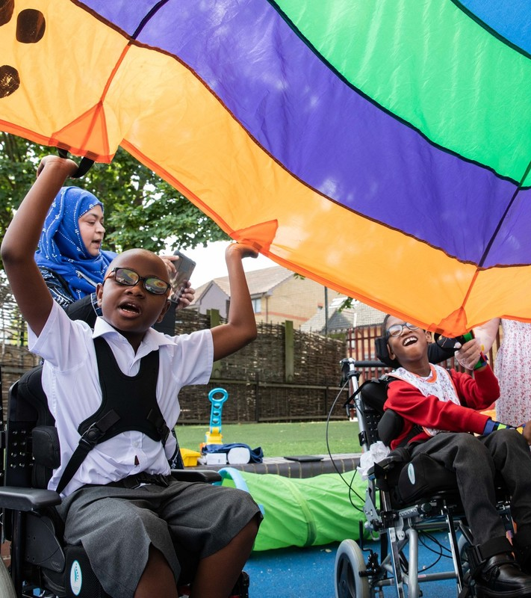
REFLECTION
© UNICEF/Dawe
What do you think is working well in terms of relationships within your classroom and the wider school?
Has this session deepened your understanding of making links between the UNCRC and relationships within the school? How?
Has this session prompted you to change/review any areas of your practise? How might you do this/ who might you discuss this with and by when?
Notes:
Presenter notes: You could ask people to write down personal commitments in the light of this reflection and collect these in and come back to them at the start of the next term to remind colleagues of their commitment and celebrate any progress.

Slide 15
RESOURCES
You may find the following resources useful for your work on linking reading to rights:
Charters
Myths and Misconceptions
Relationships and RRSA – staff discussion handout
Your Guide to a Rights Respecting classroom
of how rights cannot be taken away due to poor behaviour choice
Additional resources from other organisations:
https://whentheadultschange.com/
Books
Paul Dix: When the Adults Change
Notes:
Presenter notes: If you have time, please explore these links ahead of your session with colleagues. You may well find a particular resource that you want to highlight to all as part of your input. There may be links you want to share with the team ahead of or as follow up to your input with them.
Encourage your colleagues to explore the RRSA website to find additional resources. If you have time, please explore these links ahead of your session with colleagues. You may well find a particular resource that you want to highlight to all as part of your input. There may be links you want to share with the team ahead of or as follow up to your input with them.

