Slide 1
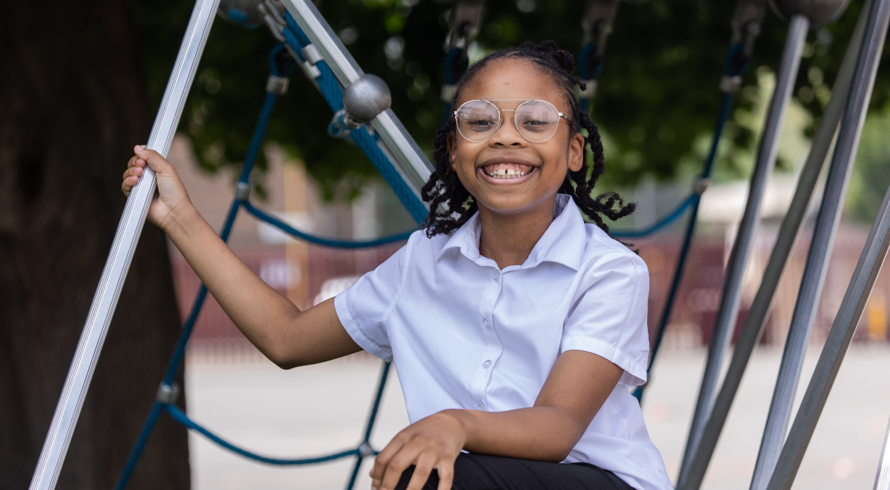
© UNICEF/Dawe
DIGNITY
CAMPAIGNING IN SCHOOL
Notes:
Image credit: UNICEFUK/DAWE
Please check guidance in subsequent slide notes.

Slide 2
CONTENTS
For each slide, please look at the presenter notes for delivery information.
Slide 3: Aims of the Session
Slide 4: Three ways to use this pack
Slide 5 : Introducing this month’s Spotlight
Slide 6: Links to RRSA Outcomes
Slide 7: Links to Articles
Slide 8: Case Study – Martin Primary School
Slide 9: Let’s Discuss
Slide 10: Activities
Slide 12: Reflection
Slide 13: Resources
Notes:
For each slide, please look at the presenter notes for delivery information. You may wish to amend or delete this slide when you deliver the session in your school.

Slide 3
AIMS OF THE SESSION
To understand the concept of dignity and its importance to children's rights. ​
To consider how the idea of dignity is relevant in our school community. ​
To understand how we can better support children's dignity.
Notes:
Presenter notes: Please edit the aims of the session to suit the time you have available. ​
​
This session is intended to support you to support staff to develop their understanding of dignity, a principle that underpins all human rights, including children's rights.
It can be a difficult concept to pin down, so the focus is on helping staff to visualise what dignity might look like in practice and how they can give greater consideration to children's dignity in their day-to-day activity. ​
​
​

Slide 4
WAYS TO USE THIS PACK
DELETE THIS SLIDE BEFORE USING
This pack is appropriate for use with the whole staff team who interact with pupils regularly such as playground assistants, lunchtime supervisors, office staff, learning mentors and student support teams.
If your time is tight, use the introduction slide and choose from the key discussion questions to explore with your colleagues. If you have longer, you can also choose some of the activities to explore.
You may wish to cover the content over several staff meeting sessions. There are trainer notes for each slide – please do have a look at these for further guidance.
There
Notes:
Delete this slide before using.
It would be useful to have copies of the summary CRC so that staff can refer to them throughout the session. Please also ask your colleagues to bring some of the key texts that are used in their year group or subject along to the meeting, as this will be needed for some of the activities.
www.unicef.org.uk/wp-content/uploads/2019/10/UNCRC_summary-1_1.pdf

Slide 5
SPOTLIGHT ON…
Dignity is a thread that runs through the Convention and other human rights treaties, such as the Universal Declaration on Human Rights.
Dignity was seen by the drafters of the Declaration as a cornerstone of human rights and it is specifically mentioned within several articles of the CRC, such as Articles 1 and 28.
We all have an inherent value and worth and that is why we are entitled to our human rights, and children to their specific rights under the CRC as well.
Dragan Nastic, Strategic Lead for the UN Convention on the Rights of the Child, introduces this month’s Spotlight.
Notes:
The video complements the content of this pack and can also be used separately. ​
​
Presenter notes: ​
​
As Dragan points out in the film, dignity underpins all human rights. It is mentioned explicitly in some articles, but it is implicit across the whole UN Convention on the Rights of the Child. We all need to be aware of the importance of dignity if we are to successfully embed a rights based approach in our work. There isn't a checklist for dignity, it's about making sure we recognise the inherent worth of all individuals and translate that into our actions.

Slide 6
LINKS TO RRSA OUTCOMES
Strand B: TEACHING AND LEARNING THROUGH RIGHTS​
Outcome 3: Relationships are positive and founded on dignity and a mutual respect for rights.​
​
Although not specifically mentioned in the outcome descriptor, dignity is also a consideration in the following outcomes...​
​
Strand B: TEACHING AND LEARNING THROUGH RIGHTS​
​
Outcome 6: Children and young people are included and are valued as individuals.​
​
Strand C: TEACHING AND LEARNING FOR RIGHTS​
​
Outcome 8: Children and young people know that their views are taken seriously.​
Outcome 9: Children and young people have taken action to claim their rights and promote the rights of others, locally and globally.​
Notes:
Presenter notes: ​
​
This slide provides an opportunity to remind colleagues of the ‘structure’ of RRSA which includes three strands: Teaching about rights; through rights; and for rights.​
​
Dignity is specifically mentioned under Outcome 3, but it features in other places, too. ​ Please note that learners’ familiarity with and understanding of the concept of dignity is not expected until you are accredited at Gold.
​
Strand B, Outcome 3: ​
​
Perhaps the biggest area for consideration when thinking about dignity is how you promote positive relationships. From an RRSA perspective, there isn't a right way or wrong way to do this, but consideration of learners' dignity when designing your approach is certainly going to help in developing rights respecting policy and practice. When something goes wrong, how do you respond? Is it handled calmly, with a focus on repair? Are you helping children to make better choices in a private, respectful way?​
​
Strand B, Outcome 6:​
Dignity is often closely tied to equity and making sure that pupils get the care and support they need to enjoy their rights. Being included and valued are central to the sense of self-worth which characterises dignity. How are you showing every child that you value them?​
​
Strand C, Outcome 8: ​
Part of valuing pupils involves listening to what they have to say and taking it seriously. It's important to take a systematic approach to listening, with many and varied opportunities for pupils to participate, especially those who are typically furthest from discussions. Also important is a recognition that some learners will need alternative methods of communication to make their 'voice' heard.​
​
Strand C, Outcome 9: ​
As your school moves through Silver to Gold, it is expected that more and more pupils will have the opportunity to engage in taking action for the rights of others. This will typically includes advocacy, campaigning and fundraising. As we approach this work, dignity is an important consideration as we think about those children we are seeking to support. Our approach should be one of empathy rather than sympathy. ​
​
The full text of the Strands and Outcomes of the Award can be found here:​
www.unicef.org.uk/rights-respecting-schools/wp-content/uploads/sites/4/2015/06/RRSA-Strands-and-Outcomes-at-Silver-and-Gold-1.pdf​
​

Slide 7
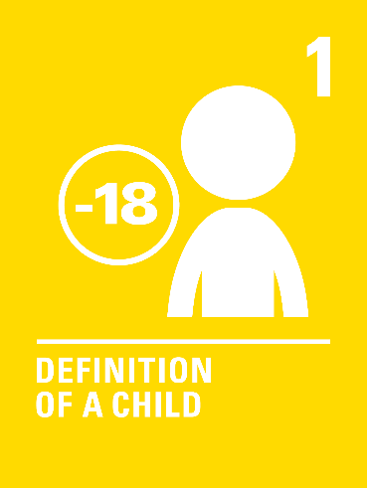
LINKS TO ARTICLES
Look at the summary of the CRC with a partner – which articles do you think are particularly relevant to the concept of dignity?
When ready click to reveal.
Dignity is one of the fundamental principles of the Convention and underpins all other human rights treaties too.
Notes:
It's good to get your colleagues to revisit the CRC whenever possible. Please make copies of the CRC summary available and ask people to explore the articles to address the task set out on the slide.
After a few minutes invite responses and discuss these, then click to reveal the articles we have identified.
These are not a ‘correct’ answer, just the articles that seemed particularly relevant to the RRSA team, in terms of dignity.

Slide 8
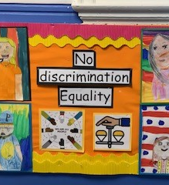
A display board promoting non-discrimination and equality.
CASE STUDY
Look at this case study from Martin Primary School.
Read the full case study online.
​​​​​One of the ways we support pupils and staff to understand the meaning and importance of treating every individual with dignity is through the curriculum. Units were introduced to reflect the diverse school community and to reflect the local area.
​All members of our school community feel they are treated with dignity, walking in to our school the feeling of dignity and respect is almost tangible. It’s there from the way you are greeted as soon as you walk around the school to seeing the way staff and pupils interact.
Restorative justice is used across the school when dealing with conflicts, particularly at playtime. This has really helped children be involved in what happens, have their story heard and reflect on their actions.
Notes:
The full case study is available on the RRSA website, where you can print it out and share with your colleagues if you are choosing to focus on this as part of your session. Encourage staff to consider whether there are any examples of good practice within this case study that your school could draw on and learn from.

Slide 9
LET’S DISCUSS
1. What does dignity mean to you? Has it ever influenced a decision you've taken?
2. Are there areas of school life where you think dignity is especially important?
3. How can we help our school community understand the importance of dignity?
Notes:
Presenter notes: Choose the questions that are most relevant to your setting and experience. Collect some of the ideas from your colleagues and add them to your action plan/evidence. ​
​
Defining dignity isn't easy, for children or adults, but most of us have a general sense of what it means. Relating it to real life situations can help us to develop that working definition and help us to see how it shapes situations. ​
There are many occasions where dignity will be involved in school life, even if you haven't thought of it before. Perhaps the most common area where it is important is in how you manage relationships. Personal care may be another area, particularly in early years or ASN settings. ​
Building everyone's understanding of dignity will help to improve your approach. For practical ideas, see the resources section.​
​

Slide 10
ACTIVITY - SCENARIOS
Consider how you can improve respect for dignity in each of the following illustrative scenarios. When you have discussed, check the presenter notes for suggestions.
In groups, draw a Rights Respecting classroom onto large pieces of flipchart paper. What do you see, hear and feel in a Rights Respecting classroom?
1. When a pupil is disrupting the class or not following the school rules, their names are written on the board, or they are moved onto the red section of the ‘traffic light’ behaviour management system.
2. Pupils are given target grades based on their performance in previous tests, these grades are highlighted on the front of their exercise books for each subject.
3. Using government funding for deprivation, the school has decided to give free school uniforms to relevant learners. Eligible pupils are called to the school hall to collect their uniform.
Notes:
Presenter Notes​
This slide and the next one, set out 6 scenarios or projects which may occur in a school. For each scenario, consider:​
- How could this scenario be changed in order to reflect an approach based on ‘dignity?’​
​
Here are some suggestions:​
Scenario 1: Consider whether it is appropriate for children’s names to be made visible to the whole class. An alternative approach might be to speak to the pupil privately, reminding them about respecting the rights of others, giving them a chance to reflect and space for consideration of the reasons behind the behaviour.​
​
Scenario 2: Consider the impact on the individual of having their target grades visible to all, especially those whose targets are low. An alternative approach would be for the target grades to be privately monitored and discussed between teacher, pupil and parent/carer.​
​
Scenario 3: This process makes each family living in poverty easily identifiable. An alternative approach would be to message the family privately to arrange collection. ​

Slide 11
ACTIVITY - SCENARIOS
Consider how you can improve respect for dignity in 4 & 5 of the following illustrative scenarios. When you have discussed, check the presenter notes for suggestions.
In groups, draw a Rights Respecting classroom onto large pieces of flipchart paper. What do you see, hear and feel in a Rights Respecting classroom?
4.The Rights Steering Group have arranged a collection of old clothes and shoes to send to children ‘in Africa’. They have created a display with photographs of poor children in Africa to encourage participation.
5. School staff and a pupil who is non-verbal attend a meeting with an Occupational Therapist from the local authority, the staff explain the pupil’s needs and request the relevant assistance.
6. In small groups look at the ideas on the RRSA website for discussing dignity with children. Explore how you might incorporate one of these into your teaching.
Notes:
Scenario 4:​
​
Consider the images that are used in the display, do they respect the inherent dignity of the recipients of the clothes and shoes? Be more specific about the community in Africa who are being supported and the challenges they face. Using a generic phrase such as ‘children in Africa’ is a generalisation which enforces negative stereotypes such as ‘all children in Africa are poor’. Consider whether sending unwanted clothes and shoes is the best way to support the recipients – have they specifically requested the items they need? Are the clothes/shoes in good condition? Would the children collecting the items be proud to wear them?​
​
Scenario 5:​
​
The pupil has been given the opportunity to attend the meeting but has not been provided with the means to participate effectively. Whilst it is often the case that staff need to be advocates for the needs of children with special needs, the pupil should be provided with the facility to express themselves and their views through non-verbal methods such as visual aids, eye gaze technology or whatever is appropriate. Consider the balance here between ‘best interests of the child’ and ‘pupil voice/participation.’ ​
​
Activity 6:​ https://www.unicef.org.uk/rights-respecting-schools/resources/teaching-resources/guidance-assemblies-lessons/exploring-dignity-with-pupils/

Slide 12
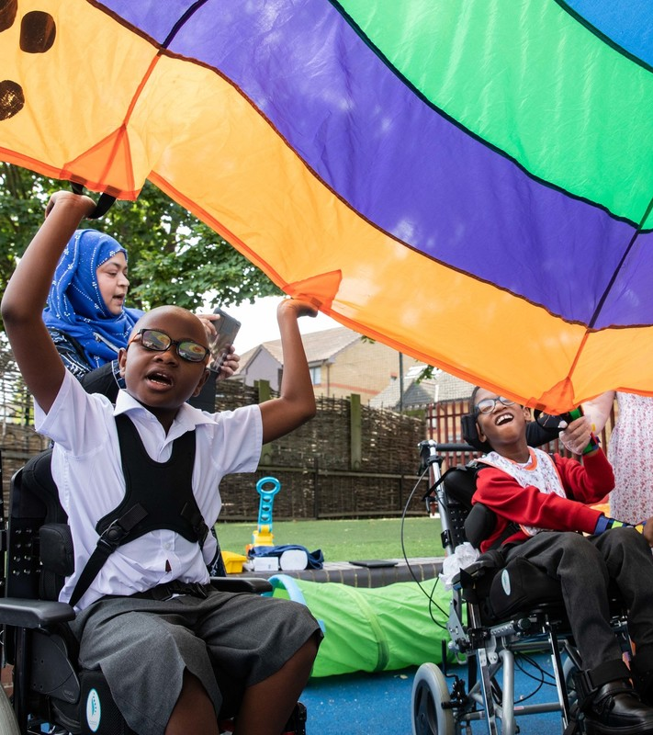
REFLECTION
© UNICEF/Dawe
Do we need to change anything in our school to ensure that the concept of dignity underpins the ethos and culture, policy and practices of the school?​
What would the challenges be in making these changes?
Notes:
Presenter notes: You could ask people to write down personal commitments in the light of this reflection and collect these in and come back to them at the start of the next term to remind colleagues of their commitment and celebrate any progress. ​

Slide 13
RESOURCES
You may find the following resources useful for your work on dignity:
Exploring Dignity with Pupils – Ideas to use with pupils in school
Article of the Week resources such as Right to Privacy – Article 16 and Social Security and Adequate Standard of Living – Articles 26 & 27.​
Dignity is one of the 7 principles of the Child Rights Based Approach promoted by our sister programme, Child Friendly Cities and Communities – A Child Rights-Based Approach
​
Other materials that may help you explore dignity further such as:​
Children’s Parliament (Scotland) ‘Dignity in School’ ​
Rights-linked reading resources – Created for an earlier Spotlight, this resource provides a selection of books which might help to explore rights; dignity (or its absence) will come through in many.
Notes:
Presenter notes: If you have time, please explore these links ahead of your session with colleagues. You may well find a particular resource that you want to highlight to all as part of your input. There may be links you want to share with the team ahead of or as follow up to your input with them. ​
​
Encourage your colleagues to explore the RRSA website to find additional resources.

