Slide 1
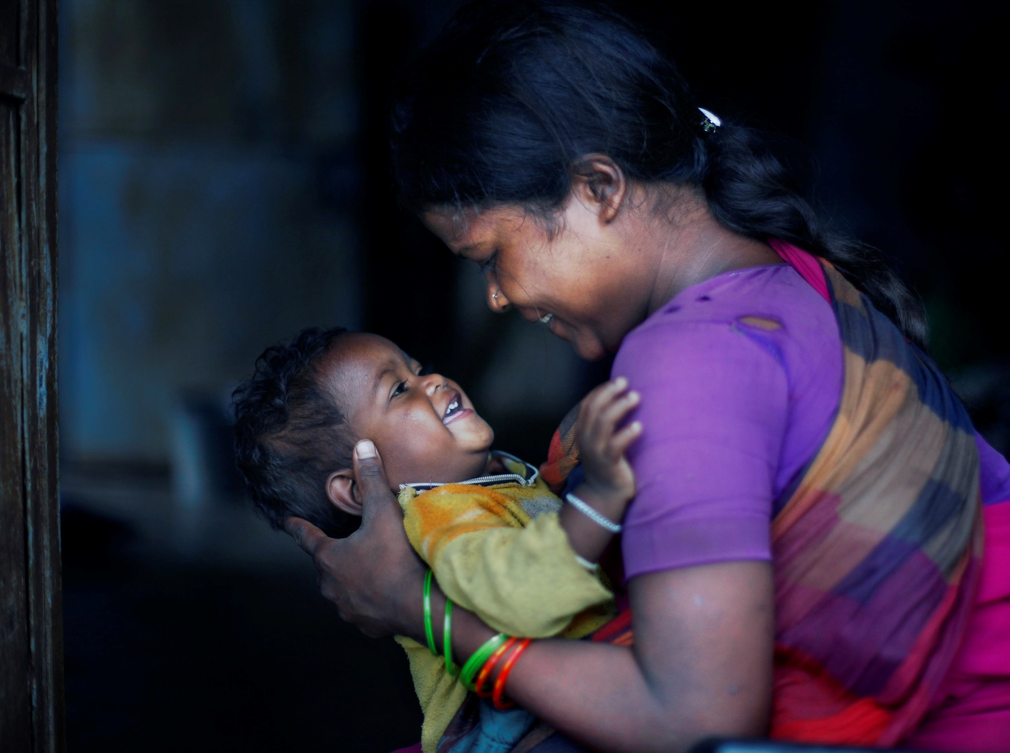

A promise to the world’s young people
© Unicef/Qadri
Notes:
Image: A woman plays with her child at primary health center in Uranga village, Mainpat, Sarguja, Chhattisgarh, August 02, 2014.

Slide 2
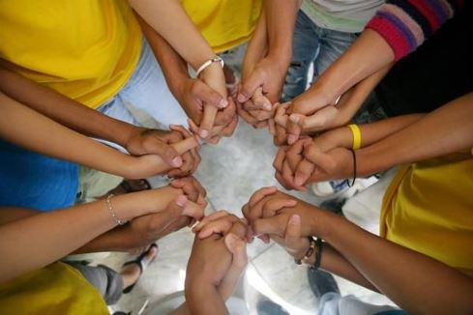
1989 was a very special year for Young people
In 1989, the United Nations adopted an international human rights treaty called the UN Convention on the Rights of the Child (UNCRC).
The UNCRC is the most widely signed and ratified human rights treaty in the world!
Every child has one thing in common – their rights!
© Unicef/Pirozzi
Notes:
Image: June, 2006. Youth leaders stand in a circle, holding hands, to symbolize the slogan 'We can do it together', at a child care centre run by Precious Jewels Ministry, a local NGO that supports AIDS-affected children in Manila, the capital. Youth leaders are themselves affected by AIDS. The UNICEF-assisted centre offers medical assistance, educational activities and counselling, as well as community outreach to raise awareness of HIV/AIDS and combat the stigma associated with the disease.
Presentation: The UNCRC was adopted by the UN General Assembly on the 20th November 1989. Every UN member state has signed the Convention and all bar the United States of America has ratified it. ‘Ratification’ is an act by which a State signifies an agreement to be legally bound by the terms of a particular treaty. The UK signed & ratified the UNCRC in 1991.

Slide 3
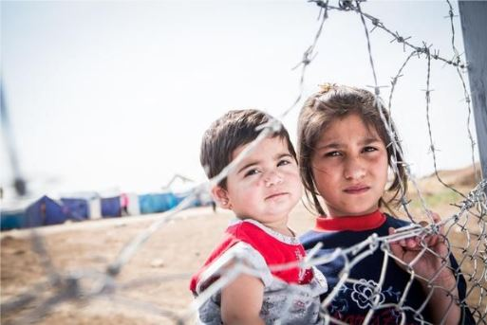
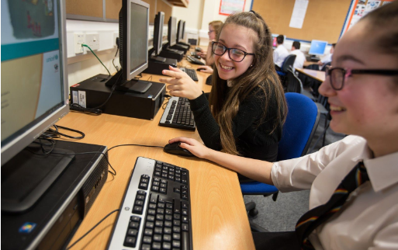
The UNCRC is for ALL Young people, EVERYWHERE
The UNCRC sets out:
The rights that everyone under 18 is entitled to.
What countries must do to ensure that all children can enjoy their rights regardless of who they are, or where they come from.
© Unicef/Schermbrucker
© Unicef/2016
Notes:
Image 1: Iraq, May 2013. Two Syrian children look through the fence in the Domiz refugee camp in Northern Iraq.
Domiz is situated near the city of Dohuk, about forty miles from the Syrian border. Approximately 40,000 Syrians are living here, in facilities provided for around half that number.
Image 2: Children at a school in the UK use a Unicef Rights Respecting school use computers as part of their lesson.
Presentation: The UNCRC applies to all children and young people (everyone under the age of 18 years), everywhere, all of the time. By ratifying the UNCRC, countries are committed to meeting its requirements but this remains a work ‘in progress’ for all countries and is monitored by the United Nations.

Slide 4
WHICH OF THESE RIGHTS IS IN THE UNCRC?
Having a mobile phone | Being treated fairly
Having an education | Owning a bike
Going on holiday | Freedom of expression
Having access to clean water | Being safe
To be able to relax | To be happy
Having a mobile phone | Be treated fairly
Having an education | Owning a bike
Going on holiday | Freedom of expression
Having access to clean water | Being safe
To be able to relax | To be happy
‘Wants’ and ‘needs’ are not always the same as rights!
Notes:
Presentation: For each statement ask the students to vote by a ‘show of hands’ whether they consider this to be a right or not in the UNCRC. The rights shown on the slide are those highlighted (second slide click). A ‘want’ or ‘need’ may coincide with a ’right’ but this may not always be the case as children’s rights are defined by the UNCRC - an
internationally agreed treaty. Students may feel that they want or need a mobile phone, bike or holiday but these are not defined by the UNCRC as rights. Neither is there the ‘right to be happy’ under the UNCRC as it is not possible to legislate for emotions but of course it would be hoped that if all the rights of a child are being met then they are likely to be
happy. The final click of the slide emphasises that ‘wants’ and ‘needs’ are not always the same as rights.

Slide 5
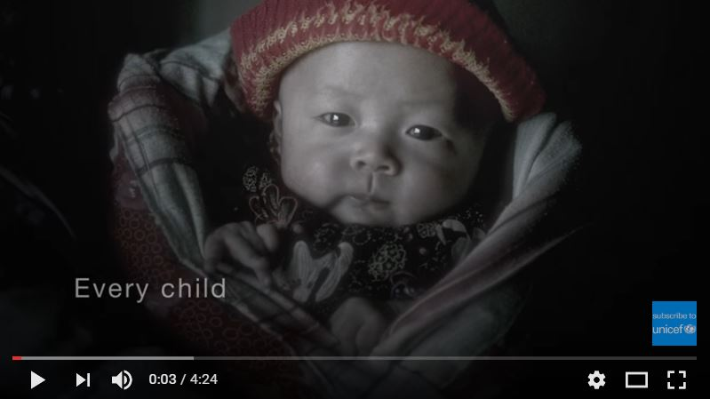
Children’s Rights have been internationally agreed
The UNCRC lists 42 rights for children - each right is called an article of the Convention.
The UNCRC has 54 articles in total and articles 43-54 are about how adults and governments must work together to make sure all children can enjoy their rights.
Notes:
Presentation: Some basic information about the Articles of the UNCRC is given. The 2010 Unicef video ‘For every child’ (approximately 4.5 minutes) gives an overview of some of these Articles supported by the emotive song “Lullaby, The UNICEF Anthem”.
Embedded video can be found here: https://www.youtube.com/watch?v=Mmy9MpwyKnQ

Slide 6
Children’s rights- examples
Article 2: Non-discrimination
Article 3: Best interests of the child
Article 13: Freedom of expression
Article 14: Freedom of thought, belief and religion
Article 19: Protection from violence, abuse and neglect
Article 24: The right to the best possible health
Article 28: The right to education
Article 29: The right that education must develop every child’s personality, talents and abilities to the full.
Article 31: The right to leisure, play and a range of cultural activities.
Notes:
Presentation: Using examples of the articles can be a starting point for further information and discussion. For example, students could be asked how well they feel these rights are being met for children in the UK or explore particular ways that governments may work to uphold these rights such as providing vaccination programmes to support the ‘right to life’.

Slide 7
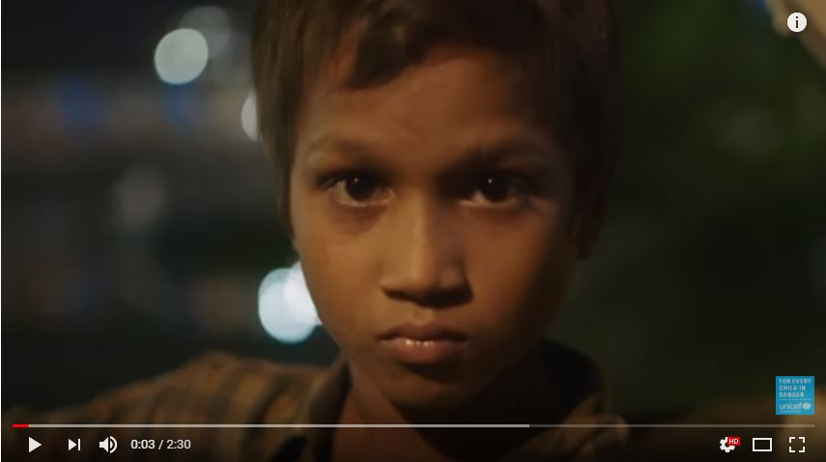
UNICEF is the United Nations Children’s Fund
Unicef works in nearly every country of the world to help make sure that all the rights of every child are met.
Children are born with their rights but sometimes they are prevented from accessing their rights because of poverty, disease, war, conflict, violence, climate change and emergencies.
Notes:
Presentation: Explain that Unicef has a mandate from the United Nations in Article 45 of the UNCRC to help provide expert advice and assistance on children’s rights. Unicef has several ambassadors that promote and support the work of Unicef, including David Beckham. The video link is to a 2016 summary of Unicef’s work around the world.
Embedded video can be found here: https://www.youtube.com/watch?v=c_DFEg2v-Y4

Slide 8
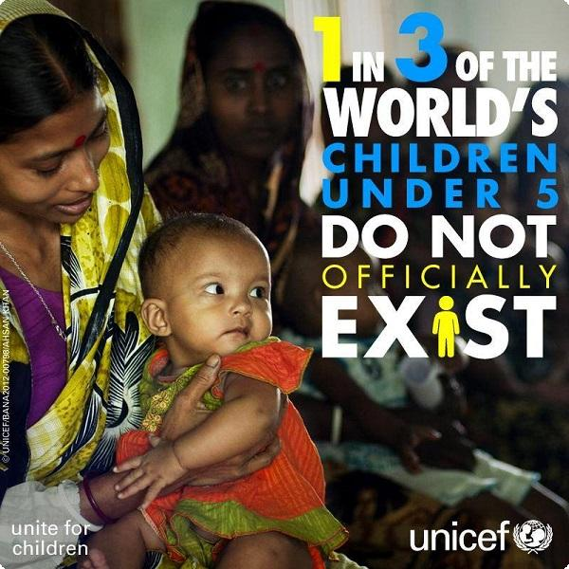

Reflection
Article 7
Every child has the right to be registered at birth, to have a name and nationality, and, as far as possible, to know and be cared for by their parents. For many children registration at birth does not happen.
What would it be like to be ‘invisible’ to the world?
Notes:
Presentation: The picture and text provide an opportunity for students to reflect upon a right, Article 7, which is taken for granted in the UK and yet for millions of children is denied.

