Slide 1
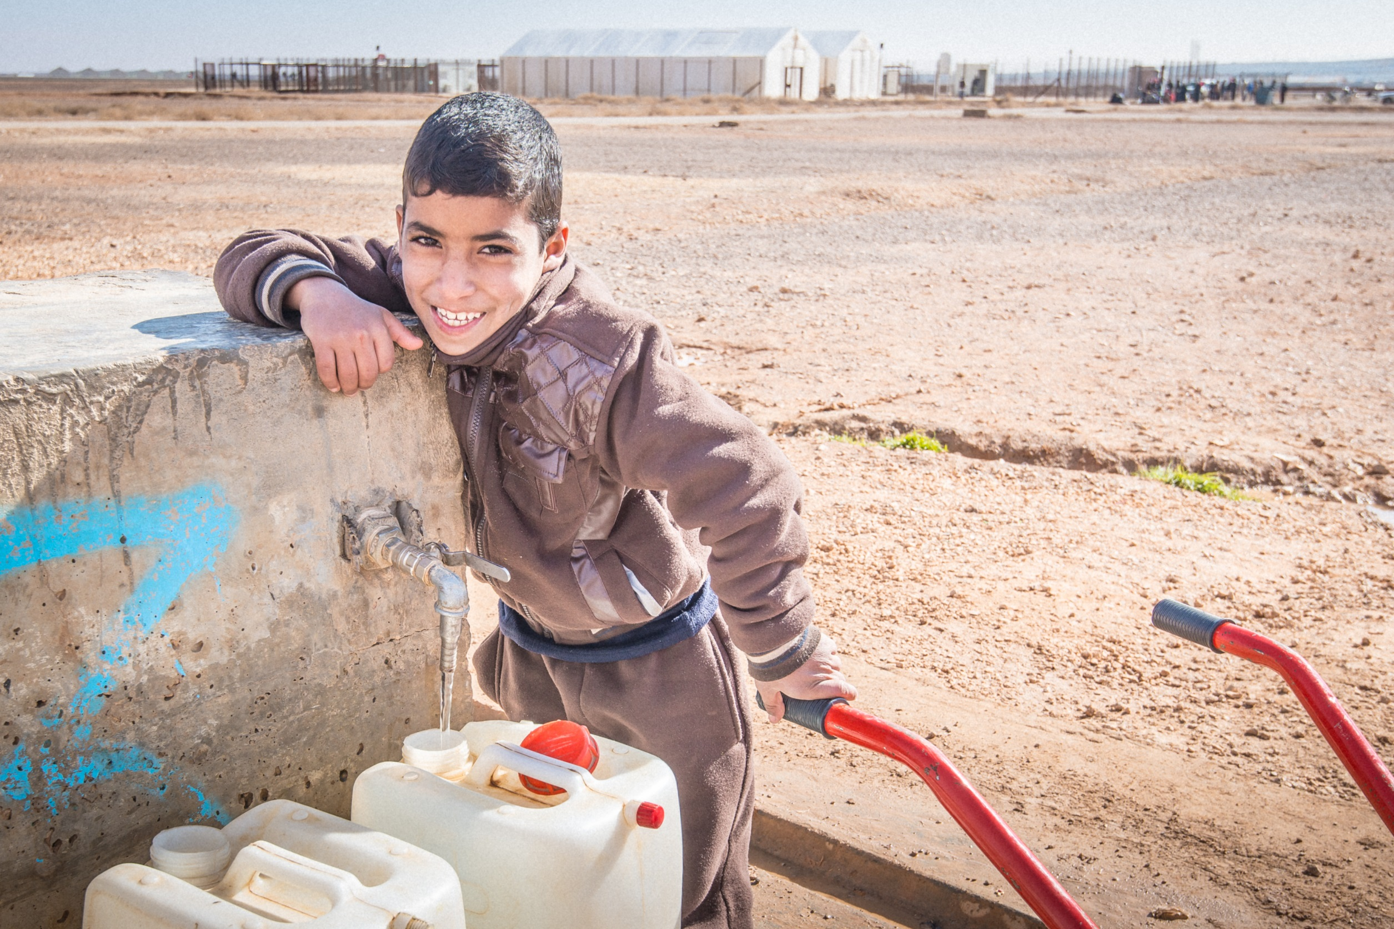

The UN global goals #6
© UNICEF/UNI144870/Singh
© Unicef/Martino
Notes:
Image: Jordan, 2016. A young boy waits by the water station in Azraq Refugee Camp with his wheelbarrow ready to assist others in transporting their jerry cans home.

Slide 2
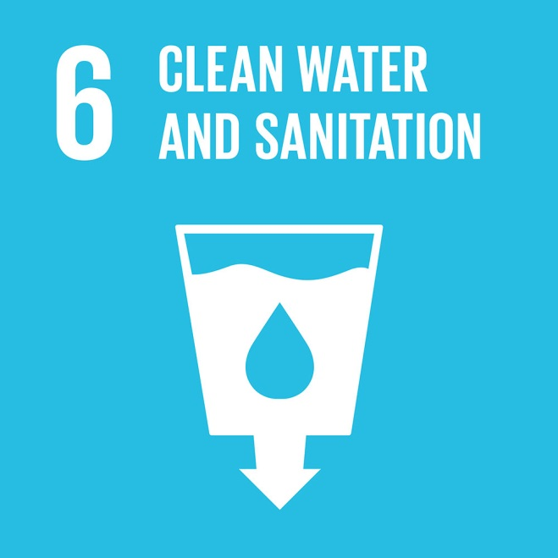
The UN GLOBAL goal #6
Some of the targets of Global Goal #6 are:
By 2030, achieve universal and equitable access to safe and affordable drinking water for all.
By 2030, achieve access to adequate and equitable sanitation and hygiene for all and end open defecation, paying special attention to the needs of women and girls and those in vulnerable situations.
Notes:
Presentation: Global goal #6 has several specific targets and two are cited on this slide. As slide 4 references, many millions of people currently do not have access to clean water and/or basic sanitation. It is important to link achieving this global goal with the positive impact it will have on children’s rights.

Slide 3
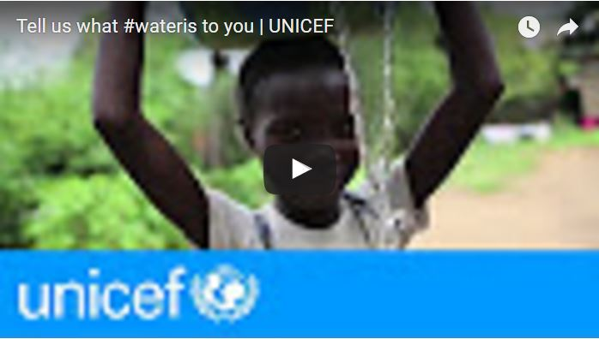
Clean water and sanitation: the good news
6 billion people have gained access to improved drinking water sources since 1990.
Between 1990 and 2015, the proportion of the global population using an improved drinking water source has increased from 76% to 91%.
Notes:
Video: If embedded video does not load then please click here https://www.youtube.com/watch?v=8gPijsVcB3s
Presentation: The data shows how much progress has already been made in the provision of clean water and sanitation. The video (approximately 1 minute) celebrates the importance of water to everyone in the world, a resource we can so easily take for granted.

Slide 4
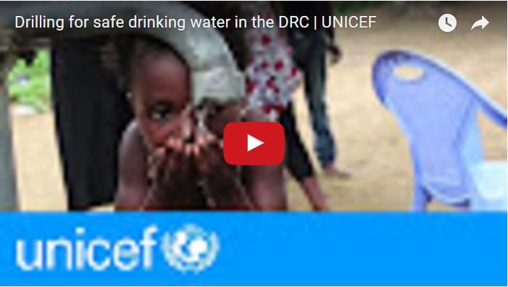
Clean water and sanitation: the challenges ahead
663 million people are still without clean water.
2.4 billion people lack access to basic sanitation services, such as toilets or latrines.
Each day, nearly 1,000 children die due to preventable water and sanitation-related diarrhoeal diseases.
Notes:
Video: If embedded video does not play then please find here https://www.youtube.com/watch?v=Bjxf-QDANqM
Presentation: The data shows that much more needs to be done to ensure that everyone has access to clean water and sanitation. In the video (approximately 2 minutes), we see how the manual drilling for water in a village within Democratic Republic of the Congo (DRC) can help transform a community. The DRC is one of three countries in the world in which more than 50% per cent of the population do not have access to safe drinking water.

Slide 5
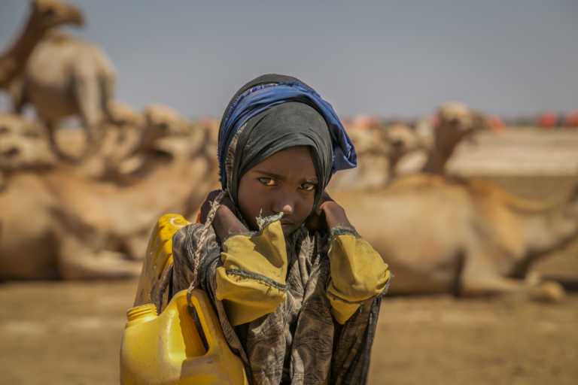
REFLECTION
Poor sanitation, water and hygiene affect more than just children’s health. Children – particularly girls – often miss out on education, because many schools lack proper toilets and hand washing facilities. Others miss out because they have to spend their days making long journeys to collect clean water, rather than going to school.
Unicef/Ayene
Notes:
Image: Sulem, 9, has to walk four kilometres from her home to collect water from a borehole - or her family will go without anything to drink.
Presentation: An opportunity for students to reflect upon the impact of the lack of clean water and poor sanitation on children's health and education.

