Slide 1
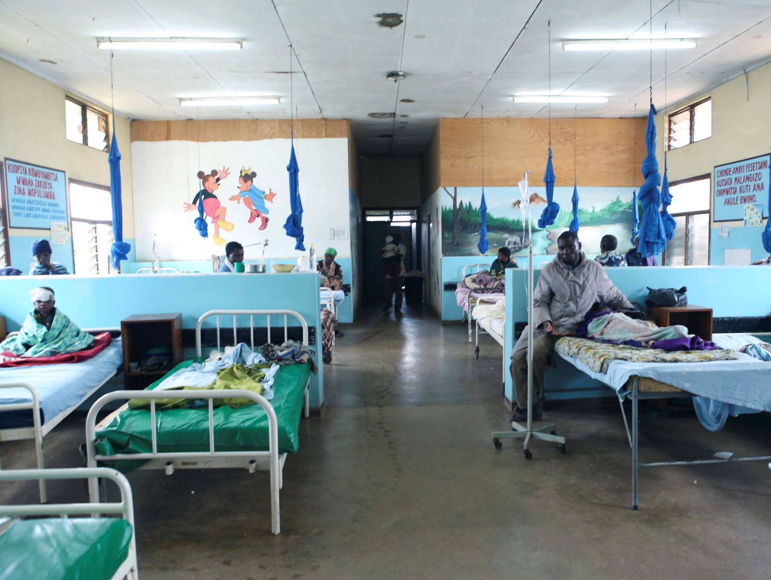
The Right To the
best possible Health
© UNICEF/UNI173761/Altaf Qadri
© Unicef//Matas
Notes:
Image: Malawi, April 2014. The children’s ward of Dedza district hospital.

Slide 2
The right to the best possible health: article 24
Every child has the right to the best possible health.
Governments must provide:
- good quality health care
- clean water
- nutritious food
- a clean environment
- education on health and well-being so that children
can stay healthy
Richer countries must help poorer countries achieve this.
Notes:
Presentation: The text on the slide is a summary of Article 24. You may wish to discuss particular elements of the text in more detail including the importance of mental well-being as well as good physical health.

Slide 3
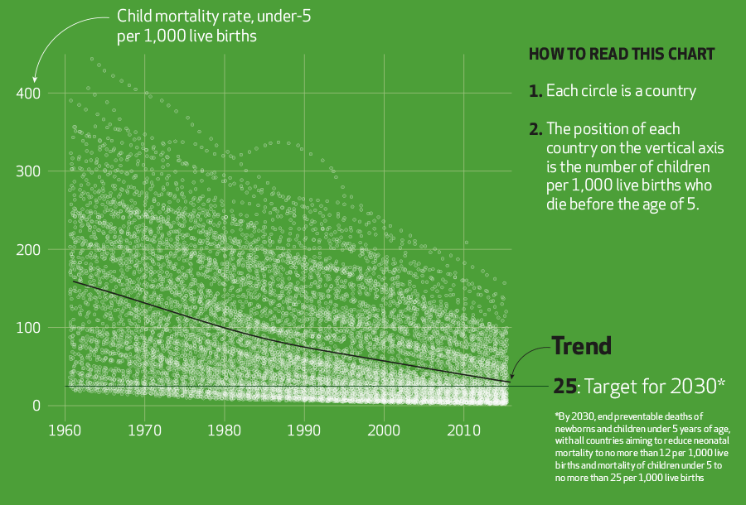
Notes:
Presentation: The graph makes the key point that child mortality figures have over time improved although there remains much work to be done. The target referred to in the graph for the year 2030 relates to the United Nation’s Sustainable Development Goals and is ‘Goal 3: Good Health and Well Being’.

Slide 4
Vaccinations Are key to reducing child mortality
Since 1980, Unicef has helped quadruple immunisation rates for children worldwide, saving up to 3 million children’s lives a year.
We take vaccinations for granted but for many people getting a vaccination is a major challenge.
Notes:
Presentation: Vaccination programmes have proven to be highly effective around the world in reducing child mortality but more still needs to be done. The video clip (approximately 2 minutes) shows the incredible journey that one mother in Sierra Leone makes in order to have her child vaccinated.
If embedded video will not play please find here: https://www.youtube.com/watch?v=jlJuGzidrsQ&feature=youtu.be

Slide 5
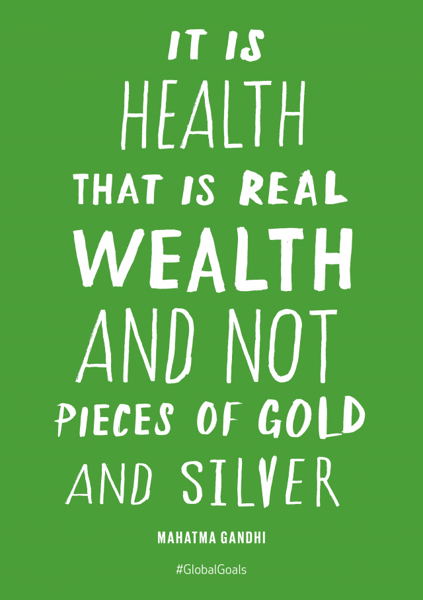
The right to the best Possible health
Nearly 1 in 5 children around the world are unable to receive vaccinations because of unequal access to immunization services.
Notes:
Presentation: The video clip (approximately two and a half minutes) illustrates the unequal access to vaccines through the fictional story of two mothers in South Africa both trying to have their babies vaccinated.
If the embedded video does not place please find here: https://www.youtube.com/watch?v=h8NEi1W9nnI&feature=youtu.be

Slide 6
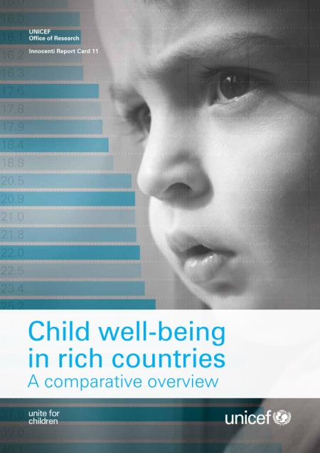
Reflection: uk CHILDREN’S WELL-BEING
The right to the best possible health includes both physical and mental health. Good health is also a vital part of wellbeing.
In a 2013 Unicef survey for child well-being for 29 of the world’s most advanced economies, the UK was placed 16th.
Why do you think this is?
Notes:
Presentation: The right to the best possible health includes physical and mental health. Good health is also a vital part of well-being. The statistics on the slide show in relation to criteria used by Unicef to estimate child well-being that the UK is behind several of the other richest countries in the world. This provides an opportunity to reflect upon the possible reasons for this.

