Slide 1
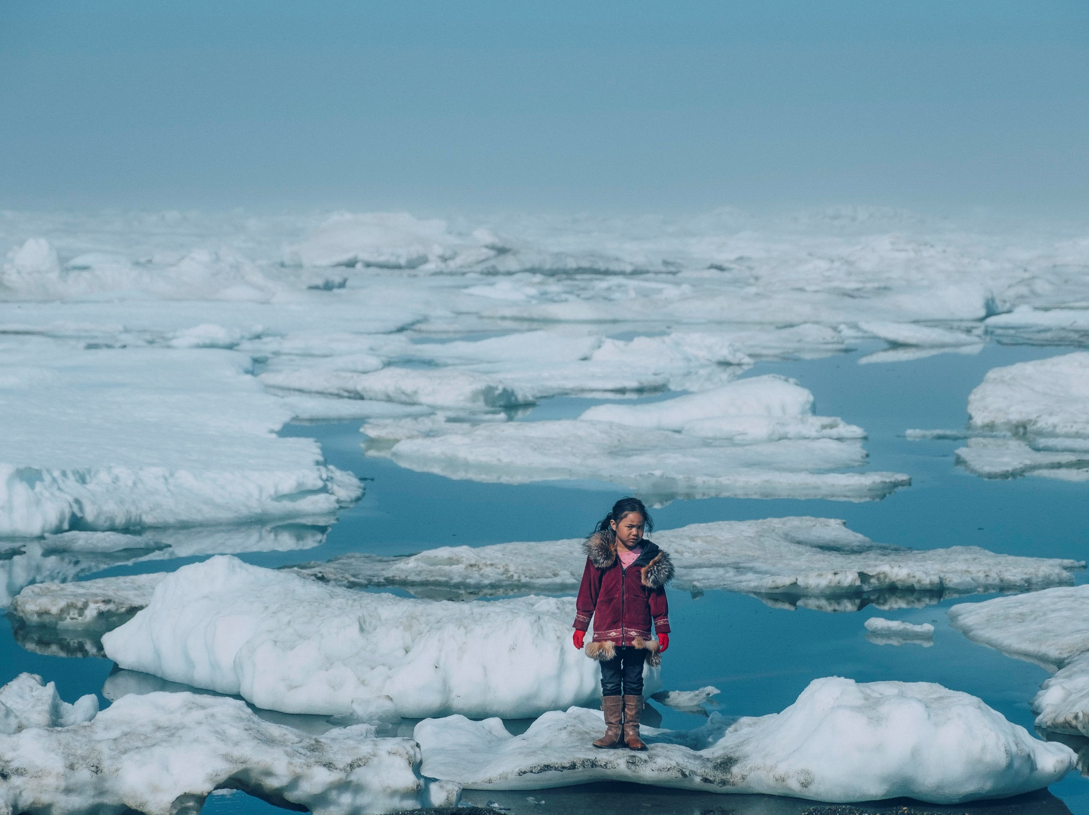
Climate change and children’s health
© Unicef/Sokhin
Notes:
Image: On 1 July 2016, Iñupiat girl Amaia, 11, standing on a ice floe on a shore of the Arctic Ocean in Barrow, Alaska in the United States of America. The anomalous melting of the Arctic ice is one of the many effects of global warming that has a serious impact on the life of humans and the wildlife. In the several recent years, big ice floes can be found further from the shore, as the sea ice starts melting earlier and faster.

Slide 2
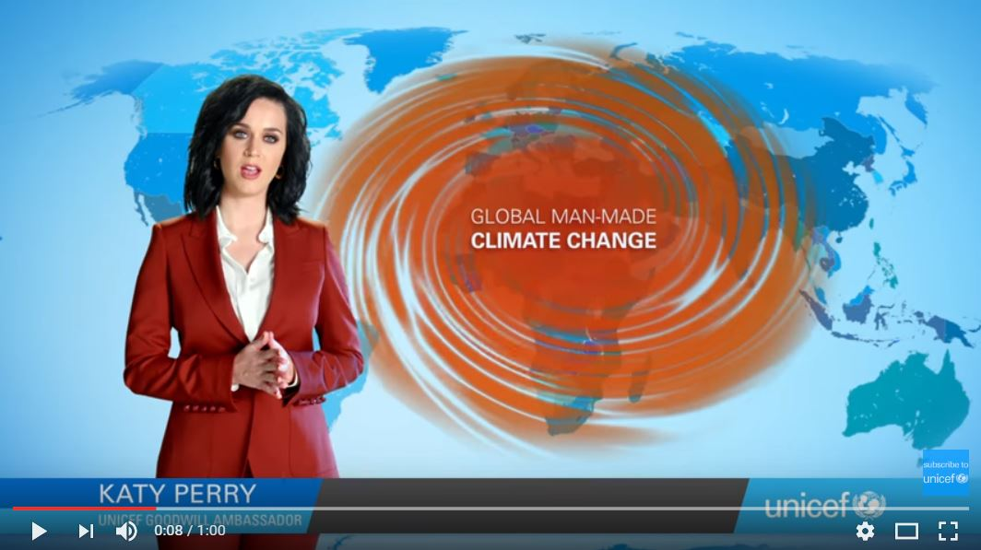
The right to life, survival and development: article 6
Every child has the right to life.
Governments must do all they can to ensure that children survive and develop to their full potential.
How does climate change effect children’s rights?
Notes:
Video: If this embedded video does not work then please find here: https://www.youtube.com/watch?v=lZG8xJcxhOE
Presentation: The text on the slide is a summary of Article 6. This is not the only Article that can be linked to the impact of climate change (for example, see Article 24) but it enables the presenter to make the vital point that climate change can lead to life threatening situations. The video clip (1 minute) shows how throughout the world climate change and its effects are forcing millions of children and families to flee their homes.

Slide 3
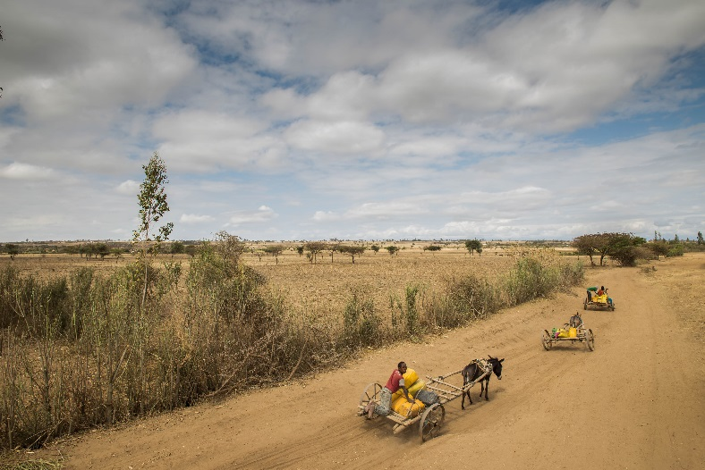
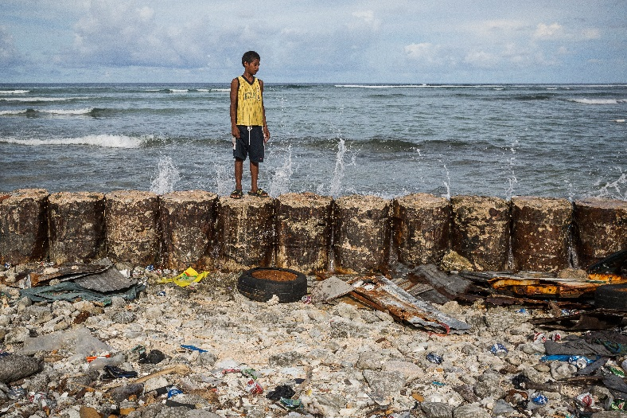
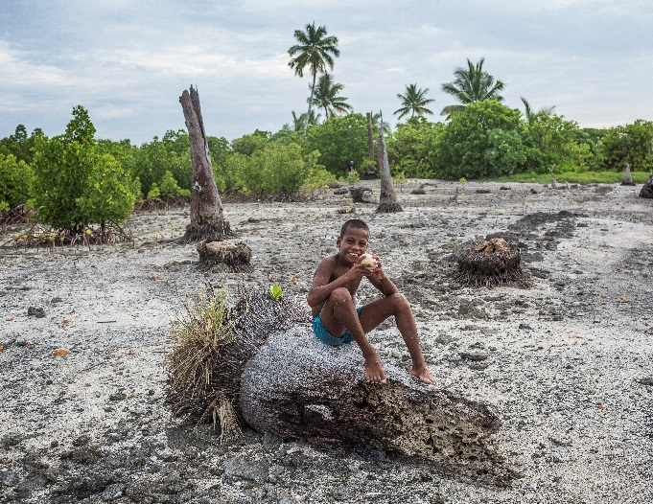
The impact of Climate Change on child rights
Children are the most vulnerable, yet least responsible for the effects of climate change.
© Unicef/Ayene
© Unicef/Sokhin
© Unicef/Sokhin
Notes:
Images: From left to right:
Ethiopia is experiencing one of its worst droughts in decades, which has led to water scarcity and food insecurity for millions. Approximately 5.8 million people need access to safe drinking water. In areas with severe water shortages, some children have to travel long distances to get water for household use. As a result, they go to school late or miss school altogether.
2. Frank, 13, stands on a seawall that protects his family home from the rising seas in Jenrock village in the Majuro Atoll in the Marshall Islands. His parents say that despite the wall during high tides the water breaks in to their yard.
3. Tekua, 10, sits on a dead coconut tree in the village of Tebunginako, Kiribati. Residents of the village have been planting mangroves in the area that usually floods at high tide. The island is most threatened by rising sea levels. The country's government says Tebunginako is a "barometer for what Kiribati can expect in the future".
Presentation:
Left image: Ethiopia is currently (in 2017) experiencing one of its worst droughts in decades. In areas with severe water shortages, some children have to travel long distances to get water for household use. As a result, they go to school late or miss school altogether.
Middle image: Frank, 13, stands on a seawall that protects his family home from the rising seas in Jenrock village in the Majuro Atoll in the Marshall Islands (2014). His parents say that despite the wall during high tides the water breaks in to their yard.
Right image: Tekua, 10, sits on a dead coconut tree in the village of Tebunginako, Kiribati (2016). Residents of the village have been planting mangroves in the area that usually floods at high tide.

Slide 4
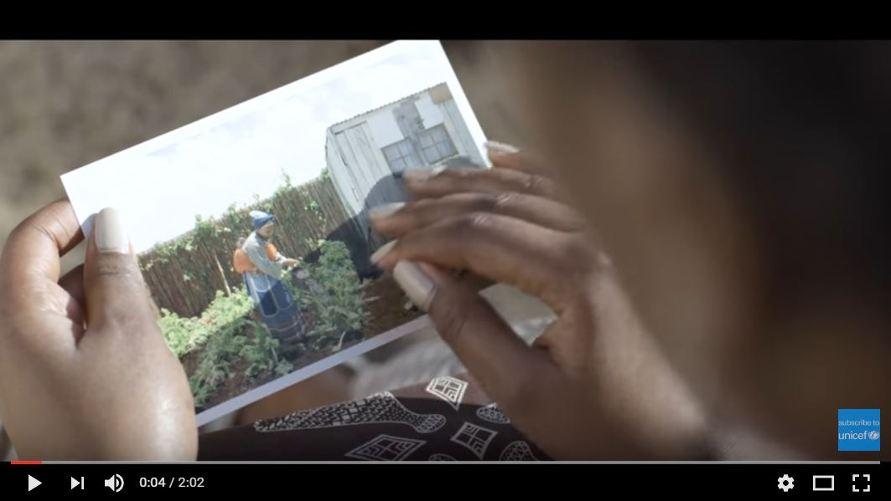
The impact of climate change on child rights
Climate change means more droughts, floods, heatwaves and other severe weather conditions.
Notes:
Video: If the embedded video will not load then please find it here: https://www.youtube.com/watch?v=YteS-sS9xQs
Presentation: The video clip highlights how a small family is affected by the changing climate during the course of three generations. Children are the most vulnerable, yet least responsible for the effects of climate change.

Slide 5
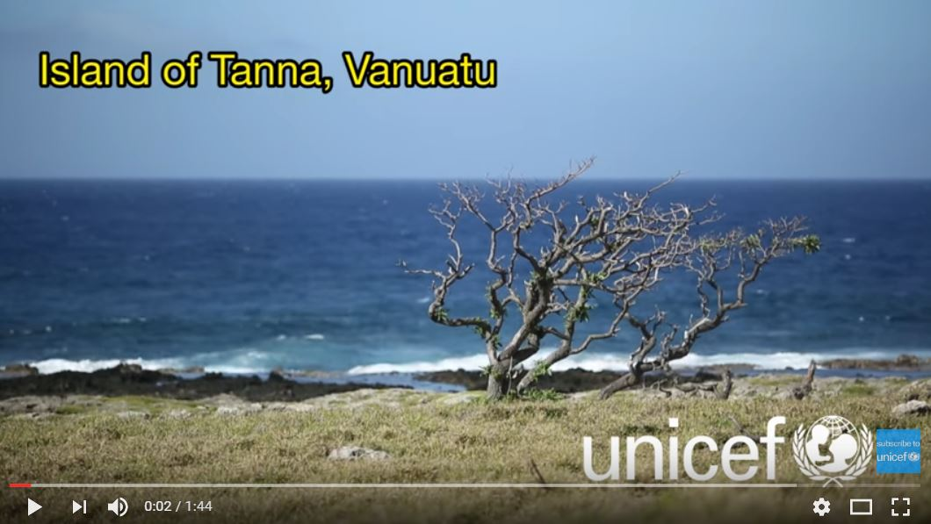
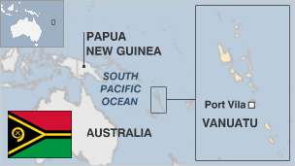
The impact of climate change on child rights
These events can ripple throughout a child's life and ​limit​ their access to sanitation, education and opportunities.
Notes:
Video: If the embedded video will not load then please find here: https://www.youtube.com/watch?v=qersZxgMQcQ
Presentation: The video clip ‘John from Vanuatu tells his story’ relates to March 2015, when Vanuatu was hit by Cyclone Pam which destroyed many houses, buildings and ruined crops. Instead of having the chance to recover, it is now experiencing extreme dry weather due to El Nino. UNICEF is working in the region to provide health and nutritional support.

Slide 6
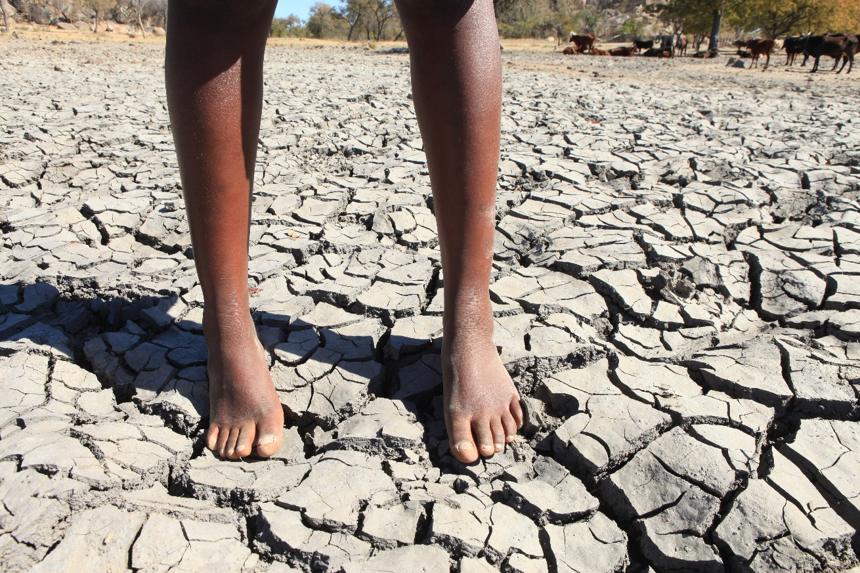
Reflection
Nearly 160 million children live in areas of high or extremely high drought severity.
Which of their rights will be affected?
© Unicef/Mukwazhi
Notes:
Image: Nhleya (17) head of the Nhleya Family is seen a the drying up dam where they fetch water in this Thursday August, 25, 2016 photo in Siyephi Village, Bullilima District in Matebeland South Province, Zimbabwe. The mother of the children ran away leaving the family to be taken care of by their elder sister Vanessa Nhleya (17) who is now heading the family. The Nhleyas are among the more than four millon Zimbabweans that the government says will need food aid assistance following the El Nino-induced drought that struck the Southern African Nation. The government, UN agencies including UNICEF and other donors are appealing for millions of dollars in emergency support to assist stricken families. UNICEF Zimbabwe says its funding gap remains above US $19 million.
Presentation: The slide asks a question for students to reflect upon using their knowledge of the UNCRC in terms of the rights that are denied due to extreme drought severity.

