Slide 1
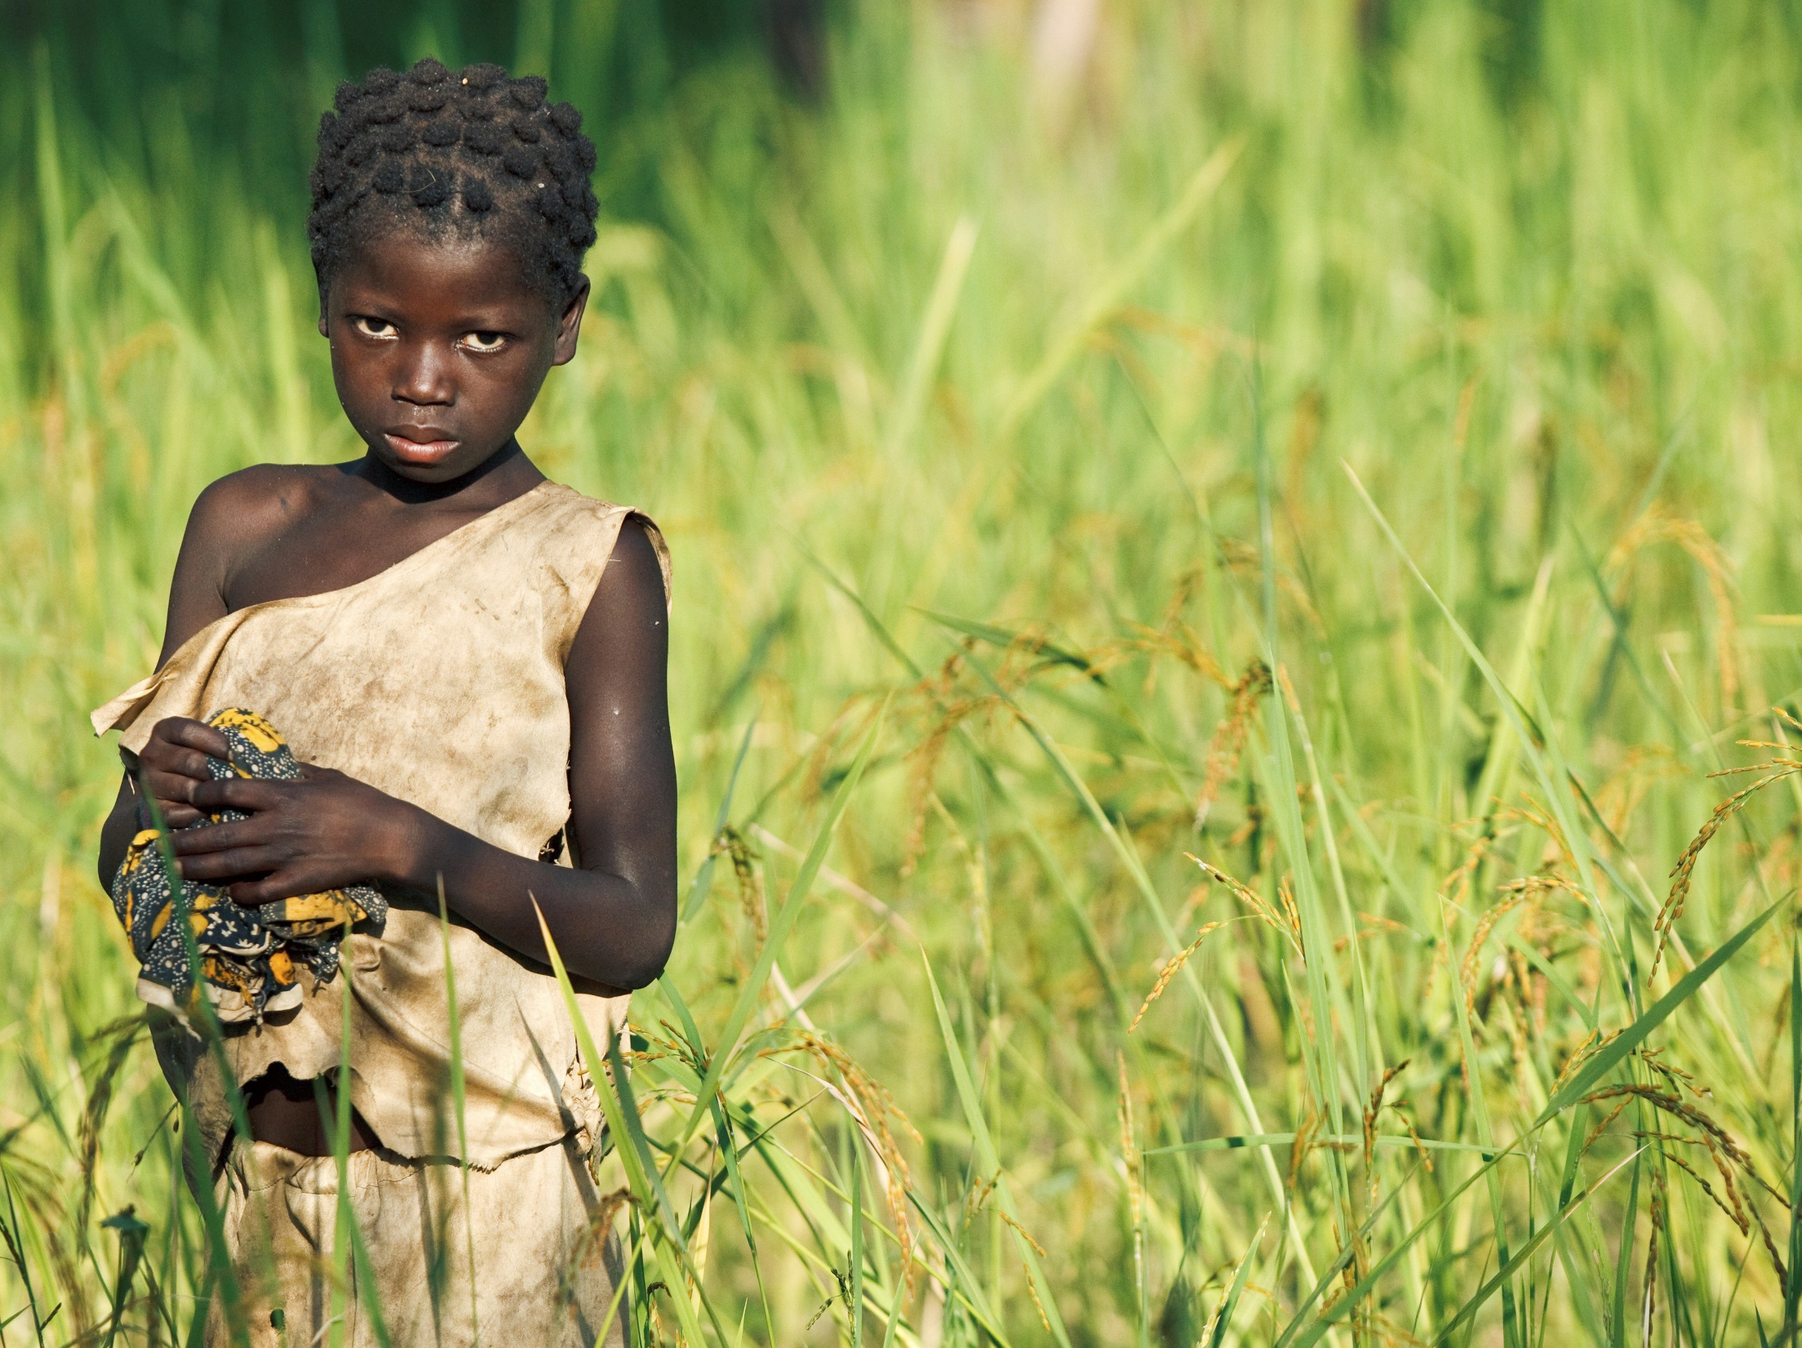

When rights are denied A case study
© Unicef/Asselin
Notes:
Image: November, 2011. A girl stands in a field where she works, in the village of Djorbana, Zanzan Region. She does not attend school.

Slide 2
The convention on the rights of the child
Article 32:
Governments must protect children from economic exploitation and work that is dangerous or might harm their health, development or education.
Governments must set a minimum age for children to work and ensure that work conditions are safe and appropriate.
Notes:
Presentation: The text on the slide is a summary of Article 32.

Slide 3
Defining child labour
Children are child labourers when they are either too young to work or are involved in hazardous activities that may compromise their physical, mental, social or educational development.
Notes:
Presentation: The slide provides a definition of child labour. You may wish to explore with students examples of child labour that have occurred in the past and in the present both in the UK and the wider world.

Slide 4
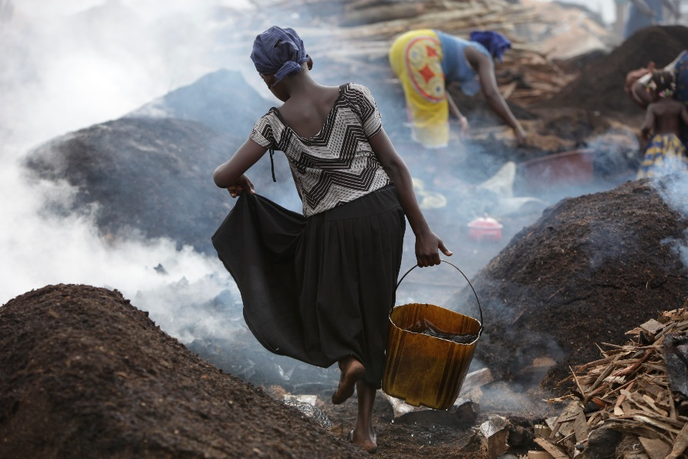
Child Labour: statistics
It is estimated that 168 million children aged 5 to 17 are engaged in child labour.
Despite a steady decline in child labour, progress is far too slow. At current rates, more than 100 million children will still be trapped in child labour by 2020.
In the world’s poorest countries, nearly one in four children are engaged in work that is potentially harmful to their health.
© Unicef/Kamber
Notes:
Image: November, 2010. In the image shown an 11-year-old girl works alongside other girls and women in a charcoal production yard near the south-western city of San Pédro. She says she does not go to school. Workers are exposed to dangerous smoke and charcoal fumes throughout the day.
Presentation: The statistics indicate that child labour remains a major global concern with the poorest countries of the world experiencing the highest levels.

Slide 5
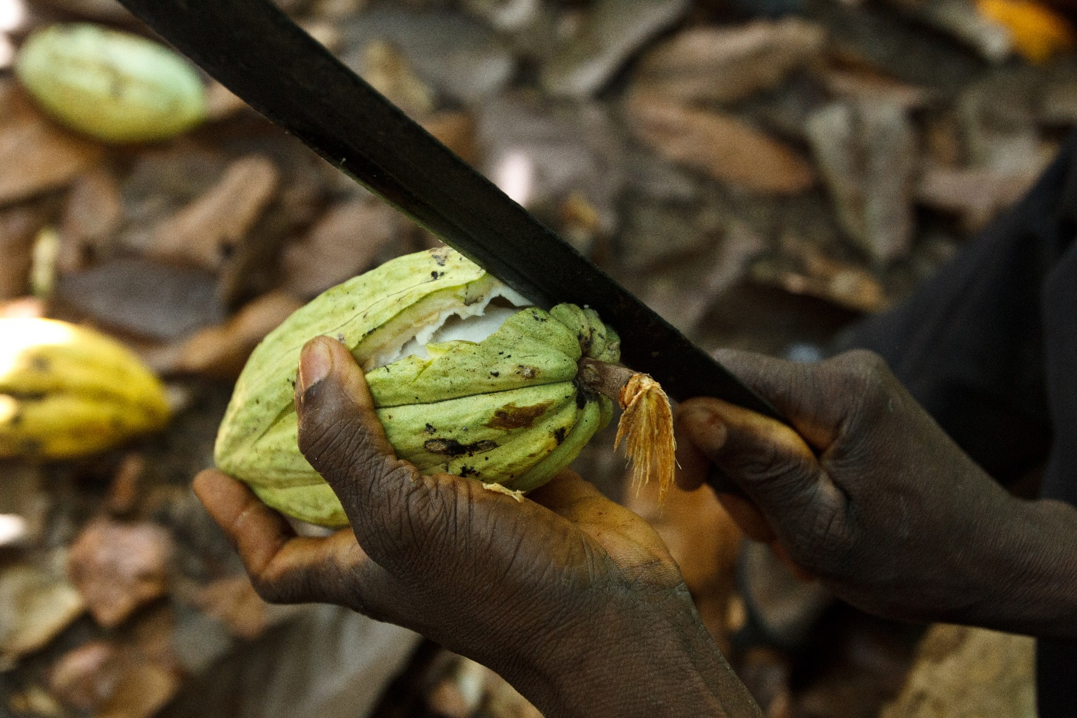
does money grow on trees?
© Unicef
Notes:
Image: March, 2012. Daniel uses a machete to break open a cacao pod on his cacao plantation, near the town of Moussadougou, in Bas-Sassandra Region of Côte d Ivoire. The country is the world’s largest producer and exporters of cocoa beans.
Presentation: The picture shows a cocoa pod, the starting point for chocolate production (the pods are harvested and then the cocoa beans inside are extracted before undergoing a series of treatments and processes to produce chocolate). Cocoa and chocolate production can yield high profits but this may be based on the use of child labour. Cocoa production also provides opportunities to explore fairtrade issues and examples of philanthropic practice.

Slide 6
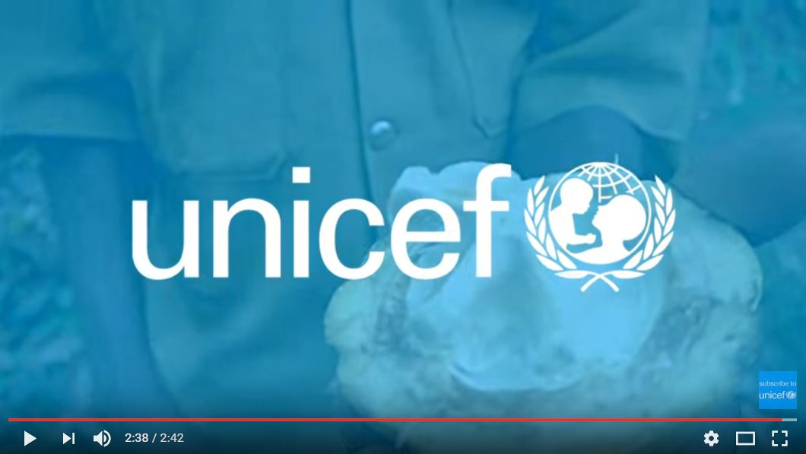
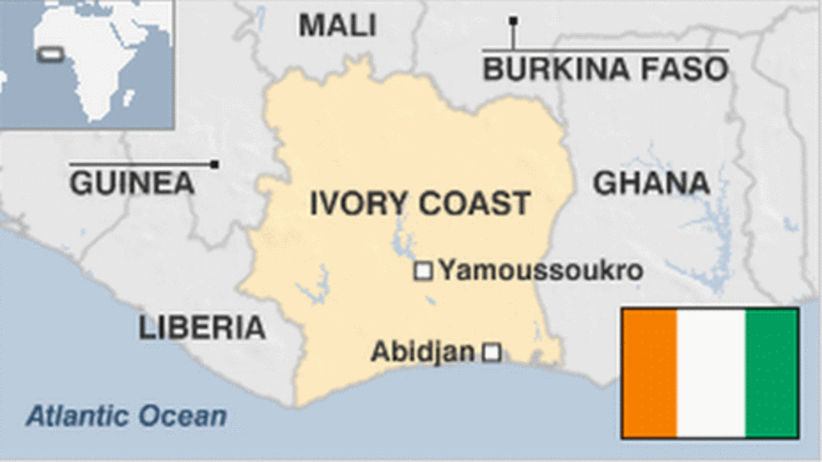
Rights and Child Labour
From cocoa fields
in West Africa
to supermarkets
in the UK
Notes:
Video: If the embedded video will not play, it can be found here: https://www.youtube.com/watch?v=tSfXh_L_a_Q
Presentation: The use of child labour to produce cocoa in Côte d’Ivoire is widespread and at the expense of children’s rights to an education (Article 28). The video (approximately three minutes) shows how the small village of Koffikro has taken steps to ensure that all children, like Halima, go to school. Approximately 40% of the world’s cocoa comes from Côte d’Ivoire.

Slide 7
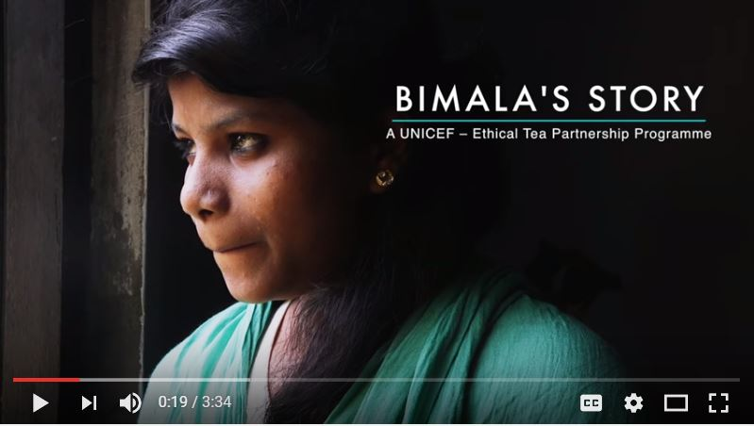
Rights And Child Labour
Being a responsible global citizen can help reduce child labour.
Unicef is trying to put a stop to child labour and exploitation.
Unicef and the Ethical Tea Partnership
Notes:
Video: If the bedded video will not play then please find here: https://www.youtube.com/watch?v=TyXZCDo4P5Y
Presentation: The video (approximately three and a half minutes) looks at how Unicef and Ethical Tea Partnership are working together to protect children and young people living in tea communities in Assam, India.

Slide 8
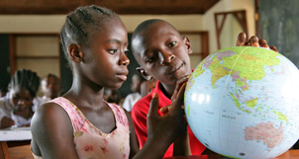
Reflection
We are living in a global community and children’s rights can be affected by the activities and actions of others elsewhere in the world.
© Unicef/Pirozzi
What you eat, wear, use, buy, and how you travel…
How might these impact on children’s rights?
Notes:
Presentation: The slide provides an opportunity for students to reflect upon the impact of children’s rights as a result of global activities such as trade, as well as how their buying habits can make a difference.

