Slide 1
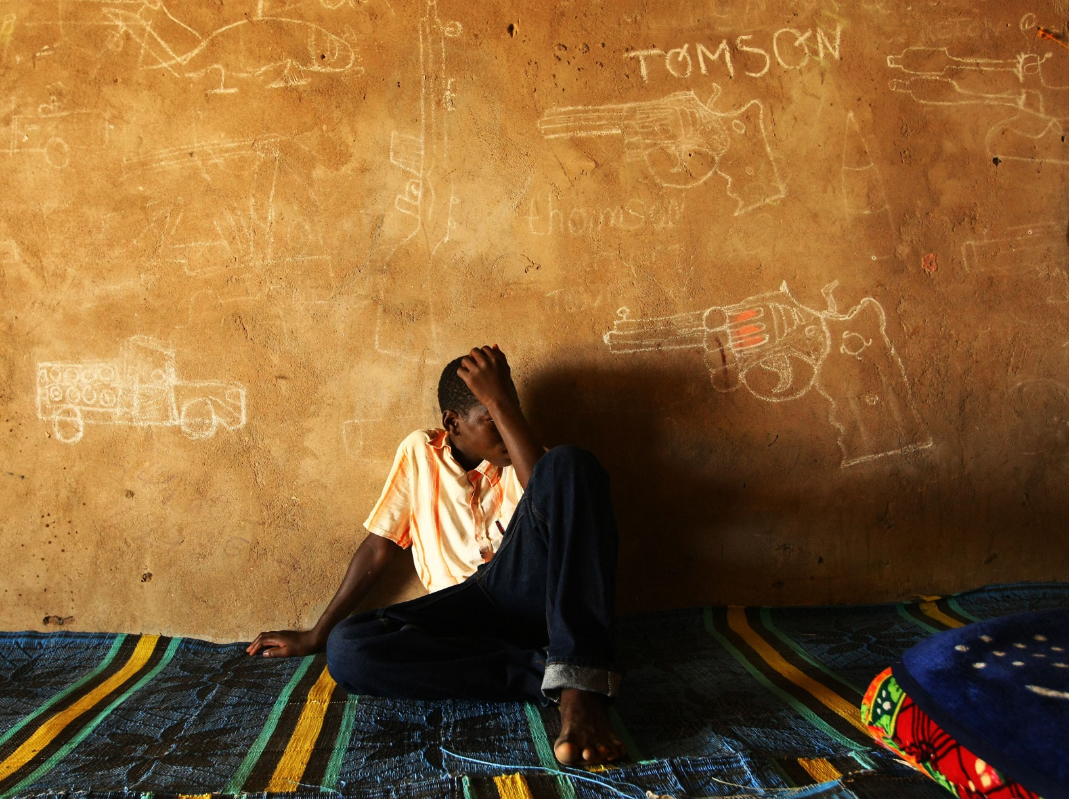
When rights are denied – recruitment by armed groupsv
When rights are denied- recruitment by armed forces or armed groups
When rights are denied – A case study
© Unicef/Asselin
© UNICEF/UNI41953/LeMoynec
Notes:
Image: On 10 June, 2010, a boy sits against a wall covered with drawings of weapons and military vehicles, including guns and a helicopter, in a transit and orientation centre for former child soldiers, in N’Djaména, the capital of Chad. The centre, run by the NGO CARE International and supported by UNICEF, provides rehabilitation services, skills training and shelter for former child soldiers until they are reunited with their families or become self-sufficient. The children are encouraged to draw to help them express, and recover from, their experiences.

Slide 2
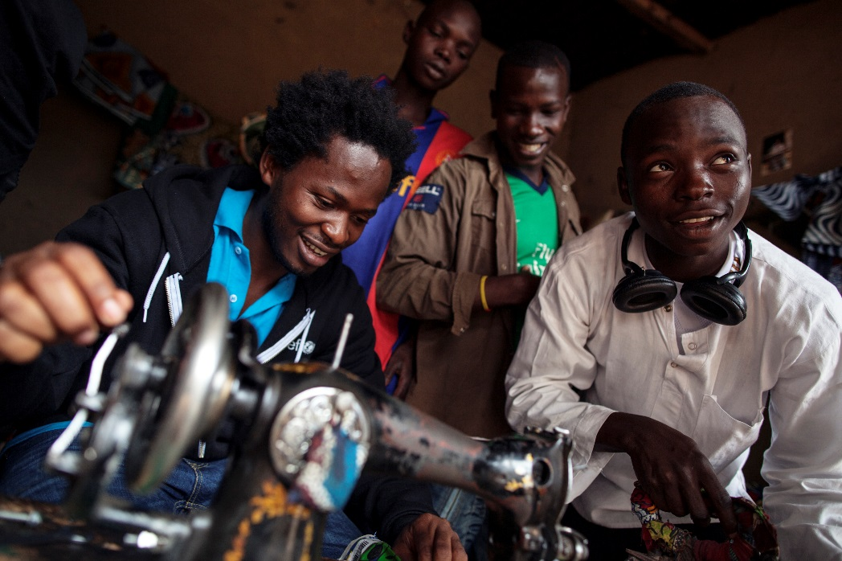
When rights are denied- recruitment by armed forces or armed groups
A child associated with an armed force or armed group is any person under 18 who is part of any kind of regular or irregular armed force or armed group in any capacity.
© Unicef/Sokol
Notes:
Image: Central African Republic, 2012. UNICEF Advocate for Children Affected by War Ishmael Beah reviews a vocational training programme with neighbourhood children and some former child soldiers, at a UNICEF-assisted transit centre for recently released former child soldiers, in the town of N’dele, capital of the northern Bamingui-Bangoran Prefecture.
Presentation: The text on the slide makes the point that children recruited by armed forces or armed groups could be exploited in many different ways.

Slide 3
The convention on the rights of the child
Article 38: Governments must not allow children under the age of 15 to take part in war or join the armed forces. Governments must do everything they can do to protect and care for children affected by war and armed conflicts.
Article 41: If a country has laws and standards that go further than the present Convention then the country must keep these laws.
Notes:
Presentation: The first bullet point on the slide is a summary of Article 38; governments must not allow children under the age of 15 to take part in war or armed conflict. It should be noted (second bullet point) that Article 41 says that if a country has laws and standards that go further than the present Convention, as for example in the UK, then the country must keep these laws.

Slide 4
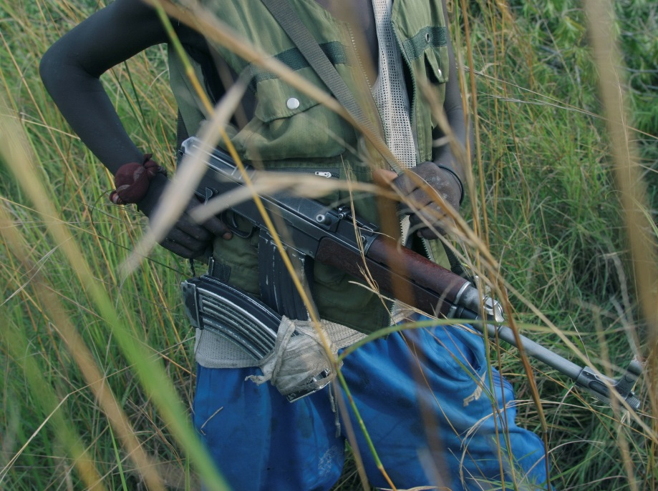
The involvement of children in armed conflict: uncrc OPTIONAL PROTOCOL
The Optional Protocol requires governments to:
ensure that children under age 18 are not compulsorily recruited into their armed forces
to raise the minimum age for voluntary recruitment to above age 15. It also forbids anyone under 18 to participate in hostilities
take all feasible measures to prevent recruitment and use of individuals under the age of 18 by non-State armed groups
Many countries have either ratified or signed the Optional Protocol (the UK ratified it in 2003) but not all countries.
© Unicef/LeMoyne
Notes:
Image: Congo, Democratic Republic, June, 2003. Child soldiers, armed with guns, stand in tall grass guarding a road outside a village near the city of Bunia in the eastern region of Ituri.
Presentation: Many countries (including the UK) but not all countries have signed the ‘Optional Protocol to the Convention on the Rights of the Child on the involvement of children in armed conflict’ and the slide text summarises the key aspects of this.

Slide 5
When rights are denied- recruitment by armed forces or armed groups
Unicef estimates that tens of thousands of boys and girls under the age of 18 are used in conflicts worldwide.
Since 2013, an estimated 17,000 children have been recruited in South Sudan and up to 10,000 children have been recruited in the Central African Republic.
In Nigeria and neighbouring countries, data verified by the United Nations and its partners indicate that nearly 2,000 children were recruited by Boko Haram in 2016 alone.
In Yemen, the UN has documented nearly 1,500 cases of child recruitment since the conflict escalated in March 2015.
Notes:
Presentation: The slide gives some examples of the scale of the problem around the world. The rights being denied children in this situation could be further explored.
Sources of this information can be found here: https://www.unicef.org/media/media_94892.html

Slide 6
Helping child soldiers
This film tells the story of Simon*, a former child soldier who has been helped by Unicef to return to his home and family in South Sudan.
*His name has been changed to protect his identity.
Notes:
Video: If the embedded video will not load then please find it here: https://www.youtube.com/watch?v=jJSqOe9k58c
Presentation: The video (approximately 3 and half minutes long) tells the story of Simon (not his real name), a former child soldier who has been helped by Unicef to return to his home and family in South Sudan.

Slide 7
Reflection
“I know the nature of what it is to be forgotten, what it is to lose your humanity, and more importantly, what it is to recover from it and to have another life” – Ishmael Beah
Notes:
Video: If the embedded video will not play please find it here: https://www.youtube.com/watch?v=9e8qRayOwug
Presentation: At thirteen years of age, Ishmael Beah was forcibly recruited into the Sierra Leone civil war. After two years with the help of Unicef he was removed from the army and placed in a rehabilitation home. In 2007 he was appointed UNICEF’s first ‘Advocate for Children Affected by War’. He is also a best-selling author and human rights spokesperson. The quotation and video clip (approximately 3 minutes) provide an opportunity for students to reflect upon his personal story.

