Slide 1
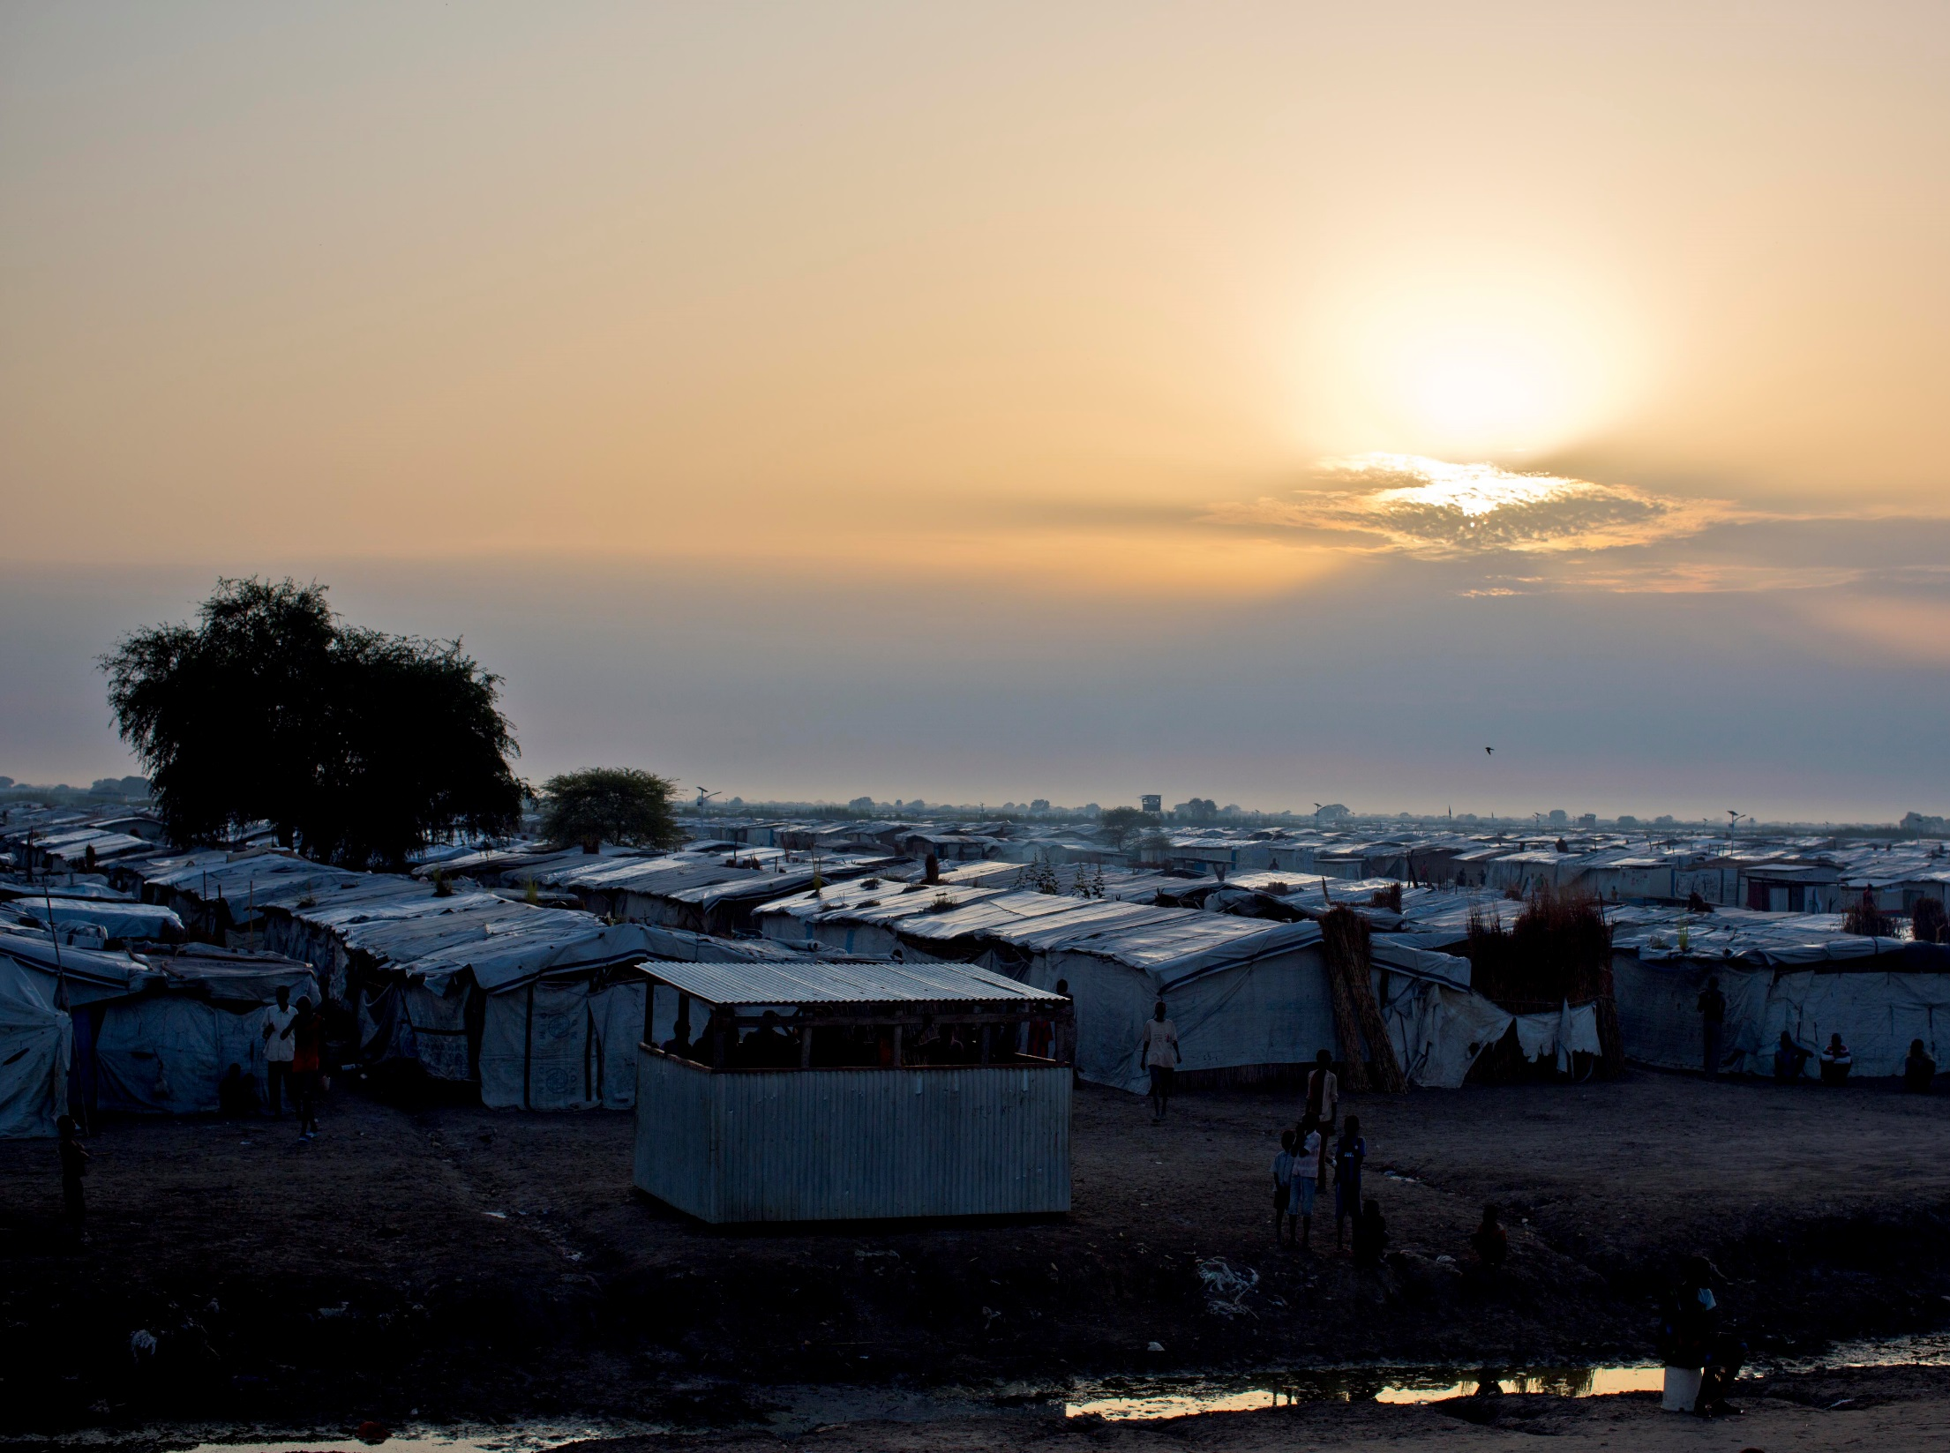
When rights are denied – recruitment by armed groups
The UN Global goals introduction
When rights are denied – A case study
© Unicef/Holt
Notes:
Image: The sun rises over the temporary plastic shelters in the UN Protection of Civilian Camp (POC) Bentiu, South Sudan Saturday, Oct. 22, 2016. Thousands of people have fled Leer in recent weeks as fighting intensifies between rebel and government soldiers and have headed for the Bentiu POC that is protected by UN soldiers.

Slide 2
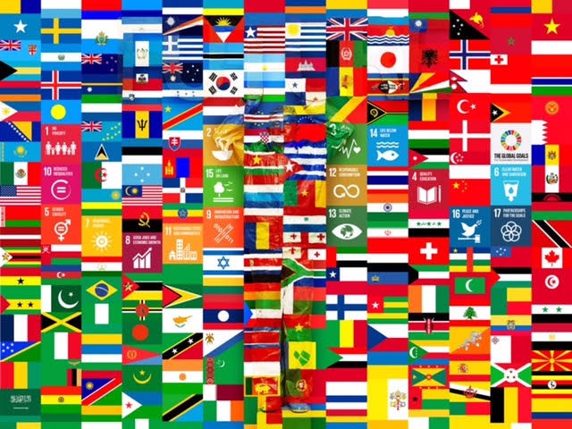
Rights and the year 2030
Notes:
Presentation: This could be used as a ‘starter’ activity asking students ‘What is the picture showing?’ The picture shows the flags of several countries but interspersed between the flags are examples of some of the United Nations' ‘Global Goals’. Key points to make are that for global problems to be solved, global action with everyone involved is needed and that achieving the goals will help children access their rights.

Slide 3
The UN GLOBAL goals
On September 25th 2015, countries adopted the United Nations Global Goals to end poverty, protect the planet, and ensure prosperity for all.
There are 17 goals and each goal has specific targets to be achieved over 15 years.
Achieving the goals will help children and young people around the world access their rights.
Notes:
Video: If the embedded video will not load please click here: https://www.youtube.com/watch?v=RTRdtrsL9jg
Presentation: Overview of the goals. The video clip with Professor Stephen Hawking introduces the goals and makes the key point of everyone sharing this information with others.

Slide 4
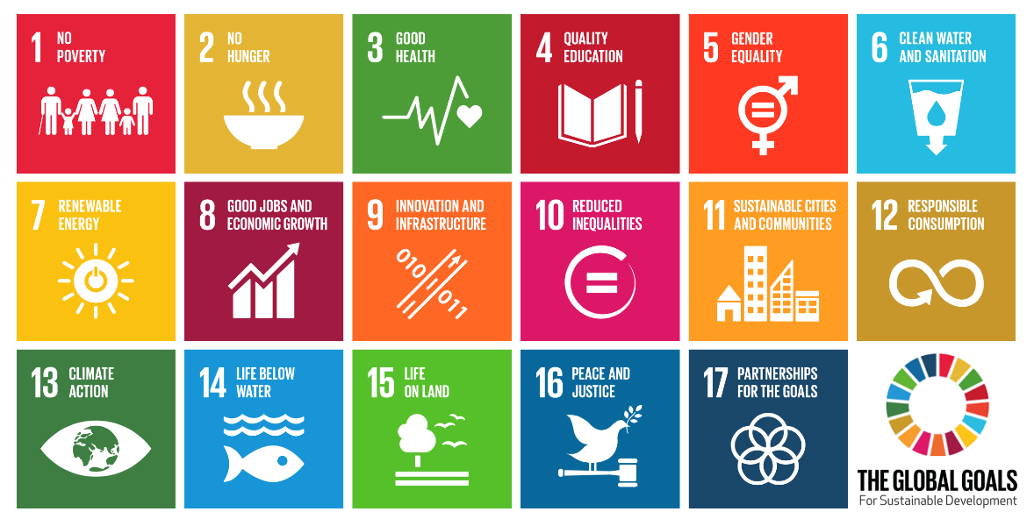
The 17 un global goals
Notes:
Video: If embedded video will not play then please click here: https://www.youtube.com/watch?v=RpqVmvMCmp0
Presentation: The 'We the People' video (approx. three minutes long) introduces the 17 UN Global Goals with the help of many celebrities from across the world. You may want to use this video as part of a separate exercise of matching celebrities with particular global goals.

Slide 5
Reflection
Which global goal is most important to you and why?
Notes:
Video: If the embedded video will not play then please click here: https://www.youtube.com/watch?v=roOkky4X0Us
Presentation: the video clip (approximately 1 minute from Unicef captures the thoughts of several children and young people as to why the global goals are important to them. Ask the students to consider which global goal is the most important to them and why. This could be extended by asking for a ‘show of hands’ or online vote/blog to see what they have chosen and provides an opportunity for audience participation. It is important to link achieving the global goals with the positive impact this would have on children’s rights.

