Slide 1
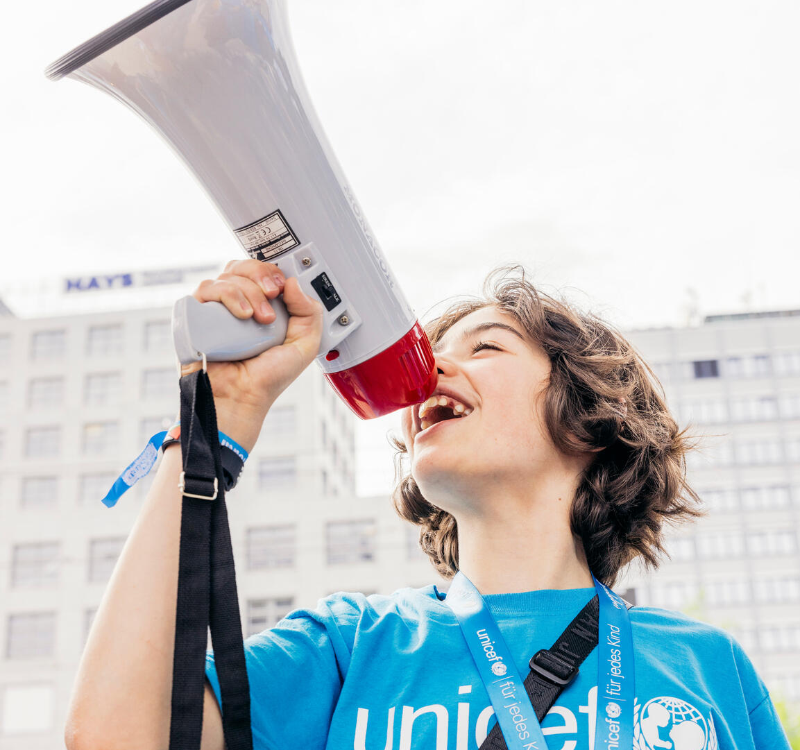
ACTIVITY 1
INTRODUCING CHILDREN’S RIGHTS AND THE CRC
© UNICEF/Al-Safadi
A young campaigner with a megaphone at the 'Stand up – speak up: Stand up for diversity and equal rights for every child' event in Mannheim, Germany.
© UNICEF/Stroisch

Slide 2
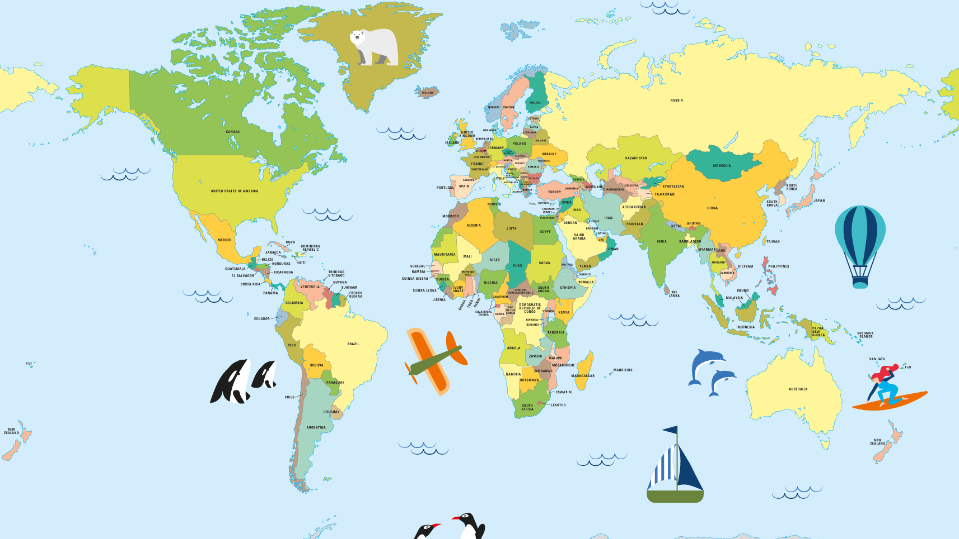
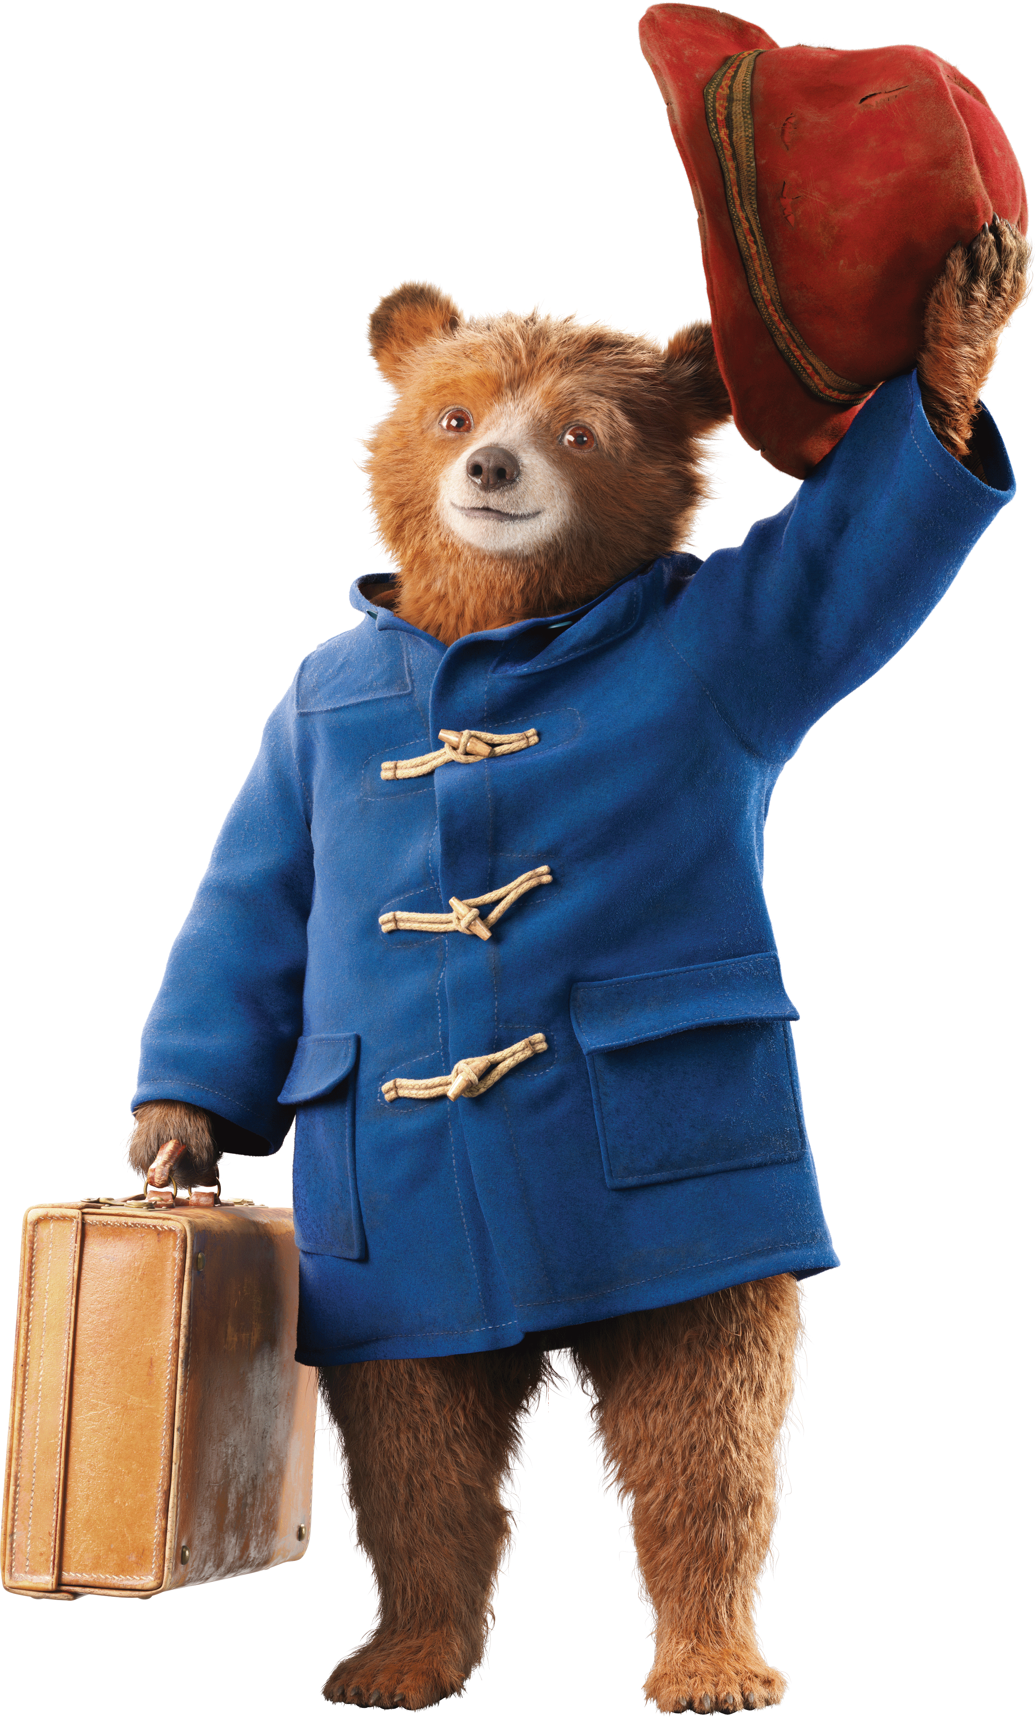
Come on a journey with me, learn about children’s rights and the CRC!
© P&Co. Ltd./SC 2024

Slide 3
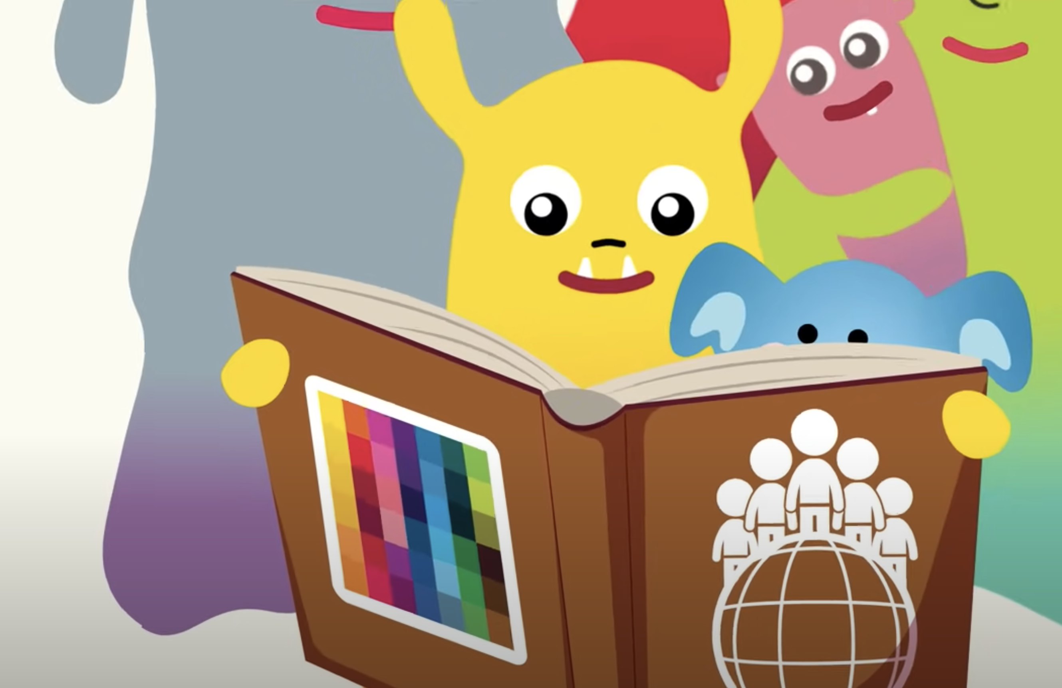
PART 1
WHAT ARE CHILDREN'S RIGHTS?
WHAT IS THE CRC?

Slide 4
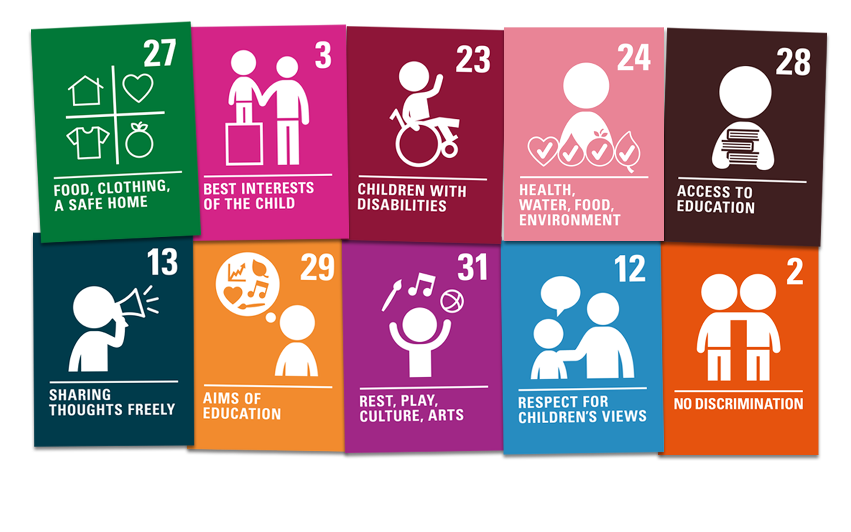
PART 2
MATCH THE RIGHTS

Slide 5
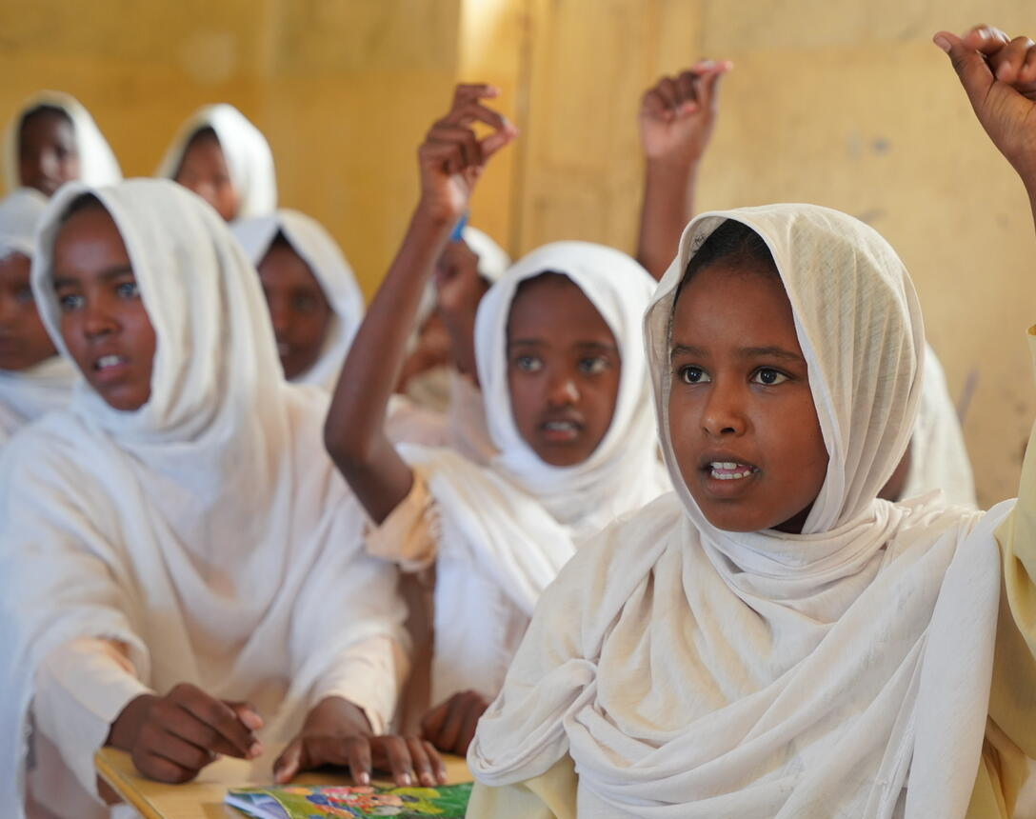
MATCH THE RIGHTS
A grade five lesson at Diam Elementary School for girls in Sudan, 2024.
© UNICEF/Awad

Slide 6
MATCH THE RIGHTS
EDUCATION
© UNICEF/Awad

Slide 7
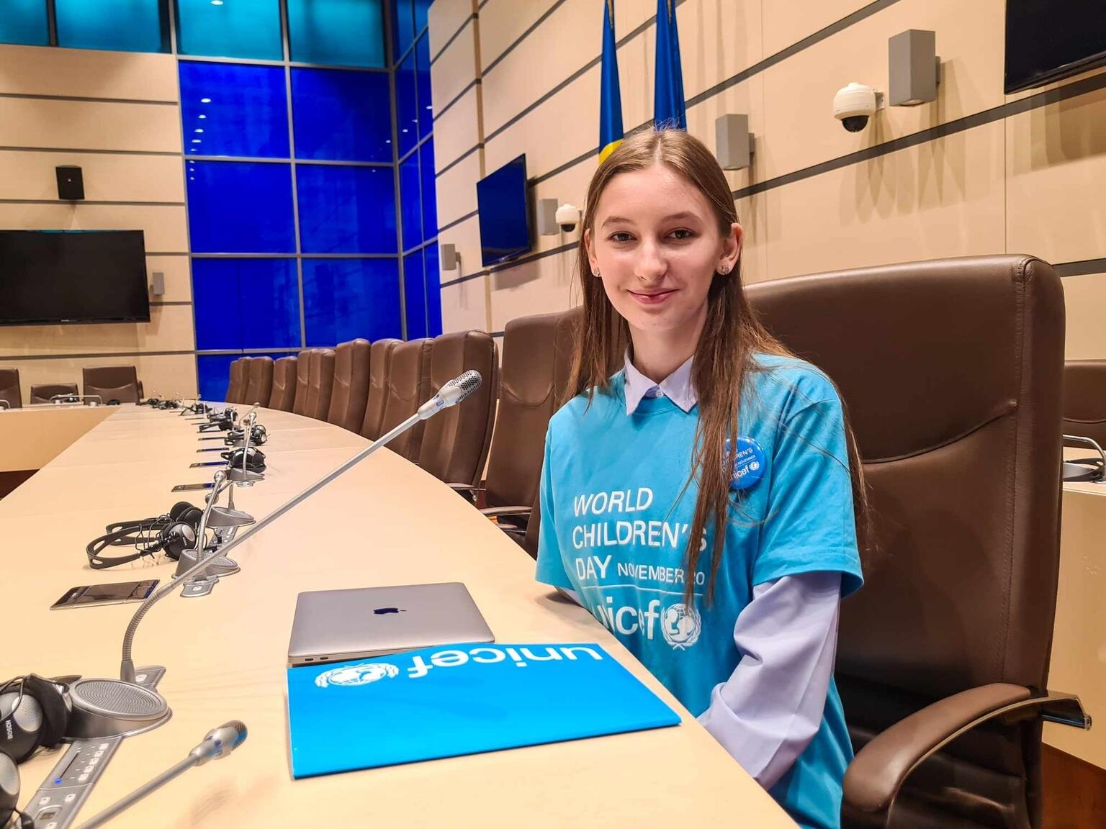
MATCH THE RIGHTS
Laura, from Chisinau, Moldova, poses for a photo after participating in a public consultation session in the country's Parliament.
© UNICEF/Sava

Slide 8
MATCH THE RIGHTS
VOICE
© UNICEF/Sava

Slide 9
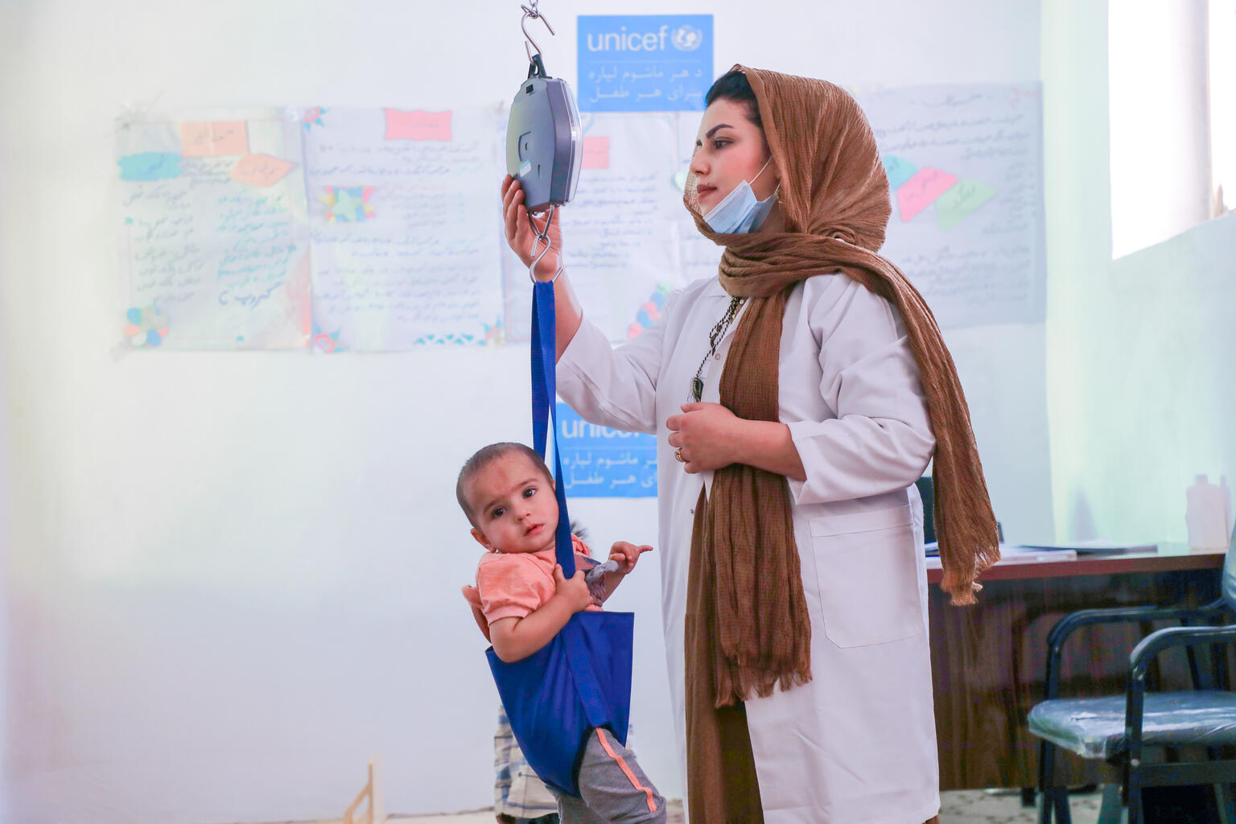
MATCH THE RIGHTS
A nutrition nurse takes care of new malnutrition patients and follows up with measurement, registration and treatment in Kabul, Afghanistan.
© UNICEF/Tanweer

Slide 10
MATCH THE RIGHTS
HEALTH
© UNICEF/Tanweer

Slide 11
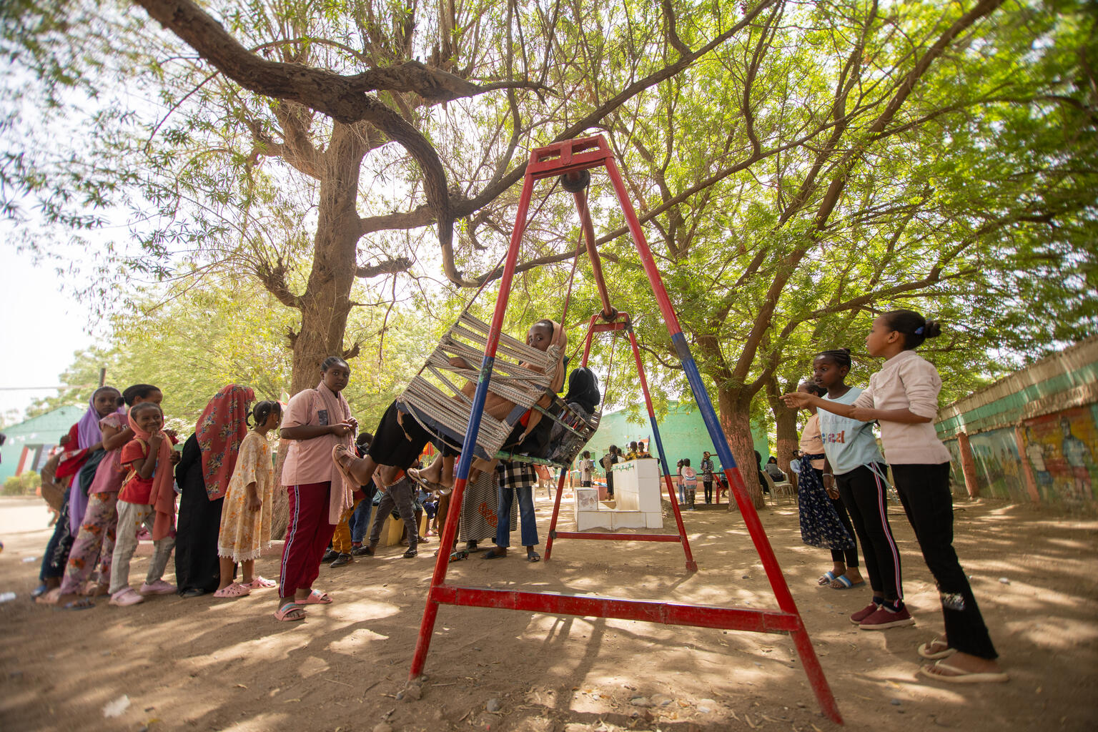
MATCH THE RIGHTS
Children play on a swing at Alshargia safe learning space, Kassala, Sudan.
© UNICEF/Elfatih

Slide 12
MATCH THE RIGHTS
PLAY
© UNICEF/Elfatih

Slide 13
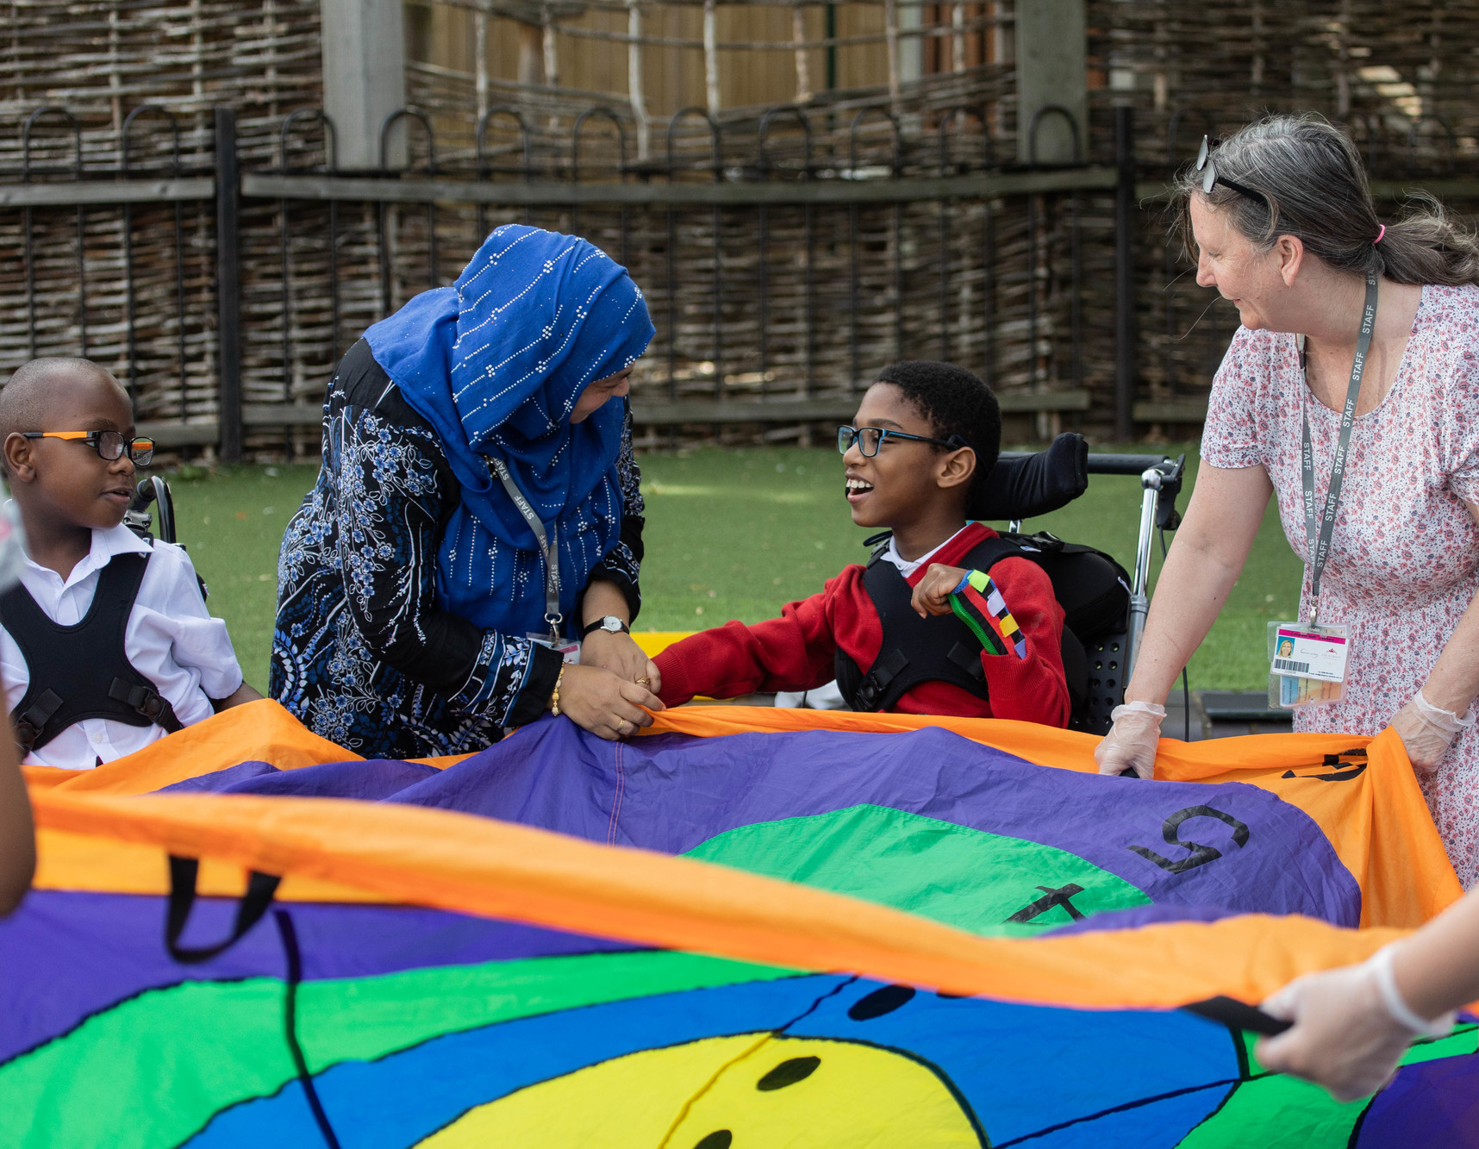
MATCH THE RIGHTS
Children engage in sensory play at a UNICEF Rights Respecting primary school in Stratford, UK.
© UNICEF/Flynn

Slide 14
MATCH THE RIGHTS
INCLUSION
© UNICEF/Flynn

Slide 15
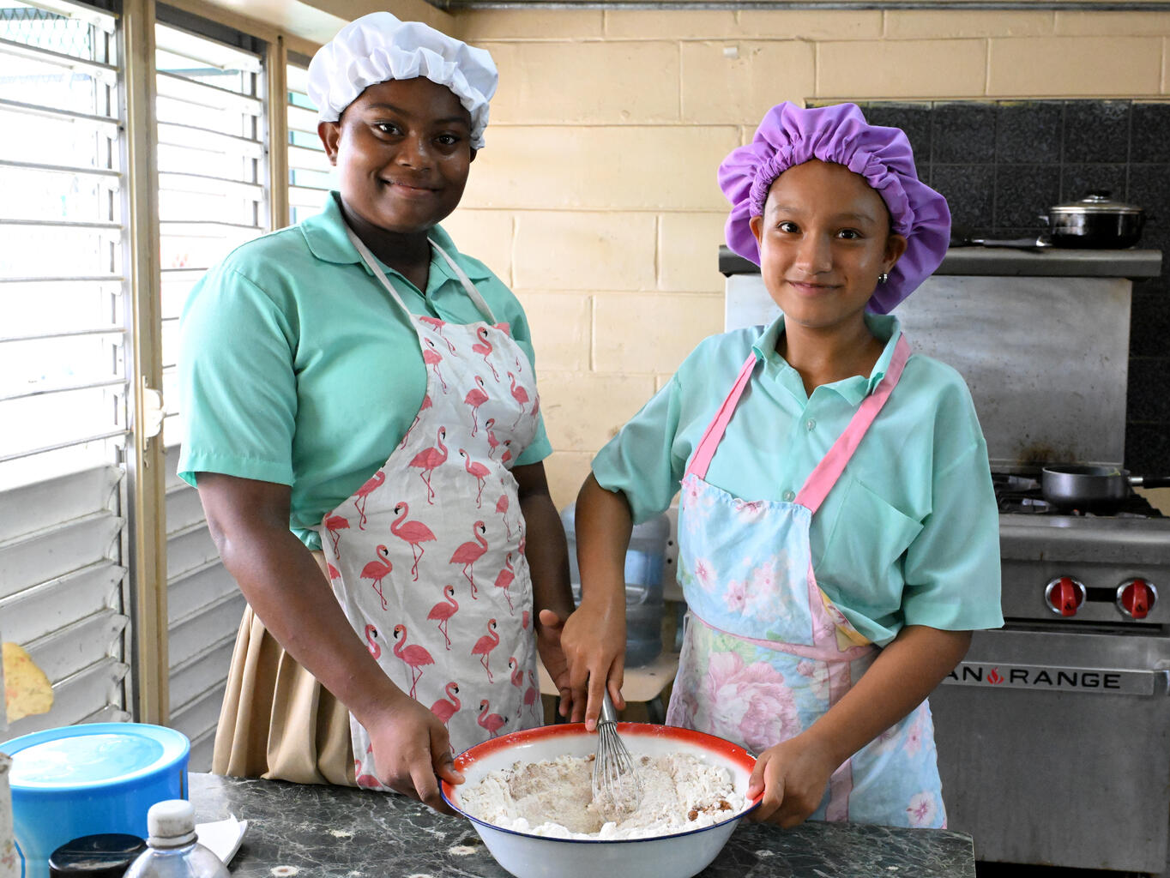
MATCH THE RIGHTS
Jade and Isabella, who are both deaf, cook at the Stella Maris primary school in Belize.
© UNICEF/Dejongh

Slide 16
MATCH THE RIGHTS
FOOD, CLOTHING, SAFE ENVIRONMENT
© UNICEF/Dejongh
Notes:
(This could also relate, again, to Article 23: children with disabilities)

Slide 17
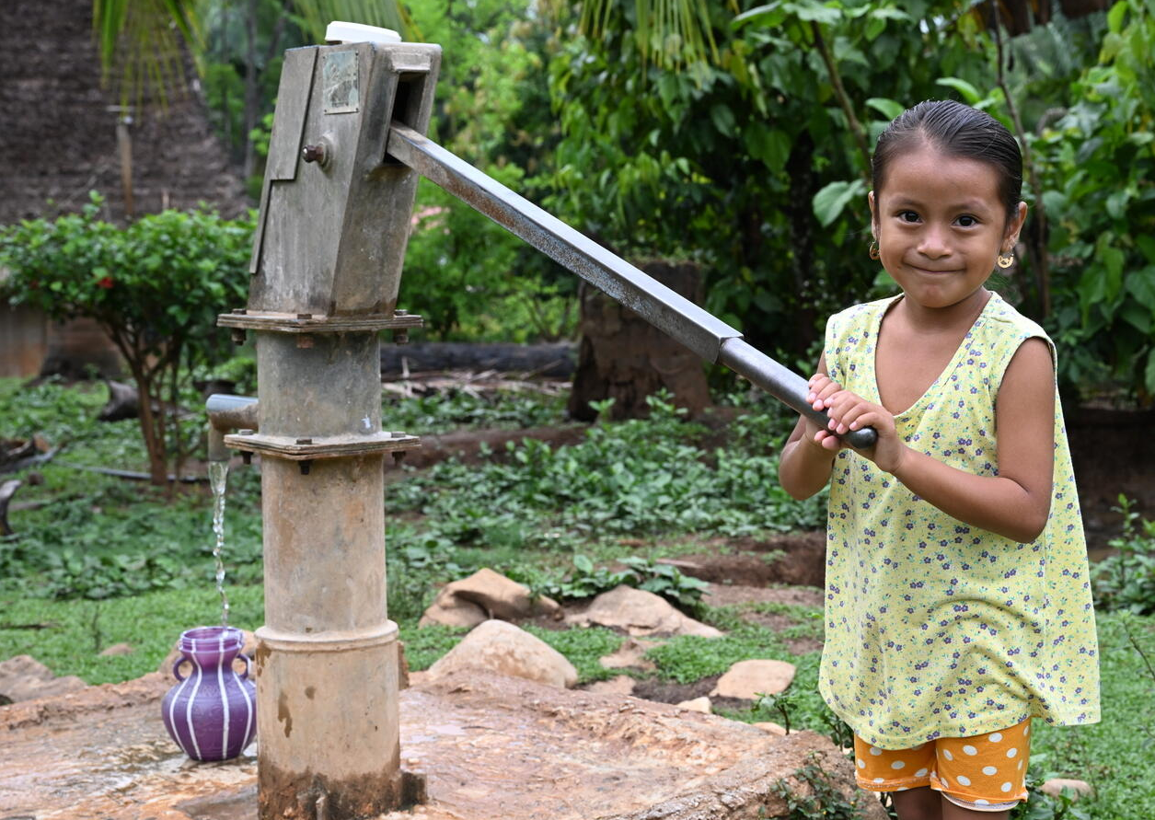
MATCH THE RIGHTS
Oneida, five, gathers water in her village in Belize.
© UNICEF/Dejongh

Slide 18
MATCH THE RIGHTS
WATER
© UNICEF/Dejongh

Slide 19
PART 3
EXPLORING SOME KEY ARTICLES

Slide 20
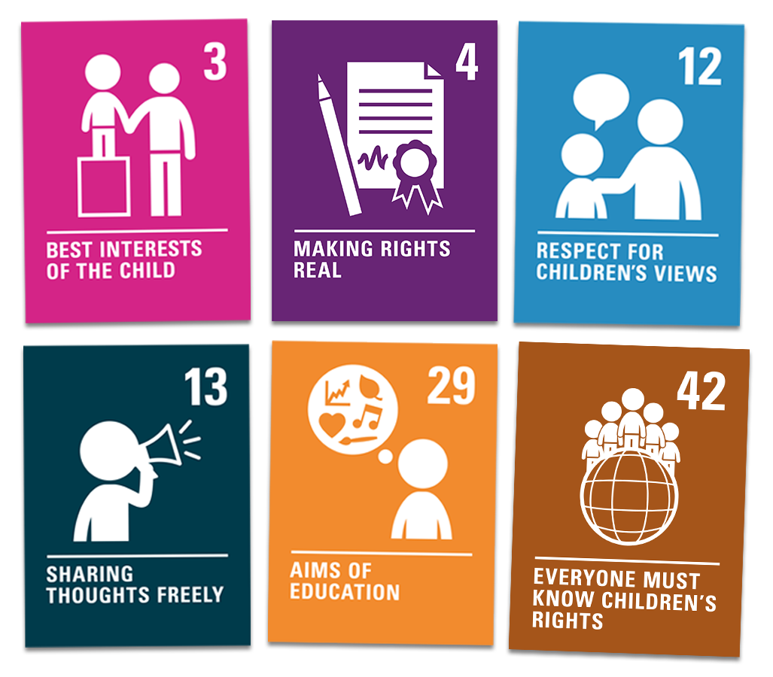
KEY ARTICLES
What does this right mean to you?
Why is it important for every child around the world to enjoy this right?
What could a world where every child can fulfil this right look like?

Slide 21
PART 4
WRAP UP
What new thing have you learned about children’s rights that you didn’t know before?

Slide 22
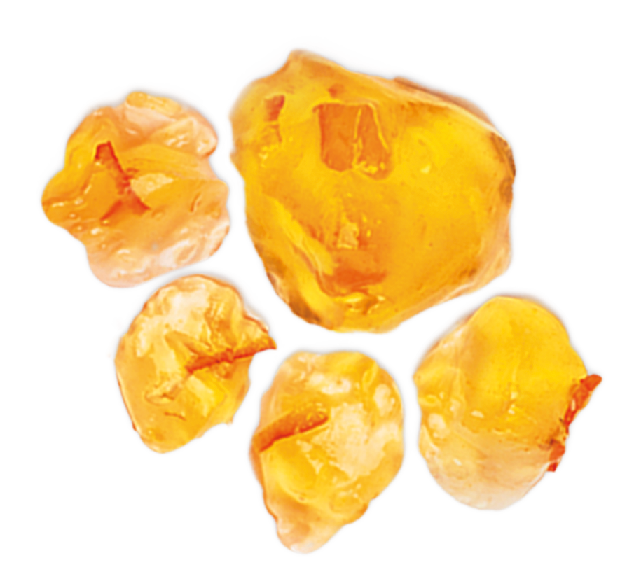
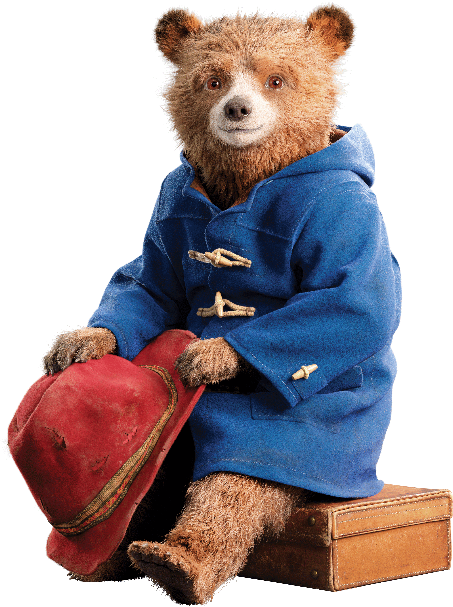
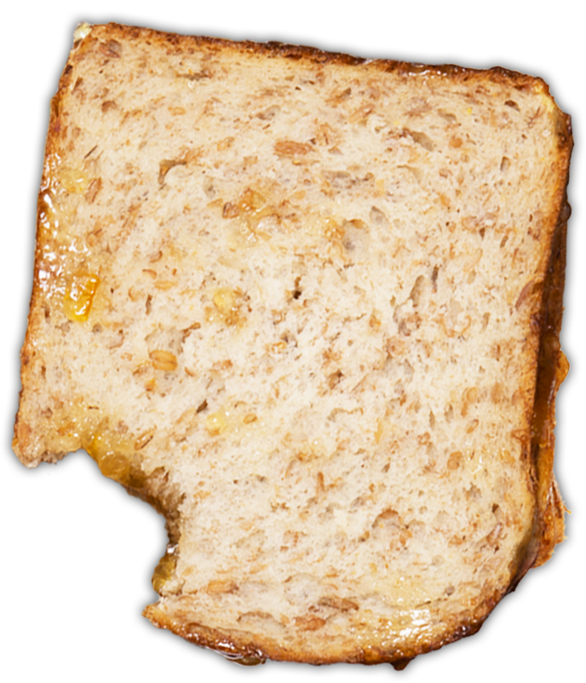
© P&Co. Ltd./SC 2024
ADD-ON ACTIVITY 1
Create a Paddington-themed ‘my rights’ suitcase to pack over the course of your OutRight journey

