Slide 1
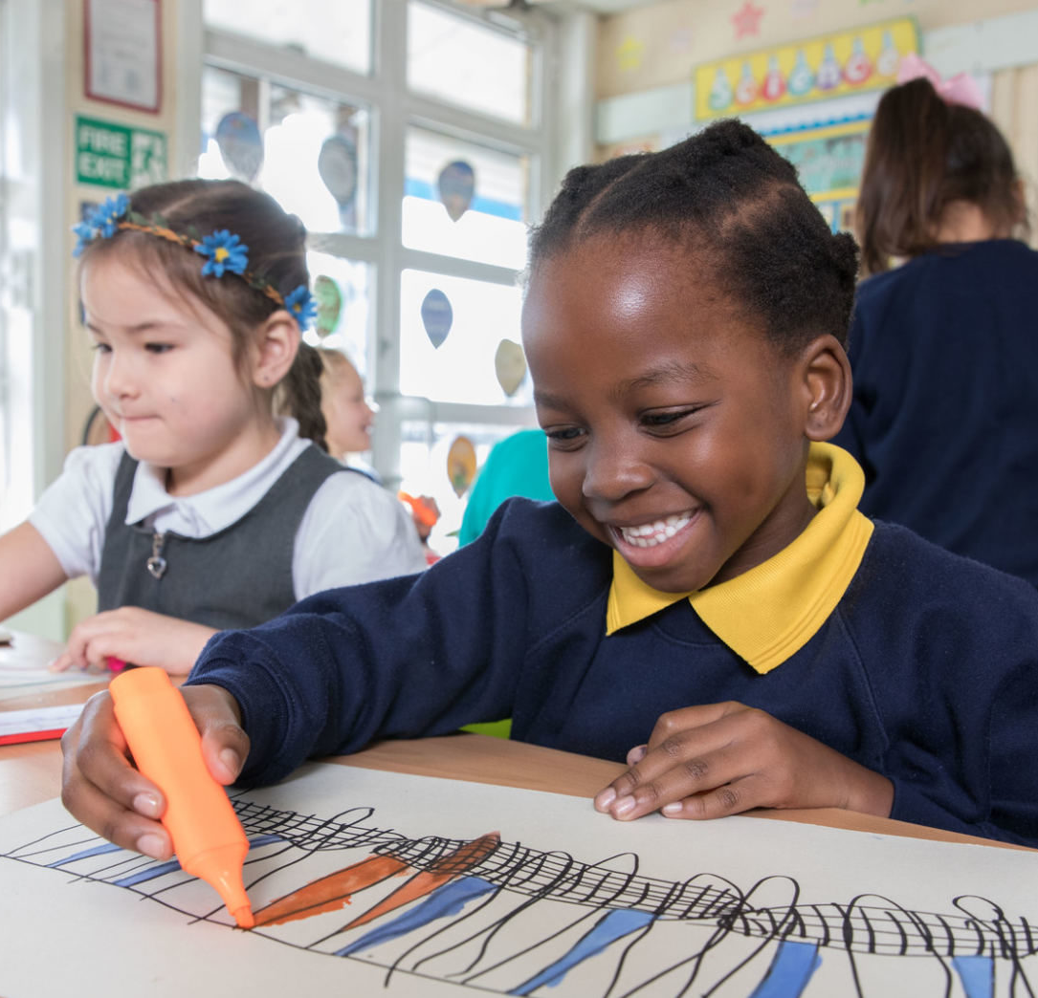
ACTIVITY 2 HOW IS THE UK PROTECTING CHILDREN’S RIGHTS?
© UNICEF/Al-Safadi
© UNICEF/Dawe
Students at a Gold Rights Respecting School in London.

Slide 2
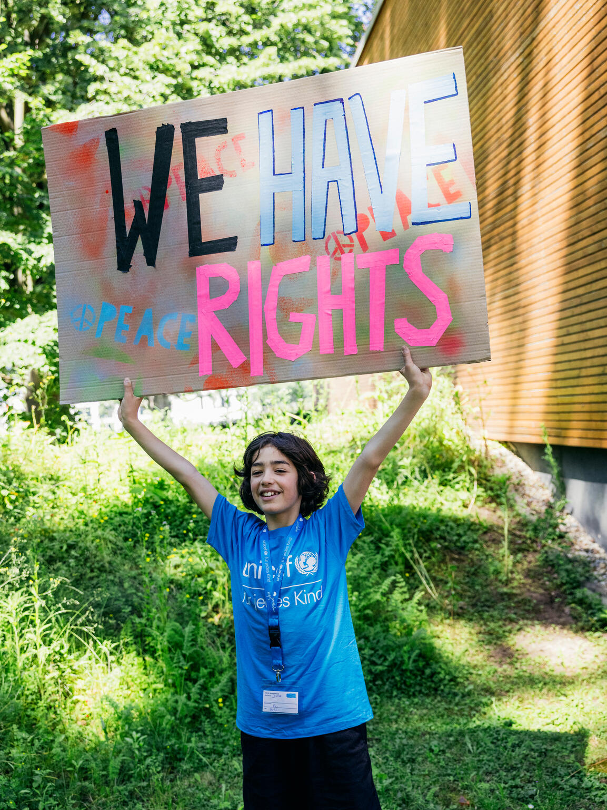
PART 1
REVIEWING YOUR RIGHTS WARM-UP
© UNICEF/Stroisch
A young campaigner at the 2024 Youth Festival, Mannheim, Germany.

Slide 3
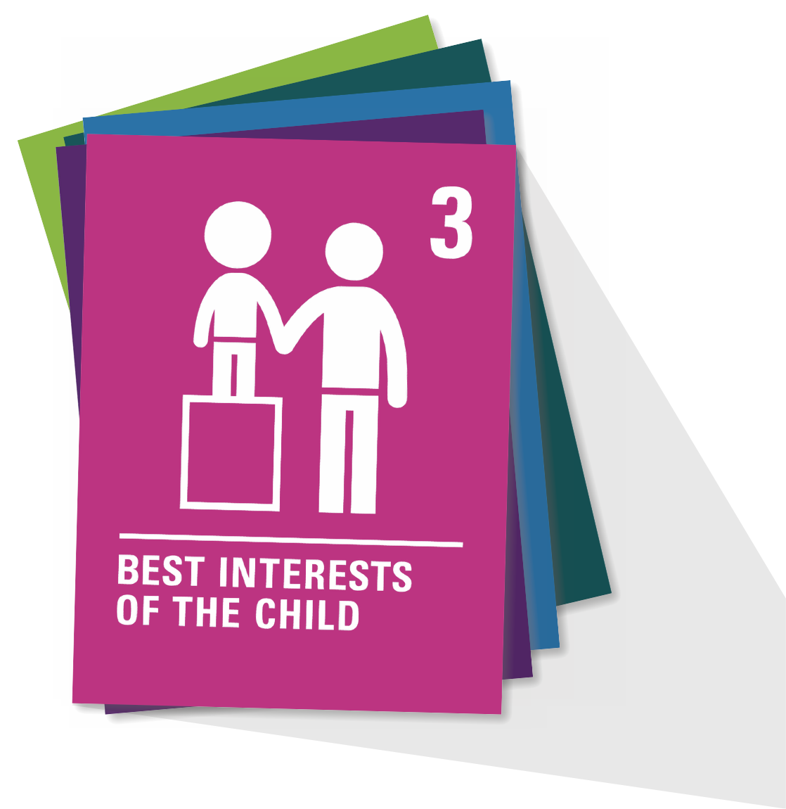
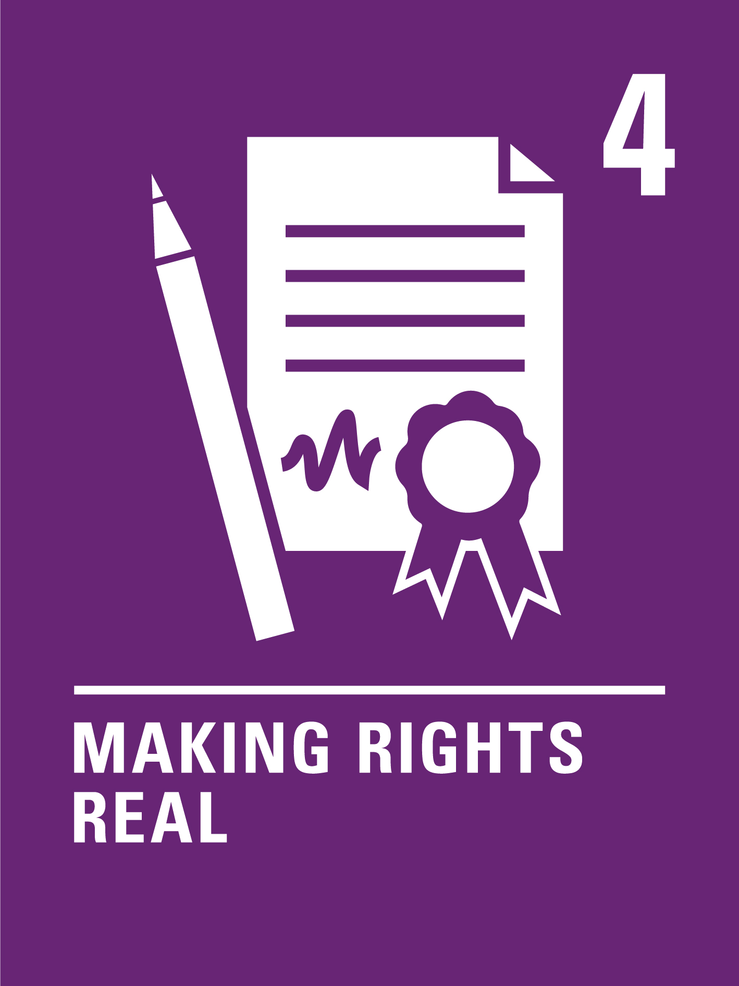
ARTICLE 4
Implementation of the CRC
Governments must do all they can to make sure every child can enjoy their rights by creating systems and passing laws that promote and protect children’s rights.

Slide 4
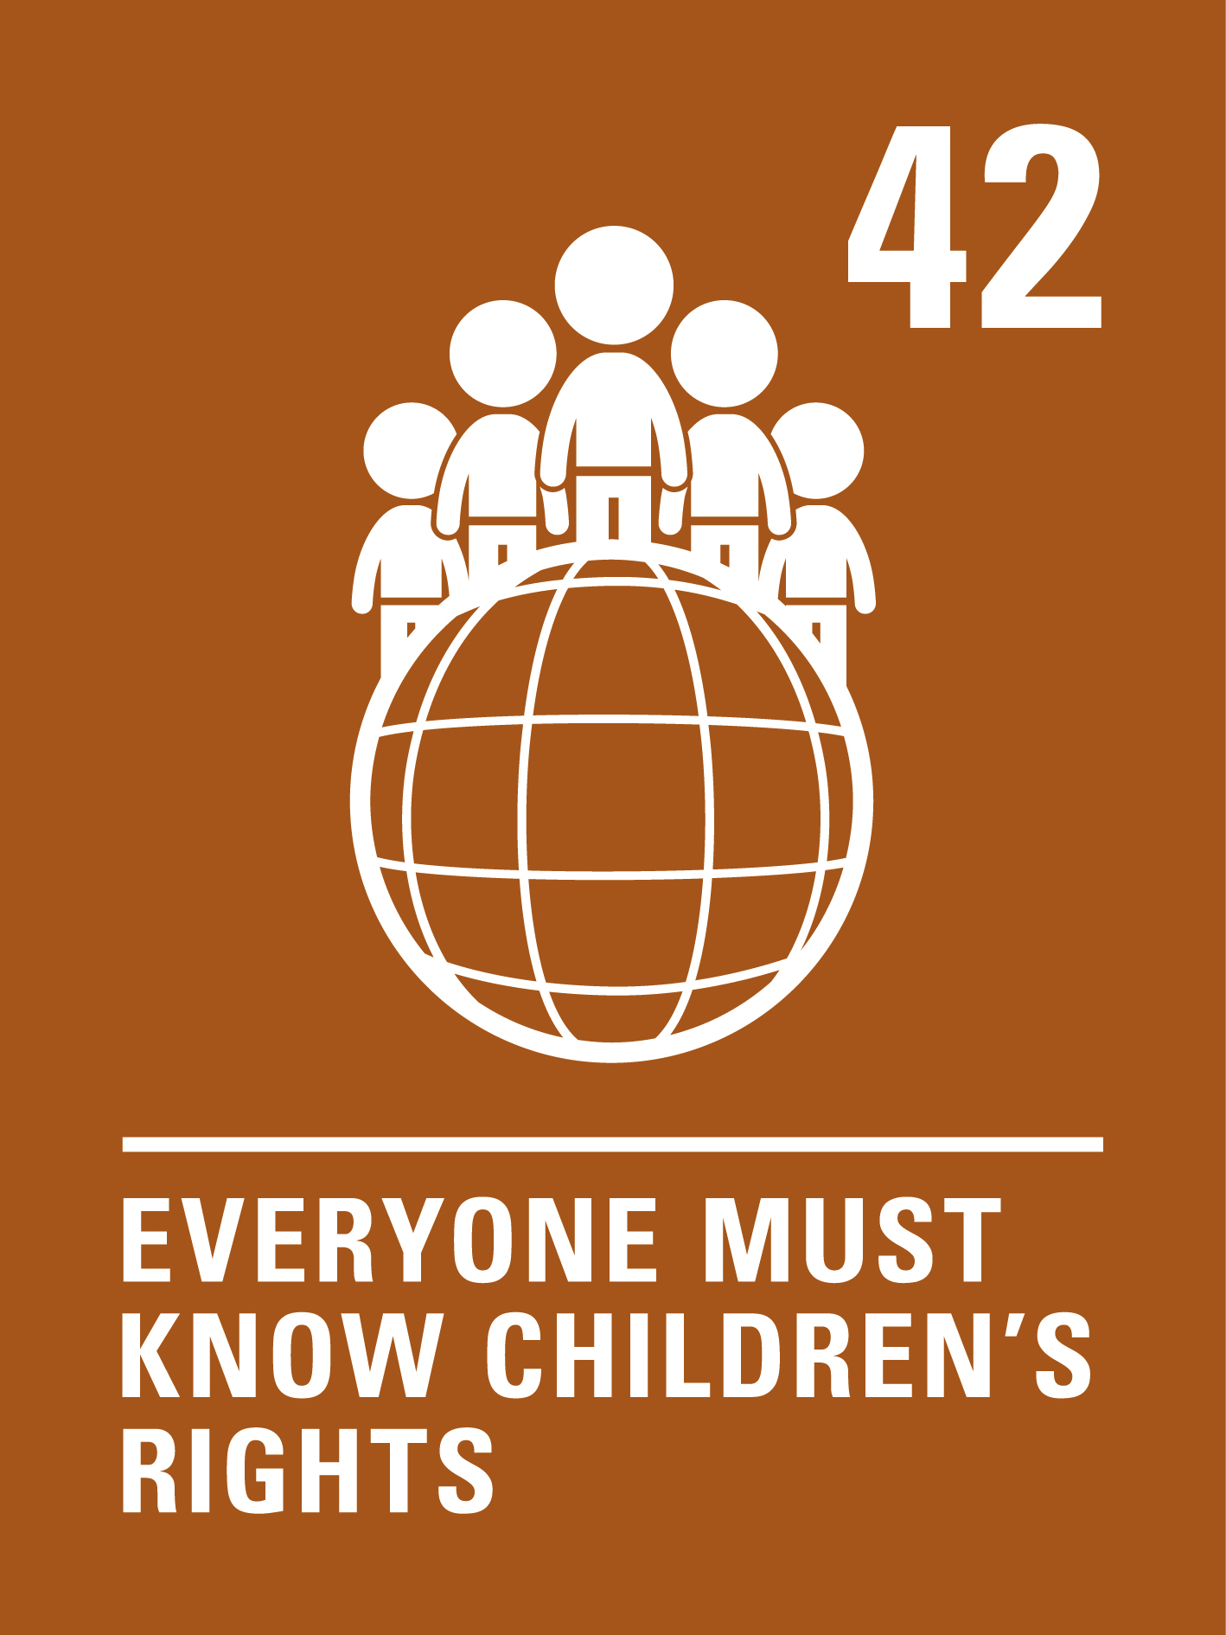
ARTICLE 42
Knowledge of rights
Governments must actively work to make sure children and adults know about the CRC.

Slide 5
PART 2
UP OR DOWN!

Slide 6
UP OR DOWN!
The health service has a scheme to make sure all children get the immunisations they need to stay healthy.

Slide 7
UP!
The health service has a scheme to make sure all children get the immunisations they need to stay healthy.

Slide 8
UP OR DOWN!
Children in some regions aren't able to go to school.

Slide 9
Children in some regions aren't able to go to school.
Down

Slide 10
UP OR DOWN!
Pollution is hurting children’s health...
...but the government is making changes to create clean air laws.

Slide 11
Pollution is hurting children’s health...
DOWN

Slide 12
UP!
...but the government is making changes to create clean air laws.

Slide 13
UP OR DOWN!
The government offers mental health care to children to keep children well...
...but services aren’t always available soon enough for everyone who needs them.

Slide 14
UP!
The government offers mental health care to children to keep children well...

Slide 15
...but services aren’t always available soon enough for everyone who needs them.
DOWN

Slide 16
UP OR DOWN!
My community has many parks and green places for children to play.

Slide 17
UP!
My community has many parks and green places for children to play.

Slide 18
UP OR DOWN!
Children are getting sick because the water in one community is polluted and not safe to drink.

Slide 19
Children are getting sick because the water in one community is polluted and not safe to drink.
DOWN

Slide 20
Up or down?
Children are sharing their opinion by participating in a children’s parliament.

Slide 21
UP!
Children are sharing their opinion by participating in a children’s parliament.

Slide 22
UP OR DOWN!
MPs and local councillors ask for children’s opinions when making decisions that relate to them.

Slide 23
UP!
MPs and local councillors ask for children’s opinions when making decisions that relate to them.

Slide 24
UP OR DOWN!
The government is making decisions to protect the environment, so children have a better future...
...but costs and competing priorities mean the environment isn’t always put first.

Slide 25
UP!
The government is making decisions to protect the environment, so children have a better future...

Slide 26
...but costs and competing priorities mean the environment isn’t always put first.
DOWN

Slide 27
UP OR DOWN!
Can you think of any examples from your local community...?

Slide 28
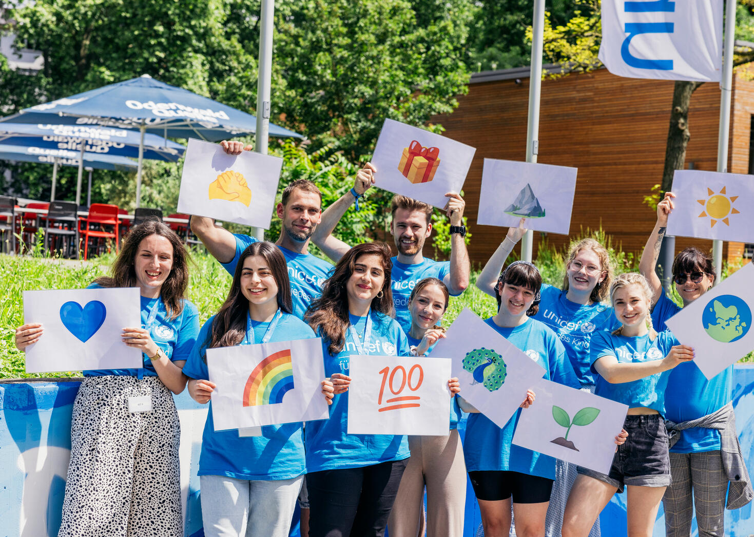
PART 3
CREATE YOUR OWN RIGHTS REPORT
Young people from all over Germany meet in Mannheim for the third UNICEF Youth Festival.

Slide 29
In your experience...
Are rights respected in my country?
Ask each other
Ask an adult

Slide 30
How do you think respect for children’s rights has changed since your interviewees were children?

Slide 31
Did anything surprise you in your discussions with people who were children before there was a CRC?

Slide 32
Did you find out about any times when children did not have their rights respected?

Slide 33
If you interviewed people who grew up outside the UK, what did you learn about differences for children between countries (in the past and now)?

Slide 34
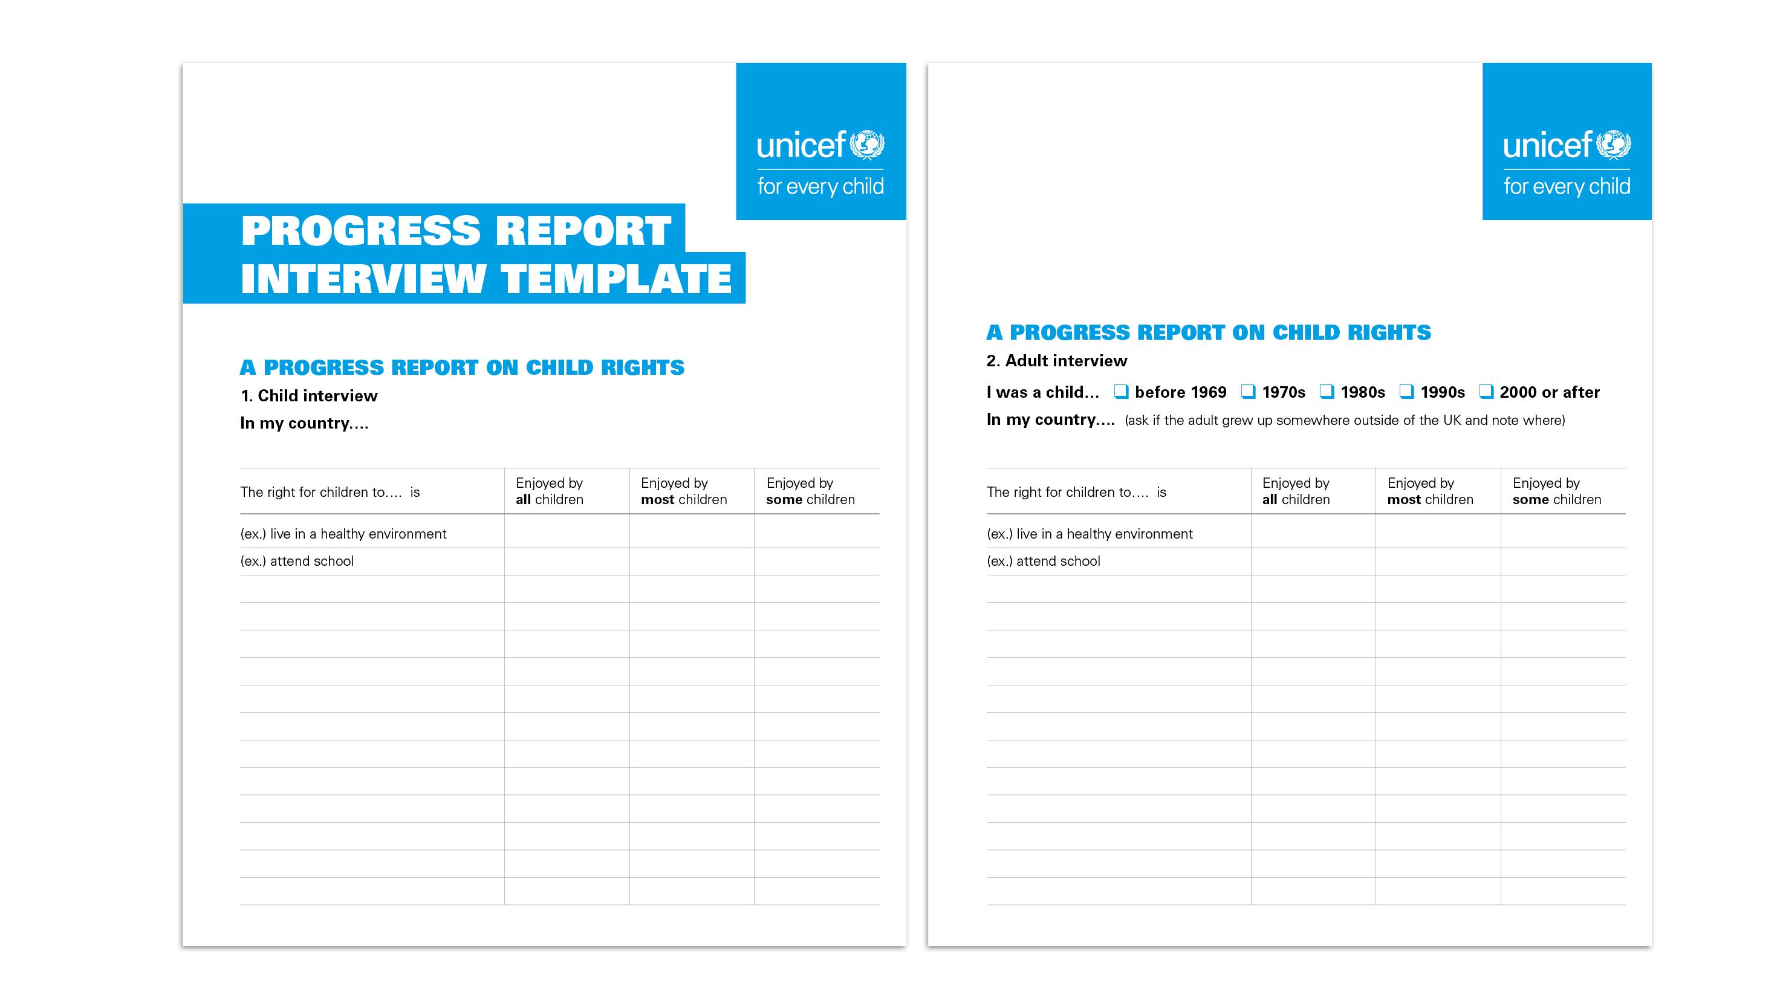
A PROGRESS REPORT ON CHILD RIGHTS

