Slide 1
ACTIVITY 1
INTRODUCING CHILDREN’S RIGHTS AND THE CRC
© UNICEF/Al-Safadi
A young campaigner with a megaphone at the 'Stand up – speak up: Stand up for diversity and equal rights for every child' event in Mannheim, Germany.
© UNICEF/Stroisch

Slide 2
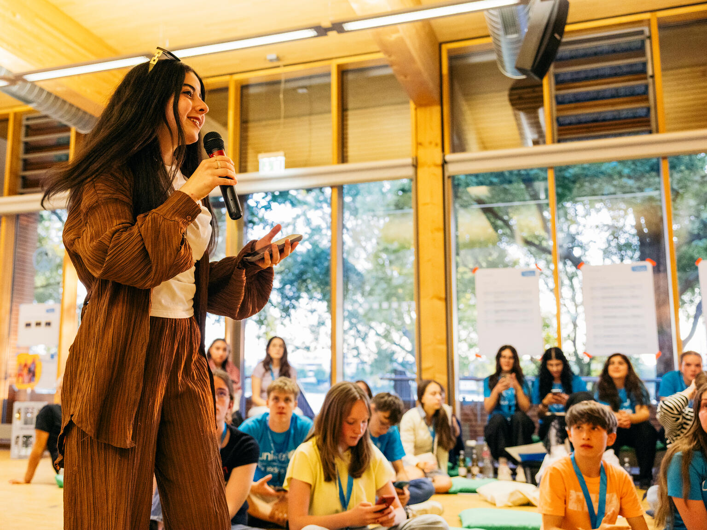
PART 1
WHAT ARE CHILDREN'S RIGHTS?
WHAT IS THE CRC?
© UNICEF/Stroisch
Jannat, 15, during her speech for her candidacy for the Youth Advisory Board, in Mannheim, Germany.

Slide 3
PART 1
WHERE DID THE CRC COME FROM?

Slide 4
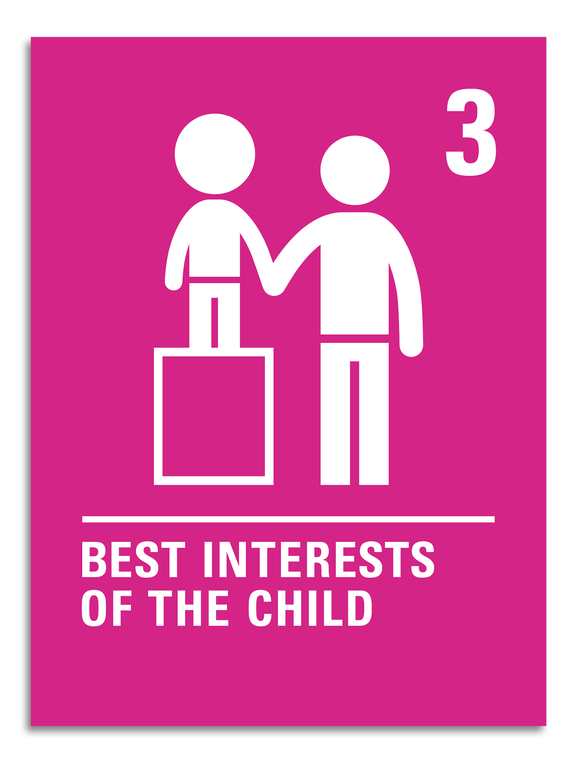
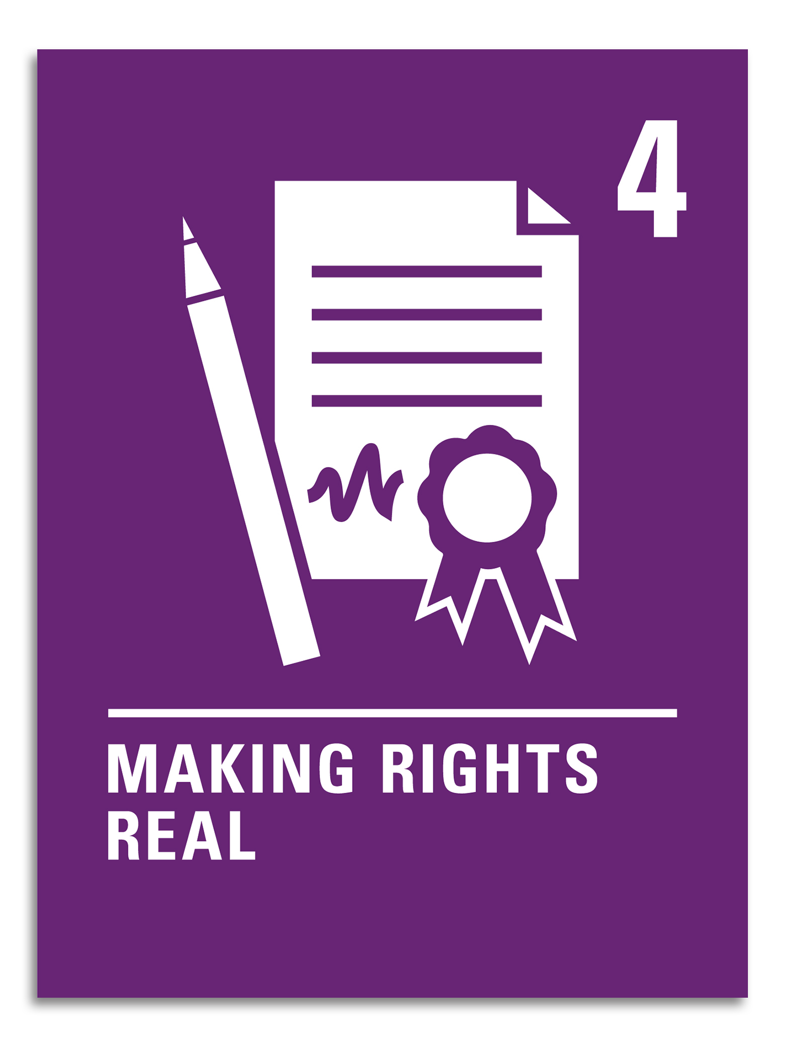
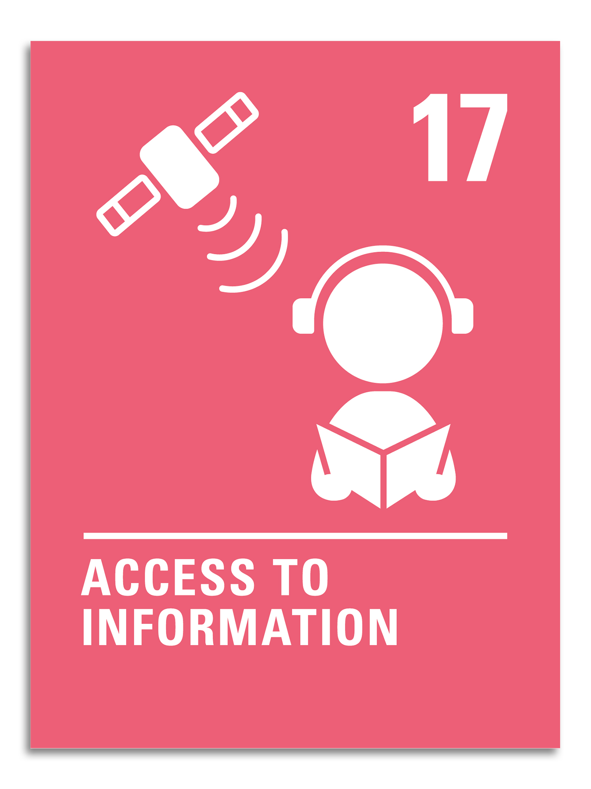
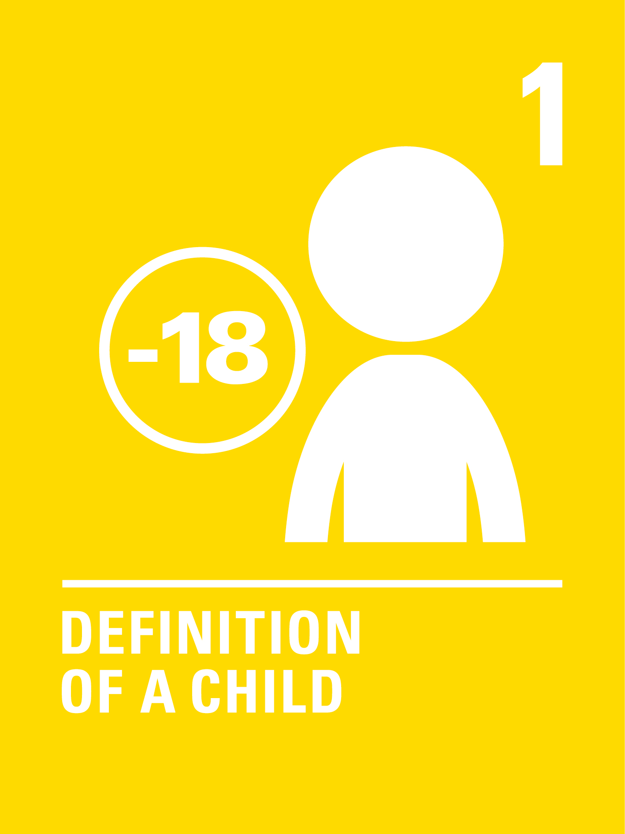
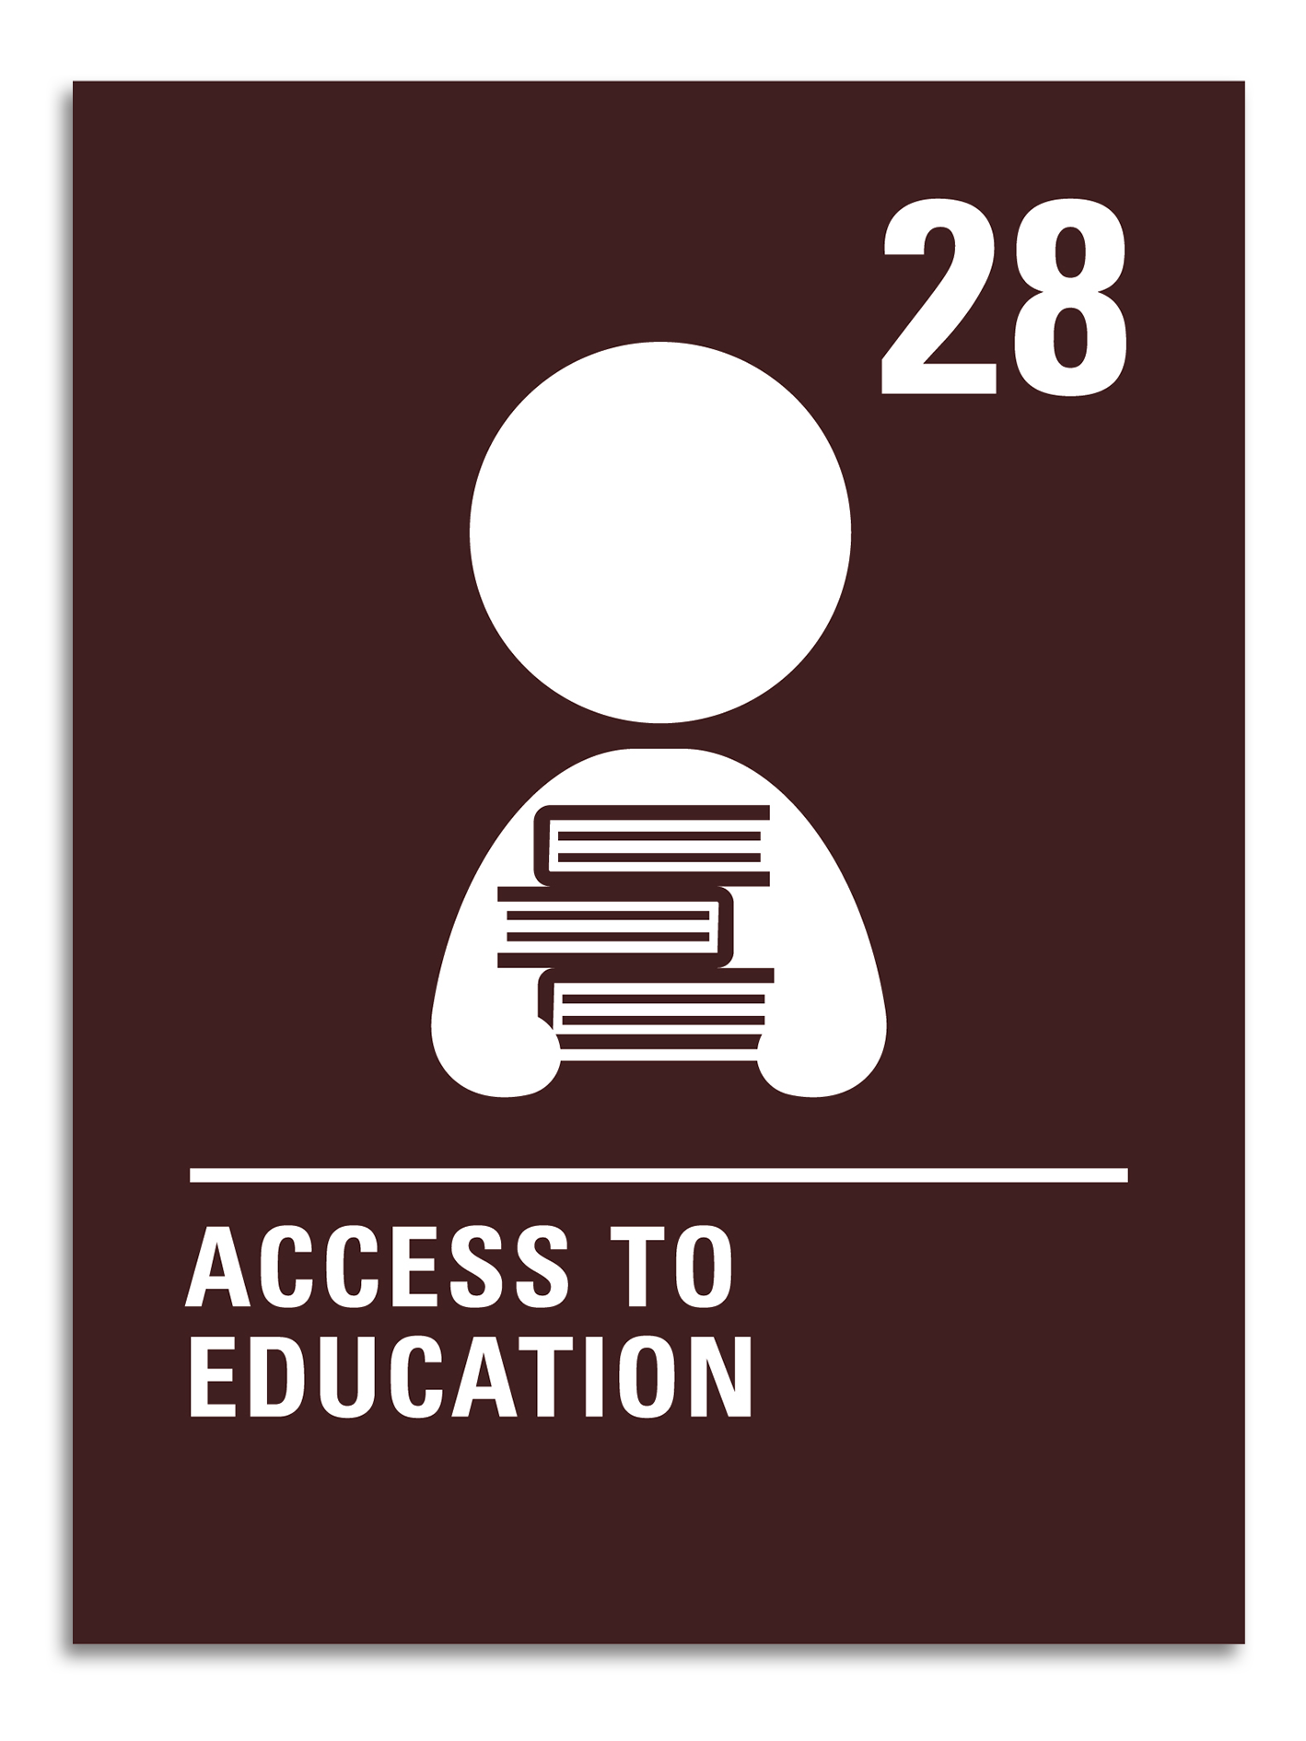
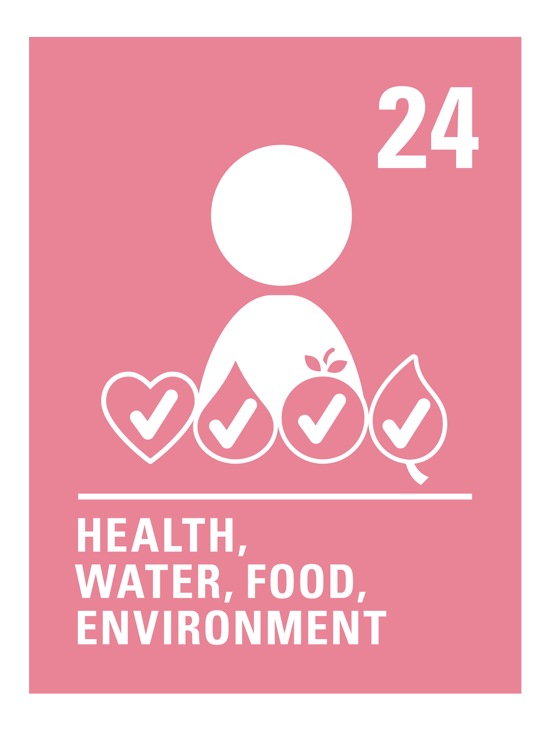
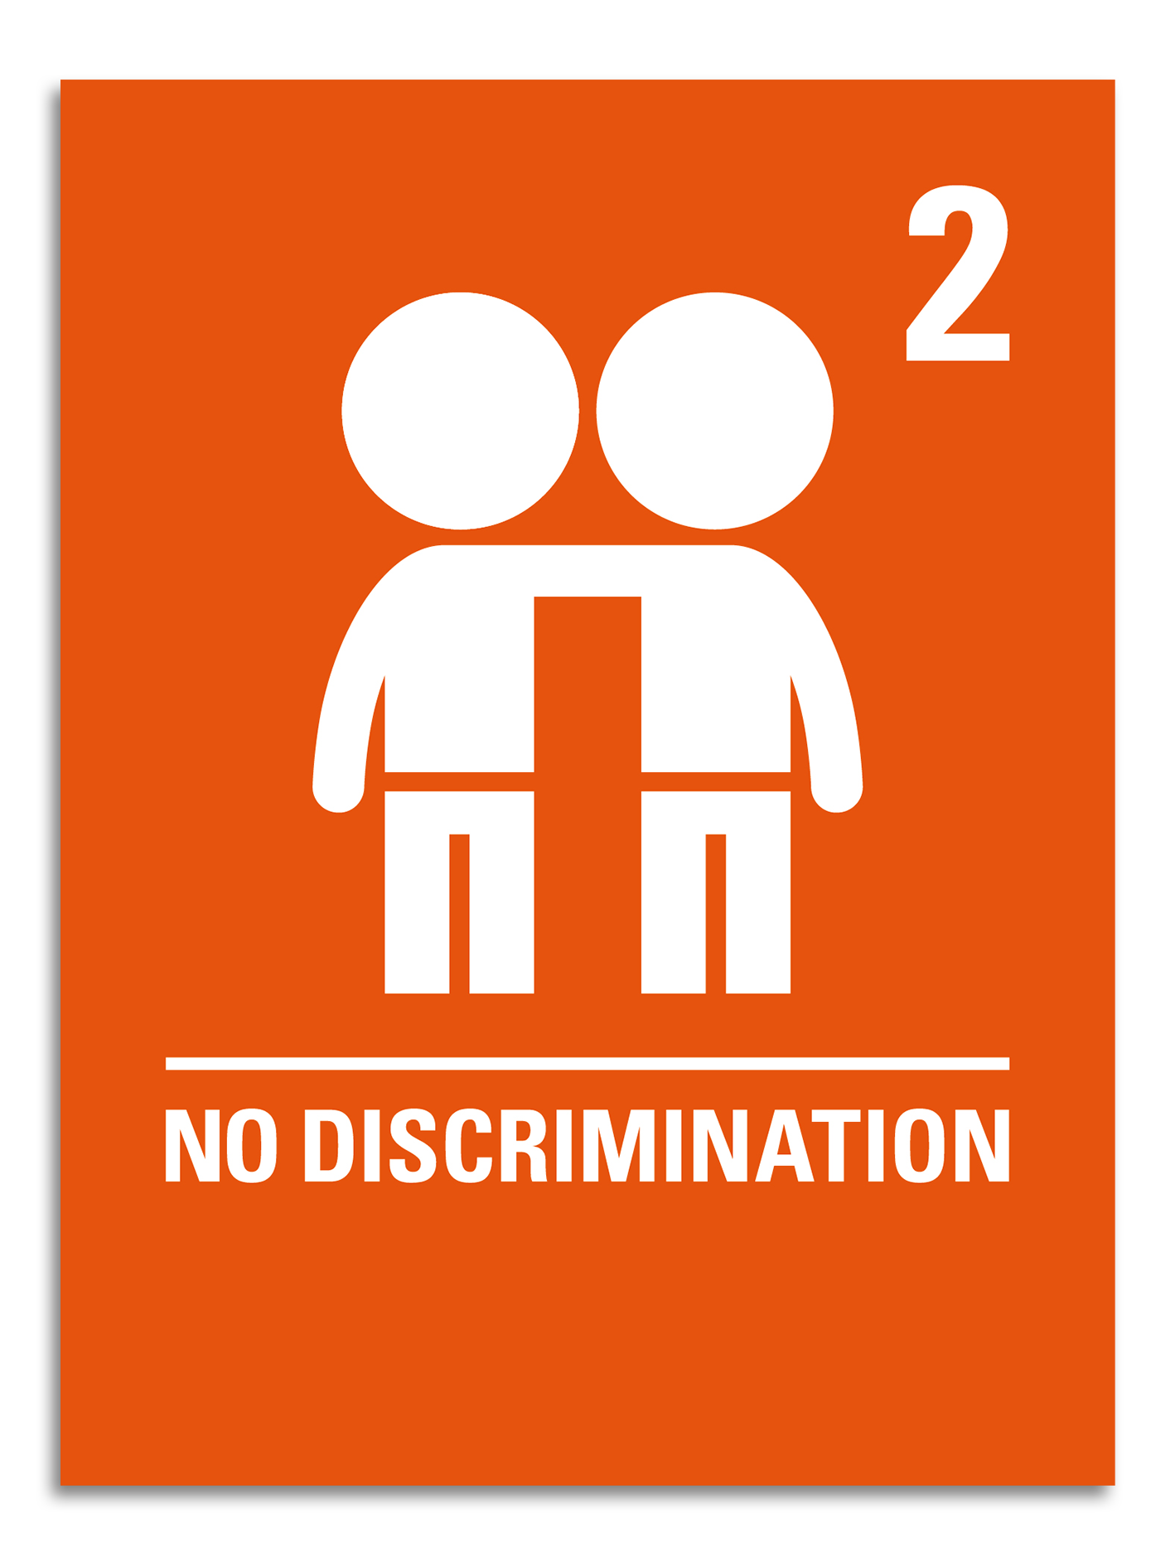
PART 2
WHICH IS RIGHT?
QUIZ

Slide 5
WHICH IS RIGHT? Q1
A
B
The UN recognises any young person below the age of 18 as a child under the CRC.
Children under 12 have different rights to those aged 13–17.

Slide 6
WHICH IS RIGHT? Q1
A
The CRC considers anyone below the age of 18 a child. Article 1 defines a child, and everyone under the age of 18 has all the rights listed in the CRC.
The UN recognises any young person below the age of 18 as a child under the CRC.

Slide 7
WHICH IS RIGHT? Q2
A
B
Children’s rights in the Convention are linked with responsibilities and can be taken away if a responsibility has not been met.
Children’s rights, like all human rights, are unconditional.

Slide 8
WHICH IS RIGHT? Q2
B
Rights are not linked to responsibilities. Children’s rights, like all human rights, are unconditional. This means there are no conditions attached to rights. Rights can never be a reward for the fulfilment of a responsibility, and they can never be taken away because a responsibility hasn’t been met.
Children’s rights, like all human rights, are unconditional.

Slide 9
WHICH IS RIGHT? Q3
A
B
The government must listen to children and young people and take their opinions seriously even if they’re not old enough to vote.
Governments must only consider the opinions of children if the opinion is shared and expressed by their parents, who are old enough to vote.

Slide 10
WHICH IS RIGHT? Q3
A
The CRC protects children’s freedom of expression. According to Article 13, every child must be free to express their views, feelings and wishes in all matters affecting them and to have their views considered and taken seriously, as long as it’s within the law.
The government must listen to children and young people and take their opinions seriously even if they’re not old enough to vote.

Slide 11
WHICH IS RIGHT? Q4
A
B
The rights that each child has are determined by the government where they live. These rights can change as governments shift.
Children’s rights, as stated in the CRC, are universal. They apply to everyone and do not change.

Slide 12
WHICH IS RIGHT? Q4
B
Children lives may look different in every country, but children’s rights, as outlined in the Convention, apply to all children no matter where they live.
Children’s rights, as stated in the CRC, are universal. They apply to everyone and do not change.

Slide 13
WHICH IS RIGHT? Q5
A
B
The UK has signed the Convention on the Rights of the Child, that makes the articles part of UK law.
The CRC is not part of UK law, but signing the convention implies the UK government must follow it.

Slide 14
WHICH IS RIGHT? Q5
B
The UK agreed to follow the Convention in 1991, but that doesn’t make the Convention part of UK law. When the Convention was ratified, it became international law, which implies that the UK government must follow it. The UK government must report to the UN on the status of children’s rights in the country every five years, and according to Article 4, it is the job of the government to create systems and pass laws that promote and protect children’s rights.
The CRC is not part of UK law, but signing the convention implies the UK government must follow it.

Slide 15
WHICH IS RIGHT? Q6
A
B
If a government is not protecting the rights of children, children can express their opinion to the government.
If a government is not protecting the rights of children, then children are entitled to break any laws that do not protect them.

Slide 16
WHICH IS RIGHT? Q6
A
Article 13 tells us that children are free to express their thoughts and opinions and to access all kinds of information, as long as it’s within the law. Children and adults can express their opinions to try to change laws so that children can better enjoy their rights.
If a government is not protecting the rights of children, children can express their opinion to the government.

Slide 17
WHICH IS RIGHT? Q7
A
B
It’s the responsibility of the governments in countries with more money and power to help and consider other countries, to make sure children everywhere are enjoying their rights.
Every country is responsible only for making laws in the interest of their own children.

Slide 18
WHICH IS RIGHT? Q7
A
Children’s rights are universal. This means they are for all children, everywhere, and governments in all countries must make sure the laws they pass and the actions they take internationally do not harm children or keep them from enjoying their rights. The CRC also specifically calls on richer countries to help children in poorer countries enjoy their rights in Articles 24 and 28.
It’s the responsibility of the governments in countries with more money and power to help and consider other countries, to make sure children everywhere are enjoying their rights.

Slide 19
WHICH IS RIGHT? Q8
A
B
All children in the UK are guaranteed the right to use the internet to access information because information is a right for children.
Having access to information is a right for children, and governments should encourage the media to provide information that children can understand.

Slide 20
WHICH IS RIGHT? Q8
B
Having access to information is a right, but having access to the internet to get this information is not a guaranteed right. Article 17 says that every child has the right to reliable information from a variety of sources, and governments should encourage the media to provide information that children can understand.
Having access to information is a right for children, and governments should encourage the media to provide information that children can understand.

Slide 21
WHICH IS RIGHT? Q9
A
B
Health, education and free speech are the most important rights, while the other rights in the CRC are not as important.
All rights in the Convention on the Rights of the Child are connected, and no right is more important than another.

Slide 22
WHICH IS RIGHT? Q9
B
Health, education, and free speech are very important rights, but no right is more important than another. A key aspect of the Convention is that it must be considered as a whole, and all rights are connected.
All rights in the Convention on the Rights of the Child are connected, and no right is more important than another.

Slide 23
WHICH IS RIGHT? Q10
A
B
The CRC is a UNICEF document and applies only in countries where UNICEF works with governments.
The CRC is a universal legal document agreed by the countries of the United Nations.

Slide 24
WHICH IS RIGHT? Q10
B
The CRC isn’t the property of UNICEF and its articles are not ‘UNICEF rights’. What is true is that UNICEF’s work is guided by the CRC and is mandated by the United Nations General Assembly to advocate for the protection of children’s rights.
The CRC is a universal legal document agreed by the countries of the United Nations.

Slide 25
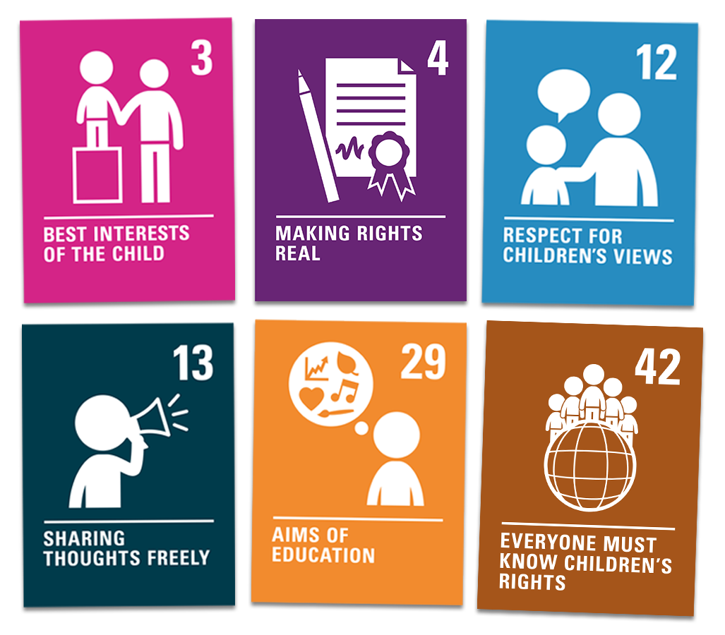
KEY ARTICLES
What does this right mean to you?
Why is it important for every child around the world to enjoy this right?
What could a world where every child can fulfil this right look like?

Slide 26
PART 4
WRAP UP
What new thing have you learned about children’s rights that you didn’t know before?
Nguegan

